Slide 1
Manufacturing Layered Attenuators for Multiple Prescribed Shadow Images
Ilya Baran Philipp Keller Derek Bradley
Stelian Coros Wojciech Jarosz
Derek Nowrouzezahrai Markus Gross
Notes:
Thanks for the introduction.
Today I’ll talk about making layered attenuators that produce several different shadows.

Slide 2
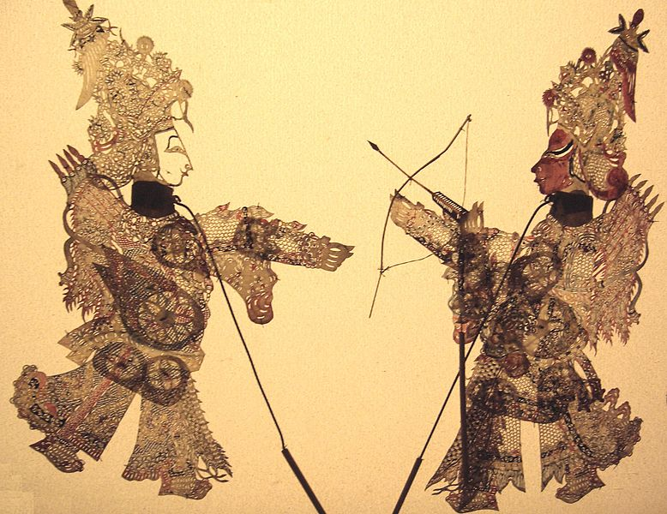
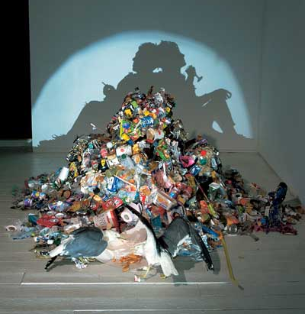
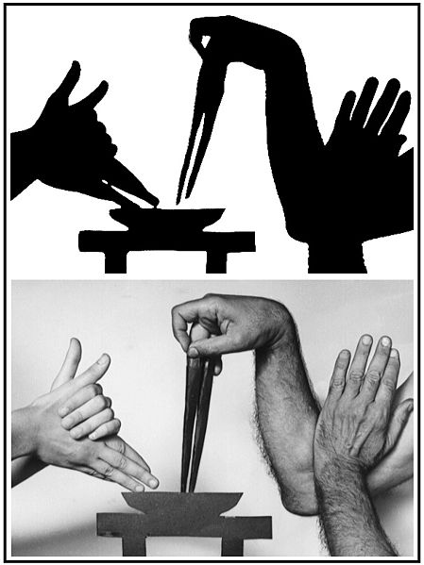
Shadow images are fun
Chinese shadow plays
Hand shadows
Sculpture
Tim Noble and Sue Webster
Notes:
For the longest time people have been fascinated with using shadows to show images.
*click*
An early example is shadow puppets, figurines designed to cast a certain type of shadow. They were making these in China as early as 2000 years ago, and other places, mostly in the east, as well. And they have entire plays with these characters.
*click*
A more familiar example is hand shadows--everyone’s made a bunny and the skill ranges all the way to professionals who can make lifelike caricatures and tell stories.
*click*
And more recently there’ve been some artists who construct sculptures out of everyday objects, even piles of junk, where they design the shadow to produce an image when lit from a particular direction.

Slide 3
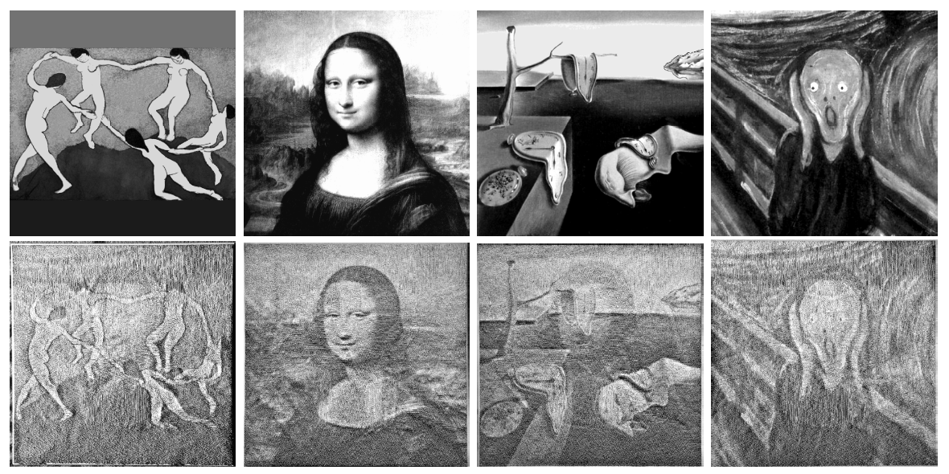
Shadow image research
Different shadows depending on light direction
black and white
Shadow Art
[Mitra & Pauly 2009]
ShadowPIX
[Bermano et al. 2012]
(Previous paper)
Notes:
In the last few years, computer graphics researchers have started looking at using shadows to display target images. Since producing a single target shadow is not very interesting from a research point of view, the focus has been on producing different shadows depending on the light direction.
*click*
Mitra and Pauly presented an interactive algorithm for designing a 3D object that can cast several prescribed shadows.
*click*
In the paper you just saw presented, we showed how to construct a surface that is both the shadow caster and the receiver and so looks like different images when lit from different sides.
*click*
Both of these methods create opaque objects: the light is either completely blocked, or completely transmitted. So the shadows that they create are black-and-white: the images that you see are effectively dithering. If we want to create color shadows, these methods will not work.

Slide 4
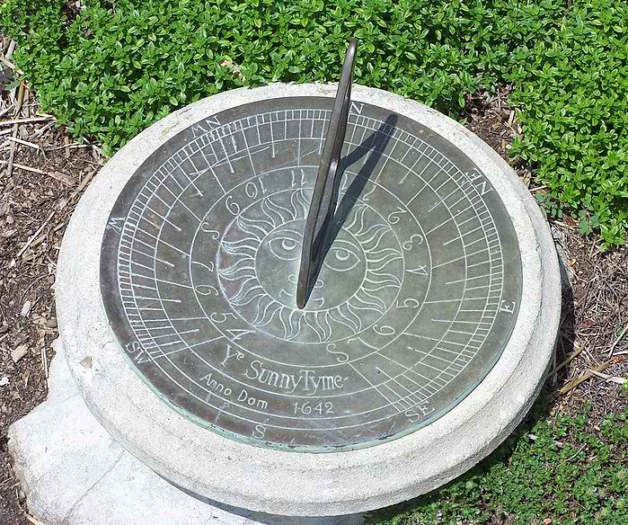
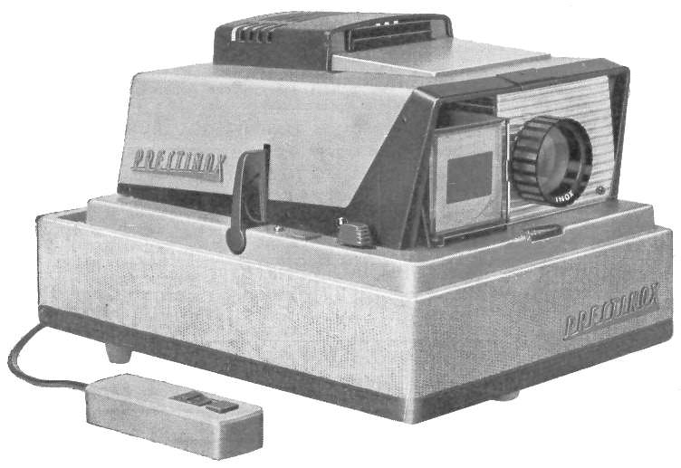
Shadows used
Notes:
Research and entertainment aside, shadows have been very useful in the real world.
*click*
For example, the sundial was the earliest timekeeping device.
*click*
A slightly more modern example is the slide projector, that displays images as shadows of slides.
Our idea was to marry them
*click*
And create a passive object that can display several colored images.

Slide 5
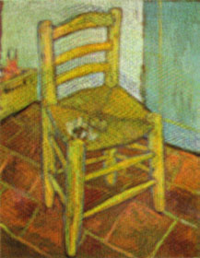
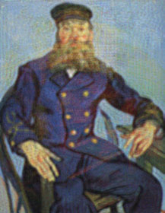
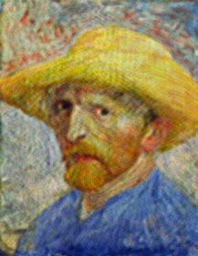
Casting different shadows depending on light direction
?
Notes:
So we want to construct an object, shown here with a question mark, that when light passes through it
*click*
Casts a shadow like this image.
And if it is illuminated from a different direction
*click*
It produces a different image.
*click*
The input to our method is therefore a set of illumination conditions, like the light source position and area of the light source, and the target images. Our goal for most experiments was to use the sun as a light source.

Slide 6
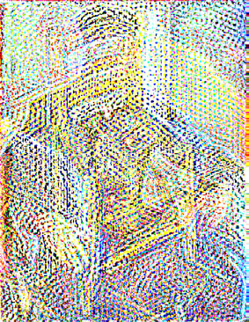
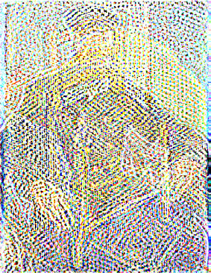
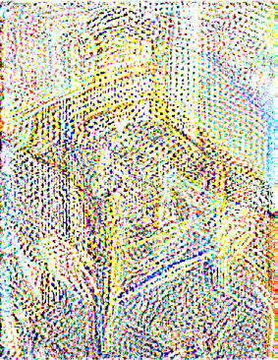
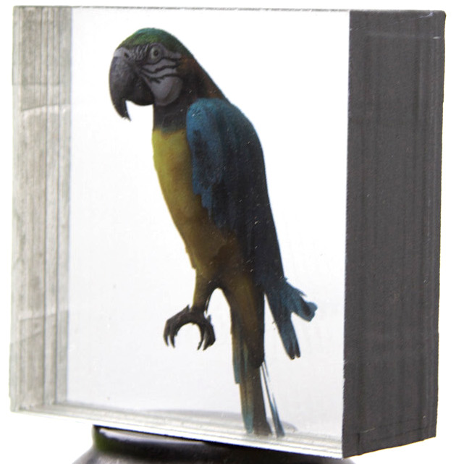
Layered transparencies
Setup also used by:
[Wetzstein et al. 2011] for lightfields
[Holroyd et al. 2011] for multilayer models
Notes:
We decided to use a set of layered transparencies, separated by glass or acrylic, as the object. We use a standard inkjet printer to print on these transparencies.
This is sort of a 2.5D setup, where the resolution of the third axis is very low – in our experiments we usually used three layers.
*click*
And this kind of setup has worked well for Wetzstein and colleagues for displaying lightfields and for our work last year on creating 3D-like models.
*click*
An important consideration was that this is cheap and easy to manufacture—our prototypes cost about 10 bucks each, neglecting the human time.
*click*
In contrast, for example, the glass cube from Mitra and Pauly’s paper, is unmanufacturable as far as I know.

Slide 7
Optimization
For each target image
For each pixel
$$Target pixel=\iint_{Sun rays}^{ }{\prod_{Layers}{Attenuation at ray hitpoint}}$$
Unknowns
Notes:
So the task is to figure out what patterns to print on the layers. We’re going to cast it as an optimization problem, to minimize the difference between the produced shadows and the target images.
*click*
This error is summed over the target images
*click*
And over the pixels in each target image
*click*
We’re assuming a diffuse white receiver surface, so we want the incident irradiance at the pixel to match the target image pixel in a least squares sense. To compute this irradiance, we accumulate the contribution over all the rays from the light source. Each ray gets attenuated whenever it hits a transparency layer, so the total contribution of the ray is the product of the attenuations at the hitpoints.
*click*
And we are of course solving for these attenuations, the printed patterns.

Slide 8
Optimization details
For each target image
For each pixel
$${\left(Target pix.−\iint_{Sun rays}^{ }{\prod_{Layers}{Attenuation at hitpoint}} \right) }^{2}$$
$$A_{min}≤Attenuation≤A_{max}$$
Error is degree 2n overall, where n is #layers
Degree n in all the unknowns
Linear in each layer
Notes:
So we’ve got this error objective, to match the target images, now written as an actual squared difference
*click*
We also have constraints on the attenuation that can be produced by the printer—the maximum ink density at a pixel.
*click*
The product of the attenuations is a degree n monomial in the unknowns, where n is the number of layers.
Once you take the squared difference and sum them up, this objective is a polynomial of degree 2n. So we can’t easily optimize it directly.
*click*
But if you hold all layers constant except for one, the attenuation product is linear in that layer and the energy becomes convex quadratic. This observation is the basis of our solve.

Slide 9
Round robin solving
Fix
Solve
Fix
Solve
Fix
Fix
Fix
Fix
Solve
Notes:
So we start with an initial guess for the layers – doesn’t matter what.
*click*
We fix the second two layers and solve for the first one as a quadratic program.
*click*
And then we fix it and solve for the next layer
*click*
And so on, in round robin fashion. At every round, the objective is guaranteed to decrease and so the whole thing converges.

Slide 10
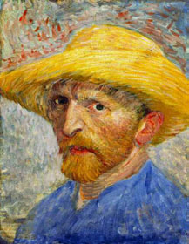
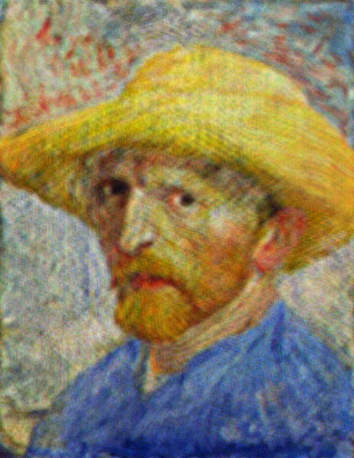
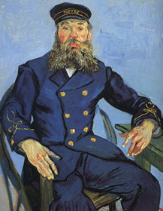
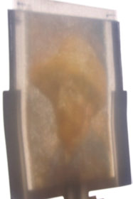
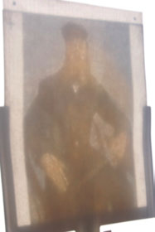
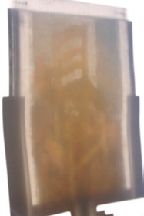
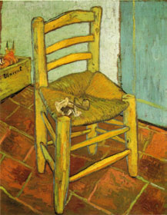
Results
Notes:
Let’s look at some results. On the right are the three target images.
*click*
These are the results you get if you simulate ideal printing and lighting conditions.
As you can see, they’re really close to the targets. There’s some sharpness loss and a little bit of ghosting—for example you can see a trace of the yellow hat around the head of the postman.
*click*
Here are photographs of real results, with the sun as a light source. They obviously don’t come close to the simulated ones, but the images are clearly discernible.

Slide 11
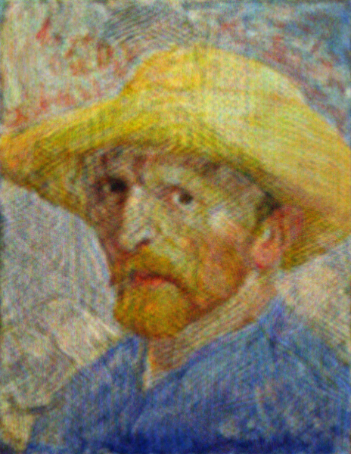
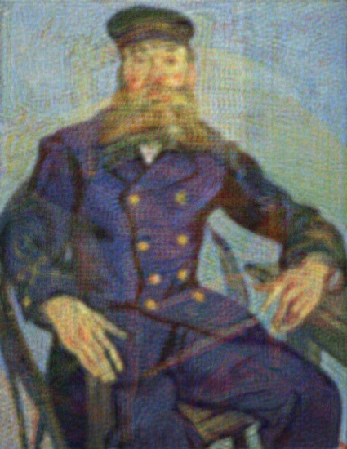
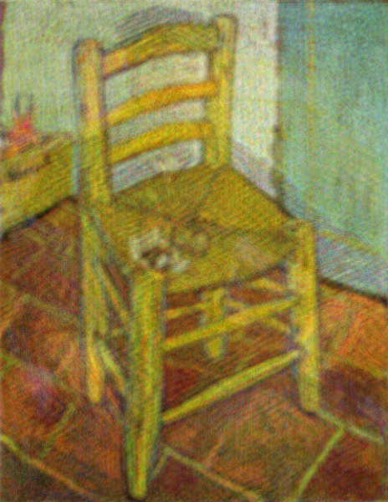
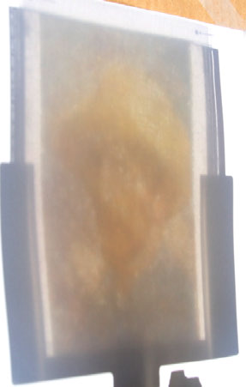
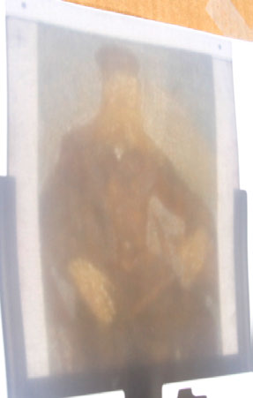
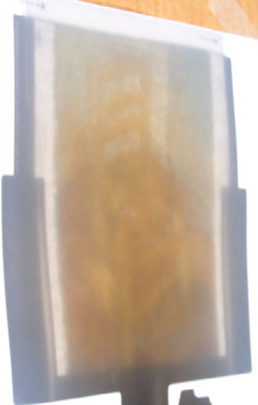
3 images 2 layers
Notes:
We were a little surprised to find that you can actually use fewer layers than images.
*click*
The ghosting is a little more pronounced, but overall, the simulated
*click*
And the real results look similar. We had originally assumed that since with one layer you can only get one image, you wouldn’t be able to get more than two images with two layers.

Slide 12
Video
Notes:
Here’s a video showing this example. Instead of moving the light source, we turn the attenuator, but it’s almost the same thing.

Slide 13
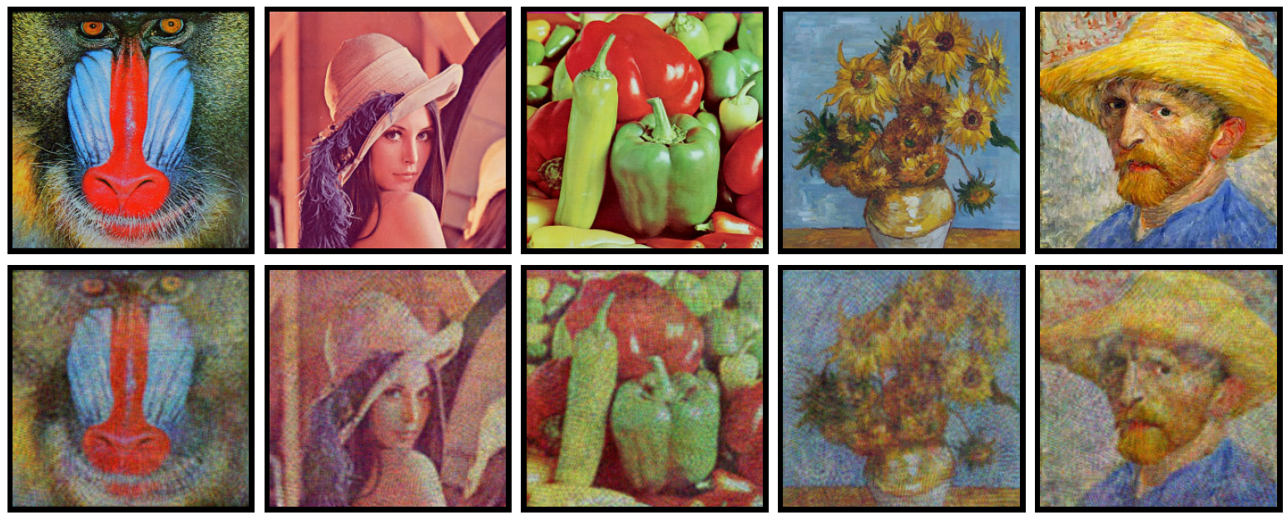
Many images (4 layers)
Notes:
We then tried to see how many images we could get into a layered attenuator. Here is a simulation with nine images. You can see the quality is way lower and there’s bad ghosting (for example, the bottom right image is supposed to be grayscale). Nonetheless, the images are still clearly discernible.
However, when we printed out a physical prototype, we could barely see the images. The sensitivity to lighting conditions and slight misalignments was too high to produce decent actual shadows.
In terms of a theoretical maximum number of images, like for ShadowPIX, it doesn’t really make sense to talk about it because it’s only a matter of how much error you are willing to tolerate—we did an experiment where we see a fairly steady increase in error as more images are added.

Slide 14
How much do we lose with sun as an area light?
With 1 layer, area light makes blurry image
Optimize and simulate with point light:
Notes:
Another question we asked was how much better would our results be with a point or a directional light than an area light, like the sun. If you have one layer (and one image), an area light necessarily blurs the image and the layer has to be a deconvolution, which is not perfect. So we figured we could also get better multilayer results with an idealized light source.
*click*
Here are the simulation results for a different set of three images with an area light.
*click*
And here’s what happens when we optimize for the point light. It is sharper, but the ghosting is way worse.
Let me flip back and forth so you can see the ghosting increase.
*flip*
The real results are way worse too. We hunted for a bug for a while and didn’t find one. So what’s going on?

Slide 15
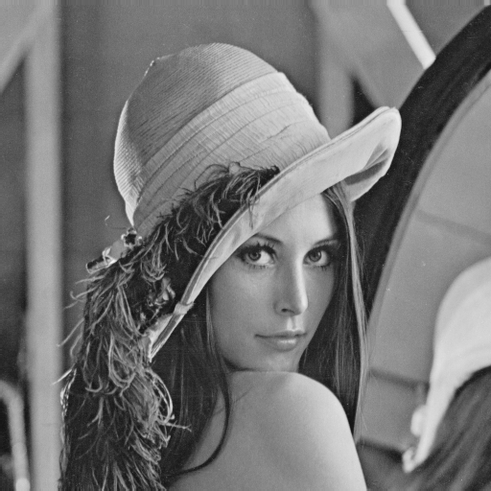
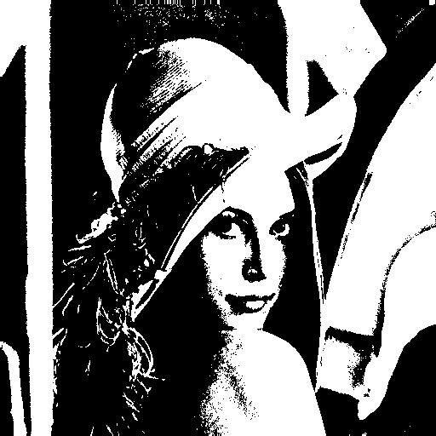
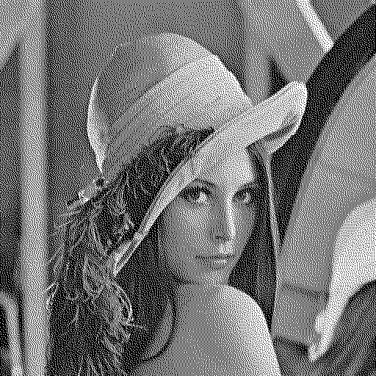
Why does an area light help?
Analogy with dithering
Area light allows spreading error over multiple pixels
Notes:
The way to understand why optimizing for an idealized light source produces worse results is through an analogy with dithering.
*click*
Imagine we start with a grayscale image.
And we try to turn it into a black-and-white image by minimizing the per-pixel differences between the source and target.
*click*
Well, then what you get is a threshold and that looks terrible.
But if you try to minimize the squared difference between the blurred source and the blurred target
*click*
You get dithering: it now makes sense to distribute error to the surrounding pixels and the result looks much better—something like this.
*click*
In our case, we have a different objective and constraints, but the blur provided by an area light source allows the optimization to distribute error to nearby pixels and achieve a much better match.

Slide 16
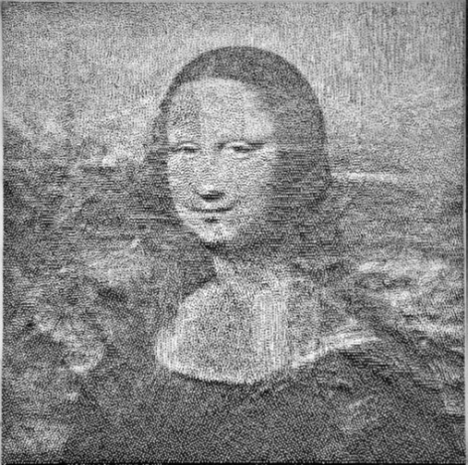
Comparison to previous work
Layered Attenuators
ShadowPIX
Attenuation
Continuous optimization
Color
Self-Shadowing
Discrete optimization
Requires 3D printing
Notes:
Recently there have been a number of related papers, so let me put this work in context by comparing to some of them.
The paper you just saw presented, ShadowPIX, also uses shadowing to produce different images depending on the light direction.
*click*
With ShadowPIX, we are constructing a surface that both casts and receives shadows, while in this work, we are only constructing the caster and the receiver is just a plane. So the shadow-forming mechanism is quite different.
*click*
Because we are computing attenuation patterns, our problem is naturally formulated as continuous optimization. For ShadowPIX, we are optimizing the heightfield in discrete increments and this is naturally written as a discrete optimization.
*click*
This work allows color shadows.
*click*
And layered attenuators are easier to manufacture, at least on a one-off basis.

Slide 17
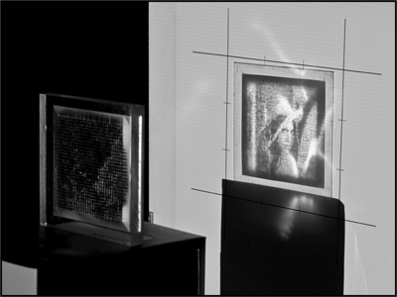
Comparison to previous work
Layered Attenuators
Goal-Based Caustics
[Papas et al. 2011]
Attenuation
Multiple images
Color
Refraction
Uses all light for image
Notes:
Another recent paper is Goal-Based Caustics.
*click*
They construct a glass surface that refracts incoming light in a specific pattern to form an image on the receiver.
*click*
Their method allows only a single image,
*click*
But because they are using refraction, no light is lost and the dynamic range of the produced image can be quite a bit higher than with attenuation.
*click*
Goal-Based Caustics also don’t produce color images.

Slide 18
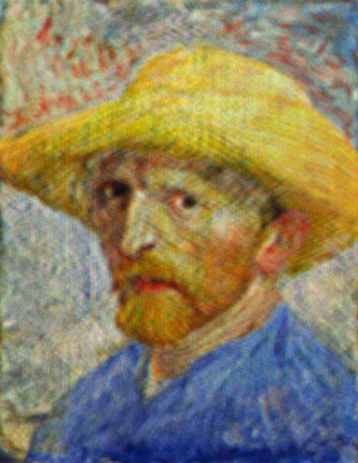
Comparison to previous work
Layered Attenuators
Layered 3D
[Wetzstein et al. 2011]
Block coordinate descent
Distinct images
Dual setup: point receiver
Convex optimization in log space
Similar images
Notes:
The light field display method from Wetzstein and colleagues is in some sense the dual of our setup.
*click*
Like us, they have layers of transparencies, but they are trying to get them to look like a lightfield, so depending on where you look from, you see a different image. Their light source is uniform planar behind the layers and their “receiver” is the eye and it moves around.
*click*
Their optimization problem is similar to ours, but because the eye is a point receiver, they don’t have an analogue of our integral over the sun. That means that they can take the standard tomography approach of taking the logarithm of the intensity, which makes the entire problem convex in all layers. So they can solve it with one QP, while we have to do this round robin thing I talked about.
*click*
However, because of the dithering-like effect of area lights, we can have very different images, while their method is limited to very similar ones, which, for light fields, is not a big problem.

Slide 19
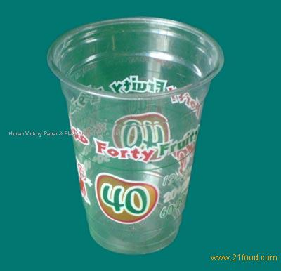
Limitations and future work
Calibration
High-frequency lighting
Computation time
Alternative attenuator geometry
Combining with caustics
Notes:
Our method does have a few limitations.
*click*
The most obvious one is that we didn’t calibrate with respect to either the printer or the lighting. A full calibration pipeline, maybe even with things like spectral analysis of the light and ink, would lead to a much better match of the real results to the simulated ones.
*click*
We also rely on having high-frequency lighting. We tried using more of an environment light source, but they couldn’t produce sharp shadows, much less specific images.
*click*
A third limitation is computation time. The examples you saw take a few hours to optimize. We think a GPU-based multigrid type of solver could make things go a lot faster.
*click*
An interesting future work direction would be to try non-planar attenuator geometry: for example, by creating a pattern on the inside and outside of this cup, we should be able to produce different nice shadows on the surface it’s standing on.
*click*
Another idea is to try to use a custom lens, like for goal-based caustics, in front or behind the attenuator to improve contrast.

Slide 20
Permutation
Notes:
Here’s another fun application. Instead of optimizing for different images depending on the light direction, we can optimize for different images depending on the permutation of the layers.
*click*
When you permute the layers, the image changes.

Slide 21
Questions?
Notes:
Thanks!

Slide 22
Coughing
I apologize for this brief interruption
This is not actually a component of layered attenuators
My healthy coauthor Derek Bradley was too lazy to give the talk instead
We will continue shortly

