Slide 1
Portal-Masked Environment Map Sampling
Benedikt Bitterli ^{1,2} Jan Novák ² Wojciech Jarosz ²
¹ Walt Disney Animation Studios ² Disney Research Zurich

Slide 2
Motivation

Slide 3
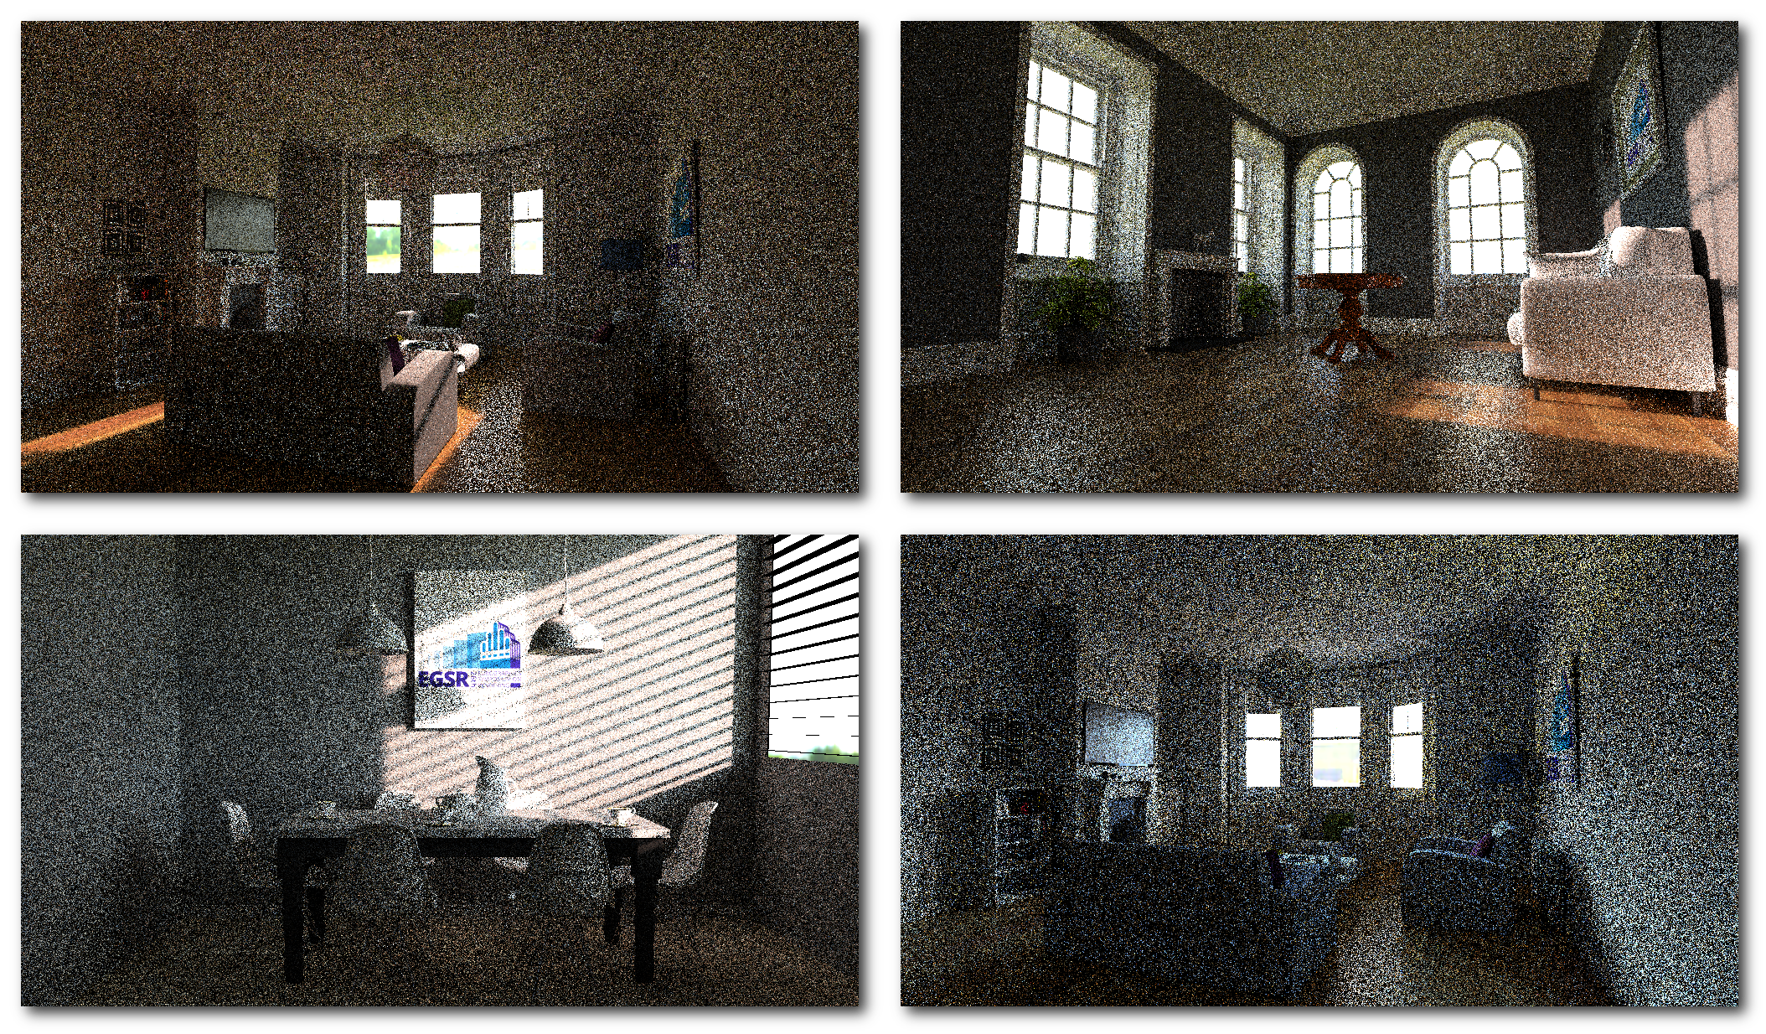
Motivation

Slide 4
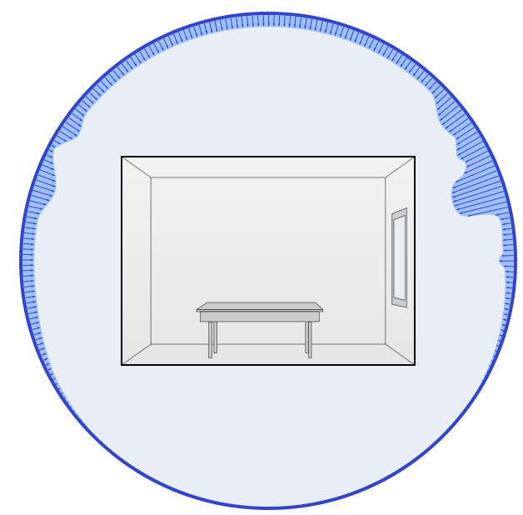
Environment Map Sampling

Slide 5
Environment Map Sampling
shading point

Slide 6
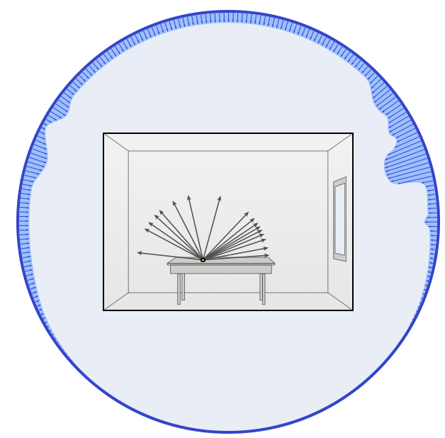
Environment Map Sampling

Slide 7
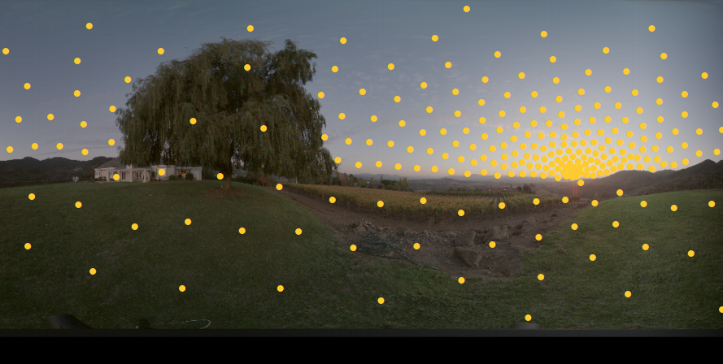
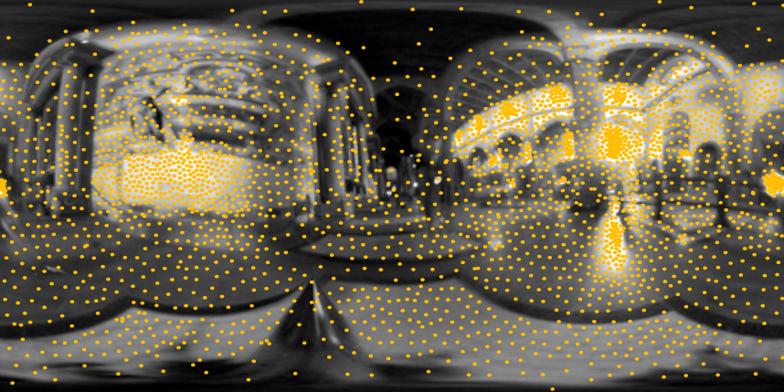
Environment Map Sampling
[Kollig and Keller]
[Ostromoukhov et al.]

Slide 8
Environment Map Sampling
[Kollig and Keller]
[Ostromoukhov et al.]

Slide 9
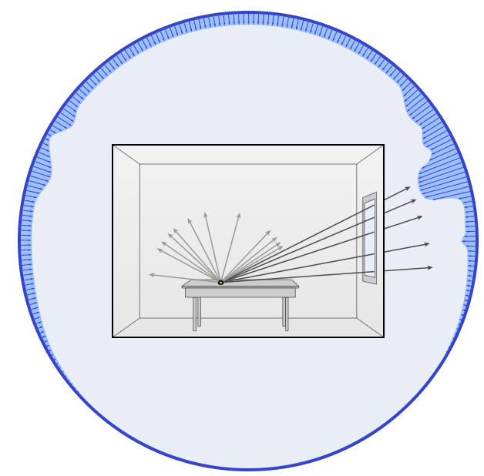
Environment Map Sampling
occluded

Slide 10
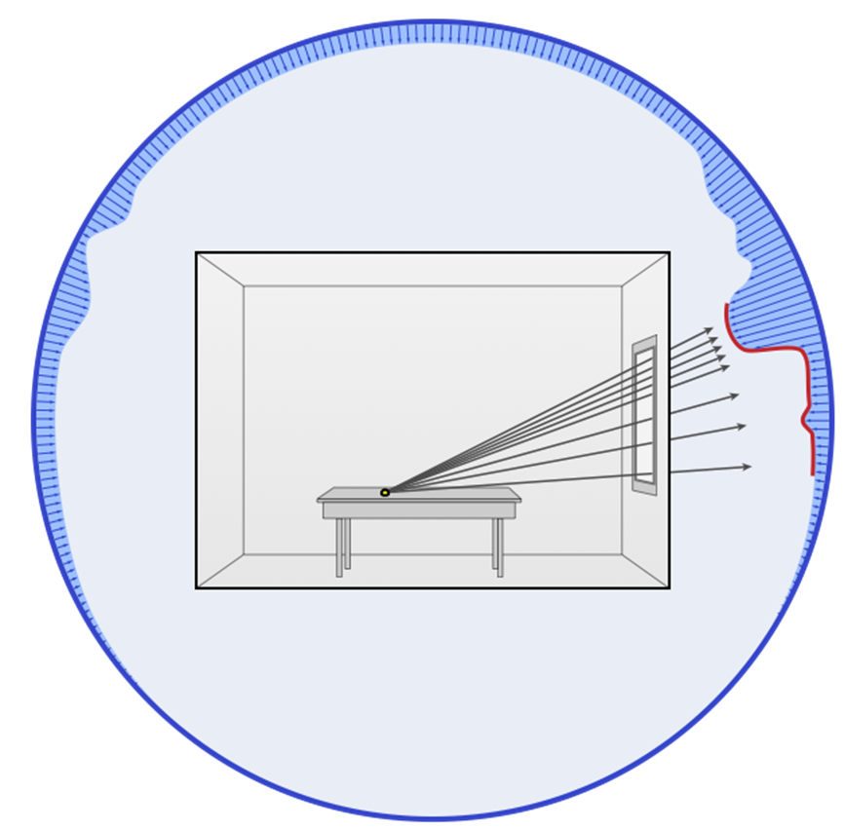
Problem Statement

Slide 11
Visibility Caching

Slide 12
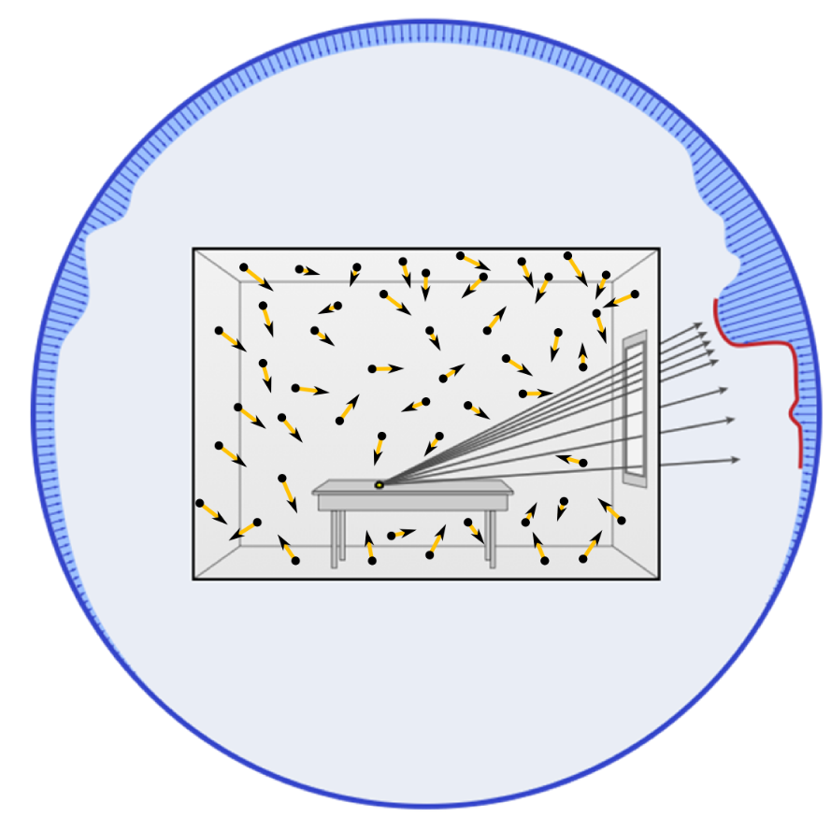
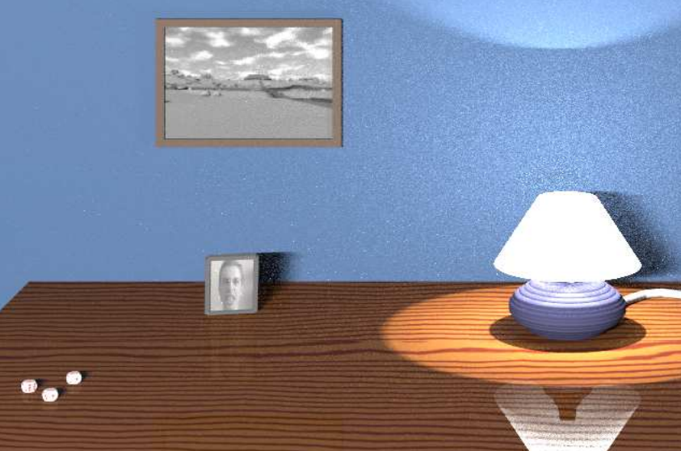
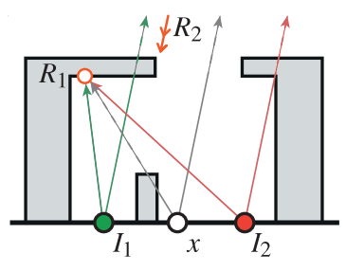
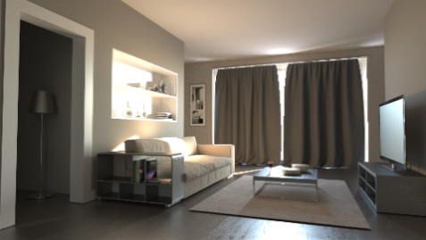
Visibility Caching
[Jensen ‘95]
[Georgiev et al.]
[Vorba et al.]

Slide 13
Visibility Caching
[Jensen]
[Georgiev et al.]
[Vorba et al.]

Slide 14
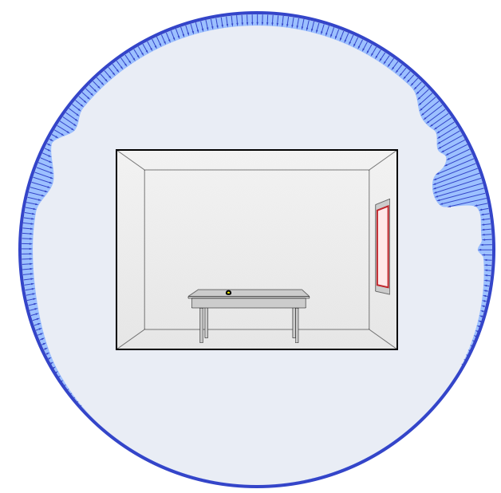
Portal Sampling
portal

Slide 15
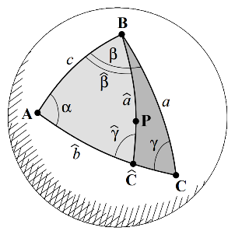
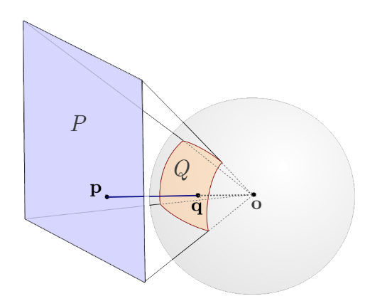
Portal Sampling
[Arvo ‘95]
[Ureña et al.]

Slide 16
Portal Sampling
[Arvo]
[Ureña et al.]

Slide 17
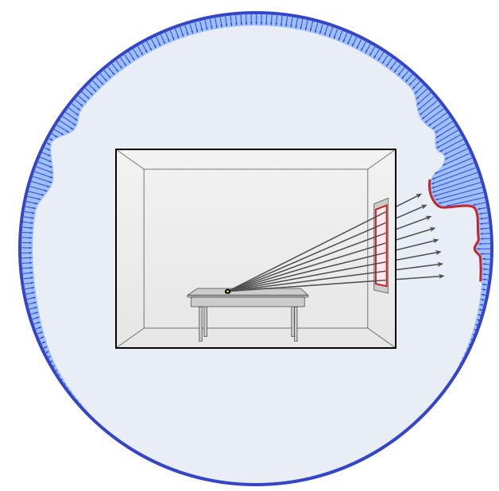
Portal Sampling

Slide 18
Ours

Slide 19
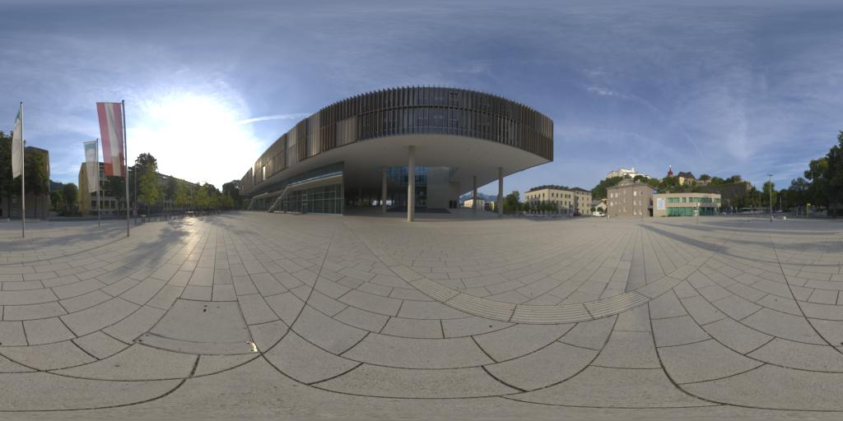
Environment Map Sampling

Slide 20
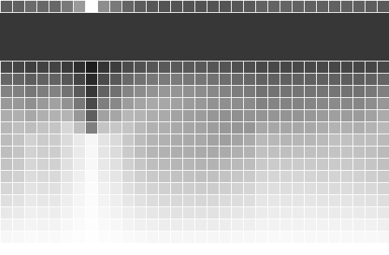
Environment Map Sampling
marginal distribution
conditional distributions

Slide 21
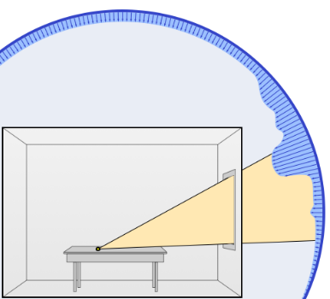
Visible Region

Slide 22
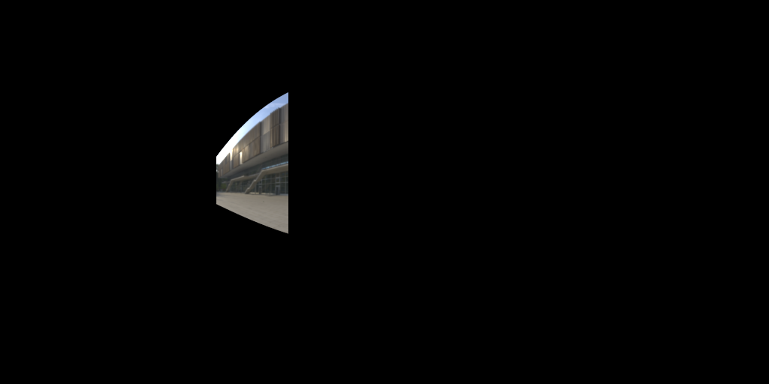
Visible Region

Slide 23
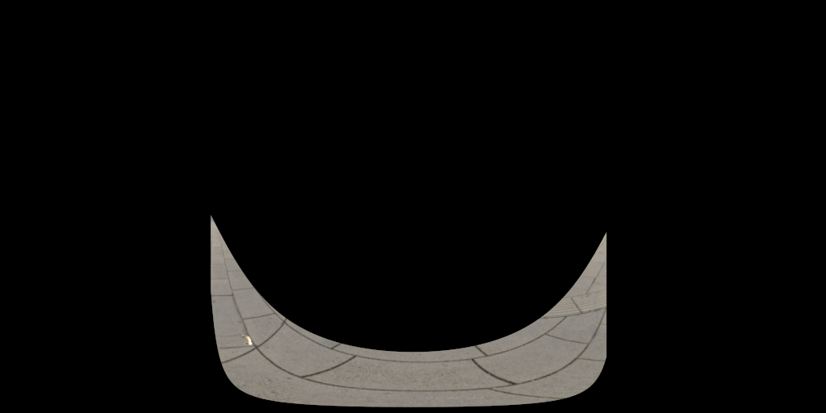
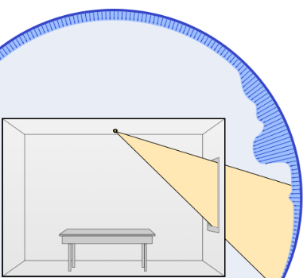
Visible Region

Slide 24
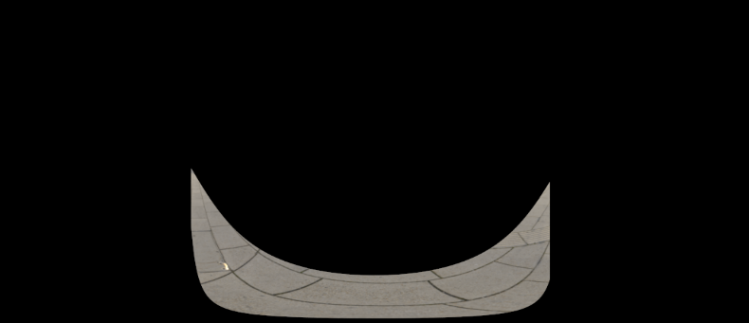
Portal-Masked Environment Map Sampling
Challenges:
Visible regions have complex shapes
Marginal/conditional decomposition difficult

Slide 25
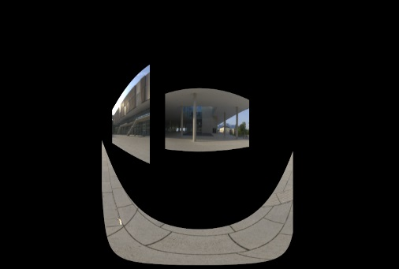
Portal-Masked Environment Map Sampling
Challenges:
Visible regions have complex shapes
Marginal/conditional decomposition difficult
Visible regions different for each shading point
Marginal/conditional cannot be precomputed

Slide 26
Portal-Masked Environment Map Sampling
Challenges:
Visible regions have complex shapes
Marginal/conditional decomposition difficult
Visible regions different for each shading point
Marginal/conditional cannot be precomputed
⇦

Slide 27
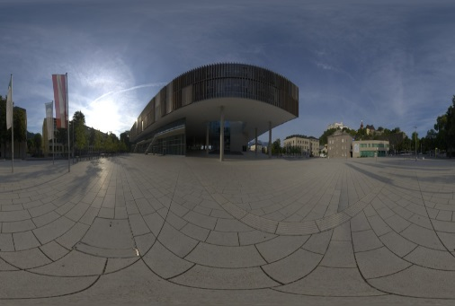
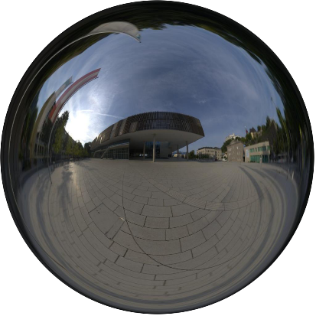
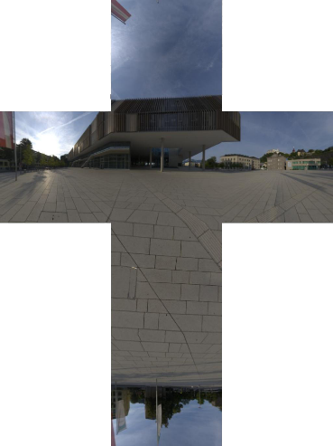
Environment Map Parameterizations
Latitude/Longitude
Light probe
Cube map

Slide 28
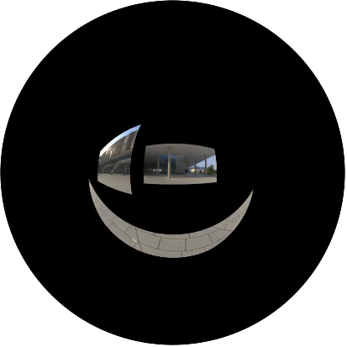
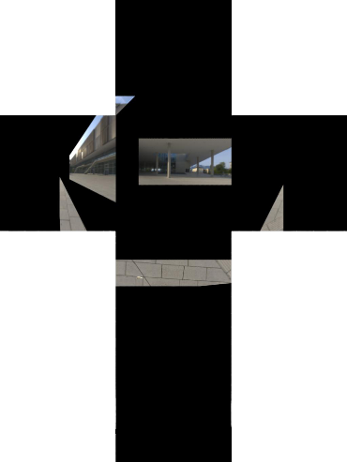
Environment Map Parameterizations
Latitude/Longitude
Light probe
Cube map
Visible regions not rectangular in these mappings

Slide 29
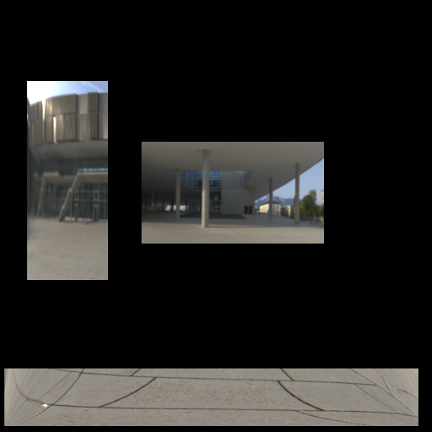
Environment Map Parameterizations
Latitude/Longitude
Light probe
Cube map
Rectified Coordinates
Visible regions not rectangular in these mappings
Let’s create one in which they are!

Slide 30
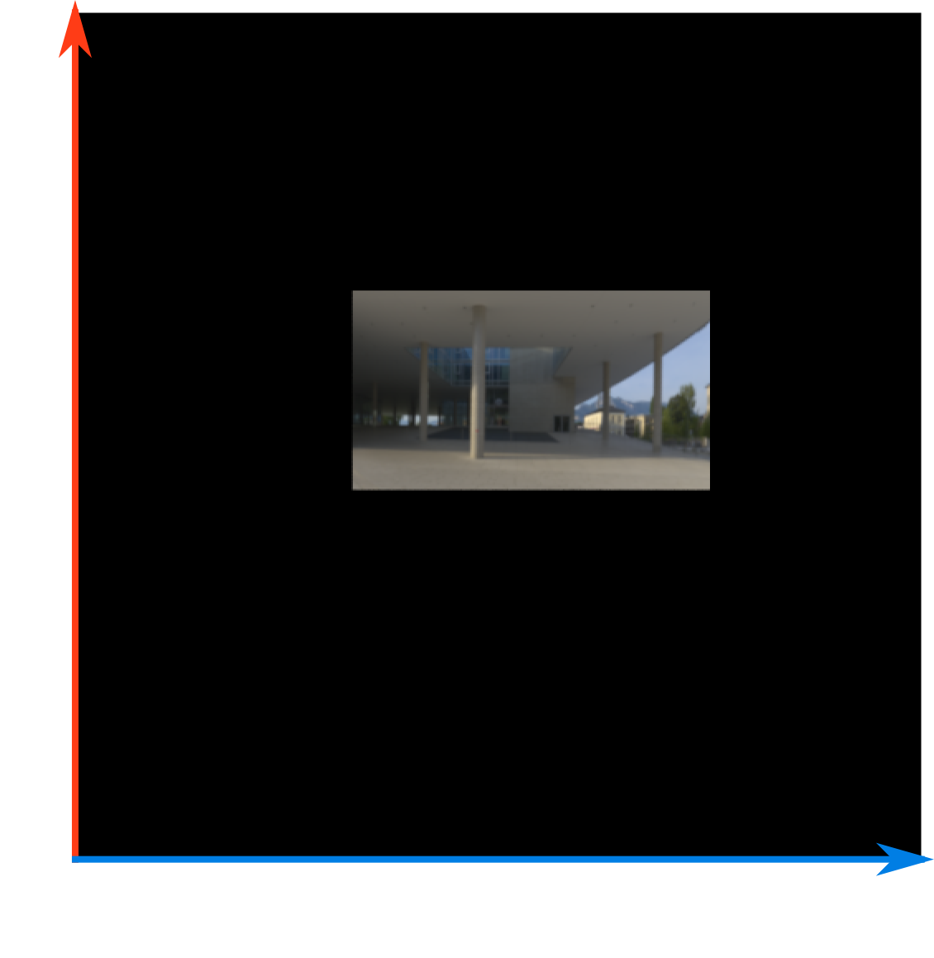
Rectified Coordinates

Slide 31
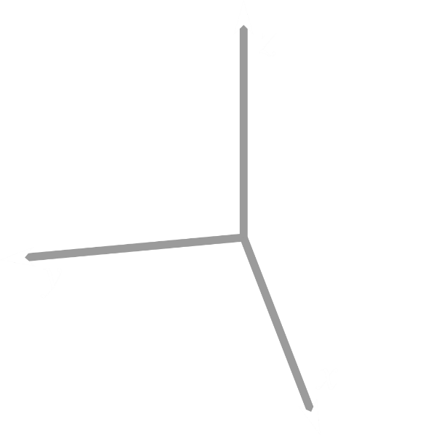
Rectified Coordinates

Slide 32
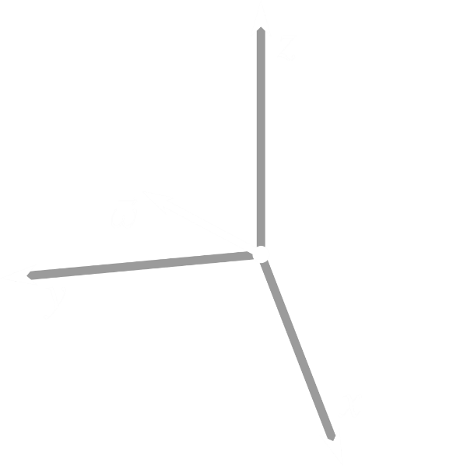
Rectified Coordinates

Slide 33
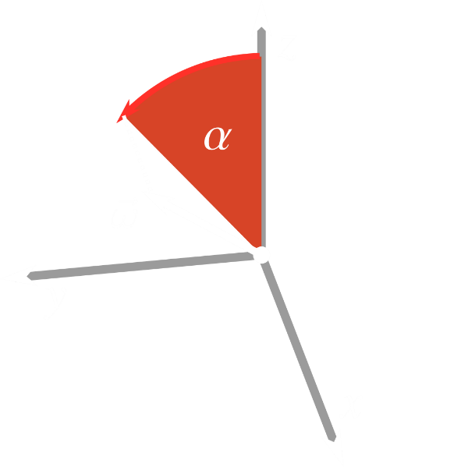
Rectified Coordinates

Slide 34
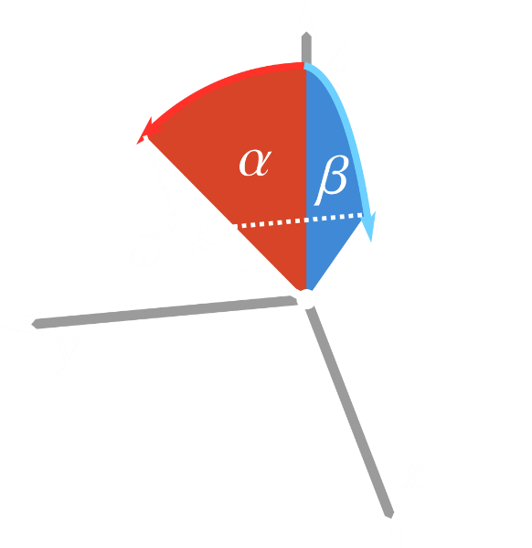
Rectified Coordinates

Slide 35
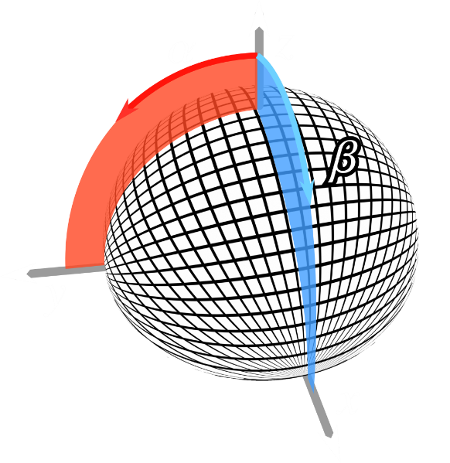
Rectified Coordinates

Slide 36
Rectified Coordinates
Parametrization is aligned with the portal

Slide 37
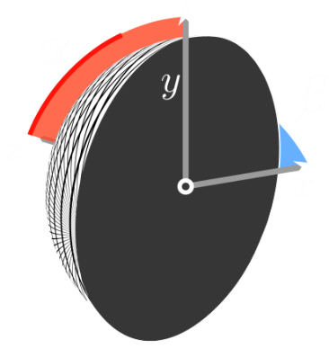
Rectified Coordinates
Parametrization is aligned with the portal

Slide 38
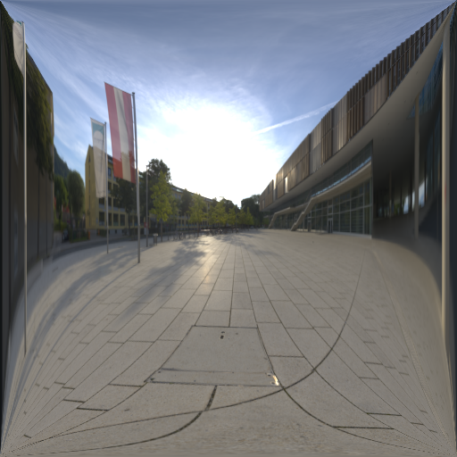
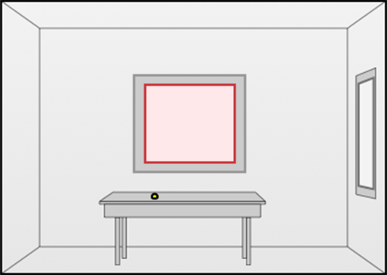
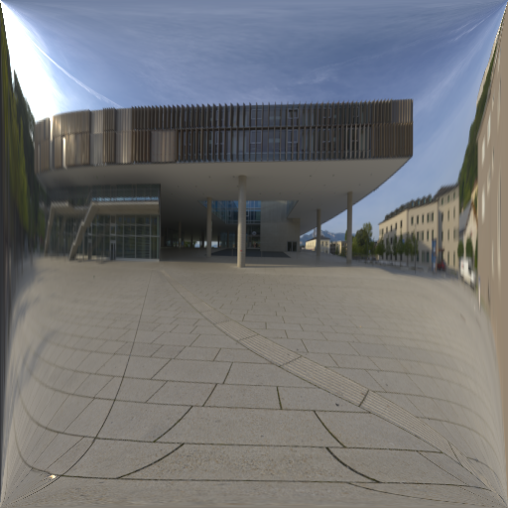
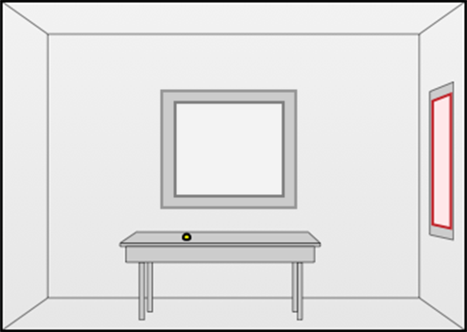
Rectified Coordinates
Need separate environment map per portal

Slide 39
Rectified Coordinates
Parametrization is aligned with the portal
Need separate environment map per portal

Slide 40
Rectified Coordinates

Slide 41
Rectified Coordinates

Slide 42
Rectified Coordinates

Slide 43
Rectified Coordinates

Slide 44
Rectified Coordinates

Slide 45
Rectified Coordinates

Slide 46
Rectified Coordinates

Slide 47
Rectified Coordinates

Slide 48
Rectified Coordinates

Slide 49
Rectified Coordinates

Slide 50
Rectified Coordinates

Slide 51
Rectified Coordinates

Slide 52
Rectified Coordinates

Slide 53
Portal-Masked Environment Map Sampling
Challenges:
Visible regions have complex shapes
Marginal/conditional decomposition difficult
Visible regions different for each shading point
Marginal/conditional cannot be precomputed
✓

Slide 54
Portal-Masked Environment Map Sampling
Challenges:
Visible regions have complex shapes
Marginal/conditional decomposition difficult
Visible regions different for each shading point
Marginal/conditional cannot be precomputed
✓
⇦

Slide 55
Sampling the Visible Region
Construct marginal/conditional distribution
Invert marginal/conditional distribution

Slide 56
Marginal Distribution

Slide 57
Marginal Distribution

Slide 58
Marginal Distribution

Slide 59
Marginal Distribution
Precompute summed-area table instead [Crow ‘84]

Slide 60
Sampling the Visible Region
Construct marginal/conditional distributions
Invert marginal/conditional distributions
Precompute summed-area table instead [Crow ‘84]

Slide 61
Inverting the Marginal Distribution

Slide 62
Inverting the Marginal Distribution

Slide 63
Inverting the Marginal Distribution

Slide 64
Inverting the Marginal Distribution

Slide 65
Inverting the Marginal Distribution

Slide 66
Inverting the Marginal Distribution

Slide 67
Sampling the Visible Region
Construct marginal/conditional distributions
Invert marginal/conditional distributions
Precompute summed-area table instead [Crow ‘84]
Use bisection algorithm for logarithmic complexity

Slide 68
Results

Slide 69
Results
Comparison of:
Environment map sampling
Portal solid angle sampling [Ureña et al. 2013]
Multiple importance sampling of a) and b) [Veach 1998]
Ours
at equal sample count (8spp)
All methods combined with 1 BRDF sample using MIS

Slide 70
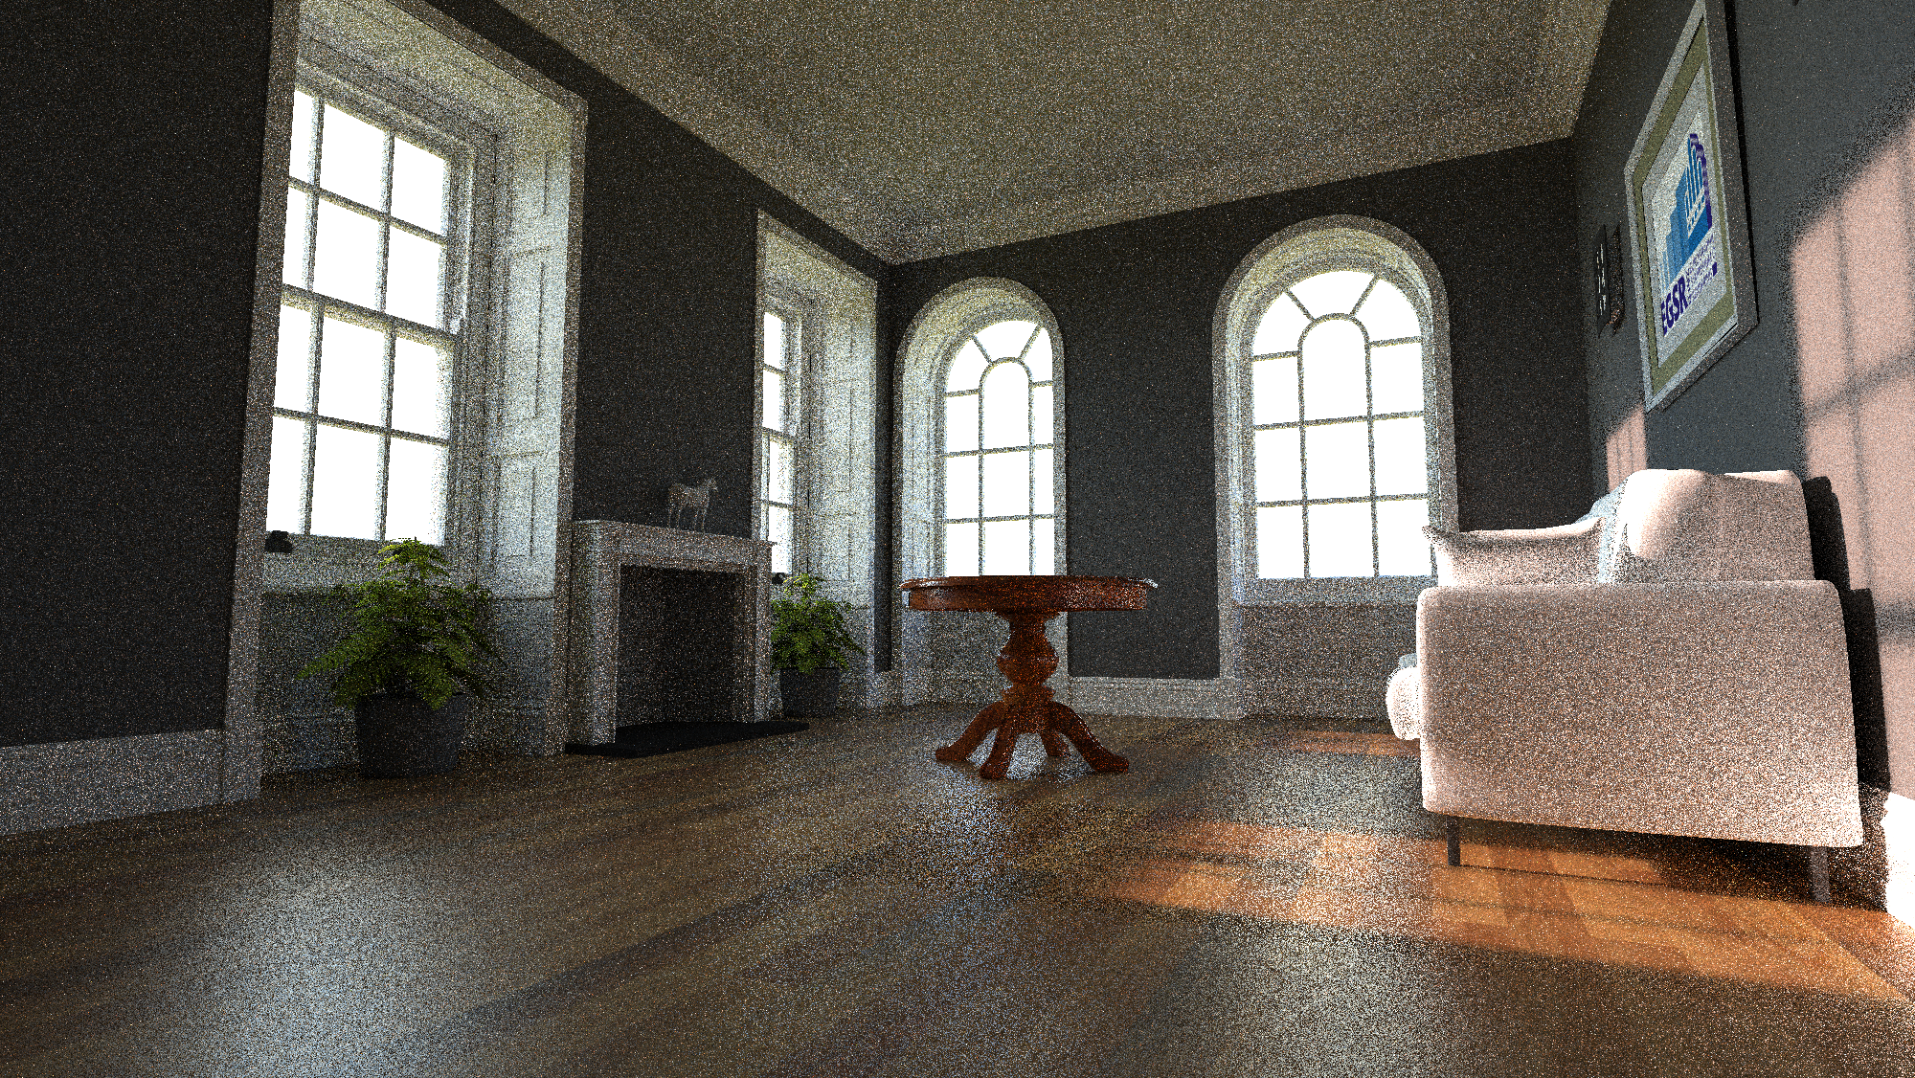
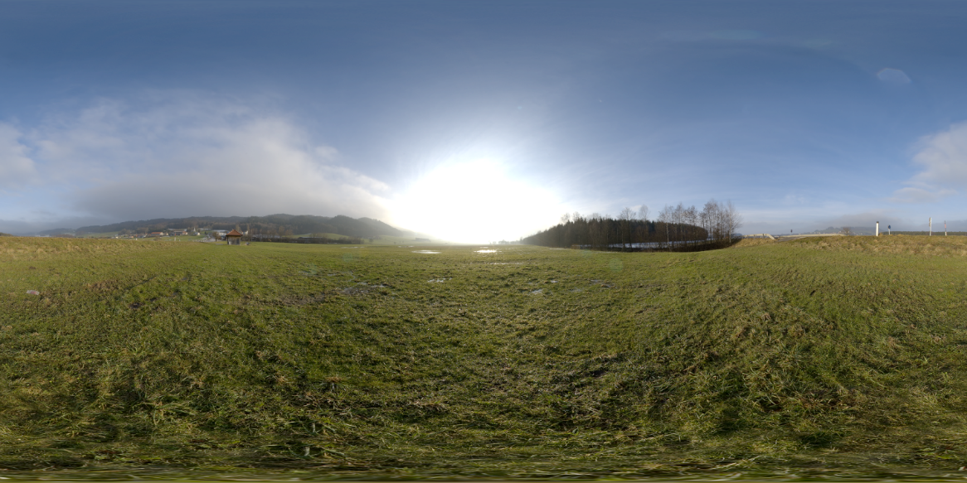
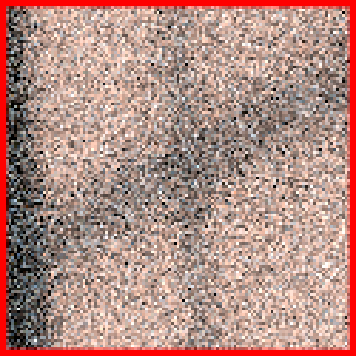
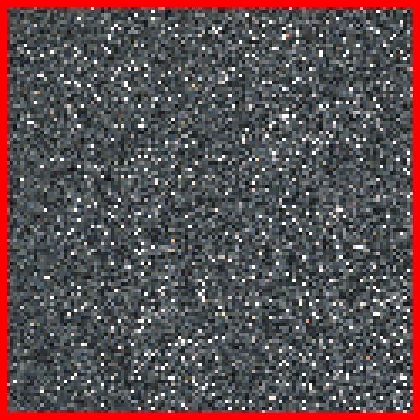
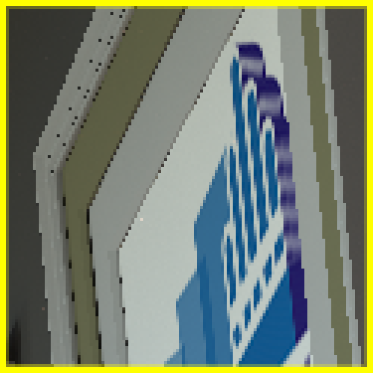
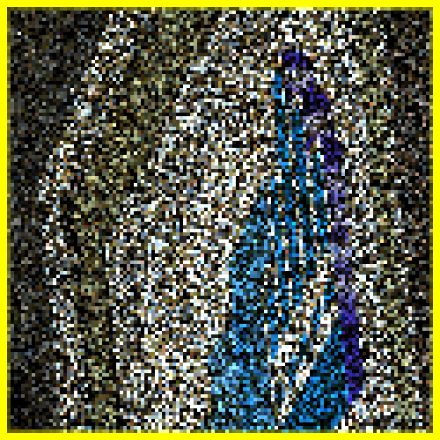
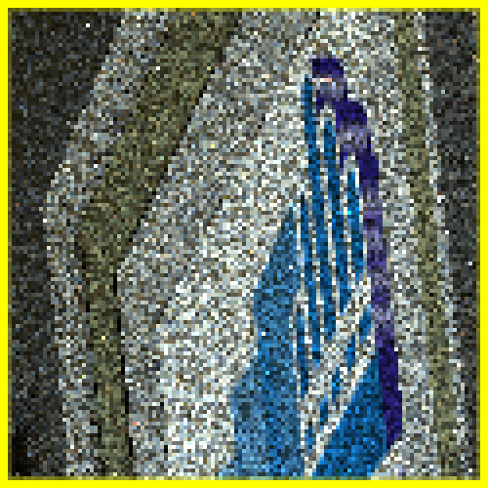
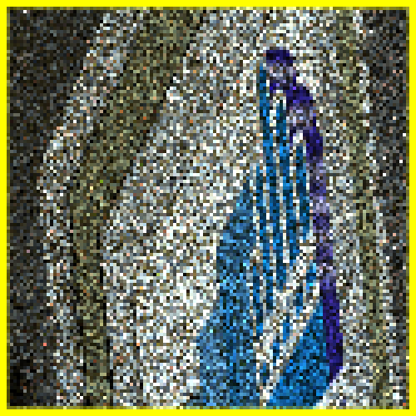
8 spp
Reference
RMSE
Env. Map
0.23
Portal S.Angle
3.31
MIS
0.26
Ours
0.16

Slide 71
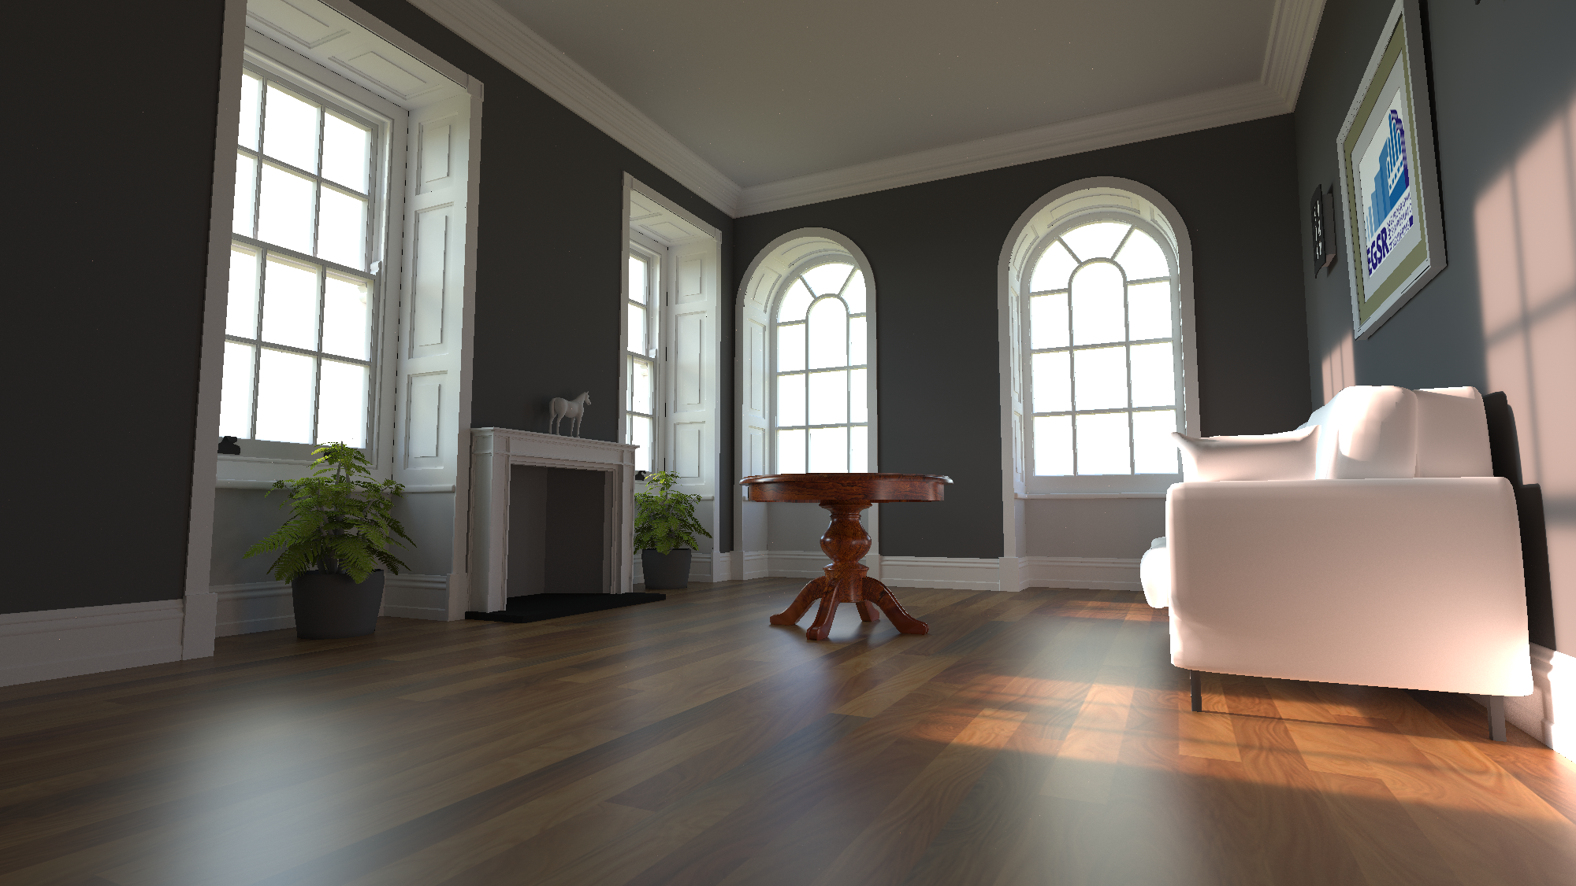

Slide 73
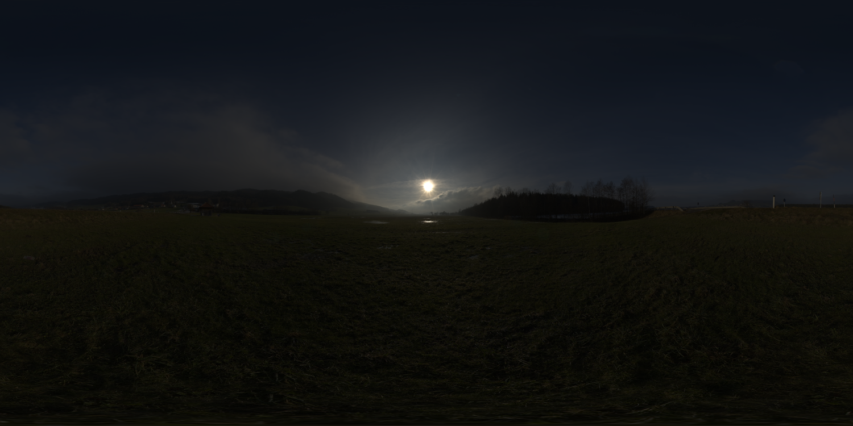

Slide 75
Reference
RMSE

Slide 76
8 spp
Reference
RMSE
Env. Map
0.23

Slide 77
8 spp
Reference
RMSE
Env. Map
0.23
Portal S.Angle
3.31

Slide 78
8 spp
Reference
RMSE
Env. Map
0.23
Portal S.Angle
3.31
MIS
0.26

Slide 79
8 spp
Reference
RMSE
Env. Map
0.23
Portal S.Angle
3.31
MIS
0.26
Ours
0.16

Slide 80
8 spp
Reference
RMSE
Env. Map
0.59
Portal S.Angle
0.74
MIS
0.60
Ours
0.34

Slide 84
Reference
RMSE

Slide 85
8 spp
Reference
RMSE
Env. Map
0.59

Slide 86
8 spp
Reference
RMSE
Env. Map
0.59
Portal S.Angle
0.74

Slide 87
8 spp
Reference
RMSE
Env. Map
0.59
Portal S.Angle
0.74
MIS
0.60

Slide 88
8 spp
Reference
RMSE
Env. Map
0.59
Portal S.Angle
0.74
MIS
0.60
Ours
0.34

Slide 89
More Results
Please see supplementary material

Slide 90
By the numbers
Equal time:
33% less shadow rays than Env. Map sampling
Equal quality:
2x – 8x speedup w.r.t. Env. Map sampling
2x – 5x speedup w.r.t. Env Map/Portal MIS

Slide 91
Area lights with directional profile

Slide 92
Area lights with directional profile
Uniform Solid Angle Sampling
Ours
10x speedup

Slide 93
Conclusion
Take away from this talk:
Can importance sample visibility x Env. Map
Need single (precomputed) SAT per portal
Easy to implement!

Slide 94
Conclusion
Take away from this talk:
Can importance sample visibility x Env. Map
Need single (precomputed) SAT per portal
Easy to implement!

Slide 95
Conclusion
Take away from this talk:
Can importance sample visibility x Env. Map
Need single (precomputed) SAT per portal
Easy to implement!

Slide 96
Conclusion
Take away from this talk:
Can importance sample visibility x Env. Map
Need single (precomputed) SAT per portal
Easy to implement!

Slide 97
Conclusion
Take away from this talk:
Can importance sample visibility x Env. Map
Need single (precomputed) SAT per portal
Easy to implement!

Slide 98
Limitations
Needs a portal to work

Slide 99
Limitations
Needs a portal to work
Only considers visibility through a rectangle

Slide 100
Limitations
Needs a portal to work
Only considers visibility through a rectangle

Slide 101
Future Work
Incorporate BRDF:
Combine with product sampling techniques
[Burke et al.]
[Clarberg et al.]
[Cline et al.]

Slide 102
Thanks!
Acknowledgements:
Environment maps: Bernhard Vogl, http://openfootage.net
Scenes: Jay Hardy, Wayne

Slide 103
Bonus Slides

Slide 104
Sampling multiple portals

Slide 105
Sampling multiple portals

Slide 106
Sampling multiple portals

Slide 107
Sampling multiple portals
Scene
Sample Allocation

