Slide 1
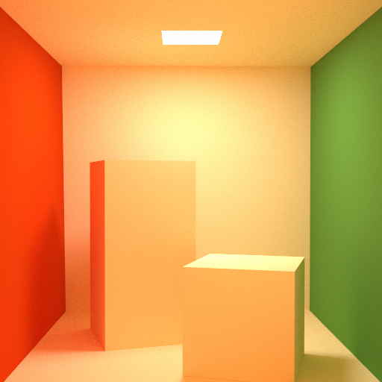
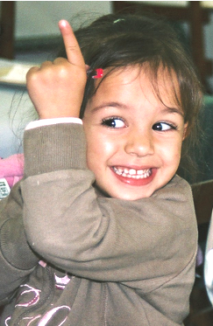
Notes:
Everybody loves beautiful photorealistic renderings,

Slide 2
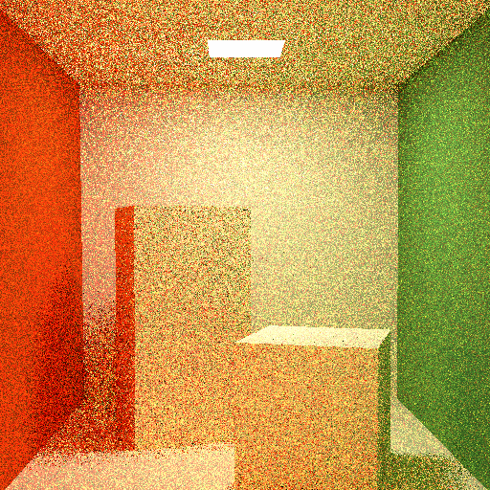

Notes:
but not the long render times and noise that come with it.

Slide 3
Amazing Adaptive
Sampler n-D
Notes:
Hi, Billy Mays here with the Adaptive Sampler n-D - the world's most powerful and efficient rendering tool you'll every use.

Slide 4
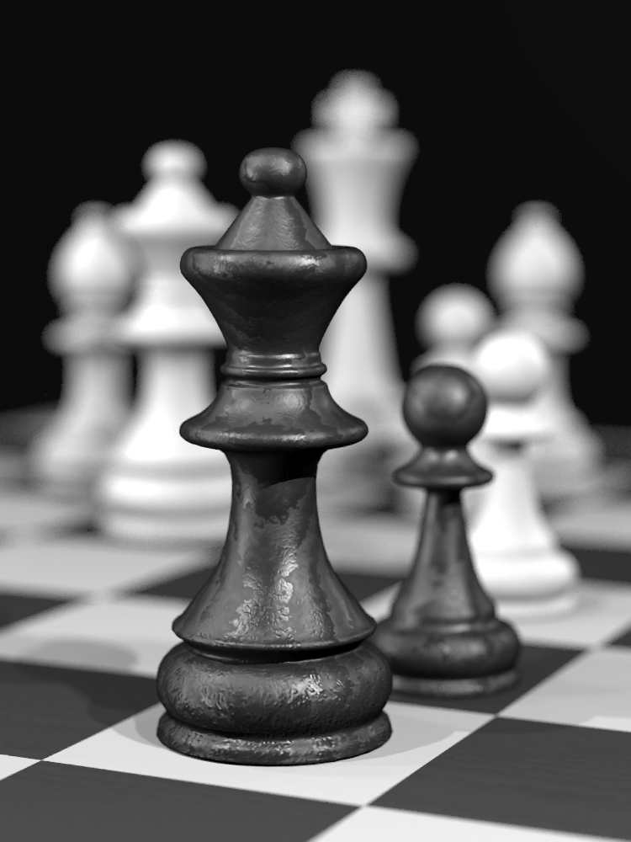
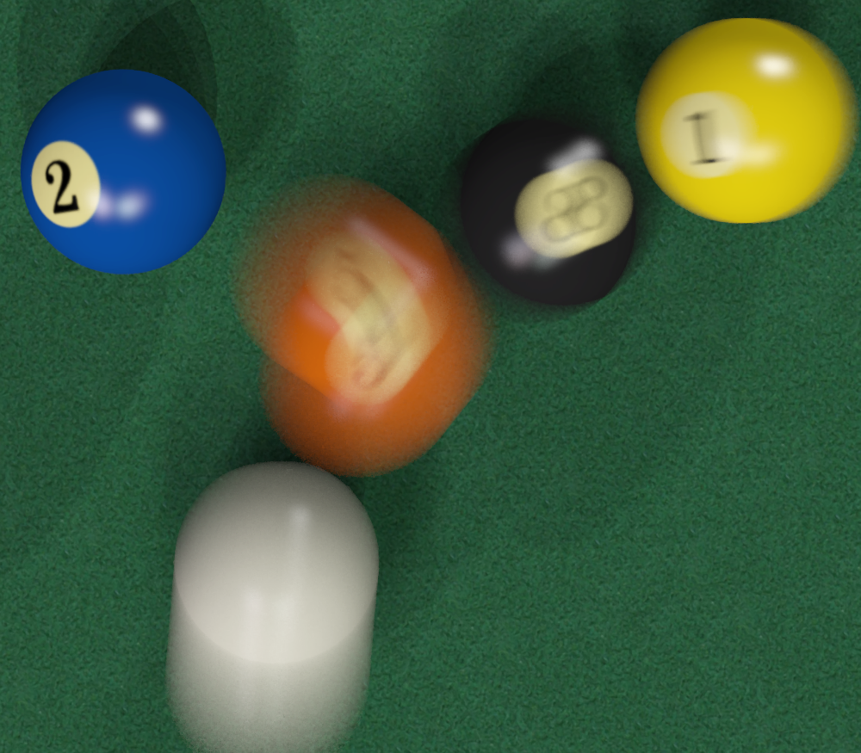
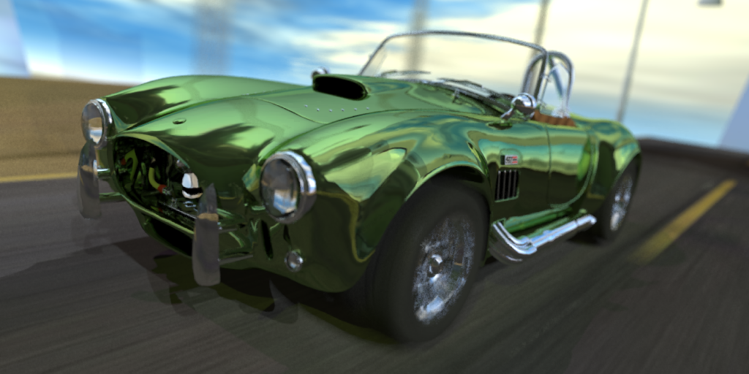
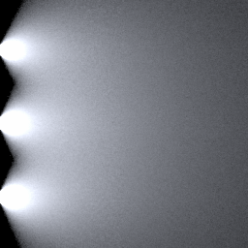
Amazing Adaptive
Sampler n-D
Renderer
Notes:
Attach it to any renderer, and get beautifully smooth renderings in seconds!
It’s great for rendering scenes with depth of field,
or use it on motion blurred objects to get amazingly smooth motion trails!
It works like magic for area light sources too!

Slide 5
Notes:
Traditional adaptive sampling techniques fall apart when you add these types of effects.

Slide 6
Notes:
But Adaptive Sampler n-D uses advanced mathematical algorithms to trace more rays where you need them most.

Slide 7

Notes:
This tool, developed by a prestigious team of scientists, allows you to create smoother images using fewer samples!

Slide 8
Amazing Adaptive
Sampler n-D
FREE
Anisotropic
Reconstruction
Just 5 easy
payments of
ORDER NOW!
$29
95
plus
S&H
1-800-SAMPLES
Notes:
Regular stores will charge you over $100 for similar products, but we are offering Adaptive Sampler n-D for just 5 easy payments of $29.95.
And if you call now we will include Anisotropic Reconstruction, a $30 value, absolutely free (just pay processing)!
This never before seen combination is not available in stores, so come to our talk to find out more!

