Slide 1
Dispersion-based Color Projection using Masked Prisms
Rafael Hostettler² Ralf Habel² Markus Gross² Wojciech Jarosz²³
²Disney Research Zurich ³Darthmouth College

Slide 2
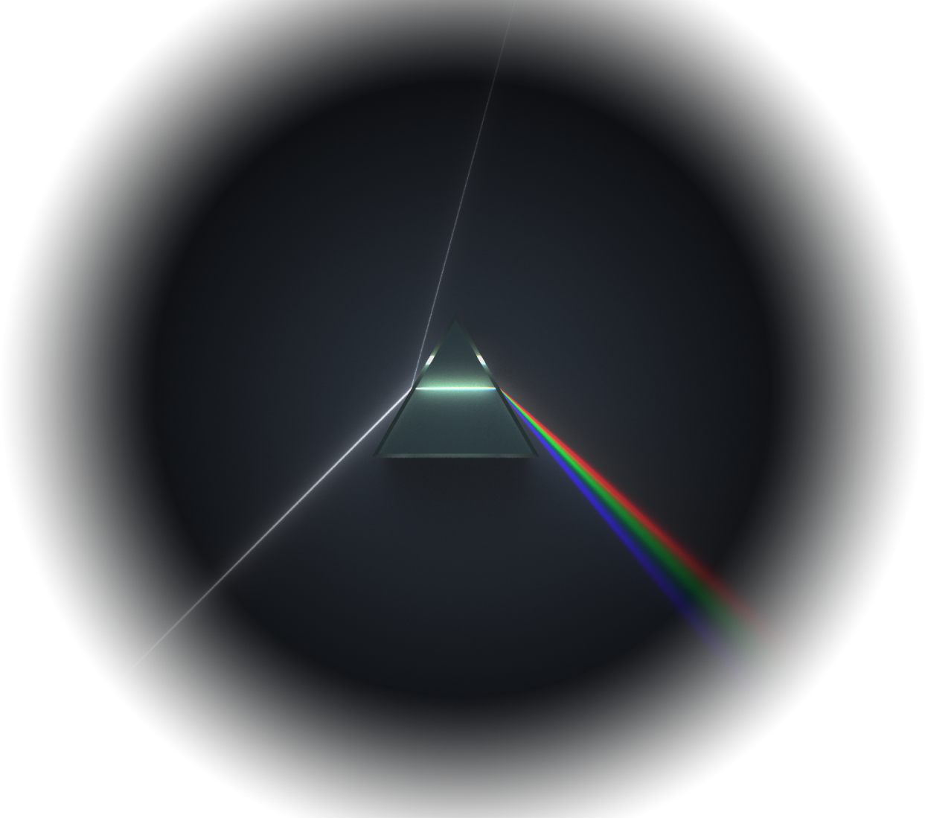
Idea

Slide 3
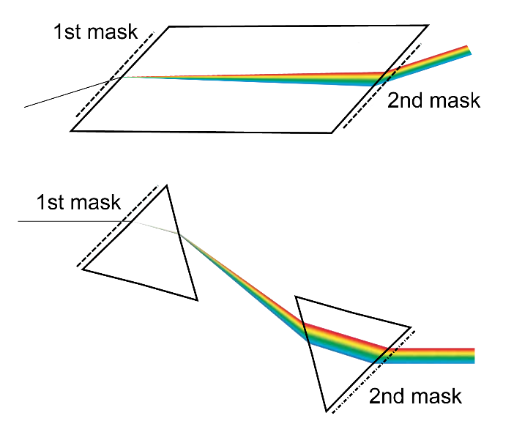
Idea

Slide 4
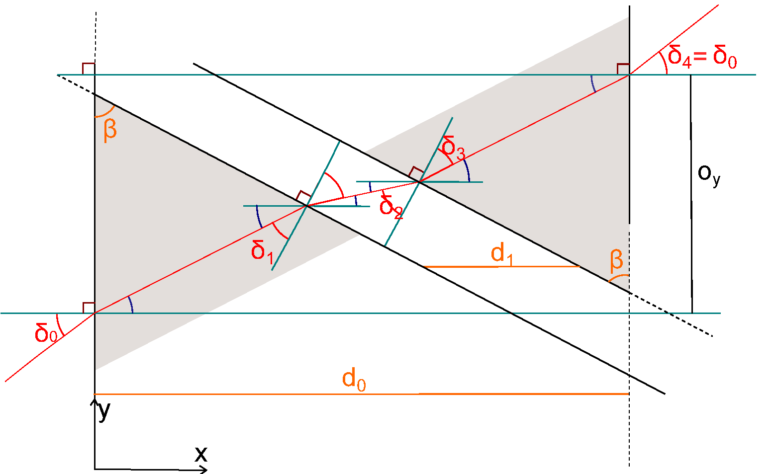
Setup

Slide 5
Setup

Slide 6
Setup

Slide 7
Prefilter

Slide 8

Prefilter

Slide 9
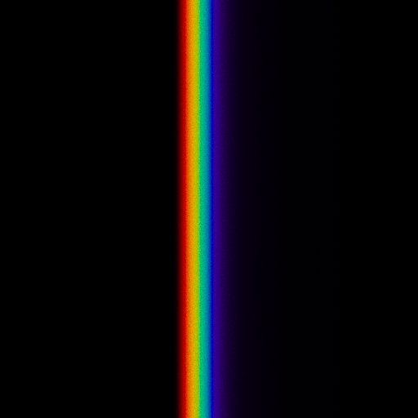
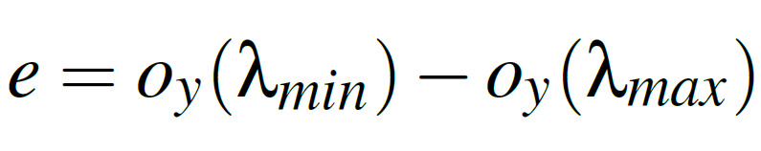
Result
Notes:
Lmin = 390nm
Lmax = 750nm

Slide 10

Prefilter Lines

Slide 11
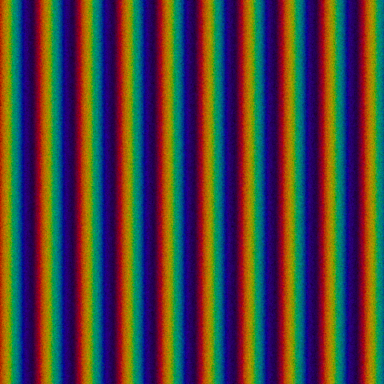
Result

Slide 12
Postfilter

Slide 13
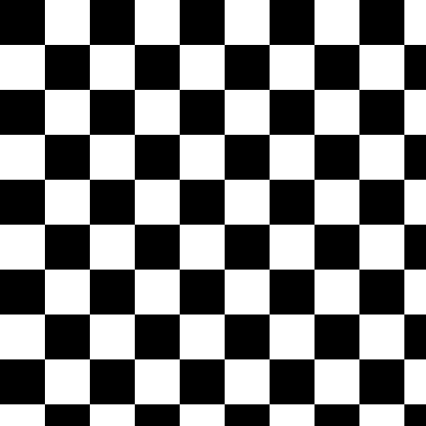
Postfilter

Slide 14
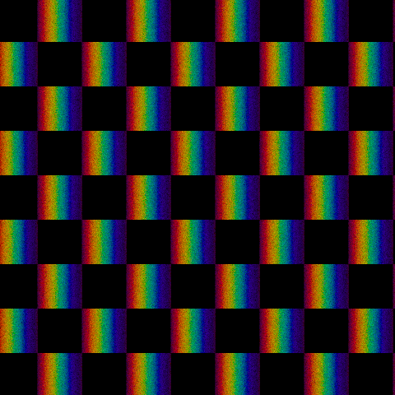
Result

Slide 15

Target Image

Slide 16
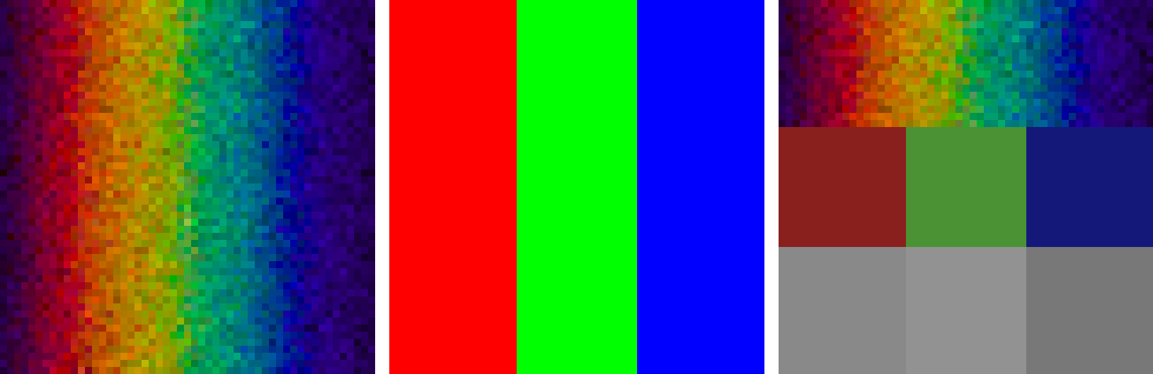
Postfilter Generation
Split Subpixel in 3 Areas
  corresponding to R, G, B
Fill area per pixel with target value through dithering the pixel

Slide 17
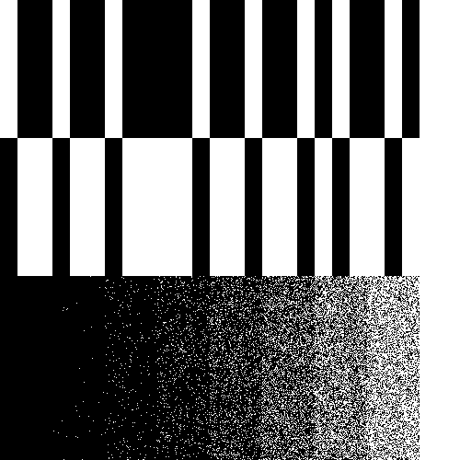
Resulting Postfilter

Slide 18
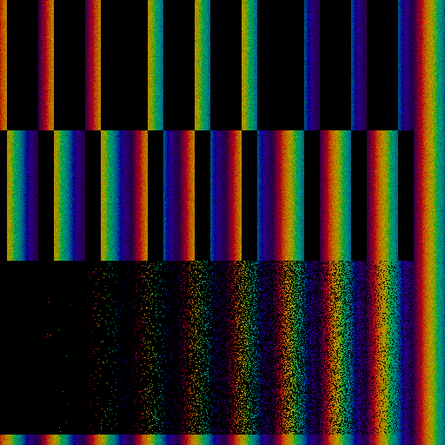
Resulting Image

Slide 19
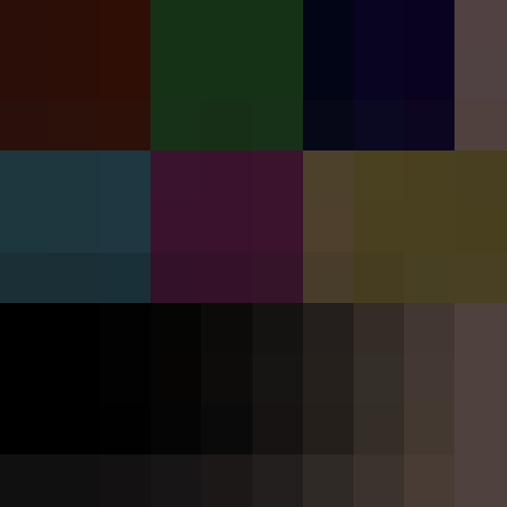
Resulting Image Rescaled

Slide 20
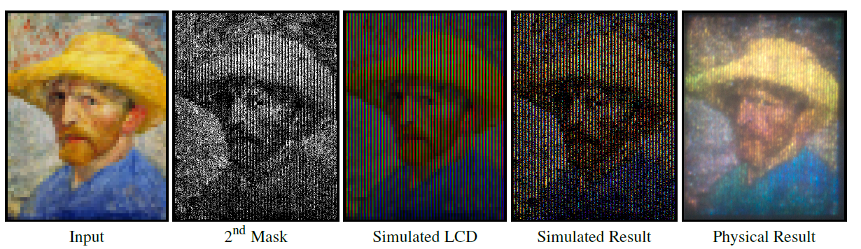
Result

Slide 21
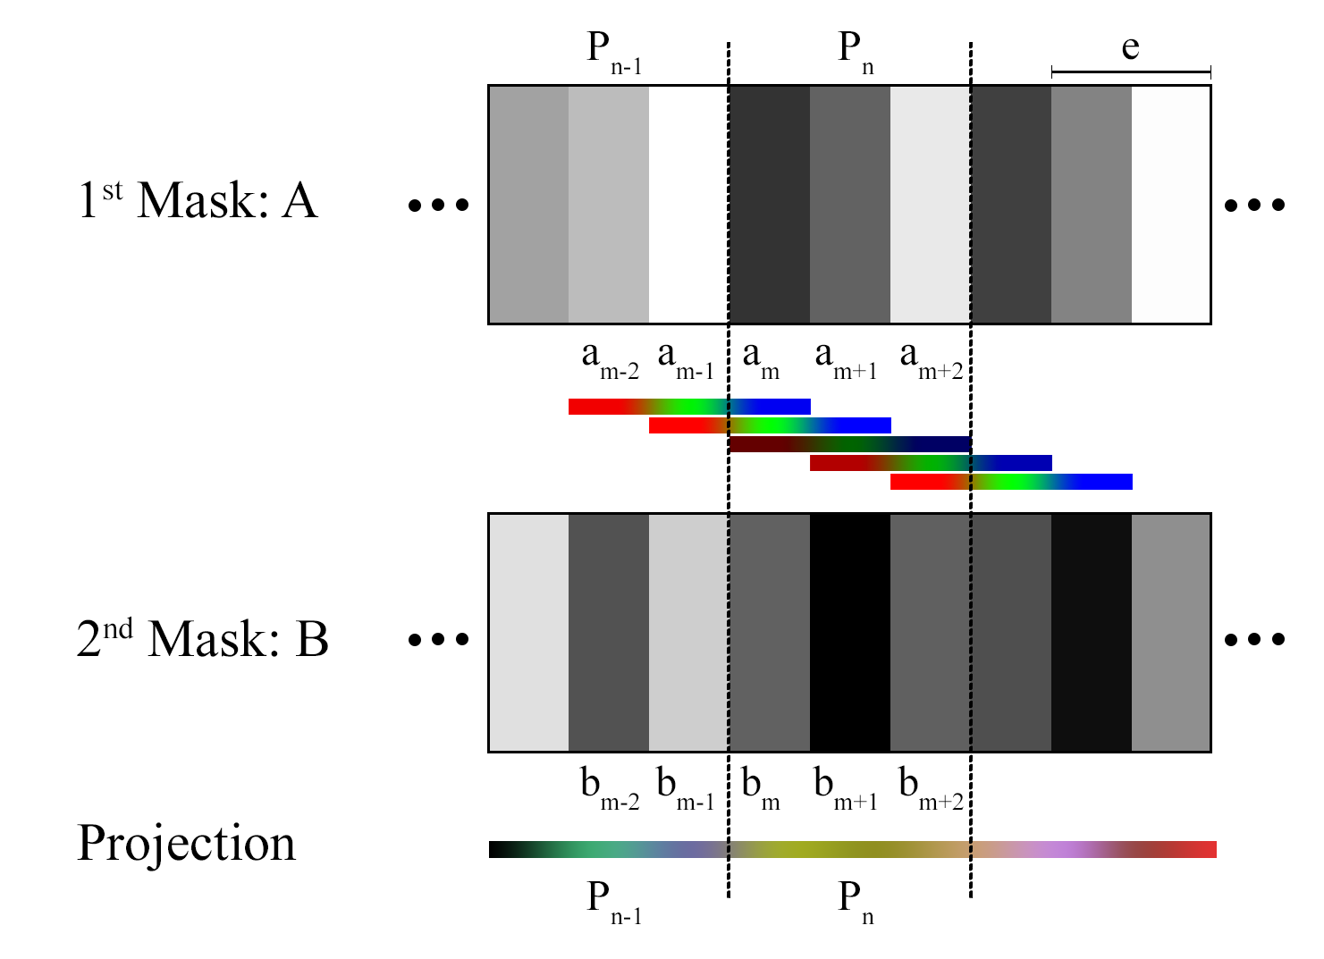
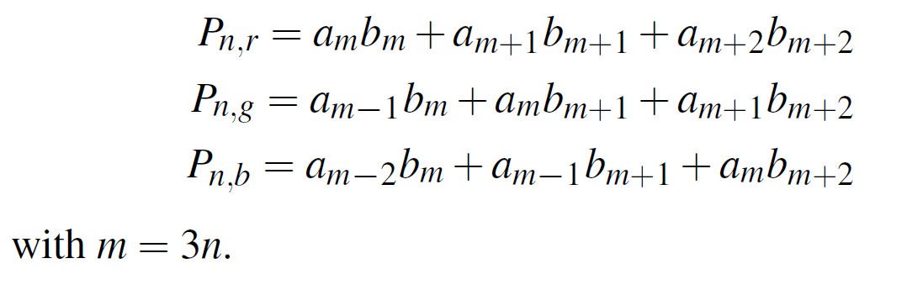
Optimizing Masks

Slide 22
Optimizing Masks

Slide 23
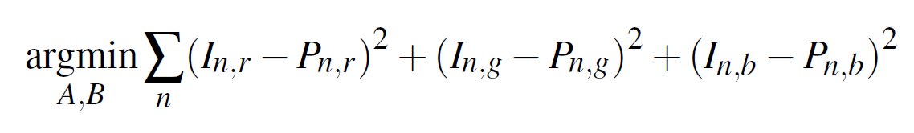
Optimizing Masks
I = Input Image
P = Pixel Value
Optimisation Function
Optimize with Levenberg-Marquardt
  Initialisation: trivial case with slit pattern

Slide 24
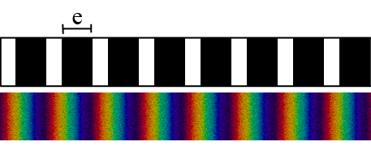
New Optimisation Target: Intensity > 1

Slide 25
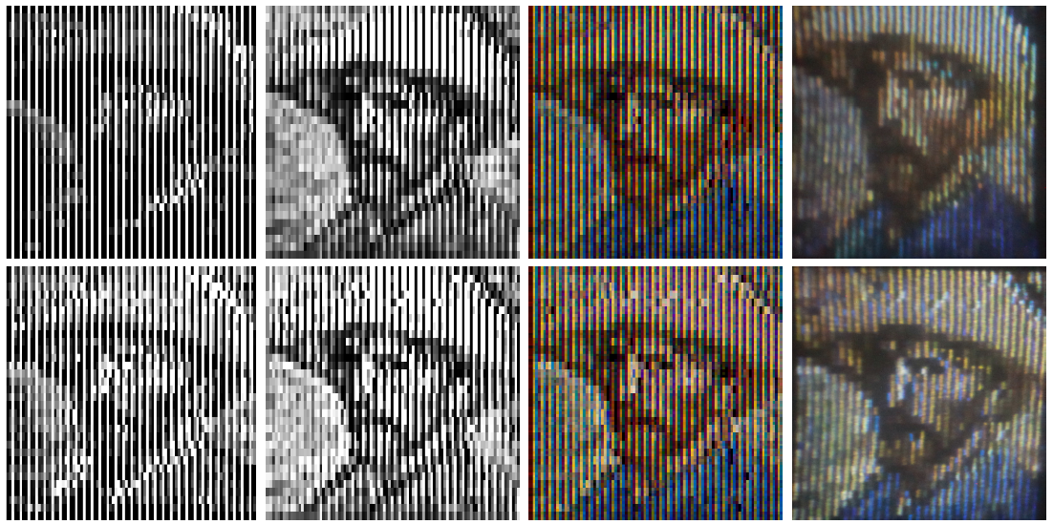
Result

Slide 26
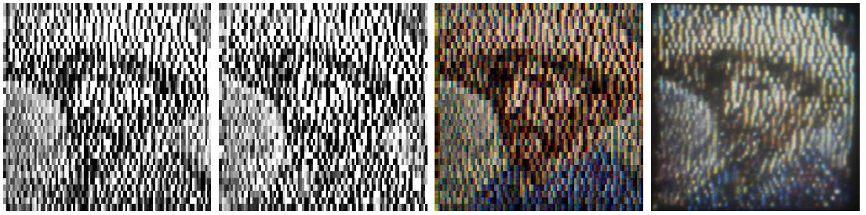
New Optimisation Target: Obfuscation

Slide 27
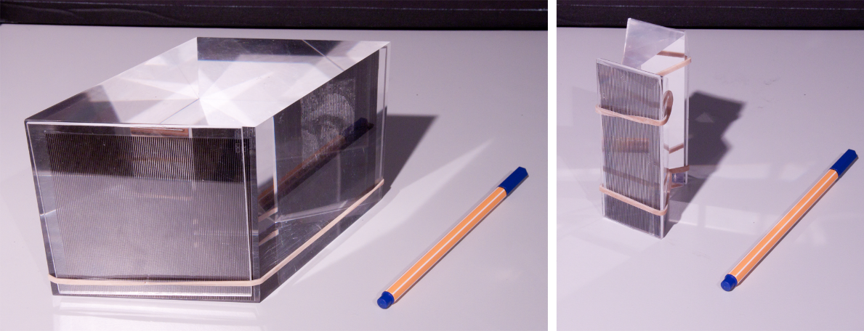
Implementation
2 Setups
  2 off the shelf prisms
  Rhombic Prism
  Material: PMMA
Lightsource
  Standard Projector, White Image, >10m distance
Filter
  Printed masks with laser printer (Brother MFC-7320) – printer dithering
  Photolithography masks for PCBs – manual dithering

Slide 28
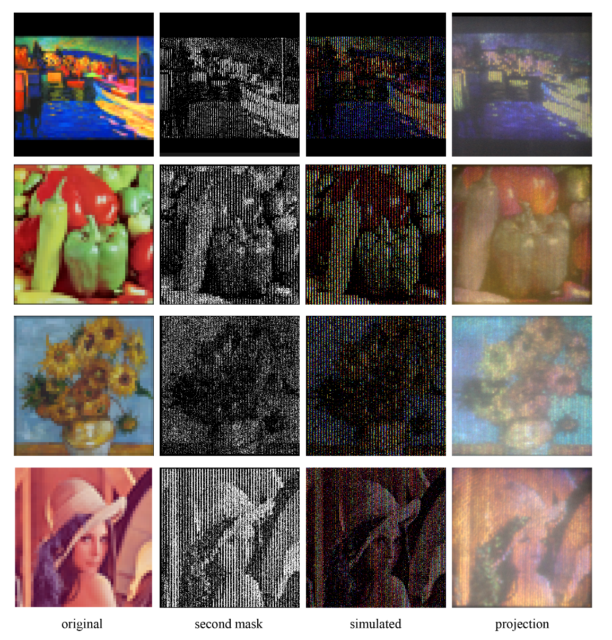
Results

Slide 29
Results

Slide 30
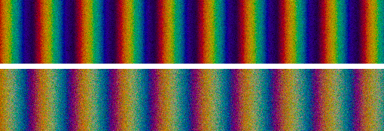
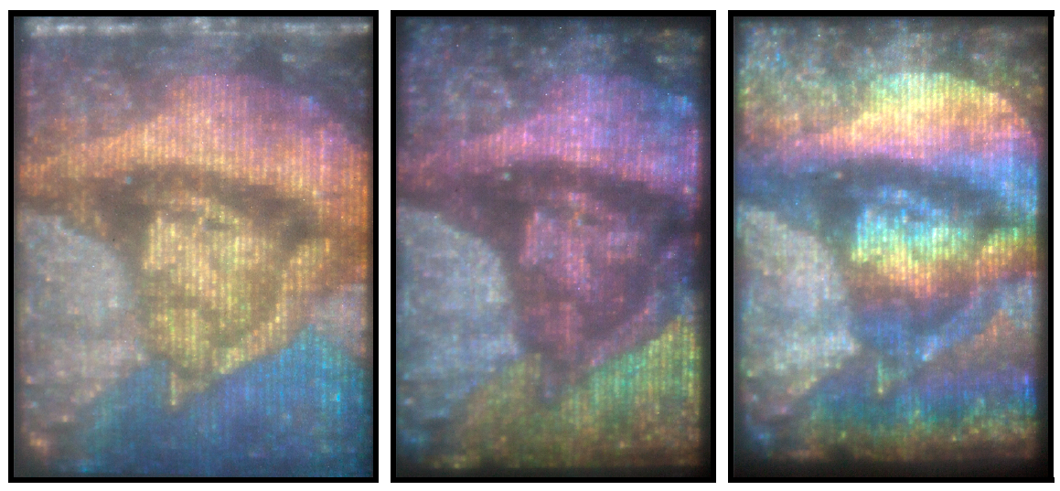
Limitations
Non Parallel Light Source
Misaligned Filters
Mask & Prism quality

Slide 31
Applications & Future Work
Smaller Subpixel (rather than RGB) up to continuous formulation
Customized setup (specialised prism, higher-quality masks, sub-mm alignment, dedicated light source)
Multi-spectral projection
Dynamic projection using LCDs
Optimisation
  Calculate target intensity
  Perceptual error metric
Smaller pixel size → Projection technology

