Slide 1
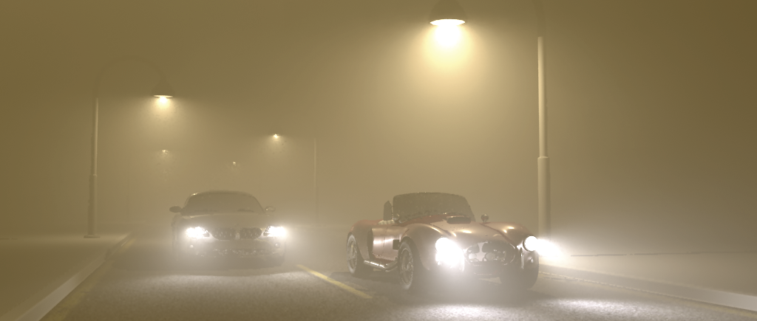
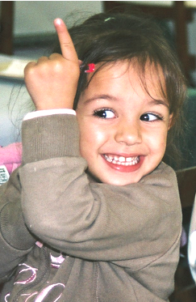

Notes:
Everybody loves beautiful images of fog, smoke, and clouds.

Slide 2
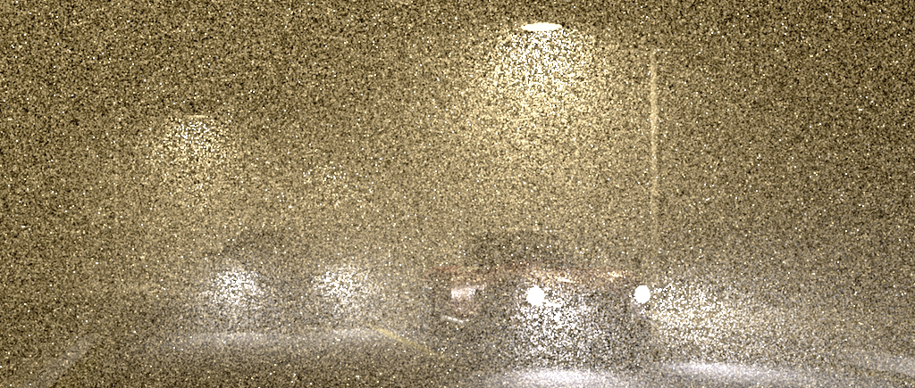

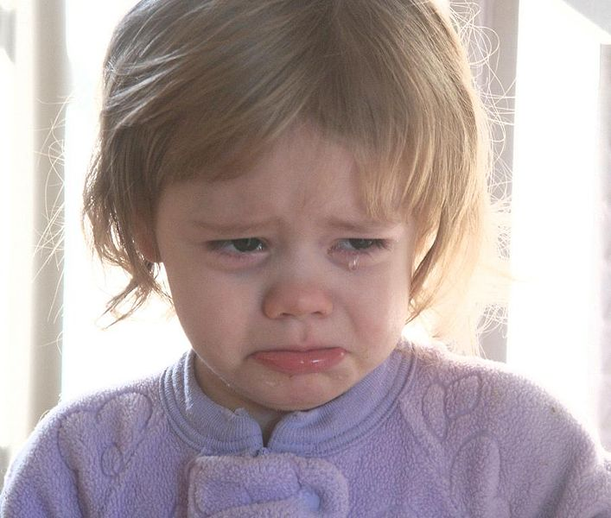
Notes:
but we all hate the long render times and noise that come with it.

Slide 3
Smoke & Mirrors
2000
Notes:
Hi, Billy Mays here with Smoke & Mirrors 2000 - the world's most powerful and efficient rendering tool you'll every use

Slide 4
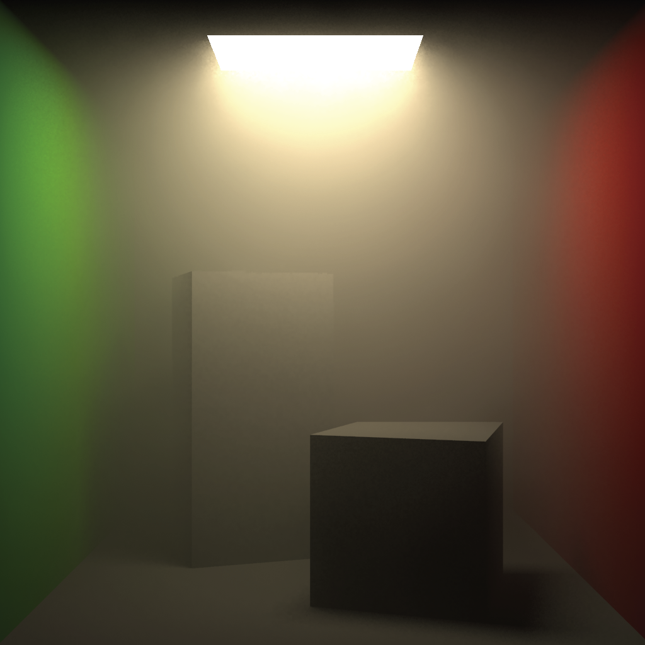
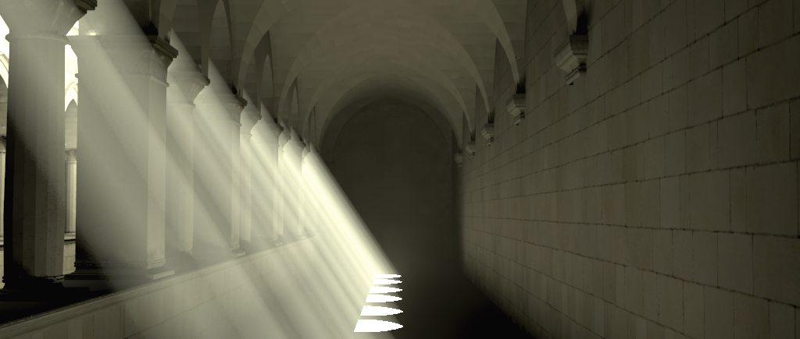
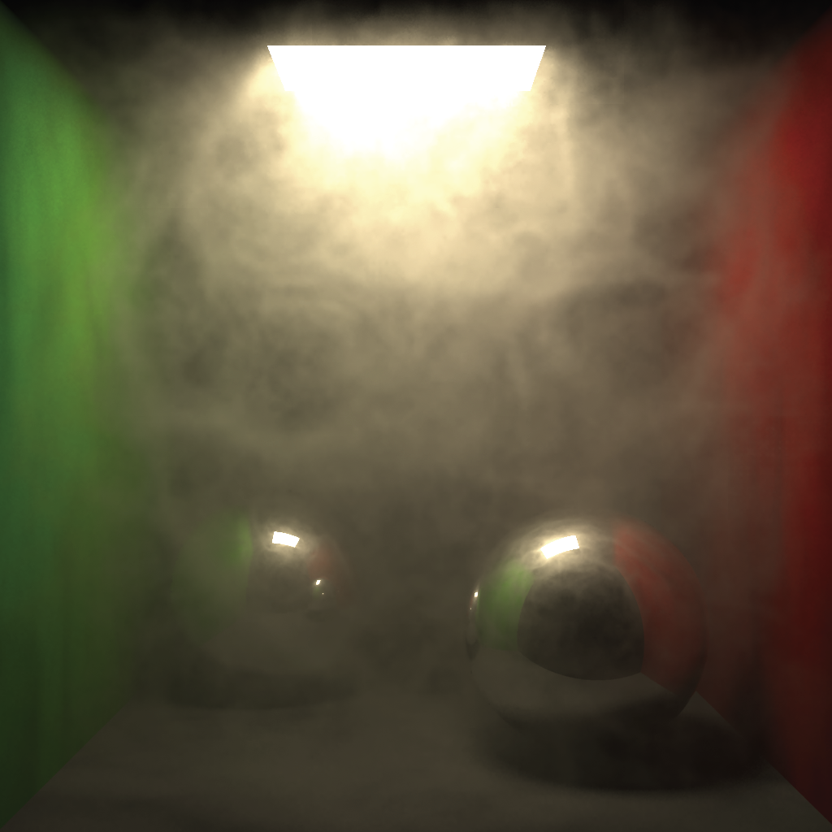
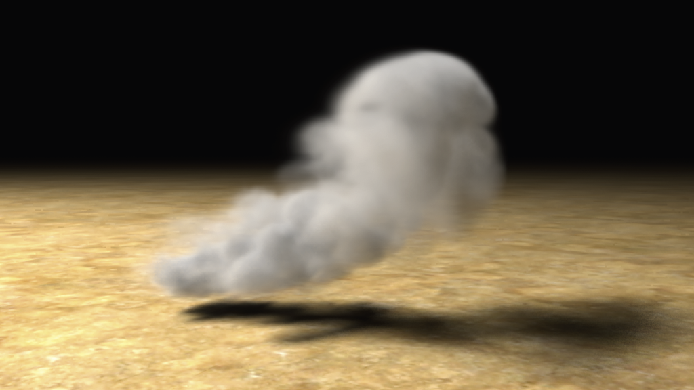
Smoke & Mirrors
2000
Renderer
Notes:
Attach it to any renderer, and get beautifully smooth renderings in seconds!
Its great for rendering scenes with uniform smoke or fog.
Or use it to simulate heterogeneous clouds.
It can even tackle scenes with anisotropic media and specular surfaces!

Slide 5
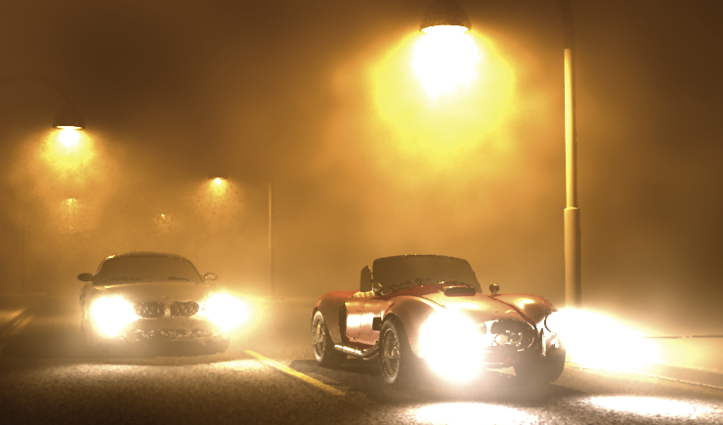
Path Tracing
Photon Mapping
Notes:
Brute force techniques like path tracing suffer from noise and photon mapping introduces distracting low-frequency artifacts.

Slide 6
Smoke & Mirrors 2000!
Notes:
But Smoke & Mirrors 2000 uses advanced mathematical algorithms to exploit the fact that lighting in participating media changes smoothly.

Slide 7
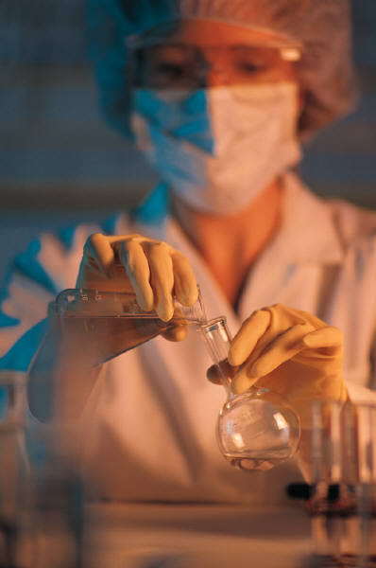
It uses SCIENCE!
Smoke & Mirrors 2000!
Notes:
This amazing innovation, developed by a prestigious team of scientists, allows you to create smoother images in less time!

Slide 8
Just 5 easy
payments of
$29
Smoke & Mirrors
2000
95
plus
S&H
INCLUDES:
Volumetric Radiance Caching
Radiance Gradients
Exponential Extrapolation
ORDER NOW!
1-800-SMOKE-IT
Notes:
Regular stores will charge you over $100 for similar products, but we are offering Smoke & Mirrors 2000 for just 5 easy payments of $29.95.
And if you call now we will include radiance gradients, and exponential extrapolation absolutely FREE! (just pay processing).
This once in a lifetime value is not available in stores, so come to our talk to find out more!

