Slide 1
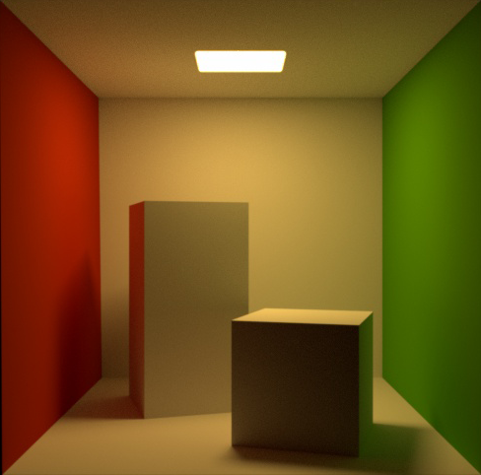
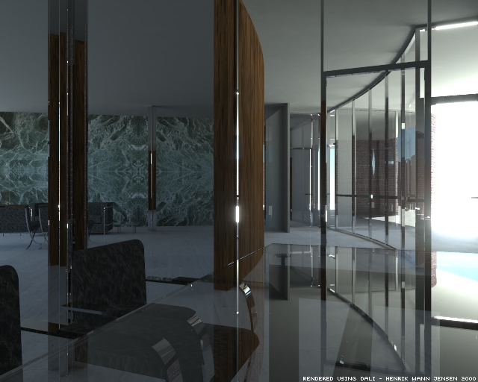


Global Illumination
Notes:
Global illumination is very important.
Unfortunately, its also very difficult

Slide 2

Notes:
Rendering nice 3D images is too complicated,
So we decided to simplify it by going to 2D.
It is easier.

Slide 3

☑
Notes:
Rendering nice 3D images is too complicated,
So we decided to simplify it by going to 2D.
It is easier.

Slide 4
3D ➔ 2D
➔
Notes:
A hemisphere becomes a hemicircle
No light coming from strange solid angles

Slide 5
Path Tracing
Photon Mapping
Notes:
We can still do path tracing and photon mapping

Slide 6
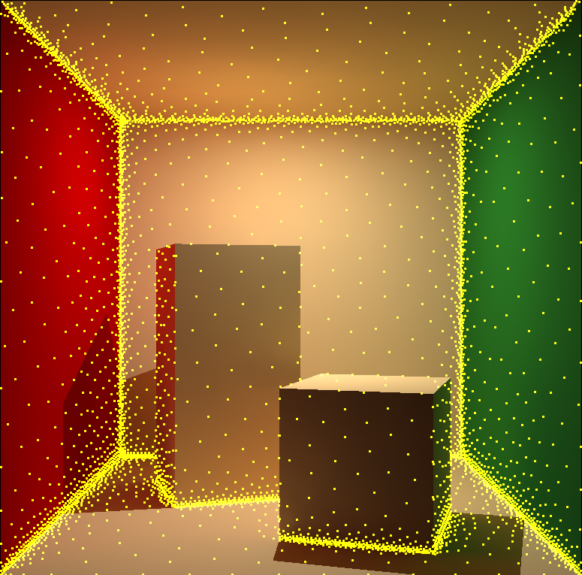
Irradiance Caching & Gradients
Notes:
And complex algorithms like irradiance caching and gradients are easily derived and analyze

Slide 7
Come learn more!
Sampling, Reconstructing, and Filtering Light
  Tuesday, 10:45 AM - 12:15, Room 502AB
Notes:
And it turns out that we can learn quite a bit and create new algorithms useful in 2D and in 3D
To learn more come to our talk at....

