Slide 1
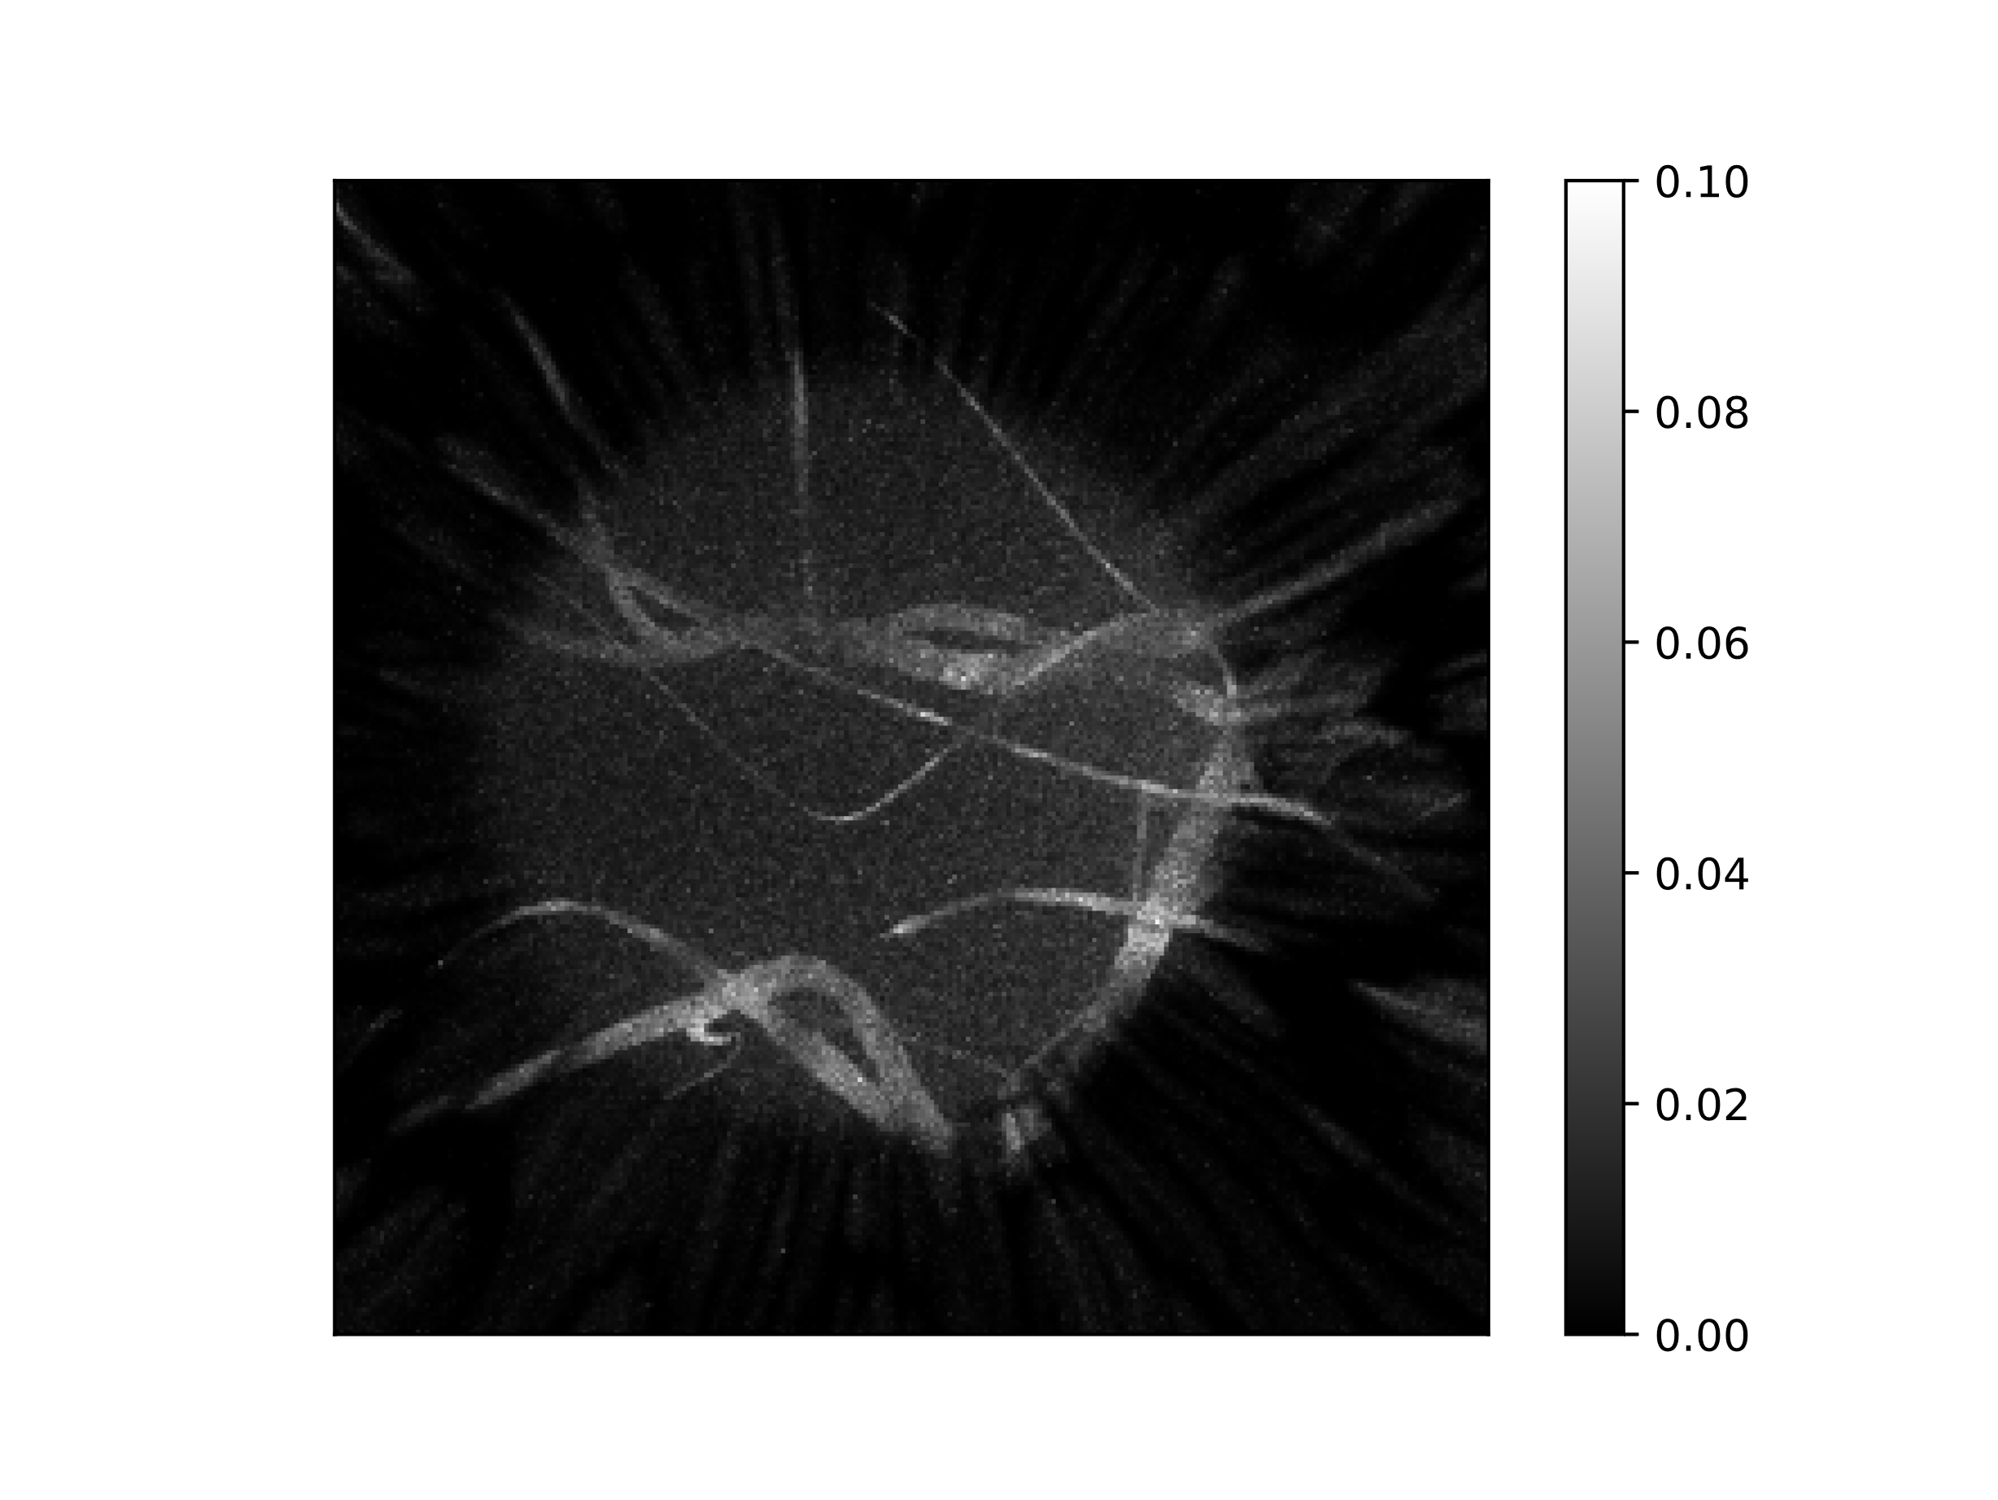
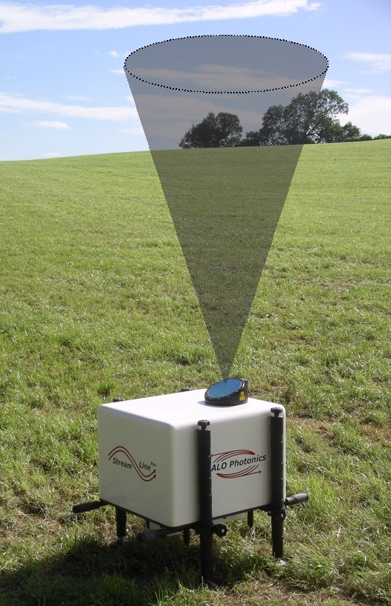
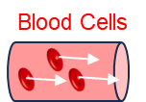
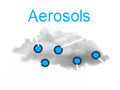
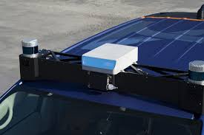
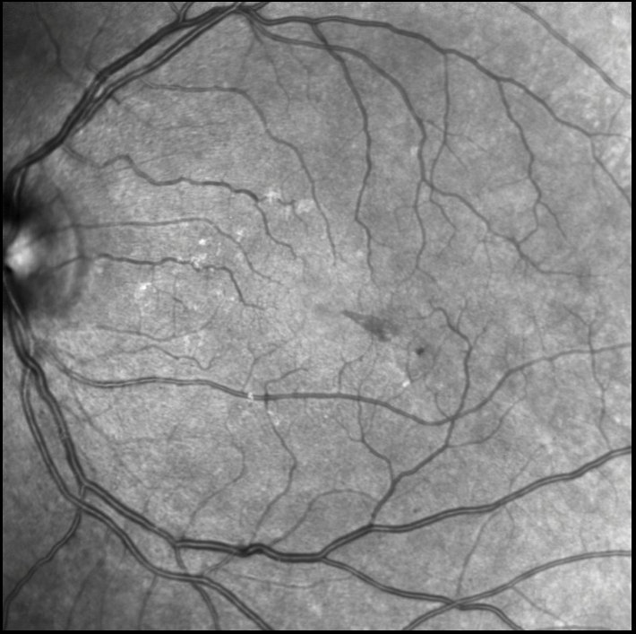
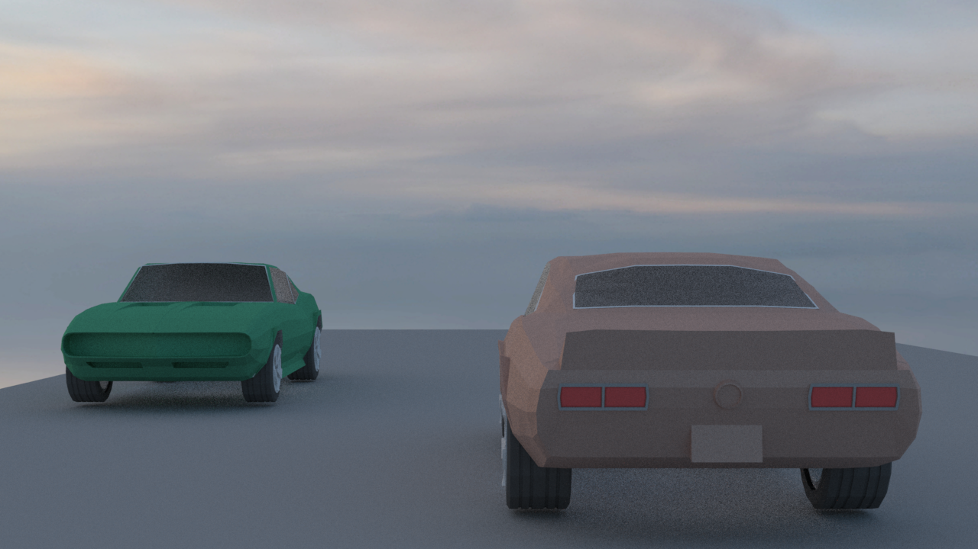
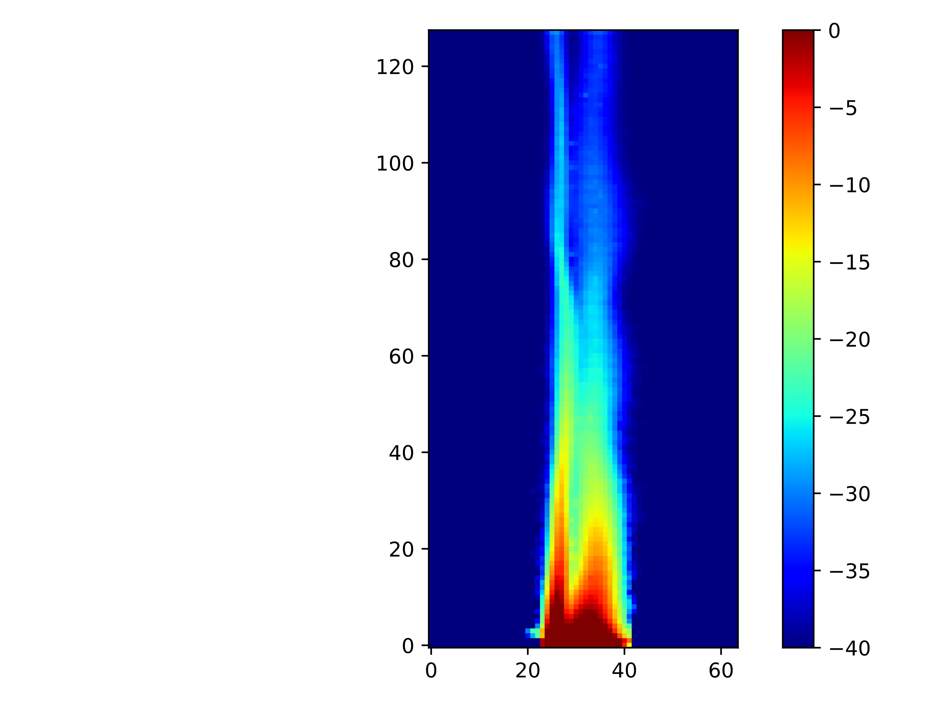
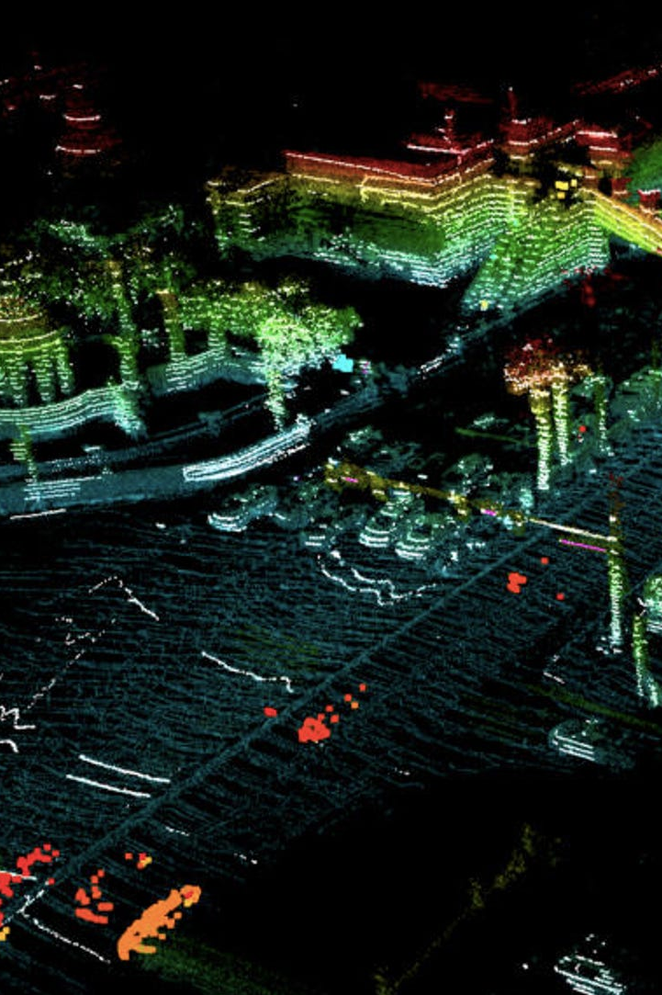
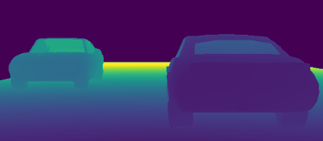
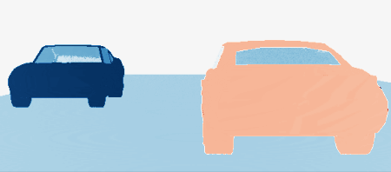
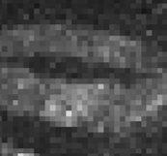



A Monte Carlo Rendering Framework for Simulating Optical Heterodyne Detection
OHD Applications
Our Monte Carlo Simulator
RGB
Distance
Velocity
FMCW Lidar
Blood Flow
Atmosphere
FMCW Lidar
Blood Flow
Atmosphere
¹ Juhyeon Kim ² Craig Benko ² Magnus Wrenninge ² Ryusuke Villemin
² Zeb Barber ¹ Wojciech Jarosz ¹ Adithya Pediredla
1
2
Project Page
Notes:
Hi, today I will present our work titled a Monte Carlo rendering framework for simulating optical heterodyne detection

Slide 2
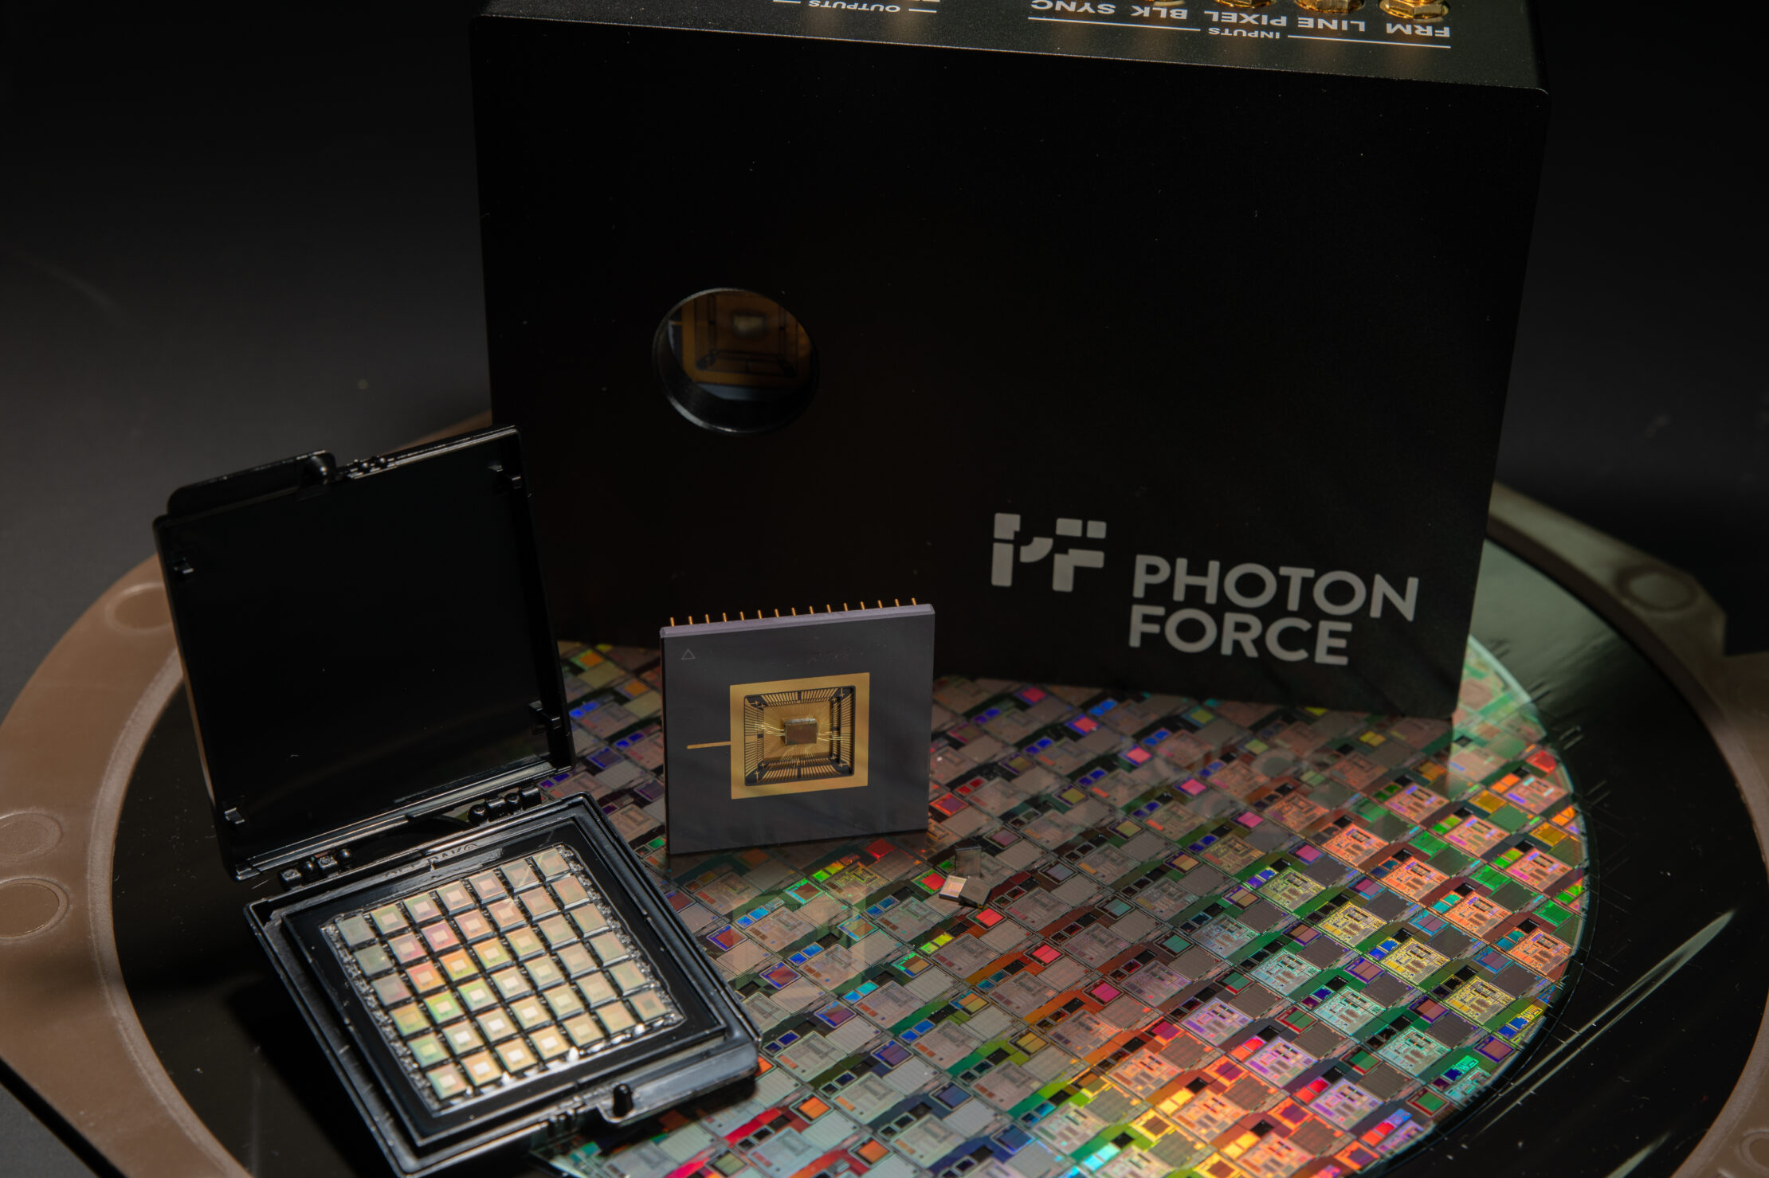
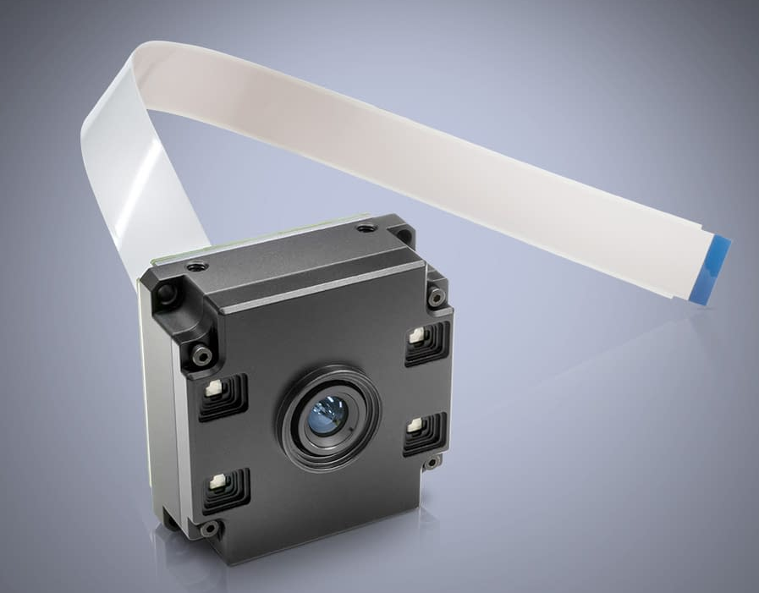
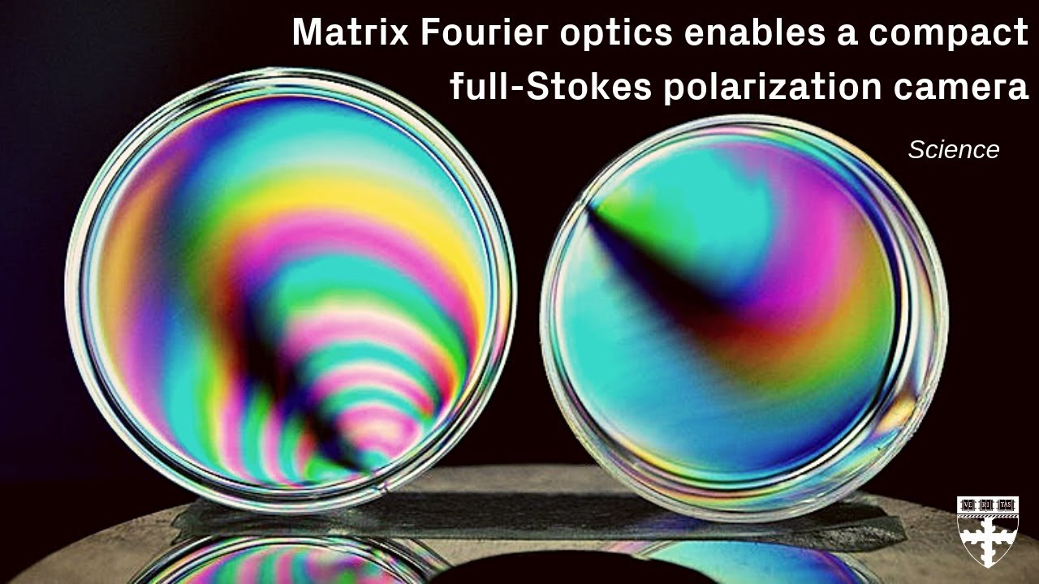
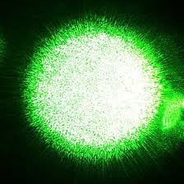
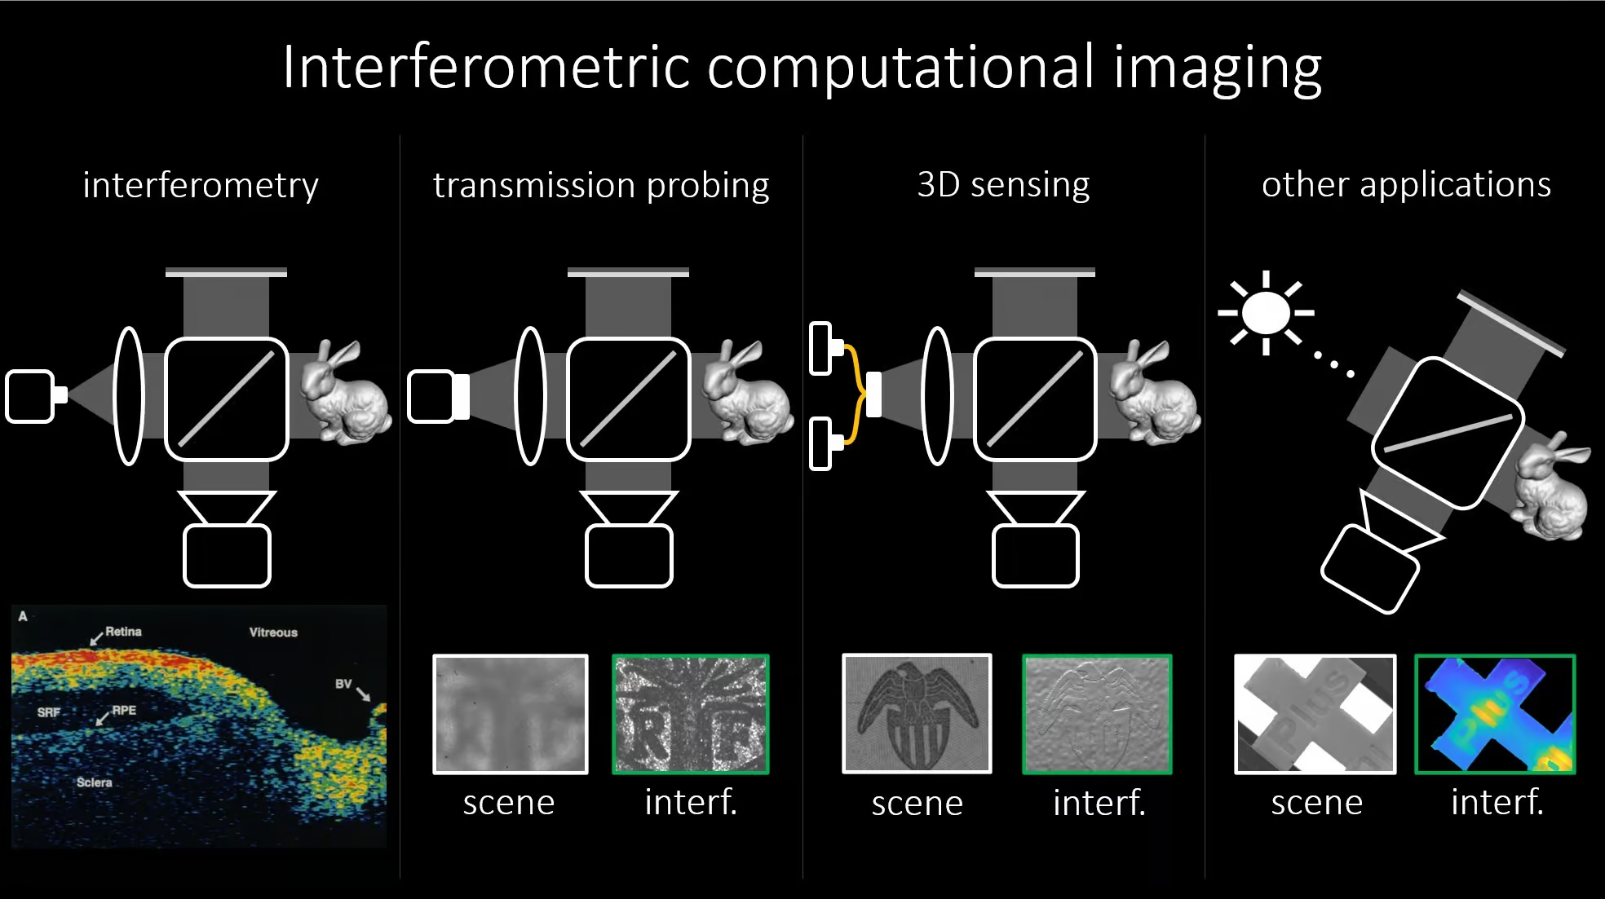
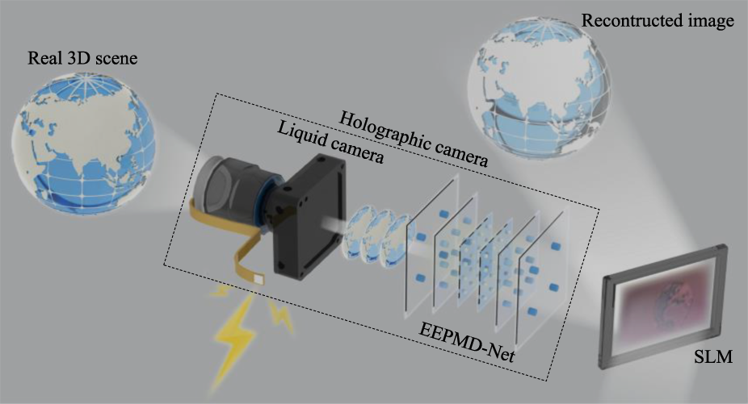
Computational Imaging
Single Photon Imaging
Time-of-Flight Imaging
Polarization-based Imaging
Speckle Imaging
Interferometric Imaging
Holographic Imaging
Notes:
I believe many of you in this room are engaged in the field of computational imaging. Over the past few decades, this field has advanced rapidly, leading to advances in techniques such as single-photon imaging, time-of-flight sensing, polarization imaging, speckle imaging, interferometry, and holography—several of which are featured in today’s talks.

Slide 3
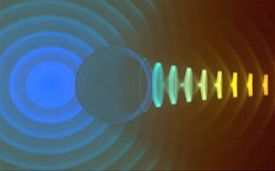
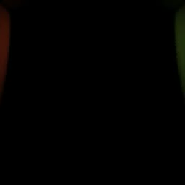
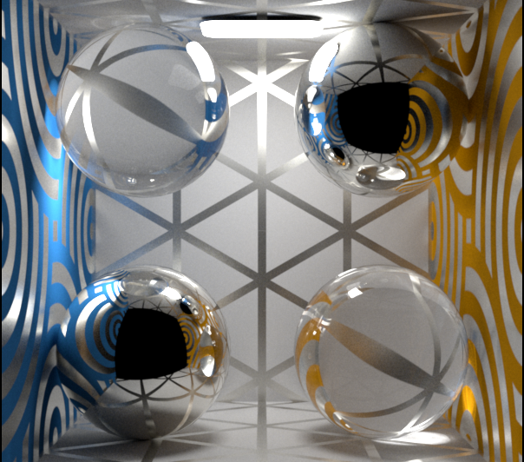
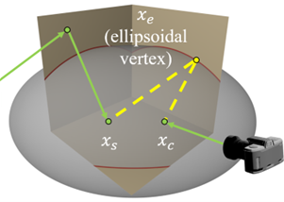
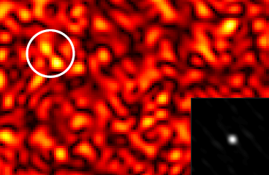
Rendering for Computational Imaging
Computational Imaging
Rendering for Computational Imaging
Design a novel imaging hardware system
Build a better computational algorithms with enhanced capabilities
Replicate measurement of computational imaging systems through simulation
Exploit physically-accurate and efficient rendering algorithm
Digital Twin
Notes:
Like this, computational imaging typically aims to design novel hardware systems enhanced by advanced computational algorithms. However, the work I’ll be presenting today is slightly different from traditional computational imaging research. It is more closely aligned with rendering—what I call rendering for computational imaging. In this line of work, instead of building hardware, we build digital twins that closely replicate the imaging measurements using efficient and physically accurate rendering algorithms.

Slide 4
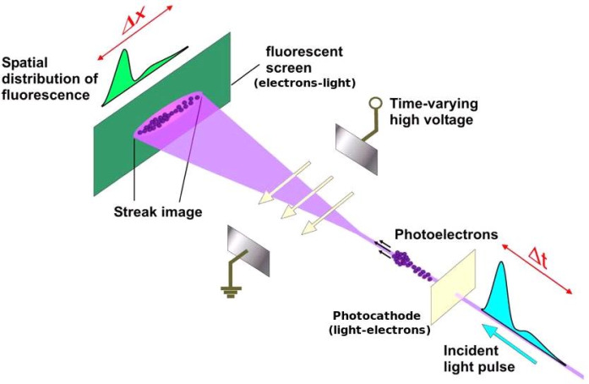
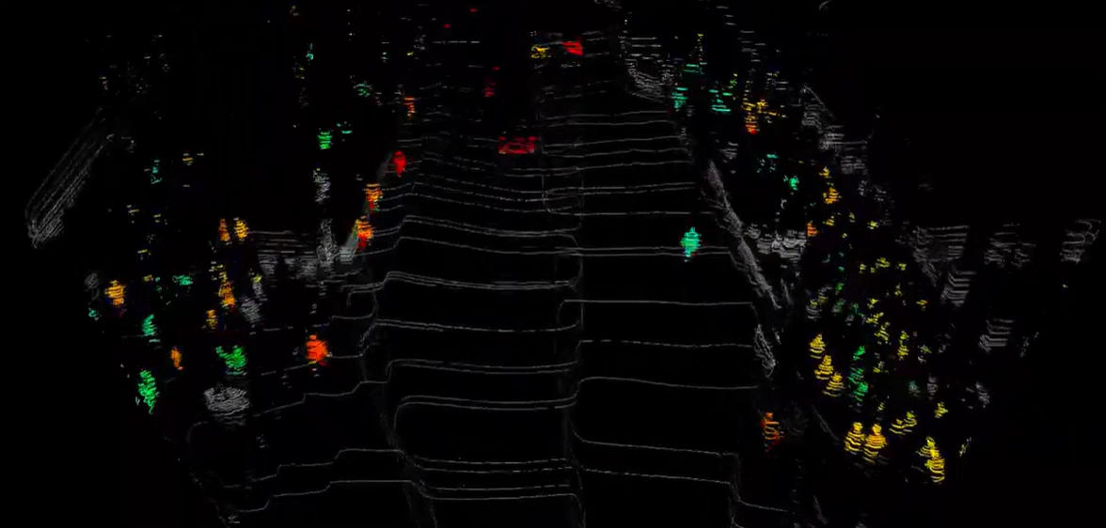
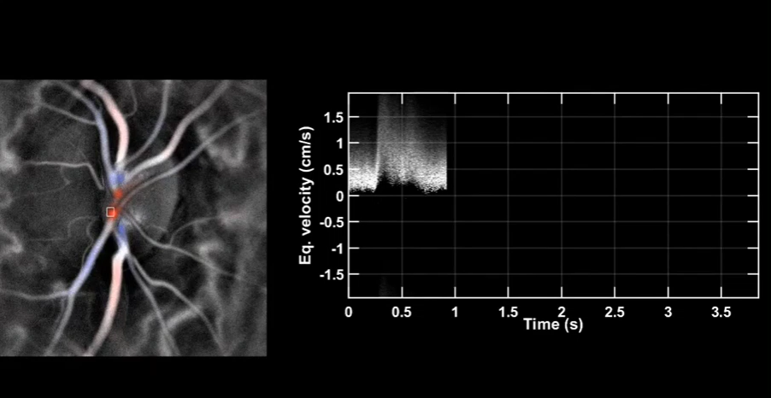
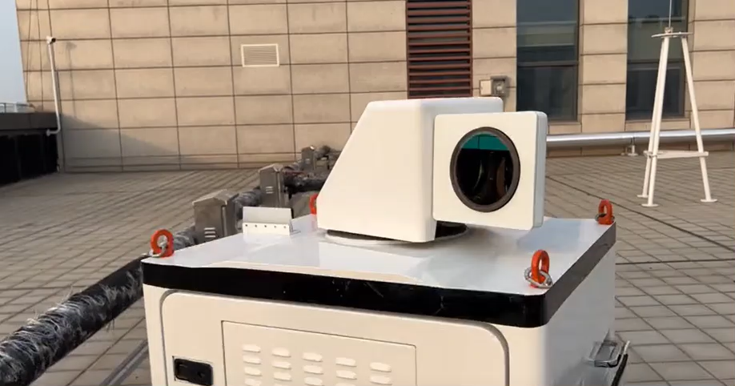
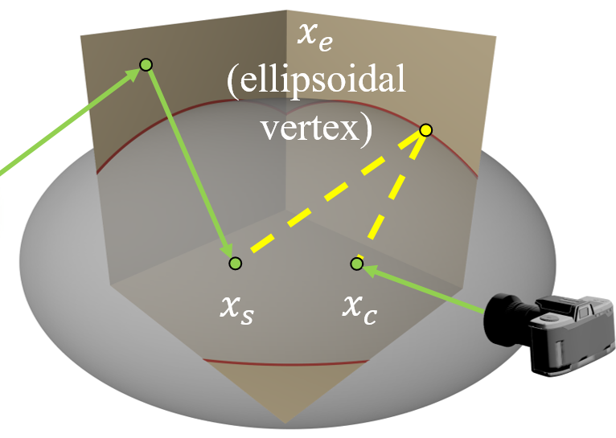
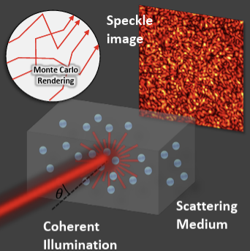
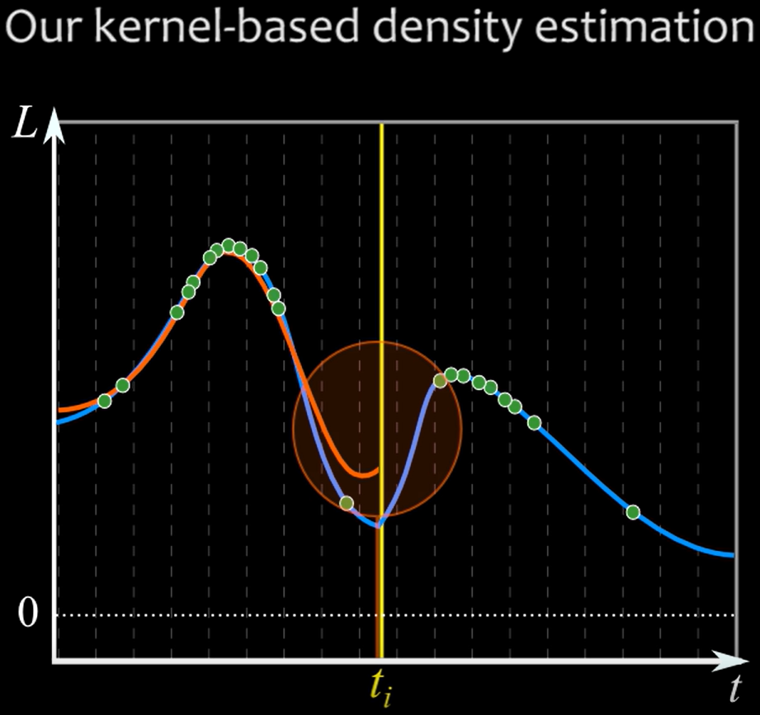
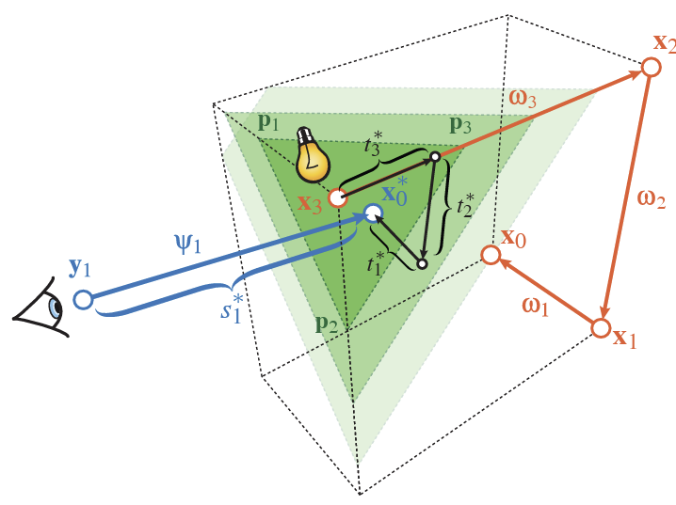
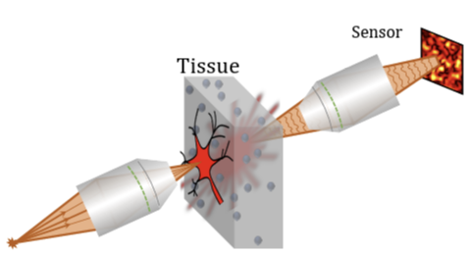

Rendering for Computational Imaging
Polarization Rendering
Speckle
Rendering
Transient / time-gated Rendering
Doppler Rendering
Imaging System
SPAD
Streak camera
Polarized imaging
Speckle imaging
Doppler Lidar / Blood / Wind Velocimetry
Rendering
?
[Pediredla et al. 2019]
[Bar et al. 2019]
[Wilkie et al. 2012]
[Jarabo et al. 2014]
[Liu et al. 2022]
[Bar et al. 2020]
Notes:
A well-known example would be rendering transient or time-gated sensors. Several techniques—such as kernel density estimation, ellipsoidal path connection, and temporally sliced photon primitives—have been proposed for this.
We also have well-established rendering theories for simulating polarized cameras, which are already integrated into renderers like Mitsuba. More recently, Monte Carlo frameworks for simulating speckle in far- and near-field have also been introduced. However, there is one important area that remained largely overlooked by rendering researchers until just a few years ago: Doppler imaging, for which no general-purpose scalable simulator exists.

Slide 5

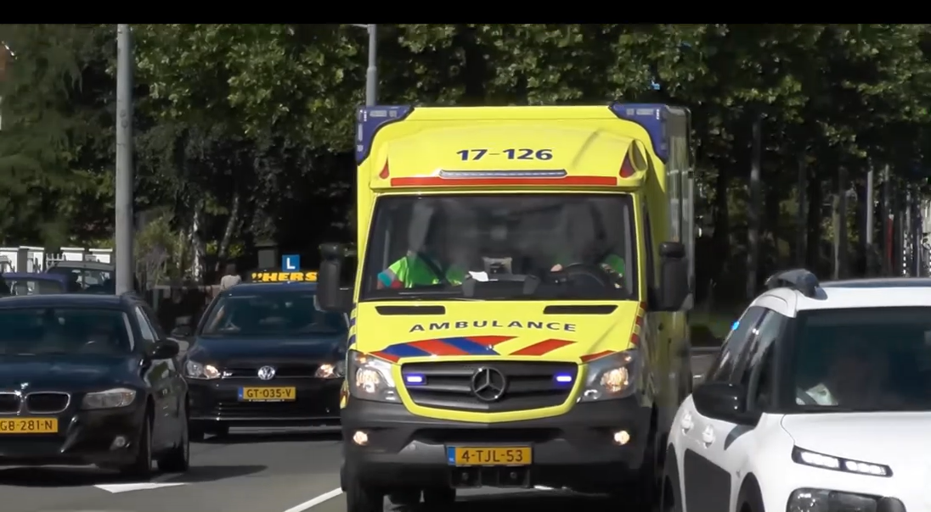
Doppler Effect
Notes:
So, what is the Doppler effect? It is a phenomenon in which the frequency of a wave changes due to the relative motion between the source and the observer.
A common example is the shift in pitch you hear from a moving sound source, like an ambulance.

Slide 6

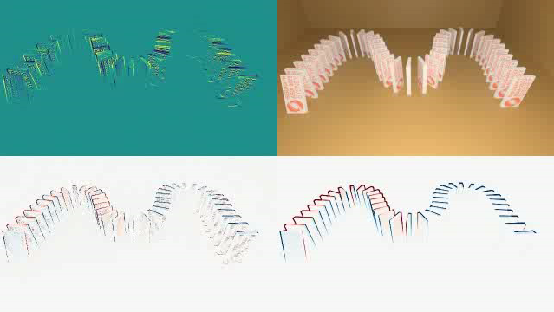
Intensity vs Field Doppler
Renderer
Doppler ToF (DToF) Imaging
Intensity
What we see
time (or distance)
[Heide et al. 2015]
[Kim et al. 2023] (Also ours)
Notes:
In optical imaging systems, the Doppler effect manifests in two ways. The first is intensity Doppler, where the effect appears as a modulation in the intensity of the light source. Doppler Time-of-Flight imaging systems leverage this phenomenon, and two years ago, our group proposed an effective Monte Carlo simulator to model it.

Slide 7
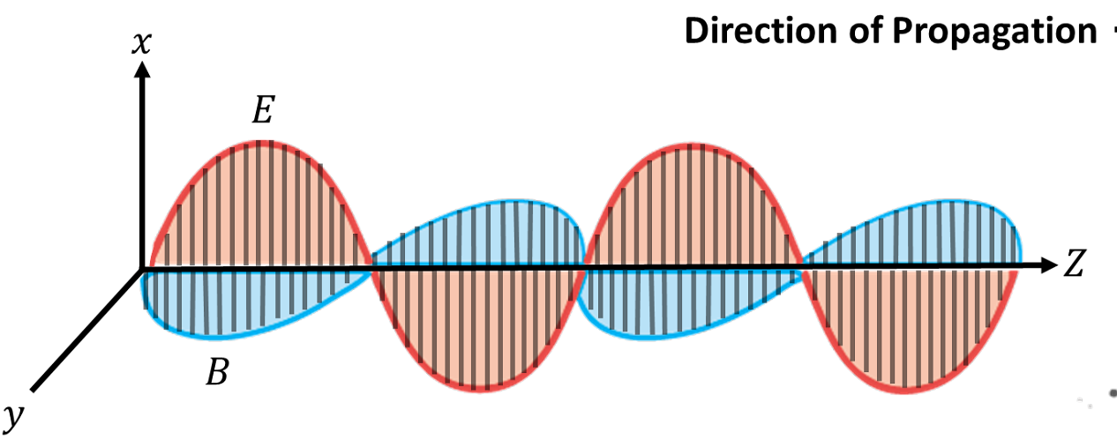
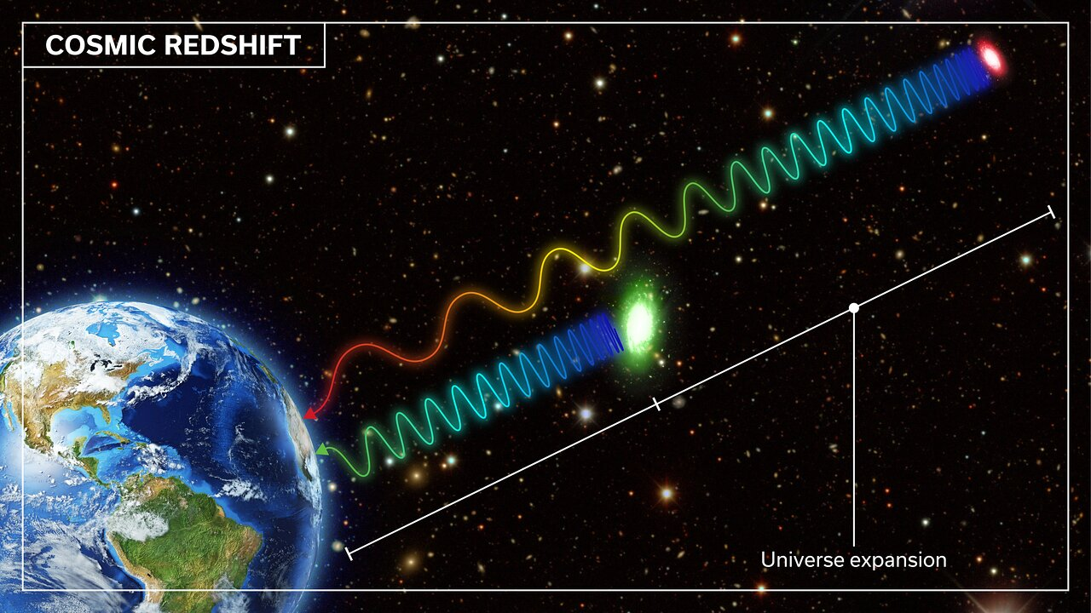
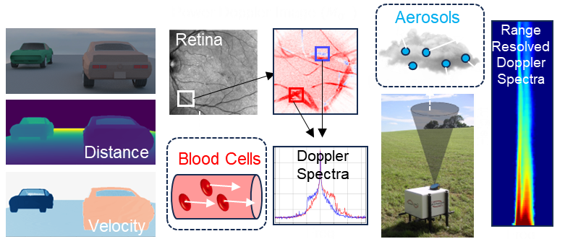
Intensity vs Field Doppler
Renderer
Doppler ToF (DToF) Imaging
Intensity
What we see
time (or distance)
[Heide et al. 2015]
[Kim et al. 2023] (Also ours)
Optical Heterodyne Detection (OHD)
Field Amplitude
time (or distance)
This work
Doppler Lidar
Blood Flow
Wind
Notes:
The second is field Doppler, where the Doppler effect occurs in the electromagnetic field of the light itself. A well-known example is the red and blue shift observed in astronomy. However, this shift also occurs at smaller scales in applications such as Doppler lidar, blood or wind velocimetry. These techniques that rely on optical interference are collectively referred to as optical heterodyne detection. In this work, we present a scalable renderer for simulating such applications.

Slide 8
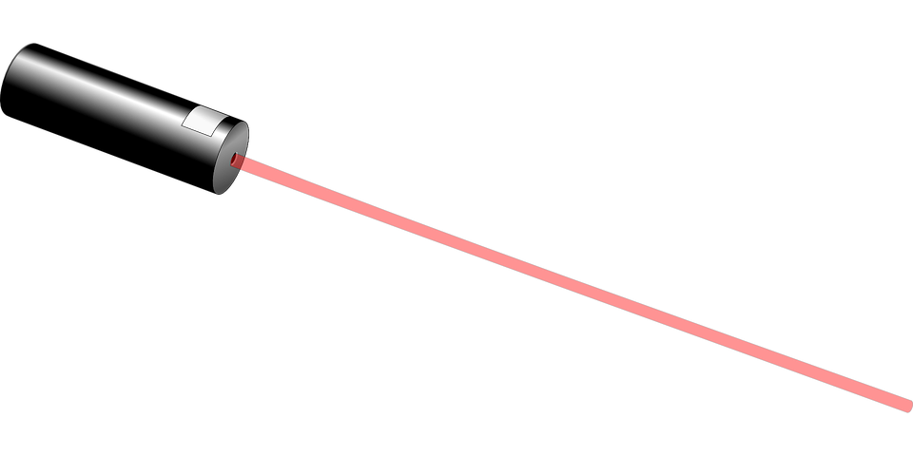





Intensity vs Field Doppler Simulation
They measure different quantities and thus need different simulation!
Microscopic geometry relative to $λ$
$λ=10m$ (DToF)
Macroscopic
Intensity
Explicit Move + Shift mapping
[Kim et al. 2023]
time (or distance)
$λ=1550 nm$ (OHD)
Microscopic
Field Amplitude
$$Δf=f_{0}(v/c)$$
time (or distance)
From Doppler Formula (Ours)
Notes:
So why do we need different renderers? These two types of Doppler effects fundamentally measure different physical quantities due to their large wavelength difference. Intensity Doppler captures macroscopic velocity, while Field Doppler detects microscopic velocity. As a result, we found that they require distinct simulation strategies. Actually, there are more interesting discussion on this comparison like shift mapping in rendering literature, but please refer to the paper for the details.

Slide 9
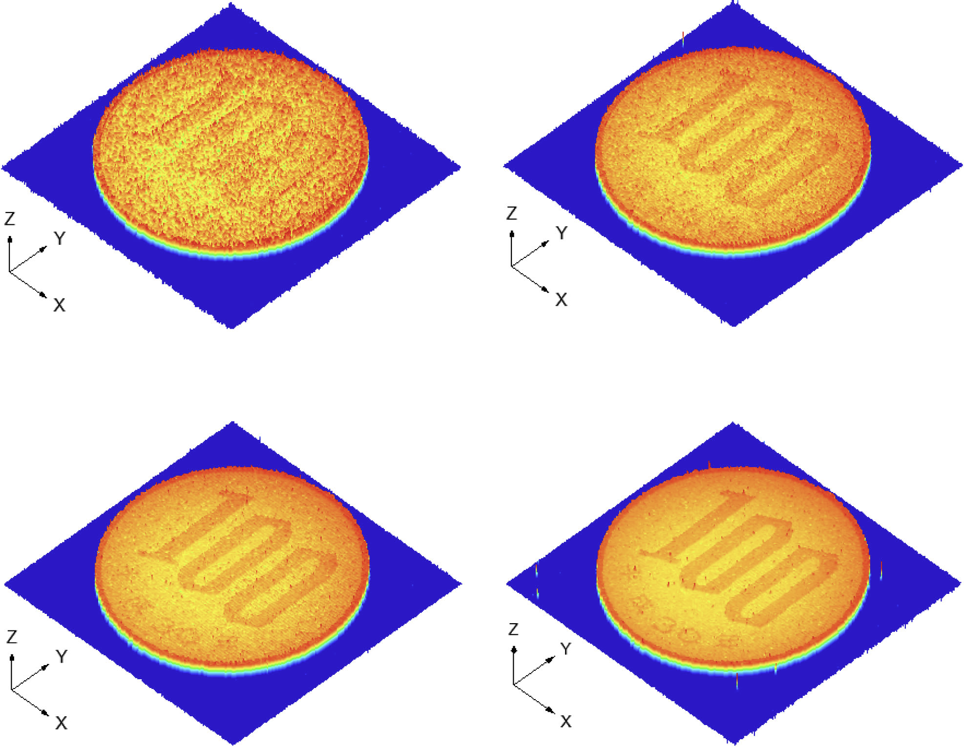
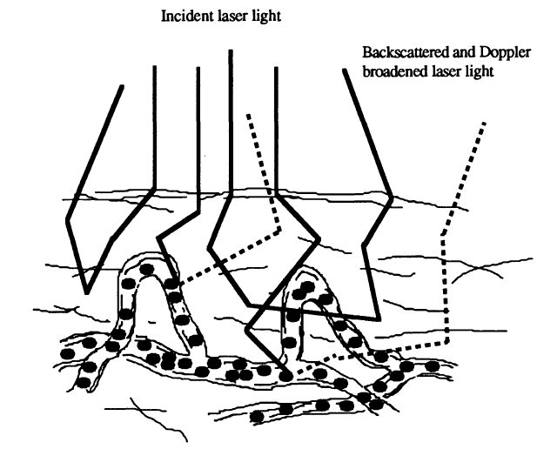
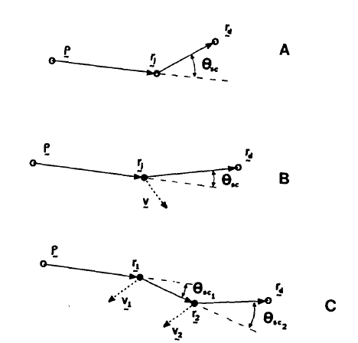
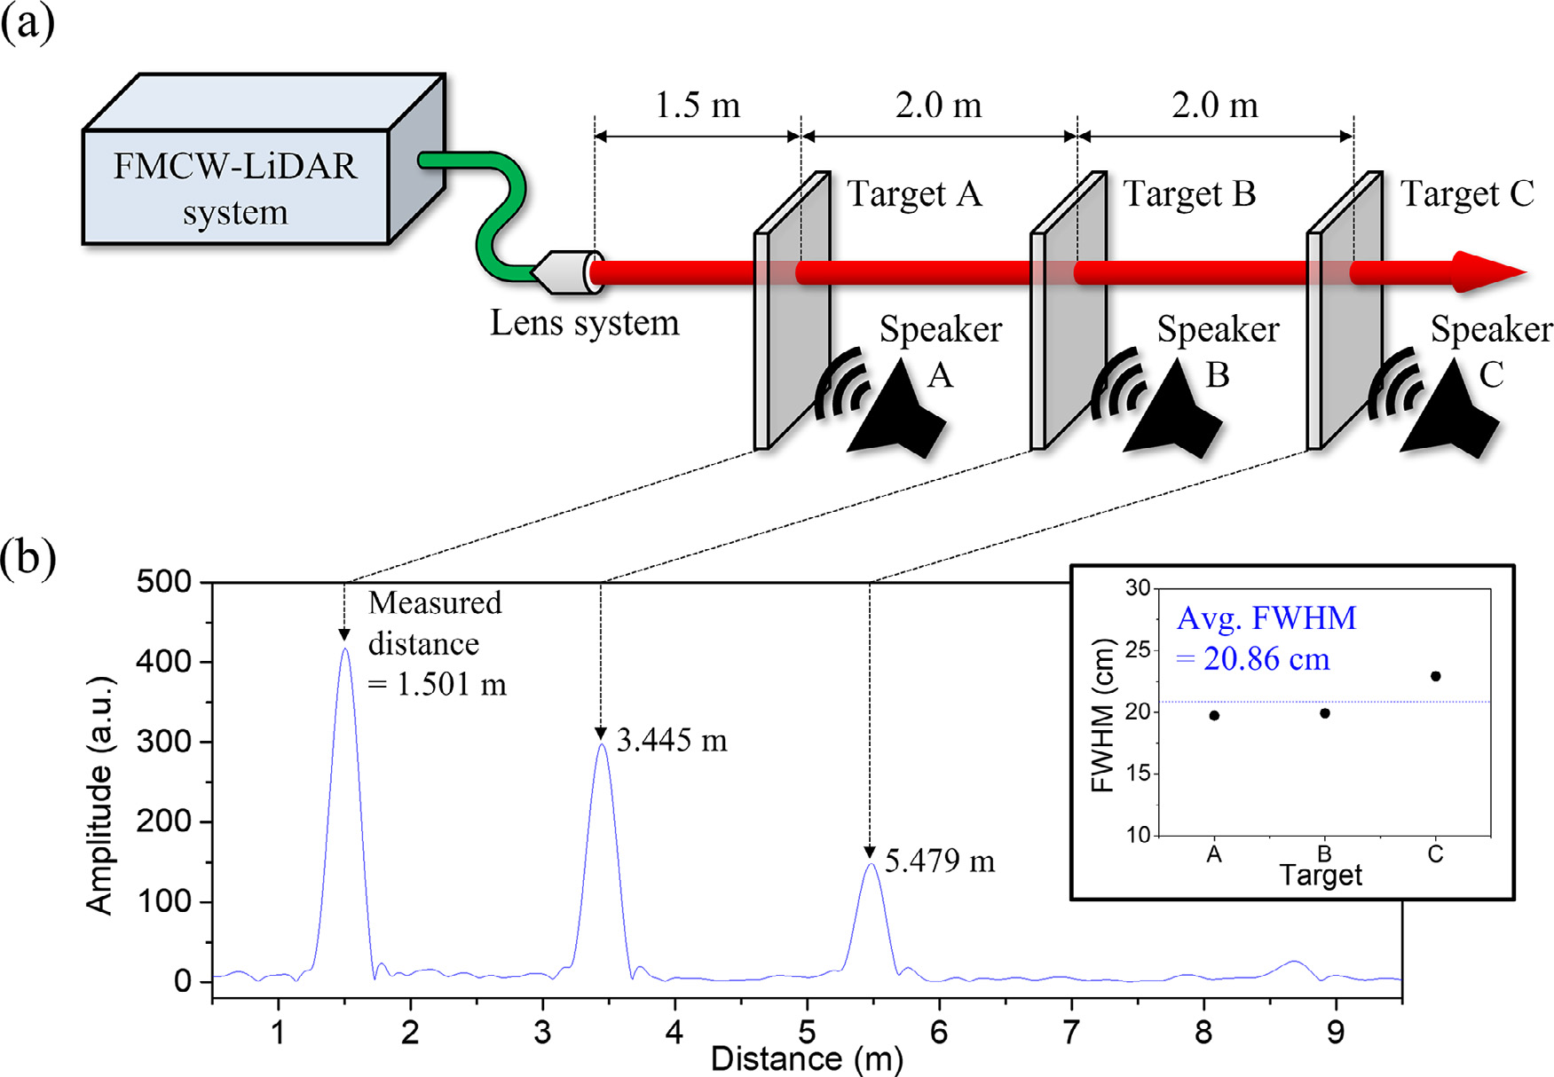
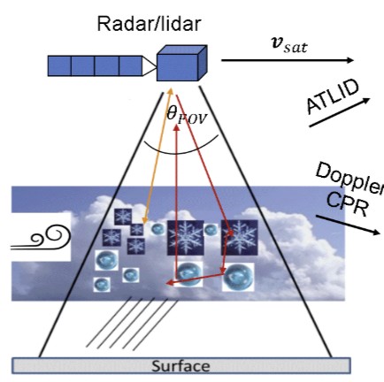
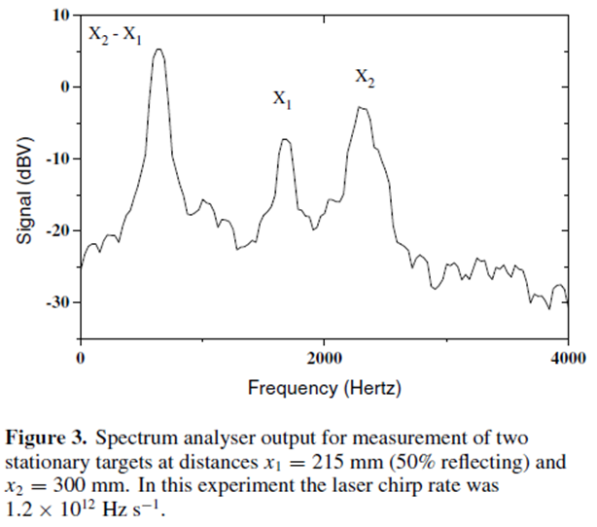
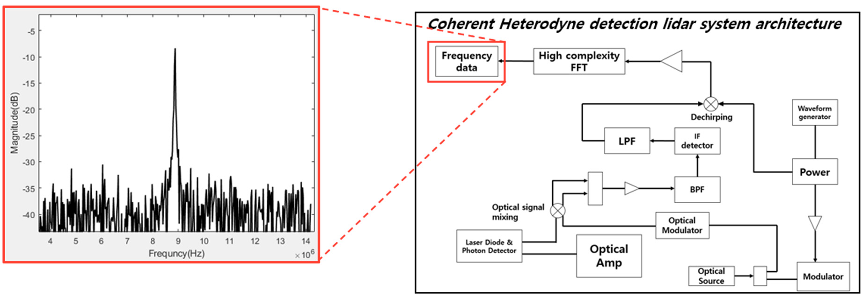
Previous Works in OHD
Over-simplified, domain-specific assumptions
[Iiyama et al., 2017]
[Nilsson et al., 1990]
[Kim et al., 2020]
[Jang et al., 2023]
[Bonner et al., 1981]
[Szczap et al., 2021]
[Shafir et al., 2001]
[Hofrichter et al., 2024]
Notes:
So going back to OHD simulation, there are several prior works that have explored OHD modeling or simulation, but they are limited in scope often relying on over-simplified, domain-specific assumptions.

Slide 10

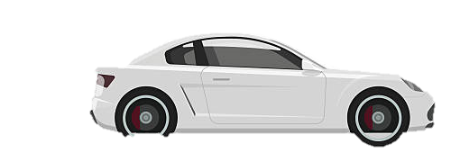
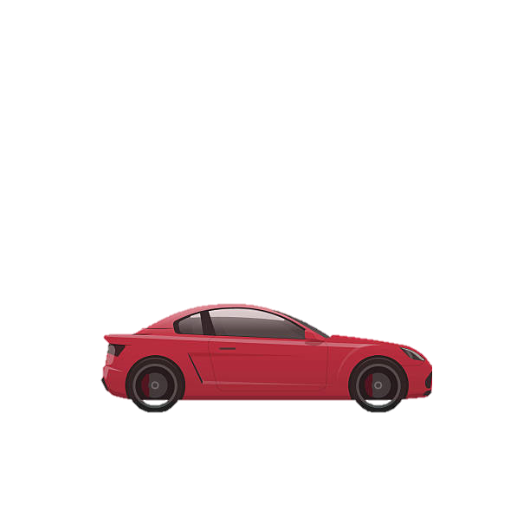
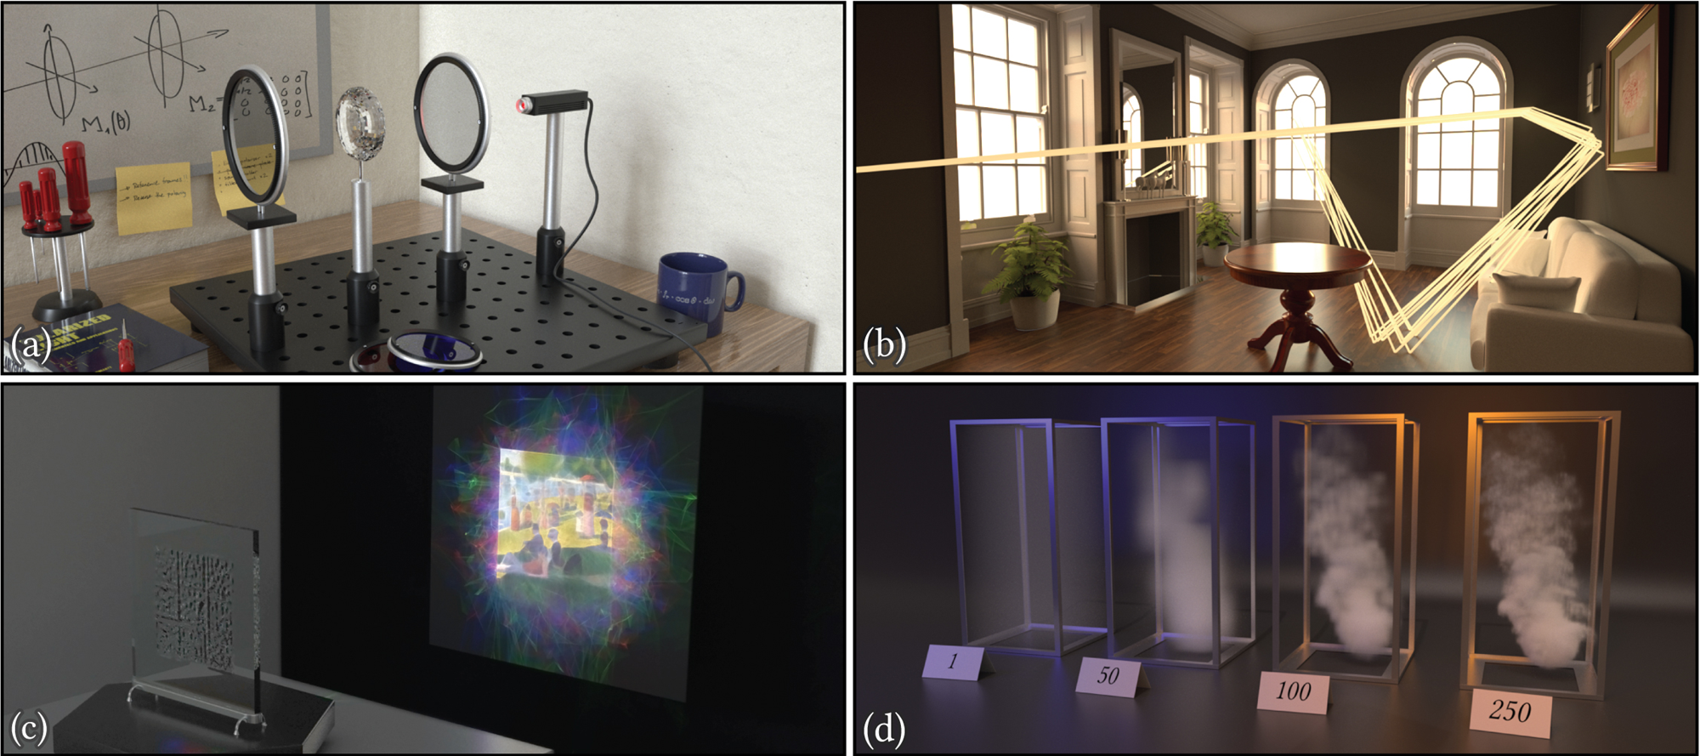



Our Monte Carlo Simulator
Rendering for Computational Imaging
Standard Rendering
Path
OHD Path Integral (Ours)
Path Integral [Veach 1997]
$$\overline{x}$$
$$S_{AC}\left(ω\right)=\int_{𝒫}^{ }{f\left(\overline{x}\right)δ\left(ω−ω\left(\overline{x}\right)\right)}dμ(\overline{x})$$
$$I=\int_{𝒫}^{ }{f\left(\overline{x}\right)}dμ(\overline{x})$$
Radiometric
Path Throughput
Path
Frequency
Radiometric
Path Throughput
Existing (Radiometric) Monte Carlo Path Tracers
Notes:
In contrast, our proposed algorithm—based on a path integral formulation that closely resembles the well-known expression from Veach in standard rendering—can leverage existing Monte Carlo path tracers, providing significant scalability across a wide range of OHD scenarios.

Slide 11
Proposed Method

Slide 12
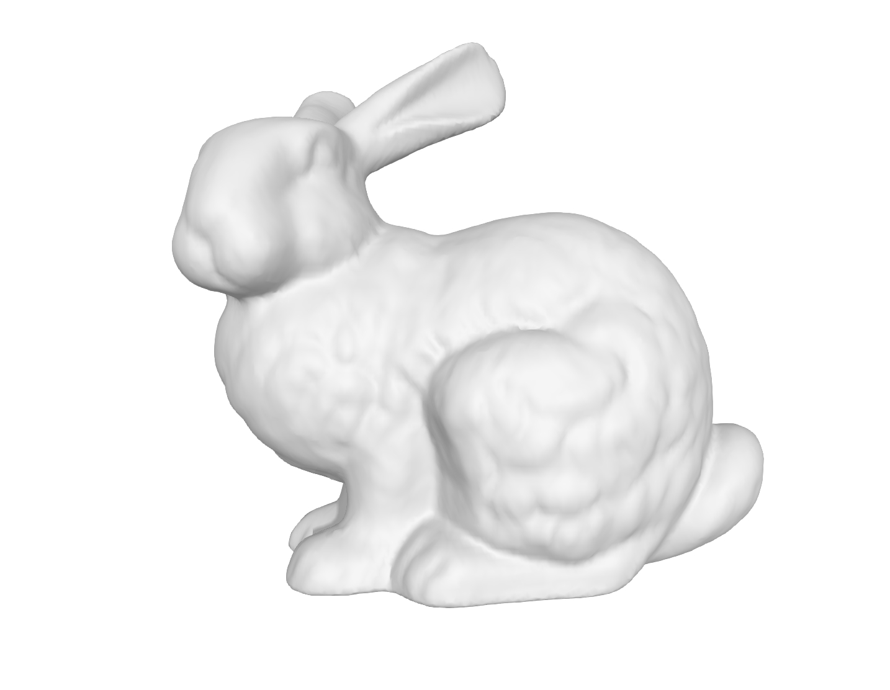
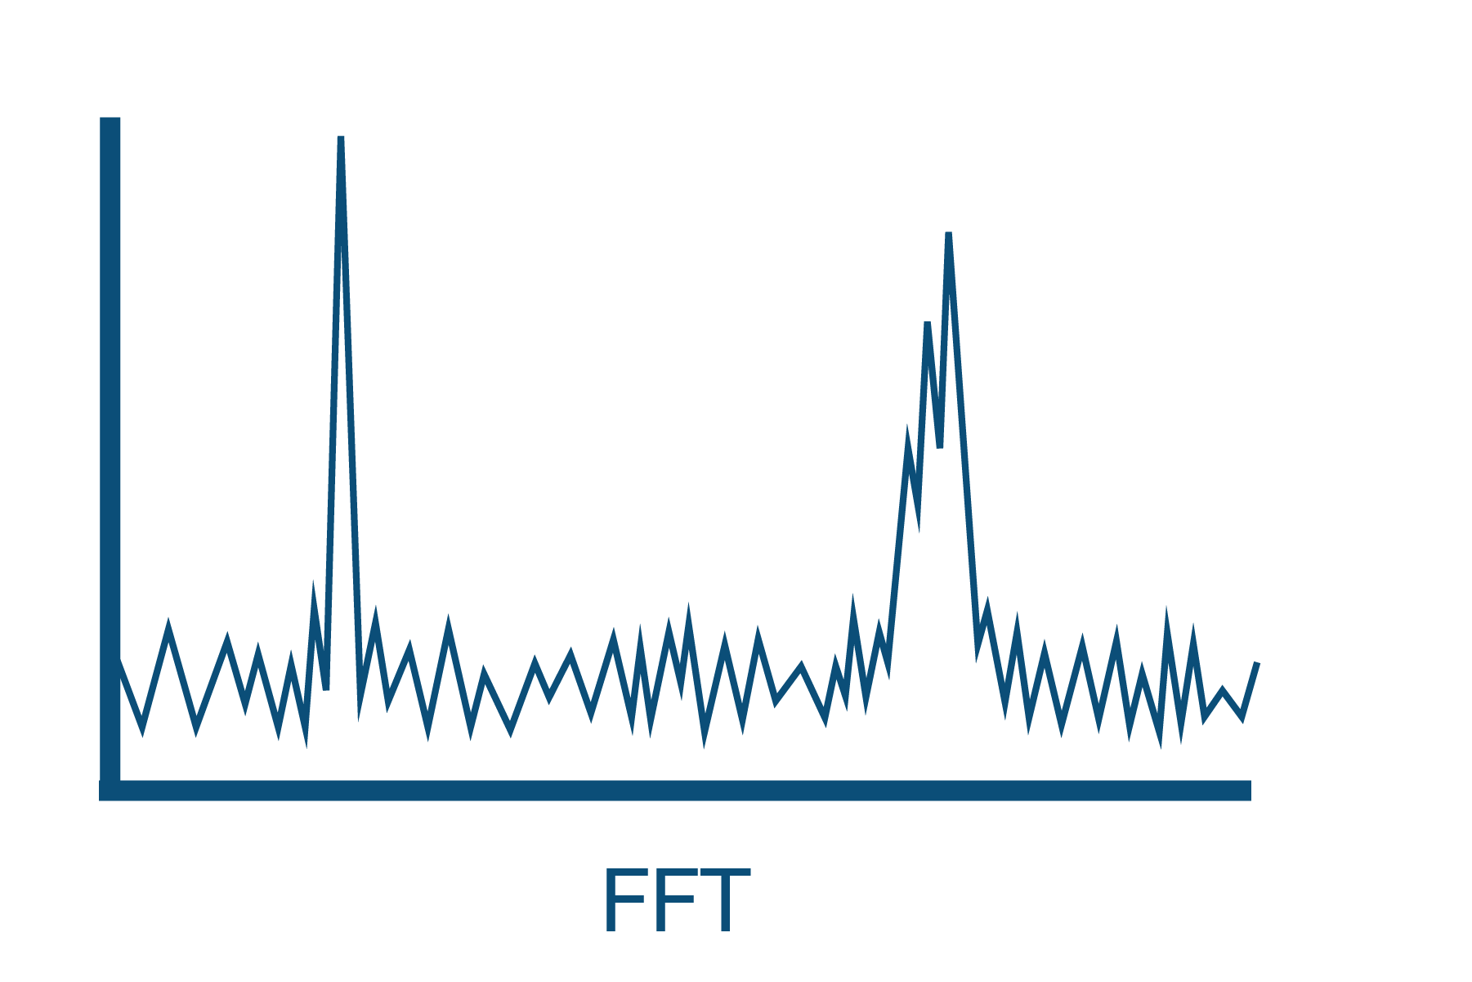








OHD Principle
0.00001 % different!
$f$ = 193.40001 THz
($v=10m/s$)
Reference Mirror
Object
$Δf=f−f_{0}$ = 100MHz
Beam
Splitter
Laser
$$f_{0}$$
Beat frequency
$f_{0}$ = 193.4 THz
$$v$$
Electronic device measurable
Optical
Interference
$$f$$
Doppler shifted!
$$Δf=f−f_{0}$$
$$∝v$$
Power
FFT
Photodetector
Freq
OHD Power Spectrum
Notes:
Let’s begin with the principle of OHD. A laser emits light at a frequency f_0, which is split by a beam splitter: one path reflects from a reference mirror, the other from the object. If the object is moving, the reflected light will have a Doppler-shifted frequency f. This shift is typically very small and is challenging to measure directly.
However, by interfering the reference and object beams, the photodetector produces measurements which oscillate at a frequency difference or beat frequency that is measurable by electronic devices.
By applying an FFT to the temporal measurements and finding the peak frequency, we compute the object’s velocity.

Slide 13























OHD with Swept-Frequency Laser
Standard Laser
$$f_{0}$$
Optical
Frequency
Received
Amplitude
$$f_{D}∝v$$
Doppler shift
$$t$$
$$f_{0}$$
Reference
$$t$$
$$0$$
$$T$$
$$2T$$
$$f_{0}+B\frac{t}{T}$$
$$f_{0}+B$$
$$f_{D}∝v$$
Swept-Freq
Laser
Doppler shift
Received
$$f_{R}∝τ$$
Time-of-Flight
Optical
Frequency
Reference
Amplitude
$$t$$
$$f_{D}+f_{R}$$
$$f_{D}−f_{R}$$
$$f_{0}$$
$$τ$$
$$t$$
$$0$$
$$T$$
$$2T$$
FMCW lidar
(Frequency-Modulated Continuous-Wave)
Notes:
Using a swept-frequency laser, we can measure not only object velocity from Doppler shift but also object distance, as the linearly varying frequency encodes both in the beat signal. FMCW lidar often uses triangular chirps to separate these two components.

Slide 14








OHD Models
Non-line-of-sight (NLOS)
OHD system
OHD system
Single object
$$v$$
Glossy Object
$$d$$
Red Blood Cells
$$Δf$$
No single beat frequency
Power
Power
$Δf$ is linear function of $d, v$
Aerosols
Frequency
Frequency
Notes:
Many OHD applications adopt a simple single-bounce model, which produces a single peak depending on the object’s velocity and distance. However, this model fails in the presence of complex geometry and global illumination. Such scenarios typically occur in non-line-of-sight imaging, when scanning glossy surfaces, or dense particles such as red blood cells or aerosols.

Slide 15













OHD Path Integral Formulation
$$S_{AC}\left(ω\right)=\int_{𝒫}{f\left(\overline{x}\right)δ\left(ω−ω\left(\overline{x}\right)\right)}dμ(\overline{x})$$
OHD Path Integral
(full derivation is in main paper)
$S_{AC}\left(ω\right)$ : power spectrum density (PSD) of OHD
(magnitude square of the FFT result)
$𝒫$: path domain (all of the possible paths)
$f\left(\overline{x}\right)$ : radiometric
path throughput
$$f\left({\overline{x}}_{1}\right)$$
Power $S_{AC}\left(ω\right)$
=
$$f\left({\overline{x}}_{3}\right)$$
$$f\left({\overline{x}}_{2}\right)$$
+
+
…
Freq $ω$
$$ω\left({\overline{x}}_{1}\right)$$
$$ω\left({\overline{x}}_{2}\right)$$
$$ω\left({\overline{x}}_{3}\right)$$
Notes:
To collectively address all of these scenarios, we derived a general and unified formulation for OHD measurements, which we call the OHD path integral.
The derivation includes many details, but the conclusion is very simple and intuitive.
It evaluates the power spectral density of the OHD signal by accounting for all possible path contributions in the scene at all measurement frequencies.
Importantly, f here is radiometric throughput—rather than complex field amplitudes—so we can leverage existing path tracers with minimal modifications to simulate OHD.

Slide 16






Standard Rendering
Supports rich libraries!
$${\overline{x}}_{1}$$
$${\overline{x}}_{2}$$
$$f({\overline{x}}_{1})$$
$$+f({\overline{x}}_{2})$$
Pixel output
Notes:
Standard path tracer uses Monte Carlo method to synthesize an image like this, by accumulating the sampled path throughput at each pixel. Many renderers provide libraries that include various reflection and geometry models, as well as lots of efficient sampling techniques.

Slide 17




















Standard Rendering
OHD Rendering
$$v_{1}$$
Can exploit all of the features in standard MC path tracers!
$$l_{1}$$
$$l_{2}$$
$${\overline{x}}_{1}$$
$${\overline{x}}_{1}$$
$$l_{3}$$
$$v_{1}$$
$${\overline{x}}_{2}$$
$${\overline{x}}_{2}$$
② Record
path length $l(\overline{x})$
path velocity $u(\overline{x})$
$$f({\overline{x}}_{1})$$
$$+f({\overline{x}}_{2})$$
$$f({\overline{x}}_{1})$$
$$f({\overline{x}}_{2})$$
OHD Power Spectrum Density (PSD)
Pixel output
Pixel output
Power
① histogram
$$ω\left({\overline{x}}_{1}\right)$$
$$ω\left({\overline{x}}_{2}\right)$$
Frequency
$$=l\left({\overline{x}}_{1}\right)+u({\overline{x}}_{1})$$
$$=l\left({\overline{x}}_{2}\right)+u({\overline{x}}_{2})$$
Notes:
For OHD rendering, we still use existing path tracer but need to modify two things.
First, instead of single image, we output a sequence of image, or histogram at each pixel.
Second, for each sampled path, we also record path length and velocity at each path vertices.
Then, we build a histogram by accumulating path throughput to corresponding frequency bin, which is calculated from path length and path velocity which we recorded before.
And this eventually gives the PSD.
Again, we can make use of all of the features in existing standard path tracer also for OHD rendering!

Slide 18



OHD Rendering
Transient Rendering
[Jarabo et al. 2014]
frequency
time
Power Spectrum
Transient Signal
frequency
time
Notes:
In fact, OHD rendering is very similar to transient rendering that generates time-resolved image sequence or histogram at each pixel.
But unlike transient rendering which is resolved in time, OHD rendering is resolved in frequency domain as a power spectrum.

Slide 19











OHD Rendering
Transient Rendering
[Jarabo et al. 2014]
frequency
time
$$v_{1}$$
$$l_{1}$$
$$l_{1}$$
$$l_{2}$$
$$l_{2}$$
$$v_{2}$$
$$l_{3}$$
$$l_{3}$$
Power Spectrum
Transient Signal
path length $l(\overline{x})$
Bin
Index
path length $l(\overline{x})$
path velocity $u(\overline{x})$
Notes:
Also when determining bin index for sampled path, transient rendering uses only path length, while OHD rendering considers both path length and path velocity.

Slide 20



















Standard Rendering
Transient Rendering
OHD Rendering
$$I=\int_{𝒫}^{ }{f\left(\overline{x}\right)}dμ(\overline{x})$$
$$I\left(t\right)=\int_{𝒫}^{ }{f\left(\overline{x}\right)δ\left(t−t\left(\overline{x}\right)\right)}dμ(\overline{x})$$
$$S_{AC}\left(ω\right)=\int_{𝒫}^{ }{f\left(\overline{x}\right)δ\left(ω−ω\left(\overline{x}\right)\right)}dμ(\overline{x})$$
Path Integral
[Veach 1997]
[Jarabo et al. 2014]
[Ours]
time
frequency
$${\overline{x}}_{1}$$
Renderer Output
$${\overline{x}}_{2}$$
$$f({\overline{x}}_{1})$$
$$+f({\overline{x}}_{2})$$
$$f({\overline{x}}_{1})$$
$$f({\overline{x}}_{2})$$
$$f({\overline{x}}_{1})$$
$$f({\overline{x}}_{2})$$
Transient Signal
$$I\left(t\right)$$
Power
Spectrum
$$S_{AC}\left(ω\right)$$
Single
Value
Pixel Output
Bin
Index
$$t\left({\overline{x}}_{1}\right)$$
$$t\left({\overline{x}}_{2}\right)$$
$$ω\left({\overline{x}}_{1}\right)$$
$$ω\left({\overline{x}}_{2}\right)$$
$$=l\left({\overline{x}}_{1}\right)$$
$$=l\left({\overline{x}}_{2}\right)$$
$$=l\left({\overline{x}}_{1}\right)+u({\overline{x}}_{1})$$
$$=l\left({\overline{x}}_{2}\right)+u({\overline{x}}_{2})$$
Notes:
Here is organized comparison between standard, transient and our proposed OHD rendering with governing path integrals.
Standard rendering outputs a single value, while transient and OHD both produce histogram, but in different manner.

Slide 21







OHD Speckle Sampling
Power Spectral Density $S_{AC}\left(ω\right)$
(Avg Power Spectrum)
Single Measurement (Accounts Speckle Effect)
Speckle
Freq
Freq
negative-exponential distribution
Algorithm 1) Sample from Power Spectral Density $S_{AC}\left(ω\right)$
How to reproduce this?
Optical Field
Random Phase
OHD Magnitude
$$ω\left({\overline{x}}_{1}\right)$$
$$ω\left({\overline{x}}_{2}\right)$$
$$ω\left({\overline{x}}_{3}\right)$$
Time
+
Time
+
Time
Measurement Index
Algorithm 2) Add Random Phase to Each Path’s Optical Field
Real Data Measurement
Notes:
Meanwhile, since OHD uses a coherent light source, its measurements are inherently affected by speckle noise when interacting with rough surfaces. To reproduce OHD speckle in our simulation, we propose two approaches: sampling from the previously evaluated PSD or directly calculating the optical field with added random phase.

Slide 22



OHD Speckle Sampling
Both converges to same PSD!
Power (dB)
Target Point
Frequency
$S_{AC}(ω)$ from Alg.1
Single Measurement from Alg.2
With convolution
Avg of 1000 Single Measurements
Notes:
Both methods converge to the same result but differ in their appropriate use cases. For more details, please refer to the main paper.

Slide 23
Applications of Our Simulators
Notes:
Now, we demonstrate our simulation algorithm across three different OHD applications.

Slide 24

Application (1) FMCW Lidar
Real data
Simulator
Retroreflector bars are used to indicate starting and end points!
Moving direction
Moving direction
Scan direction
Scan direction
Notes:
First, for FMCW lidar, we compare our simulation with a real experiment in a scenario where a shiny copper surface is observed, with a treadmill moving behind it.

Slide 25




Application (1) FMCW Lidar
(A)
Real data Reconstruction
Simulation Reconstruction
Real data
Second
treadmill
ret
treadmill
ret
First
ret
copper
dominant hit point
ret
ret
copper
ret
Moving direction
distance (m)
Scan direction
PSD
PSD
Simulator
Moving direction
Slight calibration error exists!
velocity (m/s)
Scan direction
Transition Region
Sample index along scan line
Sample index along scan line
Notes:
We found that our simulator faithfully reproduces the real experiment in both distance and velocity reconstruction.
One interesting observation is the presence of transition regions, where blurry reflection causes inaccurate reconstruction.
Our simulator is also capable to replicate these regions, with matching power spectrum.

Slide 26












Application (2) Blood Flow Measurement
Retinal Blood Flow Measurement
(A)
$$M_{0}^{+}$$
$$M_{0}^{−}$$
Real Data [Puyo18,19]
Laser Doppler Velocimetry
$$M_{0}^{+}$$
$$M_{0}^{−}$$
Simulation
$M_{0}^{±}$ : Doppler
Images
Notes:
Second, we simulate a non-invasive blood flow measurement scenario. Our simulator faithfully reproduces the results reported in a prior work on retinal blood flow measurement, capturing key features such as multi-bounce components in the Doppler spectrum.

Slide 27












Application (2) Blood Flow Measurement
$N_{w}$ : number of FFT windows
$$M_{0^{+}}$$
$$M_{0^{+}}$$
Real Data [Puyo18,19]
$$N_{w}=64$$
$$N_{w}=512$$
$$M_{0^{+}}$$
$$M_{0^{+}}$$
Simulation
Laser Doppler Velocimetry
$$M_{0}^{−}$$
$$N_{w}=64$$
$$N_{w}=512$$
Notes:
or OHD speckle patterns with respect to the number of FFT windows.

Slide 28






Application (3) Wind Doppler Lidar
Real Data
[Wei21]
Aerosol
(1)
(2)
(3)
(4)
ToF
Time
1
STFT
(1)
(2)
(3)
Multi-bounce only
Direct + Multi bounce
Doppler
Shift
(4)
Freq
Simulation
Intensity
Height (km)
Coherent Wind Doppler Lidar
0
Freq
Freq
Freq
Notes:
Finally, we simulate an atmospheric sensing scenario. Again, we find that our simulator closely matches results reported in prior work on wind and rainfall detection. Notably, our simulator also provides information that is not available in real-world—such as the decomposition of direct and multi-bounce components.

Slide 29
Conclusion

Slide 30


Conclusion : Comprehensive Doppler Simulator
Field Amplitude
Intensity
Field
Doppler
Intensity
Doppler
This work
[Kim et al. 2023] (Also ours)
Comprehensive Doppler Simulator
Notes:
In conclusion, we propose a scalable Monte Carlo rendering algorithm for simulating optical heterodyne detection. Combined with our previous work on Intensity Doppler we now have a comprehensive simulation tool for modeling Doppler effects in computational imaging.

Slide 31

Thank you!
RGB
Distance
Digital Twin
Velocity
FMCW Lidar
Blood Flow
Atmosphere
FMCW Lidar
Blood Flow
Atmosphere
OHD Applications
Our Monte Carlo Simulator
Project Page : https://juhyeonkim95.github.io/project-pages/ohd_rendering/
QR link :
Implemented in Mitsuba!
Code, tutorials are available!
Notes:
Thank you for listening.
Please checkout the project page for code and tutorials.

