Slide 1
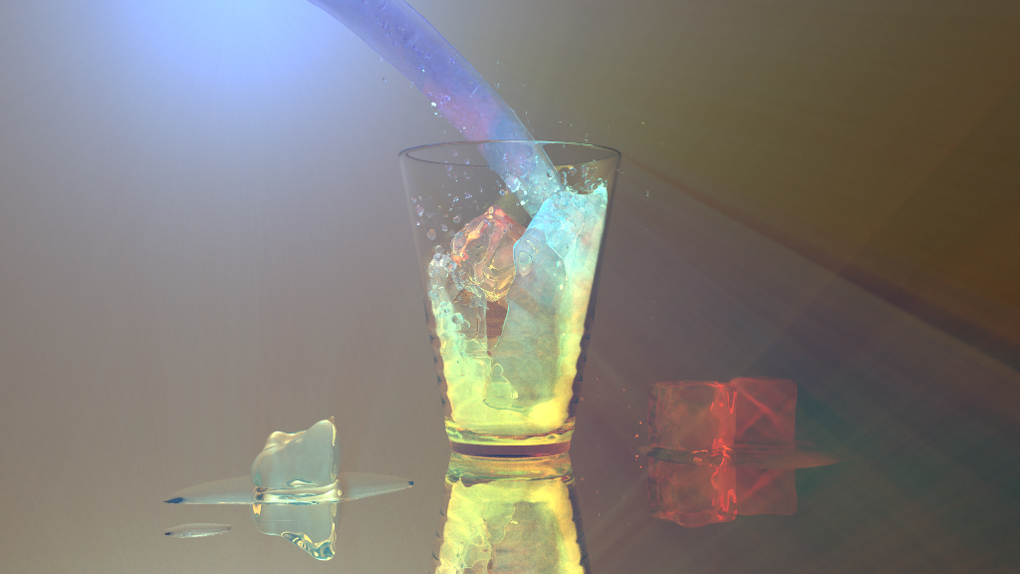
Progressive Transient Photon Beams
Julio Marco¹
Ibón Guillén¹
Wojciech Jarosz²
Diego Gutierrez¹
Adrian Jarabo¹
¹ Universidad de Zaragoza, I3A
² Dartmouth College

Slide 2
300,000 km/s LIGHT TRANSPORT

Slide 3
TRANSIENT LIGHT TRANSPORT

Slide 4
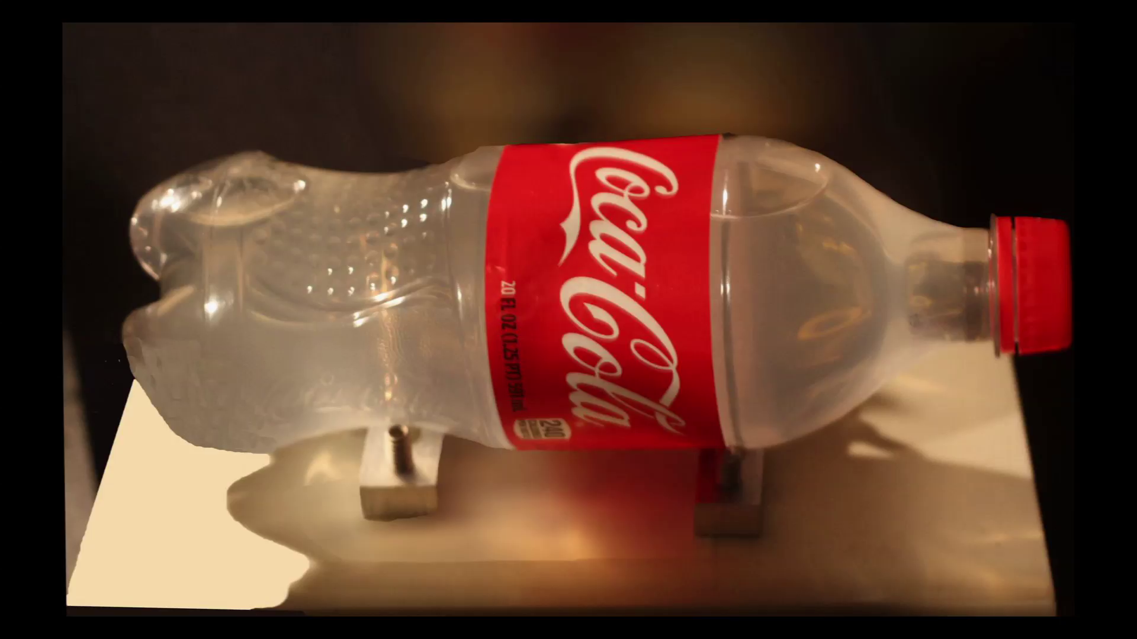
Femto-photography [Velten et al. 2013]

Slide 5
Femto-photography [Velten et al. 2013]

Slide 6
Transient Light Transport- What for?
Light in motion [Velten13, Heide13, Peters15…]
Visible geometry [Wu14, OToole14, Marco17…]
Transparent Objects [Kadambi13]
Hidden geometry [Velten12, Buttafava15, OToole18, Liu19,…]
Reflectance estimation [Naik11, Naik13]
GI Components Separation [Wu14, OToole14]
Vision through media [Heide14, Wu18…]
…

Slide 7
SIMULATION
Forward model for inverse problems
Benchmarking algorithms
Prototyping
Machine learning

Slide 8
Transient rendering
Forward model for inverse problems
Benchmarking algorithms
Prototyping
Machine learning

Slide 9
OUR GOAL
Robust time-resolved participating media
Forward model for inverse problems
Benchmarking algorithms
Prototyping
Machine learning

Slide 10
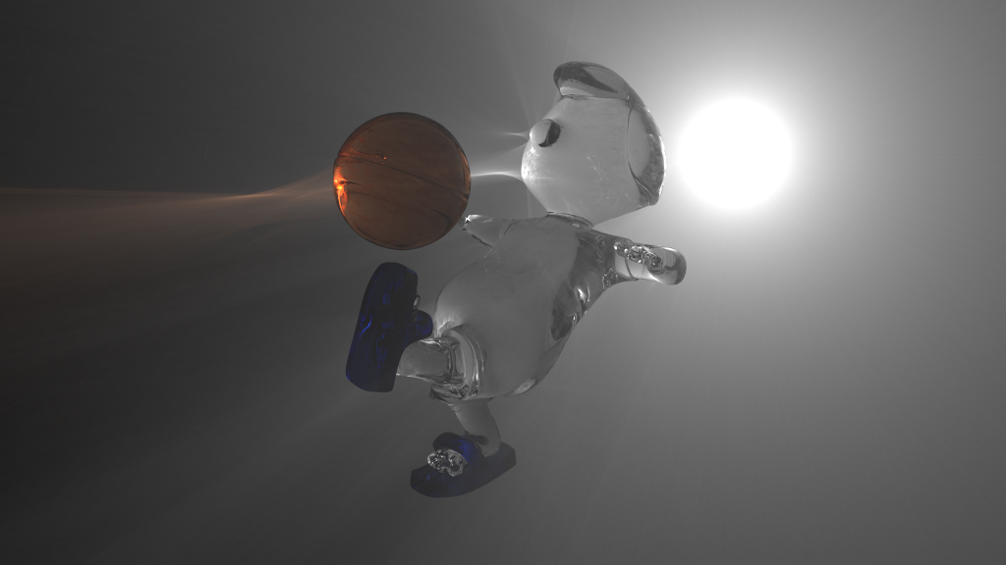
Transient Rendering
vs.
Steady-state
Steady state

Slide 11
Transient Rendering
vs.
Steady-state
Radiance
Steady state

Slide 12
Transient Rendering
Finite speed of light ➔ Temporal dimension
Radiance
time
Steady state

Slide 13
Transient Rendering
Finite speed of light ➔ Temporal dimension
Radiance
time
Steady state

Slide 14
Transient Rendering
[Meister et al. 2013, Ament et al 2014, Hullin 2014] ➔Application-specific, approximations, point samples
[Jarabo et al. 2014] ➔ Time-resolved path integral formulation ➔ Temporal progressive density estimations ➔ Time-based importance sampling ➔Point samples: Bidirectional path tracing, photon mapping

Slide 15
Transient Rendering
Challenges
Monte Carlo methods ➔ Variance is aggravated in time
Radiance
time

Slide 16
Transient Rendering
Challenges
Monte Carlo methods ➔ Variance is aggravated in time
Radiance
time

Slide 17
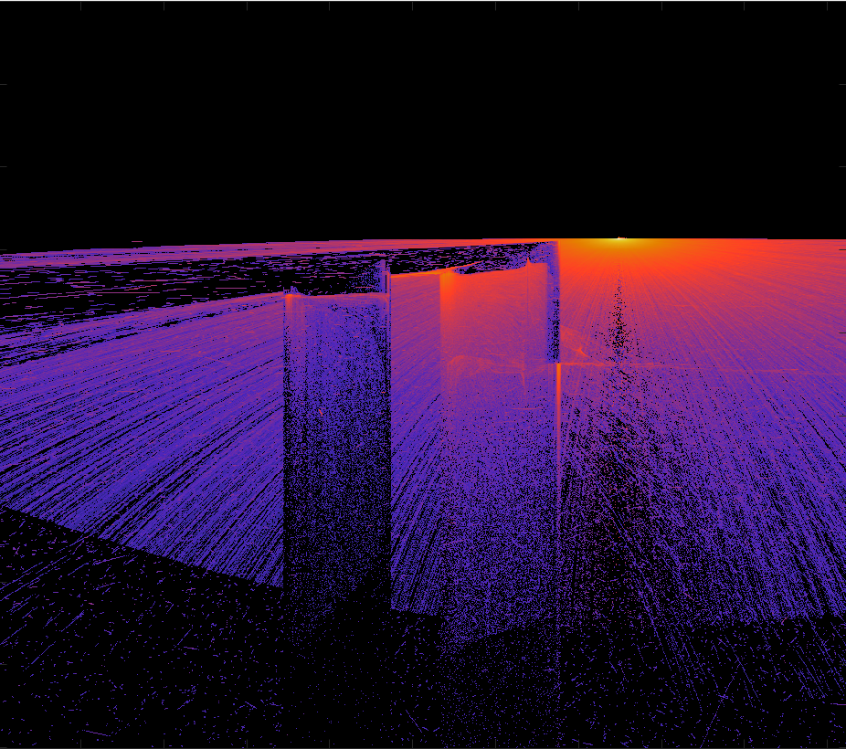
Transient Rendering
Challenges
Monte Carlo methods ➔ Variance is aggravated in time
Slow convergence
time

Slide 18
Transient Rendering
Participating media
Classic RTE in rendering
TIME-INDEPENDENT

Slide 19
Transient Rendering
Participating media
Classic RTE in rendering
TIME-INDEPENDENT

Slide 20
Transient Rendering
Participating media
Transient RTE
NEED TO ACCOUNT FOR TIME

Slide 21
Transient Rendering
Participating media
Transient RTE
NEED TO ACCOUNT FOR TIME

Slide 22
Transient Rendering
Participating media
Transient RTE
NEED TO ACCOUNT FOR TIME
Optical
path
IOR
Scattering
events

Slide 23
Transient Rendering
Participating media
[Jarabo 2014]→ Point samples (BDPT, photon mapping)
→ SPARSE SAMPLES IN TIME
Radiance
time

Slide 24
Transient Rendering
Participating media
[Jarabo 2014]→ Point samples (BDPT, photon mapping)
→ SPARSE SAMPLES IN TIME
NEED DENSER TEMPORAL SAMPLING
Radiance
time

Slide 25
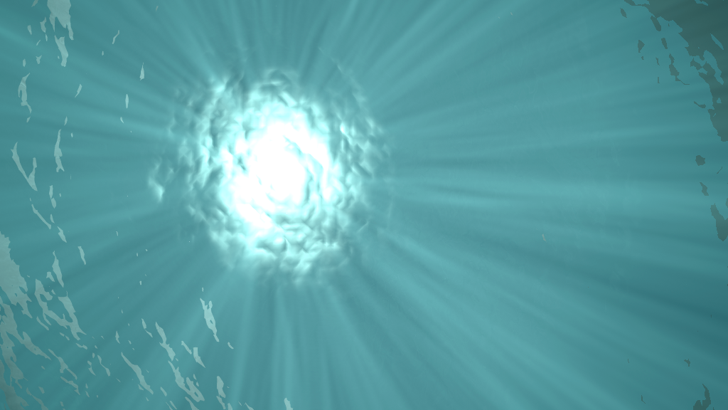
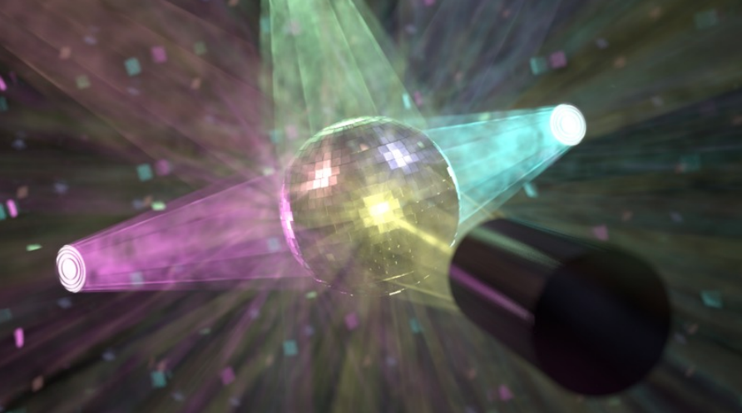
Steady-state - Photon Beams
[Jarosz et al. 2011a, 2011b]: Steady-state media rendering

Slide 26
Steady-state - Photon Beams
1. Stores photon trajectories on a BEAMS MAP

Slide 27
Steady-state - Photon Beams
1. Stores photon trajectories on a BEAMS MAP
2. Performs ray-beam density estimations

Slide 28
Transient Photon Beams
Why photon beams for transient rendering?
Full photon trajectories
Denser sampling
the temporal domain
Radiance
time

Slide 29
Transient Photon Beams
Why photon beams for transient rendering?
Full photon trajectories
Denser sampling
the temporal domain
Closed form density estimations
Arbitrary temporal
resolution
Radiance
time

Slide 30
Transient Photon Beams
1. Tracing: Sample Transient RTE ➔Store beam starting time
Optical
path
Scattering
events
IOR

Slide 31
Transient Photon Beams
1. Tracing: Sample Transient RTE ➔Store beam starting time
2. Rendering: Spatio-temporal density estimations
Optical
path
Scattering
events
Spatial KDE
(time-resolved)
IOR

Slide 32
Transient Photon Beams
1. Tracing: Sample Transient RTE ➔Store beam starting time
2. Rendering: Spatio-temporal density estimations
Temporal KDE
Spatial KDE
Radiance
Optical
path
Scattering
events
IOR
time

Slide 33
Transient Photon Beams

Slide 34
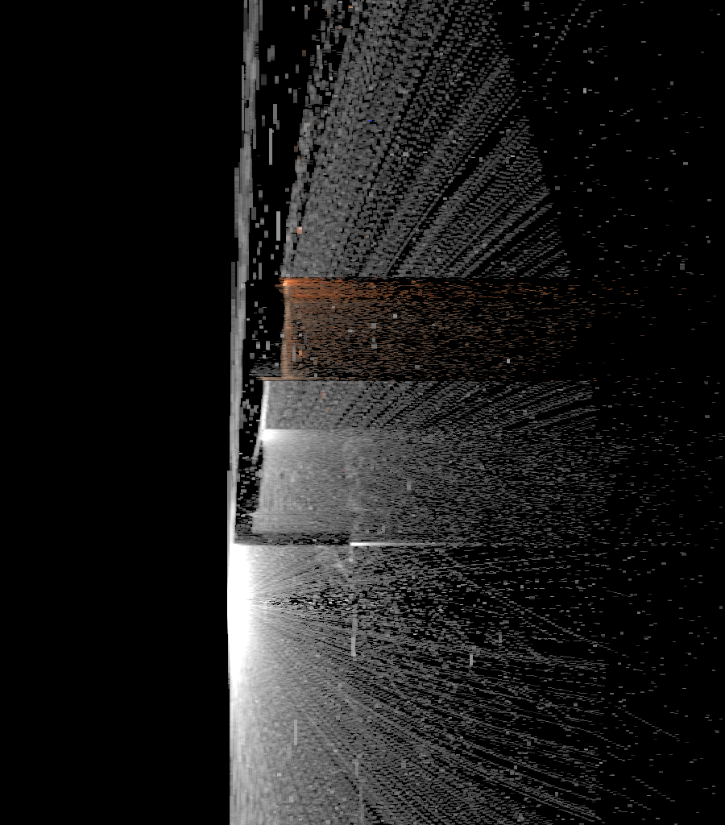
Transient Photon Beams
Spatio-temporal slice
time

Slide 35
Transient Photon Beams
Spatio-temporal slice
time

Slide 36
Transient Photon Beams
Spatio-temporal slice
time

Slide 37
Transient Photon Beams
Spatio-temporal slice
BIAS
time

Slide 38
PROGRESSIVE APPROACH

Slide 39
Progressive Transient Photon Beams
Spatial density estimations
Temporal density estimations
Radiance
time

Slide 40
Progressive Transient Photon Beams
Spatial density estimations
Temporal density estimations
Radiance
time

Slide 41
Progressive Transient Photon Beams
Spatial density estimations
Temporal density estimations
Radiance
time

Slide 42
Progressive Transient Photon Beams
Spatial density estimations
Temporal density estimations
1D spatial kernel
1D temporal kernel
Radiance
time

Slide 43
Progressive Transient Photon Beams
Spatial density estimations
Temporal density estimations
1D spatial kernel
1D temporal kernel
Radiance
time

Slide 44
Progressive Transient Photon Beams
Spatio-temporal slice
time
24 iterations

Slide 45
Progressive Transient Photon Beams
Spatio-temporal slice
time
24 iterations

Slide 46
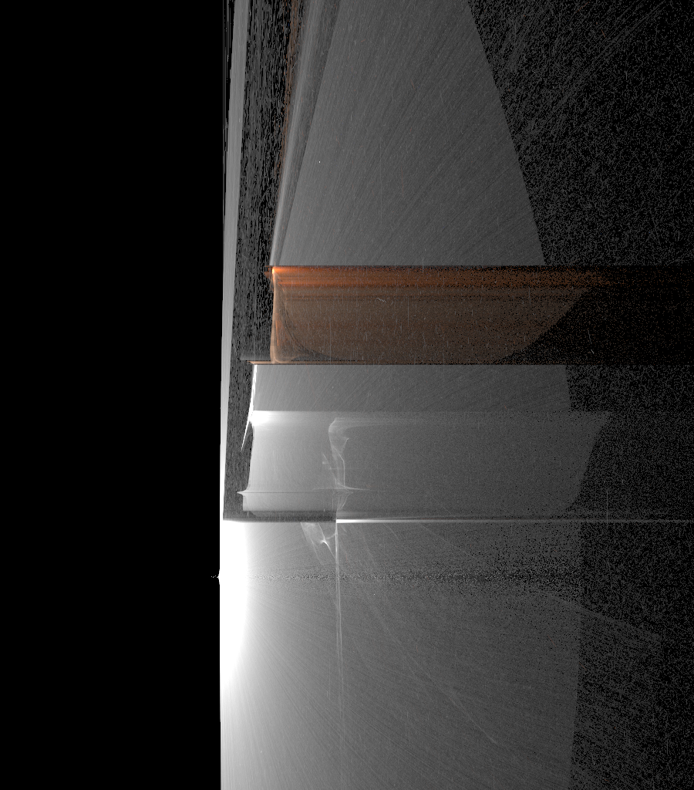
Progressive Transient Photon Beams
Spatio-temporal slice
time
2000 iterations

Slide 47
RESULTS

Slide 48
Soccer
40M beams (2000 iterations x 20k beams/iteration)

Slide 50
Pumpkin
Progressive transient PT [Jarabo 2014]
vs.
Our method
(equal–time comparsion)

Slide 51
Pumpkin – Equal-time comparison
Steady state

Slide 52
Pumpkin – Equal-time comparison
[Jarabo et al. 2014]
Our method

Slide 53
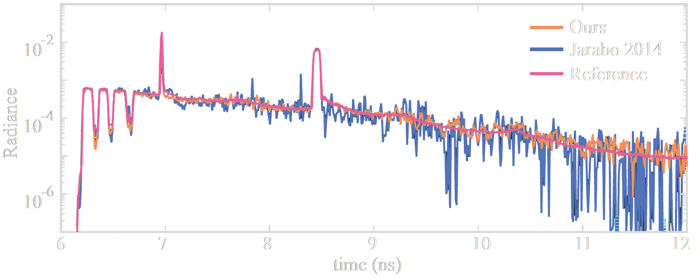
Pumpkin – Equal-time comparison
Steady state
Transient state
Radiance
time (ns)

Slide 54
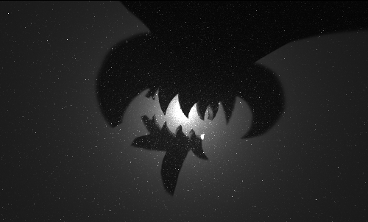
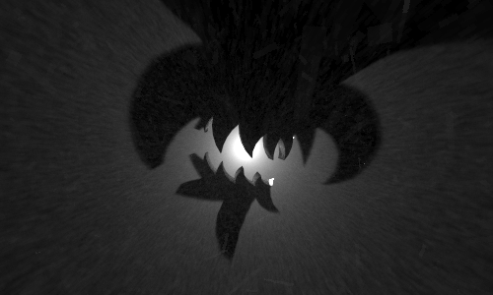
Pumpkin – Equal-time comparison
Steady state
[Jarabo 2014]
Transient state
Radiance
Ours
time (ns)

Slide 55
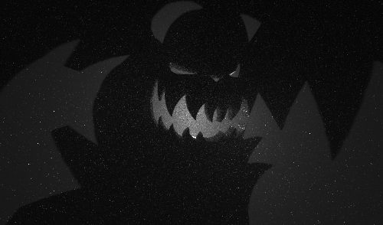
Pumpkin – Equal-time comparison
Steady state
[Jarabo 2014]
Transient state
Radiance
Ours
time (ns)

Slide 56
Pumpkin – Equal-time comparison
Steady state
[Jarabo 2014]
Transient state
Radiance
Ours
time (ns)

Slide 57
Pumpkin – Equal-time comparison
Steady state
Transient state
Radiance
time (ns)

Slide 58
Juice
24M beams (1200 iterations x 20k beams/iteration)

Slide 60
Conclusion
Robust method for low-variance time-resolved participating media
Render complex time-resolved effects
Consistent approach
Optimal 1D x 1D spatio-temporal kernel reduction ratios

Slide 61
What next?
Introduce time-based importance sampling [Jarabo et al. 2014]
Extend to hybrid methods, all volumetric estimators
Improve temporal reconstruction

Slide 62
Thanks!

