Slide 1


Slide 2

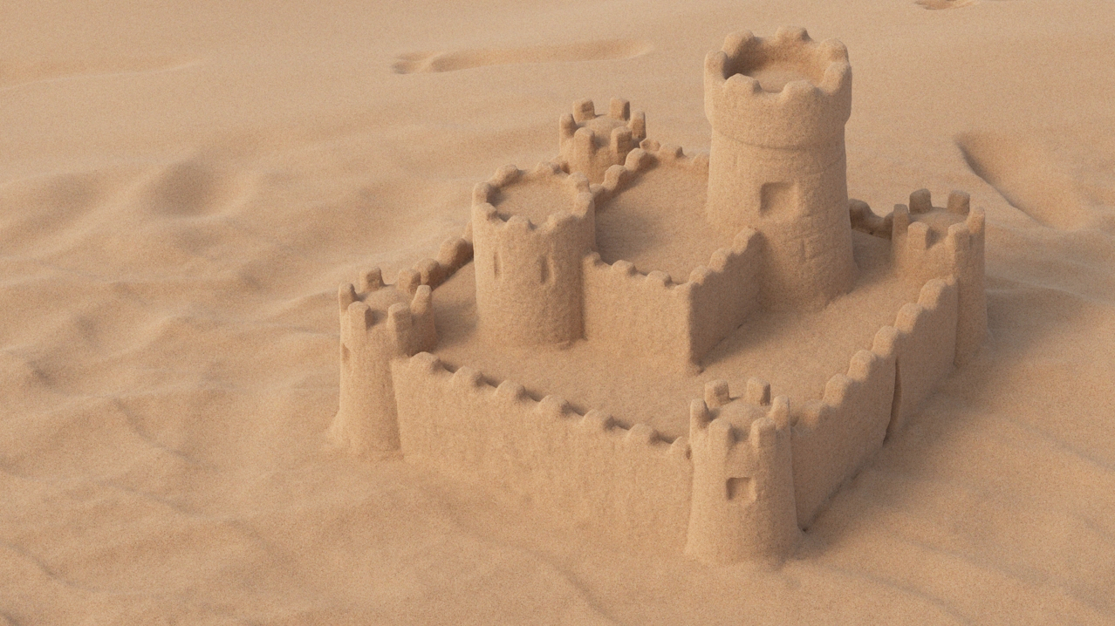


Multi-Scale Modeling and Rendering of Granular Materials
Johannes Meng^{2,1} Marios Papas^{1,3} Ralf Habel¹
Carsten Dachsbacher² Steve Marschner⁴ Markus Gross^{1,3} Wojciech Jarosz^{1,5}
¹Disney Research Zürich ²Karlsruhe Institute of Technology ³ETH Zürich ⁴Cornell University ⁵Dartmouth College

Slide 3
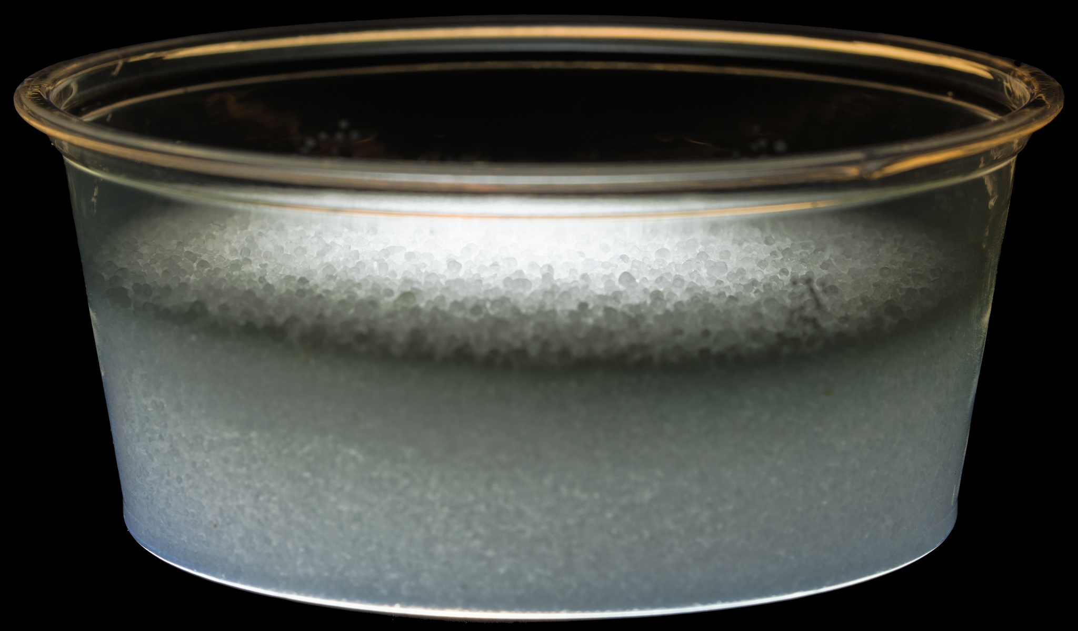
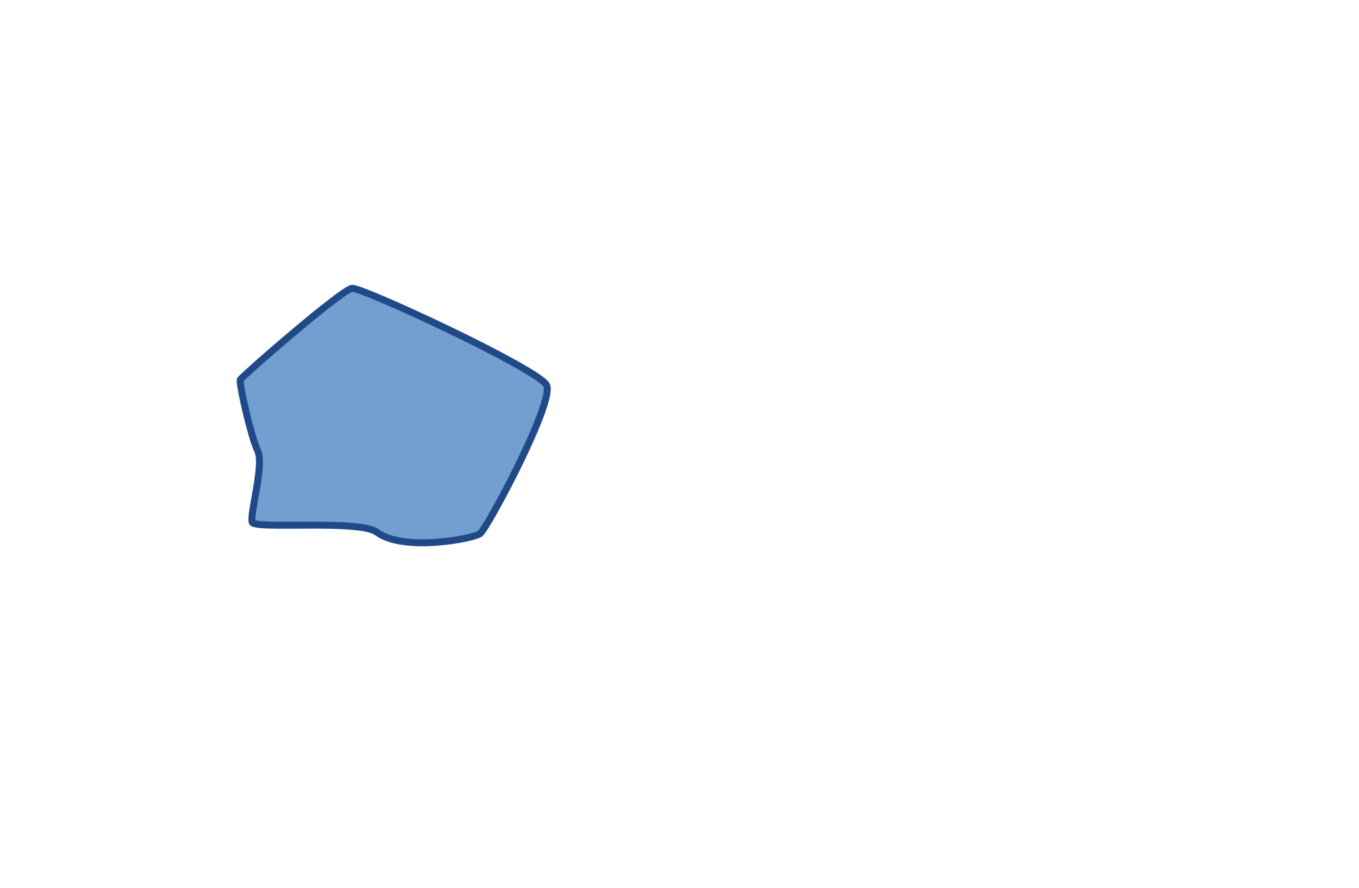
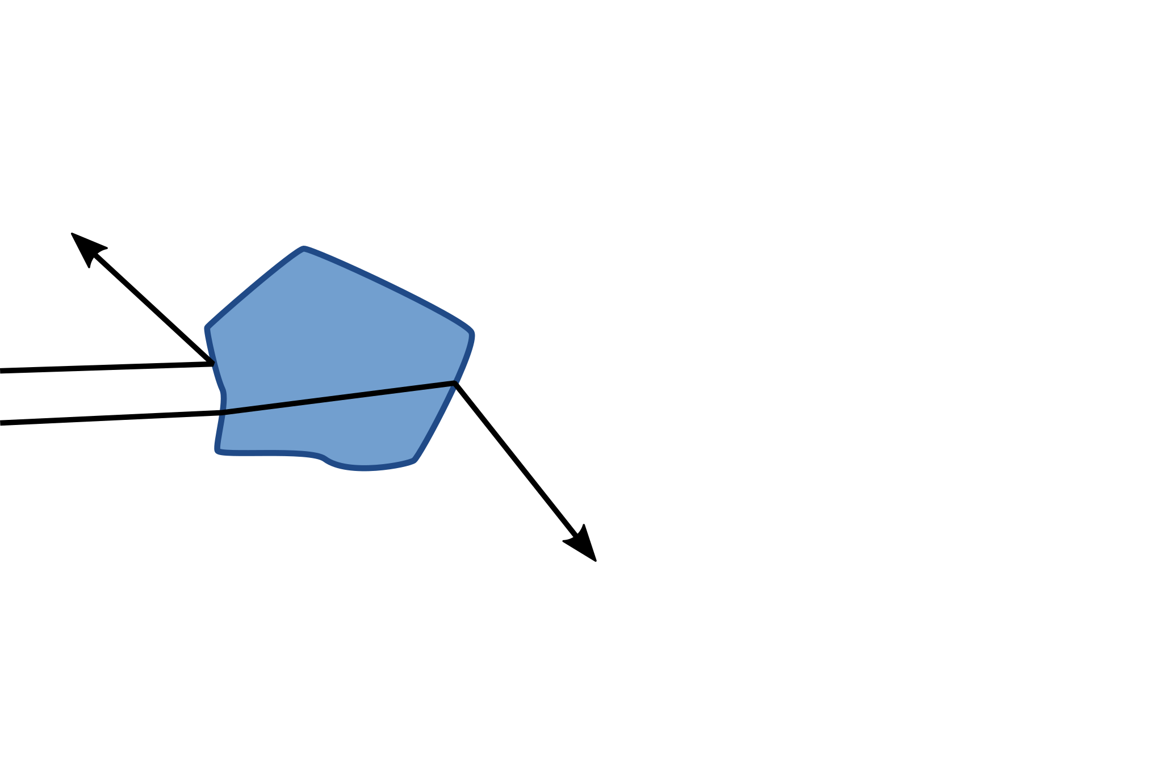

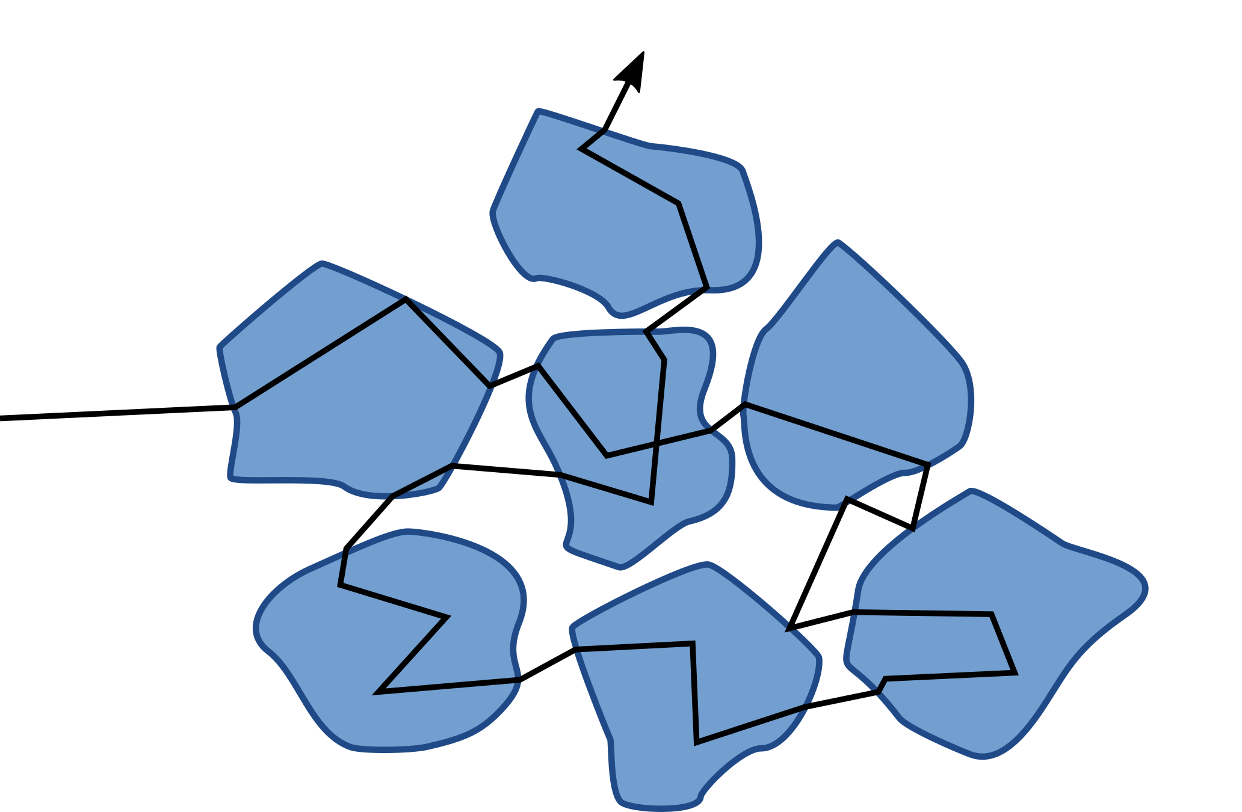
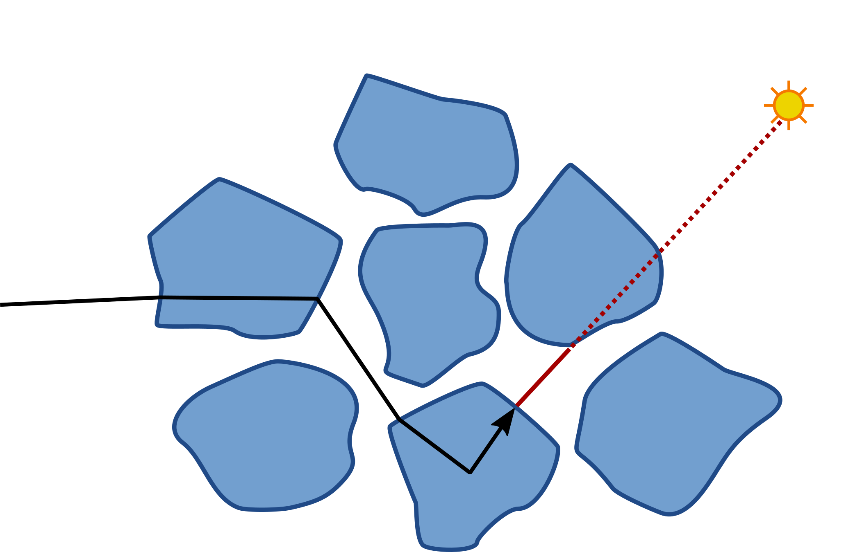
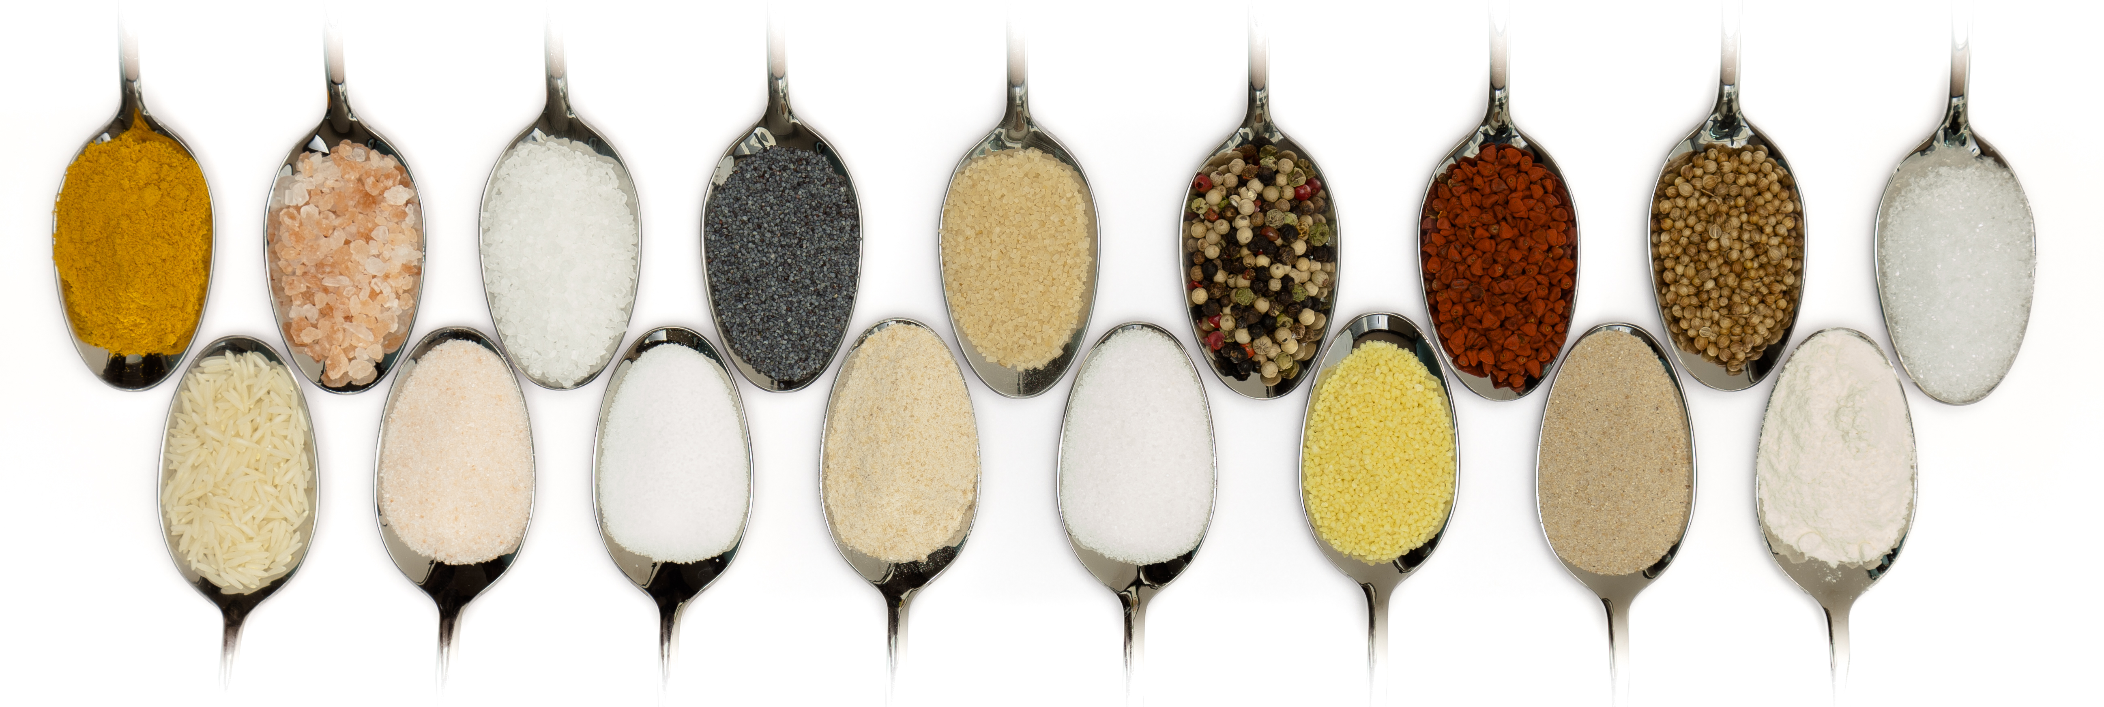
Motivation
Specular reflection
Salt
High grain albedo:
long paths contribute
Scattering interiors
Shadow connections blocked
Sugar
Sand
Specular transmission

Slide 4
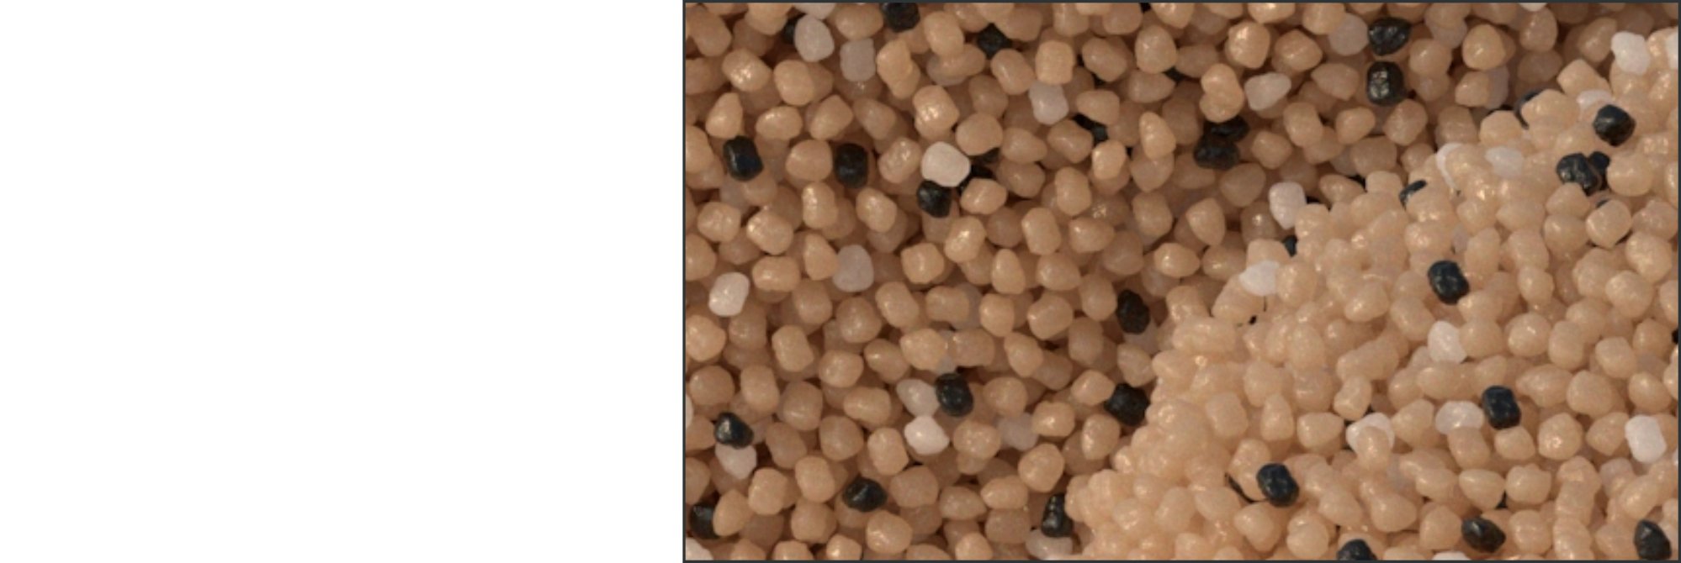
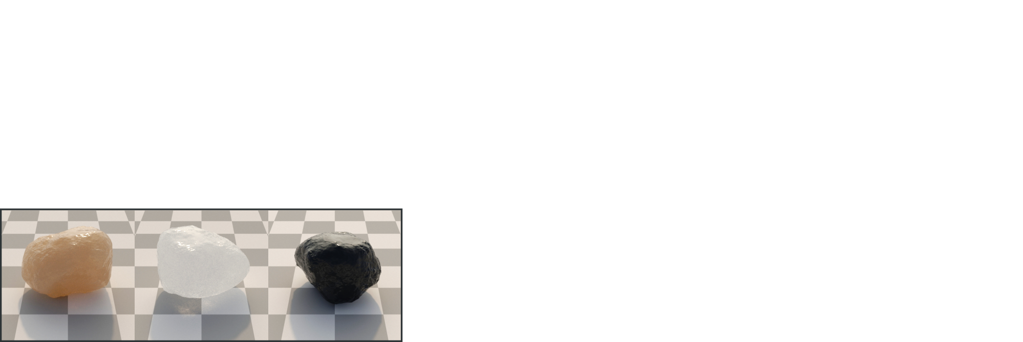
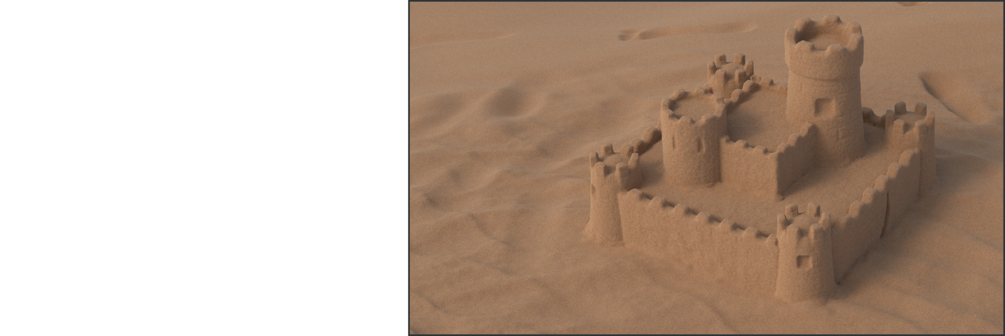
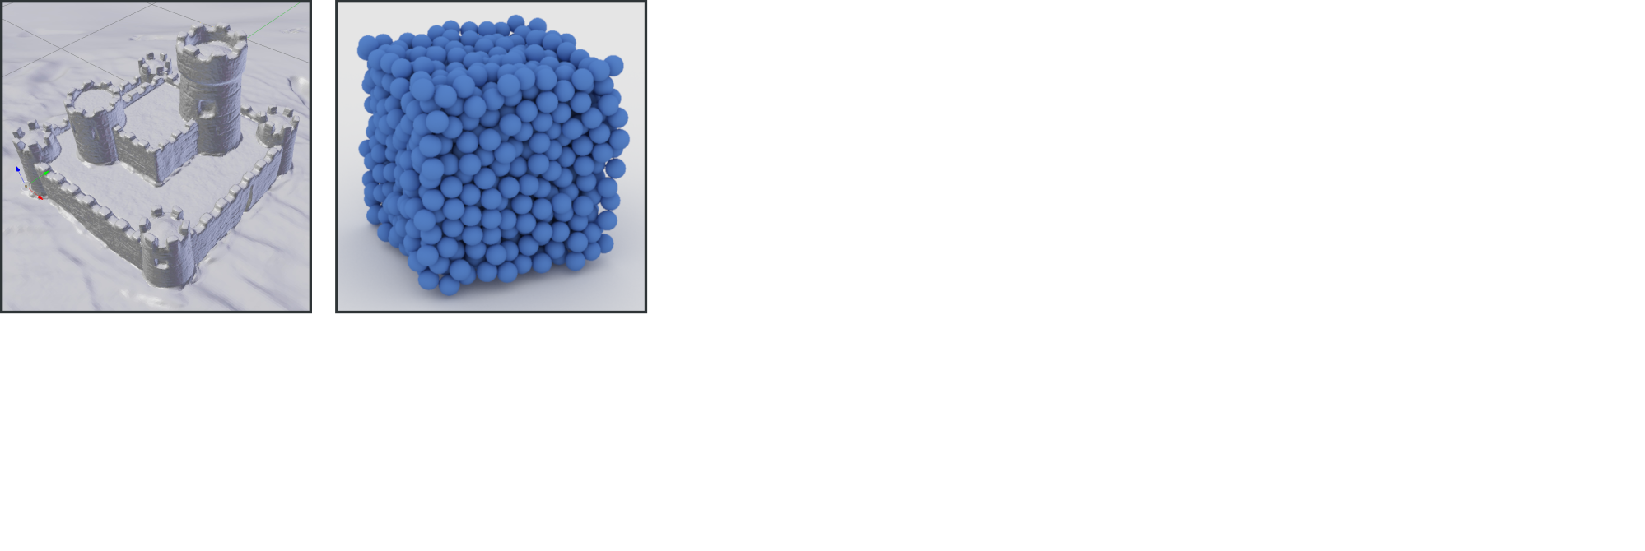
Modeling Granular Materials
Macro mesh / Grain bounding spheres.
85%
10%
5%
A few grains for instancing.
Grains can be randomly mixed and oriented.

Slide 5
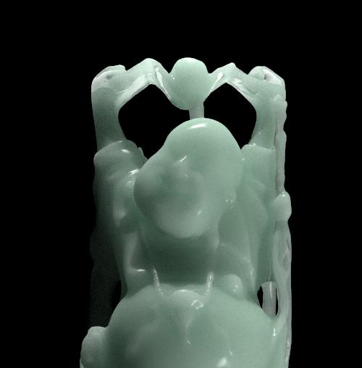
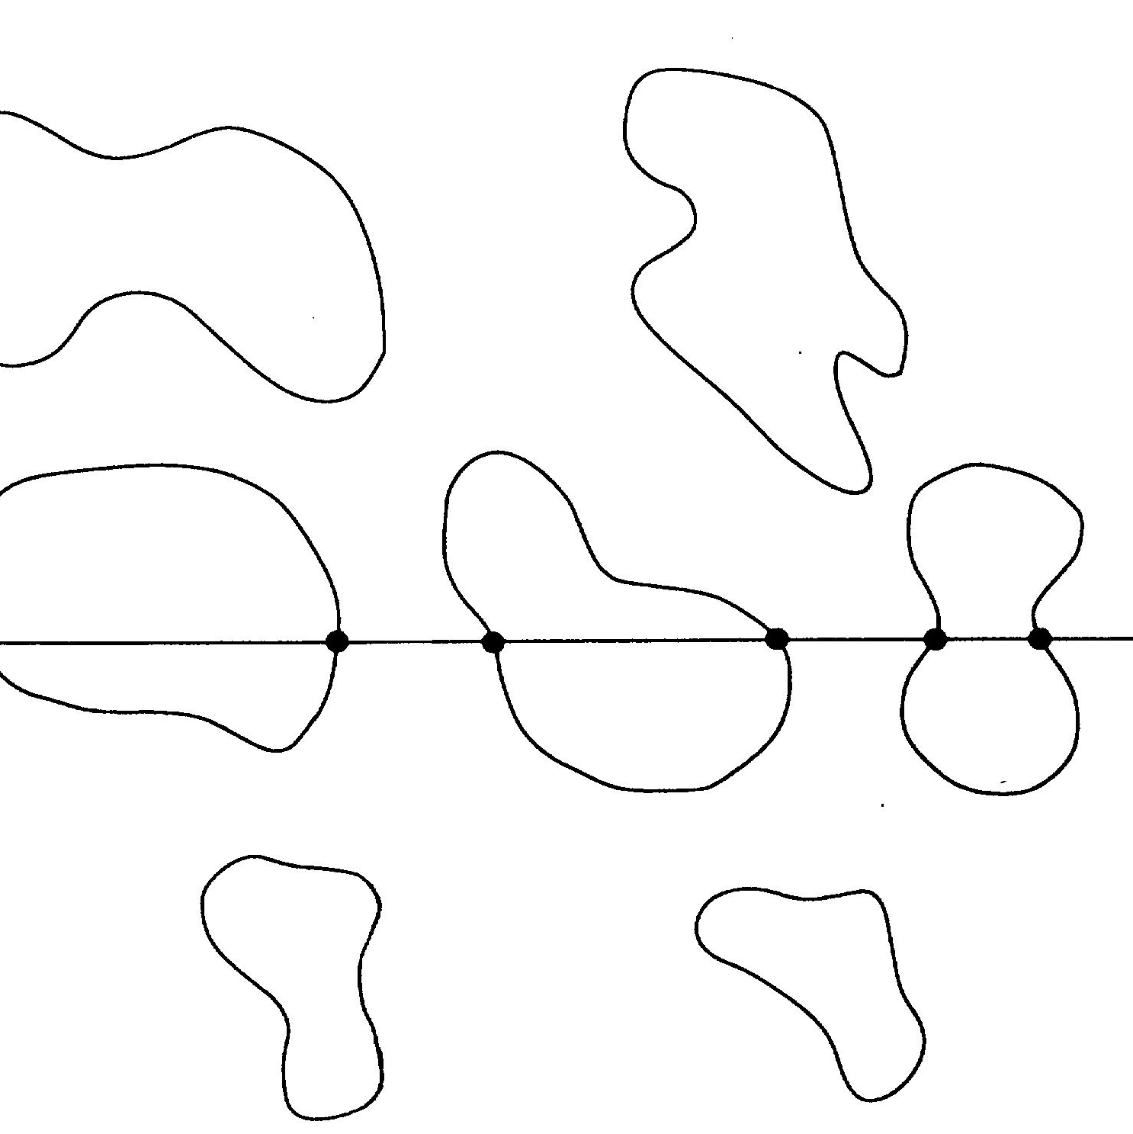
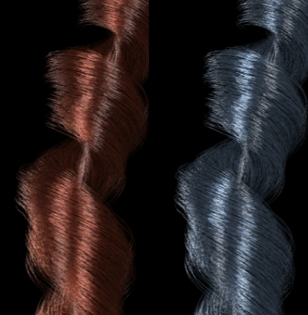
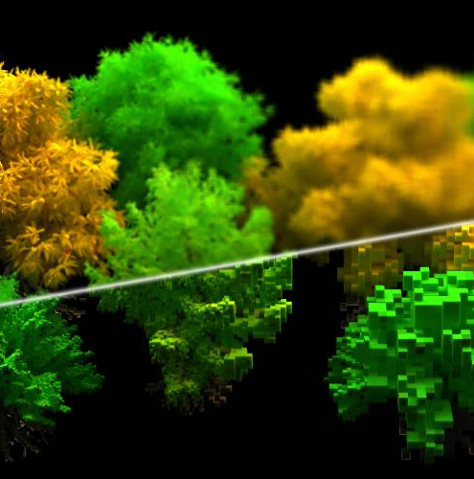
Related Work
Li et al. 2005
A hybrid Monte Carlo method for accurate and efficient subsurface scattering.
Torquato and Lu 1993
Chord-length distribution function for two-phase random media.
Zinke and Weber 2007
Light scattering from filaments.
Heitz et al. 2015
The SGGX Microflake Distribution.
… and many more.

Slide 6
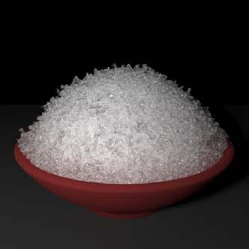
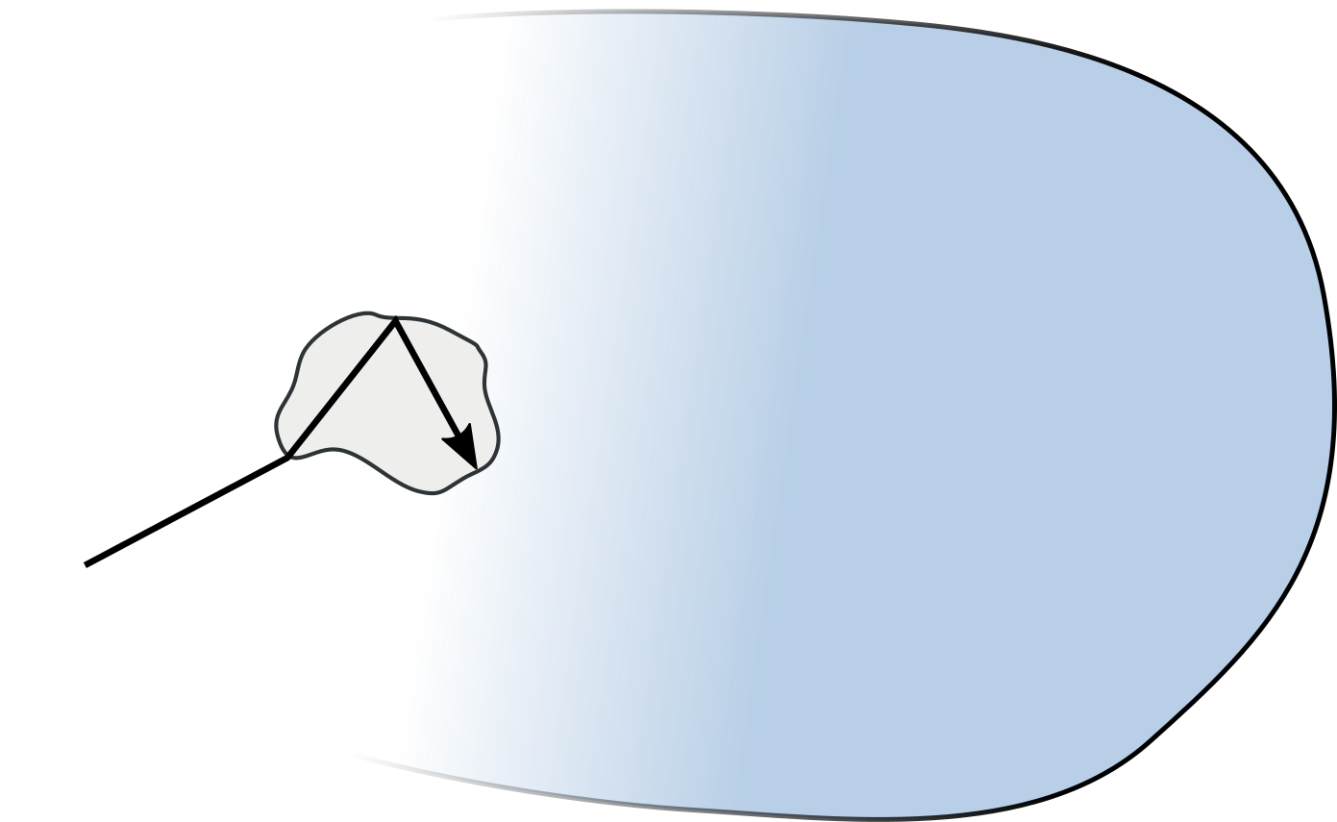
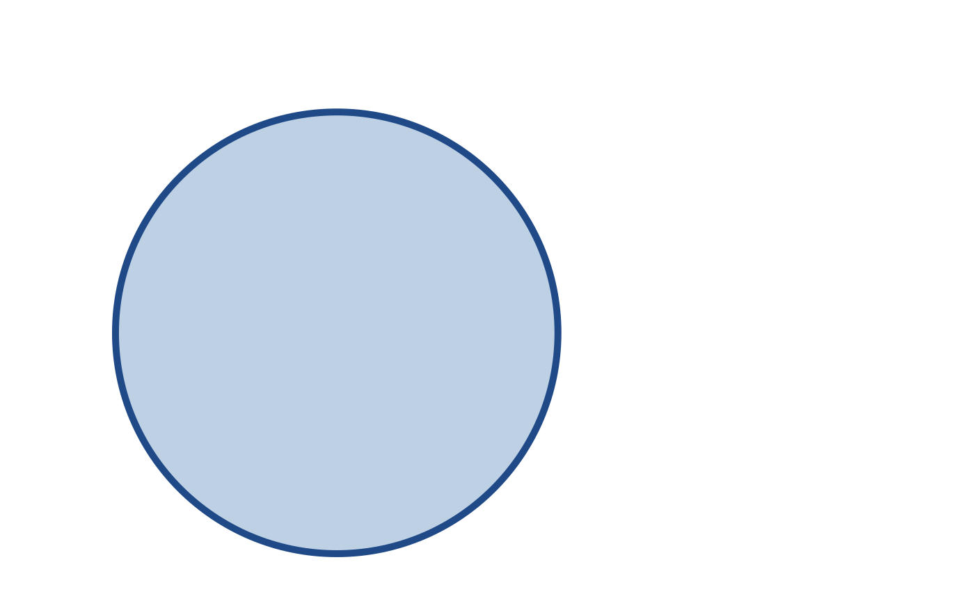
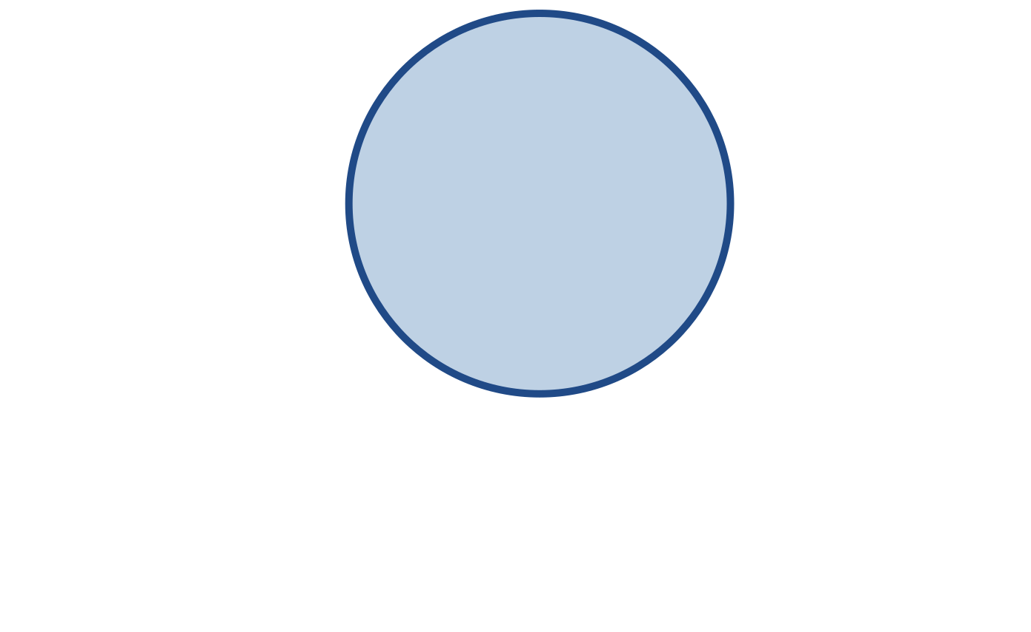
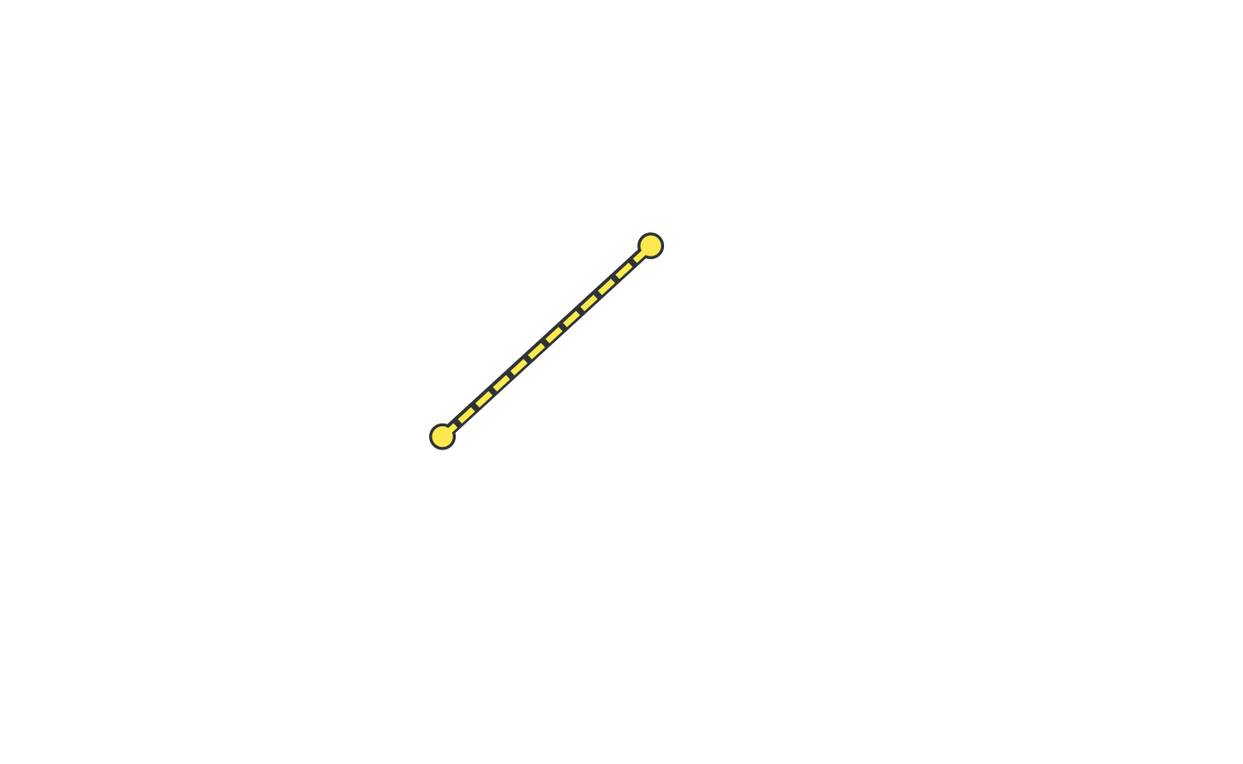
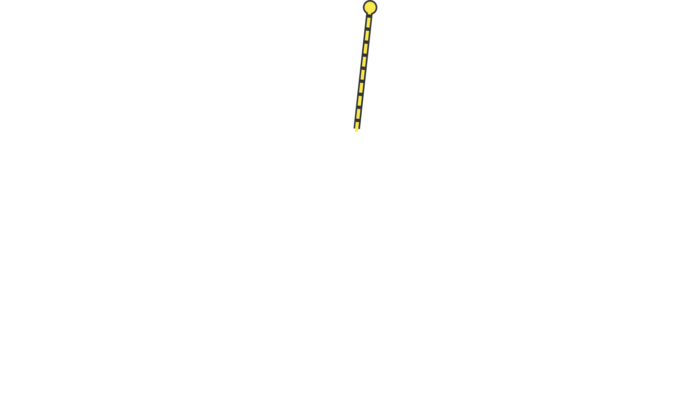

Shell Transfer Functions
[Moon et al. 2007: Rendering Discrete Random Media Using Precomputed Scattering Solutions.]

Slide 7
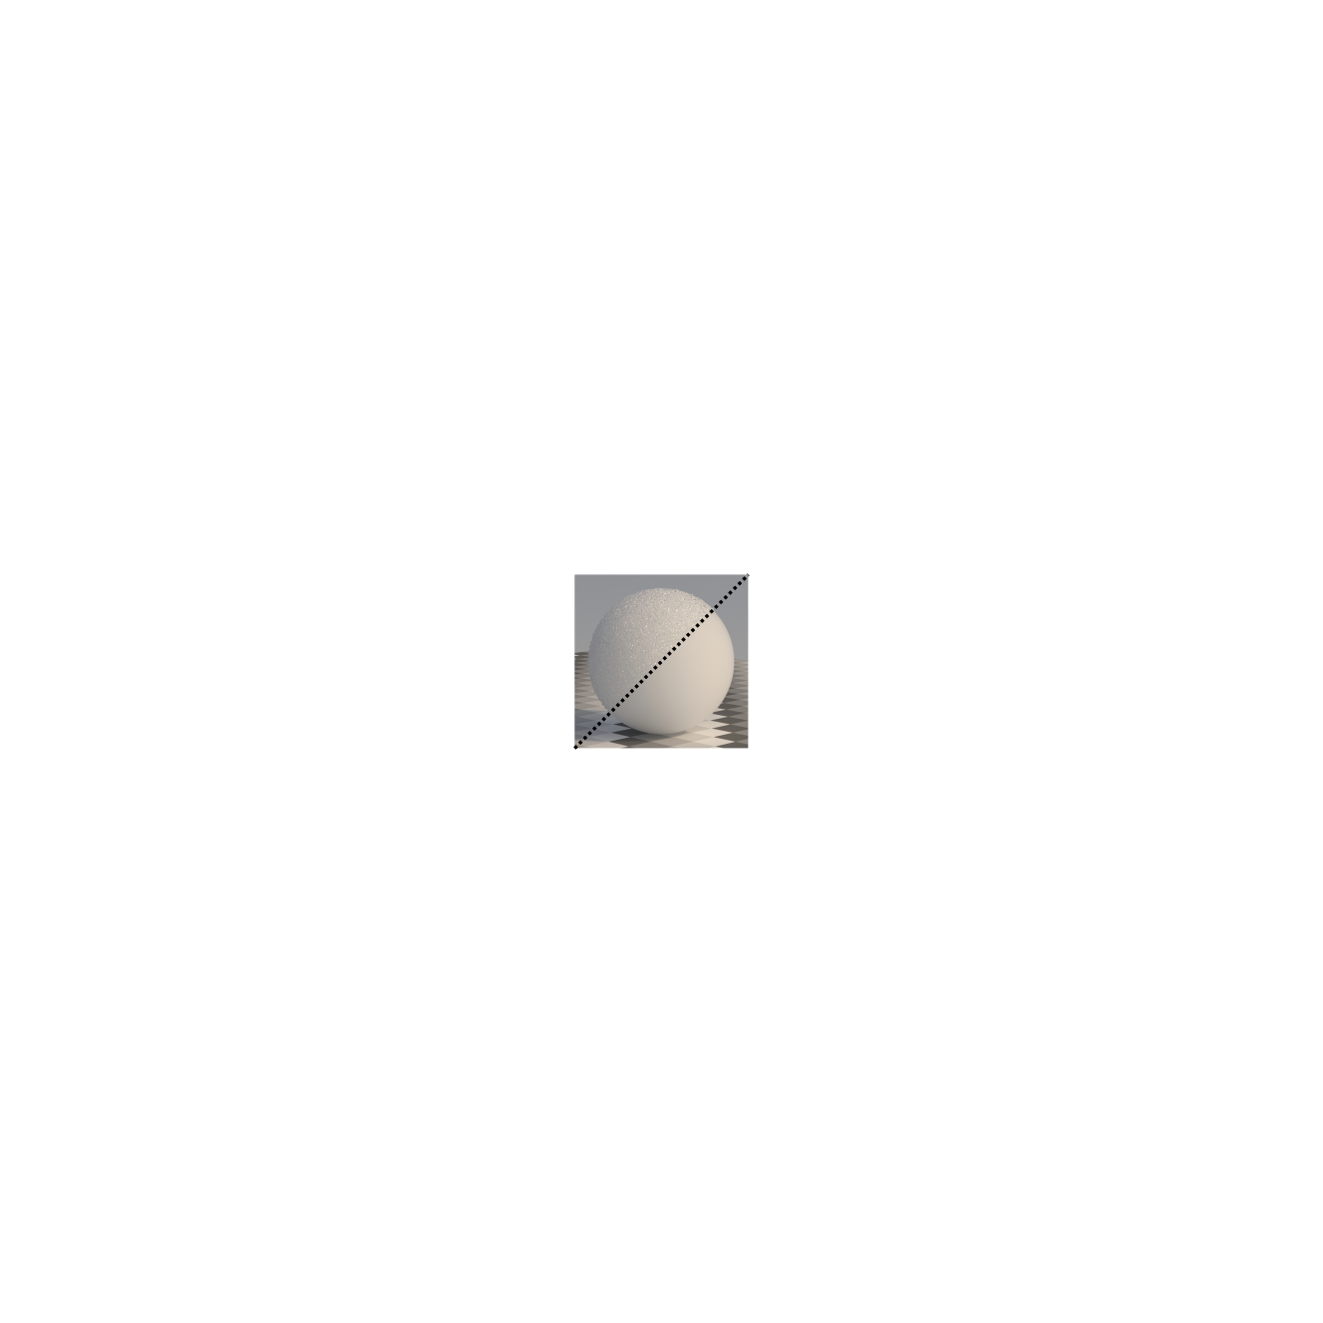
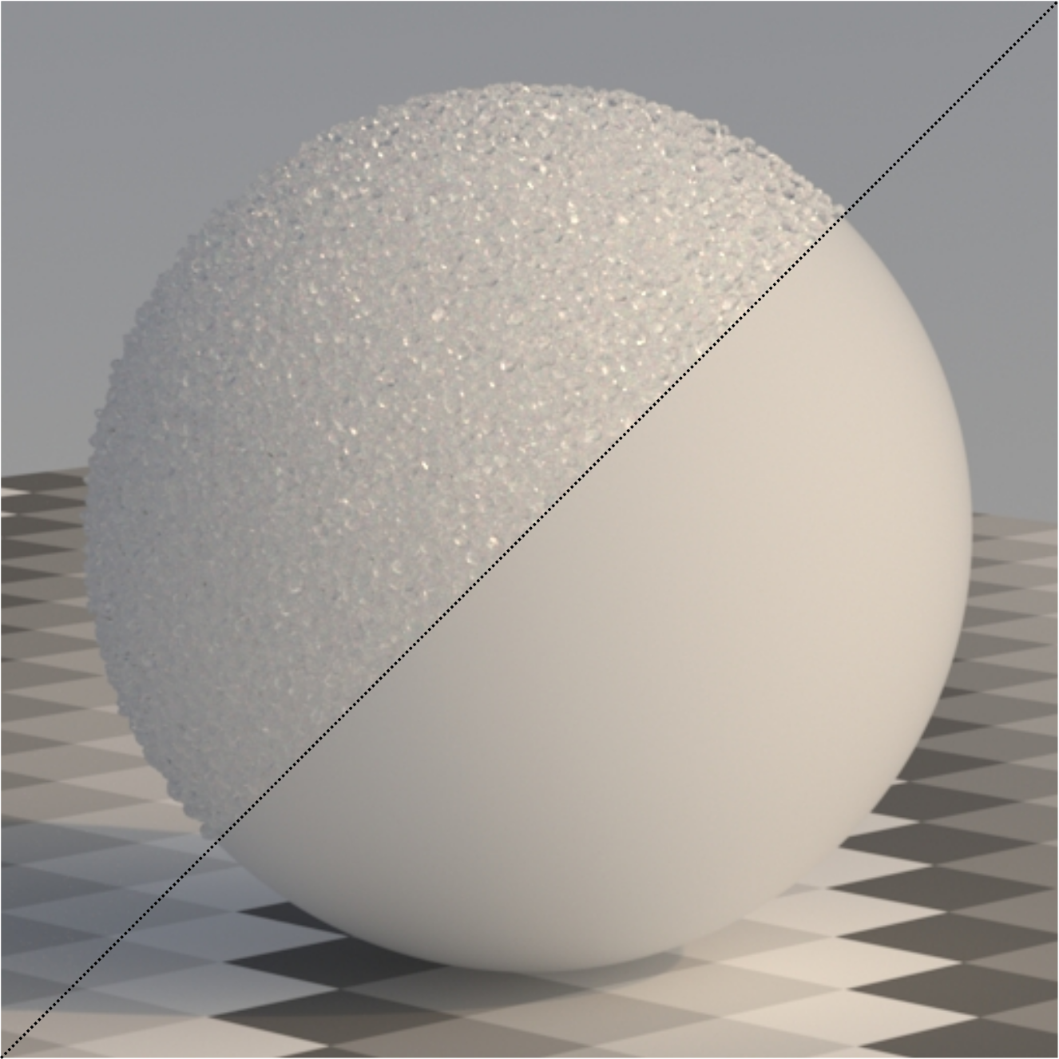
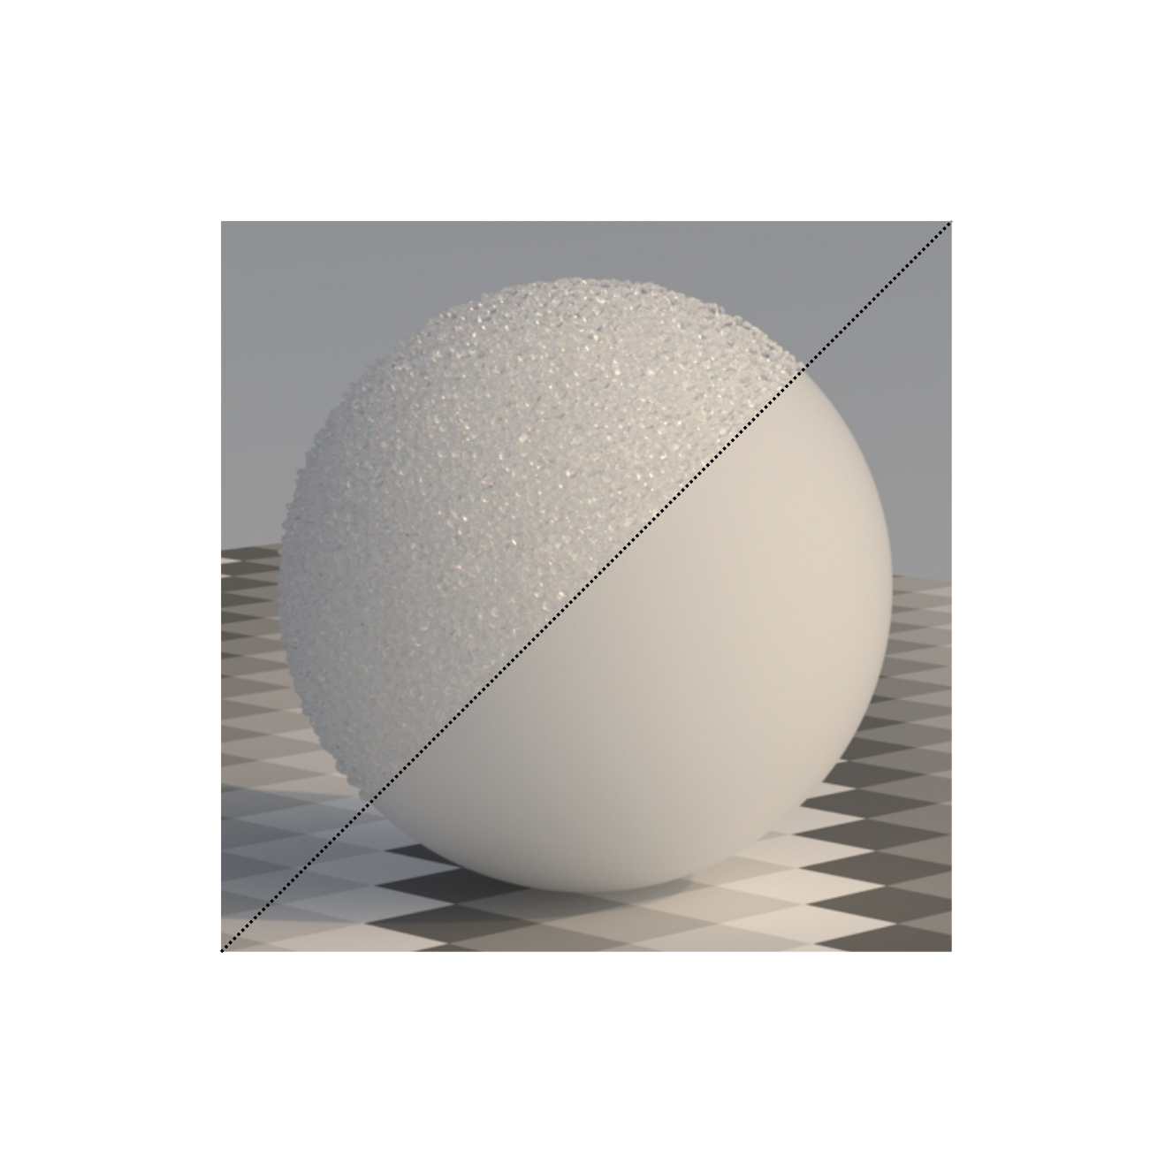
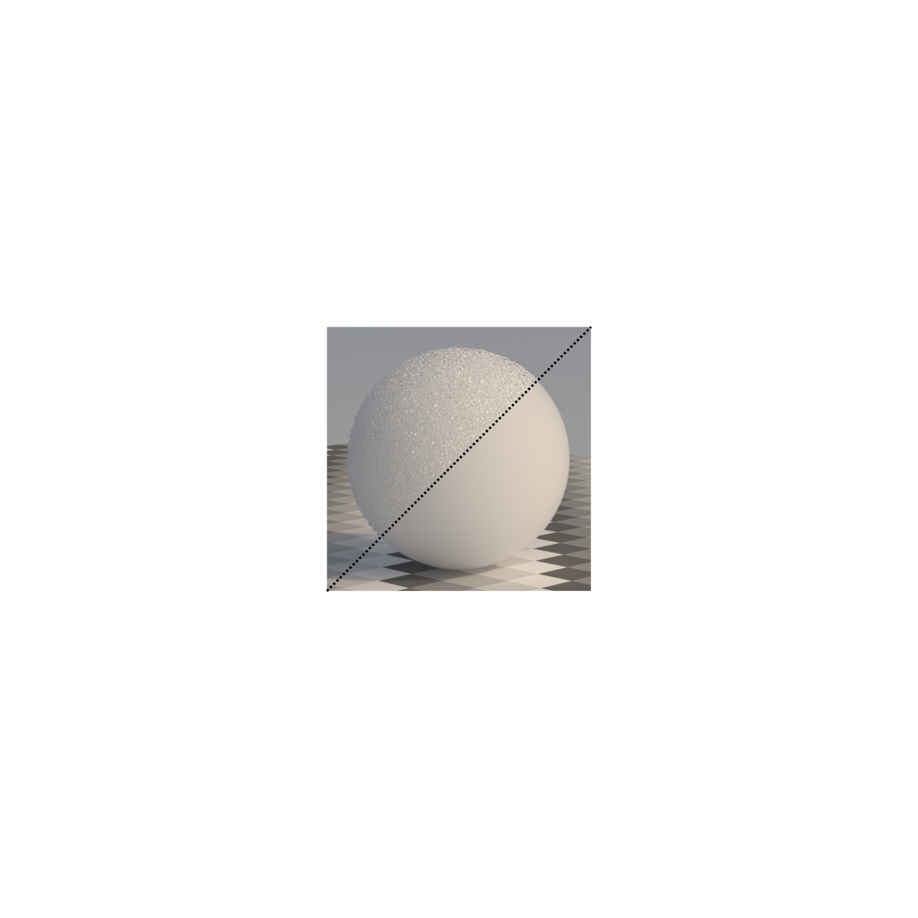
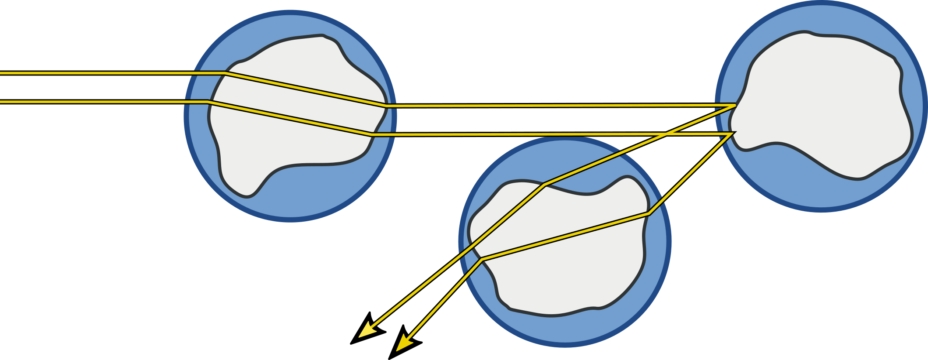
What do we want?
Like Moon et al.,
Avoid tracing grain geometry when possible
Exit the medium quickly
However,
Avoid global precomputation
Multi-scale: Switch as early as
possible.
Original grains
Continuous approximation

Slide 8
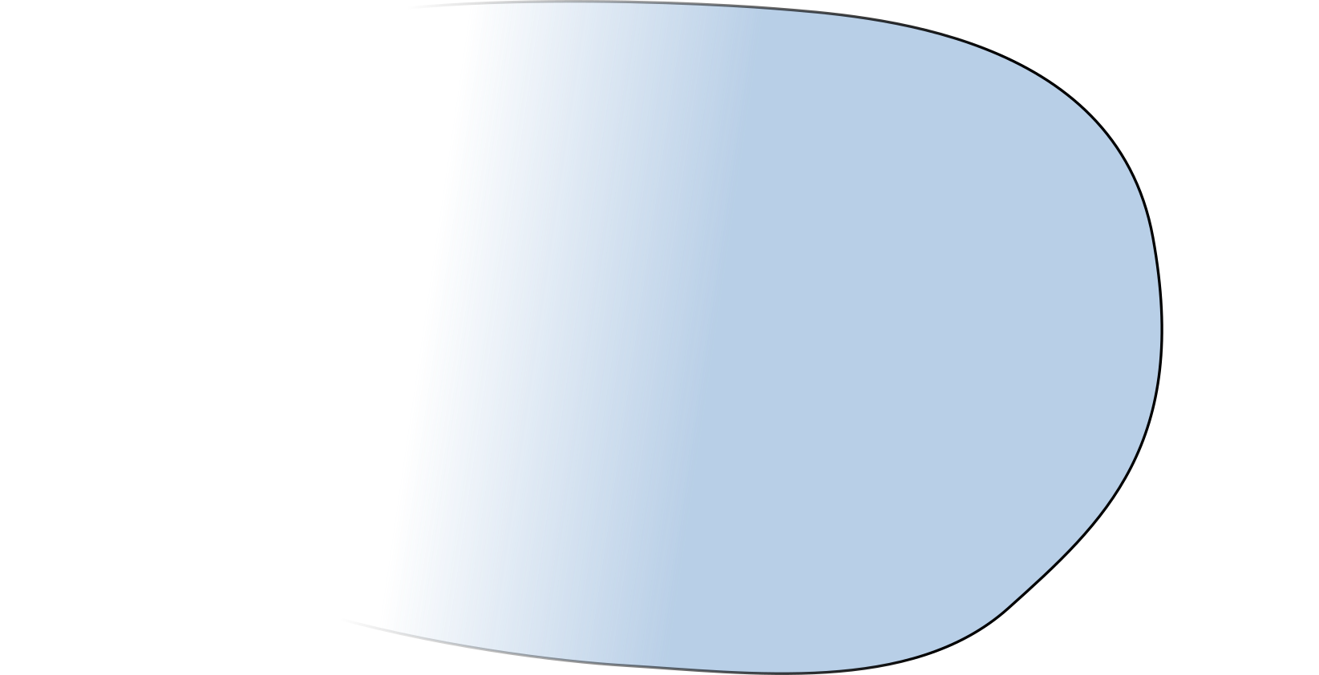
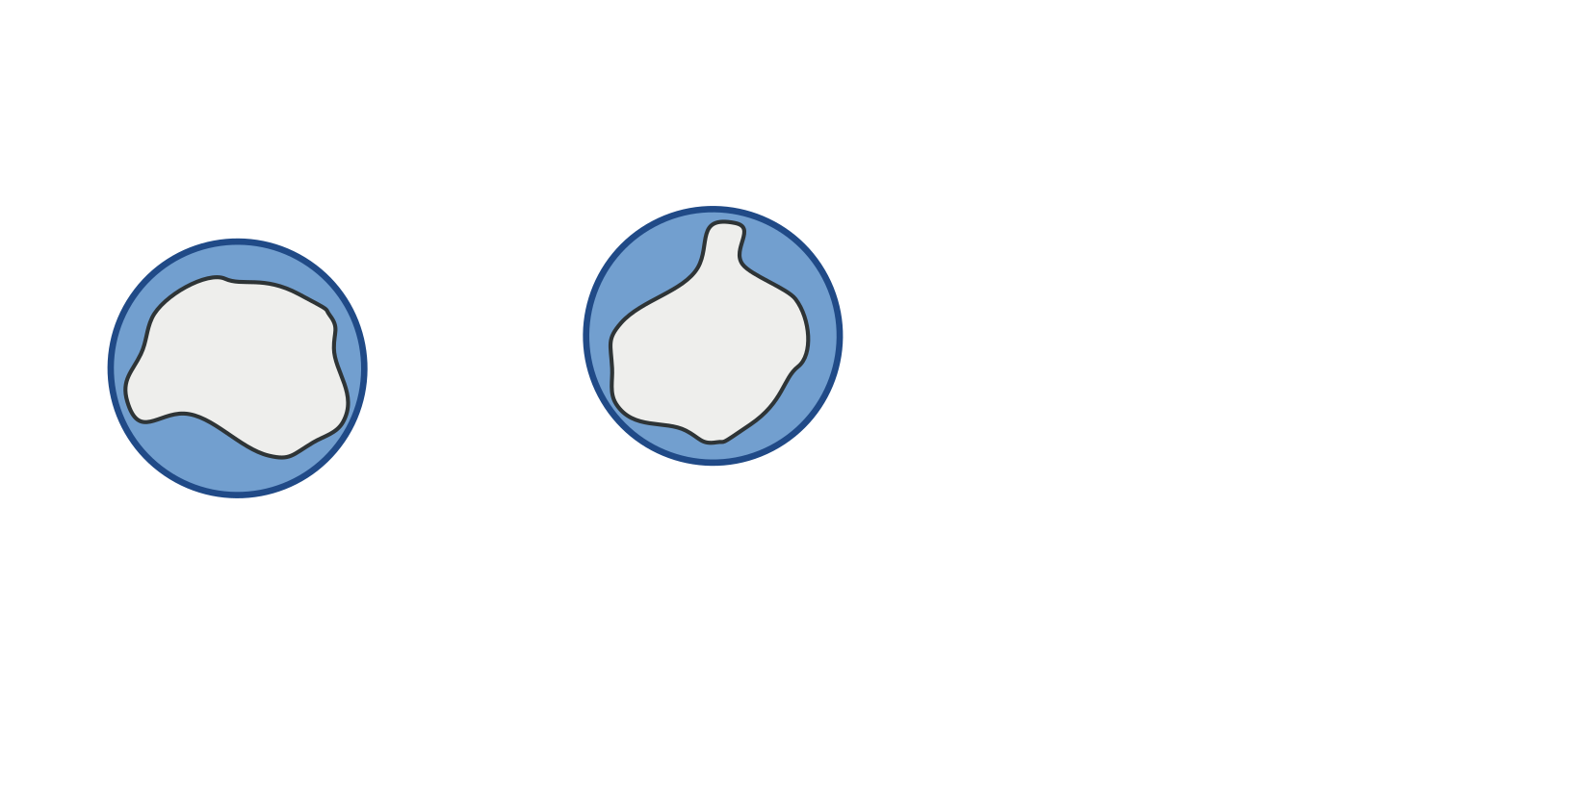
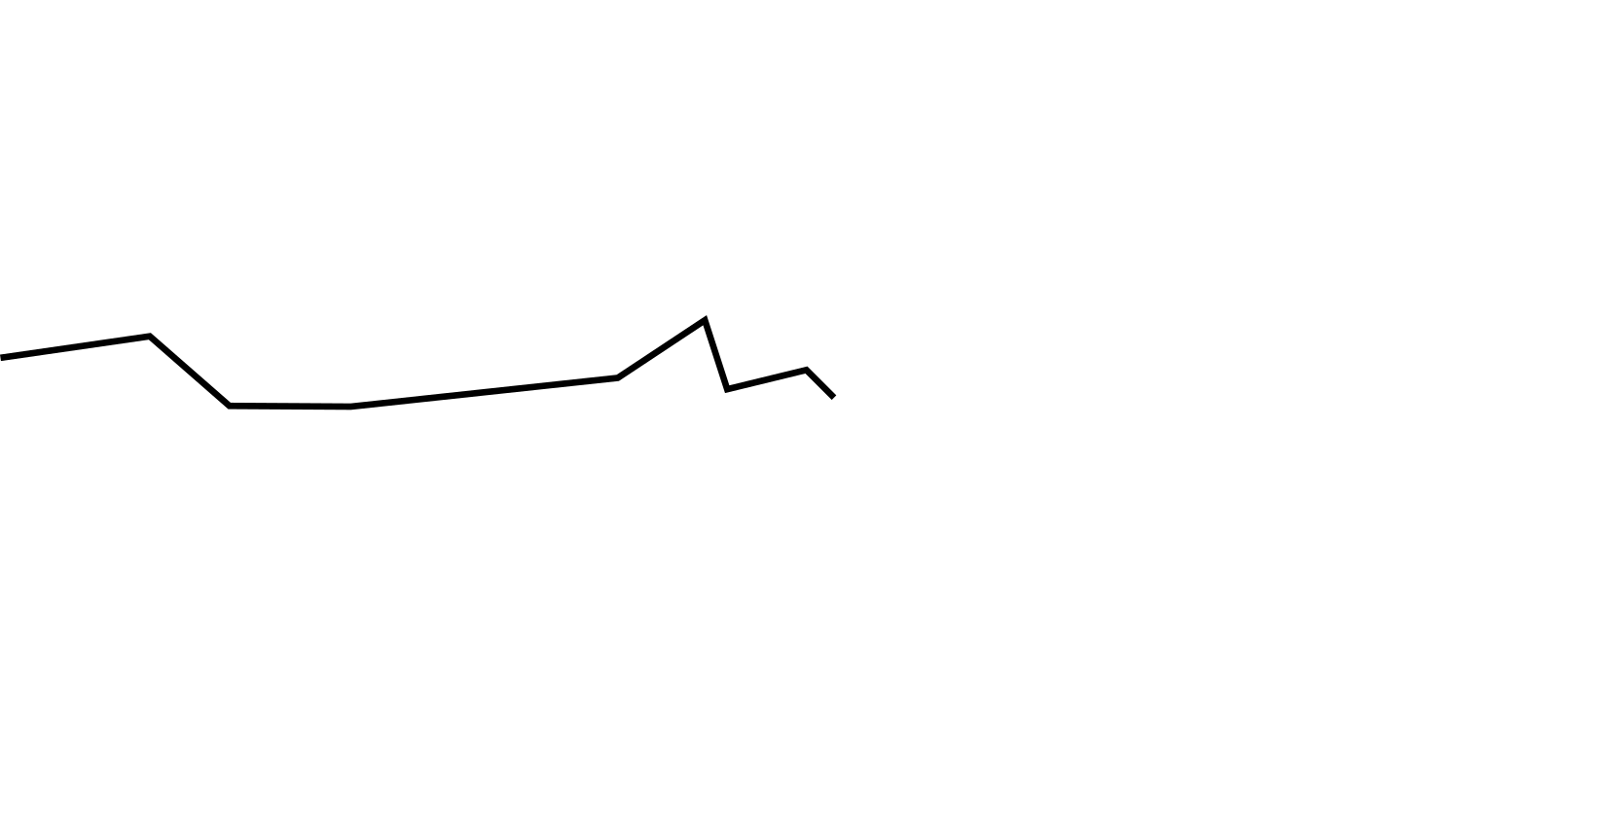
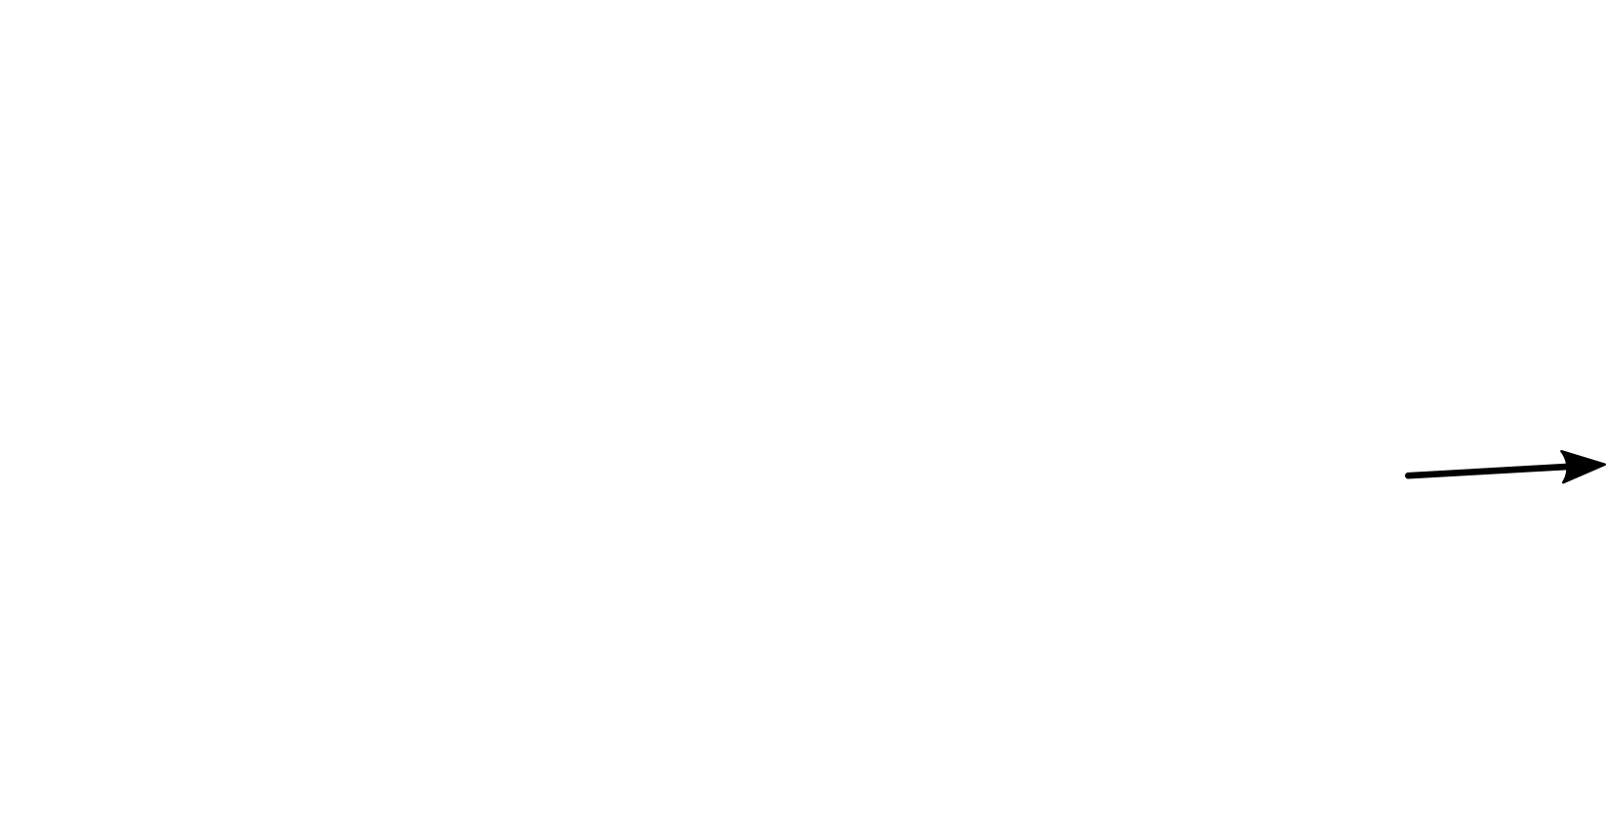
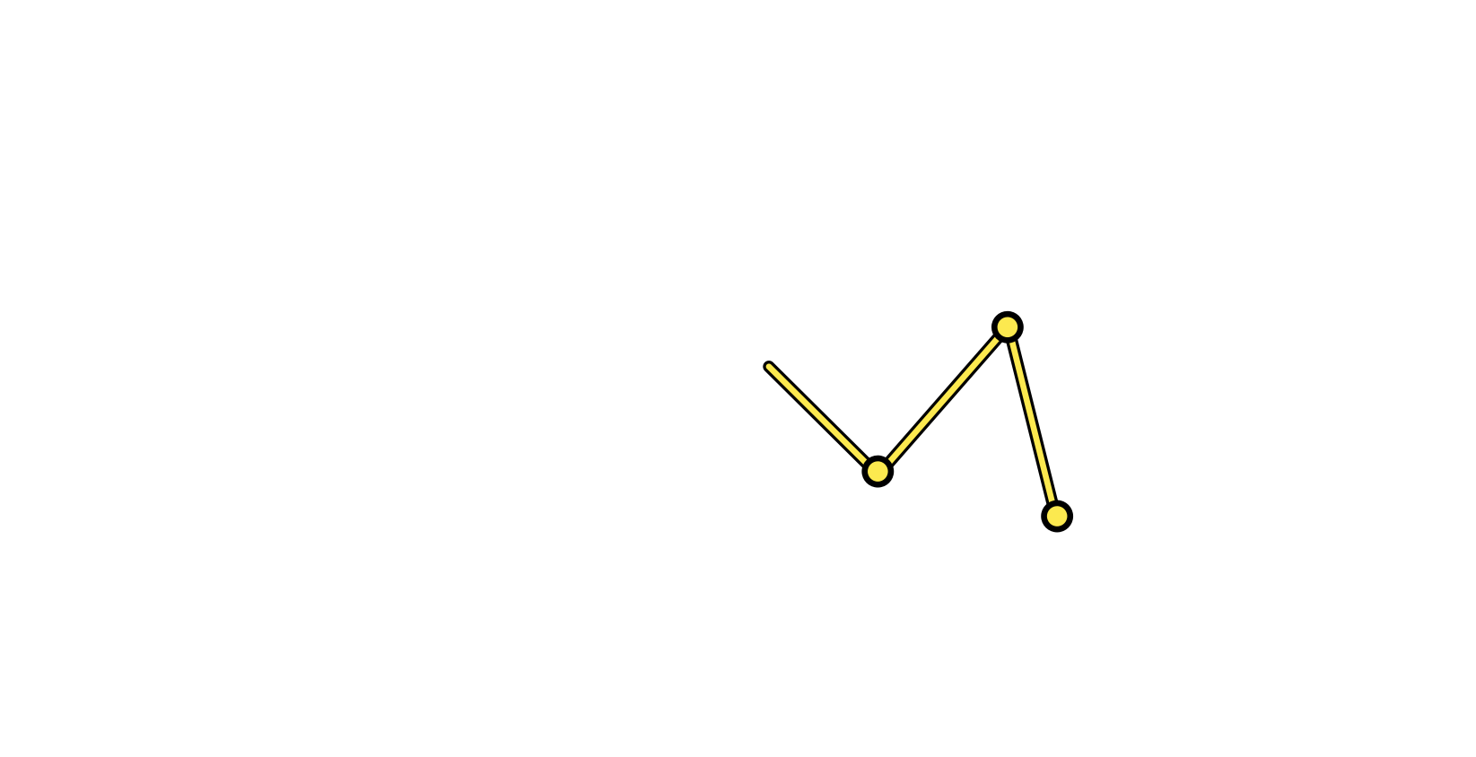
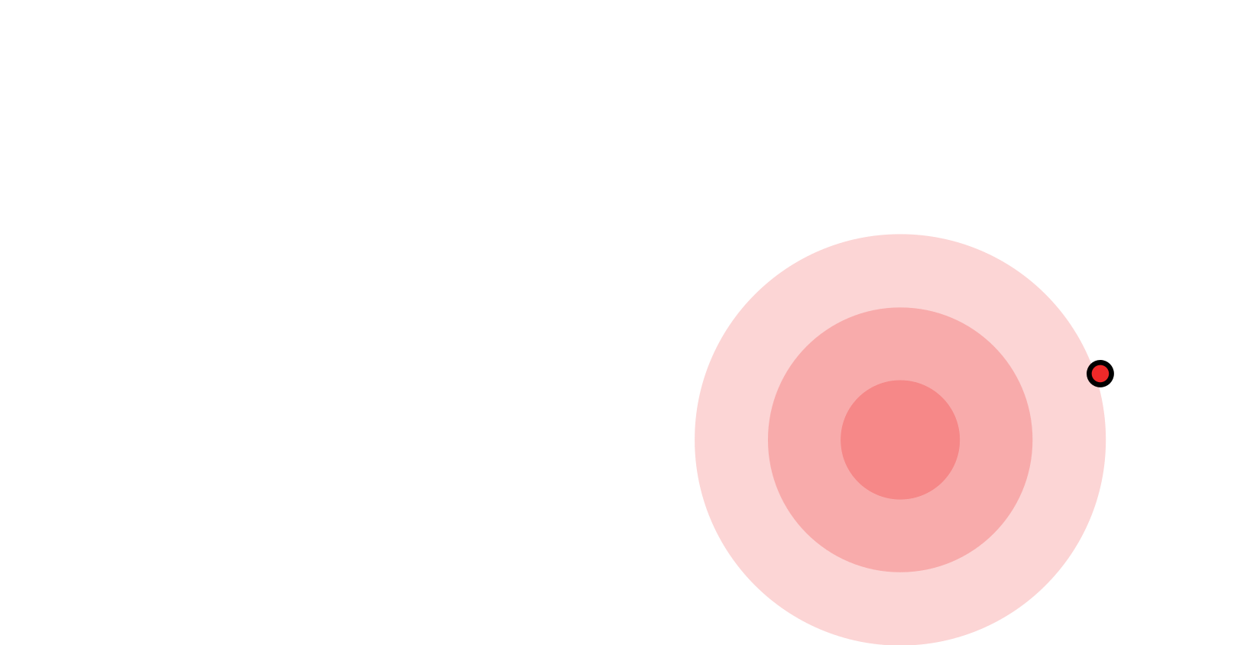
Our Technique
Explicit Path Tracing (EPT)
Volumetric Path Tracing (VPT)
Diffusion Approximation (DA)
EPT + VPT + DA

Slide 9
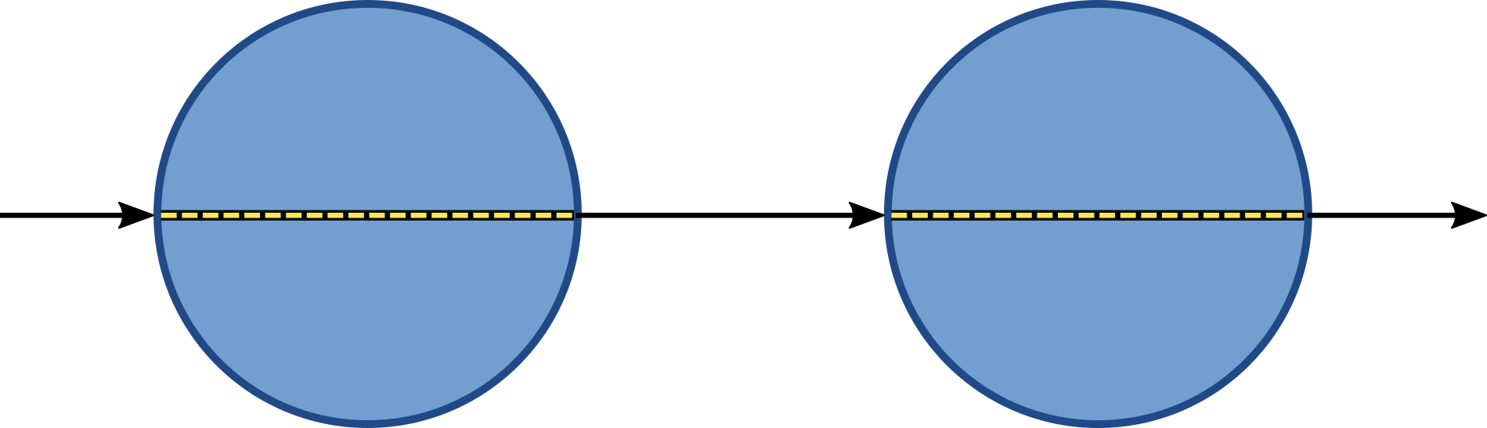
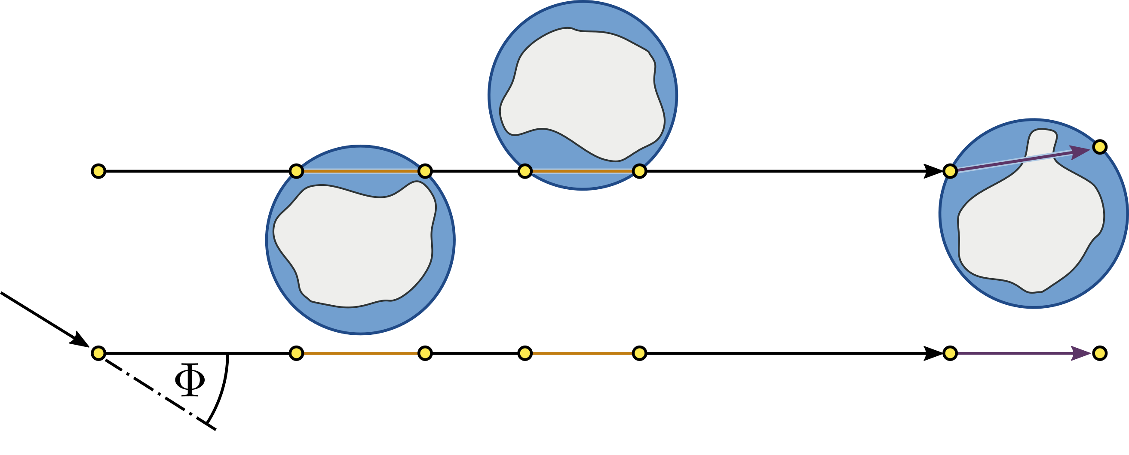
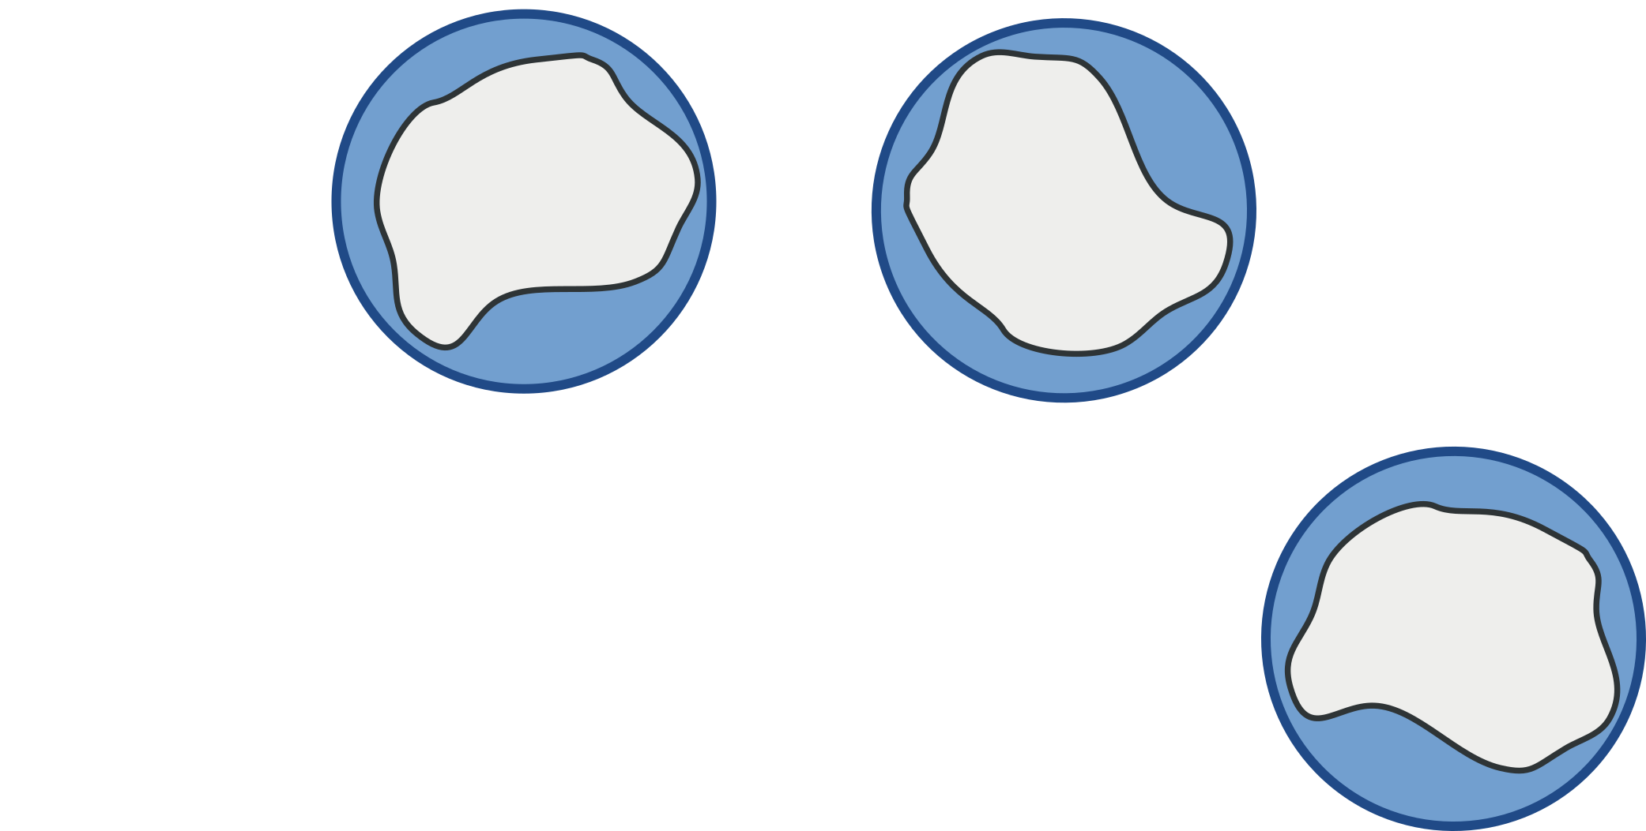
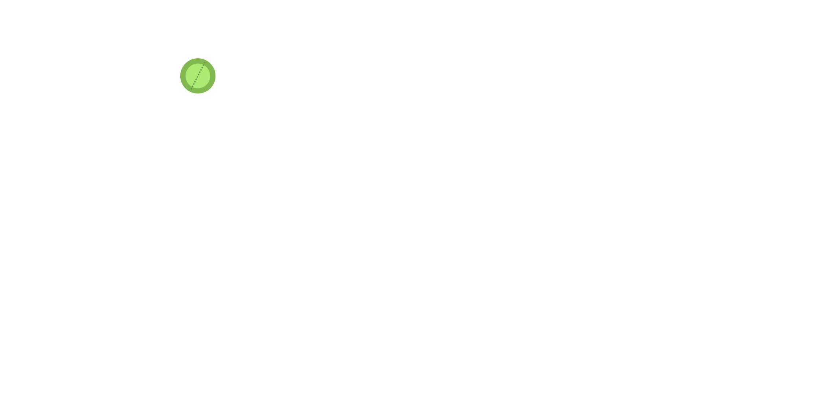
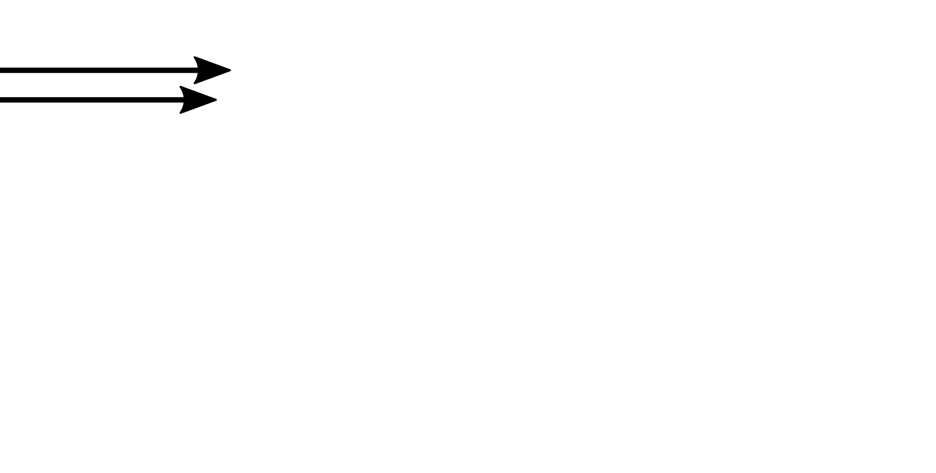
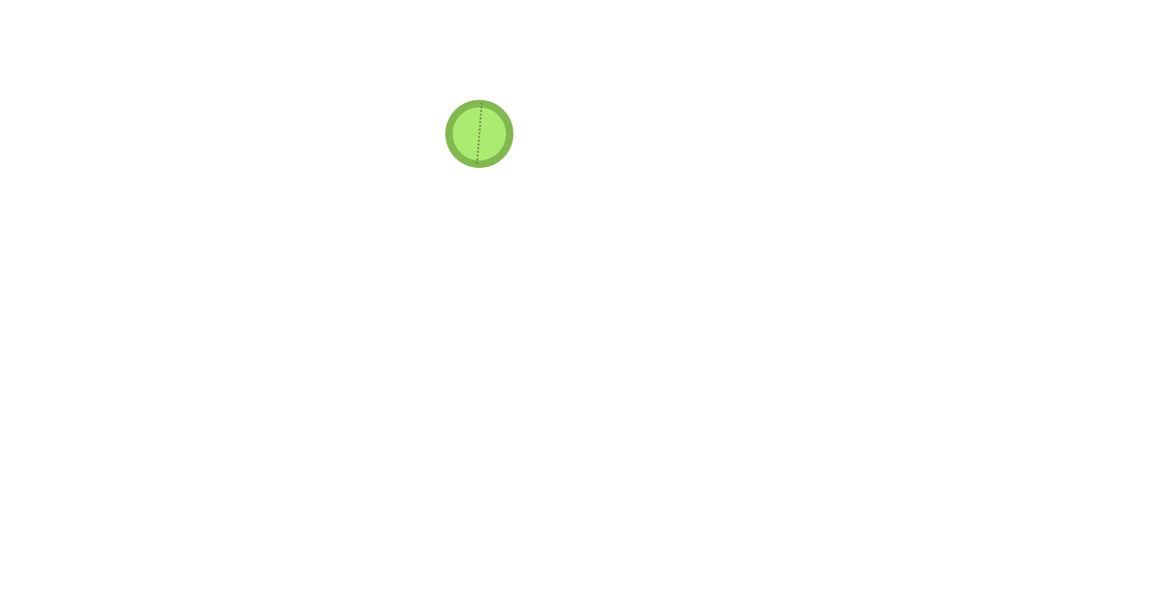
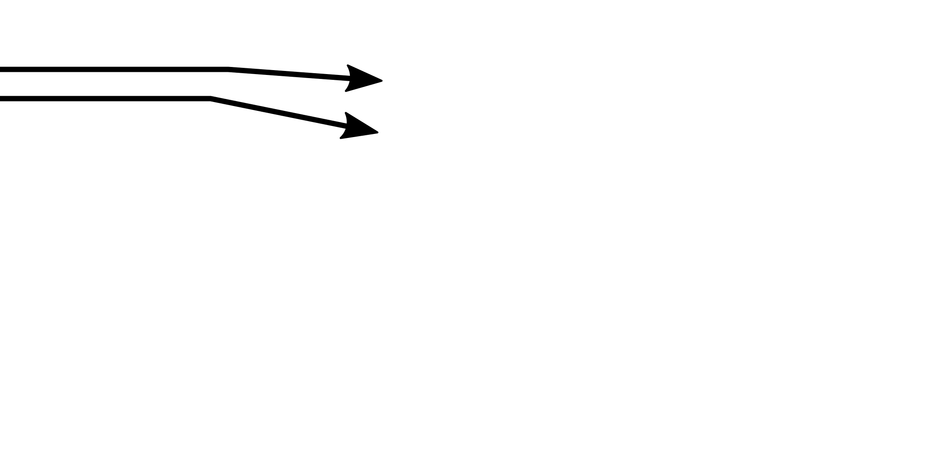
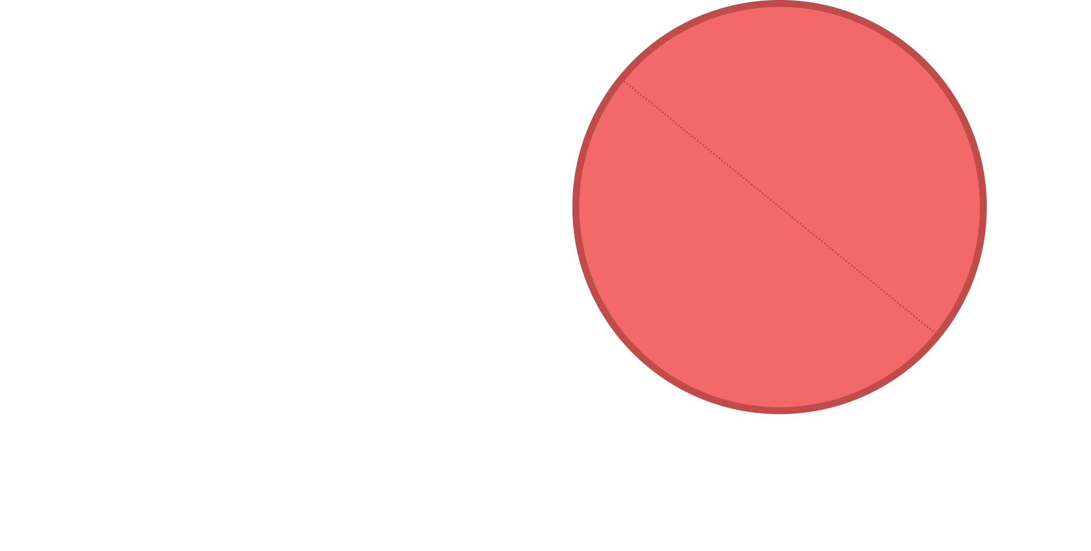
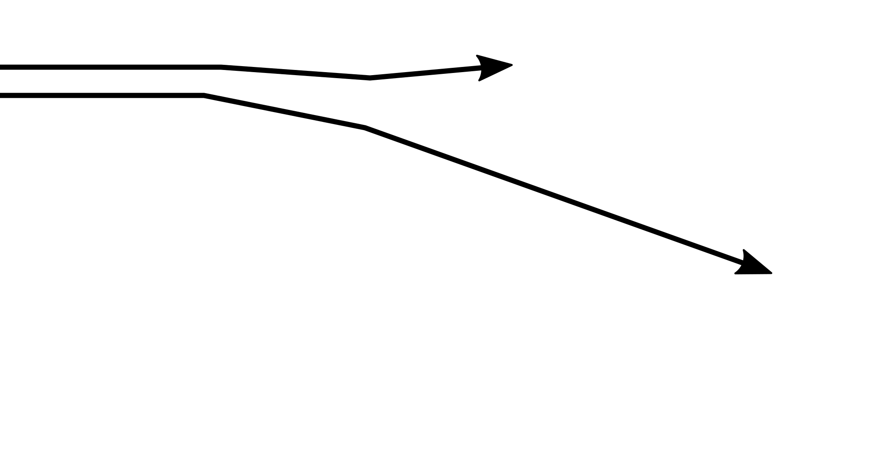
Overview
0. Conceptual model for light transport in grains
1. Deriving parameters for VPT / DA
2. Automatic switching

Slide 10
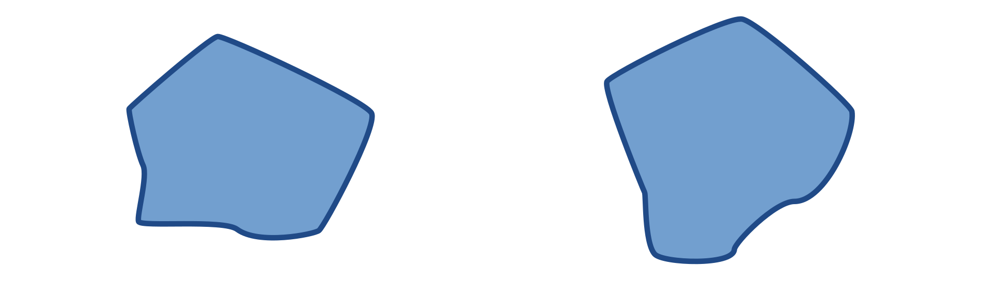
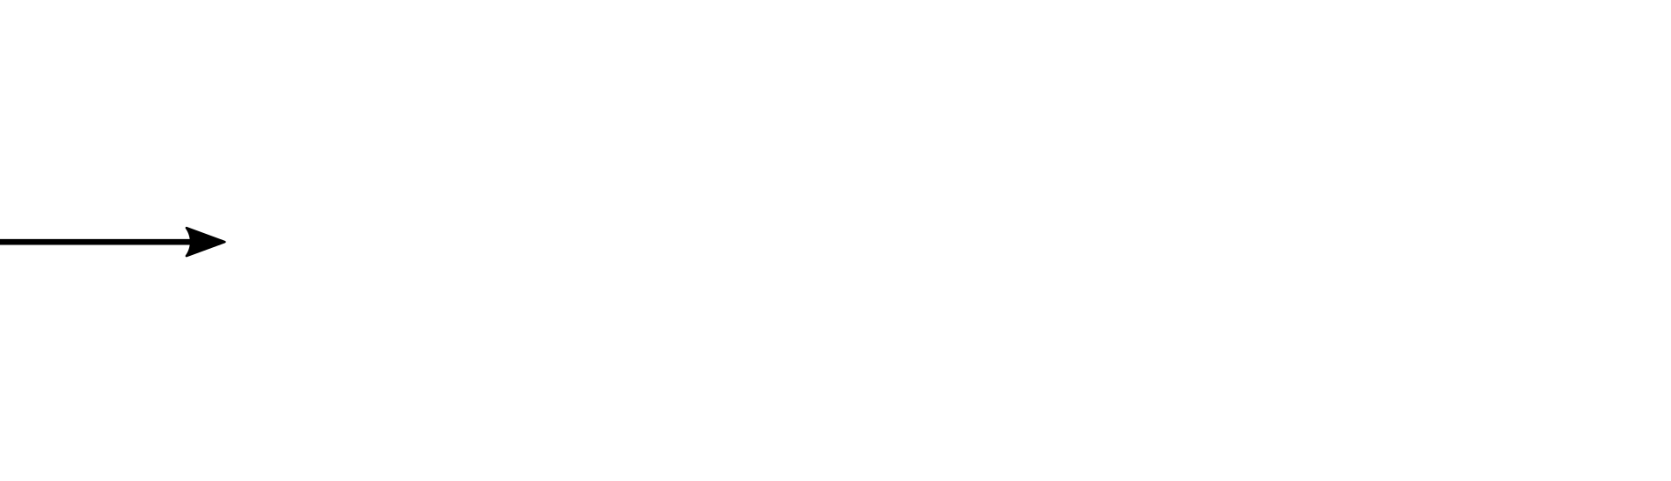
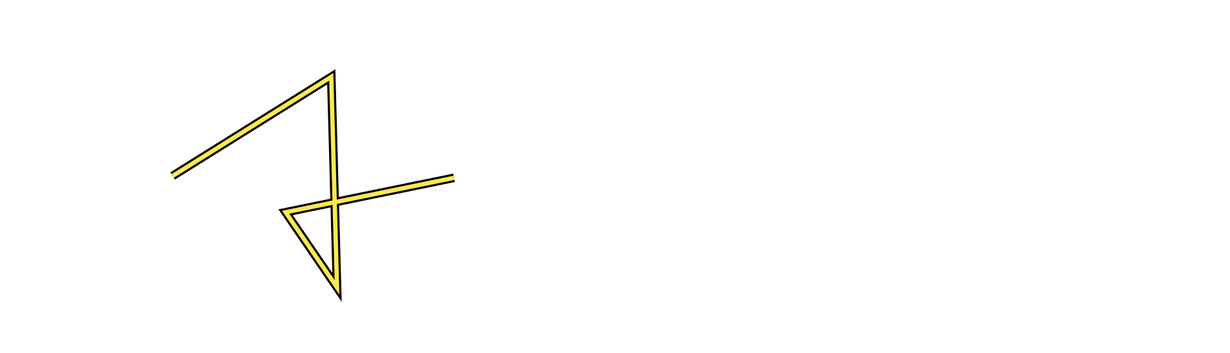
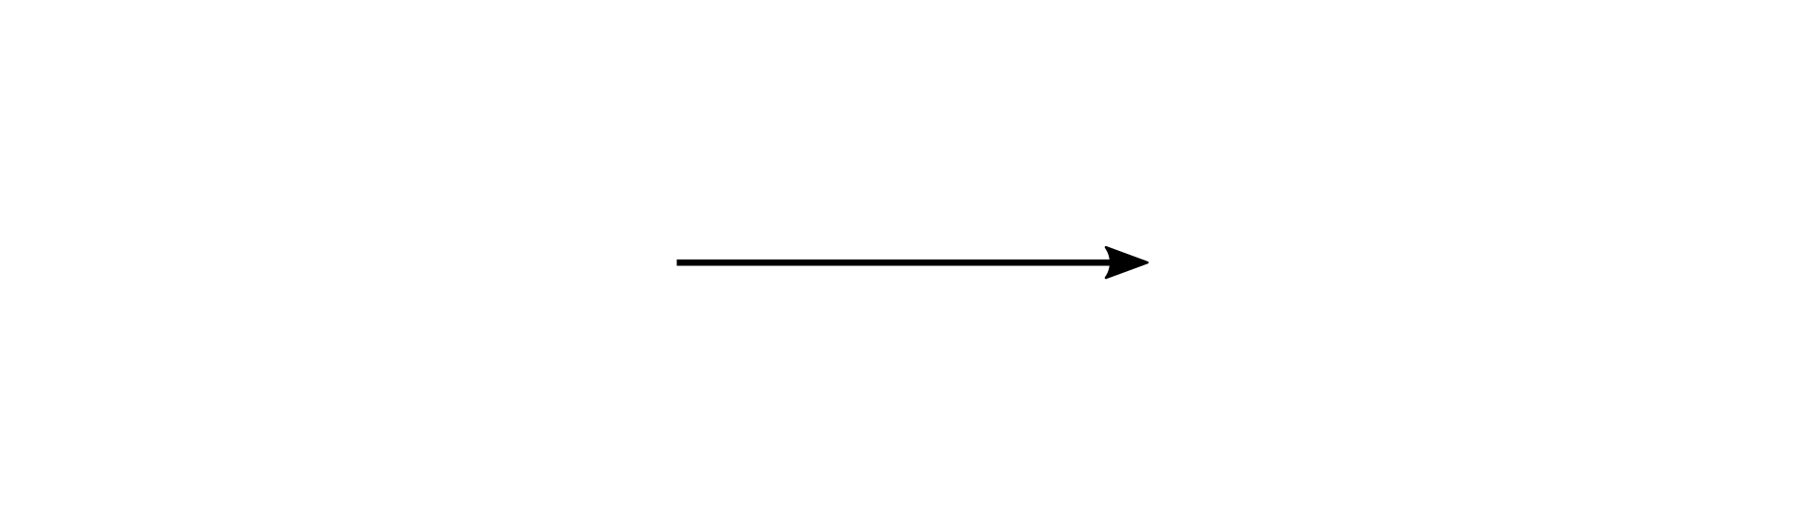
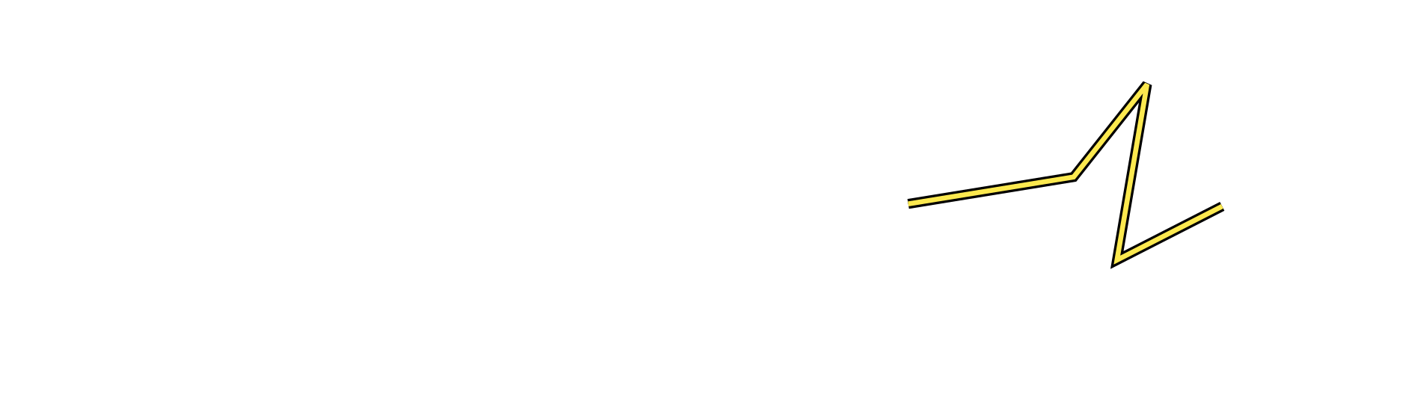
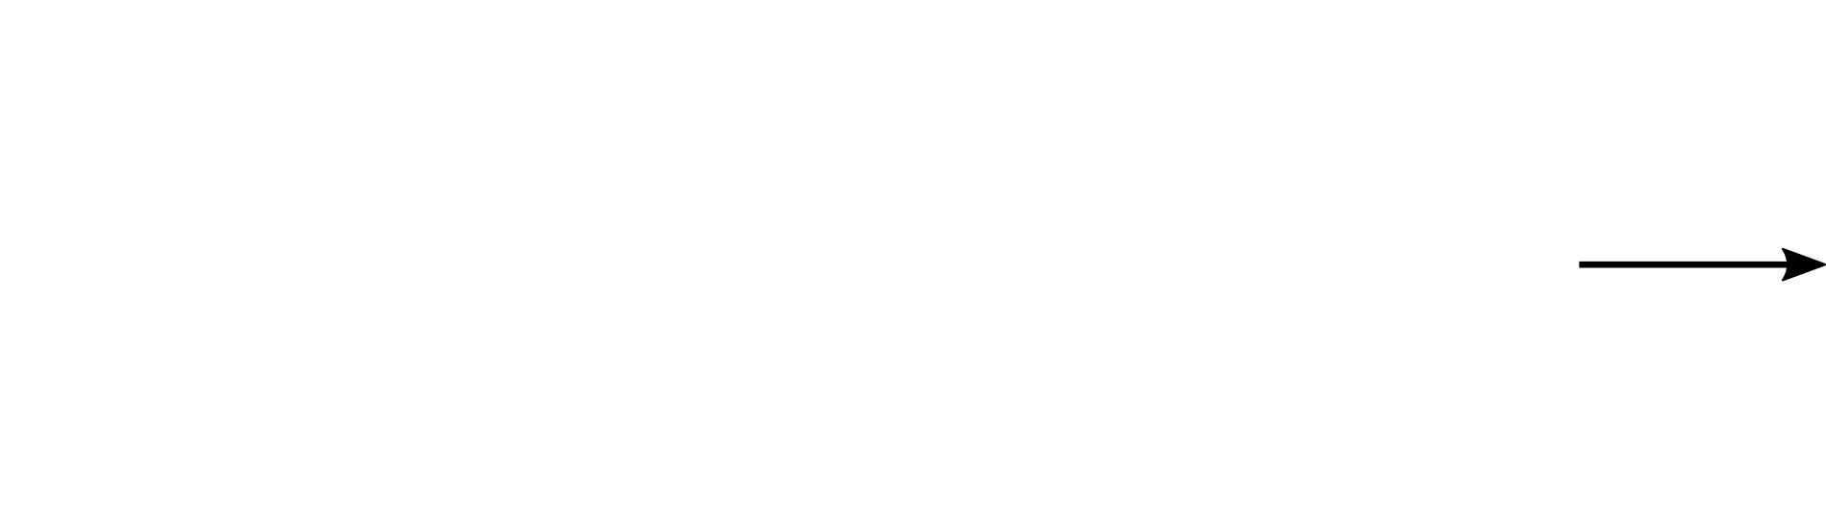
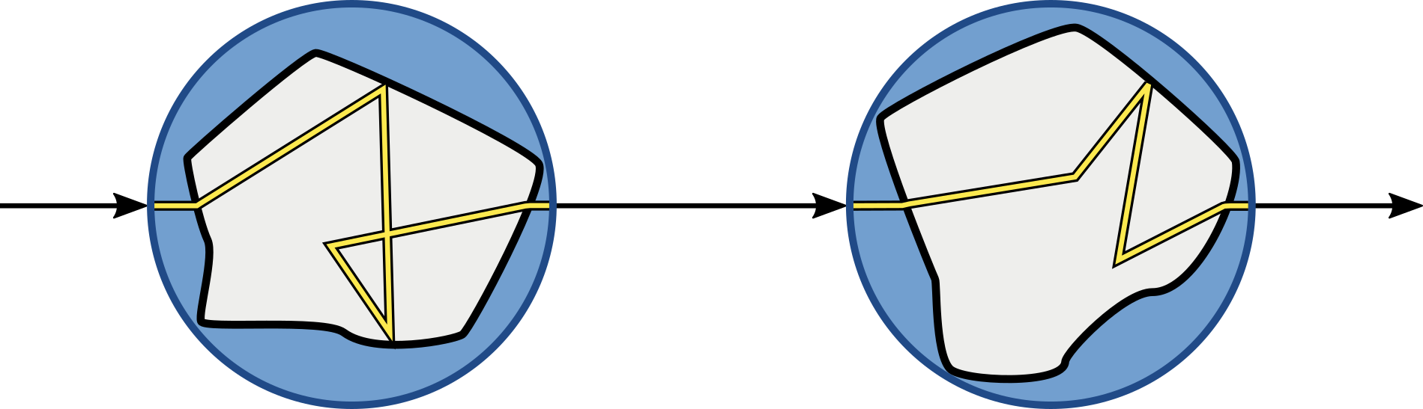
Conceptual Model:
Light Transport in Grains
Non-intersecting bounding spheres!

Slide 11
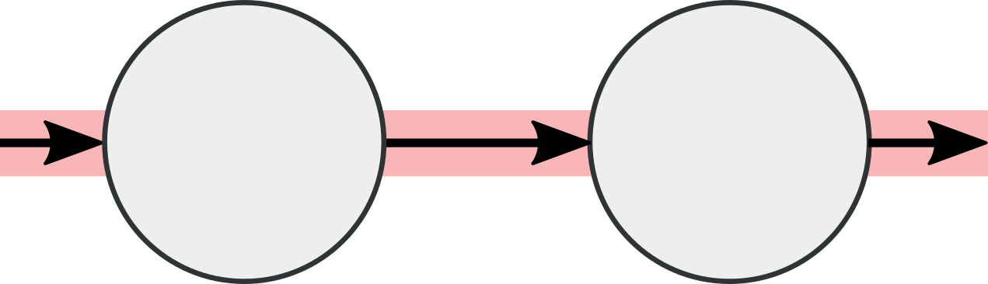
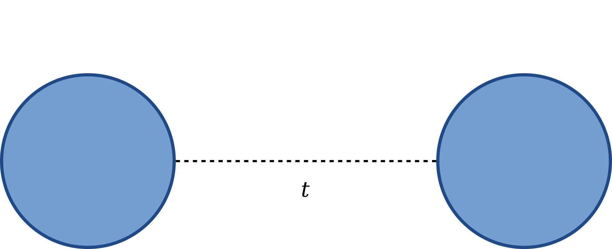




Free Paths in Sphere Packings
$$p\left(t\right)=σ_{b}e^{−σ_{b} t}$$
$$σ_{b}= \frac{3}{4R}\frac{f}{1−f}$$
[Dixmier 1978: Une nouvelle description des empilements aléatoires et des fluides denses.]

Slide 12


Conceptual Model:
Light Transport in Grains
Non-point scattering: Teleportation Scattering Distribution Function (TSDF)

Slide 13







TSDF: Teleportation Scattering Distribution Function
Monte Carlo-simulation of photons scattering on a single grain
Tabulate deflection angle and conditional teleportation vector
$$\left\{α, λ_{s},β,λ_{δ}\right\}$$

Slide 14












Volumetric Path Tracing (VPT)
Deriving Parameters from Teleportation Path Tracing
Phase function
$$β λ_{b}$$
$$+ λ_{s}$$
$$λ_{b}$$
Mean free path
$$β λ_{b}$$
$$+\left(1−β\right)β \left(2λ_{b}+λ_{δ}\right)$$
$$β λ_{b}$$
$$+\left(1−β\right)β \left(2λ_{b}+λ_{δ}\right)$$
$+{\left(1−β\right)}^{2}β (3λ_{b}+2λ_{δ})$ …

Slide 15



Volumetric Path Tracing (VPT)
Low order: Explicit Path Tracing
High order: Volumetric Path Tracing

Slide 16



Diffusion Approximation (DA)

Slide 17
What do we want?
Like Moon et al.,
Avoid tracing grain geometry when possible
Exit the medium quickly
However,
Avoid global precomputation
Multi-scale: Switch as early as possible

Slide 18
Switching to VPT

Slide 19

Techniques
Explicit Path Tracing (EPT)
+ Volumetric Path Tracing (+VPT)
+ Diffusion Approximation (+DA)

Slide 20





Sand Castle
EPT: 1736 hrs
EPT+VPT+DA: 789 hrs

Slide 21


Slide 22










Spices
EPT: 5646 hrs
+VPT: 876 hrs
+DA: 709 hrs

Slide 23





Snowman
EPT: 75600 hrs
+VPT: 756 hrs
+DA: 291 hrs

Slide 24
Granular materials are practical to render
Granular materials are impractical to render

Slide 25




Future Work
Packing densities $>64\%$
(Anisotropic grains, e.g. rice!)
Spatially varying medium properties.

Slide 26


Slide 27
Backup

Slide 28


Notes:
Example: Standard Path Tracing is noisy, but importantly doesn’t find the highlights until after a VERY long time.

Slide 29









Modeling Granular Media Procedurally
Raytracing: find entry point.
Find next grid cell and repeat.
Box packed with spheres
Cut out macro shape.
Randomized instantiation. Intersect grain mesh.
Infinite space of spheres.
Find intersection with sphere in current cell.
Notes:
Modelling hard: many grains to be placed, usually requires expensive simulation
For research purposes: need a way to quickly model scenes with arbitrary macro shapes and
Billions of grains.
-> procedural approach

Slide 30

Diffusion Approximation – Corner Bias
Path Tracing
+ VPT
+ DA
Notes:
Bias because need to be able to connect to light source – hard in concave places.

Slide 31




Switching - Spices
EPT
VPT
DA
Switch Depth

Slide 32





Teleportation Path Tracing
Sample free path
Sample TSDF
Sample free path
Sample TSDF
Notes:
With these components, we can implement what we call Teleportation Path Tracing, a two-step model.

Slide 33
What do we want?
Like Moon et al.,
Avoid tracing grain geometry when possible
Exit the medium quickly
However,
Avoid global precomputation
Multi-scale: Switch as early as possible
Notes:
Multiscale: In close-up shots, details must be visible (left), but zooming out, we should switch to approximate methods earlier. We want an automatic criterion for this!

