Slide 1
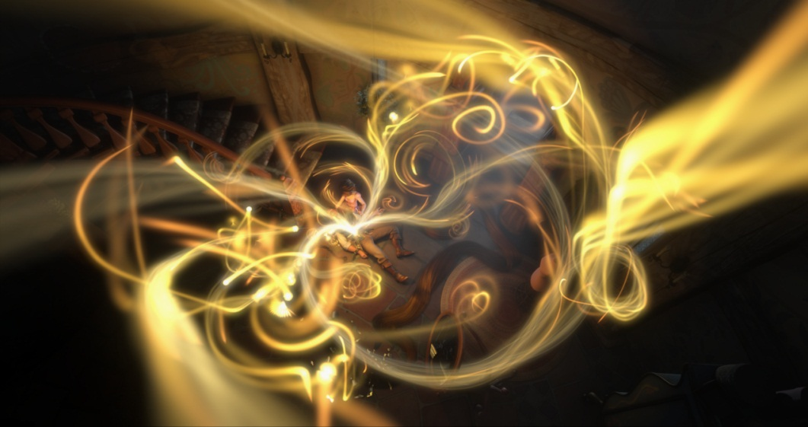



A Programmable System for Artistic Volumetric Lighting
© Disney Enterprises, Inc.
Derek Nowrouzezahrai Dylan Lacewell | Jared Johnson Michael Kaschalk | Andrew Selle Wojciech Jarosz
Notes:
Thank you for the introduction, Adam.
Hello and thank you for attending my talk.
This work was completed in collaboration with Jared Johnson, Andrew Selle, Dylan Lacewell and Michael Kaschalk from the Walt Disney Animation Studios, and Wojciech Jarosz from Disney Research Zurich.

Slide 2

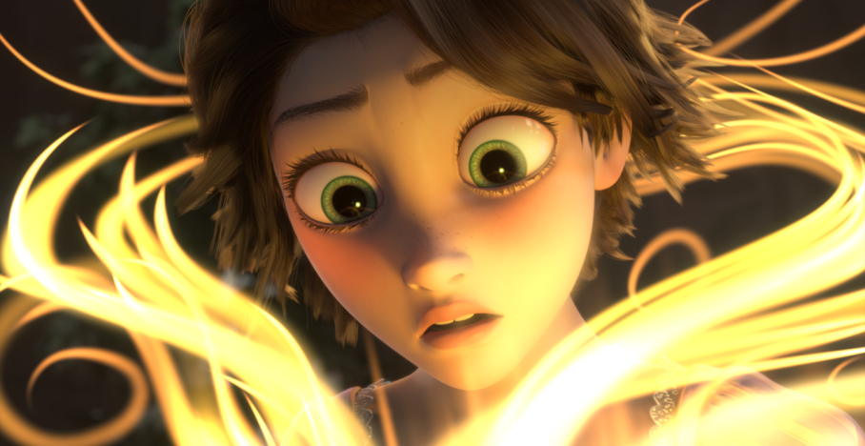
Motivation
Volume lighting is a powerful effect in feature-films
Tangled: sense of magic conveyed using volume effects
© Disney Enterprises, Inc.
© Disney Enterprises, Inc.
Volumetric light draws attention and instills fascination
Notes:
Volumetric lighting effects can produce stunning visuals, and are becoming common-place in feature-film production
For example, in Disney’s Tangled, where magic plays an important role in the plot,
Volumetric effects are used to draw the audience’s attention and instill this magical sense of fascination.

Slide 3
Main Challenges
Authoring volumetric effects is difficult
  Physical simulation not expressive enough
  Non-physical effects may be required
  Lack of intuitive control
  No 3D tools mimic natural volume design workflows
Notes:
The MAIN CHALLENGE when it comes to volumetric effects in feature-film production is that they are difficult to author. Some key reasons for this are:
- Physically accurate volume lighting may only get you 90% the way to a target result,
- Sometimes, non-physical effects may be required,
- And editing volumetric shading parameters often leads to unintuitive results.
Our main observation is that no existing 3D tools enable artists to *draw* volumetric effects the way they *think* about them.

Slide 4
Goals and Contributions
Goal: enable intuitive control of volumetric effects
Contributions
  Driven by the needs and skills of technical artists
  Integrates into production pipelines
  Extends a physically-based approach
  General and intuitive shading model
Notes:
Our goal is to enable artists to author volume lighting effects in a manner that’s both intuitive and natural.
Our contributions are driven by the needs and skills of our artists
→ “needs”: we talk to artists to see what they need in such a system
→ “skills”: based on the way artists think about, and sketch, volumetric effects.
First and foremost, we integrate our system into existing production pipelines to enable rapid adoption with a minimal learning curve,
In many cases, physically-based shading is a powerful stepping stone for art-directable volumetric effects, and so we base our model on existing physically-based volume lighting techniques, but extend them in several novel ways.
We itemize the way artists often need to bend or break the physical constraints of these approaches, and develop a general art-directable volumetric shading model based on these requirements.

Slide 5
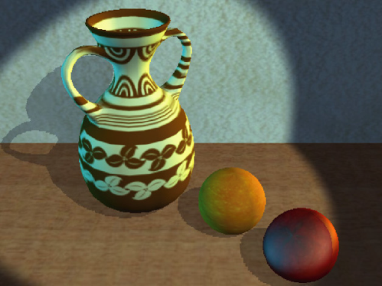
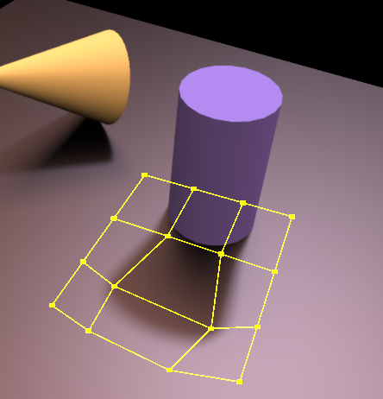
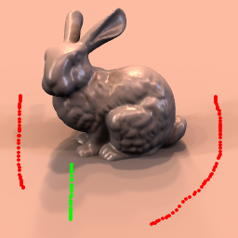
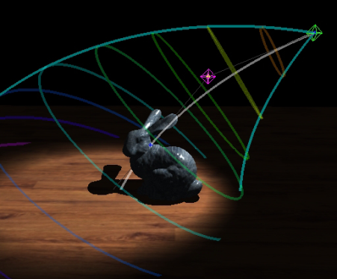
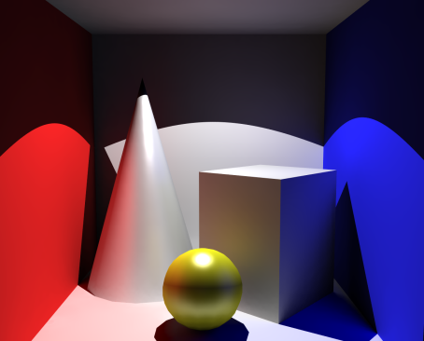
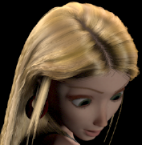
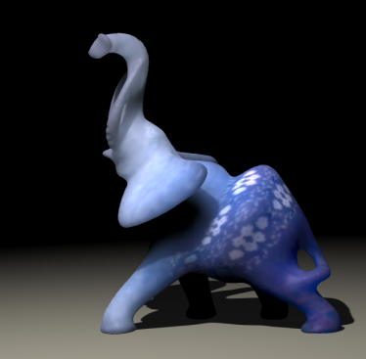
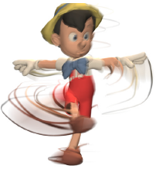
Previous Work – Controllable Surface Shading
Rich literature in art-directable control of surface shading effects
[Pellacini et al. 2007]
[Obert et al. 2010]
[Pellacini 2010]
[Kerr et al. 2010]
[Obert et al. 2008]
[Sadeghi et al. 2010]
[Song et al. 2009]
[Schmid et al. 2010]
Notes:
Many recent works have considered putting artists in the loop, most of which deal with surface shading effects.
Many different approaches allow artists to edit the contrast of a scene, the placement and shape of shadows, and the manner in which light sources affect different parts of an environment.
There are also approaches that allow the user to edit and exaggerate indirect illumination effects,
modify specialized reflectance models,
author intricate sub-surface scattering patterns, and
devise programmable motion effects.
<*** DON’T SAY “ARTIST-FRIENDLY” ***>

Slide 6

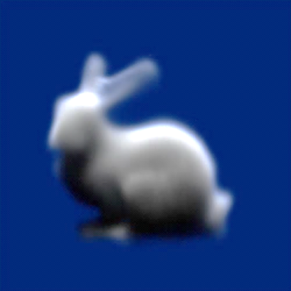
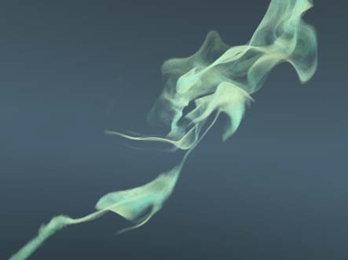
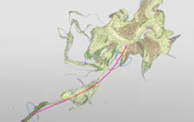
Previous Work – Controllable Fluid Animation
[Treuille et al. 2003]
[McNamara et al. 2004]
[Angelidis et al. 2006]
We focus on the lighting in the media
Notes:
We are also motivated by work in controllable fluid animation.
The seminal works in this area allowed artists to specify target density shapes that would be matched by the fluid simulation system.
Other approaches give artists direct control of the path of the fluid, for example by defining and dragging 3D curves over time.
We instead treat lighting as a first class citizen, and focus on directing the appearance of volumetric media.

Slide 7


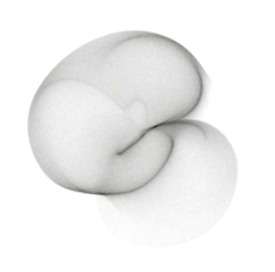
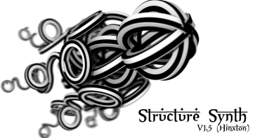
Previous Work – Artist Tools and DSLs
3D tools and domain specific languages
  applied research in industry and academia
Placeholder
FELT
[Tessendorf and
Kowalski 2010]
Notes:
A significant amount of research has gone behind the development of industrial calibre 3D content generation tools.
Technical artists are trained, comfortable and capable of generating unimaginably creative results using the interaction controls that have become ubiquitous in the areas of 3D design. The video on the left illustrates how an artist can seamlessly take an idea from conception of prototype using these tools.
Tools exposed through domain specific languages are also commonly used, such as Pixar’s RenderMan, where an artist can programmatically specify complex geometric and reflectance behavior in their virtual scenes.

Slide 8

Requirements and Solutions
Artist wish list for a volume lighting system:
1. Integrate into production pipeline
Use existing tools; don’t re-invent the wheel
2. Expose flexibility with programmability
Model will leverage DSLs
3. Mimic traditional volumetric design abstractions
4. Support physical and non-physical volume effects
Notes:
Together with technical artists at the Walt Disney Animation Studios, we devised a minimal list of requirements for a volume lighting system. The rest of the talk will discuss these four requirements, and how we satisfied them.
Firstly, any system should integrate seamlessly into their existing production pipeline.
To do so, we built our system on top of existing 3D tools, such as Houdini and Renderman.
Secondly, our system must allow artists to specify animation and shading behavior programmatically.
In this case, we ensured that our model adhered to the domain specific languages of choice for technical artists at Disney.
Thirdly, and arguably most importantly, our system should exploit the way artists think about drawing volumetric effects. For this requirement, we need to discuss exactly how artists sketch these types of effects.

Slide 9
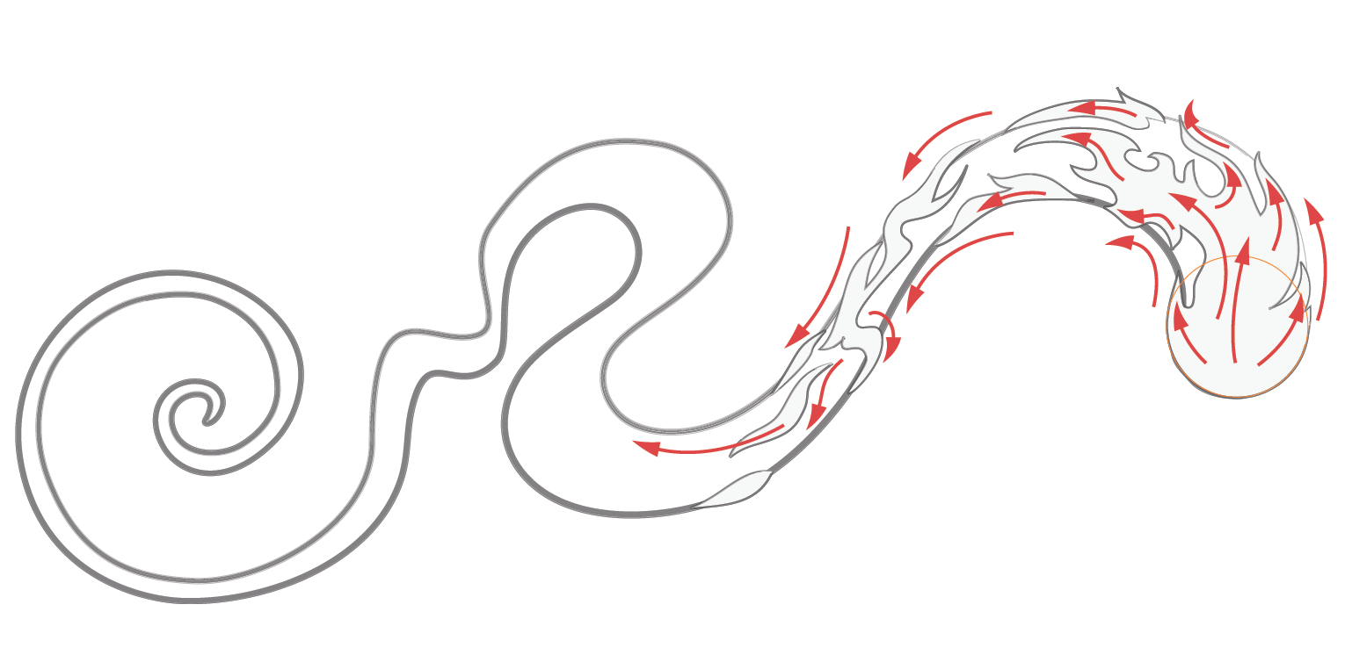
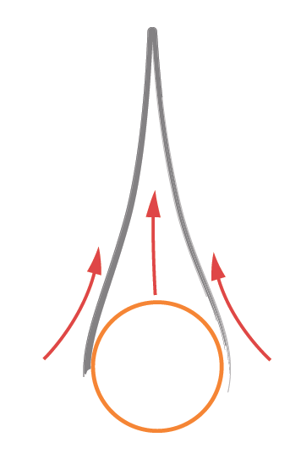
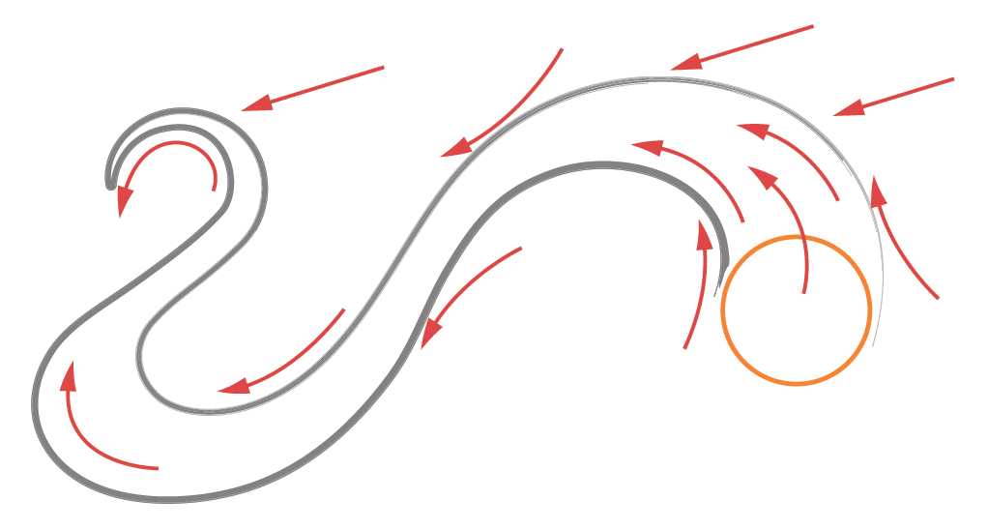
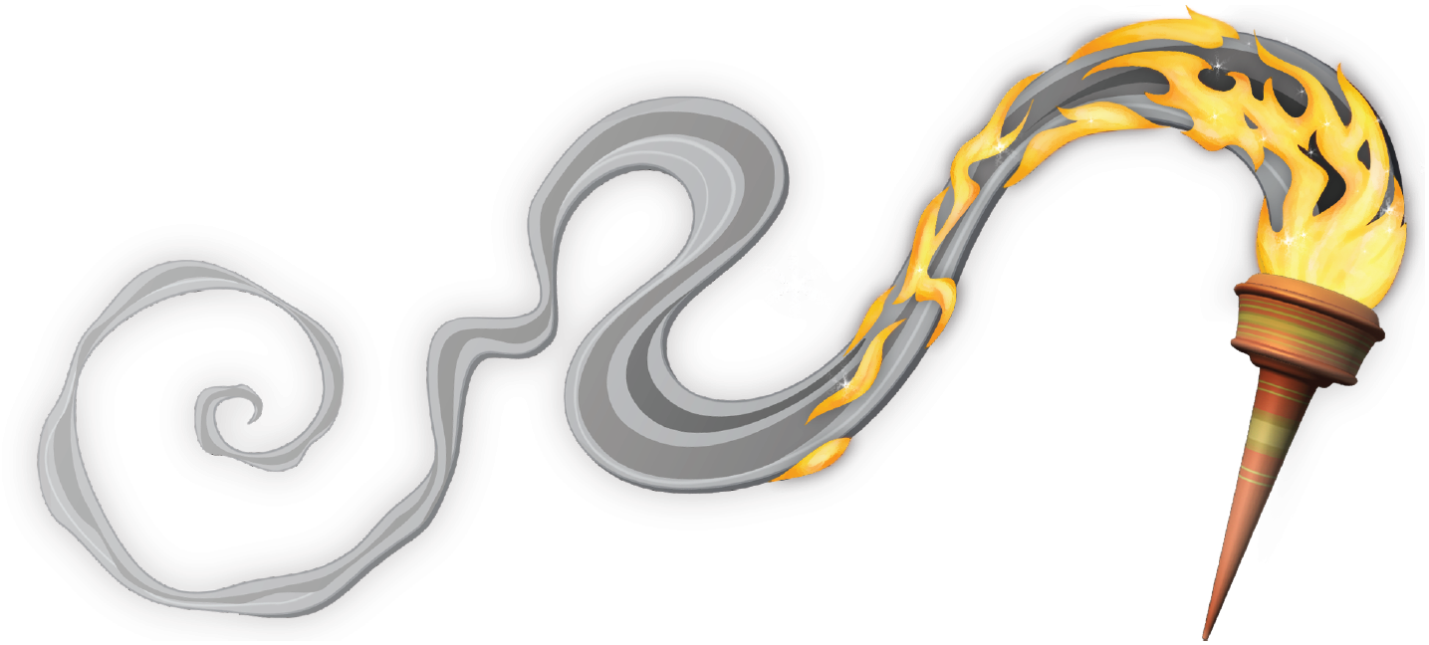
Traditional Volume Sketching Workflow
Sketch media’s form
(may include flow annotation)
Sketch media’s evolution
[optional]
Shade
Add volume detail
Current 3D workflows do not adhere to this approach
Sketches inspired by Gilland [2009]
Notes:
---

Slide 10
Requirements and Solutions
Artist wish list for a volume lighting system:
1. Integrate into production pipeline
Use existing tools; don’t re-invent the wheel
2. Expose flexibility with programmability
Model will leverage DSLs
3. Mimic traditional volumetric design abstractions
Need analogues for sketching, animation, and shading
Notes:
Given this traditional sketching workflow, our system needs to develop 3D analogues for the sketching, animating, and shading stages of this process.
To do so, we build off existing work on physically-accurate rendering of participating media.

Slide 11
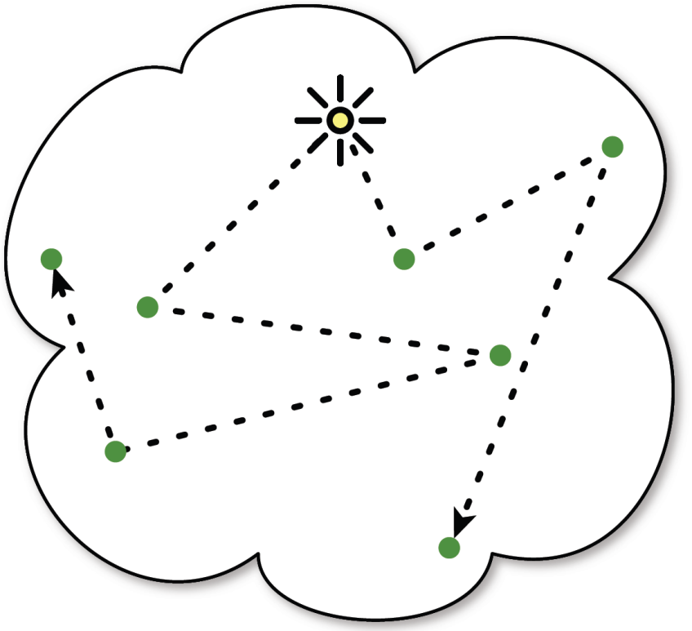
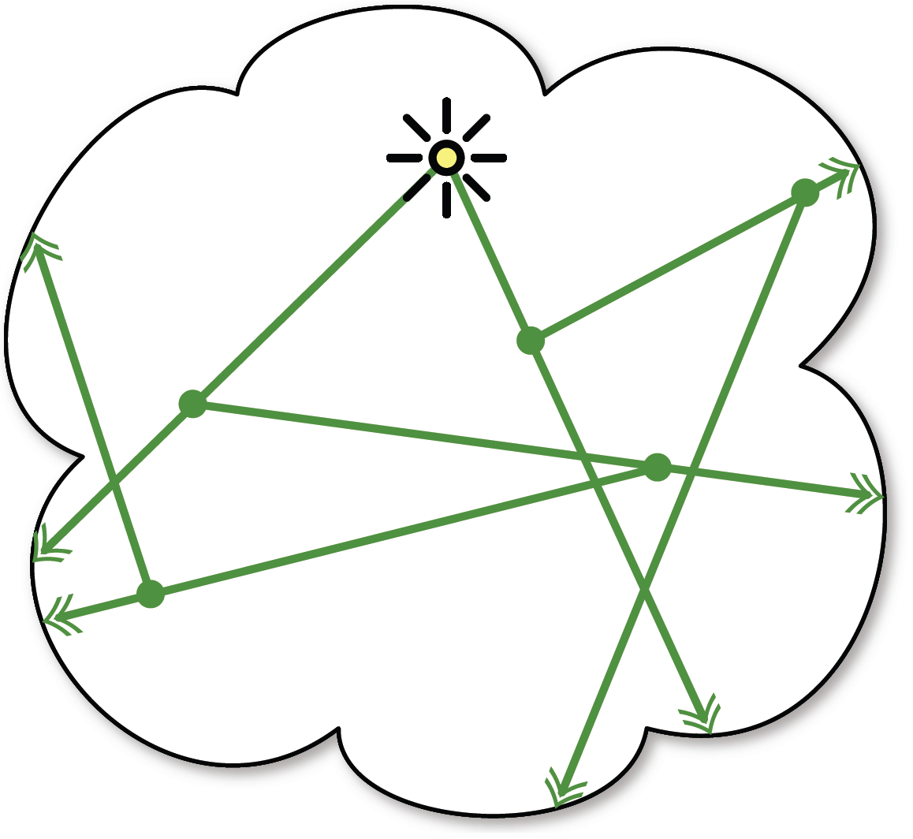
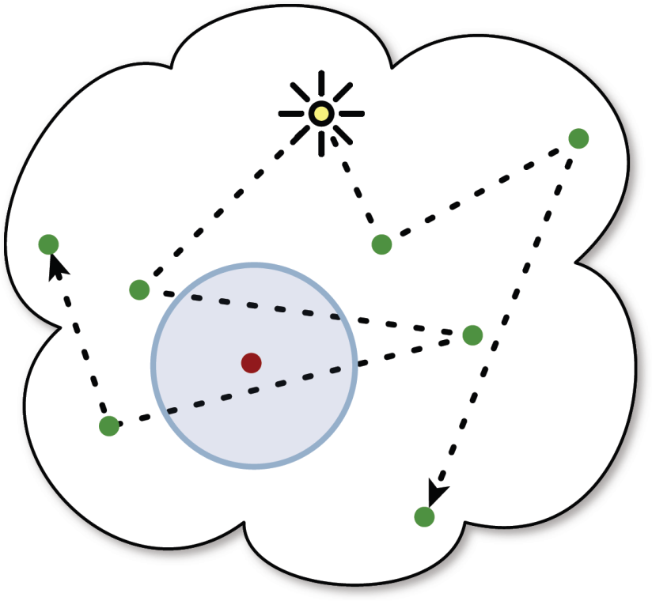
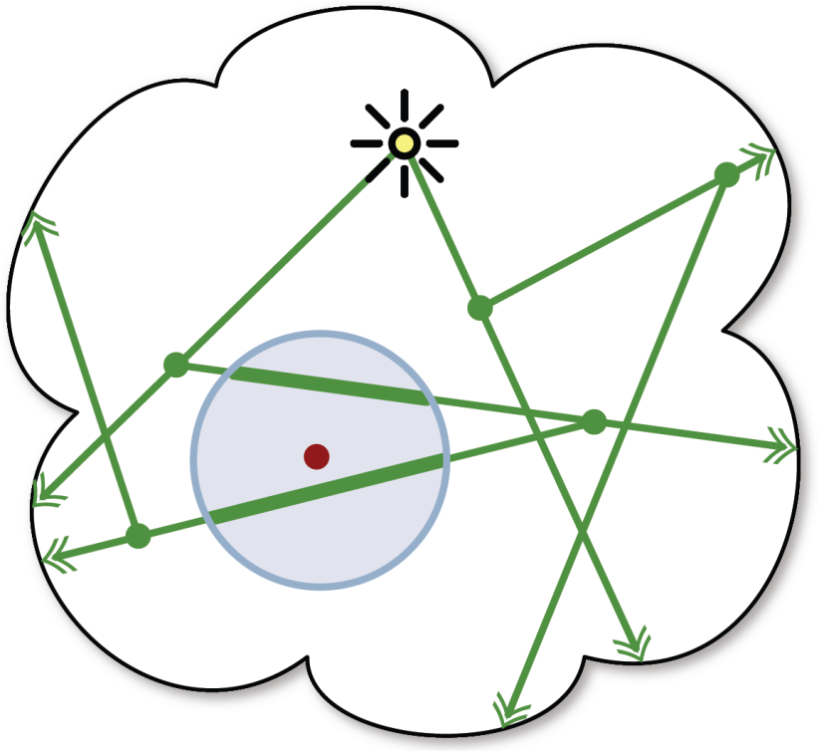
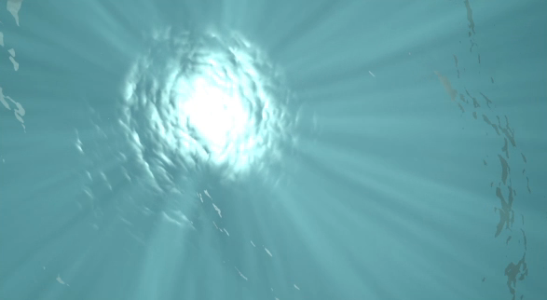
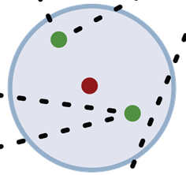
Sketching Abstraction – Photon Beams
*
Photon mapping based extension
* see our talk tomorrow in Volumes & Photons
Notes:
Many techniques are capable of rendering physically-accurate shading due to participating media, like the intricate scattering light through the ocean in this underwater scene.
One such popular algorithm is volumetric photon mapping,
where, in a first pass, photons (visualized in green here) are shot from the light source, scattered in the media, and are deposited in 3D.
In a second pass at render time, the intensity of the pixel in red is estimated using the local photon density.
We build on a new extension to this approach, called Photon Beams, that stores the paths the photons take instead of their locations.
With photon beams in the media, we can get much more accurate estimates of pixel intensity. For example, in this tricky situation, volumetric photon mapping on the left does not find any photons near the red pixel. Photon beams, on the right, gives a more accurate result by implicitly increasing the photon density, where appropriate, in the scene. For more details on this work, please attend our talk tomorrow in the Volumes & Photons session at XX o’clock. We’ve chosen to use Photon Beams as our 3D lighting primitive: let’s discuss this in more detail.
=====================================================
1. Ocean rendering (with citation): “there exist many approaches for rendering physically-accurate participating media, such as this sequence with light scattering underwater.”
2. One popular algorithm, capable of generating these types of results, is Volumetric photon mapping
3. <explain volumetric photon mapping and beams 101>
4. We use photon beams as our rendering primitive and extend them to meet the needs of artists
still need to talk about two passes, but don't need to sell photon beams... "it's a new technique that builds upon VPM“
- forget about "density"
- kill most of the animation of VPM->PB... keep (and animate) last comparison image
==============
can just say: "there are a lot of good algorithms, there just happens to be one that best suits our approach... see details tomorrow"
===================== OLD SIGGRAPH Nano Text =======================
We base our approach on a new extension to Volumetric Photon Mapping, called Photon Beams. Later on I will describe how Beams can be tailored into an intuitive lighting primitive for art-directable volumetric lighting effects.
While the mathematical details of Photon Beams are not the focus of our talk, rendering buffs can attend our talk tomorrow in session XYZ that will overview the mathematical formulation of photon beams and further discuss their benefits.
I’ll begin with a high-level overview of VPM, and introduce the idea of Photon Beams and why they’re important.
……

Slide 12
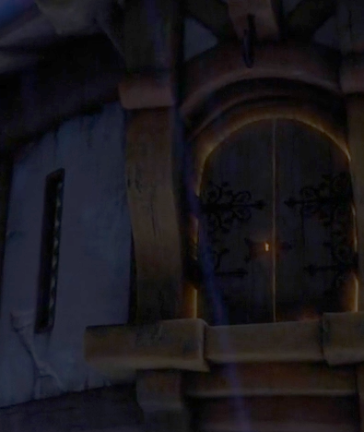
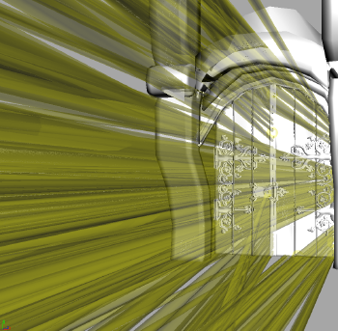
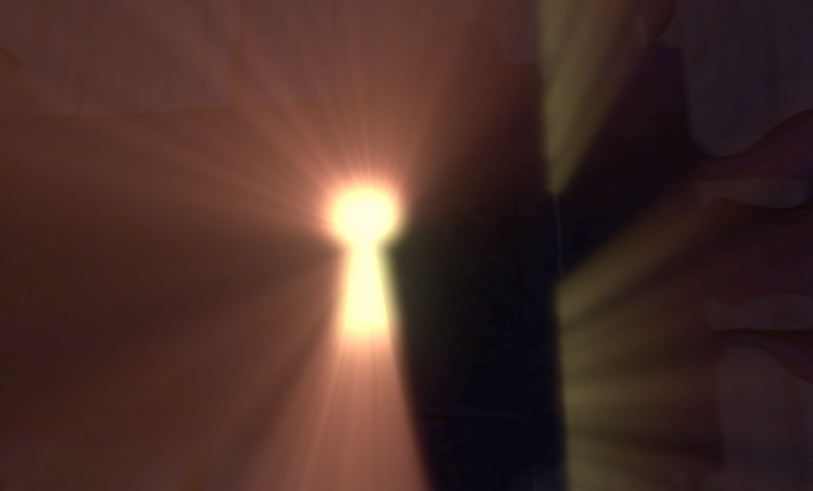
Beams as an 3D Artistic Abstraction
Artists sketch streaks of light in volumes
  Beams are a 3D analogue to this streak primitive
© Disney Enterprises, Inc.
Beams simultaneously represent form and light in a volume
Notes:
In the traditional volumetric design workflow, artists sketch streaks of light in 2D.
Beams form a powerful 3D analogue to this streak primitive, allowing artists to directly translate their 2D streak sketching skills to 3D modeling of beams.
Here, we visualize beams of light, created using standard 3D modeling tools, coming out of a keyhole and around the cracks of a door.
Once shaded, these beams simultaneously capture the form and lighting within a volume of participating media.
=======================================================
THIS SLIDE: ok, I just introduced beams. Now, why are beams a good representation. Artists draw streaks of light.
MAIN POINT TO SELL: we have beams of light, instead of blotches of points ➔ tie to sketching
artists think about drawing these streak of lights (show screenshot of ocean)
Reference ocean example
- make it clear that the (first) left image is the Maya/modeling view
not "limitations", but “challenges”
Not in Tangled Teaser

Slide 13
Requirements and Solutions
Artist wish list for a volume lighting system:
1. Integrate into production pipeline
Use existing tools; don’t re-invent the wheel
2. Expose flexibility with programmability
Model will leverage DSLs
3. Mimic traditional volumetric design abstractions
Need analogues for sketching, animation, and shading
4. Support physical and non-physical volume effects
Notes:
The last requirement for our system is that we support both physical and non-physical effects. We will satisfy these two remaining requirement by modifying the original photon beams algorithm.

Slide 14
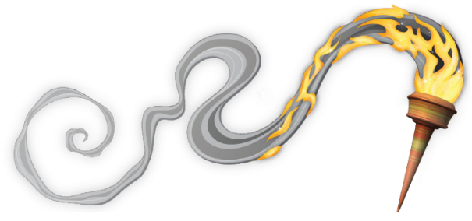
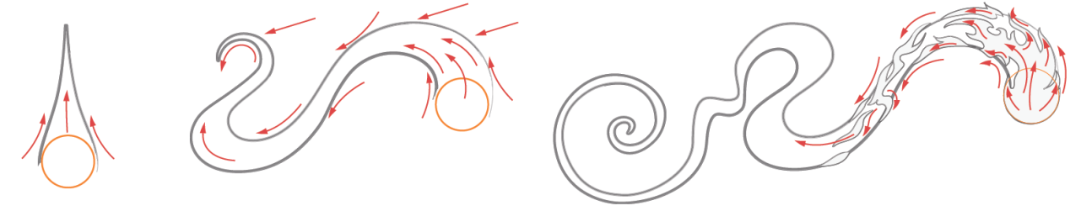
Bending and Breaking the Laws of Physics
What needs to change in the photon beams approach?
+
Modeling
Shading
These steps map to the photon beam passes
Need to enable artists to bend or break physics
Notes:
We’ve seen how beams can be thought of as 3D analogues to the 2D sketching primitives artists, but what practical changes do we have to make to the photon beams approach before it become a powerful tool for art-directable volumetric shading?
Taking a step back, we can segment the traditional volume sketching workflow into two stages: a modeling step, where artists define the lighting, form and evolution of the media,
and
a shading step, where some shading model is applied to this modeled data in order to render a final image.
These two stages map directly to the beam shooting and beam shading passes of the original photon beams approach.
We need to modify these two stages to allow artists to bend, or sometimes outright break, the physical laws of light transport.
=======================================================
THIS SLIDE HAS TO CHANGE:
Theme = in what ways does photon beams have to change
we add knobs for artists to break/tweak the original photon beams algorithm
MAKE THIS CLEAR: after this slide, there are TWO main threads:
1. making modeling more general,
2. making shading more general.
Start with SHADING....
Modeling + Shading Phases
Beams as a volumetric lighting primitive
Some shading model

Slide 15
Controllable Volume Modeling
Notes:
We will start by discussing how the beam shooting phase is modified.

Slide 16
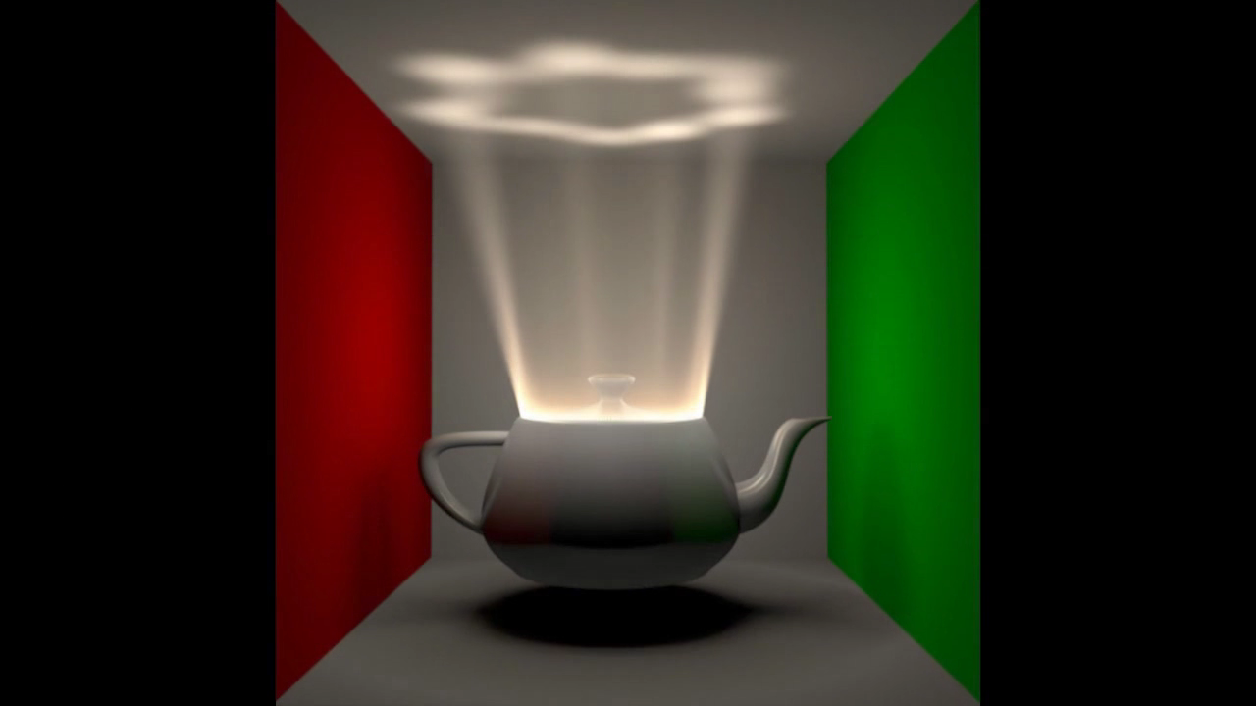
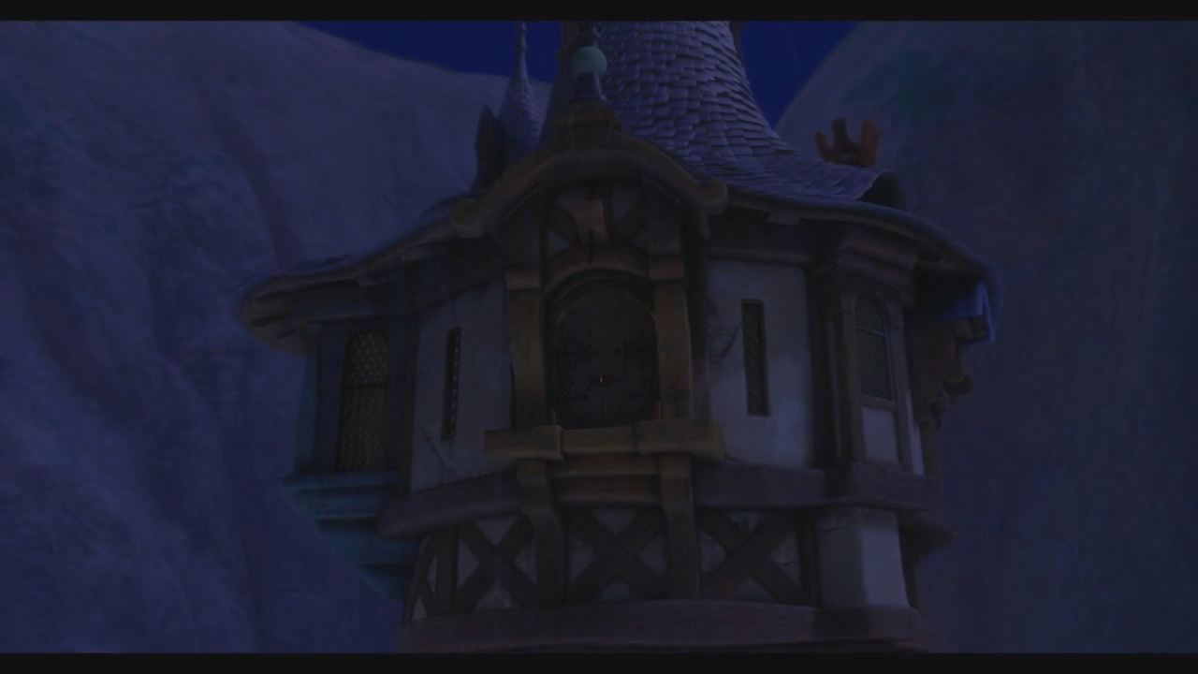

Controllable Volume Modeling
Art-directable modeling: build on existing tools
  Artists seed and programmatically evolve beams
  Side-step difficult sampling problems
    Curved beams
© Disney Enterprises, Inc.
Notes:
In the physically-accurate approach, beams are shot from light sources and allowed to scatter in the media, spawning new beams.
However, for art-directable beam modeling, we rely on existing 3D tools and allow artists to seed and programmatically evolve beam geometry in the scene.
We noticed that, by giving direct control of the beam generation to artists, we can create effects that would otherwise require a lot of computation.
For example, in the case of the teapot or keyhole scenes here, generating similar beam distributions using a physically-accurate simulation would require tedious manual tweaking of light sources in order to get the beams to scatter out of the tiny cracks, let alone in the manner required by art direction.
In this example, you can imagine sprinkling particles on the surface of the water, evolving these particles as the surface animates, and using them to generate beams that point through the ocean towards the viewer.
Lastly, giving artists direct control over the beam geometry allows for the creation of non-physical beam geometry, such as the curvy beams used in this shot from Tangled.
==================================================
Start with: WITH PHOTON-BEAMS, photon shooting is the modeling
-- beam generation can be physically-based, *or*, they can use BLAH ...
- talk about streaks
for teapot: in the traditionally method, you place a light source in here.... we give artist direct control over the lighting (tie that into "manually solving difficult sampling problems.")
- add: can easily manipulate beams, instead of manipulating photon points, more expressive primitive
Teapot and doorknob scene: solve difficult sampling problem!
Sprinkle particles
Evolution computed with tools they’re familiar with (requirement!)
DON’T SAY “many many”
Don’t say “manually”

Slide 17
Requirements and Solutions
Artist wish list for a volume lighting system:
1. Integrate into production pipeline
Use existing tools; don’t re-invent the wheel
2. Expose flexibility with programmability
Model will leverage DSLs
3. Mimic traditional volumetric design abstractions
Need analogues for sketching, animation, and shading
4. Support physical and non-physical volume effects

Slide 18
Controllable Volume Shading
Notes:
Next we’ll discuss how we modified beam shading in our system.

Slide 19
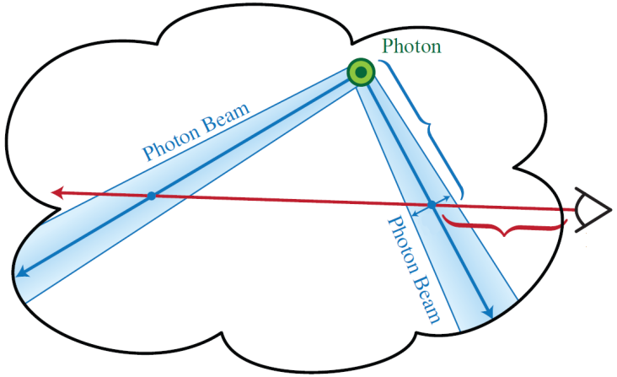

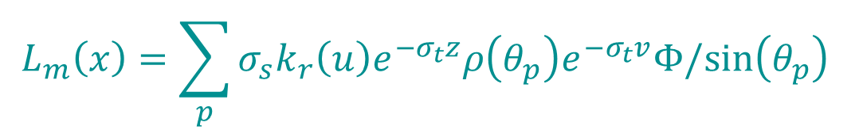









An Abstract Volumetric Shading Model
$$L_{m}\left(x\right)=\sum_{p}{σ_{s}k_{r}\left(u\right)e^{−σ_{t}z}ρ\left(θ_{p}\right)e^{−σ_{t}v}Φ/sin\left(θ_{p}\right) }$$
Distill beam shading into its core behavior:
$$L_{m}\left(x\right)=$$
$$\sum_{p}{ }$$
$$f_{b}(v)$$
$$f_{e}(z)$$
$$f_{f}(θ_{p})$$
$$f_{t}(u)$$
  Color changes along the beam
  Color changes towards the eye
$$v$$
$$θ_{p}$$
  Color changes with the view angle
$$u$$
$$z$$
  Color changes with the beam thickness
Notes:
In physically-based beam shading, as will be discussed in our talk tomorrow, beams are shaded using the following radiance estimate.
Instead of forcing authors to familiarize themselves with the intricate details of this mathematical formulation, we took a step back and tried to distill the process of beam shading into its core behavior.
Given the simple scene on the right, with two beams and a view ray, we noticed that
the shade at a point x due to a single beams is the product of four terms:
One that dictates how color changes along the length of the beam, v
with distance towards they eye, z
How color changes with the viewing angle, \theta_z
and how color changes with the beam thickness, u
To compute the final shade, we sum over all beams in the scene.
This general shading model is easy to understand and modify. It’s a meaningful abstraction abstration that focuses on the high-level behavior of volumetric shading, while also encapsulating the physically-accurate model.
==============================================
Start off with: "in physically-based shading, we have this crazy expression (show BxB1d math), but don't worry about the details... we take a step back, distill these behaviors, and use this general model that we develop.“
→ don’t go into detail about the BxB1D equation… just show it briefly and say that it isn’t easy to understand
“easy to understand”
mention that this encapsulates physically based model, its just an abstraction that focuses on the high-level behaviors
<missing> - need to emphasize that we can still render all the physically-accurate things... it's just a high-level factorization
- levers/dials
- we expose "high-level behaviors" instead of parameters

Slide 20

Editing Physically-Based Volume Effects
Physically-based shading effects may be desired
Keep physically accurate shading model settings
Edits fully described by light & media parameters
Problem: editing media parameters is not intuitive
Notes:
……
<at the end: give the motivating example with albedo and the effects of specifying the scattering coefficient directly>
===========================================
HERE: should show an image of a beam of light that changes color (for the analogy: render a single beam)

Slide 21
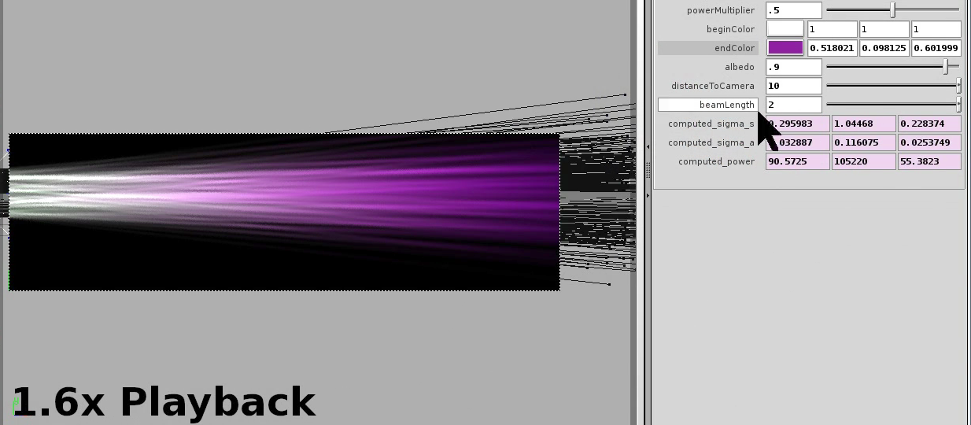
Editing Physically-Based Volume Effects
We allow goal-based editing
User specifies colors → system computes parameters
(see paper for details)
Notes:
……………….

Slide 22
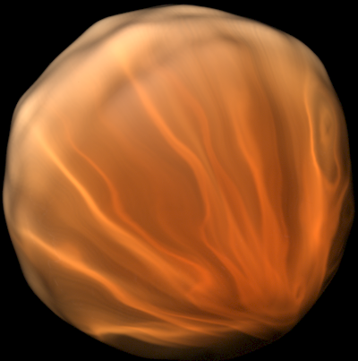
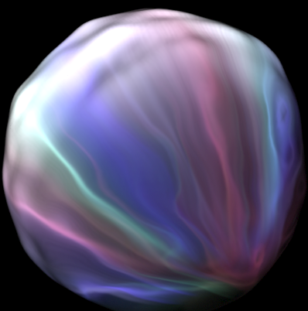
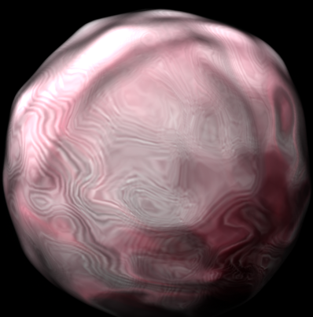
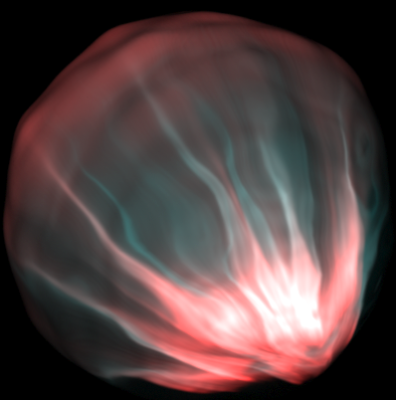
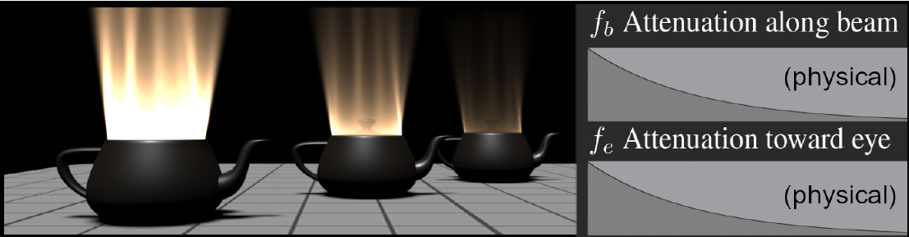
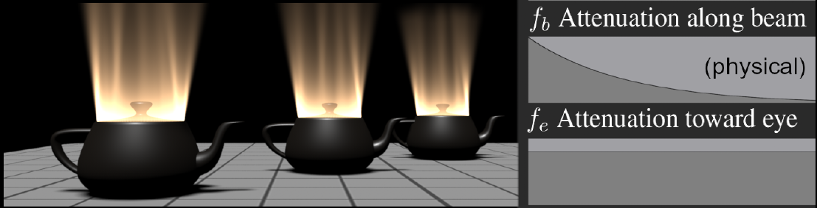
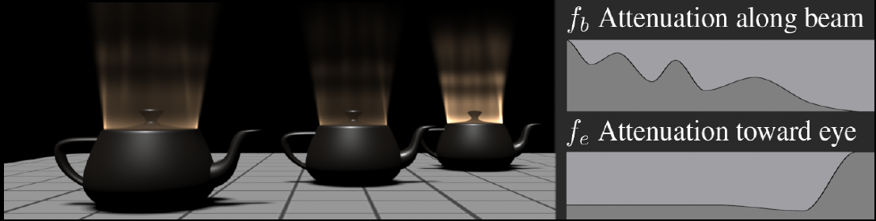
Non-Physical Volume Shading
The abstract model extends beyond this
  Bend physics, increase convenience
  Explore artistic manipulation
[Scene courtesy Bruce Walter]
Notes:
Our general shading model allows for much more expressivity. For one, it allows artists to bend physics however they please.
In some cases, these tweaks can be minor: <walk through the teapot eye function example>
In other cases, artists can experiment with artistic settings of the terms in the shading model. For example here, changing the attenuation along the beam and towards the eye using these spline settings.
In the physically-accurate example, a bumpy sphere is filled with a scattering material (such as amber), and when light out side the sphere refracts at the surface and scatters inside the object, it generates the intricate lighting patterns we see.
By making simple changes to the terms in our shading model, in this case programmatically using Renderman, artists can explore a wide range of non-physical shading effects for this scene.
==========================================
“BUT OUR MODEL IS A LOT MORE Expressive... here are some more tweaks”
The beams in this initial rendering use physically-accurate settings of the attenuation functions along the length of the beam, as well as towards the eye. In an artistic workflow, this can cause problems since the shading will change whenever the artist moves a beam relative to the viewpoint.
Our shading model can easily allow artists to alleviate such workflow problems, in this case by removing the exponential attenuation towards the eye.
--> explain bumpy sphere more... caustics from a point light source, scaterring internally, bumpiness...

Slide 23
Requirements and Solutions
Artist wish list for a volume lighting system:
1. Integrate into production pipeline
Use existing tools; don’t re-invent the wheel
2. Expose flexibility with programmability
Model will leverage DSLs
3. Mimic traditional volumetric design abstractions
Need analogues for sketching, animation, and shading
4. Support physical and non-physical volume effects
Generalized beam modeling and beam shading
Notes:
Let’s review the requirements of our system.
For the third item, we have shown how beams can be used as 3D analogues of the sketching, animation and shading stages of the traditional design workflow.
We also showed how controllable beam modeling, and our general, programmable shading model generalizes the photon beams approach to handle both physical and non-physical volume effects. Now we’ll show some results generated using our system.

Slide 24
Results
Notes:
<Talk over video:>
Light from beams also affects the surfaces
- artists don't want the media to affect the surfaces... they want media to be additive
-- Mention: difference between non-physical and accurate: you can affect the surface shading (attenuation), or you can make it additive
-- incorporate: artists don't want media to affect the scene
Here we see the animated, curvy beams generated by seeding and evolving particles using a fluid simulation, and then chaining particles together to form the beams
In the final, shaded version of this sequence, we have another example of how beams act effectively as secondary light sources: note the reflection of the beams in Rapunzel’s eyes, as well as the light they cast onto the scene geometry

Slide 25
Conclusions and Future Work
Beams: expressive volume lighting primitives
  Using beams with existing tools accelerates adoption
Identified the core behaviors of volume shading
  Led to a novel, general shading model
Future work
  UI for physically-based media editing
  Combining with homogeneous volumes
  Quantitative user-study: fine-tune the design workflow
Notes:
We show that beams are an expressive volumetric lighting primitive
- <question: why isn't there an example of "non-streaky volume effects"> FUTURE WORK: non-streaky. we develop very specific interaction metaphors for these types of streaky/caustic effects... model is abstract enough, but you need new metaphors... existing diffusion--based editing approaches may be suitable for these types of non-streaky effects. Blobs + use our shading model.
- consider adding a slide: with and without physically-based media/surface coupling

Slide 26
Thank you
Questions?

Slide 27


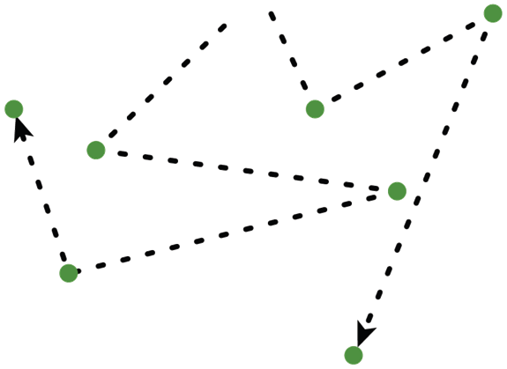
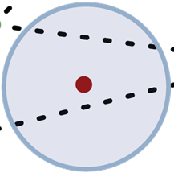
Shading Volumetric Media – Photon Beams
*
Volumetric Photon Mapping
Photon Beams – increase lighting density
  2 pass algorithm: photon shooting + gathering
* see our talk tomorrow in session XYZ
Notes:
1. Ocean rendering (with citation): “there exist many approaches for rendering physically-accurate participating media, such as this sequence with light scattering underwater.”
2. One popular algorithm, capable of generating these types of results, is Volumetric photon mapping
3. <explain volumetric photon mapping and beams 101>
4. We use photon beams as our rendering primitive and extend them to meet the needs of artists
==============
can just say: "there are a lot of good algorithms, there just happens to be one that best suits our approach... see details tomorrow"
===================== OLD SIGGRAPH Nano Text =======================
We base our approach on a new extension to Volumetric Photon Mapping, called Photon Beams. Later on I will describe how Beams can be tailored into an intuitive lighting primitive for art-directable volumetric lighting effects.
While the mathematical details of Photon Beams are not the focus of our talk, rendering buffs can attend our talk tomorrow in session XYZ that will overview the mathematical formulation of photon beams and further discuss their benefits.
I’ll begin with a high-level overview of VPM, and introduce the idea of Photon Beams and why they’re important.
……

Slide 28
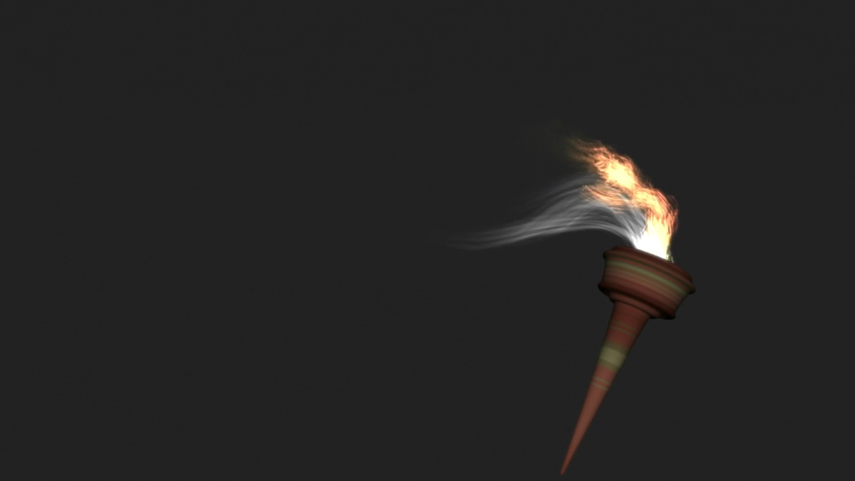
Results
Notes:
Give the back story for the project:
Introduced late in the summer 2010
Movie released in Fall 2010
We were still able to integrate it into their pipeline and get it used in two pivotal scenes
Give back story of the keyhole trailer scene
Show old result, then show new result

Slide 29
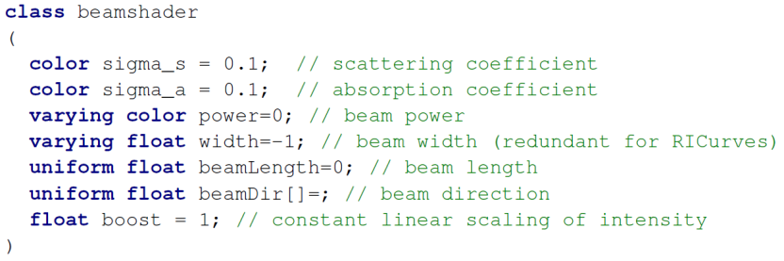





Non-Physical Participating Media – Shading
Recall requirements:
  Supporting physical and non-physical shading
  Exposing flexibility through programmability
Implemented in Renderman and Houdini
  Modularized implementation; familiarity
$$L_{m}\left(x\right)=\sum_{p}{ }$$
$$f_{b}(v)$$
$$f_{e}(z)$$
$$f_{f}(θ_{p})$$
$$f_{t}(u)$$
Physical shading is a subset of our general model
(see paper for details)
2 birds, 1 stone: integrated into pipeline
See supplemental material for source code
Notes:
Give a motivating example/analogy: surface shading
Need Normal, outgoing view direction
Albedo
Reflectance model

Slide 30
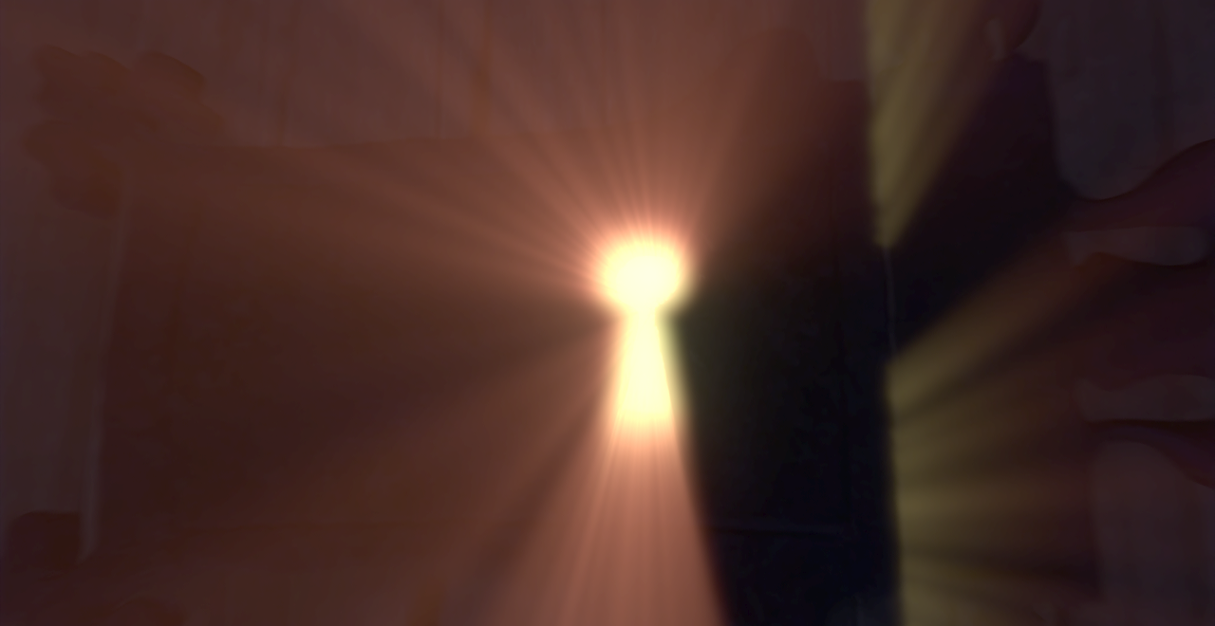
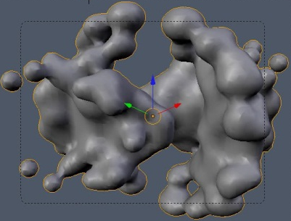
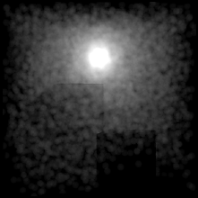


Beams as an Artistic Abstraction
A representation to match this artistic abstraction
  Note: density & lighting are not explicitly separated
metablobs
photons
grids
particles
© Disney Enterprises, Inc.
Beams can represent both the form and light in a volume
Notes:
Lead out with: what do we need to do to physical beams to make them more artist-friendly?

