Slide 1
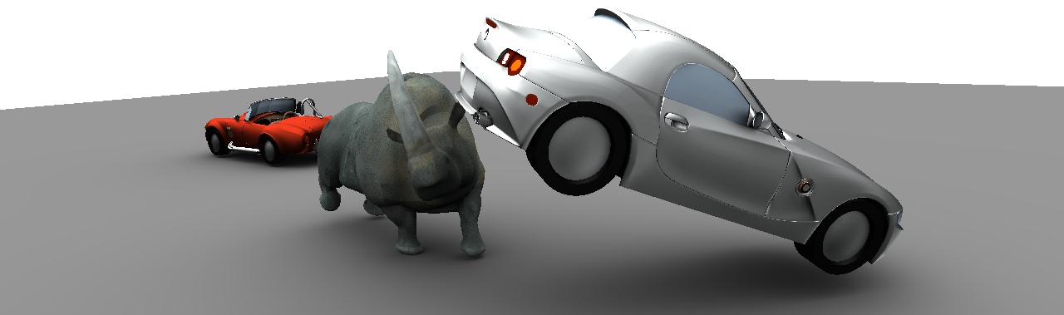
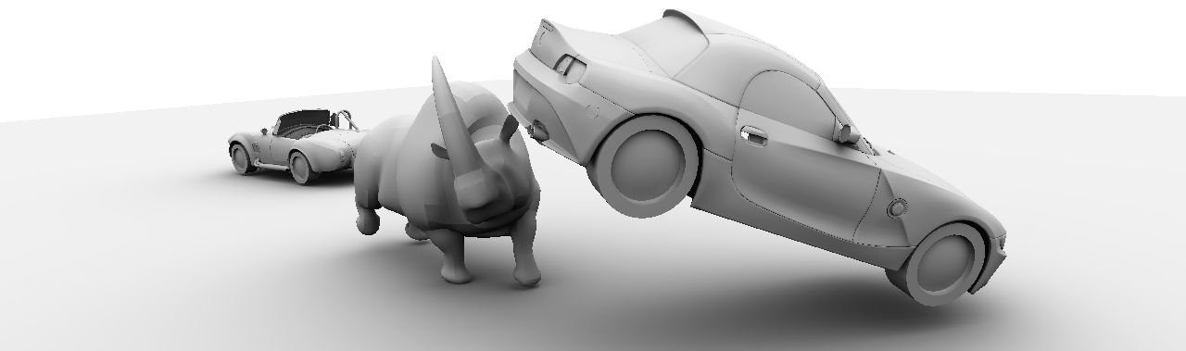



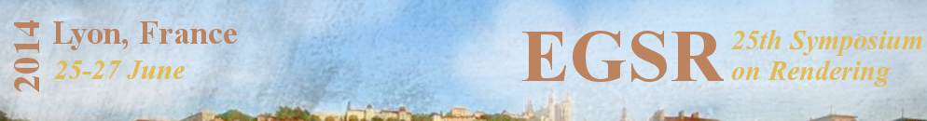
Visibility Silhouettes for Fast and Accurate Illumination Integration
Derek Nowrouzezahrai
Ilya Baran
Kenny Mitchell
Wojciech Jarosz
Notes:
Hi, Thanks for attending the last session of the week.
As Naty said, here are the co-authors and their current affiliations of this work done under Disney Research Zurich
Visibility is often a challenge in rendering.
It’s a common bottleneck in the render pipeline
and also a source of noise & aliasing.
So, let me begin our presentation by defining our specific problem statement.

Slide 2
Problem Statement
Integration of spherical visibility-masked functions
Direct Illumination from Environment Maps
  All-frequency shadows and reflections
  Ignore all indirect effects
Notes:
In essence, we are dealing with the integration over the sphere of visibility-masked functions.

Slide 3
Problem Statement
Integration of spherical visibility-masked functions
Direct Illumination from Environment Maps
  All-frequency shadows and reflections
  Ignore all indirect effects
Notes:
In essence, we are dealing with the integration over the sphere of visibility-masked functions.
So, Given a spherical function f(w)

Slide 4
Problem Statement
Integration of spherical visibility-masked functions
Direct Illumination from Environment Maps
  All-frequency shadows and reflections
  Ignore all indirect effects
Notes:
In essence, we are dealing with the integration over the sphere of visibility-masked functions.
So, witha spherical function f(w)
we want to efficiently determine the corresponding binary visibility mask

Slide 5
Problem Statement
Integration of spherical visibility-masked functions
Direct Illumination from Environment Maps
  All-frequency shadows and reflections
  Ignore all indirect effects
Notes:
…
And only Integrate the subdomain regions that are visible
So, here, we’re only interested in the visible regions for direct environment illumination,
recovering the effect of all-frequency shadows and occluded environment reflections
But ignoring all indirect effects

Slide 6
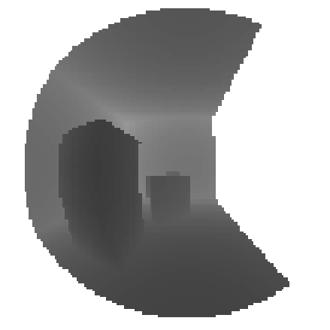
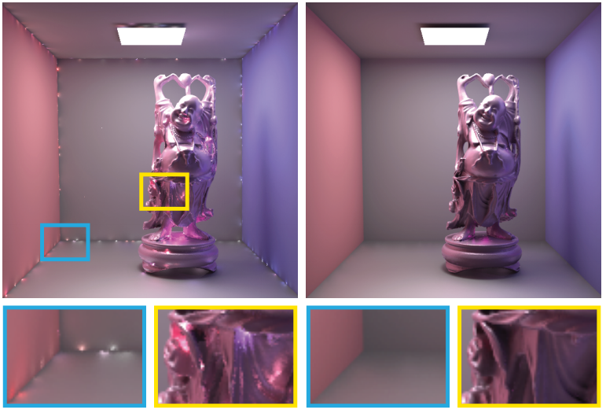
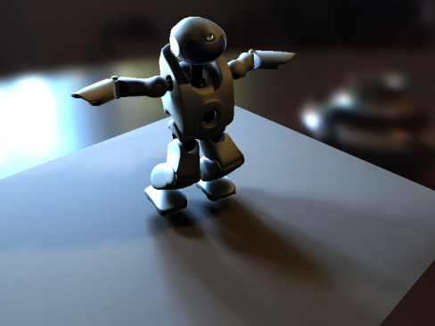
Traditional Solutions
Rasterization-based solutions
  VPLs / Many-light approach
Shadowing difficult:
  many shadow maps? many shadow volumes?
[Annen 2008, Ritschell 2008]
[Dachsbacher 2013]
Notes:
If we consider the problem of evaluating integration solutions, there are several choices, one family of solutions is rasterisation.
For traditional rasterisation based approaches.
we have seen virtual point lights / many light sources examples,
such as Annen/Dong et al’s use of convolution shadow maps
, imperfect shadow maps, clustered visibility, etc.
But to recover aliases free with complex environmental spherical integration it’s arguably still too costly for shadow map and Shadow Volumes approaches
So can we find an alternative way?

Slide 7
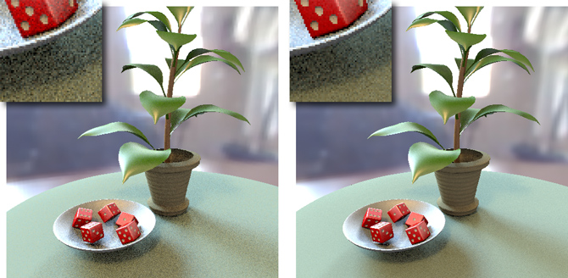
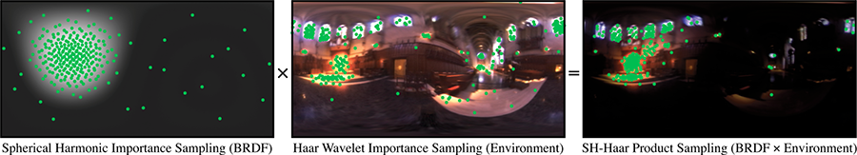
Traditional Solutions
Ray-tracing solutions
  Importance sampling
Noise
Difficult to predict required sampling rate
[Jarosz 2008]
[Clarberg 2008]
Notes:
Ray tracing is another common family to resolving visibility when integrating functions over the sphere.
typically we use importance sampling to be more efficient in direct illumination evaluation
and we refer to Kartic’s paper yesterday on error analysis of sampling direct illumination
but we do acknowledge there’s more to be done here on predicting the required sampling rate
and the time to converge to a noise free result

Slide 8
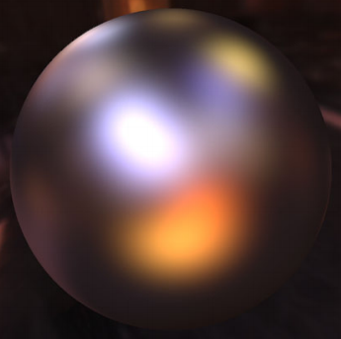
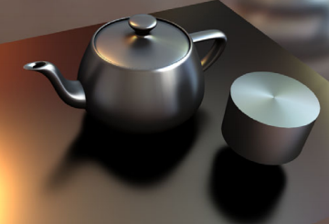
Traditional Solutions
Hybrid solutions
  Precomputed Radiance Transfer
Fast reconstruction/rendering
Basis approximation
[Sloan 2002]
[Xu 2013]
Notes:
Further, one might approach the problem with a hybrid ray/raster approach
such as, pre-computing occluded radiance transfer with spherical harmonics,
or anisotropic spherical Gaussians for fast reconstruction/rendering with various bases
but still these are approximate bases, and still indeed need a visibility evaluation in the pre-processing stages anyway.
Our method can also be applied to the preprocess stage of these approaches.

Slide 9
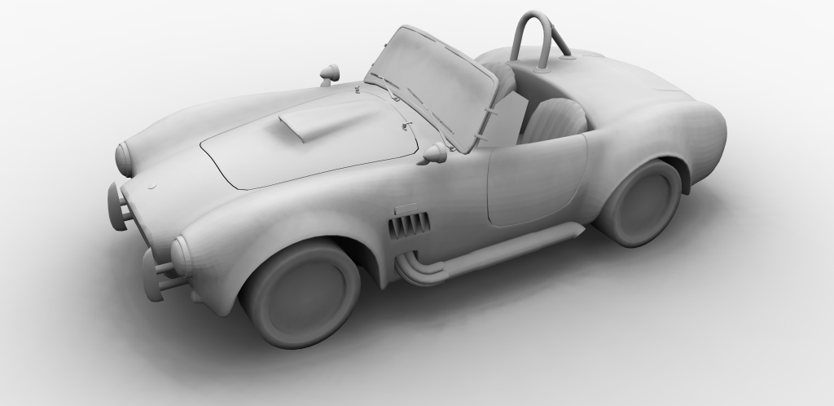
Our Idea in a Nutshell
Traditional numerical integration point-samples visibility-masked functions
  e.g. shooting rays or using (many) shadow maps
Notes:
So onto an overview of _our_ idea,
Traditional approaches are focused around point sampling.
Generally is near-impossible to come up with an analytic form of the visibility function due to the variety of geometry configurations
, and so these works try to point sample visibility to the determine regions of interest in the integral.
As you can see point samples can lose important information and accuracy without many of them

Slide 10
Our Idea in a Nutshell
Completely avoid any ray-tracing:
Notes:
We however avoid ray tracing and raster point visibility sampling, by addressing the core problem directly. [click]
That is, finding the regions over sphere where visibility changes [click] _geometrically_ [click]
Here we show the visible environment as red regions
and green silhouettes in view from the given shade point, here.

Slide 11
Our Idea in a Nutshell
Completely avoid any ray-tracing:
Resolve spherical visibility
Notes:
We however avoid ray tracing and raster frustum aligned point visibility sampling, by addressing the core problem directly. [click]
That is, finding the regions over sphere where visibility changes [click] _geometrically_ [click]
Here we show the visible environment as red regions
and green silhouettes in view from the given shade point, here.

Slide 12
Our Idea in a Nutshell
Completely avoid any ray-tracing:
Resolve spherical visibility geometrically
Notes:
We however avoid ray tracing and raster frustum aligned point visibility sampling, by addressing the core problem directly. [click]
That is, finding the regions over sphere where visibility changes [click] _geometrically_ [click]
Here we show the visible environment as red regions
and green silhouettes in view from the given shade point, here.

Slide 13
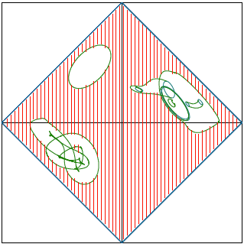
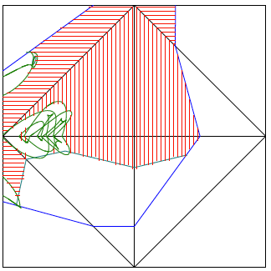
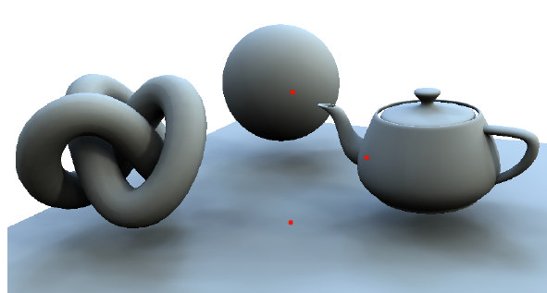
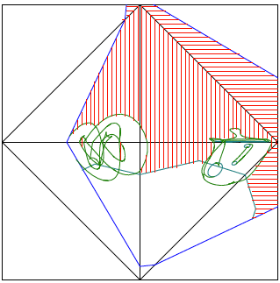
Our Idea in a Nutshell
Completely avoid any ray-tracing:
Resolve spherical visibility geometrically
Notes:
Here we show the visible environment as red regions
and green silhouettes in view from the given shade point, here.

Slide 14
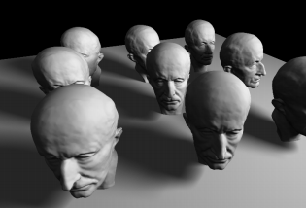
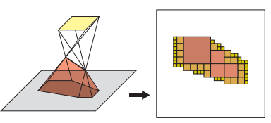
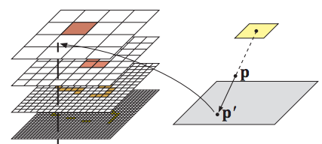
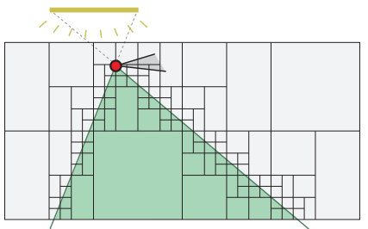
Related Work
Silhouette integration for area lights
  Efficient occluder silhouette search for soft area light shadows using penumbra wedges and hemicube/octrees
We refocus this work to the spherical domain and environment lighting
[Laine05, Lehtinen06]
Notes:
Of course, there is some related work on this geometrical approach.
Previous work from Samuli, Timo, Jaakko and others have looked at light sample hierarchies for area sources, using Penumbra wedges and hemicube/octrees,
but this doesn’t easily generalize to spherical visibility where you’d need a hemicube for each shading point or texel in the envmap

Slide 15
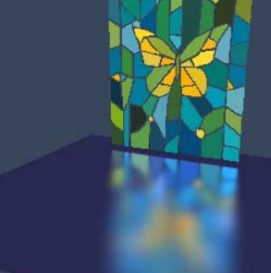
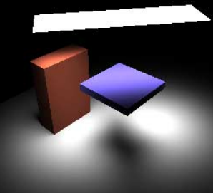
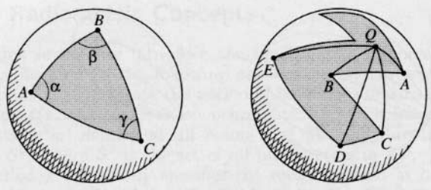
Related Work
Analytic integration for shading
[Arvo 1995]
Notes:
Ok…
Once visible regions are determined, we need to integrate our spherical functions over these unoccluded regions.
Here we are inspired by Avro’s pioneering work on integrating many different types of shading function over polygonal domains.

Slide 16
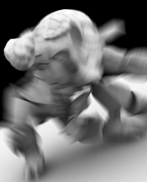
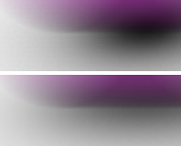
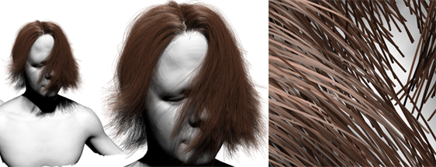
Related Work
Line sampling and semi-analytic integration
We sample along spherical isolines, not points
[Gribel 2011]
[Barringer 2012]
Notes:
Semi-analytic approaches have also been proposed recently.
For example, Thomas highlighted Gribel’s work on Wednesday.
Often times point sample approaches can be simplified to line sampled visibility.
In our approach, we also perform line sampling, except we do so over the sphere,
to integrate over spherical iso-lines across the environment as opposed to spherical _directional_ samples.

Slide 17
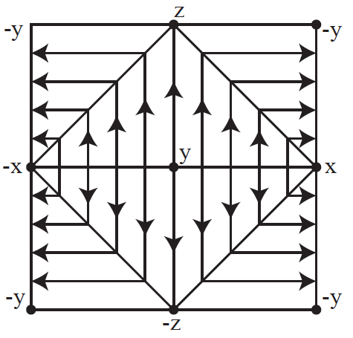
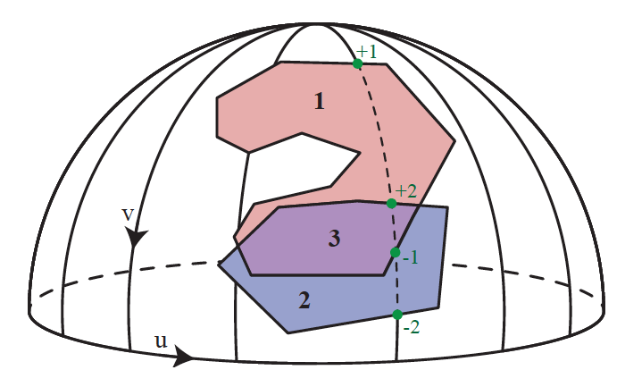
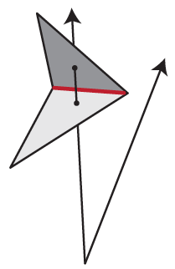
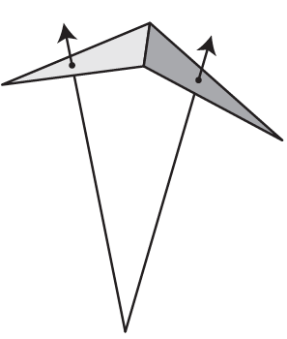
Overview of our Technique
Spherical silhouettes and depth complexity
  Dual-space silhouette search
Spherical contour edge detection
Final semi-analytic integration
  Spherical parameterization choice
Notes:
We first want to determine the visible regions over the sphere and integrate.
So in overview, for our technique, we consider
- spherical silhouettes and their depth complexity function
With a dual-space silhouette search (sounds more complicated than it is)

Slide 18
Overview of our Technique
Spherical silhouettes and depth complexity
  Dual-space silhouette search
Spherical contour edge detection
Final semi-analytic integration
  Spherical parameterization choice
Notes:
And we’re going to show that by detecting spherical contours,
we can identify these regions more efficiently.

Slide 19
Overview of our Technique
Spherical silhouettes and depth complexity
  Dual-space silhouette search
Spherical contour edge detection
Final semi-analytic integration
  Spherical parameterization choice
Notes:
And once these regions are determined we perform
Our Semi-analytic integration
And we’ll highlight, a key efficiency of the method is our spherical parameterization choice.

Slide 20
Overview of our Technique
Spherical silhouettes and depth complexity
  Dual-space silhouette search
Spherical contour edge detection
Final semi-analytic integration
  Spherical parameterization choice
Applications and Results
Ambient occlusion | Precomputed Radiance Transfer
Image relighting | Material editing
Notes:
Finally, we’ll provide a recipe for a range of application types
to illustrate ways to exploit the method for different problems in rendering,
such as AO, PRT, Image relighting and a material edit

Slide 21
Silhouettes and Depth Complexity
Consider the spherical projection of occluders, both simple and complex, about a shading point
Notes:
So, let’s look at these spherical silhouettes and the overlap function process
Consider a simple scene with two occluders and their projection onto the sphere.
we have dual-space silhouette search, which accounts for _both_ simple and complex occluders__
Here pink region is a thin planar surface, and blue is a closed object

Slide 22
Silhouettes and Depth Complexity
Consider the spherical projection of occluders, both simple and complex, about a shading point
Notes:
In an example case, we have the following configuration

Slide 23
Silhouettes and Depth Complexity
The depth complexity function (DCF) is defined as
the number of times a ray intersects an object
Notes:
Consider a ray that starts at the centre of projection at the shade point
and is traced over all directions on the sphere.
The depth complexity function (DCF) then,
is a spherical function that is defined as the number of times a ray intersects at each direction

Slide 24
Silhouettes and Depth Complexity
The DCF generalizes binary (spherical) visibility
Notes:
And this DCF is processed over the sphere.
For example
1 intersection occurs on the planar surface
2 intersections occur on a closed object
3 intersections occur here where they overlap

Slide 25
Silhouettes and Depth Complexity
The DCF generalizes binary (spherical) visibility
  visibility can also be easily determined given the DCF
Notes:
The DCF generalizes binary (spherical) visibility
visibility can also be easily determined given the DCF
All non-zero regions of DCF correspond to the zero region of visibility

Slide 26
Silhouettes and Depth Complexity
Key observations:
  visibility changes at silhouette crossings
Silhouettes are defined using a global condition
Notes:
This brings us to one of our key observations
This gives us a piece-wise constant _binary_ function of visibility changes.
With the key observation that visibility changes only at silhouette crossings defined using a global condition

Slide 27
Silhouettes and Depth Complexity
Key observations:
  DCF changes at contour crossings
Contours are defined using a local condition
Notes:
And _DCF_ which is also a piece-wise linear function, only changes identify the contours using a local condition, which are therefore much easier to find than silhouettes.

Slide 28
Silhouettes and Depth Complexity
We discretize the DCF along spherical isolines
  we will later perform line-integrals over these spherical arcs
Notes:
We’re going to use contours to construct our DCF and from this we determine visibility.
So in this process we discretize the DCF along spherical isolines
To find the visible spherical arcs to perform line-integrals over

Slide 29
Silhouettes and Depth Complexity
The DCF can be computed, without ray-tracing, by counting contour crossings
Notes:
By simply counting contour crossing events without ray tracing.

Slide 30
Silhouettes and Depth Complexity
The DCF can be computed, without ray-tracing, by counting contour crossings
Notes:
If we follow one isoline, we increment upon the first contour

Slide 31
Silhouettes and Depth Complexity
The DCF can be computed, without ray-tracing, by counting contour crossings
Notes:
Increment again at the next contour crossing of an overlapping object

Slide 32
Silhouettes and Depth Complexity
The DCF can be computed, without ray-tracing, by counting contour crossings
Notes:
Decrement at the next crossing out of the pink surface overlap

Slide 33
Silhouettes and Depth Complexity
The DCF can be computed, without ray-tracing, by counting contour crossings
Notes:
And finally decrement once more out of the blue closed object

Slide 34
DCF Tracking
How to increment/decrement the DCF? 2 cases:
Notes:
So, how do we know when and with what values to inc or dec? [click]
We consider two cases, boundary and contours. [click]
A boundary is defined as an edge the belongs to only one triangle.
When we have a defined boundary, this is where a sweep ray starts at point of projection and traverses into or out of the boundary edge
And note, if we are only dealing with planar polygons, we need only consider boundary edges. [click]

Slide 35
DCF Tracking
How to increment/decrement the DCF? 2 cases:
  boundary edges, and
  contour edges
Notes:
So, how do we know when and with what values to inc or dec? [click]
We consider two cases, boundary and contours. [click]
A boundary is defined as an edge the belongs to only one triangle.
When we have a defined boundary, this is where a sweep ray starts at point of projection and traverses into or out of the boundary edge
And note, if we are only dealing with planar polygons, we need only consider boundary edges.

Slide 36
DCF Tracking
How to increment/decrement the DCF? 2 cases:
  boundary edges, and
  contour edges
Boundary: an edge that belongs to only 1 triangle
  when a ray crosses a boundary, DCF changes by +/- 1
Notes:
So, how do we know when and with what values to inc or dec? [click]
We consider two cases, boundary and contours. [click]
A boundary is defined as an edge the belongs to only one triangle.
When we have a defined boundary, this is where a sweep ray starts at point of projection and traverses into or out of the boundary edge
And note, if we are only dealing with planar polygons, we need only consider boundary edges.

Slide 37
DCF Tracking
How to increment/decrement the DCF? 2 cases:
  boundary edges, and
  contour edges
Contour: an edge shared between a front- and a back-facing triangle
  when a ray crosses a contour, DCF changes by +/- 2
Notes:
For a contour,
that edge is shared between the front and back facing triangle
So, when a ray crosses a contour, the DCF changes by + or – 2,
since the ray will it enters or exits a closed object

Slide 38
Boundary and Contour Detection
Boundary edge detection is simple:
  boundaries do not vary over shading points; we simply identify edges belonging to only 1 triangle
Notes:
So the boundary preprocess is quite trivial,
it doesn’t vary over shading points,
We simply identify edges belonging to only 1 triangle [click]
However for a contour, front and back will vary according to point of projection,
but we want to avoid iterating over all edges exhaustively from the point of view of the shading point

Slide 39
Boundary and Contour Detection
Boundary edge detection is simple:
  boundaries do not vary over shading points; we simply identify edges belonging to only 1 triangle
Contour edges can be handled naively by:
  iterating over edges
  marking those shared between front- and back-faces (from the point of view of the shading point)
Notes:
However for a contour, front and back faces will vary according to the point of projection, and we could go through and mark all these
but we want to avoid iterating over all edges exhaustively from the point of view of each shading point

Slide 40
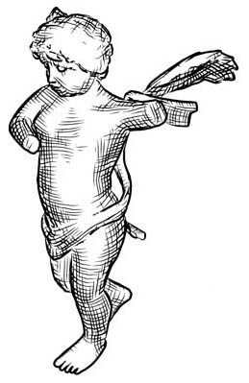
Boundary and Contour Detection
We avoid visiting all edges by adapting Hertzmann and Zorin’s fast silhouette detection [2000]
We define a dual mesh:
Notes:
and we avoid this by adapting hertzmann and zorin’s fast silhouette detection.
Their application defines a dual mesh for identifying contours in non-photorealistic rendering,
and our insight to apply it in visibility computation
So, here we define a dual mesh

Slide 41
Boundary and Contour Detection
We avoid visiting all edges by adapting Hertzmann and Zorin’s fast silhouette detection [2000]
We define a dual mesh:
Notes:
And have non-boundary edges map to 4D segments

Slide 42
Boundary and Contour Detection
We avoid visiting all edges by adapting Hertzmann and Zorin’s fast silhouette detection [2000]
We define a dual mesh:
Notes:
with their endpoints defined by
the two triangles’ plane equation vectors
And so we have a 4D segment for every edge in the mesh

Slide 43
Boundary and Contour Detection
We avoid visiting all edges by adapting Hertzmann and Zorin’s fast silhouette detection [2000]
We define a dual mesh:
Contour detection = hyperplane/line intersection
Notes:
Contour edge detection then, simplifies to intersecting these lines with the 3D hyperplane , normal to the shade point,
which in turn is a very simple half space style calculation
We accelerate these intersections further by storing in a bounding volume hierarchy

Slide 44
Semi-analytic Integration
DCF values are tracked along each u-isoline
Notes:
Ok,
given now that we process the DCF function across each isoline,
we can see that it does track the discretized values perfectly and unambiguously

Slide 45
Semi-analytic Integration
We can re-write the visibility-masked integral
in terms of this discretization, as
Notes:
So, Lets now consider how we’re going to evaluate the visibility masked integratal,
using our discretization.
Each u isoline comprises of the sum of discrete integrals

Slide 46
Semi-analytic Integration
Notes:
For a single iosline

Slide 47
Semi-analytic Integration
Notes:
Delta u is our spacing of line samples

Slide 48
Semi-analytic Integration
Notes:
And Nu is the visible regions,
in this case 2 unoccluded line integrals.

Slide 49
Semi-analytic Integration
Notes:
V0,-u

Slide 50
Semi-analytic Integration
Notes:
To V0,+u as the first boundary of the first sub-integral domain

Slide 51
Semi-analytic Integration
Notes:
And Move directly onto the 2nd sub-intergral boundary

Slide 52
Semi-analytic Integration
Notes:
V1.-u to v1,+u

Slide 53
Semi-analytic Integration
Notes:
And so the sum of the two sub-intergrals, is the u isoline integral

Slide 54
Semi-analytic Integration
Notes:
And we do this for each arc

Slide 55
Semi-analytic Integration
The Jacobian and
angular spacing depend
exclusively on our choice of
spherical parameterization
We use an octohedral
parameterization
[Praun, Hoppe 2003]
Notes:
Ok
So far we’ve ignored the Jacobian.
Recall, this depends on the choice of the discretised spherical parameterization.
We’ve investigated a number of common spherical projections and mapping parameterizations for this problem,
and we’ve concluded in this work to adopt an octahedral parameterization

Slide 56
Semi-analytic Integration
Advantages of an octahedral parameterization:
  straight lines remain straight within octants
  no trig to compute edge intersection’s v-coordinate
  allows for roughly 2x faster v-intersection
Notes:
This gives us key efficiency properties, in that
Straight lines stay straight.
Given a DCF crossing we still need to compute the v edge intersection,
And what’s most cool is, we can do so without trig calculations in the octahedral parameterization
And this gives us a roughly 2x faster v-coordinate intersection point

Slide 57
Semi-analytic Integration
The evaluation of the definite (sub-)integrals
along u-isolines depends on ‘s form
  certain applications afford analytic expressions for these integrals, and
  others can benefit from efficiently precomputed summed-area tables (SATs)
We present several applications of our method
Notes:
Once we’ve determined the subregions, we still need to do the integration and the way we do this depends on the form of integrand f
For certain cases we can define an analytic form of f intervals
In other cases, we use summed area tables to efficiently pre-compute these f intervals

Slide 58
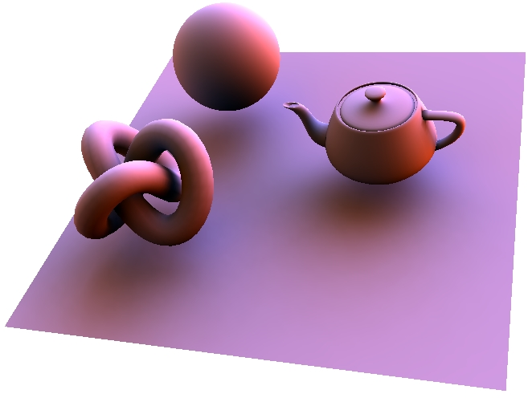
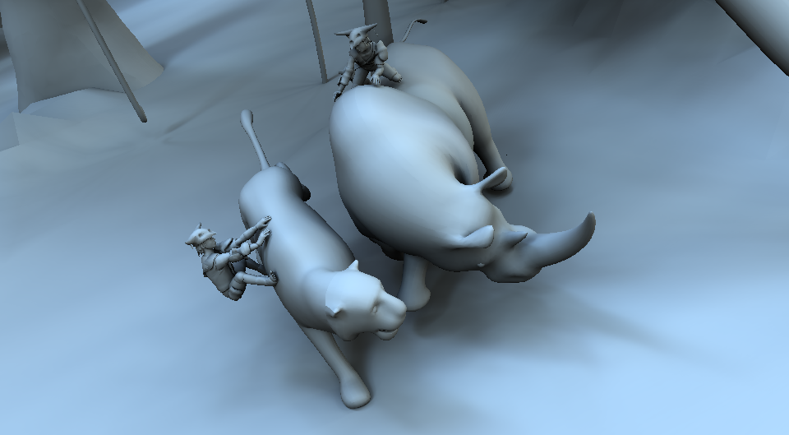
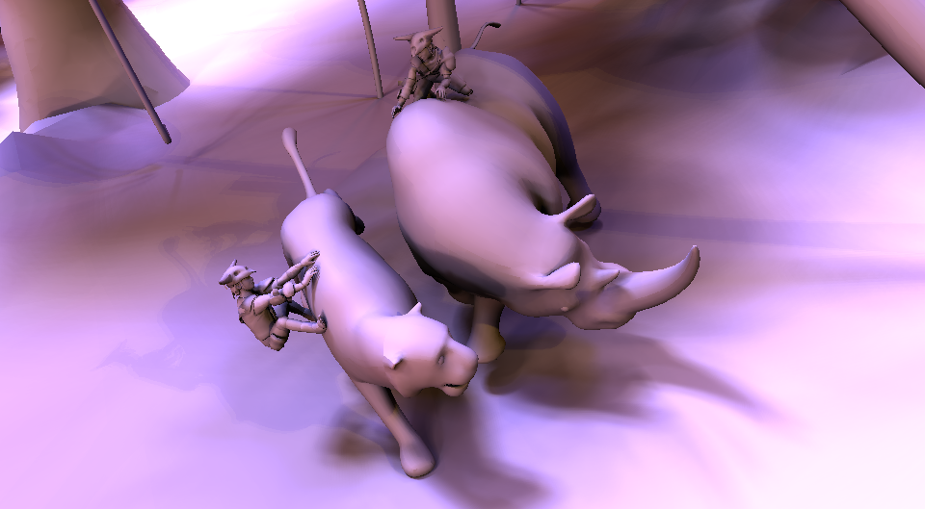
Applications
Ambient occlusion | Precomputed Radiance Transfer
Image relighting | Material editing
Notes:
The Applications we present include ambient occlusion,
pre-computation stages of double and triple product PRT,
image relighting and a simple material edit example

Slide 59
Applications
For each application we must:
express the problem in the form
by defining the masked integrand
determine how to compute the definite integrals
Notes:
And so, here is our common recipe for defining the evaluations for any application in rendering.
1 We express the rendering problem in the now familiar form, by defining the masked integrand f(w)
2 and determine how to compute the definite integrals over isolines and sub-arcs.
I’ll now show to apply this recipe to our 4 example applications.

Slide 60
Ambient Occlusion
Ambient occlusion is the diffuse outgoing radiance from uniform distant illumination:
Notes:
In general AO is defined as, diffuse outgoing radiance from uniform distant illumination
Here we use a simple definition and don’t address falloff, attention factors, etc.

Slide 61
Ambient Occlusion
Ambient occlusion is the diffuse outgoing radiance from uniform distant illumination:
Notes:
At each shading point, we need to integrate over all directions omega (W)

Slide 62
Ambient Occlusion
Ambient occlusion is the diffuse outgoing radiance from uniform distant illumination:
Notes:
And here the integrand f is simple the clamped cosine.

Slide 63
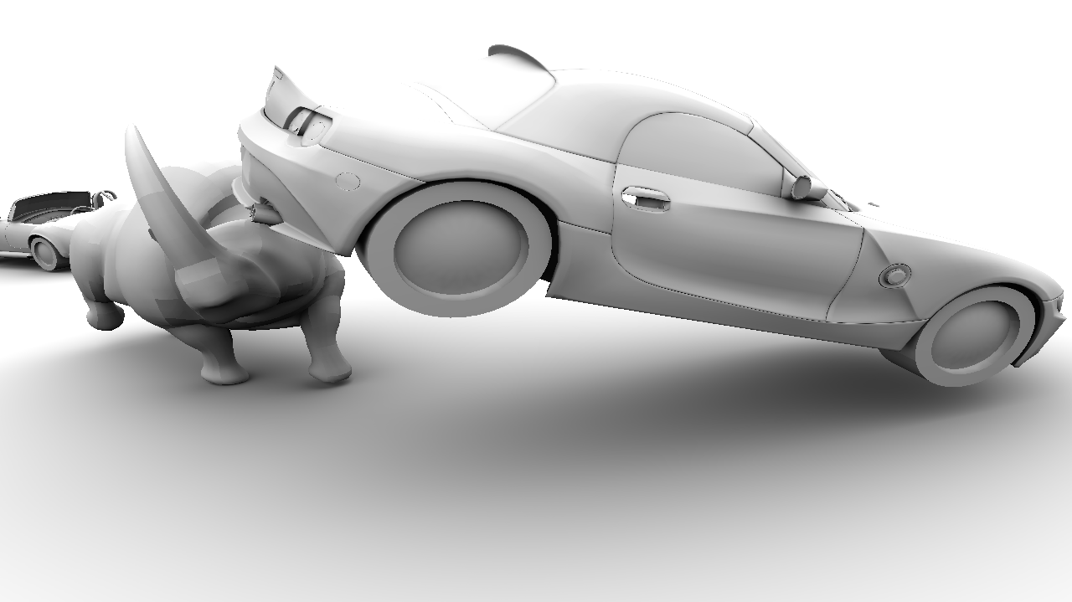
Ambient Occlusion
Ambient occlusion is the diffuse outgoing radiance from uniform distant illumination:
Notes:
Depending on the analytic form of the Jacobian,
we could calculate the different integration boundaries analytically,
however in all cases, practically, we find it’s easy to use summed area tables.
SAT generation required a negligible amount of compute time → always less than .1% of the total render time in all our applications.

Slide 64
Precomputed Radiance Transfer
Transport vectors are computed by projecting light transport functions onto basis functions
  In triple-product relighting [Ng 2004], the projection coefficients of the visibility function are required
Notes:
For triple-product relighting in PRT,
one key operation is the projection of visibility onto some spherical basis function [CLICK: equation shows up]
Here, the i^th projection coefficient of the visibility at x, is the integral of the visibility times the i^th basis function B_i

Slide 65
Precomputed Radiance Transfer
Transport vectors are computed by projecting light transport functions onto basis functions
  In triple-product relighting [Ng 2004], the projection coefficients of the visibility function are required
Notes:
For triple-product relighting in PRT,
one key operation is the projection of visibility onto some spherical basis function [CLICK: equation shows up]
Here, the i^th projection coefficient of the visibility at x, is the integral of the visibility times the i^th basis function B_i

Slide 66
Precomputed Radiance Transfer
Transport vectors are computed by projecting light transport functions onto basis functions
  In triple-product relighting [Ng 2004], the projection coefficients of the visibility function are required
Notes:
Clearly, using our recipe, the integrand is simply the basis function itself and,
for certain basis functions like spherical harmonics,
we can either analytically or numerically compute the sub-integrals

Slide 67
Precomputed Radiance Transfer
Transport vectors are computed by projecting light transport functions onto basis functions
  Similarly, in (e.g., diffuse) double-product relighting [Sloan 2002], the projection coefficients of the transport function are required
Notes:
In the case of double-product integrals in PRT, such as with diffuse relighting, [CLICK: equation shows up]
The transfer function must be projected onto a spherical basis.
Here the i^th coefficient of the transfer vector at x is the integral of the visibility
times the basis function
times the clamped cosine term

Slide 68
Precomputed Radiance Transfer
Transport vectors are computed by projecting light transport functions onto basis functions
  Similarly, in (e.g., diffuse) double-product relighting [Sloan 2002], the projection coefficients of the transport function are required
Notes:
In the case of double-product integrals in PRT, such as with diffuse relighting, [CLICK: equation shows up]
The transfer function must be projected onto a spherical basis.
Here the i^th coefficient of the transfer vector at x is the integral of the visibility
times the basis function
times the clamped cosine term

Slide 69
Precomputed Radiance Transfer
Transport vectors are computed by projecting light transport functions onto basis functions
  Similarly, in (e.g., diffuse) double-product relighting [Sloan 2002], the projection coefficients of the transport function are required
Notes:
And so, in order to use this within our integration scheme,
the integrand we use is the clamped cosine, times each of the basis functions;
to avoid computing integrals for discrete values of n,
we perform this integration in a local coordinate frame
and rotate the lighting in the basis space when shading.

Slide 70
Image Relighting and Material Editing
The direct illumination from an environment is:
Notes:
Further.
In the general case of direct illumination from environment lighting, we consider two applications of our recipe
[CLICK]
First, image relighting fixes the view-evaluated BRDF at each pixel/shade-point and allows the lighting to be manipulated dynamically at run-time, and
[CLICK]
Second, material editing fixes the lighting at run-time and allows the view-evaluated and cosine-clamped BRDF to be manipulated at run-time.

Slide 71
Image Relighting and Material Editing
The direct illumination from an environment is:
Image Relighting: fixed BRDF, dynamic lighting
Notes:
Further.
In the general case of direct illumination from environment lighting, we consider two applications of our recipe
[CLICK]
First, image relighting fixes the view-evaluated BRDF at each pixel/shade-point and allows the lighting to be manipulated dynamically at run-time, and
[CLICK]
Second, material editing fixes the lighting at run-time and allows the view-evaluated and cosine-clamped BRDF to be manipulated at run-time.

Slide 72
Image Relighting and Material Editing
The direct illumination from an environment is:
Image Relighting: fixed BRDF, dynamic lighting
Material Editing: fixed lighting, dynamic BRDF
Notes:
Further.
In the general case of direct illumination from environment lighting, we consider two applications of our recipe
[CLICK]
First, image relighting fixes the view-evaluated BRDF at each pixel/shade-point and allows the lighting to be manipulated dynamically at run-time, and
[CLICK]
Second, material editing fixes the lighting at run-time and allows the view-evaluated and cosine-clamped BRDF to be manipulated at run-time.

Slide 73


Image Relighting and Material Editing
Notes:
In each of these cases, we integrate the product of the distant environment light

Slide 74
Image Relighting and Material Editing
Notes:
the cosine-clamped BRDF evaluated in the view direction \omega_o

Slide 75
Image Relighting and Material Editing
Notes:
and the visibility

Slide 76
Image Relighting and Material Editing
Notes:
over all lighting directions \omega

Slide 77
Image Relighting and Material Editing
Notes:
In the case of diffuse image relighting, such as in double-product PRT,
basis-space representations are unable to reconstruct all-frequency shadows with a finite number of coefficients.

Slide 78
Image Relighting
We project the hemispherically-clamped incident lighting onto band-1 spherical harmonics (SH)
Notes:
Since our visibility-masked integration can trivially incorporate the hemispherical clamping about the normal,
we can use it to project the visibility-masked and hemispherically-clamped lighting
That is. the incident illumination,
onto a basis as follows
[click]

Slide 79
Image Relighting
We project the hemispherically-clamped incident lighting onto band-1 spherical harmonics (SH)

Slide 80
Image Relighting
We project the hemispherically-clamped incident lighting onto band-1 spherical harmonics (SH)
Since the unclamped cosine has non-zero SH projection coefficients only in band 1…
Notes:
We choose the 3 band-1 SH basis functions since, in its unclamped form,
the cosine foreshortening term is exactly bandlimiited
and can be *perfectly* reconstructed using only the band-1 SH basis functions.

Slide 81
Image Relighting
Double-product relighting simplifies to
Notes:
Given this, double-product relighting simplifies to this 3-term dot-product, [click]
where the unclamped cosine’s projection coefficients are pre-computed analytically once
and rotated to align with the normal at the shade point using Peter-Pike et al’s fast ZH rotation rule.

Slide 82
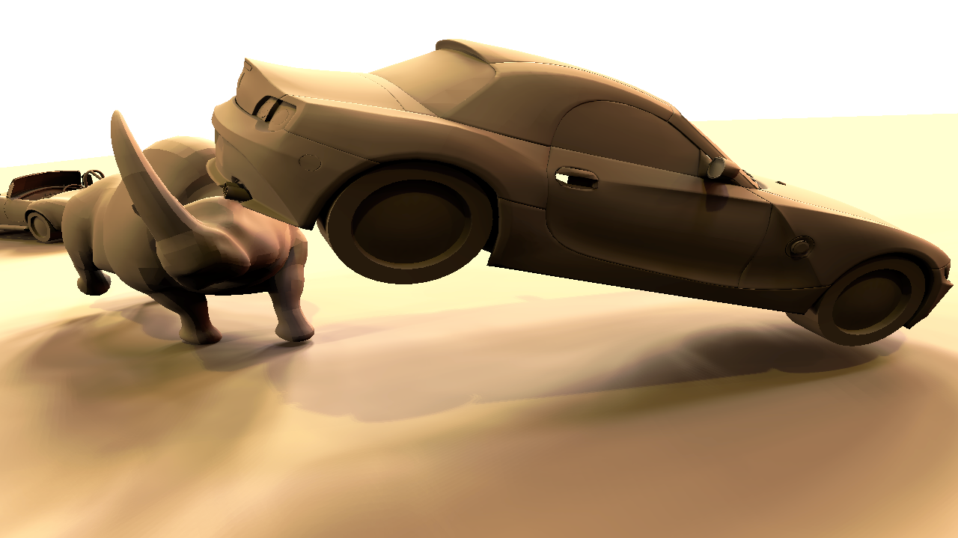
Image Relighting
Double-product relighting simplifies to
where is computed using
the fast ZH rotation rule [Sloan 2005]
Notes:
Given this, double-product relighting simplifies to this 3-term dot-product, [click]
where the unclamped cosine’s projection coefficients are pre-computed analytically once
and rotated to align with the normal at the shade point using Peter-Pike et al’s fast ZH rotation rule.

Slide 83
Material Editing
Similarly to the all-frequency diffuse double-product relighting, we allow dynamic BRDFs by projecting the lighting against all basis functions
Notes:
In the case of material editing, we instead project the visibility-masked lighting onto *all* basis functions since…

Slide 84
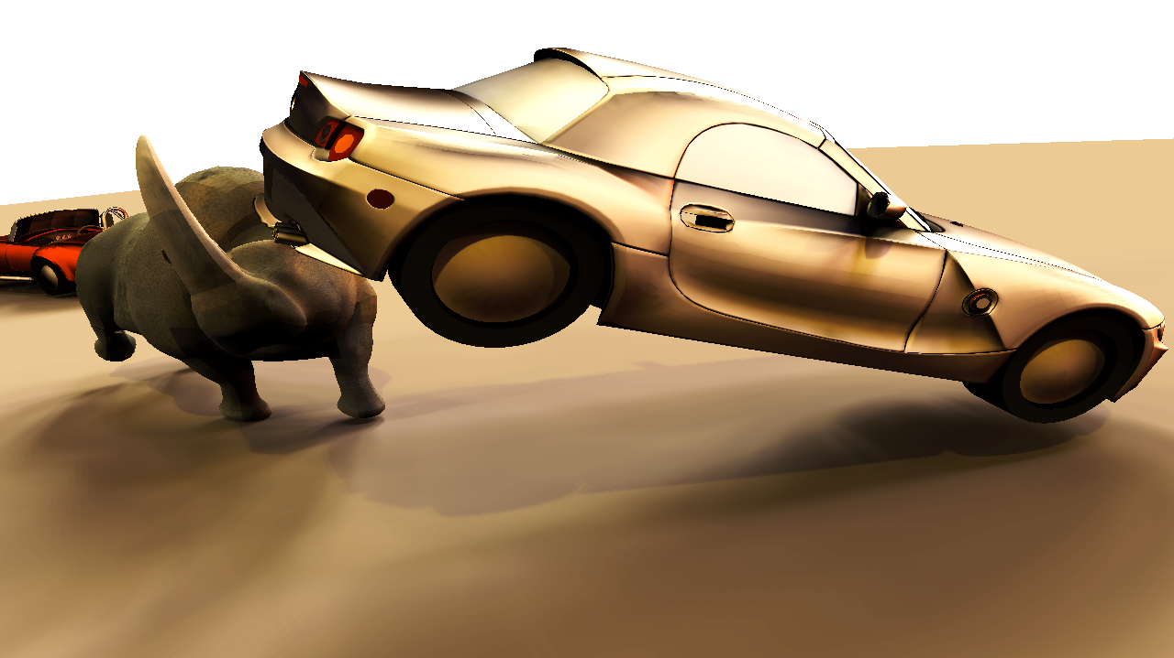
Material Editing
Similarly to the all-frequency diffuse double-product relighting, we allow dynamic BRDFs by projecting the lighting against all basis functions
  The SH projection of the view-evaluated cosine-weighted BRDF is computed at run-time for relighting
Notes:
… the projection coefficients of the view-evaluated and cosine-weighted BRDF can be evaluated interactively at run-time
and used in a double-product rendering framework for simple material editing.

Slide 85
Results
Our method converges to ground truth
  We compare against Quasi-Monte Carlo integration using light importance sampling using Embree v1.1
We do not suffer from noise
On scenes of moderate geometric complexity, our approach is comparable or superior to QMC
Notes:
We conduct an equal-quality comparison to ray-traced solutions computing using Embree’s high-performance CPU ray-tracer and light importance sampling.
Our approach does not suffer from noise and, as we will discuss shortly, scales much more efficiently with sampling rate than the Quasi-Monte Carlo solution.
In scenes of moderate geometric complexity, we are competitive with optimized QMC.

Slide 86
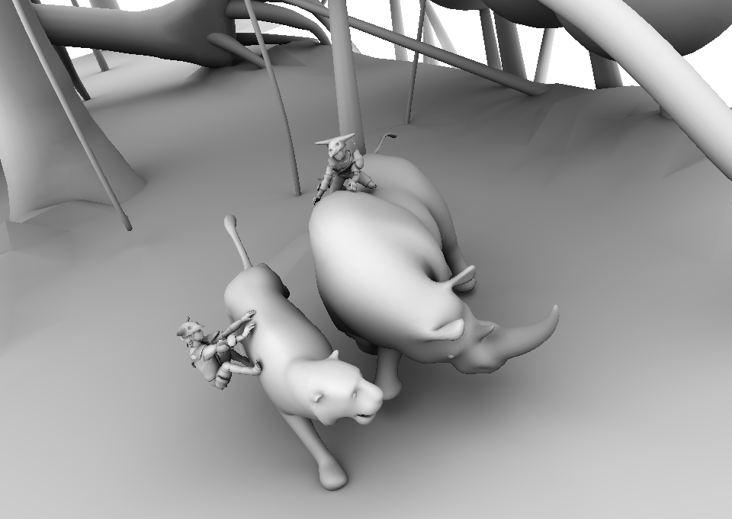
Ours
Notes:
And we show a few comparisons to illustrate this here
AO

Slide 87

QMC
(equal time)

Slide 88
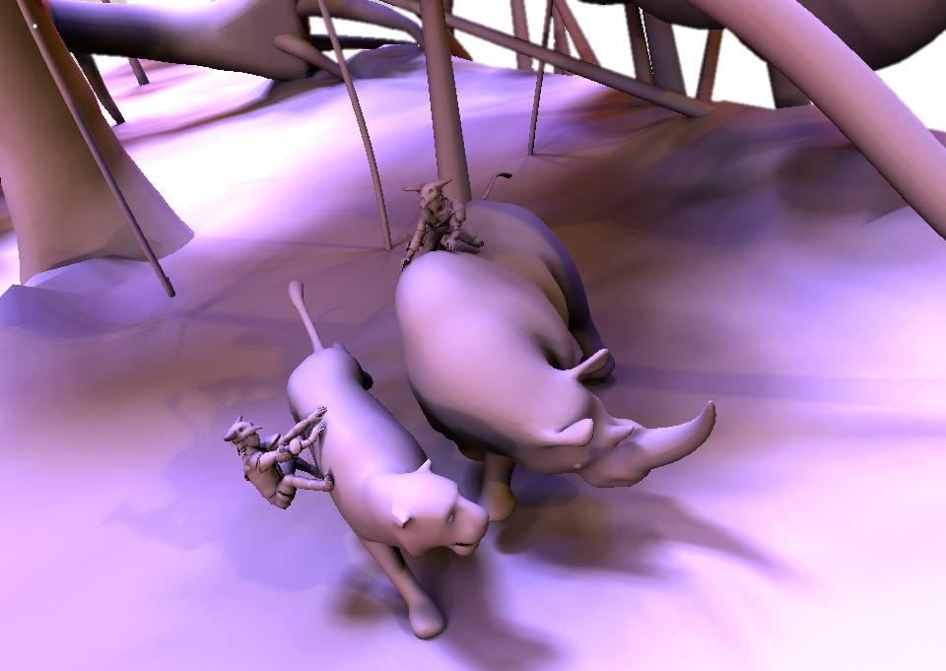
Ours
Notes:
Relighting with all-frequency shadows

Slide 89

QMC
(equal time)

Slide 90
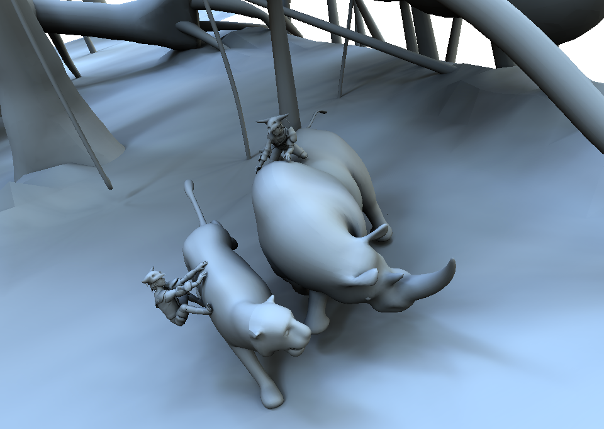
Ours
Notes:
Another light environment example

Slide 91

QMC
(equal time)
Notes:
To highlight noise free comparison to equal time QMC

Slide 92
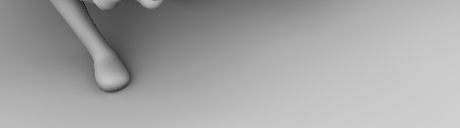
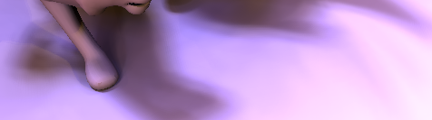
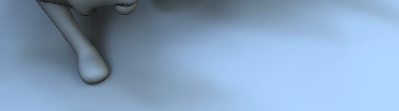

Notes:
And here are some zoomed in comparisons to show the noise detail more clearly

Slide 93
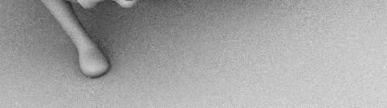
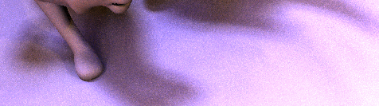

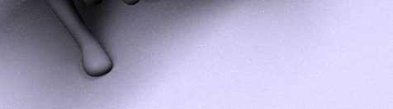
QMC
(equal time)
Notes:
And you can hopefully see noise still present in the equal time QMC renders

Slide 94
Performance and Scalability
Fundamental Limitation:
  Finding silhouettes does not scale as well as tracing rays
Notes:
A *fundamental limitation* of our approach stems from the fact that searching for contour and silhouette edges does not scale as well, for increasing scene sizes, as tracing rays.

Slide 95
Performance and Scalability
Fundamental Limitation:
  Finding silhouettes does not scale as well as tracing rays
Our runtime scales roughly as
for m shade points, k integration samples, and
n triangles
Notes:
Our runtime scales as roughly order m root k n to .8.

Slide 96
Performance and Scalability
Fundamental Limitation:
  Finding silhouettes does not scale as well as tracing rays
Our runtime scales roughly as
for m shade points, k integration samples, and
n triangles
Ray-tracing scales roughly as
Notes:
Whereas ray-tracing has order m k log n complexity
Note that, especially in domains where n^0.8 is close to log n,
we scale much better with the sampling rate k,
and so we can afford to discretize our spherical domain much more finely than RT
Which results in efficient high frequency shadow recovery

Slide 97
Performance and Scalability
Notes:
This is illustrated in our performance table, you can see we win in many cases, but have trouble on high complexity scenes such as the teapot grid
We can also see the scaling behavior of the increasing sample rates.

Slide 98
Synopsis
We generalize silhouette integration to general spherical, visibility-masked integration
Notes:
So, In summary..
. We generalize silhouette integration to general spherical, visibility-masked integration

Slide 99
Synopsis
We generalize silhouette integration to general spherical, visibility-masked integration
We apply this template to various problems in realistic rendering
  For scenes of moderate-to-low complexity, we compete with QMC ray-tracing; otherwise, we lose on larger scenes
Notes:
We apply this template to various problems in realistic rendering
For scenes of moderate-to-low complexity, we compete with QMC ray-tracing; otherwise, we lose on larger geometric complexity

Slide 100
Future Work
Applying a dual hierarchy over shade points and silhouettes → amortize the silhouette search cost
GPU acceleration
  Promising results with CUDA implementation
Notes:
In further work,
We’d like to applying a dual hierarchy over shade points and silhouettes → amortize the silhouette search cost
GPU acceleration, I’ve implemented some tests in CUDA with Derek and had some promising results
And of course, extension to indirect illumination and dynamic BVHs for deformable geometry are on the horizon

Slide 101
Thank you! Questions?
Thanks to Wenzel Jacob for diagram graphics

Slide 102
Backup Slides

Slide 103
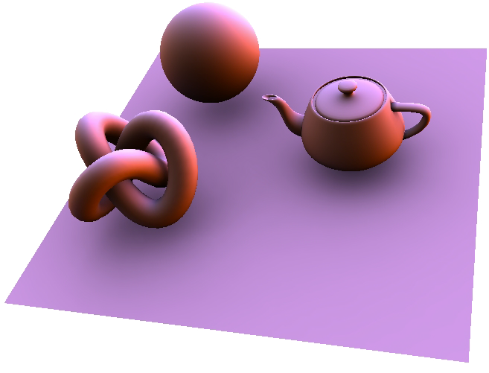
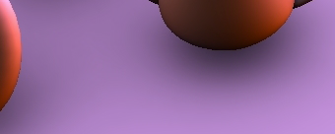

Slide 104

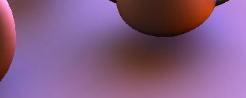

Slide 105
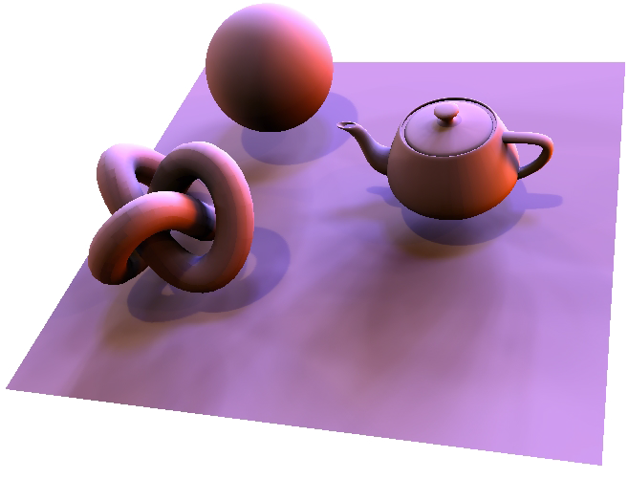
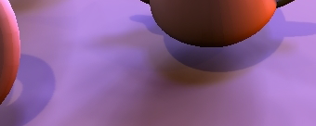

Slide 106



Slide 107



