Slide 1
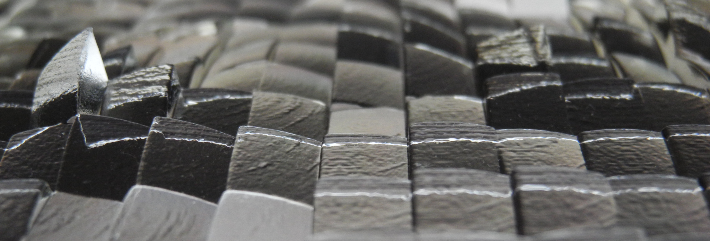
The Magic Lens:
Refractive Steganography
Marios Papas, Thomas Houit, Derek Nowrouzezahrai, Markus Gross, Wojciech Jarosz
Notes:
Today I will present the Magic Lens, a project which was a joint collaboration between CGL @ ETH and Disney Research Zurich.

Slide 2
Steganography
Notes:
This paper deals with steganography.
Steganography is the art and science of writing secret messages for an intended recipient.

Slide 3
Steganography
Cardan Grille
The front door is made with oak wood. The key characteristic for understanding the material is its unique texture and color.
Invisible Ink
Magic Decoder rings
Notes:
A simple example of a steganographic device is the Cardan Grille. Here I wrote a paragraph of text that contains a secret message.
The recipient can de-code the text by placing [click] our pre-shared cardan grille on top of the paragraph.
The secret message here reads: The key is under the mat
There are other classical methods for achieving this, such as writing with invisible [click] ink, using magic [click] decoder rings and others …

Slide 4
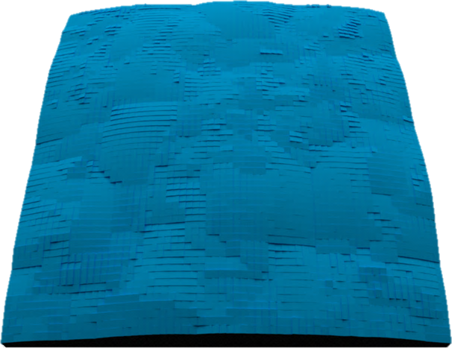
High Level Goal
Enable steganography using refraction
Notes:
Our goal is to enable steganography by using refraction.
That is, given a source image, and a desired target [click] image
We device a method that automatically designs a lens [click] such that when a viewer looks through it, the source image will be transformed to the target image.

Slide 5
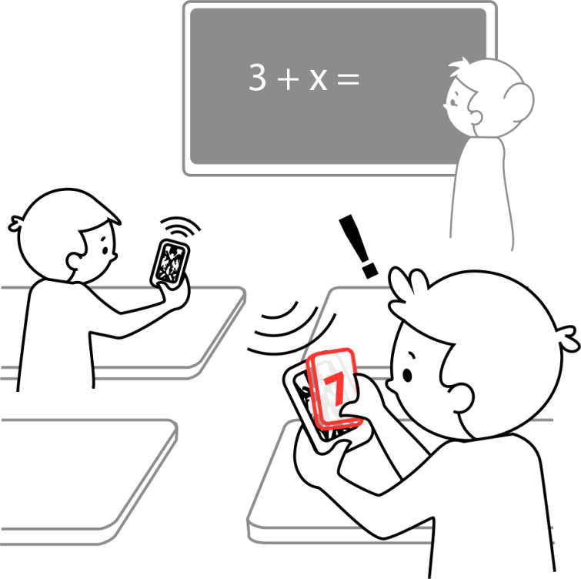
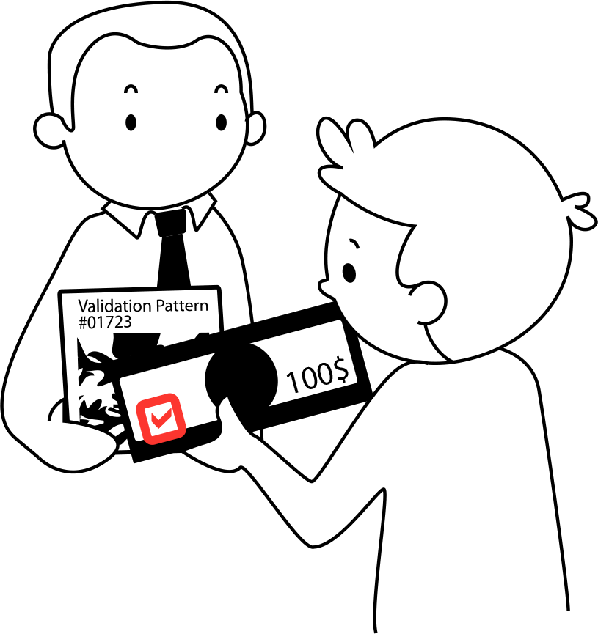
Why?
Many potential applications:
Notes:
Being able to manufacture such a lens, has many potential interesting applications, such as :
[click] secret message passing, where friends can send encoded messages to each other that can only be decoded by using such a lens,
Or you can imagine miniaturizing [click] these lenses such that they can fit into bank notes, the authenticity of the note can be verified by looking at a validation pattern through the bank note lens.
Another application is …

Slide 6
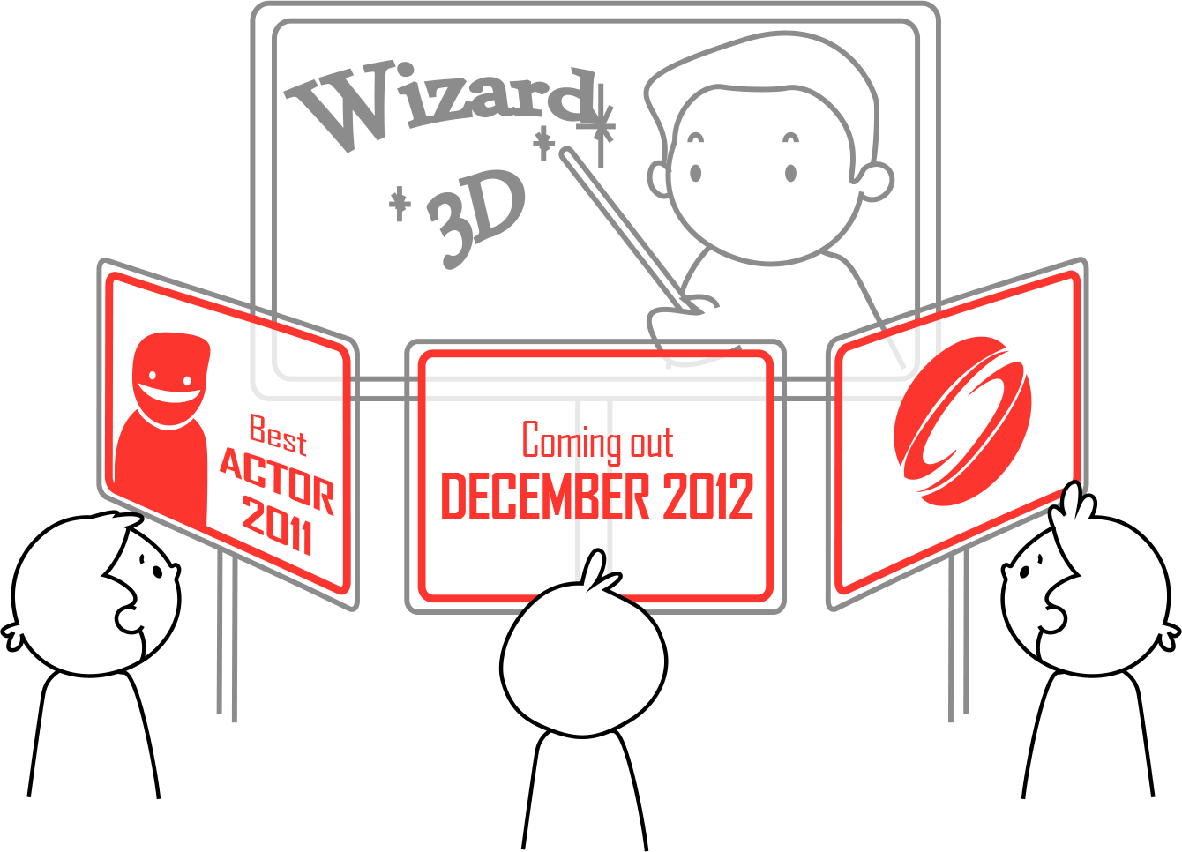
Why?
Many potential applications:
Notes:
Multi-view displays, where similarly to a lenticular array, a lens is designed to decode a single source image into view dependent target images.

Slide 7
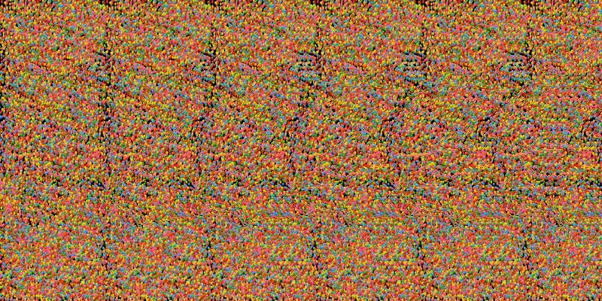
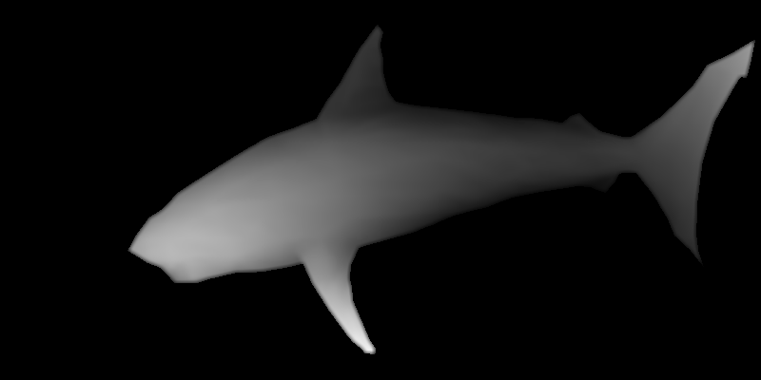
Related Work: Hiding Images
Autostereograms [Tyler & Clarke 1990]
Depth image encoded in a 2D image
[Source: Wikimedia Commons]
[Source: Wikimedia Commons]
Notes:
Hiding and encoding images has been of interest in computer graphics for a long time. An example of this is the autostereogram work of Tyler and Clark in the early 90s.
An autostereogram is seen on the left where a depth image of a shark has been encoded.
The viewer, by controlling vergence and focus can decode the image.

Slide 8
Related Work: Hiding Images
Emerging Images [Mitra et al 2009]
hide images in temporal domain
[Source: Mitra et al. 2009]
Notes:
Mitra et al, in their Emerging Images paper, were able to hide animations in the temporal domain as seen in this video.

Slide 9
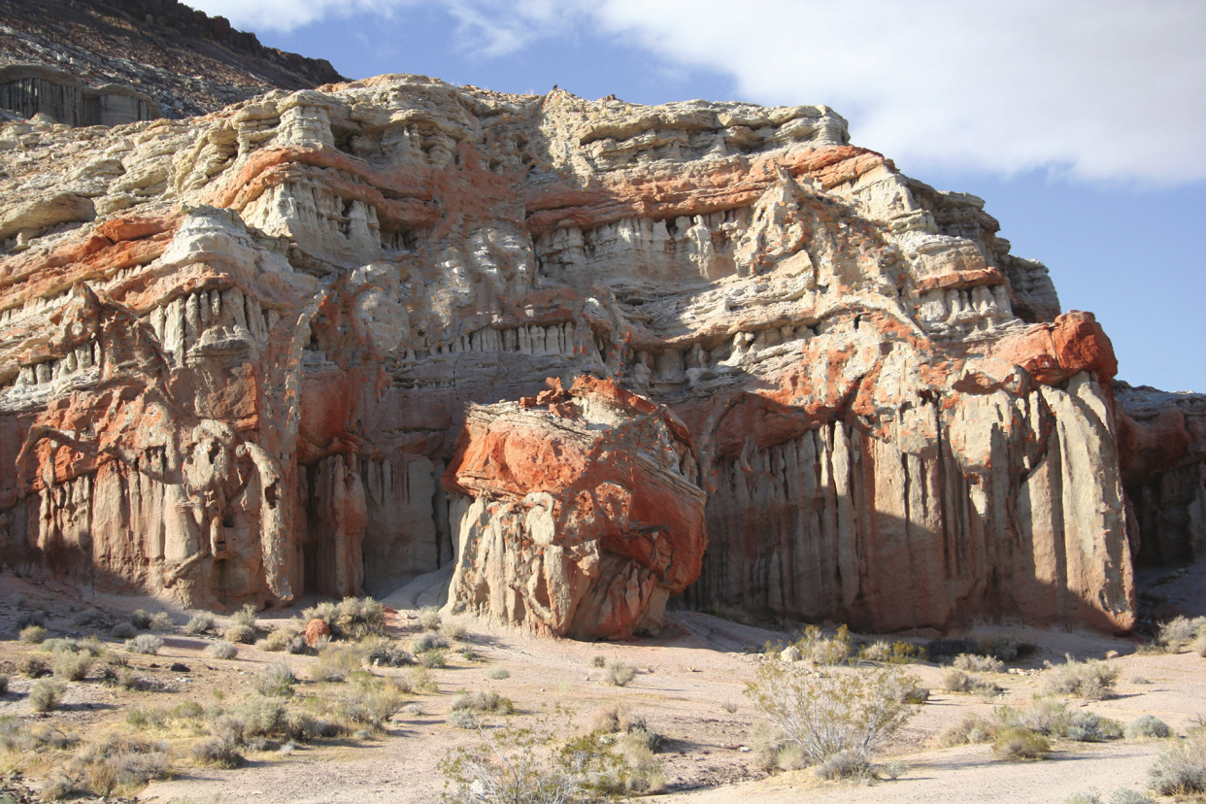
Related Work: Hiding Images
Camouflage Images [Chu et al 2010]
[Source: Mitra et al. 2009]
Notes:
Recently Chu et al presented camouflage images. They were able to hide images in normal looking photographs [click], such as these 2 hidden horses we highlight here.

Slide 10
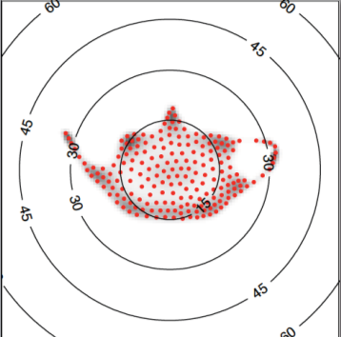
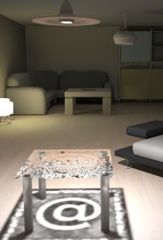
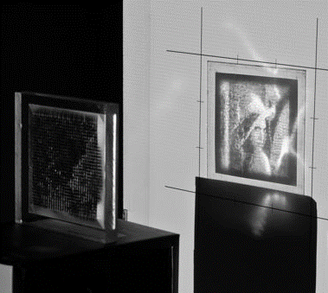
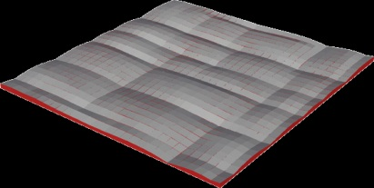
Related Work: Refractive and Reflective Surfaces
Custom micro-facet BRDF [Weyrich et al. 2009]
Geometry from Caustics [Finckh et al. 2010]
Goal Based Caustics [Papas et al. 2011]
Notes:
Weyrich et al in 2009 [click] , were able to encode images in the angular distribution of a BRDF.
More related to our project is the work by Finch et al [click] and Papas et al [click] , where they were able to design lenses that when illuminated with a distant light source an image would appear as a caustic on the wall.
You can think of our method as a sort of dual to these methods:
The light is replaced by the camera and the caustic image is replaced by the source image.

Slide 11
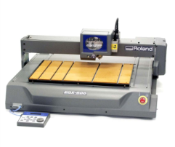
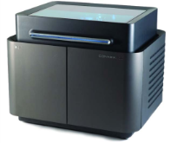
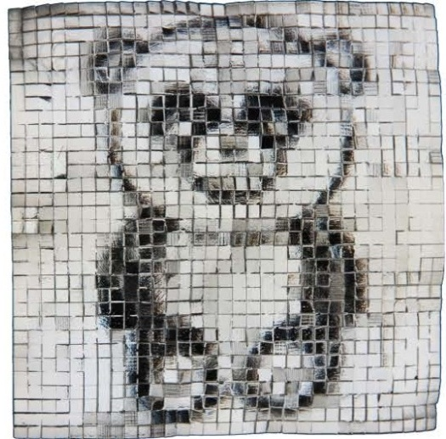
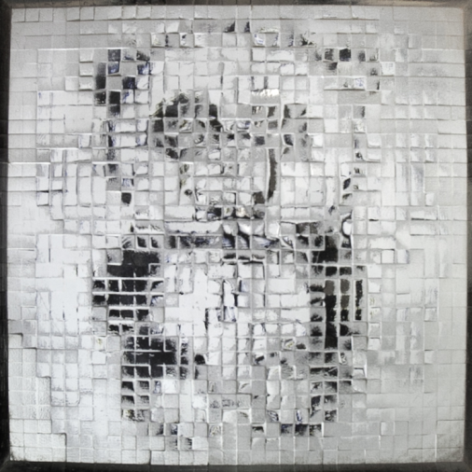
Fabrication
Goal:
Manufacture Steganographic Lenses
3D Printing
Milling
Notes:
An important goal of our method, is to actually manufacture steganographic lenses. At our disposal we had 2 fabrication methods:
3D Printing and milling.
Fabrication poses a series of limitations, which, as we will see later on, were taken into account during our design phase.

Slide 12
Lenses Classification
Source Optimized
N→N
Magic Lens
Universal
∞→∞
Notes:
We create 2 different types of lenses.
Source Optimized lenses are tied to a particular set of images [click] which are specified ahead of time.
Universal Lenses on the other hand, are designed to work on an arbitrary number [click] of source and target images, which are not specified ahead of time.
We will now explain the methodology for creating the simplest source optimized lens, which transforms 1 source image to a target image.

Slide 13
Single Source Optimized Lenses
Single Source Image
Target Image
Process:
Patch
Matching
Facet
Orientation
Simulated
Annealing
Height
Optimization
Notes:
So we want to define the lens geometry [click], such that when its placed on top of a source image, it will transform it into the target image.
We use a 4 step process to do that:
Initially we want to find similar regions in both the source and target image, and then aim the lens facets on those regions. The final two steps, simulated annealing and height optimization, are for improving the overall continuity of the lens.

Slide 14
Single Source Optimized Lenses
Patch Matching
Source Image
Target Image
Candidate list
Target tile
Notes:
Now lets start with the first step of the process, the patch matching step:
The goal here is to find regions in the source image, that are similar to regions in the target image.
So we first divide the target image into an NxN grid [click].
For each tile in the target [click] image, we collect [click]various possible similar candidates from the source image, within [click] a permittable range.
Within this range [click]we perform an exhaustive search at various scales, rotations and positions.
Candidates are collected in a list, when their image difference, with the target tile, is below a certain threshold.
For each tile, we now have a set of candidate image locations in the source image that are similar.

Slide 15
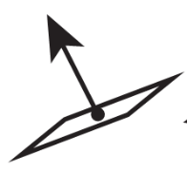
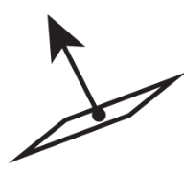
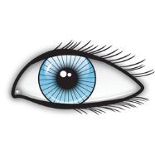
Single Source Optimized Lenses
Facet Orientation
Candidate list
[Walter et al. 2007]
Facets
Lens Back
Source Image
Notes:
Now for each element in this list we need to find the orientation of each facet.
To do that we initally assume that each facet is planar, and we also assume a fixed distance to the eye, which we will modify later.
Now given the eye location, and the position of the first candidate on the source image, we need to compute the facet normal, [click]
such that the camera ray will be refracted to the center of the candidate region.
We use snells law to find the first refraction, and a few gauss newton iterations [click], as in Walter et al 2007, to compute the 2nd refraction.
We repeat [click] this process for all candidates in the list, and for all lens facets.

Slide 16
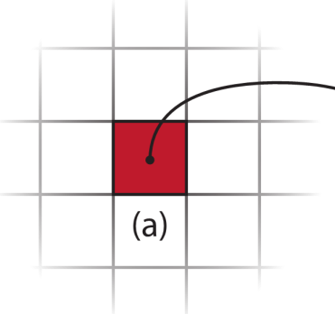
Single Source Optimized Lenses
Simulated Annealing
Select a random facet
Select a random candidate
Check neighborhood compatibility
Change target?
Repeat
Notes:
Now given the candidate normal orientations for each facet, we would like to optimize the overall continuity of the lens.
This is done by examining whether we can exchange a facets current target with another one in the candidates list, which could improve the facets compatibility with it’s neighbors. For this combinatorial problem we employ Simulated Annealing [click].
Initially we choose a facet at random.
Then [click] we select a random candidate from the list of possible candidates.
Then we check the neighboring [click] facets for compatibility, according to the x and y components of their normals. The specifics about this compatibility term are detailed in our paper.
Now if the neighborhood compatibility is below a certain threshold [click] then the swap is accepted, and the facets target is changed.
Finally [click] we repeat the process, while reducing the swap acceptance threshold, until there are no remaining swaps to be made.

Slide 17
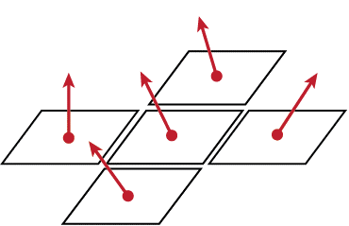
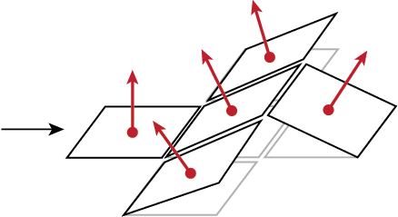
Single Source Optimized Lenses
Height Optimization [Weyrich et al. 2009]
Notes:
So far, we ‘ve just computed normals for each facet, now we need to elevate the surface such that the vertical discontinuities are minimized.
To achieve that we integrate [click] the slope of the facets for computing their height.
This is modeled as a sparse linear system, and the process is similar to Weyrich et al 2009.
Now since the height of each patch is changed, the facet orientations are invalid, and they have to be re-calculated. [click]
As we can see here , due to the height change the targets are shifted to other locations on the source image

Slide 18
Single Source Optimized Lenses
Process:
Patch
Matching
Facet
Orientation
Height
Optimization
Simulated
Annealing
Simulated
Annealing
Update Facet Heights
Notes:
So we repeat a few times the process of Facet Orientation and Height Optimization, and at each iteration we use the updated heights.
This process converges usually after a few iterations.

Slide 19
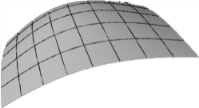
Single Source Optimized Lenses
Curved Facets [Papas et al. 2011]
Facet
Lens Back
Source Image
Notes:
So far we just focused the center of the facet to the center of its assigned region [click].
What we actually want to do is to replace each planar facet, with a small curved facet that redirects light uniformly on the entire assigned region.
To do that, we divide each facet, [click], into smaller facets and
each smaller facet redirects light to a point on the source region. Then by integrating the slopes, similarly to Papas et al 2011, we get the curved facet shape.

Slide 20
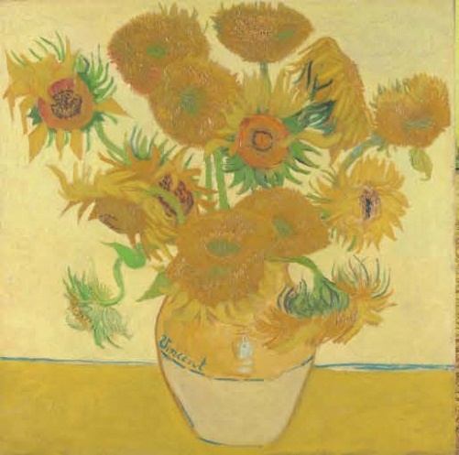
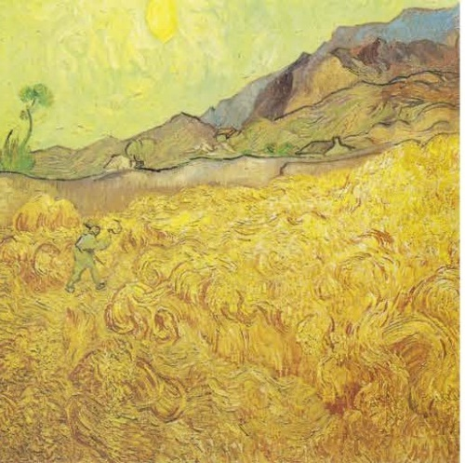
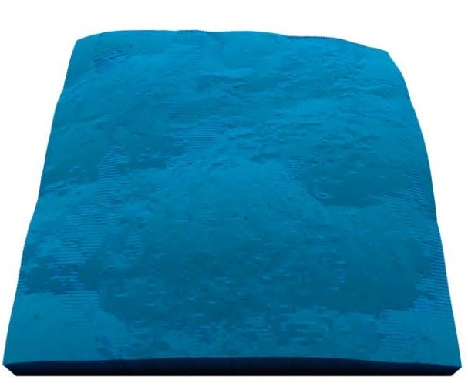
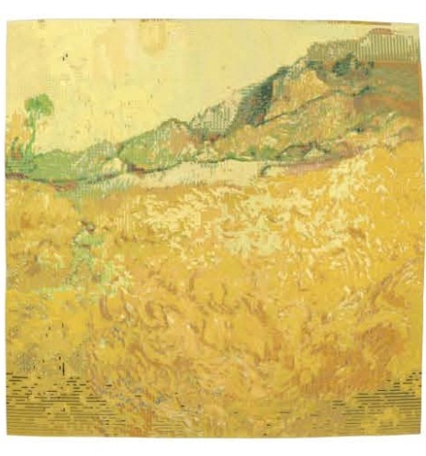
Single Source Optimized Lenses
Simulated Results
Source Image
Target Image
Magic Lens
128x128
Image seen
through lens
Notes:
Now lets look at some simulated results.
On the left we have a desired source image, followed by the desired target image.
In the 3rd position we have the Magic Lens, produced by the method I just explained, and finally on the right we see a simulation, rendered with a path tracer. This shows the source image as seen through the lens.

Slide 21
Single Source Optimized Lenses
Simulated Results
Source Image
Target Image
Magic Lens
128x128
Image seen
through lens
Notes:
Another similar example is this 128x128 lens where the flowers image is transformed into a bus.
---------------
The lenses are relatively smooth, which is due to the simulated annealing and height optimization steps of our pipeline.

Slide 22
Single Source Optimized Lenses
Simulated Results
Source Image
Target Image
Magic Lens
Image seen
through lens

Slide 23
Single Source Optimized Lenses
Simulated Results
Source Image
Target Image
Magic Lens
64x64
Image seen
through lens
Notes:
Another simulated result is the transformation of this bridge painting to the peppers scene.
This lens shown here has 64x64 facets.

Slide 24
Single Source Optimized Lenses
Milled Result
Source Image
Simulation
Magic Lens
Photograph
Notes:
Now lets look at a manufactured result.
Here we have a source image composed out of random circles, and next to it we show the simulated result with a
32x32 lens, which is placed 10cm away from source.
On the right we see a photograph of a physical prototype fabricated with a milling machine.

Slide 25
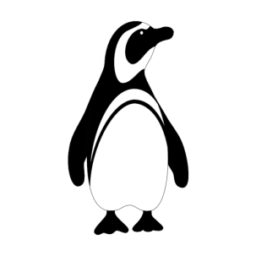
Multiple Source Optimized Lenses
Multiple Source Images
Target Images
Patch
Matching
Facet
Orientation
Simulated
Annealing
Height
Optimization
Patch
Matching
Notes:
Now lets proceed with designing source optimized lenses that work with multiple images.
Multiple source optimized lenses, are lenses that will decode a different target image for each source image.
To do that we need to perform a simple change in the [click] patch matching step.
The change is that now we try to find a target that will minimize the overall error, of the facet, for all [click] source and target image pairs.
For example: if all target images should appear white through a facet, then a region that is white at all source images, within a permitted range, will be preferred.

Slide 26
Multiple Source Optimized Lenses
Results
Notes:
Here is the decoding result of a rotating image (or 4 different images) as seen through the lens.
In the middle we have a high quality simulation with 128x128 facets and on the right a photograph of a 3D printed lens.

Slide 27
Multiple Source Optimized Lenses
3D Printed Results
Source Image
Magic Lens
Photographs
Notes:
Another result is this 16x16 facet lens that unscrambles 4 source images into numbers

Slide 28
Source Optimized Lenses
Multi View Results
Source Image
Multi-view Lens
Left view
Right view
Notes:
Another type of source optimized lens is this multi-view lens, which when viewed from the left, an image of a penguin appears, and when viewed from the right an image of a panda appears.

Slide 29
Source Optimized Lenses
Pros
Unmodified source images
Good continuity
Multi-view
Cons
Limit on number of sources
Lens dependent on images
Notes:
Now the source optimized lenses have some very interesting properties:
[click] They can transform a source image to a target image without modifying it
Their overall continuity is optimized
And they can be used to display view dependent target images
But [click] on the other hand
The number of image pairs that can be decoded using a single lens is limited, and as the number of images increases, the quality decreases.
In addition manufacturing is tied to these images, and this can be expensive and time consuming. For example it wouldn’t be feasible to use a source optimized lens for a long animation.

Slide 30
Lenses Classification
Source Optimized
N→N
Magic Lens
Universal
∞→∞
Notes:
This motivates the need for a new type of lens, that can transform an unlimited number of source and target image pairs:
the universal lens.

Slide 31
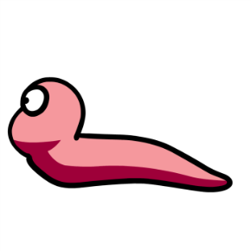
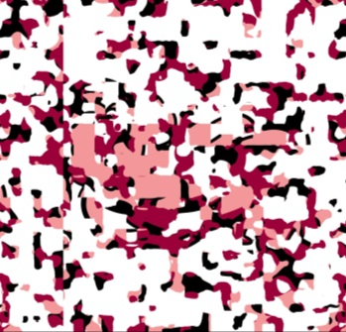
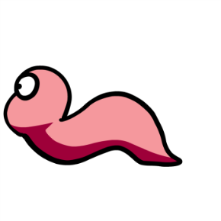
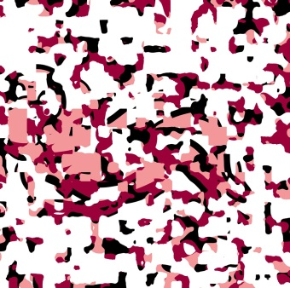
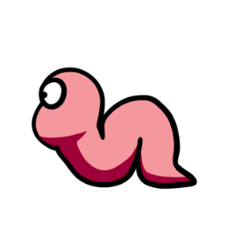
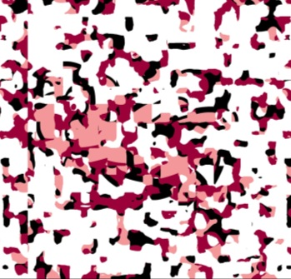
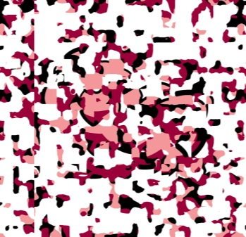
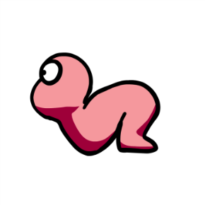
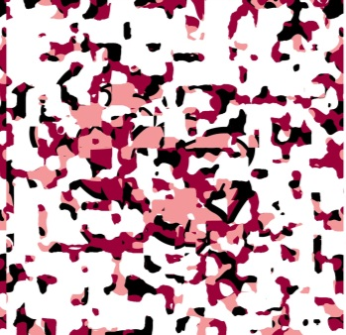
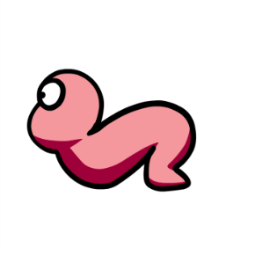
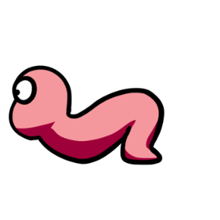
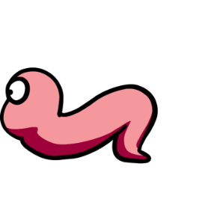
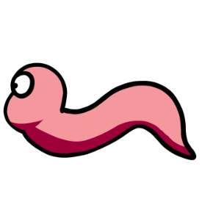
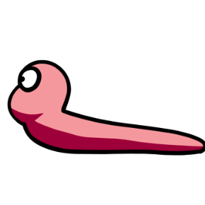
Universal Lens
Required Properties
Unlimited number of images
Images depend on the lens
In-painted Source Images
Unlimited Target Images
Notes:
What we define as a universal lens, is a lens that has 2 required properties:
First: It can decode an unlimited number of images
And second: the source images are now dependent on the lens and the target image, and not vice versa. This implies that the source images will now be modified.

Slide 32
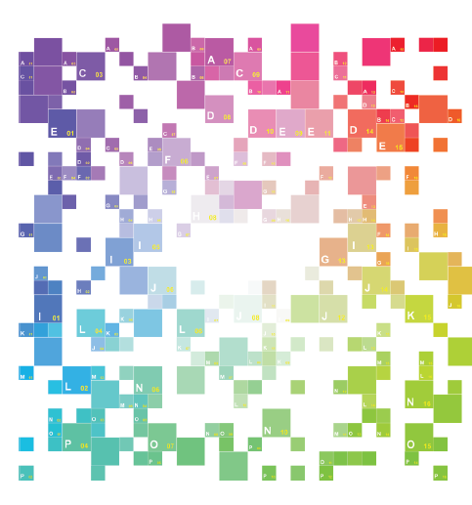
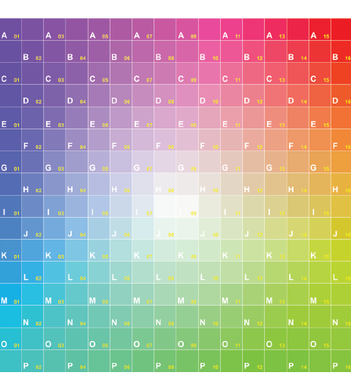
Universal Lenses
Scrambled Mapping
Patch
Matching
Facet
Orientation
Height
Optimization
Random Mapping
Computation
Notes:
By relaxing the constraint on modifying the source image, we can create lenses that can decode an unlimited amount of generated source images.
The pipeline is changed to the following:
First we compute a scrambled mapping, using dart throwing and then we proceed with the previously mentioned facet orientation and height optimization procedures, to produce a lens that unscrambles it.
Now lets dive into the details [click] of the random mapping computation.

Slide 33
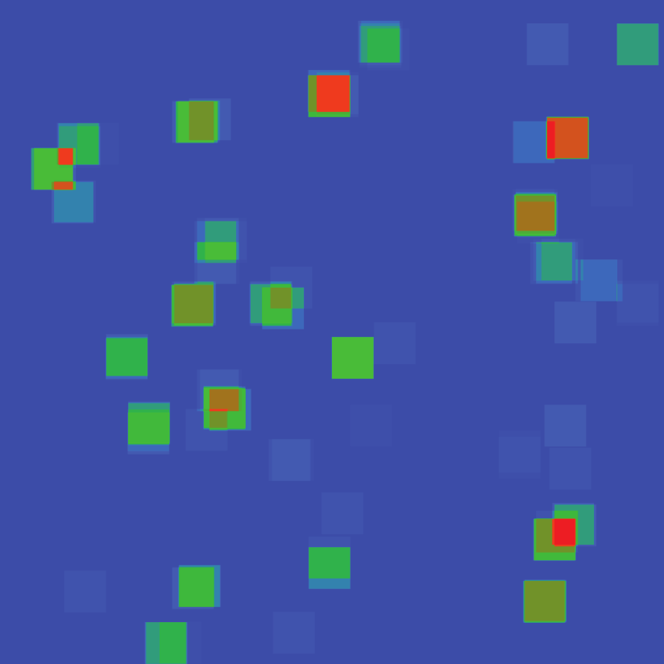
Universal Lenses
Random Mapping Computation
Goal : Zero Overlaps
18 Overlaps
Source optimized lens heat map
Notes:
Our main goal when computing the random mapping is to guarantee that there will be no overlaps.
In the heat map seen here, from one of our source-optimized lenses, we highlight the regions in the source image which overlap.
Blue corresponds to 0 overlaps and red [click] corresponds to 18 overlaps.
That means that 18 facets aim at the same location on the source image.
The problem when two or more facets focus on the same image region is that when you look through the lens, those facets will have the same content.
This prevents us from showing different images with the same lens.
If we were able to force non overlapping targets, then we could create arbitrary target images by just coloring their corresponding targets in the source image.

Slide 34
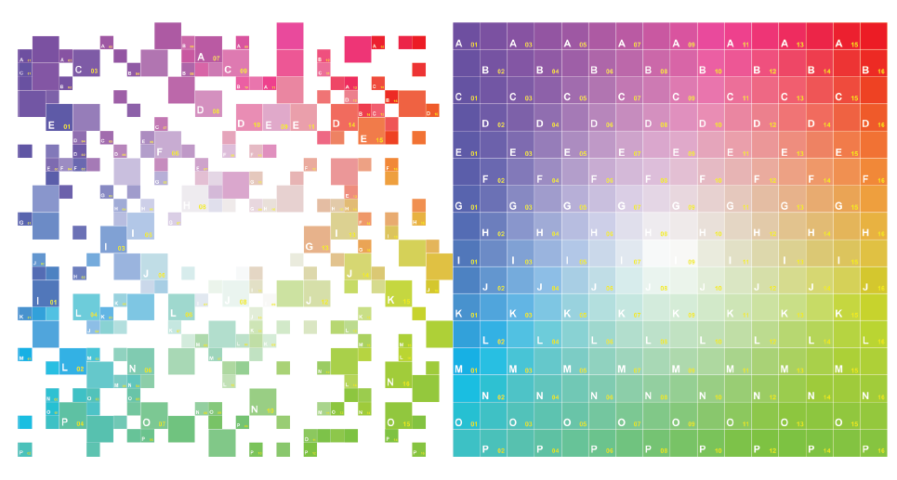
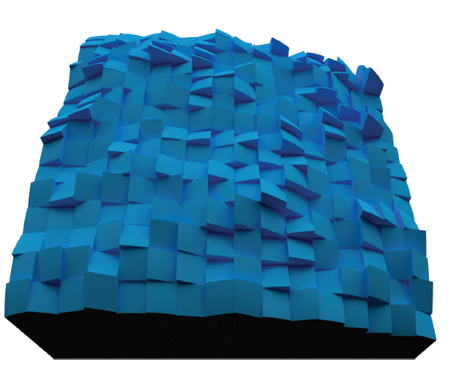
Universal Lenses
Random Mapping Computation
Source Image
Target Image
Notes:
For the random mapping computation, we employ a simple hierarchical dart-throwing method that scrambles the facet targets as much as possible, while guaranteeing that there will be no overlaps.
We allow translations, 90 degree rotations and scale changes.
The white part on the source image indicate regions that will not be visible through the universal lens. In those regions we can in-paint camouflage patterns to better obfuscate the source image, without affecting the target image.
The resulting universal lens [click] that achieves this scrambling, is shown on the right.

Slide 35
Universal Lenses

Slide 36
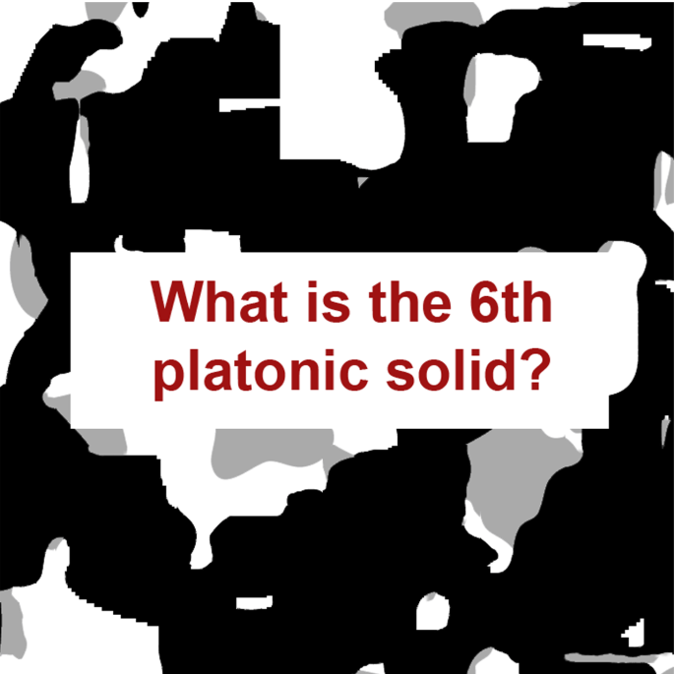
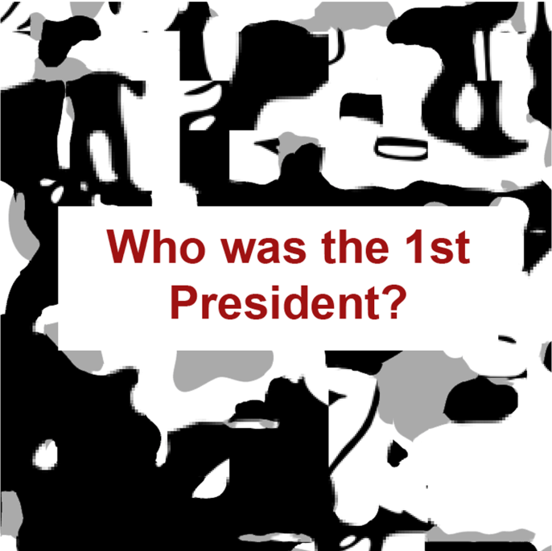
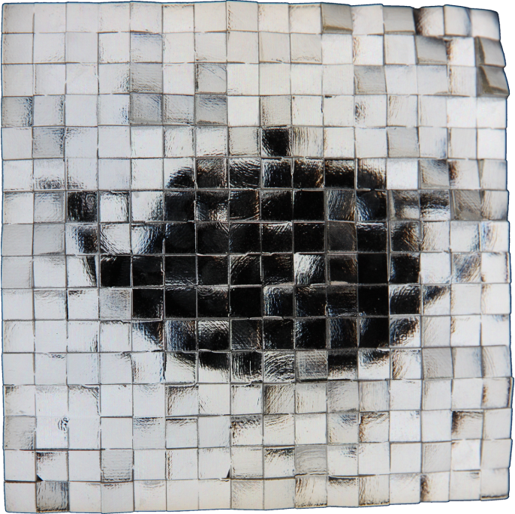
Universal Lenses
Questions & Answers (Same Lens)
Notes:
Backup

Slide 37
Limitations & Future Work
Reduce discontinuities
Better universal lens camouflage
Investigate roughness
Notes:
Our method, although works well as a proof of concept, still needs improvement.
First [click] we would like to further reduce discontinuities, which have a negative impact on the overall quality and fabrication.
We believe that the camouflage [click] used for the universal lens can be improved, especially in the temporal domain.
Unfortunately it is still possible to see the worm animation cycle in the scrambled source images.
Finally we would like to further investigate the effect of surface roughness [click] and how that impacts the overall quality and refraction directions.

Slide 38
Conclusion
Complete pipeline for:
Manufacturing steganographic lenses
Two types of lenses
Source Optimized
Universal
Variety of applications
Notes:
To summarize, we have presented a complete pipeline for manufacturing steganographic lenses.
We presented two types of lenses where each one is targeted towards a specific application
And finally we demonstrated a variety possible use cases ranging from decoding video, to sending secret messages and multi-view displays. We hope that our work will inspire future research in this very exciting field

Slide 39
A-Q-A
Acknowledgements:
CGL @ ETH Zurich
Disney Research Zurich Lab
Anonymous Reviewers
Time for questions!
Notes:
Special thanks should go to the colleagues at the CGL Lab at ETH Zurich, and the Disney Research Lab. In addition I would like to thank our anonymous reviewers for their feedback and suggestions.

Slide 41
Manufacturing Constraints
Milling
High depth accuracy
Discontinuities are problematic
Post-processing required
3D Printing
Low depth accuracy
Discontinuities possible
No post-processing

Slide 42
Manufacturing aware decisions
Milling
Prioritize smoothing
Lens away from source
3D Printing
Prioritize quality
Lens on the source

