Slide 1
Fabricating Translucent Materials Using Continuous Pigment Mixtures
Marios Papas
Christian Regg
Wojciech Jarosz
Bernd Bickel
Philipp Jackson
Wojciech Matusik Steve Marschner
Markus Gross
ETH / DRZ
ETH / DRZ
DRZ
DRZ
WDI
MIT CSAIL / DRZ Cornell University / DRZ
ETH / DRZ
Fabricating Translucent Materials using Continuous Pigment Mixtures

Slide 2
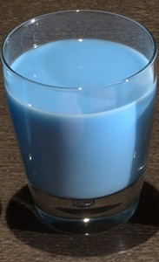
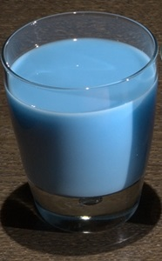
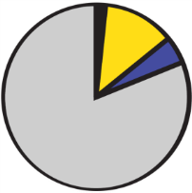
Overview
Target
Pigments
System
Replica
Recipe
Notes:
So we have this translucent material and we want to replicate its appearance, by mixing some [click] pigments with silicone.
Our goal is to design [click] a system that automatically [click] generates a pigment recipe (that when mixed [click]) results in a translucent replica which matches the target appearance.

Slide 3
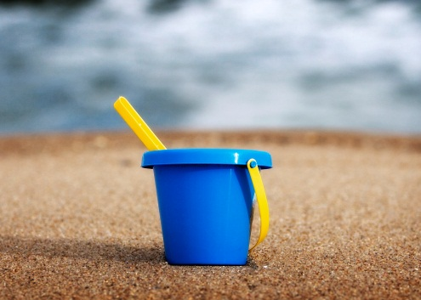
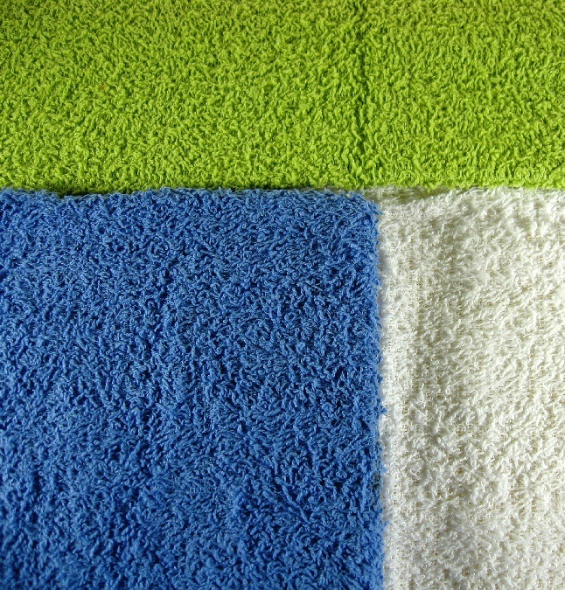
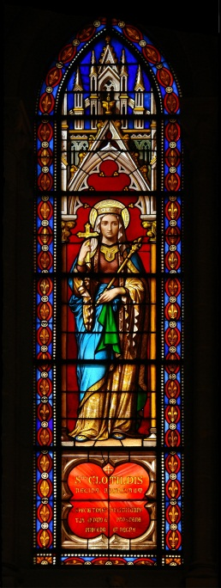
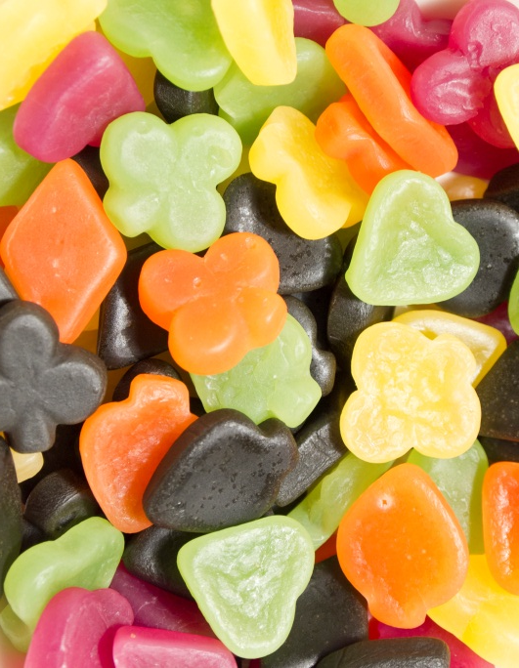
Motivation: Pigments are Everywhere
[Flickr/Longhorndave]
[wikimediacommons/yann]
[Flickr/Steve Johnson]
[wikimediacommons/kulmalukko]
Notes:
Many materials around us are colored by dyes, pigments or other colorants. Some examples of such materials are plastics [click], papers, textiles, stained glass, candy and others. Now if we were just interested in predicting and controlling their color then, fortunately the technology of doing that is very mature.

Slide 4
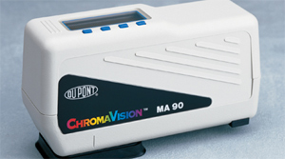
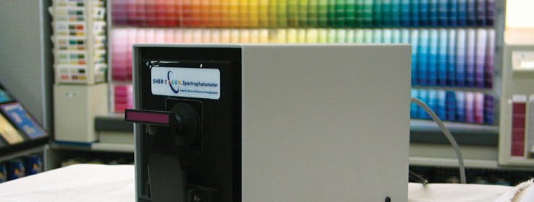
Replicating Color: Done
[dupont.com]
[sherwin-williams.com]
Dupont ChromaVision®
[1987]
Sherwin-Williams Sher-Color™
[1989]
Notes:
Here we show two of the many automated methods that exist for replicating just color.
The way these devices work is that they perform spectral color measurements and then pick a color match from a densely populated color palette.

Slide 5
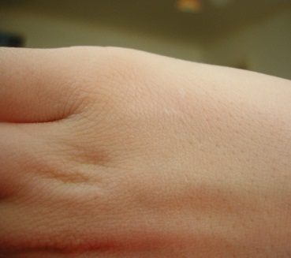
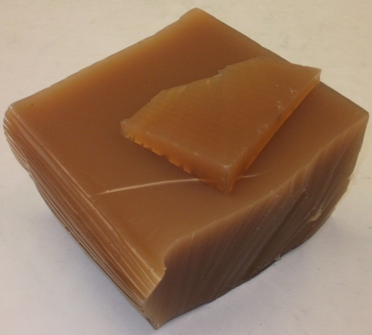
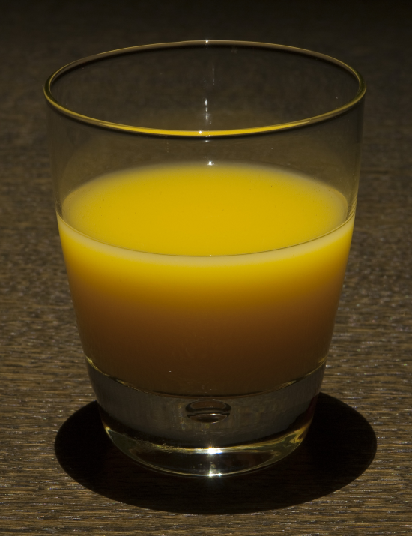
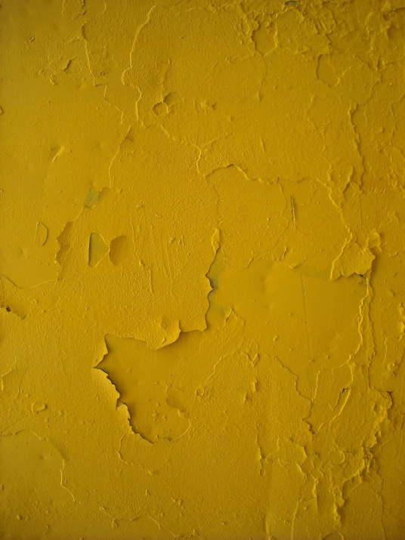
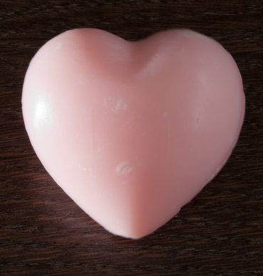
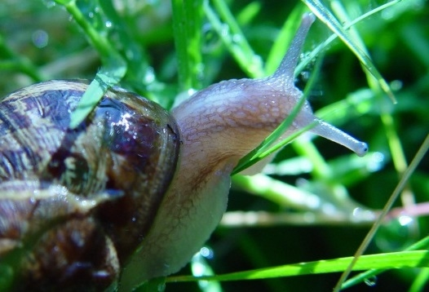
Importance of Translucency
[wikimediacommons/paperxcrip]
[wikimediacommons/Gmhofmann]
Ignored Subtle Important
Notes:
These methods work well for dense materials where their translucency can be ignored, such as wall paint for instance.
But they don’t work so well, for other materials where [click] translucency is subtly or obviously part of the appearance.
Translucency is a more complex phenomenon than diffuse color, and currently the appearance of such materials is normally controlled by trial and error.
Our goal is find a method that automatically replicates both color and translucency.

Slide 6
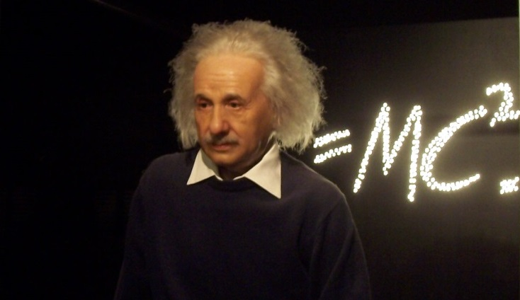
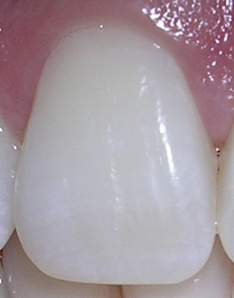
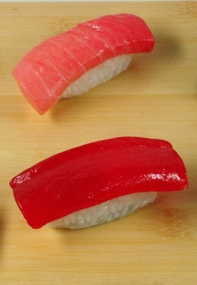
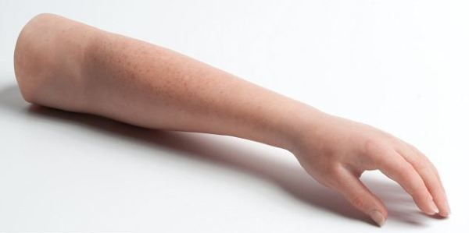
[wikimediacommons/dozenist]
?
[wikimediacommons/Lionel Allorge]
System
Notes:
Now if we have this ability of reproducing translucent materials [click] we can use it to create realistic looking [click] animatronic figures, [click] prosthetic limbs, [click] artificial teeth, and all kinds of other translucent materials like maybe.. Sushi [click]!
Appearance in all of these cases is currently matched manually by trial and error.

Slide 7
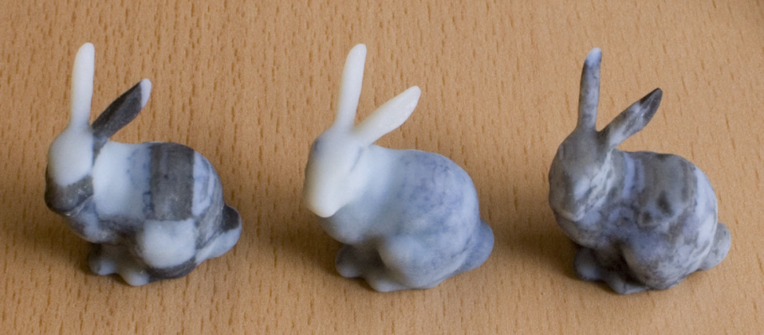
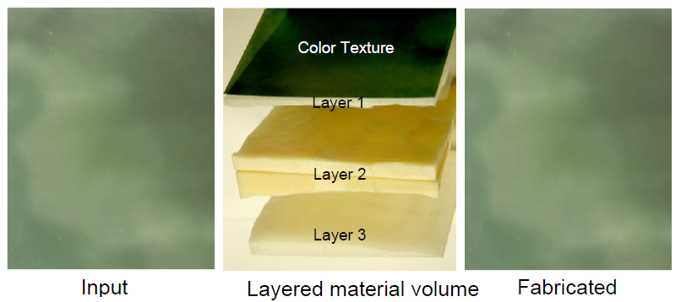
Related Work: Appearance Fabrication
Discrete combinations
Voxel dithering approach
[Hasan et al. 2010]
Multi-layer approach
[Tong et al. 2010]
Notes:
In the general area of fabricating translucent appearance, the focus has been so far on heterogeneous combinations of discrete materials.
Hasan et al in 2010 presented a method for fabricating translucent materials, using a voxel dithering approach. For a target SV BSSRDF, their method can find an arrangement such that the voxelized result would match the target.
Similarly [click] Tong et al, used a layered method where they modified the thickness of each layer for controlling the overall appearance.
These methods are limited by the fixed set of [click] discrete materials that are available either for dithering or for layering.
Its not clear how to use these methods for replicating a homogeneous, arbitrary shaped material, where its appearance is very different from the materials available for dithering or for layering.
Here the building blocks are fixed and currently there is no method, until now, for continuously varying the appearance of each individual voxel or layer.

Slide 8
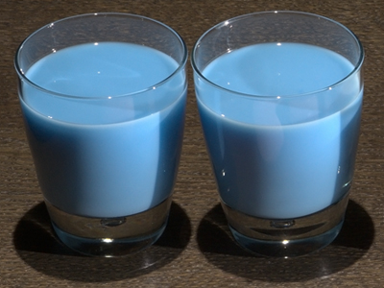
Our Goal
Reproduce
Translucency
Color
Real homogeneous materials
Continuous pigment mixtures
Replica
Target
Notes:
Our goal is to take a step back and create the fundamental technology of
reproducing [click] translucency as precisely as colour can already be reproduced,
on real homogeneous materials.
In addition we would like our method to be able to continuously [click] vary appearance by mixing pigments.

Slide 9
Problem Statement
Pigment Concentrations
Appearance
Forward Mapping:
Measurement
Target
Pigment 2 (%)
Translucency
Replica
Inverse Mapping
Recipe
Pigment 1 (%)
Color
Notes:
Lets define our problem statement a bit more formally.
We have a target translucent appearance and we would like to replicate it [click] using pigments.
Just for the purposes of this presentation [click] we pin down this target appearance as a point in a 2D space, where one axis is color [click] and the other is translucency. Actually in our paper appearance is properly treated as a higher dimensional space.
Now given this appearance, would like to find a [click] pigment recipe, that when mixed with silicone [click], will result in an identical replica.
Again for illustration purposes, the high dimensional pigment concentrations space is shown as a 2D [click] space with only 2 pigments.
The forward mapping from [click] concentrations to appearance is done by measurement, and finding the inverse mapping [click] is actually what this is all about.

Slide 10
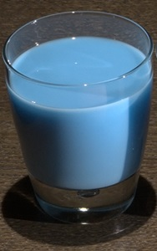
First Step for Replicating
Appearance
Target
Translucency
Color
Notes:
The first step needed for replicating a translucent target appearance, [click] is to be able to measure it, and map it into some appearance space.

Slide 11
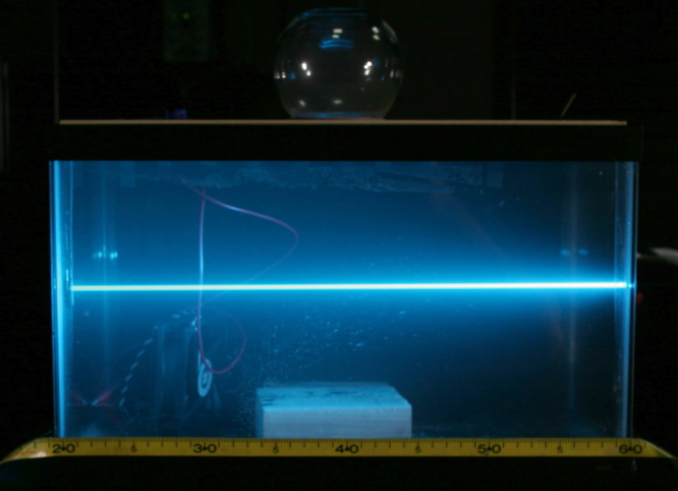
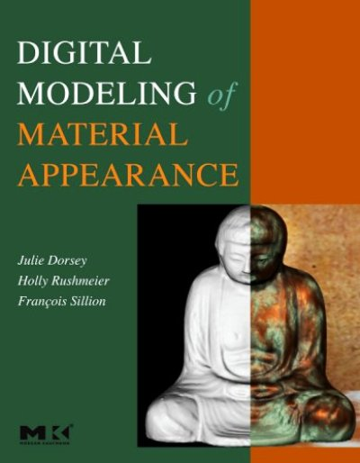
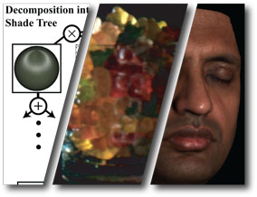
Related Work: Measurement
[Hawkins et al. 2005]
[Dorsey et al. 2008]
[Weyrich et al. 2009]
Notes:
There has been a large amount of work on measuring translucent materials, ranging from smoke, to homogeneous and heterogeneous BSSRDFs, to complex layered human faces.

Slide 12
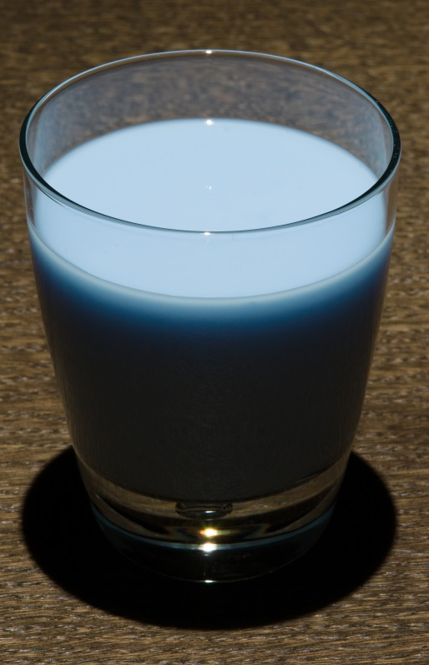
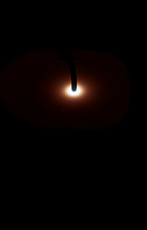
What to measure?
Color
Profile
Notes:
What we are interested in measuring, is first the color [click] of a target, by uniformly illuminated it.
Getting an accurate color measurement is extremely important and this is one of the main aspects of appearance.
The second measurement is of the bulk scattering profile [click], which is basically the BSSRDF value as a function of distance, when our sample is illuminated at a single point.

Slide 13
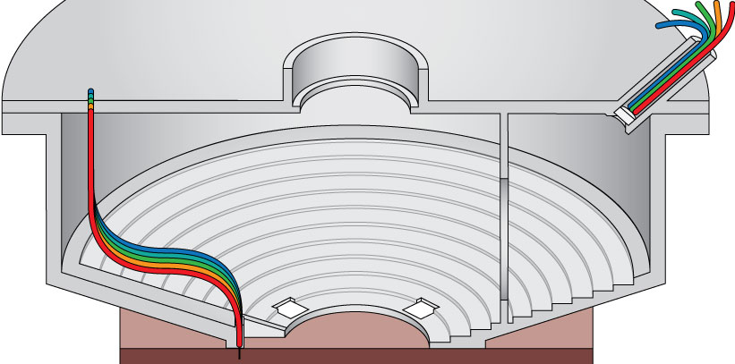
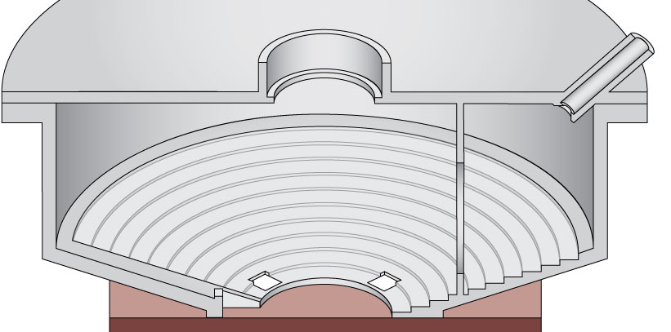
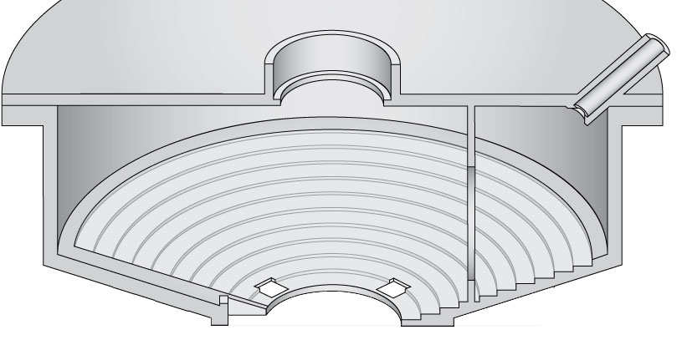
Measurement Device
LEDs 2
LEDs 1
Sample
Notes:
Here we see a cross-section view of our measurement device.
Our device can perform measurements in 5 spectral bands.
Our setup consists of a monochromatic camera located at the top center [click] looking down at the center of the sample to be measured.
This cylindrical box is around 20 cm in diameter and it is optimized for minimizing stray light.
Two identical sets of LEDs [click] emit light into fiber optic cables which illuminate the sample. And each set of LEDs is used to perform one type of measurement.

Slide 14
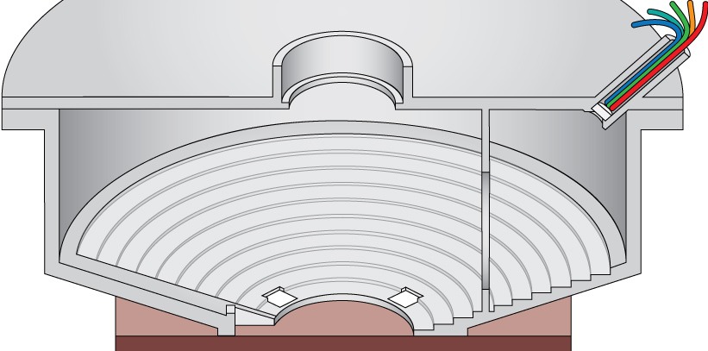
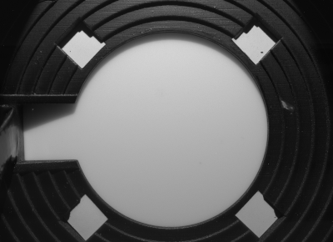
Measuring Reflectance
Notes:
For the reflectance measurement, [click] we uniformly illuminate the sample with our LEDs, through the fiber optic cables at the top right.
An example [click] captured HDR image is shown on the right. By using this HDR image and one of a calibration standard, we can compute the per wavelength band reflectance of the sample.

Slide 15
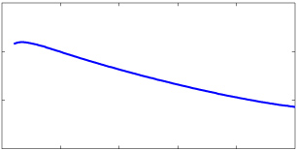
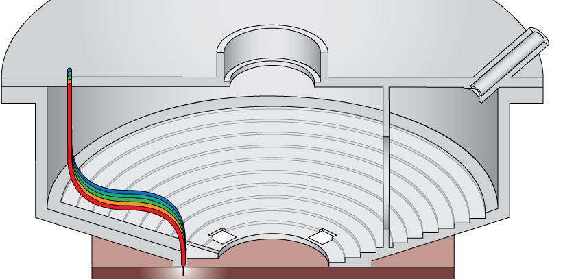
Measuring Bulk Scattering Profile
Notes:
This same device can also perform a second type of measurement, that of the bulk scattering profile.
The second pair of LEDs, illuminates the sample at the bottom left [click] through the other set of fiber optic cables.
The cables are in contact with the sample and as we can see [click] at the HDR image on the right the camera captures light that scattered through the measured material.
The bulk scattering profile measurement, can be easily extracted from this image as it is simply a line [click] starting from the location where the cables touch the sample.

Slide 16
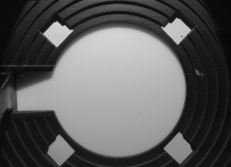
Measurement Device Ready
Pigment Concentrations
Appearance
Pigments
Pigment 2 (%)
Translucency
Pigment 1 (%)
Color
Notes:
So now that we have a measurement device, we can [click] characterize our pigments.
So we went down to the lab and [click] mixed a bunch of pigments with silicone, with the goal of sampling well, a variety of different appearances and the edge of our pigments gamut.
Then we measured [click] these mixtures, using our device, and we created, what we call our pigment measurement database.

Slide 17
From Appearance to Recipes
Linear
Relation
Forward Model
Pigment Concentrations
Scattering Parameters
Appearance
High-Dimensional Function
Non Linear
Minimization
Pigment 2 (%)
Absorption Coefficient
Translucency
Pigment 1 (%)
Scattering Coefficient
Color
Notes:
As expected, the [click] high dimensional function (from concentrations to appearance) which we would like to invert, is very non linear.
Our solution to this problem [click], is to use a fast and accurate forward model as an intermediate step, and invert that instead.
Again, the high dimensional scattering parameters of the model, that we show here, are simplified for illustration purposes.
A helpful property, of models that are based on radiative transport theory, is that they use physical parameters [click] which are linearly related to pigment concentrations.
So we can use a non-linear minimization [click] to invert the forward model and then use this linearity property to relate scattering parameters and pigment concentrations.

Slide 18
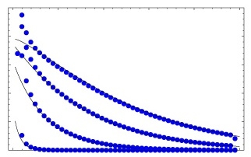
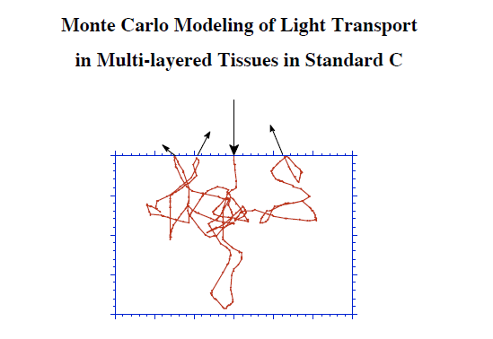
The Forward Appearance Model
Profile Shape
Reflectance
Quantized Diffusion
[D’Eon & Irving 2011]
MCML
[Wang et al. 1992]
Notes:
For this we created the following forward appearance model, by combining existing models, which meet all of the previously mentioned requirements.
For the profile shape measurement we used Quantized Diffusion. For diffuse reflectance [click] we used densely 2D tabulated results from a Monte Carlo simulator by Wang et al. The reason for using Monte Carlo simulations for reflectance is because we (humans) are extremely sensitive to color, and we needed a model with extremely high accuracy.

Slide 19
Fitting Using the Forward Model
Forward Model
Scattering Parameters
Appearance
Non Linear
Minimization
Notes:
Now we would like to use this forward model, in a non linear optimization, to fit scattering parameters on our measurements. For this fitting we need to define an objective function.

Slide 20
Objective Function: Reflectance
Forward model
Interpolate Monte Carlo
Low-order scattering
Reflectance distance
Mean square difference
Across all wavelength bands
Reflectance Measurement
Notes:
The first component of our objective function is the reflectance (or color) distance.
On the right, we show a reflectance measurement that we need to match. For predicting reflectance we use [click] interpolation over our densely tabulated Monte Carlo results, which can account for low-order scattering effects.
The reflectance distance [click] component of our objective function is basically the mean square difference between the model prediction and the measurement, across all wavelength bands.

Slide 21
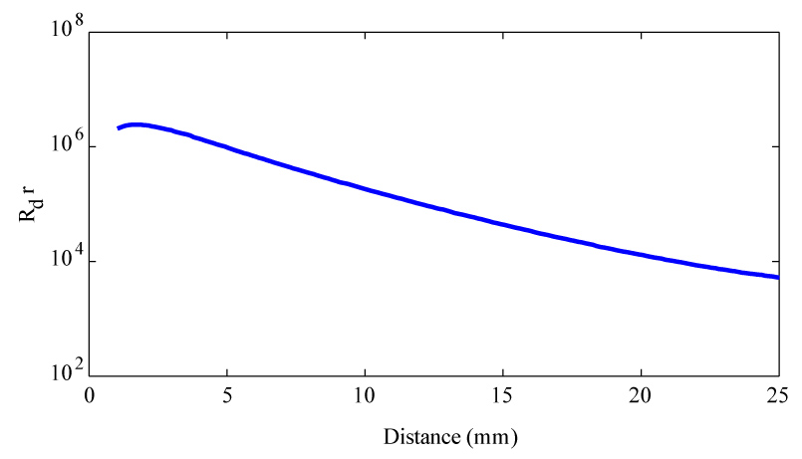
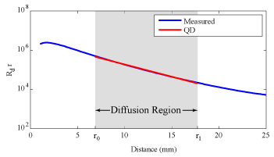
Objective Function: Profile Shape
Profile Shape Measurement
Forward model
Quantized Diffusion
Profile Shape distance
Within diffusion region
Across all bands
Noise &
Stray Light
Low-Order
Scattering
Notes:
The forward model [click] we use for predicting profiles is Quantized Diffusion.
In the semi-log plot shown on the right, we show the measured profile as a function of distance.
But there are a couple of problems:
If we are fitting on profile measurements too close to the light source, [click] then low order scattering effects are present and the model is not able to handle them properly.
On the other hand if we are fitting too far [click] then noise and stray light starts polluting our dim measurements.
In this middle “sweet spot” [click] diffusion works really well, and we use it to fit [click] parameters for QD that will match the shape of the measured data.

Slide 22
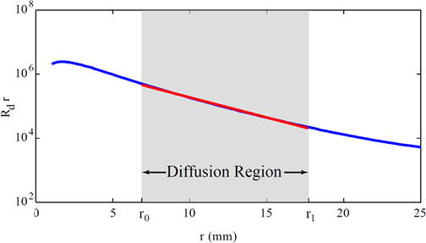
Objective Function: Appearance Distance
Final Objective Function
Appearance Distance
Combination of
Reflectance distance
Profile shape distance
Notes:
Our final objective function [click] we named as Appearance distance
Appearance distance is simply a combination [click] of the profile shape difference and reflectance difference across all measured wavelength bands.

Slide 23
Characterizing Pigments
Forward Model
Linear
Relation
Pigment Concentrations
Scattering Parameters
Appearance
Non Linear
Minimization
Pigment 2 (%)
Absorption Coefficient
Translucency
Pigment 1 (%)
Scattering Coefficient
Color
Notes:
Now we can use this appearance distance in a non-linear optimization to find scattering parameters for our pigment database measurements.
The parameters of our forward model are basically scattering and absorption coefficients (for each wavelength).
So the expected behavior when we increase the concentration of a pigment [click], is to get mixture parameters [click] that are linearly increasing with respect to concentration. This is dictated by RTT assuming that similarity theory holds.

Slide 24
Fitting Mixtures Independently
Global Pigment Parameter Estimation
Pigment Concentrations
Pigment Parameters
Scattering Parameters
Appearance
Pigment 2
parameters
Pigment 2 (%)
Absorption Coefficient
Pigment 2
parameters
Translucency
Pigment 1 (%)
Scattering Coefficient
Color
Notes:
By fitting independently you get these parameters which are consistent with appearances, but [click] there is often a range of parameters that can produce very similar appearance.
At the end of the day these samples were made by 6 different pigments, so the real unknowns are the scattering parameters of the pigments [click] and not the scattering parameters of each individual mixture.
So we can get a much better accuracy by performing a second fit where we fit on pigment parameters [click] (which are shown here as lines) instead of on independent mixtures.

Slide 25
Mixture Optimization
Forward Model
Linear
Relation
Non Linear
Optimization
Pigment Concentrations
Pigment Parameters
Appearance
Pigment 2
parameters
Pigment 2 (%)
Absorption Coefficient
Pigment 2
parameters
Translucency
Pigment 1 (%)
Scattering Coefficient
Color
Notes:
So we are now at our final step (which we call Mixture Optimization).
So far we found some scattering [click] parameters for our pigments, and we have a target [click] appearance measurement to match.
Since we know the scattering parameters of each pigment, we can [click] now blend them according to a recipe, and feed these into our forward model [click]. Then the model predicts some appearance for the mixture, which we finally compare against the target.
This is basically the inner loop of another non-linear optimization [click] , which aims to minimize the appearance distance, by tweaking the recipe and comparing the predicted appearance against the target.
It is important to note here that we minimize the appearance distance [click] and not the distance between scattering parameters, [click] since small residuals in parameters, might lead to large changes in appearance.

Slide 26
Summary
Forward Model
Linear
Relation
Pigment Concentrations
Pigment Parameters
Appearance
Non Linear
Optimization
Notes:
This concludes our method, we showed how to move from pigment concentrations to appearance with the use of a forward mapping, and also how to invert that by a non-linear minimization.
Let proceed now to our validations.

Slide 27
Validation in Simulation
T
R
T
R
T
R
T
R
T
R
T
R
T
R
T
R
T
R
T
R
T
R
T
R
T
R
T
R
Monte Carlo Validations
Virtual Measurement Device
Virtual Pigments
Targets: mix of pigments
Virtual Pigment Database
Shadow Edge Setup
Sample
Shadow
Edge
Sample
Blocker
Notes:
Ultimately we want to be able to replicate materials in the real world but we want to see how well our method works in an idealized environment first!
We used [click] Monte carlo simulations for generating our virtual device [click] measurements. Then we assigned parameters to our [click] virtual pigments and mixed [click] them to produce our virtual targets. We also created an analogous virtual database [click] of pigments for finding the pigment parameters. We then used our pipeline to find recipes for the virtual targets.
For our visual comparisons [click] the camera is looking down to the sample where the light is illuminating from the side. A blocker is also placed on the side such that it shadows half the sample and creates a shadow edge [click]. In the resulting image we can see the color of the sample on the top part and judge translucency by the blurriness of the shadow edge.
Now [click] we show the simulated results. On the left we show the targets, and on the right the replicas. In general we observe extremely good agreement (in this simulation) between the appearance of targets and their replicas .
This tells us that first, our optimization works well and second, that our forward model is a good approximation for Monte Carlo.

Slide 28
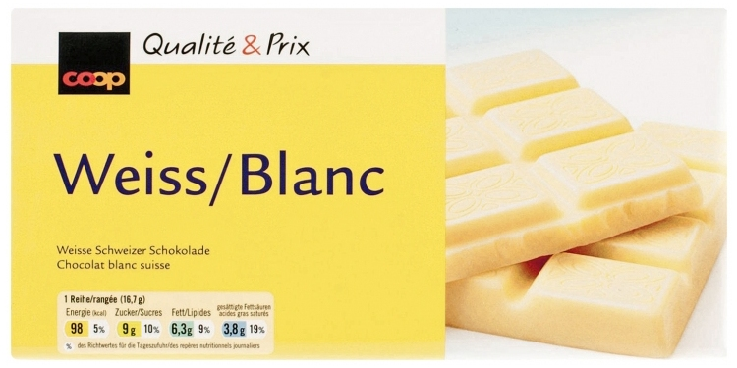
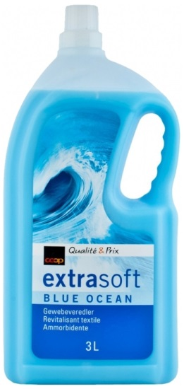
Results: Real World (Global Parameters)
Silicone
Mixture 1
Strawberry
Yogurt Drink
White
Chocolate
Mocca
Yogurt Drink
Blue Fabric
Softener
Full-Fat
Milk
Low-Fat
Milk
Silicone
Mixture 2
Pink Soap
T
R
T
R
T
R
T
R
T
R
T
R
T
R
T
R
T
R
Notes:
Now we are finally to the part where we will check how our method works for real world examples.
So we went to our local grocery shop and bought some translucent looking materials. In addition we created [click] 2 synthetic examples by mixing our pigments together.
As before we show shadow edge photographs of our targets, where again only the top part is illuminated. [click].
On the left we show the target, and on the right photographs of the replicas, where their recipes are automatically generated by our method.
With this visual inspection we observe generally good matches. Color matches well but also profiles match both in their tail colors and lengths.
An exception is the green [click] sample on the right, which is not a good match.
This specific target has low [PAUSE] optical thickness and it is relatively dark. (this is exactly where the forward model has the biggest approx error)

Slide 29
Extension: Local Refinement
Pigment 2
parameters
Pigment 1
parameters
Pigment 2
Absorption Coefficient
Translucency
Pigment 1
Scattering Coefficient
Color
Notes:
To account for these issues we propose an extension to the basic version of our method. We use local refinement to better improve the pigment parameters estimation, in regions of the domain where the forward model performs poorly.
Given the problematic target material marked with X [click], we use our global method [click] to find a replica that matches its appearance. But when we measure [click] the replica we find that actually the error in the predicted appearance is higher than we expected. What we can do is add [click] this sample in our database and locally re-weight the pigment parameters such that this sample will have a bigger influence on them.
By doing this local refinement we are able (in a successive iteration) to better match appearance, because we have a better estimate of the effective pigment parameters in the neighborhood of the target.

Slide 30
Local Vs. Global
Replica
(Global)
Replica
(Local)
Target
Notes:
Lets re-visit our problematic example [click].
Here we have a close-up of our previous comparison against the global method.
On the right now [click] we can see the result of the method with local refinement. We observe a much better match than the global method.
As previously mentioned we used the global replica as part of our pigments database and our method applied more weight on it during the pigment parameter estimation phase. This way we are able to find better pigment parameters in the neighborhood of the target.

Slide 31
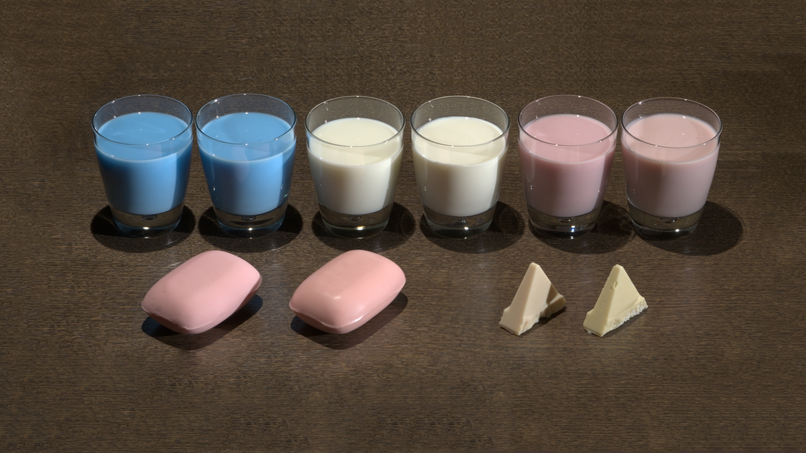
Results: Real World
Notes:
In this photograph we show a side by side comparison of target materials next to their replicas (which are on the left) under more natural illumination conditions.
Please notice that the color is generally matched well between our targets and replicas.
In addition translucency (around shadow edges) is matched really well.
In the case of the pink soap, there is an inconsistency in the specularity of the replica. This is due to our molding process which affected the surface roughness of the replica.

Slide 32
Summary
Target
Pigments
System
Replica
Recipe
Notes:
We presented a complete method for matching color and translucency of homogeneous translucent materials using continuous pigments. Our method uses a database of pigment measurements to find pigment scattering parameters and uses them to generate recipes of matching replicas.
We validated our method both in simulation and in the real world and finally I would like to refer you to our paper for further details about an extension of our method which allows editing.

Slide 33
Limitations & Future Directions
Heterogeneity by combining with
[Hasan et al. 2010] & [Tong et al. 2010]
Perceptual appearance distance
More accurate fast forward models
3D printing with pigment mixtures
Notes:
Further in to the future, we envision that our method will be combined with the voxelized and layered methods of Hasan eta al and Tong et al which are actually orthogonal to our research. We believe that our method can be used for continuously varying the properties of individual layers or voxels and consecutively extending the gamut of reproducible heterogeneous materials .
As we show in our paper there are spectral distributions that cannot be reconstructed using our pigments. We believe that by using [click] a perceptual appearance distance we will be able to find metamers instead to help in these cases.
Additionally our method will benefit from [click] fast and accurate forward models, which can handle low order scattering, arbitrary shapes, and micro-surface roughness at reasonable time frames.
Finally we envision a future where we will be able to very accurately 3D print [click] appearance and we hope that our research will motivate 3D printer manufacturers to allow continuous mixing of their materials.
Comments:
Surface roughness, phase functions (forward model)
How to measure rough?
SILICONE!!
We could somehow zoom out in this slide and show the small part we did and add the new directions
Sum up editing and then sum up the whole method (overview slide), remind what we achieved and then go to FW.
Take a step back and discuss the difference between the “seemingly” similar previous methods. They seem to be more general, but they are actually orthogonal …
ADD LIMITATIONS

Slide 34
Acknowledgments
Internal review
Simon Heinzle
Marc Polleyfeys
Bernhard Thomaszewski
Derek Nowrouzezahrai
Deadline & Discussions
Amit Bermano
Mitsuba Renderer
Wenzel Jakob
Anonymous reviewers
Notes:
I would like to thank … for reviewing an early draft of this project.
Amit Bermano for helping me out with the deadline and for our various fruitful discussions about this project.
Also I would like to thank Wenzel Jakob for his support when I was using Mitsuba renderer.
In addition I would like to thank the anonymous reviewers for their feedback and guidance.

