Slide 1

A bidirectional formulation for
Walk on Spheres
Yang Qi, Dario Seyb, Benedikt Bitterli, Wojciech Jarosz

Slide 2
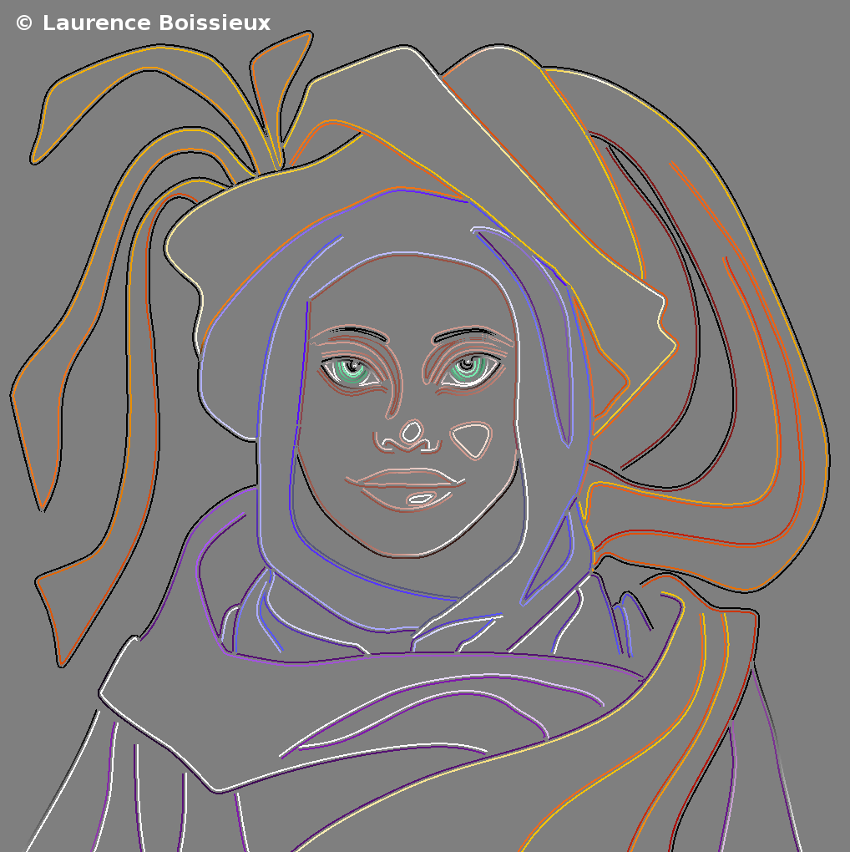
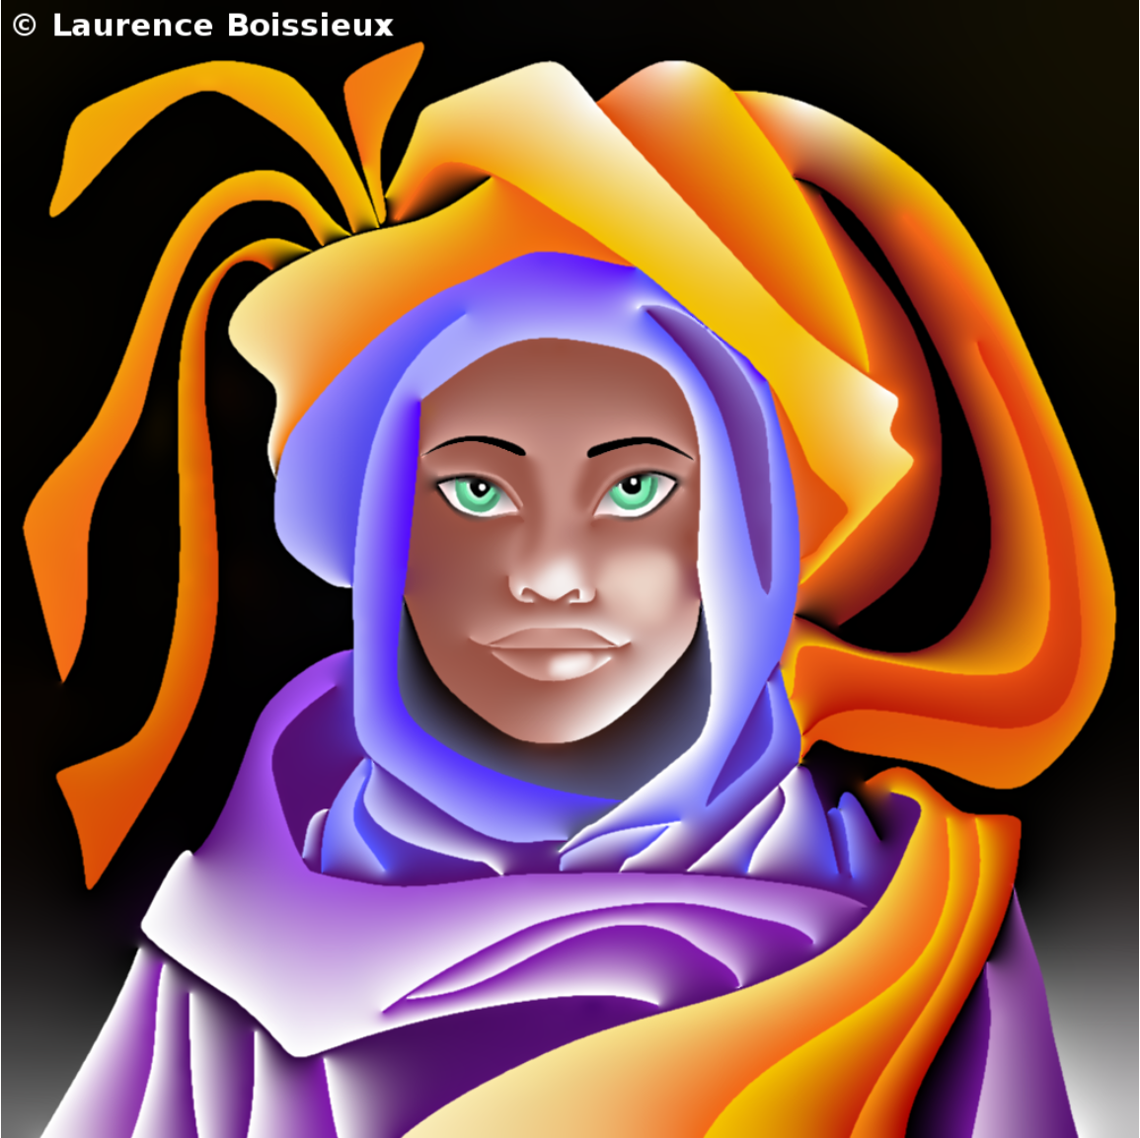
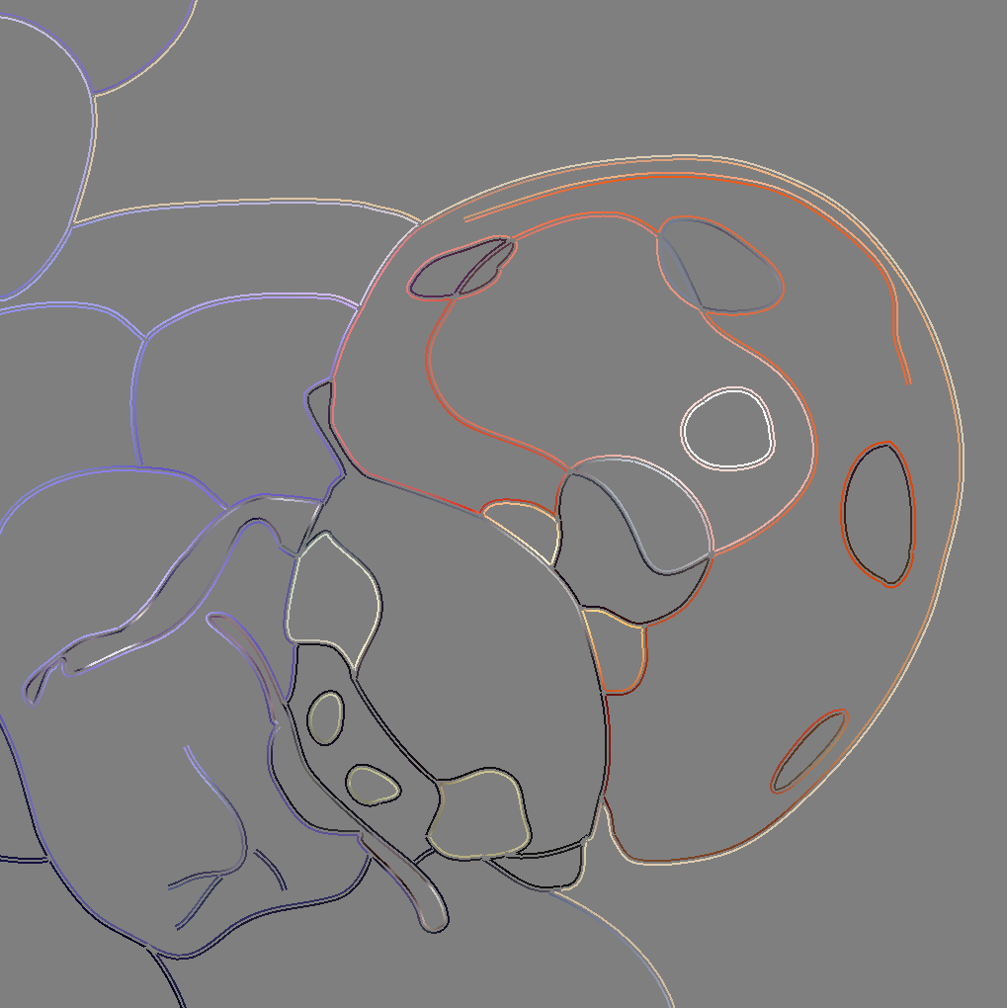
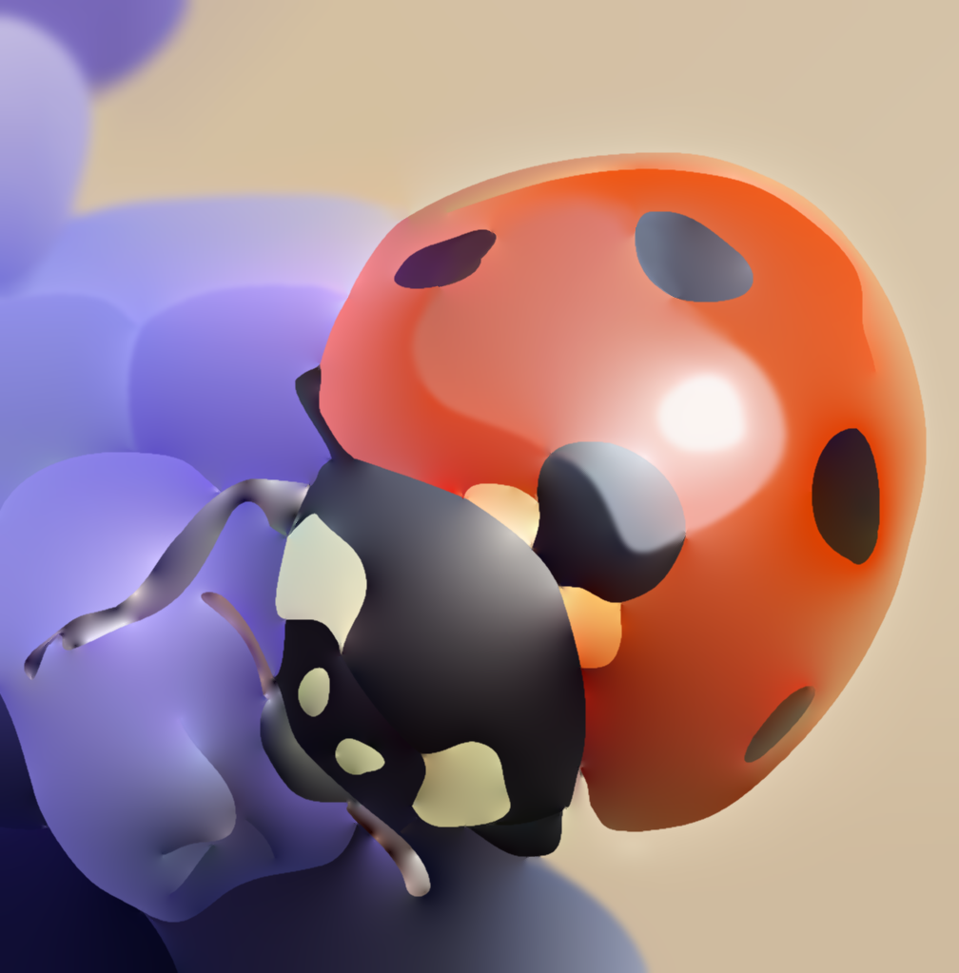
Diffusion curves
Orzan, A. Bousseau, A. Winnemöller, H. Barla, P. Thollot, J. and Salesin, D.
“Diffusion curves: a vector representation for smooth-shaded images” (SIGGRAPH 2008)
Bowers, J. Leahey, J. and Wang, R.
“A Raytracing Approach to Diffusion Curve” (EGSR 2009)
Prévost, R. Jarosz, W. Sorkine-Hornung, O.
“A Vectorial Framework for Ray Traced Diffusion Curve” (Computer Graphics Form 2015)
…
https://maverick.inria.fr/Publications/2008/OBWBTS08/
https://maverick.inria.fr/Publications/2008/OBWBTS08/

Slide 3
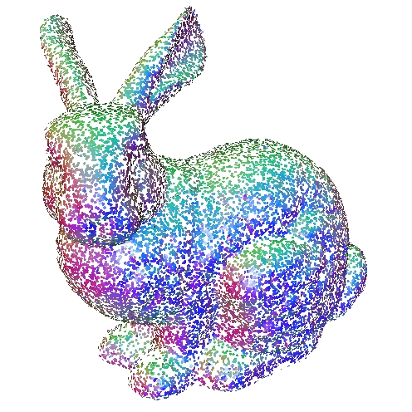
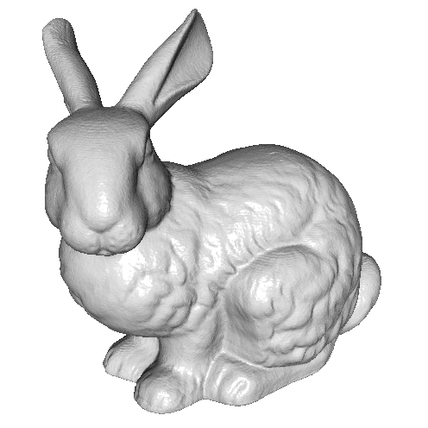
Surface reconstruction
Kazhdan, M. Bolith, M. and Hoppe, H.
“Poisson Surface Reconstruction” (SGP 2006)
Kazhdan, M. and Hoppe, H.
“Screened Poisson surface reconstruction” (SIGGRAPH 2013)
…
https://hhoppe.com/proj/screenedpoisson/

Slide 4
Subsurface Scattering
Joe Stam “Multiple scattering as a diffusion process” (EGSR 1995)
Christensen, N. and Jensen, H.
“A Practical Guide to Global Illumination using Photon maps” (SIGGRAPH 2000)
d’Eon, E. Irving, G.
“A Quantized-Diffusion Model for Rendering Translucent Materials” (SIGGRAPH 2011 )
…
https://graphics.stanford.edu/courses/cs348b-00/course8.pdf
https://naml.us/paper/deon2011_subsurface.pdf

Slide 5
PDE Solver
Traditional PDE solver
Finite element method
Finite difference method
Meshing is costly for complex shape
cs.dartmouth.edu/wjarosz/publications/sawhneyseyb22gridfree.html

Slide 6
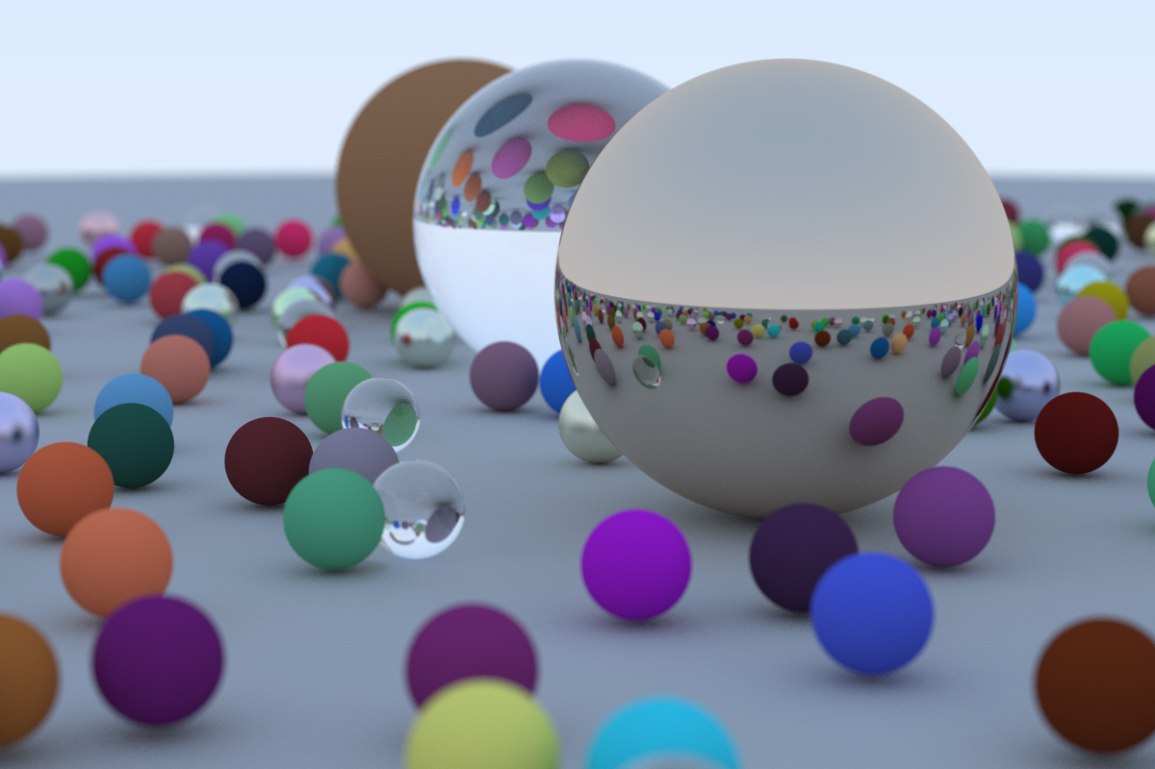
Methods in Rendering
Mesh based method
“Radiosity and Realistic Image Synthesis”
Wallace, J. and Cohen, M. (1993)
…
Monte-Carlo method
“The Rendering Equation”
James T. Kajiya. (1986)
…
www.cg.tuwien.ac.at/research/rendering/rays-radio/
raytracing.github.io/books/RayTracingInOneWeekend.html

Slide 7
Walk on Spheres (WoS)
Mervin E. Muller (Ann. Math. Statist. 1956)
“Some continuous monte carlo methods for the Dirichlet problem”
Sawhney, R. and Crane, K. (SIGGRAPH 2020)
“Monte Carlo geometry processing”
Sawhney, R. Seyb, D. Jarosz, W. and Crane, K (SIGGRAPH 2020)
“Grid free Monte Carlo for PDEs with spatially varying coefficients”

Slide 8
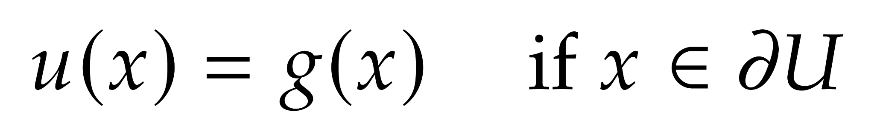
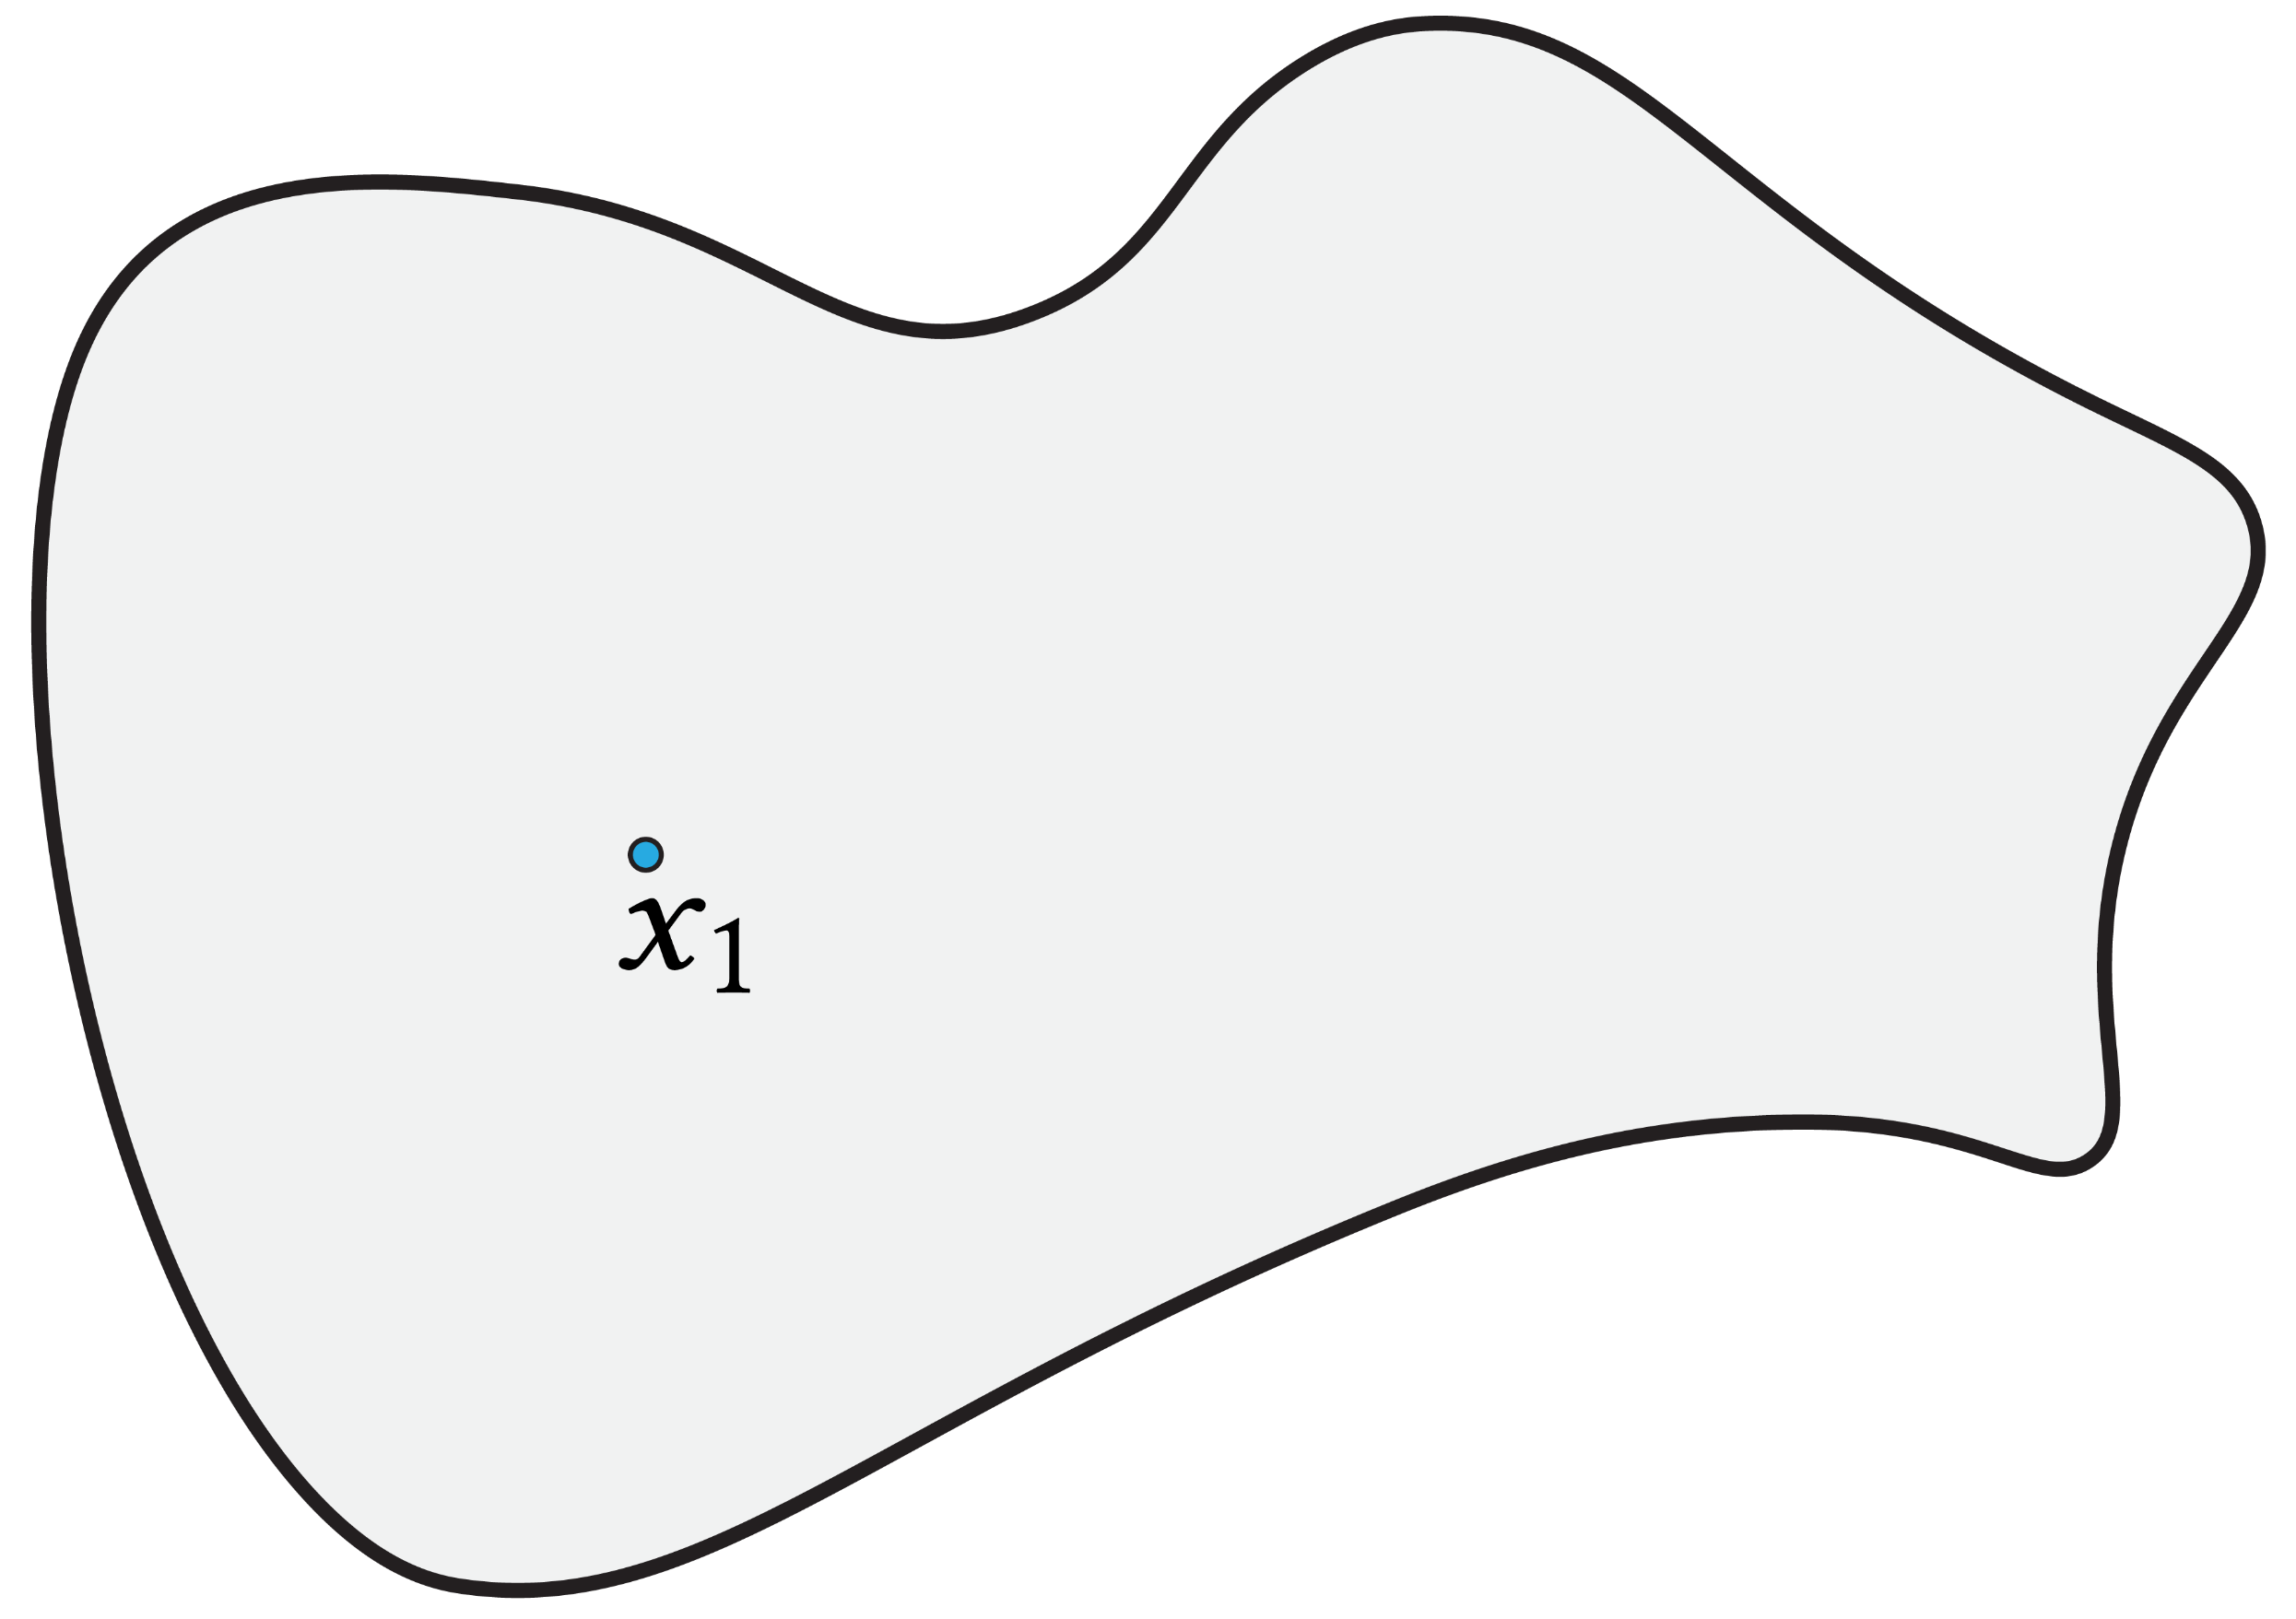
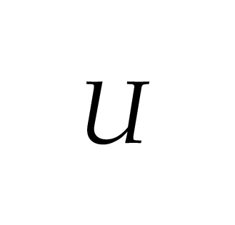
Walk on Spheres (WoS)
How to solve u(x) inside U?

Slide 9
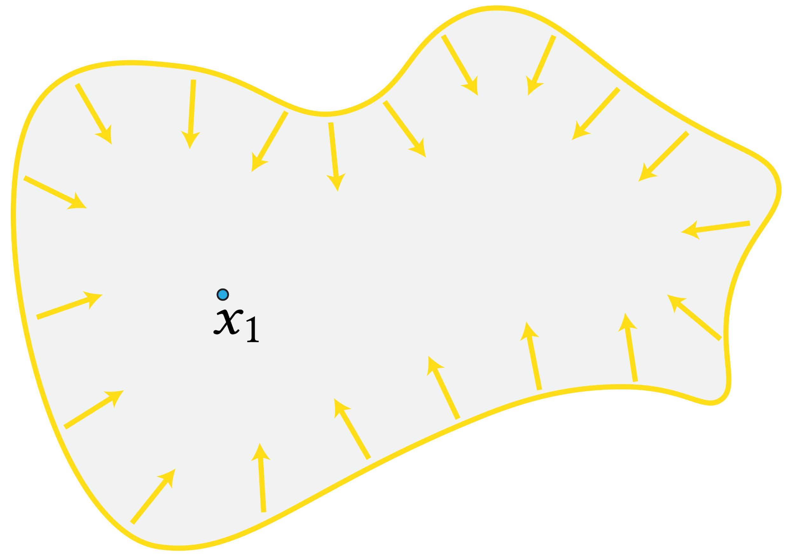
Walk on Spheres (WoS)
How to solve u(x) inside U?

Slide 10
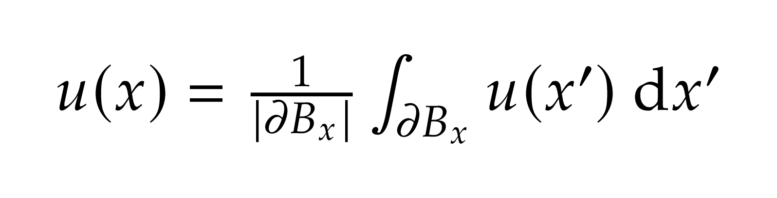
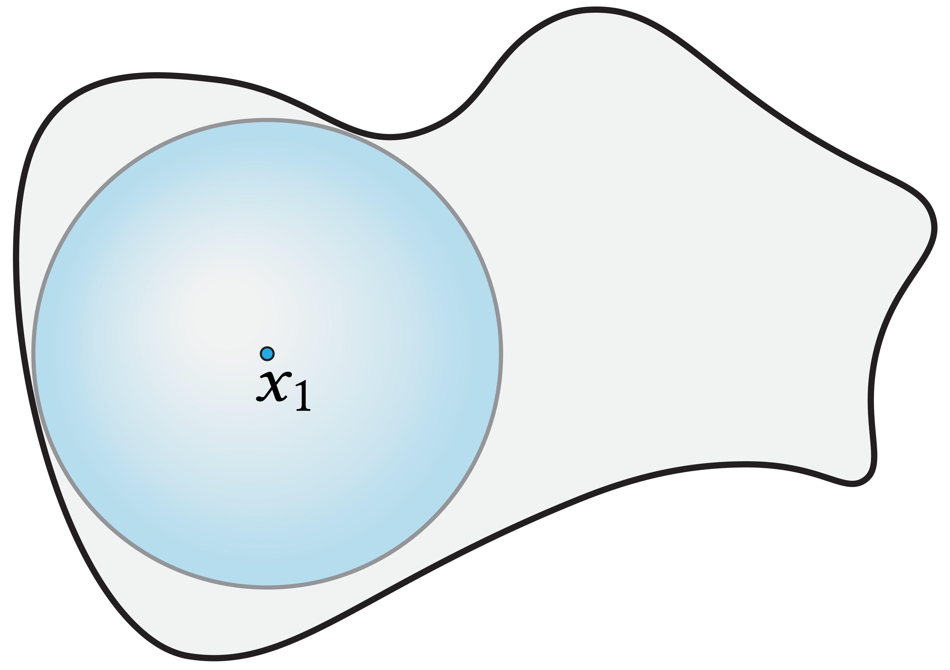
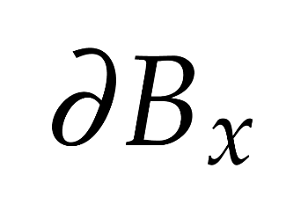
Walk on Spheres (WoS)
Mean value theorem:

Slide 11
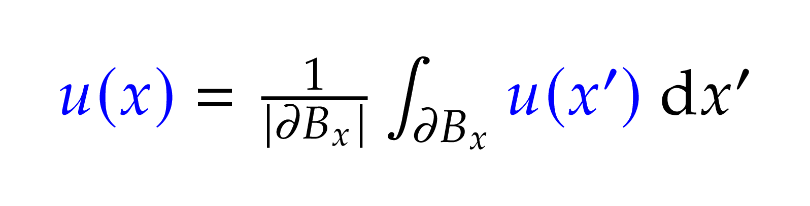
Walk on Spheres (WoS)
Mean value theorem:
Rendering Equation[Kaj86]:

Slide 12
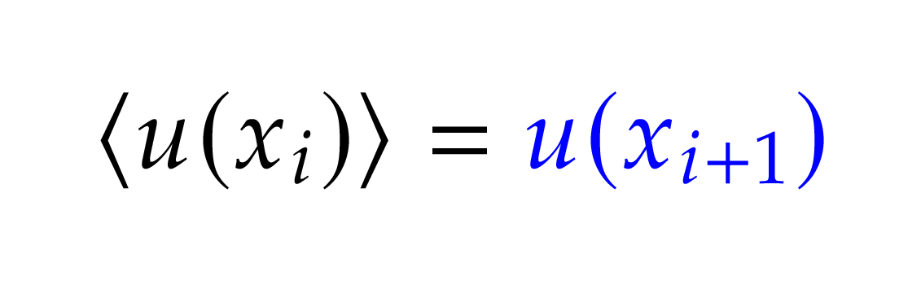
Walk on Spheres (WoS)
Mean value theorem:
Estimator:

Slide 13
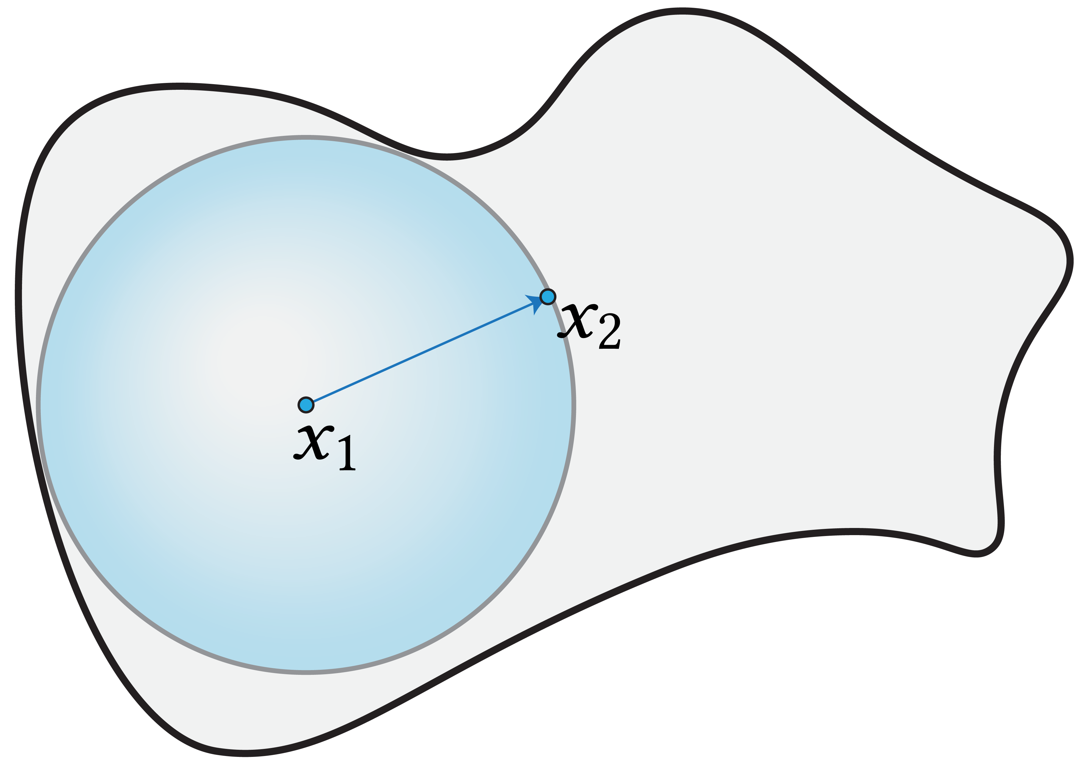
Walk on Spheres (WoS)
Mean value theorem:
Estimator:

Slide 14
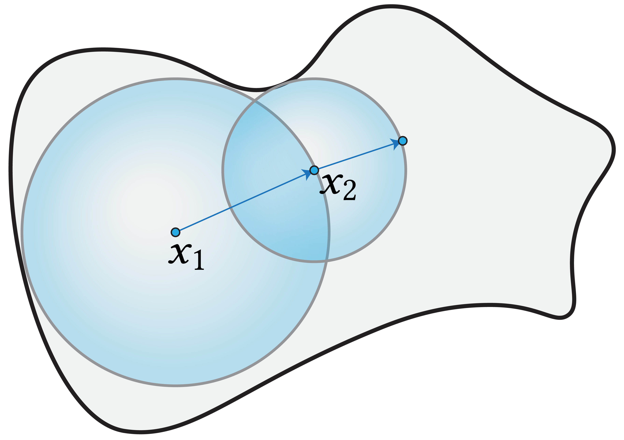
Walk on Spheres (WoS)
Mean value theorem:
Estimator:

Slide 15
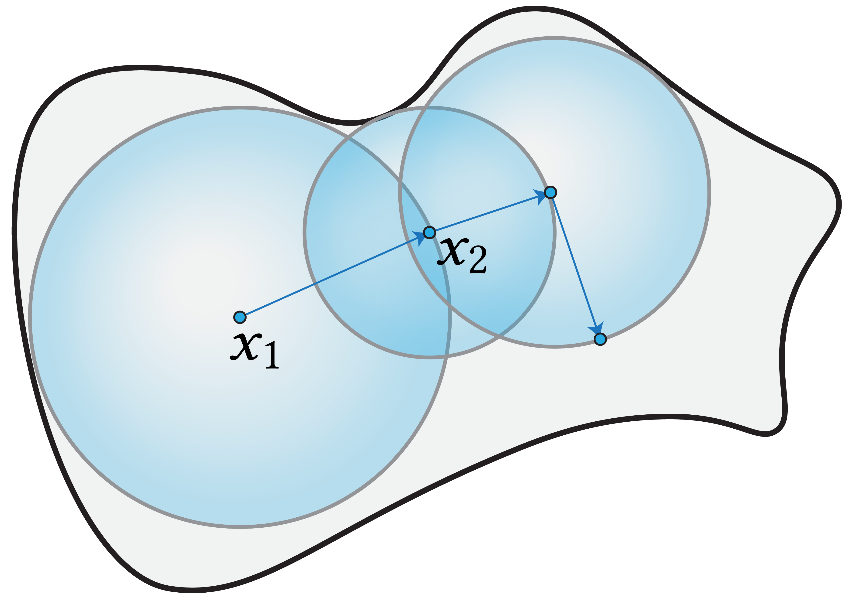
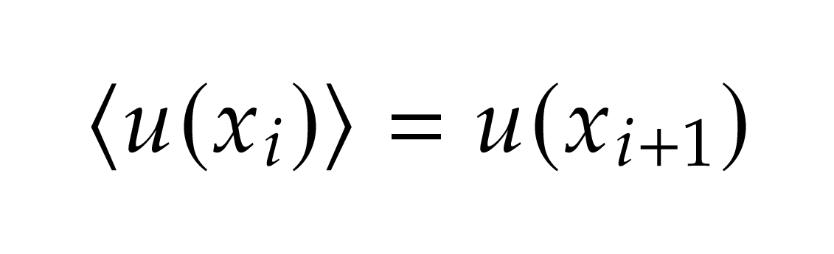
Walk on Spheres (WoS)
Mean value theorem:
Estimator:

Slide 16
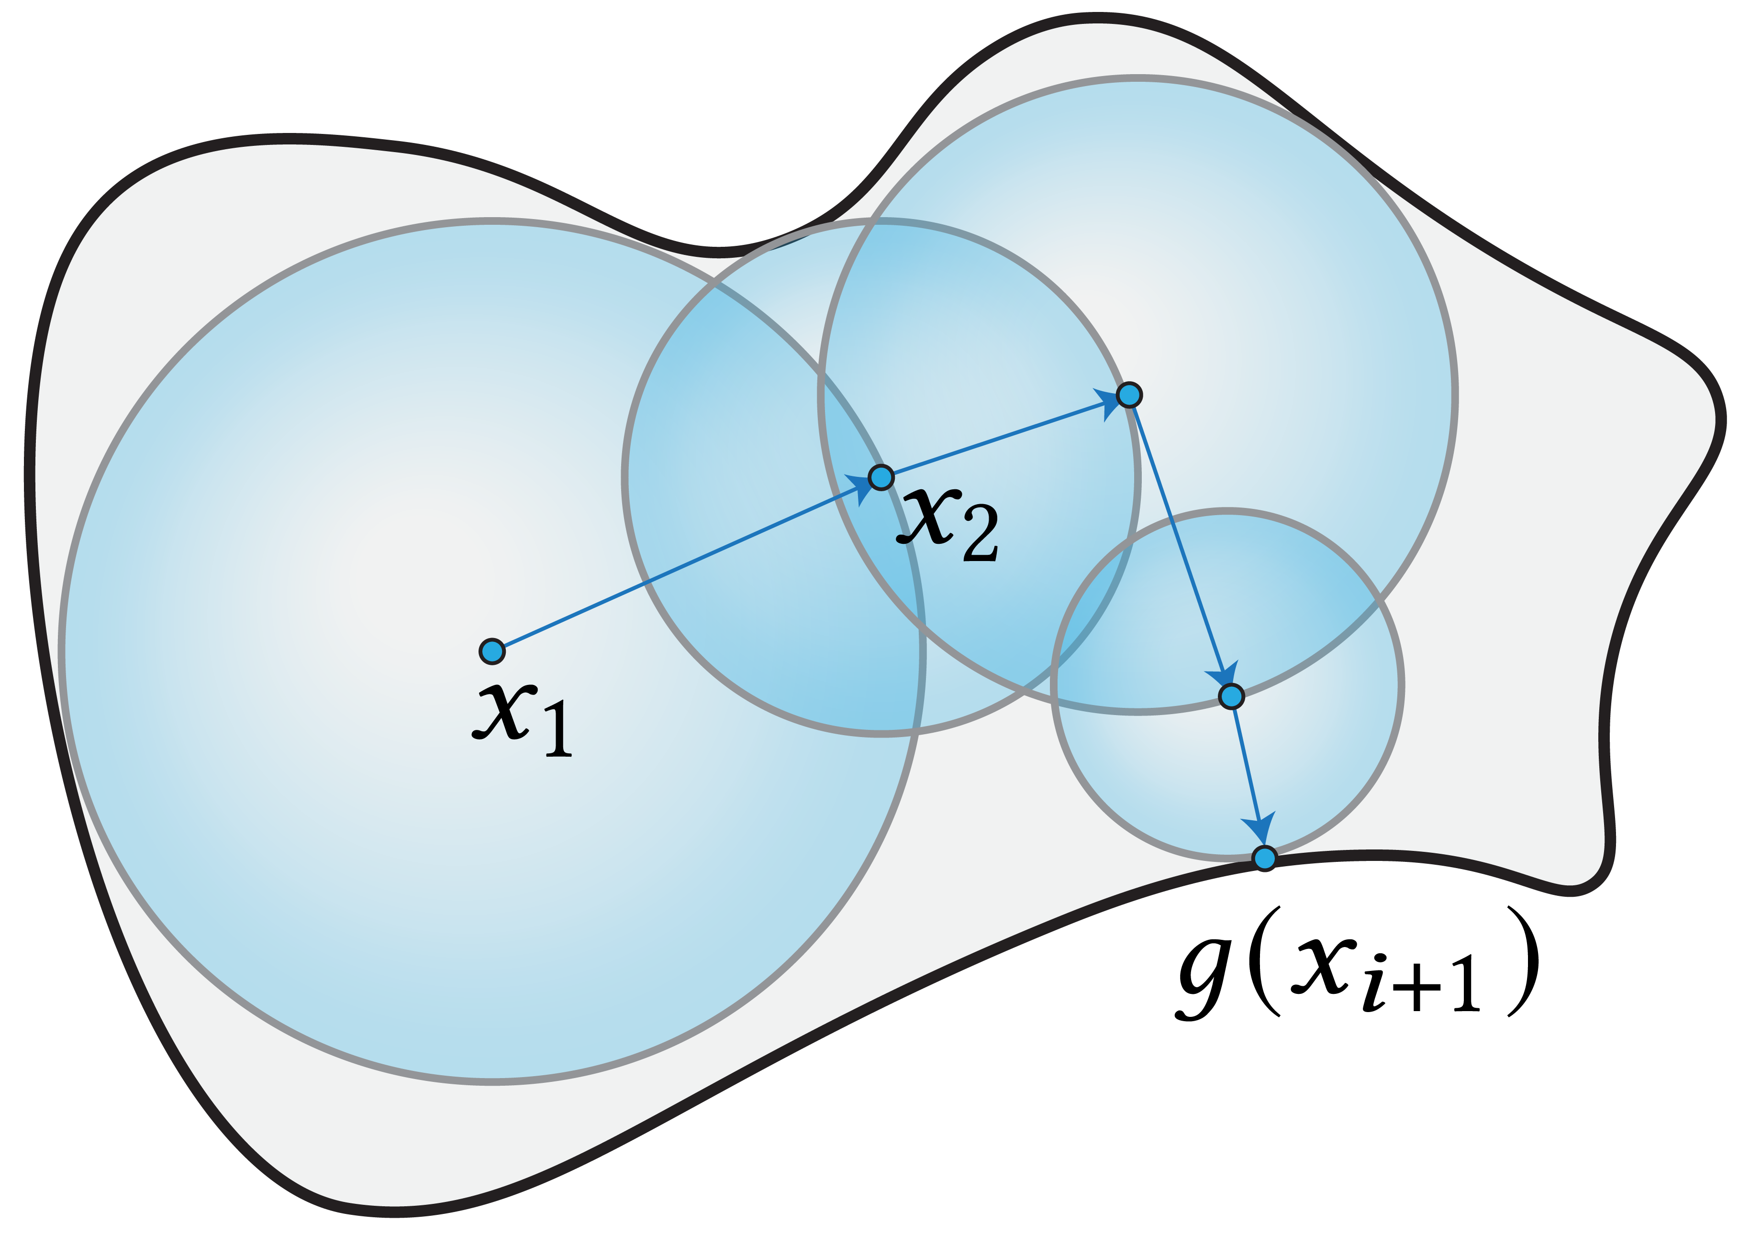
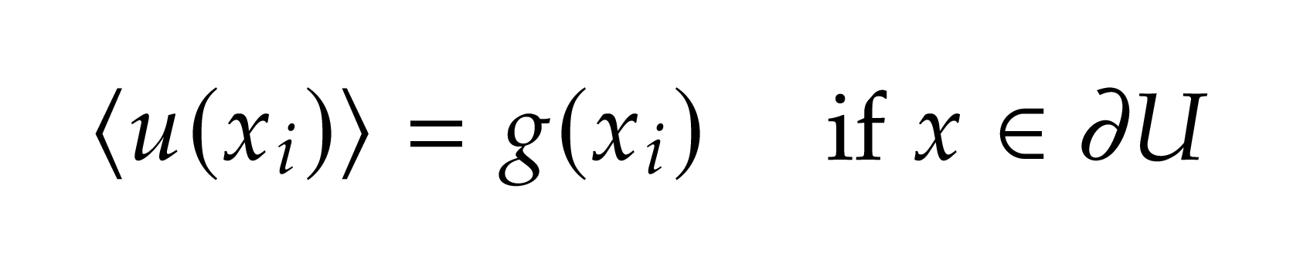
Walk on Spheres (WoS)
Mean value theorem:
Estimator:

Slide 17
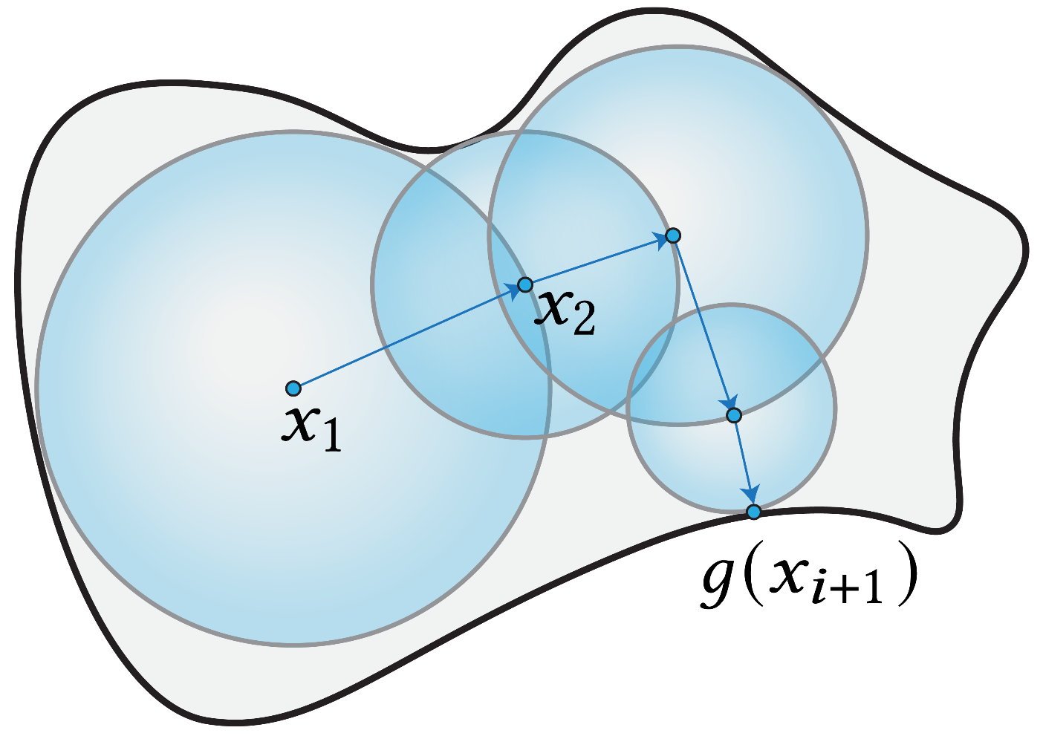
Rendering & PDE
“Forward” Method
“Reverse” Method
Path Tracing
Rendering:
No reuse of paths
No global importance sampling
raytracing.github.io/books/RayTracingInOneWeekend.html
Walk on Spheres
PDE:

Slide 18
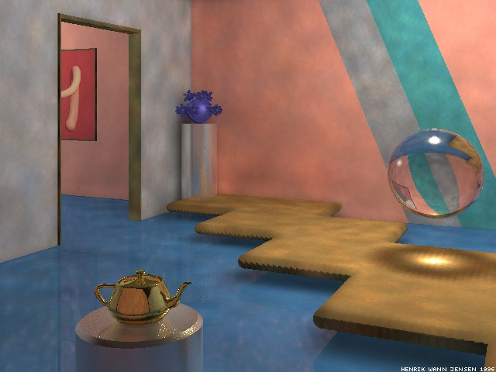
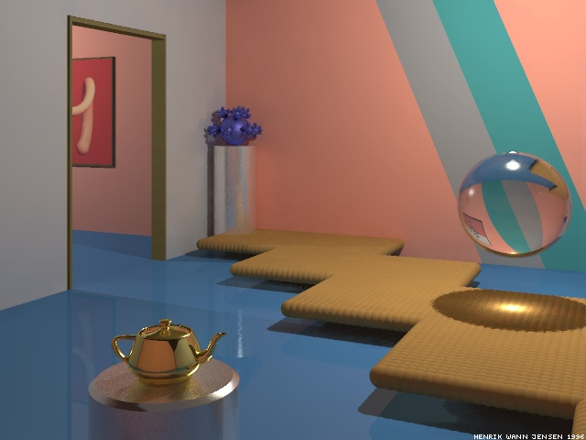
Photon mapping
    Henrik Wann Jensen
    “Global illumination using photon maps”
    Henrik Wann Jensen
    “Realistic Image Synthesis Using Photon Mapping”
    …
http://graphics.ucsd.edu/~henrik/papers/photon_map/

Slide 19
VPL / Many-light rendering
Keller, A.
“Instant Radiosity” (SIGGRAPH 1997)
Walter, B. Fernadandez, S. Arbree, A. Bala, K. Donikian, M. and Greenberg, D. P.
“Lightcuts: a scalable approach to illumination” (SIGGRAPH 2005)
Walter, B., Arbree, A., Bala, K., and GREENBERG, D. P.
“Multidimensional lightcuts” (SIGGRAPH 2006)
Hašan, M., Pellacini, F., and Bala, K.
“Matrix row-column sampling for the many-light problem” (SIGGRAPH 2007)
…

Slide 20
Rendering & PDE
“Forward” Method
“Reverse” Method
Path Tracing
Photon Mapping / VPLs
Rendering:
raytracing.github.io/books/RayTracingInOneWeekend.html
graphics.ucsd.edu/~henrik/papers/photon_map/
Walk on Spheres
“Reverse WoS”?
PDE:
?

Slide 21
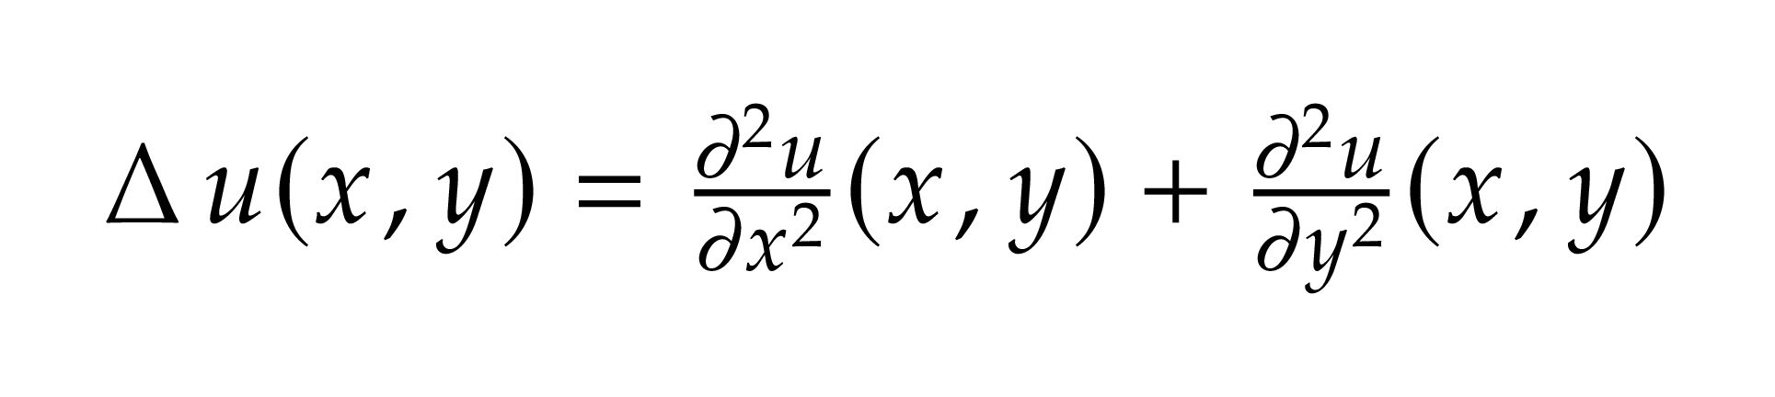
PDE
Laplace operator:
Sum of second derivatives

Slide 22
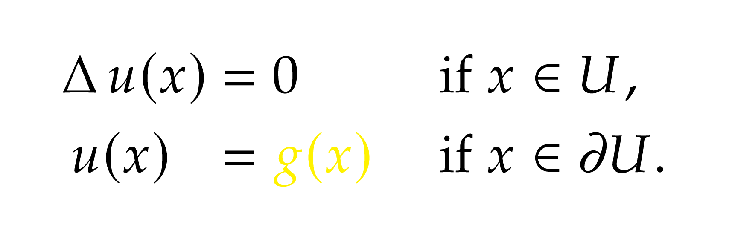
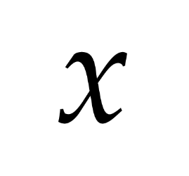
PDE
Poisson’s equation:

Slide 23
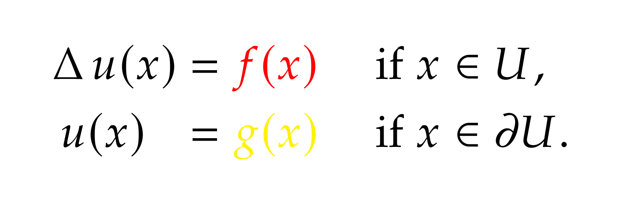
PDE
Poisson’s equation (with sources):

Slide 24
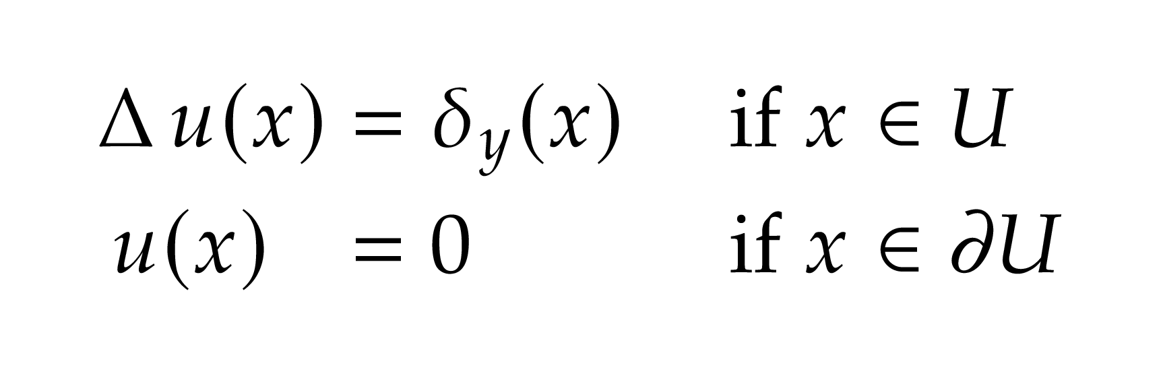
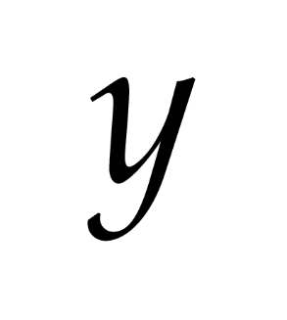
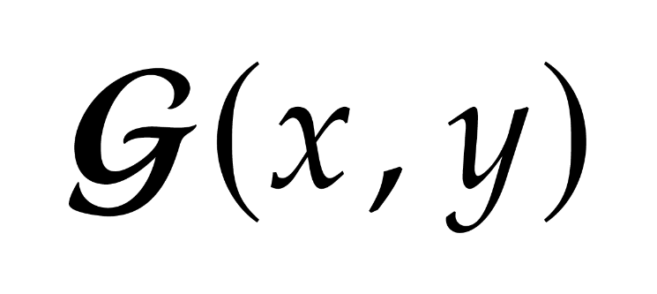
Green’s Function
Delta-Point source:
Green’s function:
Solution to the delta point source PDE

Slide 25
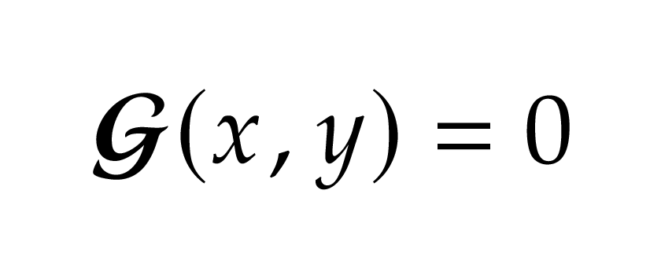
Green’s Function
Delta-Point source:
Green’s function:
Solution to the delta point source PDE
Define if x or y is not inside U

Slide 26
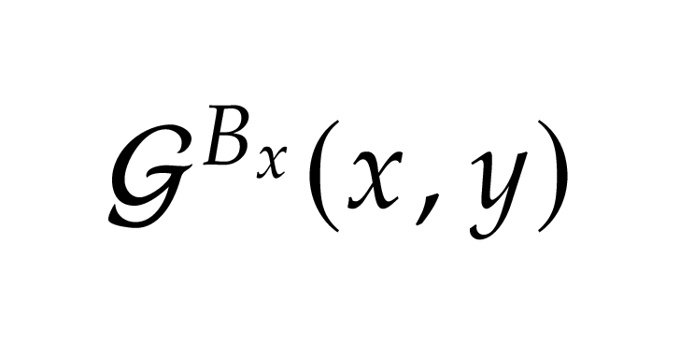
Green’s Function
Green’s function for the domain
(Usually hard to calculate)
Green’s function for the ball
(Has a simple analytical form)

Slide 27
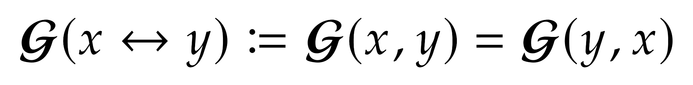
Symmetry property of Green’s Function
Use double side arrow to denote the symmetric property

Slide 28
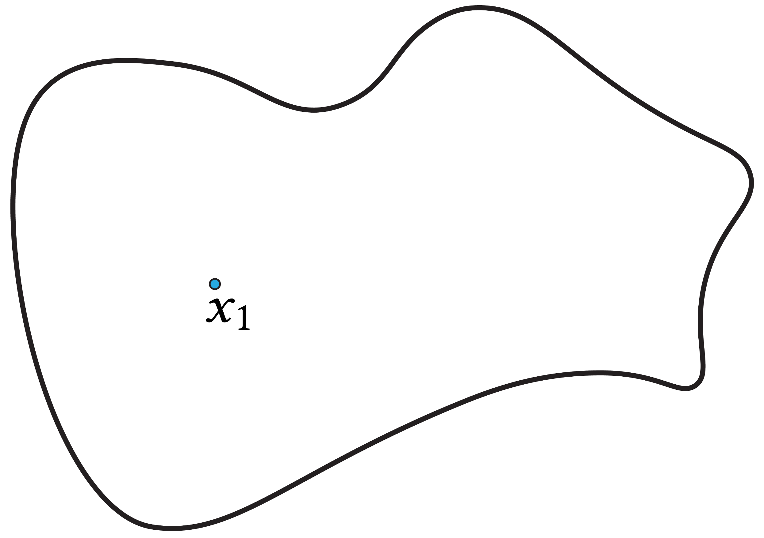
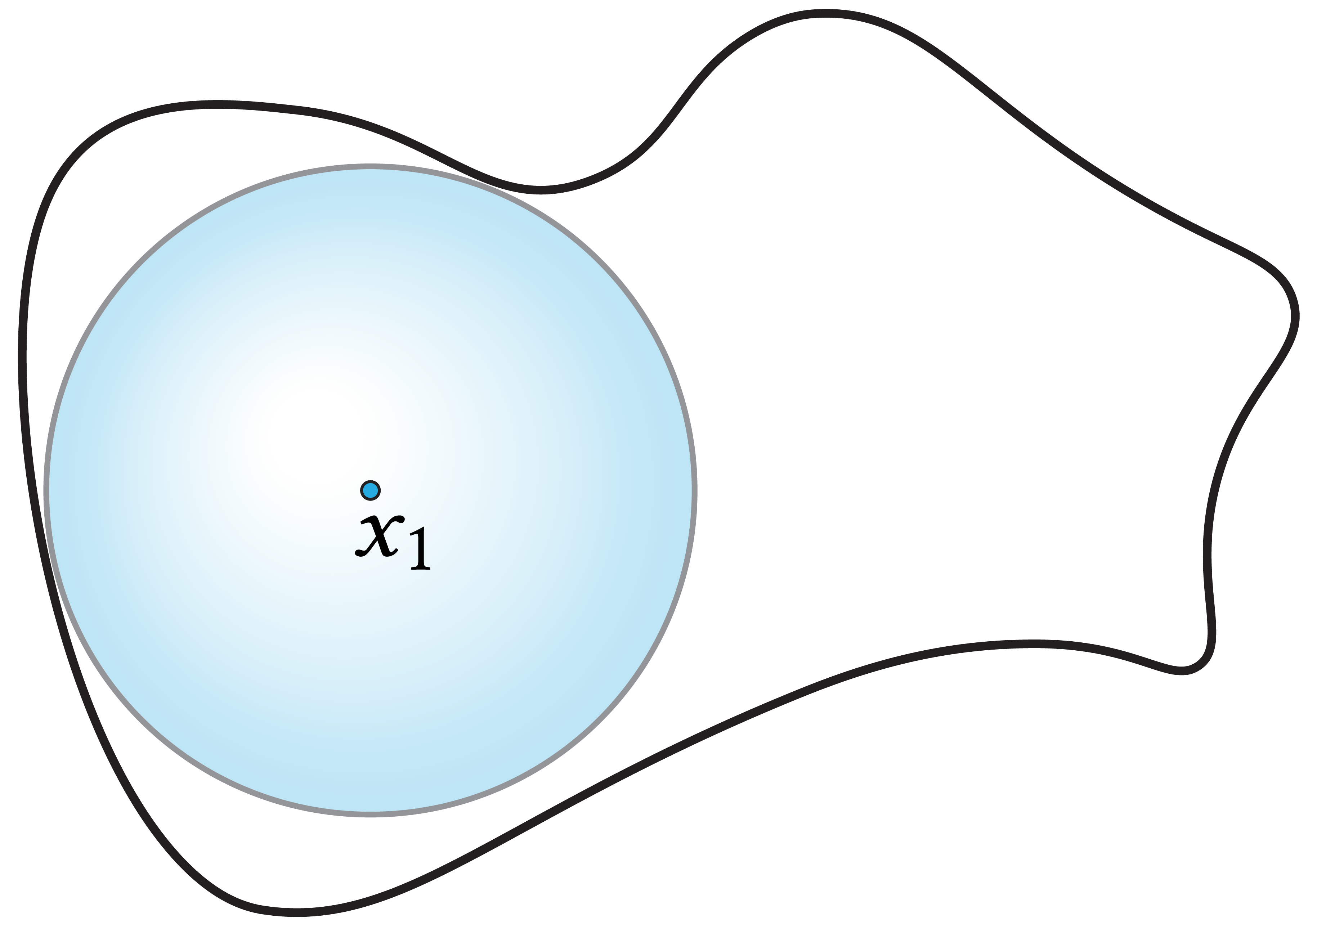
Walk on Spheres with Sources
Mean Value Theorem:

Slide 29
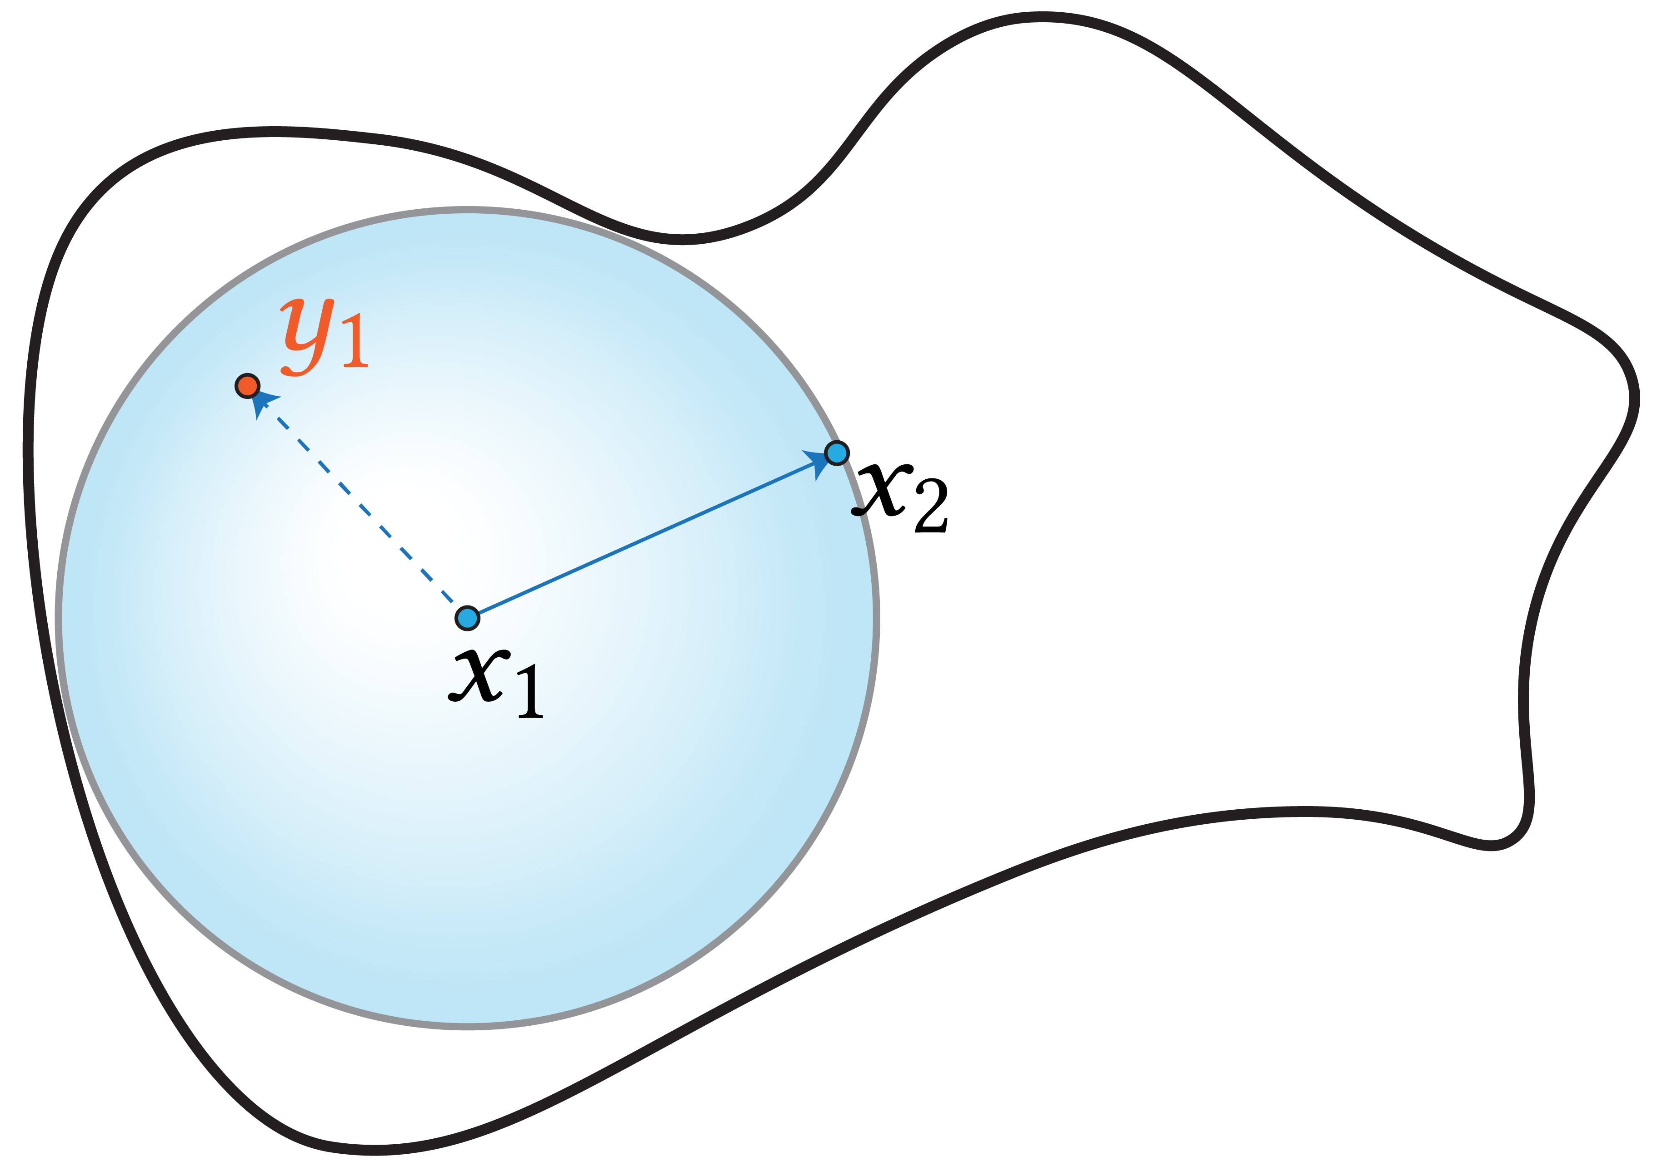
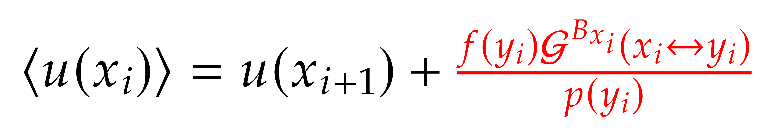
Walk on Spheres with Sources
Mean Value Theorem:
Estimator:
Estimate contribution from sources

Slide 30
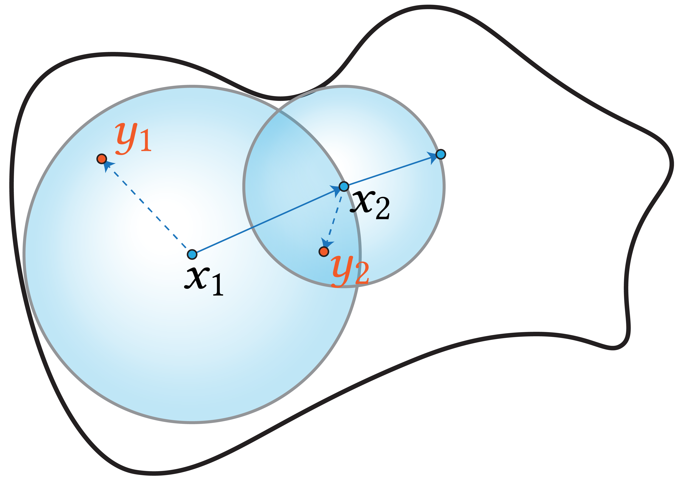
Walk on Spheres with Sources
Mean Value Theorem:
Estimator:

Slide 31
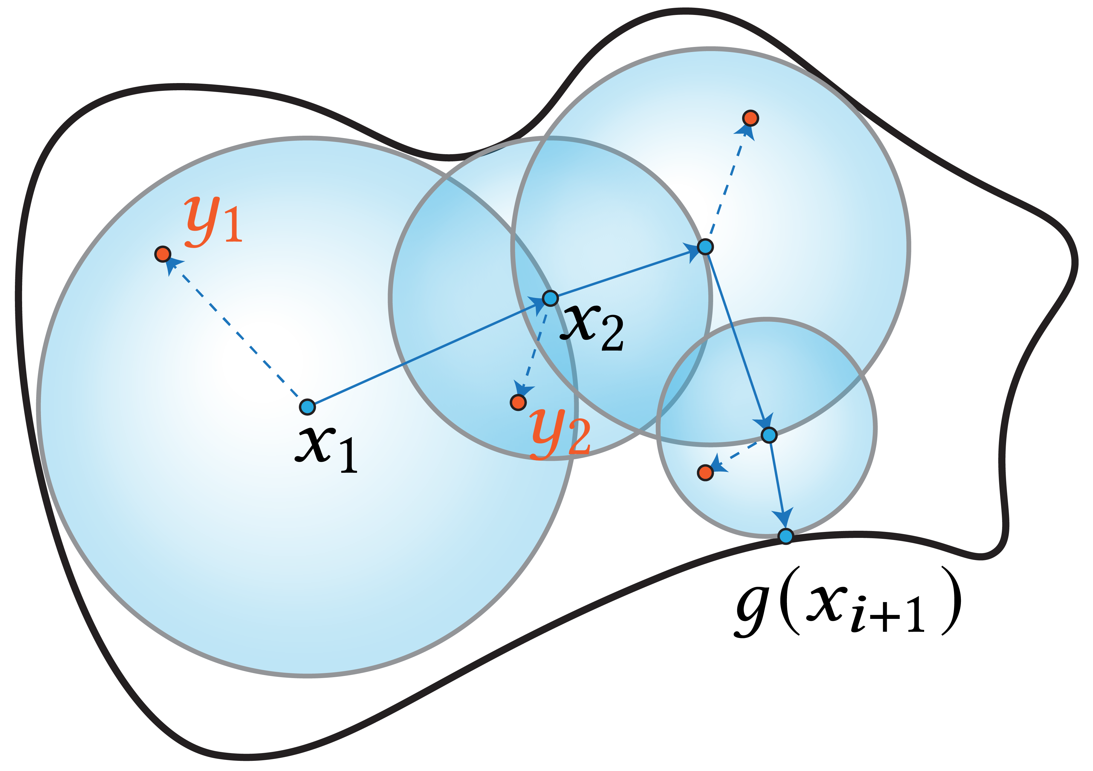
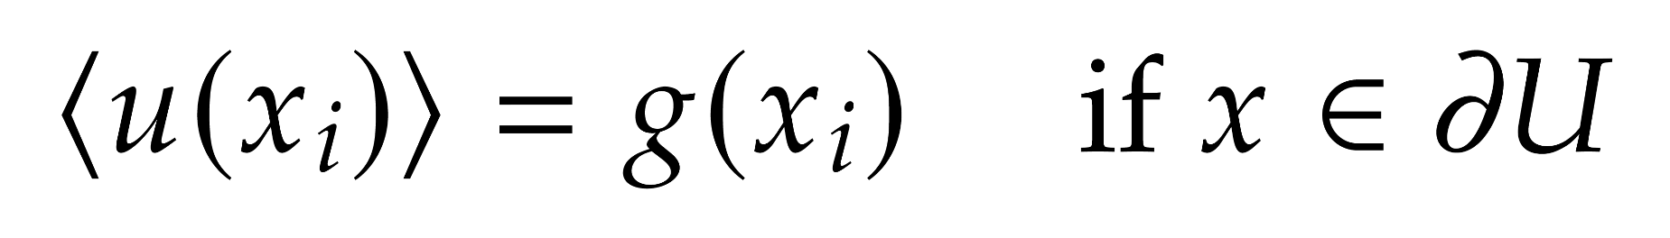
Walk on Spheres with Sources
Mean Value Theorem:
Estimator:

Slide 32
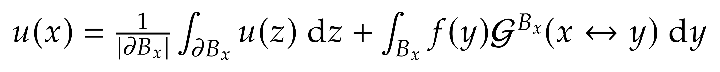
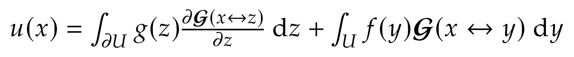
Our Approach
Mean Value Theorem:
Representation formula using Green’s function:
Need an estimate for the Green’s function!

Slide 33
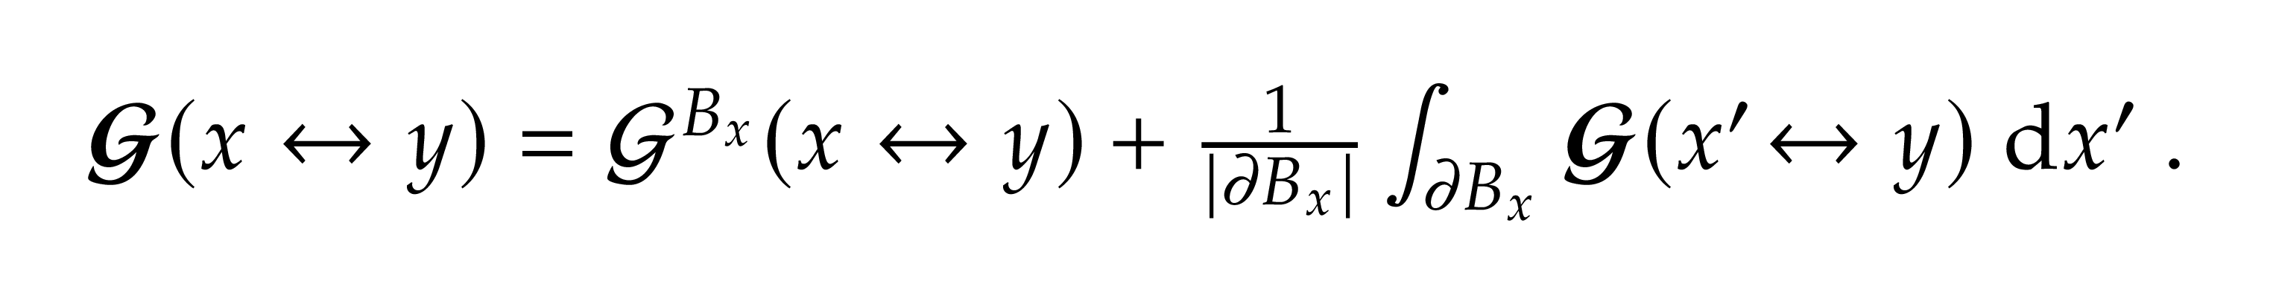
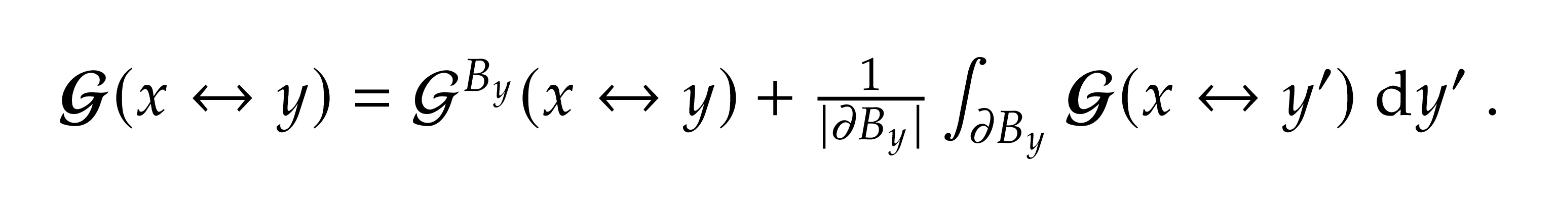
MVT for Green’s function
Delta point source PDE
+
Mean value theorem
=
MVT for Green’s function:
Swap x and y:

Slide 34
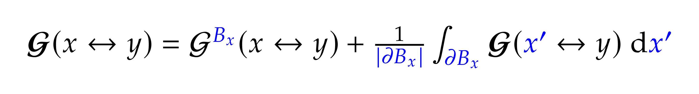
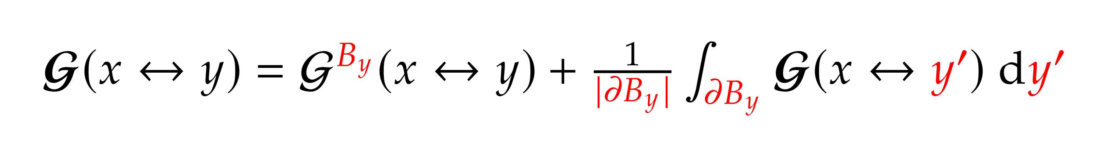
MVT for Green’s function
MVT for x:
MVT for y:

Slide 35
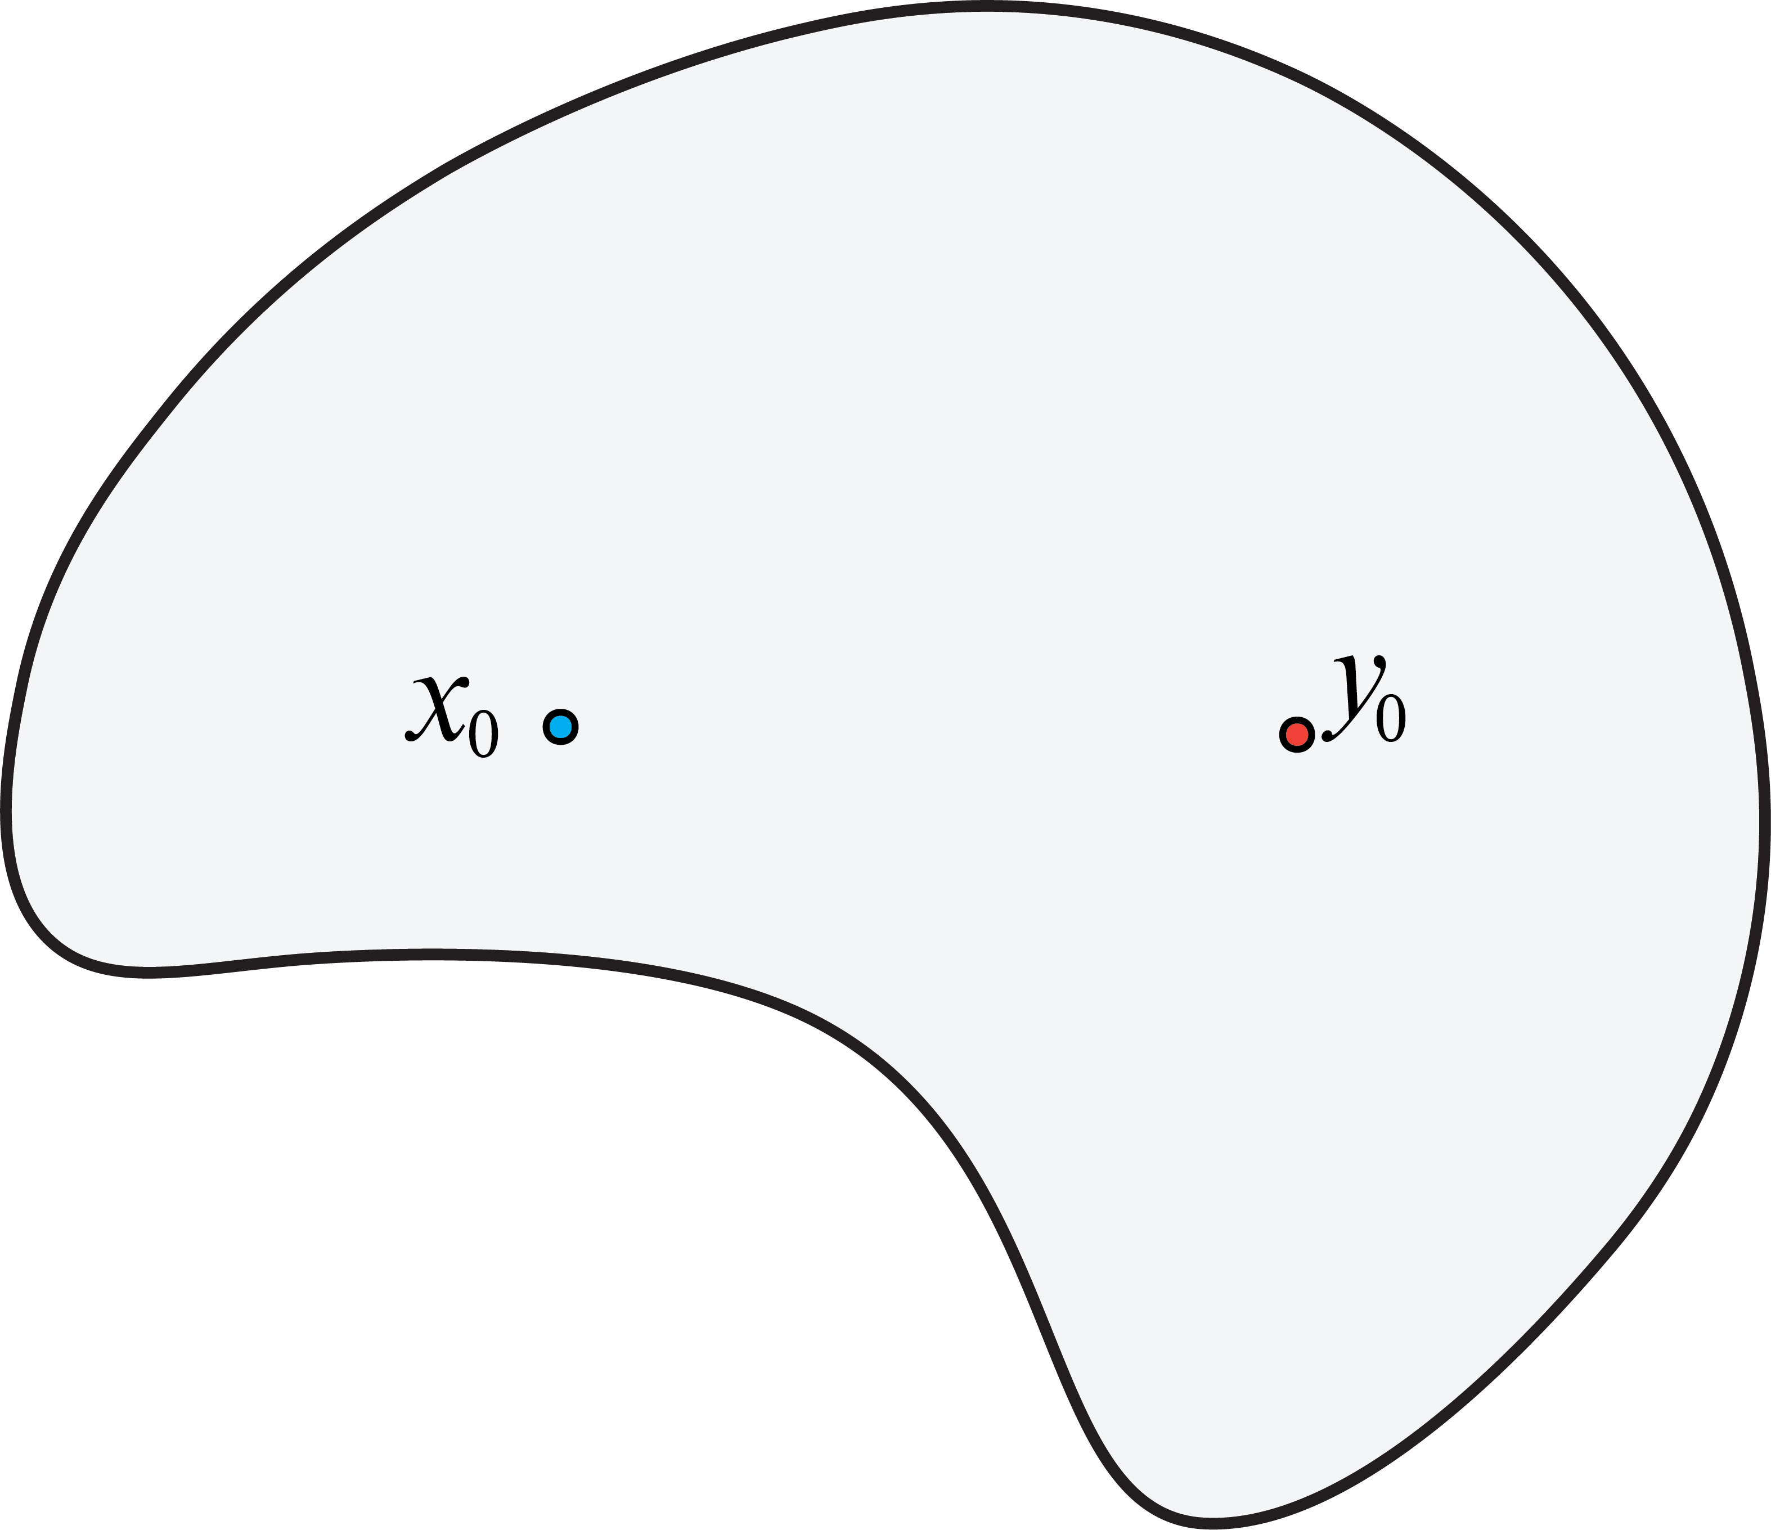
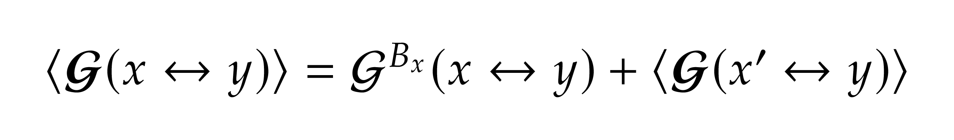
Forward Estimator
Forward:
Forward Estimator:

Slide 36


Forward Estimator
Forward:
Forward Estimator:

Slide 37


Forward Estimator
Forward:
Forward Estimator:

Slide 38


Forward Estimator
Forward:
Forward Estimator:

Slide 39


Reverse Estimator
Reverse:
Reverse Estimator:

Slide 40


Reverse Estimator
Reverse:
Reverse Estimator:

Slide 41


Reverse Estimator
Reverse:
Reverse Estimator:

Slide 42


Reverse Estimator
Reverse:
Reverse Estimator:

Slide 43
Reverse Estimator
Start walks from sources
Globally importance sampling
Reuse walks

Slide 44

Reverse Estimator
Start walks from sources
Globally importance sampling
Reuse walks
1 step

Slide 45

Reverse Estimator
Start walks from sources
Globally importance sampling
Reuse walks
2 steps

Slide 46

Reverse Estimator
Start walks from sources
Globally importance sampling
Reuse walks
4 steps

Slide 47

Reverse Estimator
Start walks from sources
Globally importance sampling
Reuse walks
Hits boundary

Slide 48



Reverse Estimator
1 sample
64 samples
Converged

Slide 49

Solve Poisson’s equation
Linear Property:
Source only part
Boundary only part
=
Sources
Sources
+

Slide 50



Source Part
1. Sample
2. Estimate the solution using Green’s function estimator

Slide 51



Boundary Part
Use finite difference method to estimate the derivative.
1. Sample

Slide 52


Boundary Part
Use finite difference method to estimate the derivative
1. Sample
2. Push the point out by

Slide 53


Boundary Part
Use finite difference method to estimate the derivative
1. Sample
2. Push the point out by
3. Estimate the Green’s function
4. Estimate the solution through finite difference

Slide 54


Combine Forward & Reverse

Slide 55


Combine Forward & Reverse

Slide 56


Combine Forward & Reverse

Slide 57


Combine Forward & Reverse

Slide 58


Combine Forward & Reverse

Slide 59

Combine Forward & Reverse

Slide 60



Final Gather
Boundary value
Reverse WoS (Insufficient samples)
Final gather through forward walks

Slide 61


Equal Time Comparison:
Sparse Source Term:
Forward WoS
Reverse WoS

Slide 62


Equal Time Comparison:
Sparse Boundary Value:
Forward WoS
Reverse WoS

Slide 63

3D Diffusion:
Ours(1000) Ours(10000) Ours(100,000) VPM(100,000)

Slide 64
Other PDEs:
Rendering equation
Volume rendering equation

Slide 65

Shell Tracing:
LEE, R. T. and O’SULLIVAN, C.
“Accelerated light propagation through participating media”.
MULLER, T., PAPAS, M., GROSS, M., JAROSZ, W., and NOVAK, J.
“Efficient rendering of heterogeneous polydisperse granular media”.
LEONARD, L., HOHLEIN, K., and WESTERMANN, R.
“Learning multiple-scattering solutions for sphere-tracing”.
https://cs.dartmouth.edu/~wjarosz/publications/muller16efficient.html

Slide 66
Other PDEs:
Rendering equation
Volume rendering equation
Heat equation (time dependent)

Slide 67


Bidirectional Method
Forward
Bidirectional
Reverse
Path Tracing
Bidirectional Path Tracing
Photon Mapping / VPLs
raytracing.github.io/books/RayTracingInOneWeekend.html
graphics.stanford.edu/papers/veach_thesis/thesis.pdf
graphics.ucsd.edu/~henrik/papers/photon_map/
Forward WoS
Bidirectional WoS?
Reverse WoS
?

Slide 68
MIS
Different choices of forward & reverse steps lead to different path spaces
How to perform MIS between all different path spaces?

Slide 69
Thank you!

