Slide 1

Practical Hessian-Based
Error Control
For Irradiance Caching
Jorge Schwarzhaupt¹
Henrik Wann Jensen¹
Wojciech Jarosz²
¹UC San Diego ²Disney Research, Zurich
Notes:
Thank you for the introduction, and thanks everyone for coming to this talk.

Slide 2
Irradiance Caching
Notes:
Irradiance caching is a method for accelerating the computation of global illumination. It was introduced by Wald et al. in ’88 and since then has been used in fields (click) such as architecture and industrial design, (click) and of course the entertainment industry.

Slide 3

Irradiance Caching
Architecture Design
Notes:
Irradiance caching is a method for accelerating the computation of global illumination. It was introduced by Wald et al. in ’88 and since then has been used in fields (click) such as architecture and industrial design, (click) and of course the entertainment industry.

Slide 4
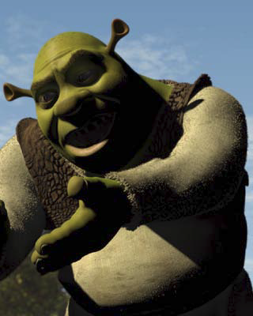
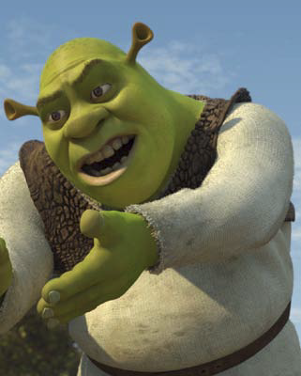
Irradiance Caching
Architecture Design
Entertainment Industry
[Tabellion & Lamorlette ’04]
Notes:
Irradiance caching is a method for accelerating the computation of global illumination. It was introduced by Wald et al. in ’88 and since then has been used in fields (click) such as architecture and industrial design, (click) and of course the entertainment industry.

Slide 5
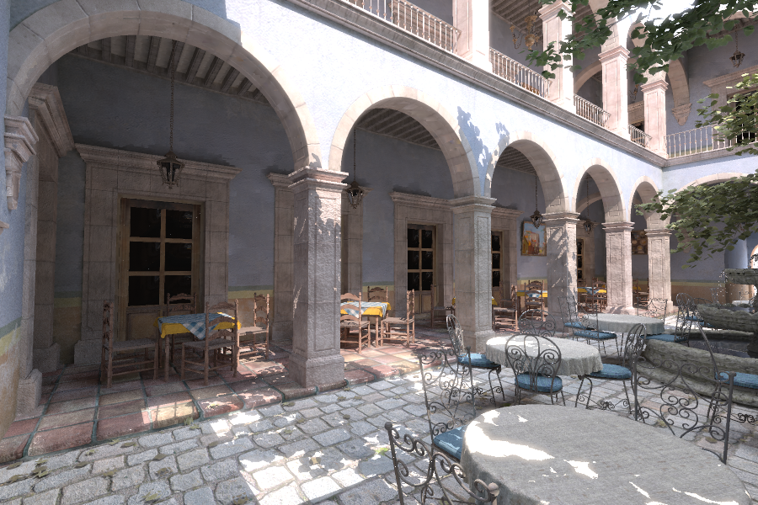
Irradiance Caching – Quick Intro
Sharp discontinuities but…
Notes:
Irradiance caching is based on the fact that while direct lighting generally has sharp discontinuities, (click) indirect illumination varies slowly. (click)
Irradiance cache records store the indirect illumination computed at a certain location in the scene. At each new location, we see if there are any existing records we can use in the cache. If so, then we just extrapolate the irradiance from them.
If not, we compute a new record by sampling the hemisphere over that new position, and insert it into the cache. (click)
We continue in this way until we have rendered the entire image.

Slide 6
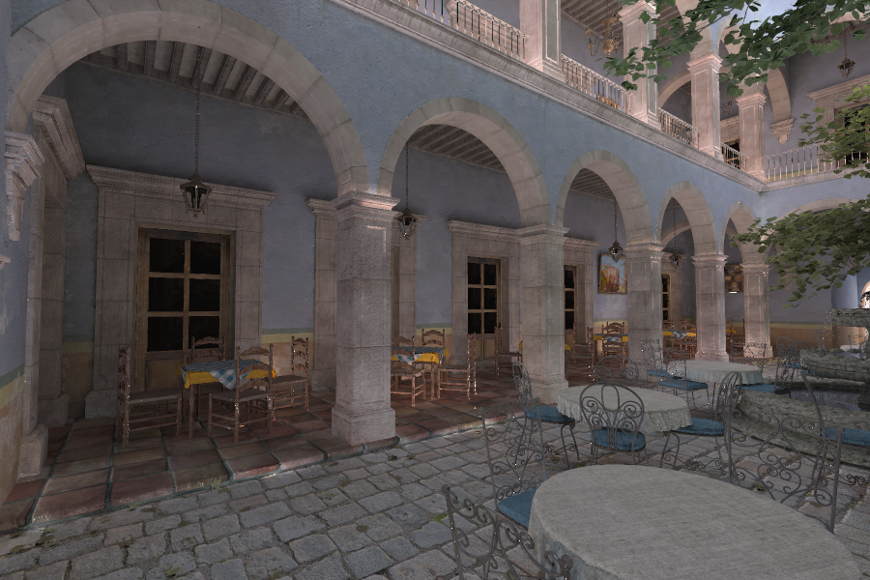
Irradiance Caching – Quick Intro
The indirect illumination is mostly smooth!
Notes:
Irradiance caching is based on the fact that while direct lighting generally has sharp discontinuities, (click) indirect illumination varies slowly. (click)
Irradiance cache records store the indirect illumination computed at a certain location in the scene. At each new location, we see if there are any existing records we can use in the cache. If so, then we just extrapolate the irradiance from them.
If not, we compute a new record by sampling the hemisphere over that new position, and insert it into the cache. (click)
We continue in this way until we have rendered the entire image.

Slide 7
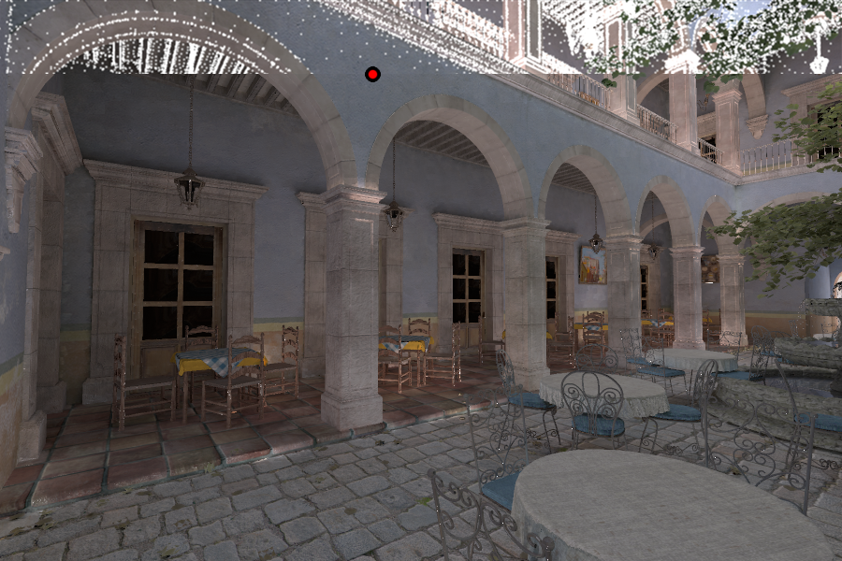
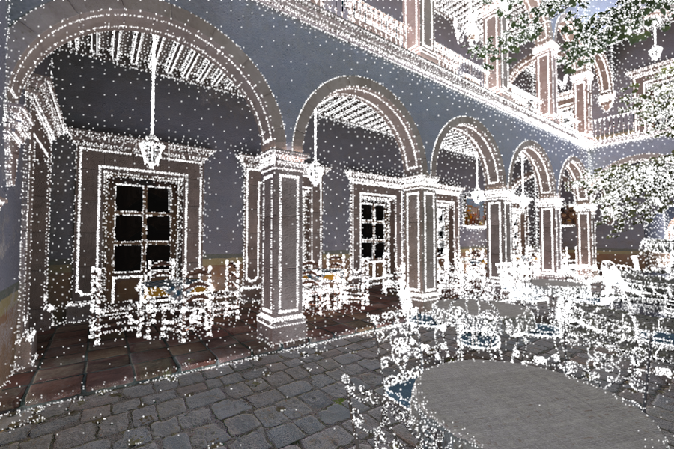
Irradiance Caching – Quick Intro
Can we extrapolate from existing cache records?
Notes:
Irradiance caching is based on the fact that while direct lighting generally has sharp discontinuities, (click) indirect illumination varies slowly. (click)
Irradiance cache records store the indirect illumination computed at a certain location in the scene. At each new location, we see if there are any existing records we can use in the cache. If so, then we just extrapolate the irradiance from them.
If not, we compute a new record by sampling the hemisphere over that new position, and insert it into the cache. (click)
We continue in this way until we have rendered the entire image.

Slide 8
Irradiance Caching – Quick Intro
Accurate but sparse sampling of irradiance – fast!
Notes:
Irradiance caching is based on the fact that while direct lighting generally has sharp discontinuities, (click) indirect illumination varies slowly. (click)
Irradiance cache records store the indirect illumination computed at a certain location in the scene. At each new location, we see if there are any existing records we can use in the cache. If so, then we just extrapolate the irradiance from them.
If not, we compute a new record by sampling the hemisphere over that new position, and insert it into the cache. (click)
We continue in this way until we have rendered the entire image.

Slide 9
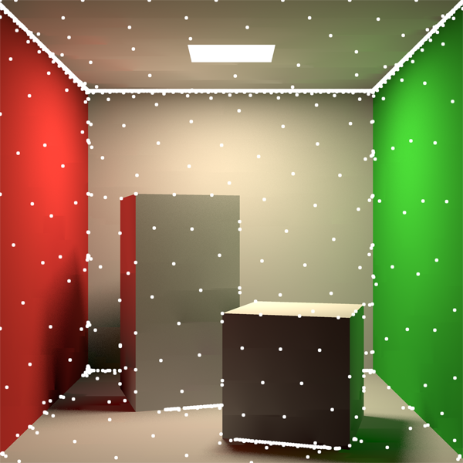
Irradiance Caching
Notes:
The decision of when we can use the cached records to interpolate the irradiance is therefore crucial. The idea is to define some sort of measure that tells us how much error we get from interpolation when compared to the value we would get if we instead sampled the irradiance. (click) Improper error-control can lead to large artifacts in the rendered image. (click)
In this paper, we deal precisely with this aspect of irradiance caching.
Our goal is to improve the error control method in order to make irradiance caching more robust, more efficient and easier to control.

Slide 10

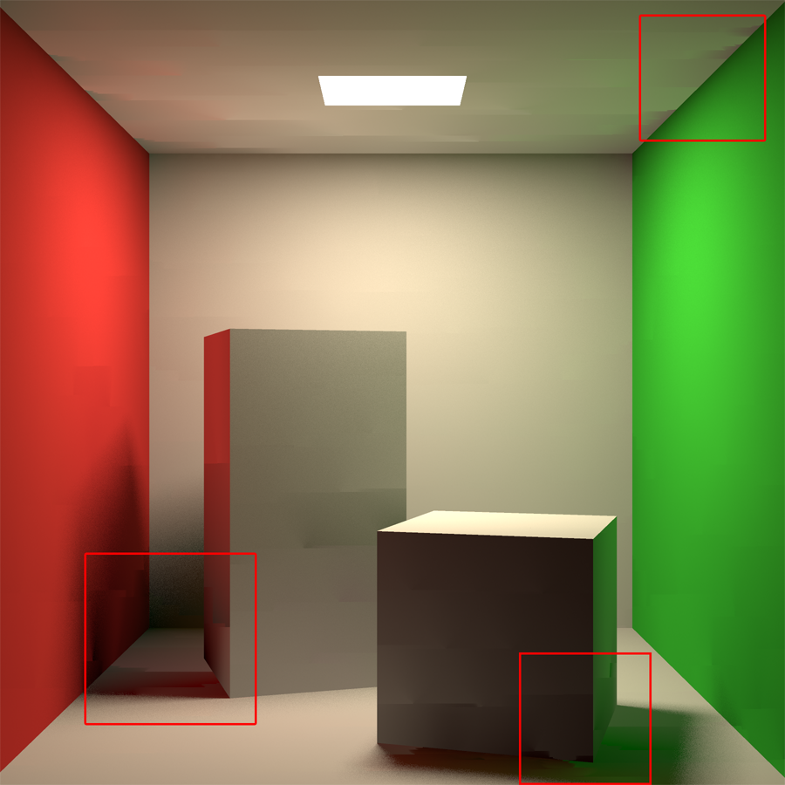
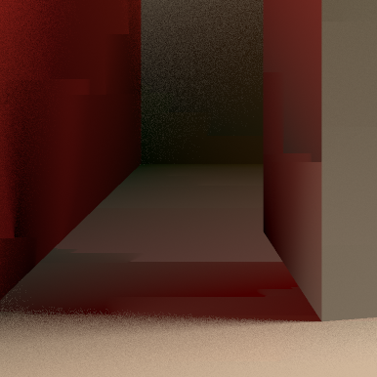
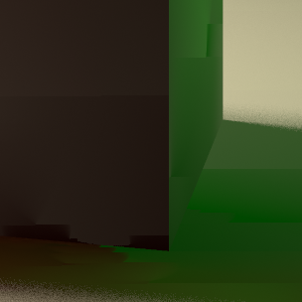
Irradiance Caching
Notes:
The decision of when we can use the cached records to interpolate the irradiance is therefore crucial. The idea is to define some sort of measure that tells us how much error we get from interpolation when compared to the value we would get if we instead sampled the irradiance. (click) Improper error-control can lead to large artifacts in the rendered image. (click)
In this paper, we deal precisely with this aspect of irradiance caching.
Our goal is to improve the error control method in order to make irradiance caching more robust, more efficient and easier to control.

Slide 11
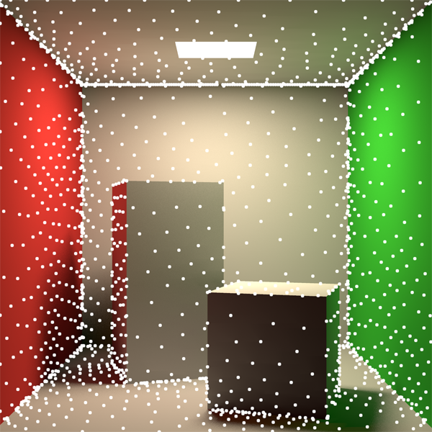
Irradiance Caching
~1,700 Cache Points
Split-Sphere
Our Method
Better Error Control
Notes:
The decision of when we can use the cached records to interpolate the irradiance is therefore crucial. The idea is to define some sort of measure that tells us how much error we get from interpolation when compared to the value we would get if we instead sampled the irradiance. (click) Improper error-control can lead to large artifacts in the rendered image. (click)
In this paper, we deal precisely with this aspect of irradiance caching.
Our goal is to improve the error control method in order to make irradiance caching more robust, more efficient and easier to control.

Slide 12
Overview: Hessian-Based Error Control
New error control method
Notes:
In order to do this, we introduce a new method for error control, which we base on the second derivative, or Hessian, of the irradiance.
We show how to compute a Hessian that takes occlusions into account, which significantly improves the accuracy of our method. (click)
This makes our approach radiometrically principled, which leads (click) to significantly better results, improving the efficiency of irradiance caching, the quality of the resulting images, and making it easier to control. (click)
But radiometrically-based methods also come with their share of problems, that can sometimes make a practical implementation infeasible - so we take a look at these problems and propose practical solutions.

Slide 13
Overview: Hessian-Based Error Control
New error control method
Radiometrically principled approach
Notes:
In order to do this, we introduce a new method for error control, which we base on the second derivative, or Hessian, of the irradiance.
We show how to compute a Hessian that takes occlusions into account, which significantly improves the accuracy of our method. (click)
This makes our approach radiometrically principled, which leads (click) to significantly better results, improving the efficiency of irradiance caching, the quality of the resulting images, and making it easier to control. (click)
But radiometrically-based methods also come with their share of problems, that can sometimes make a practical implementation infeasible - so we take a look at these problems and propose practical solutions.

Slide 14
Overview: Hessian-Based Error Control
New error control method
Radiometrically principled approach
Better results
Notes:
In order to do this, we introduce a new method for error control, which we base on the second derivative, or Hessian, of the irradiance.
We show how to compute a Hessian that takes occlusions into account, which significantly improves the accuracy of our method. (click)
This makes our approach radiometrically principled, which leads (click) to significantly better results, improving the efficiency of irradiance caching, the quality of the resulting images, and making it easier to control. (click)
But radiometrically-based methods also come with their share of problems, that can sometimes make a practical implementation infeasible - so we take a look at these problems and propose practical solutions.

Slide 15
Overview: Hessian-Based Error Control
New error control method
Radiometrically principled approach
Better results
Make it practical!
Notes:
In order to do this, we introduce a new method for error control, which we base on the second derivative, or Hessian, of the irradiance.
We show how to compute a Hessian that takes occlusions into account, which significantly improves the accuracy of our method. (click)
This makes our approach radiometrically principled, which leads (click) to significantly better results, improving the efficiency of irradiance caching, the quality of the resulting images, and making it easier to control. (click)
But radiometrically-based methods also come with their share of problems, that can sometimes make a practical implementation infeasible - so we take a look at these problems and propose practical solutions.

Slide 16
Overview: Other Improvements
Anisotropic cache records
  Improved quality and efficiency
Notes:
Beyond this, the Hessian we compute naturally supports anisotropic records, which further improve the quality of the results and the efficiency of the algorithm. (click)
We also derive a new method for computing the irradiance gradient that is not bound to any particular stratification of the irradiance samples, even while taking occlusions in the scene into account. (click)
In fact, it could even work without any stratification.

Slide 17
Overview: Other Improvements
Anisotropic cache records
  Improved quality and efficiency
New irradiance gradient formulation
  Works with any stratification
Notes:
Beyond this, the Hessian we compute naturally supports anisotropic records, which further improve the quality of the results and the efficiency of the algorithm. (click)
We also derive a new method for computing the irradiance gradient that is not bound to any particular stratification of the irradiance samples, even while taking occlusions in the scene into account.

Slide 18
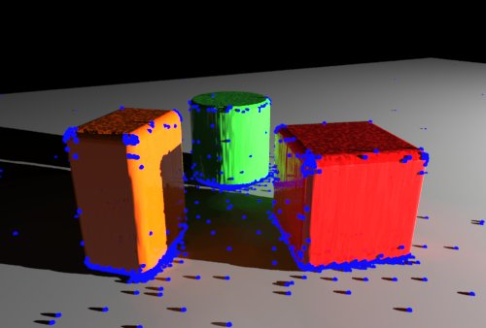
Previous Work: Irradiance Caching
Introduced by [Ward et al 1988]
[Ward et al ‘88]
Notes:
Ward et al introduced irradiance caching in their seminal ‘88 paper. (click)
They derived the split-sphere heuristic, which defines a conservative bound on the error that can be expected from interpolating the irradiance from the samples stored in the cache. (click)
Ward and Heckbert then significantly improved the quality of irradiance caching in 92, when they showed how to compute the gradient of irradiance and how to use it to improve the quality of the reconstructed irradiance.

Slide 19
Previous Work: Irradiance Caching
Introduced by [Ward et al 1988]
The “Split-Sphere Heuristic”
  Upper bound of the error
  Based on first-order Taylor expansion of the irradiance
[Ward et al ‘88]
Notes:
Ward et al introduced irradiance caching in their seminal ‘88 paper. (click)
They derived the split-sphere heuristic, which defines a conservative bound on the error that can be expected from interpolating the irradiance from the samples stored in the cache. (click)
Ward and Heckbert then significantly improved the quality of irradiance caching in 92, when they showed how to compute the gradient of irradiance and how to use it to improve the quality of the reconstructed irradiance.

Slide 20
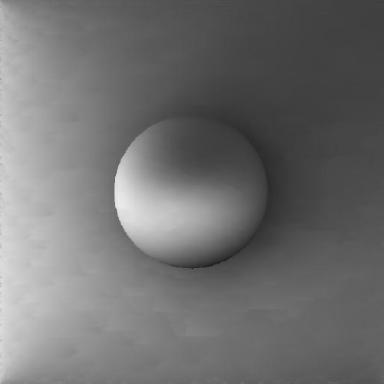
Previous Work: Irradiance Caching
Introduced by [Ward et al 1988]
The “Split-Sphere Heuristic”
  Upper bound of the error
  Based on first-order Taylor expansion of the irradiance
Irradiance Gradients
  [Ward and Heckbert 1992]
  Significant improvement in quality
[Ward et al ‘88]
[Ward and Heckbert ‘92]
Notes:
Ward et al introduced irradiance caching in their seminal ‘88 paper. (click)
They derived the split-sphere heuristic, which defines a conservative bound on the error that can be expected from interpolating the irradiance from the samples stored in the cache. (click)
Ward and Heckbert then significantly improved the quality of irradiance caching in 92, when they showed how to compute the gradient of irradiance and how to use it to improve the quality of the reconstructed irradiance.

Slide 21
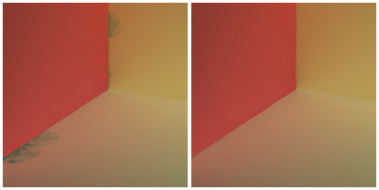
Previous Work: Split-Sphere Extensions
Neighbor Clamping
  [Krivanek et al 2006]
  Enforce geometric consistency of the scene
Notes:
Work has also been done to extend the split-sphere heuristic.
Neighbor clamping helps to avoid some common artifacts around corners and intricate geometry. (click)
Adaptive caching progressively refines the irradiance cache using a perceptual error metric, and ensures that there are no discontinuities in the reconstructed irradiance. (click)
Anisotropic records were added by Herzog et al in 2009, but used a uniform user-provided eccentricity for all records.
All these methods have in common that they attempt to fix some of the shortcomings of the split-sphere heuristic. Instead of that, we propose doing away with it entirely, in such a way that these kinds of fixes are no longer needed.

Slide 22
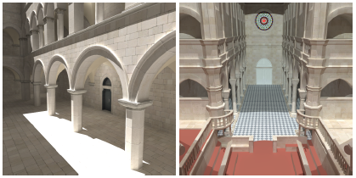
Previous Work: Split-Sphere Extensions
Neighbor Clamping
  [Krivanek et al 2006]
  Enforce geometric consistency of the scene
Adaptive Caching
  [Krivanek et al 2006]
  Progressively refine the irradiance cache
Notes:
Work has also been done to extend the split-sphere heuristic.
Neighbor clamping helps to avoid some common artifacts around corners and intricate geometry. (click)
Adaptive caching progressively refines the irradiance cache using a perceptual error metric, and ensures that there are no discontinuities in the reconstructed irradiance. (click)
Anisotropic records were added by Herzog et al in 2009, but used a uniform user-provided eccentricity for all records.
All these methods have in common that they attempt to fix some of the shortcomings of the split-sphere heuristic. Instead of that, we propose doing away with it entirely, in such a way that these kinds of fixes are no longer needed.

Slide 23
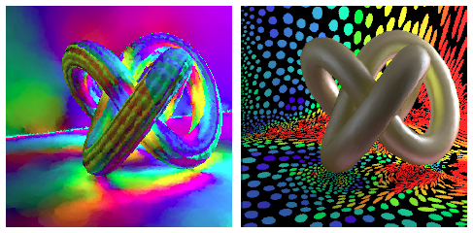
Previous Work: Split-Sphere Extensions
Neighbor Clamping
  [Krivanek et al 2006]
  Enforce geometric consistency of the scene
Adaptive Caching
  [Krivanek et al 2006]
  Progressively refine the irradiance cache
Anisotropic Records
  [Herzog et al 2009]
  User defined eccentricity
Notes:
Work has also been done to extend the split-sphere heuristic.
Neighbor clamping helps to avoid some common artifacts around corners and intricate geometry. (click)
Adaptive caching progressively refines the irradiance cache using a perceptual error metric, and ensures that there are no discontinuities in the reconstructed irradiance. (click)
Anisotropic records were added by Herzog et al in 2009, but used a uniform user-provided eccentricity for all records.
All these methods have in common that they attempt to fix some of the shortcomings of the split-sphere heuristic. Instead of that, we propose doing away with it entirely, in such a way that these kinds of fixes are no longer needed.

Slide 24
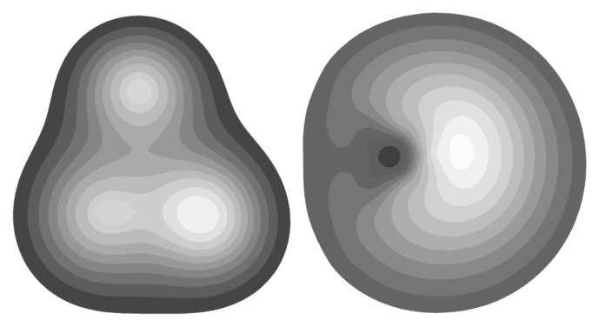
Previous Work: Illumination Derivatives
Error Control
Illumination Derivatives
  [Arvo 1994]
  [Holzschuch and Sillion 1995, 1998]
  [Ramamoorthi et al. 2007]
Notes:
Illumination derivatives have been studied by various researchers.
In particular, Holzschuch and Sillion derived a second derivative of the point-to-area form factor that we use in our work. (click)
Error control has also been extensively studied. In 2012, (click) my co-authors proposed a completely new way to control sample placement in irradiance caching by performing an in-depth analysis of global illumination. In this paper, we build on that work and translate it from the theoretical to a practical implementation.

Slide 25
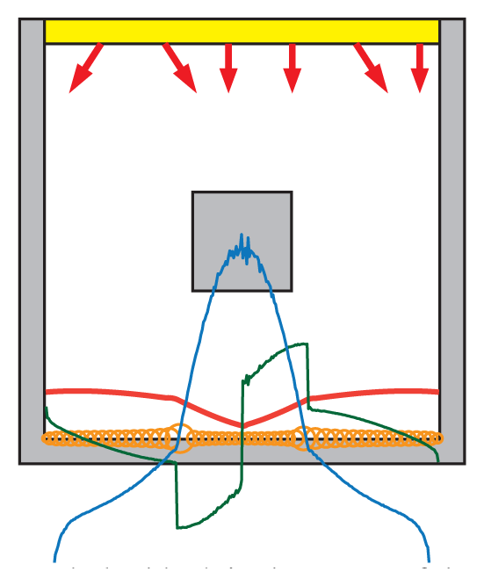
Previous Work: Illumination Derivatives
Error Control
Illumination Derivatives
  [Arvo 1994]
  [Holzschuch and Sillion 1995, 1998]
  [Ramamoorthi et al. 2007]
Error Control
  [Shirley 1991]
  [Arvo 1994]
  [Holzschuch and Sillion, 1998]
  [Jarosz et al. 2012]
Notes:
Illumination derivatives have been studied by various researchers.
In particular, Holzschuch and Sillion derived a second derivative of the point-to-area form factor that we use in our work. (click)
Error control has also been extensively studied. In 2012, (click) my co-authors proposed a completely new way to control sample placement in irradiance caching by performing an in-depth analysis of global illumination. In this paper, we build on that work and translate it from the theoretical to a practical implementation.

Slide 26
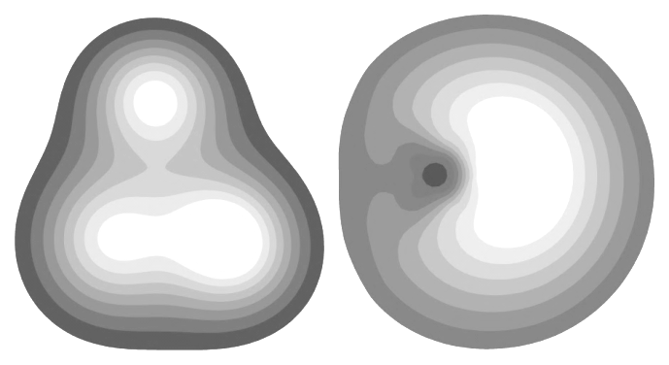
Previous Work: Illumination Derivatives
Error Control
Illumination Derivatives
  [Arvo 1994]
  [Holzschuch and Sillion 1995, 1998]
  [Ramamoorthi et al. 2007]
Error Control
  [Shirley 1991]
  [Arvo 1994]
  [Holzschuch and Sillion, 1998]
  [Jarosz et al. 2012]
Notes:
Illumination derivatives have been studied by various researchers.
In particular, Holzschuch and Sillion derived a second derivative of the point-to-area form factor that we use in our work. (click)
Error control has also been extensively studied. In 2012, (click) my co-authors proposed a completely new way to control sample placement in irradiance caching by performing an in-depth analysis of global illumination. In this paper, we build on that work and translate it from the theoretical to a practical implementation.

Slide 27
Background
Reflected radiance of diffuse surface:
Notes:
Now a bit of background on our work.
Irradiance caching exploits the fact that the (click) reflected radiance L on diffuse surfaces can be expressed in terms of (click) the irradiance, E (pause) (click)
We estimate the irradiance via monte carlo ray tracing and, as long as the sampled directions follow a cosine-weighted distribution, this boils down to this simplified formula, which tells us that the irradiance is simply an average of the incoming radiances.

Slide 28
Background
Reflected radiance of diffuse surface:
Notes:
Now a bit of background on our work.
Irradiance caching exploits the fact that the (click) reflected radiance L on diffuse surfaces can be expressed in terms of (click) the irradiance, E (pause) (click)
We estimate the irradiance via monte carlo ray tracing and, as long as the sampled directions follow a cosine-weighted distribution, this boils down to this simplified formula, which tells us that the irradiance is simply an average of the incoming radiances.

Slide 29
Background
Reflected radiance of diffuse surface:
Notes:
Now a bit of background on our work.
Irradiance caching exploits the fact that the (click) reflected radiance L on diffuse surfaces can be expressed in terms of (click) the irradiance, E (pause) (click)
We estimate the irradiance via monte carlo ray tracing and, as long as the sampled directions follow a cosine-weighted distribution, this boils down to this simplified formula, which tells us that the irradiance is simply an average of the incoming radiances.

Slide 30
Background
Reflected radiance of diffuse surface:
The irradiance is estimated via Monte Carlo integration:
Notes:
Now a bit of background on our work.
Irradiance caching exploits the fact that the (click) reflected radiance L on diffuse surfaces can be expressed in terms of (click) the irradiance, E (pause) (click)
We estimate the irradiance via monte carlo ray tracing and, as long as the sampled directions follow a cosine-weighted distribution, this boils down to this simplified formula, which tells us that the irradiance is simply an average of the incoming radiances.

Slide 31
Background
Interpolation [Ward and Heckbert 1992]:
Notes:
The irradiance is reconstructed from the stored cache records by taking a weighted average of the first-order Taylor expansion computed for each cache point that overlaps with the new location. In our work, we use this formula without modification. (click)
However, we use a different weighting function in order to support anisotropic cache records. The details of this can be read in the paper.

Slide 32
Background
Interpolation [Ward and Heckbert 1992]:
New weighting formula
Notes:
The irradiance is reconstructed from the stored cache records by taking a weighted average of the first-order Taylor expansion computed for each cache point that overlaps with the new location. In our work, we use this formula without modification. (click)
However, we use a different weighting function in order to support anisotropic cache records. The details of this can be read in the paper.

Slide 33
Background
Goal: minimize error from interpolation / extrapolation
Notes:
To make irradiance caching as efficient as possible, we would like to place samples in a way that minimizes the error we get when we interpolate irradiance from those samples.

Slide 34
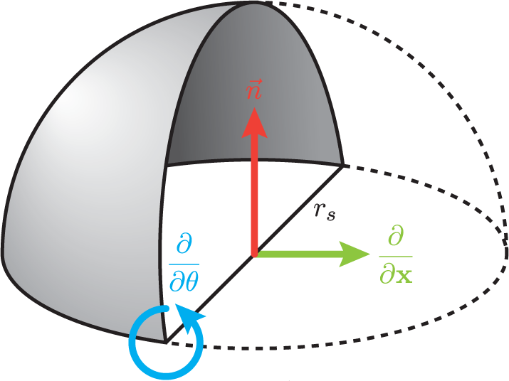
Background – Split-Sphere Heuristic
Notes:
For this, Ward et al introduced the split-sphere heuristic.
He imagined a hypothetical scenario that would lead to the maximum possible change in irradiance under the assumption that there are no concentrated light sources. Since we’re only computing indirect illumination, this seems like a fair assumption. In this scenario, the environment around the sampling location is split, with one half being perfectly black and the other being perfectly white. (click)
Doing a first-order Taylor expansion of irradiance in this hypothetical setting leads to a conservative bound on the error induced by extrapolating irradiance.

Slide 35
Background – Split-Sphere Heuristic
1st-order Taylor expansion is conservative bound
Notes:
For this, Ward et al introduced the split-sphere heuristic.
He imagined a hypothetical scenario that would lead to the maximum possible change in irradiance under the assumption that there are no concentrated light sources. Since we’re only computing indirect illumination, this seems like a fair assumption. In this scenario, the environment around the sampling location is split, with one half being perfectly black and the other being perfectly white. (click)
Doing a first-order Taylor expansion of irradiance in this hypothetical setting leads to a conservative bound on the error induced by extrapolating irradiance.

Slide 36

Background – Split-Sphere Heuristic
Notes:
In practice, unfortunately, the split-sphere heuristic does not work all that well (click), and using it as-is can lead to very distracting artifacts when rendering, like the ones we see here.
The assumption that there are no concentrated sources of irradiance turns out to be broken a lot of times – surfaces lit by a strong light source become strong sources of indirect illumination themselves. When this happens, the error estimation of the split-sphere can be very far from the true difference between interpolating irradiance and directly sampling it. (click)
To fix this, the standard approach is to add new parameters, like minimum and maximum cache point radii, and all of a sudden instead of a single parameter we need to finely balance three. (click) This means that irradiance caching becomes hard to control, and producing good images efficiently takes a lot more trial and error than we would like.

Slide 37
Background – Split-Sphere Heuristic
Artifacts
Notes:
In practice, unfortunately, the split-sphere heuristic does not work all that well (click), and using it as-is can lead to very distracting artifacts when rendering, like the ones we see here.
The assumption that there are no concentrated sources of irradiance turns out to be broken a lot of times – surfaces lit by a strong light source become strong sources of indirect illumination themselves. When this happens, the error estimation of the split-sphere can be very far from the true difference between interpolating irradiance and directly sampling it. (click)
To fix this, the standard approach is to add new parameters, like minimum and maximum cache point radii, and all of a sudden instead of a single parameter we need to finely balance three. (click) This means that irradiance caching becomes hard to control, and producing good images efficiently takes a lot more trial and error than we would like.

Slide 38
Background – Split-Sphere Heuristic
Too many parameters
Notes:
In practice, unfortunately, the split-sphere heuristic does not work all that well (click), and using it as-is can lead to very distracting artifacts when rendering, like the ones we see here.
The assumption that there are no concentrated sources of irradiance turns out to be broken a lot of times – surfaces lit by a strong light source become strong sources of indirect illumination themselves. When this happens, the error estimation of the split-sphere can be very far from the true difference between interpolating irradiance and directly sampling it. (click)
To fix this, the standard approach is to add new parameters, like minimum and maximum cache point radii, and all of a sudden instead of a single parameter we need to finely balance three. (click) This means that irradiance caching becomes hard to control, and producing good images efficiently takes a lot more trial and error than we would like.

Slide 39
Background – Split-Sphere Heuristic
Too many parameters
Hard to control!
Notes:
In practice, unfortunately, the split-sphere heuristic does not work all that well (click), and using it as-is can lead to very distracting artifacts when rendering, like the ones we see here.
The assumption that there are no concentrated sources of irradiance turns out to be broken a lot of times – surfaces lit by a strong light source become strong sources of indirect illumination themselves. When this happens, the error estimation of the split-sphere can be very far from the true difference between interpolating irradiance and directly sampling it. (click)
To fix this, the standard approach is to add new parameters, like minimum and maximum cache point radii, and all of a sudden instead of a single parameter we need to finely balance three. (click) This means that irradiance caching becomes hard to control, and producing good images efficiently takes a lot more trial and error than we would like.

Slide 40
Background
Goal: minimize error from interpolation / extrapolation.
Notes:
So we return to our original goal of minimizing the error. (click)
Jarosz et al defined the total error of a cache record as the difference between the correct irradiance and the extrapolated irradiance, integrated over the support of the cache record. (click)
E prime is the first order Taylor expansion of irradiance, and is precisely the irradiance estimate we get from irradiance caching. (click)
On the other hand, E is precisely what we are trying to avoid computing! (click)
If we can compute a second derivative of irradiance, we can use a second order expansion as an oracle for this true irradiance

Slide 41
Background
Goal: minimize error from interpolation / extrapolation.
[Jarosz et al. 2012]:
Notes:
So we return to our original goal of minimizing the error. (click)
Jarosz et al defined the total error of a cache record as the difference between the correct irradiance and the extrapolated irradiance, integrated over the support of the cache record. (click)
E prime is the first order Taylor expansion of irradiance, and is precisely the irradiance estimate we get from irradiance caching. (click)
On the other hand, E is precisely what we are trying to avoid computing! (click)
If we can compute a second derivative of irradiance, we can use a second order expansion as an oracle for this true irradiance

Slide 42
Background
Goal: minimize error from interpolation / extrapolation.
[Jarosz et al. 2012]:
E’ is 1st order Taylor expansion
Notes:
So we return to our original goal of minimizing the error. (click)
Jarosz et al defined the total error of a cache record as the difference between the correct irradiance and the extrapolated irradiance, integrated over the support of the cache record. (click)
E prime is the first order Taylor expansion of irradiance, and is precisely the irradiance estimate we get from irradiance caching. (click)
On the other hand, E is precisely what we are trying to avoid computing! (click)
If we can compute a second derivative of irradiance, we can use a second order expansion as an oracle for this true irradiance

Slide 43
Background
Goal: minimize error from interpolation / extrapolation.
[Jarosz et al. 2012]:
E’ is 1st order Taylor expansion
E is unknown!
Notes:
So we return to our original goal of minimizing the error. (click)
Jarosz et al defined the total error of a cache record as the difference between the correct irradiance and the extrapolated irradiance, integrated over the support of the cache record. (click)
E prime is the first order Taylor expansion of irradiance, and is precisely the irradiance estimate we get from irradiance caching. (click)
On the other hand, E is precisely what we are trying to avoid computing! (click)
If we can compute a second derivative of irradiance, we can use a second order expansion as an oracle for this true irradiance

Slide 44
Background
Goal: minimize error from interpolation / extrapolation.
[Jarosz et al. 2012]:
E’ is 1st order Taylor expansion
E is unknown!
Use 2nd-order Taylor expansion instead
Notes:
So we return to our original goal of minimizing the error. (click)
Jarosz et al defined the total error of a cache record as the difference between the correct irradiance and the extrapolated irradiance, integrated over the support of the cache record. (click)
E prime is the first order Taylor expansion of irradiance, and is precisely the irradiance estimate we get from irradiance caching. (click)
On the other hand, E is precisely what we are trying to avoid computing! (click)
If we can compute a second derivative of irradiance, we can use a second order expansion as an oracle for this true irradiance

Slide 45
Background
Support area of each cache record:
Notes:
In their 2012 paper, my co-authors related this total error to the Hessian of irradiance. The formula they obtained involves (click) the total error as a threshold parameter, (click) as well as the eigenvalues of the Hessian matrix, (click) and gives us a way to derive anisotropic cache records whose expected error is below the threshold.
As I mentioned earlier, in this paper we improve some of the theory in their work as well as address practical problems with their approach.

Slide 46
Background
Support area of each cache record:
Notes:
In their 2012 paper, my co-authors related this total error to the Hessian of irradiance. The formula they obtained involves (click) the total error as a threshold parameter, (click) as well as the eigenvalues of the Hessian matrix, (click) and gives us a way to derive anisotropic cache records whose expected error is below the threshold.
As I mentioned earlier, in this paper we improve some of the theory in their work as well as address practical problems with their approach.

Slide 47
Background
Support area of each cache record:
Notes:
In their 2012 paper, my co-authors related this total error to the Hessian of irradiance. The formula they obtained involves (click) the total error as a threshold parameter, (click) as well as the eigenvalues of the Hessian matrix, (click) and gives us a way to derive anisotropic cache records whose expected error is below the threshold.
As I mentioned earlier, in this paper we improve some of the theory in their work as well as address practical problems with their approach.

Slide 48
Background
Support area of each cache record:
Notes:
In their 2012 paper, my co-authors related this total error to the Hessian of irradiance. The formula they obtained involves (click) the total error as a threshold parameter, (click) as well as the eigenvalues of the Hessian matrix, (click) and gives us a way to derive anisotropic cache records whose expected error is below the threshold.
As I mentioned earlier, in this paper we improve some of the theory in their work as well as address practical problems with their approach.

Slide 49
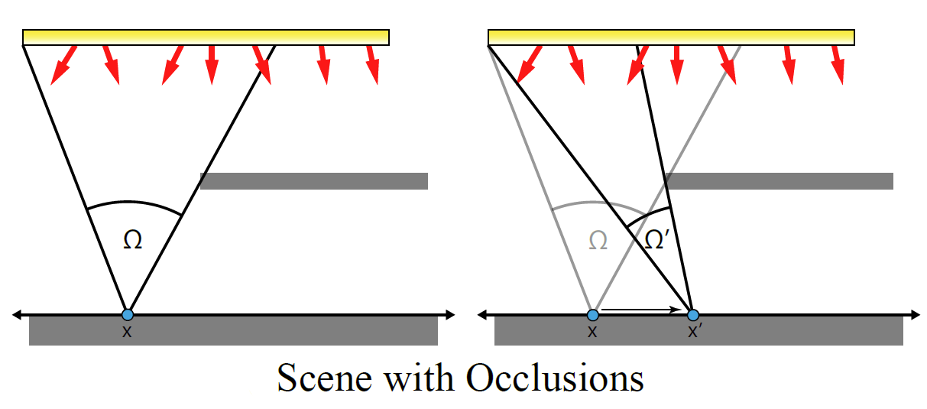
Translation Derivatives of Irradiance
Notes:
The core of our approach is an irradiance gradient and Hessian that accurately considers scenes with occlusions, like the one in the figure.

Slide 50
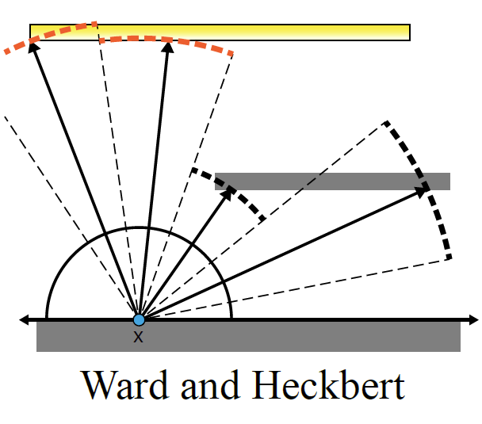
Translation Derivatives of Irradiance
Notes:
Ward and Heckbert derived an accurate occlusion-aware gradient in 1992.
They considered the change in the area of each of the strata, as x is translated.
Unfortunately, Jarosz et al showed that this approach does not extend to a second order gradient – the approximation errors become too large. Because of this, they instead derived, and proposed using, a Hessian that does not take occlusions into account.

Slide 51
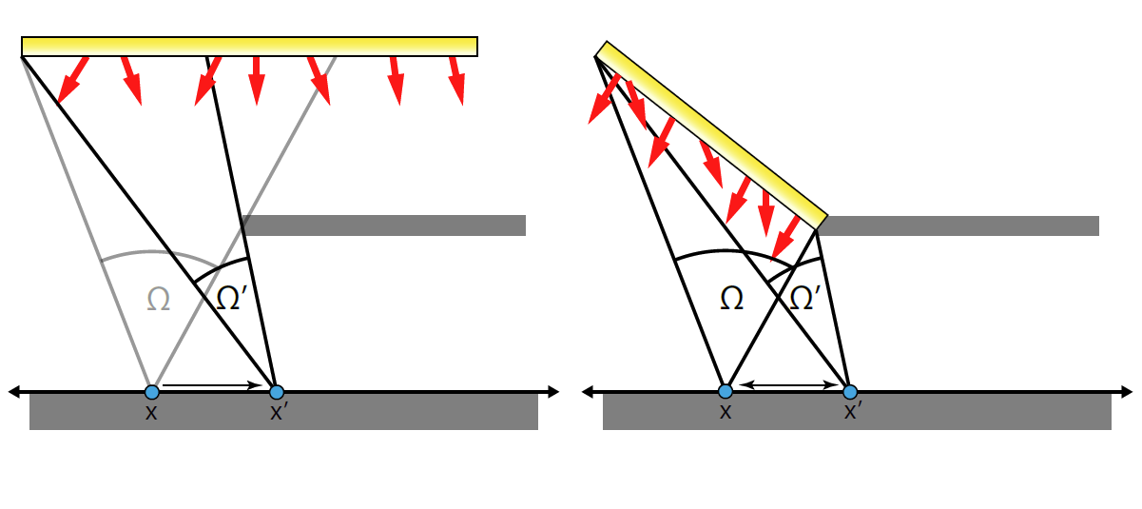
Translation Derivatives of Irradiance
Notes:
Our key insight is that it is possible to instead transform the original scene. (click)
As the figure illustrates, the solid angle subtended by the emitter is the same in both cases, and the change in solid angle, with translation of x, is also the same, even though there are no occlusions. (click)
This means that this modified scene has the same irradiance, irradiance gradient and irradiance Hessian as the original. (click)
Since we use ray tracing, we can use the information we get from sampling the hemisphere over x – the hit positions and the incoming radiance – to construct an approximation of this modified scene.
The figure shows this in 2D, where we simply connect the sample locations using segments.

Slide 52
Translation Derivatives of Irradiance
Notes:
Our key insight is that it is possible to instead transform the original scene. (click)
As the figure illustrates, the solid angle subtended by the emitter is the same in both cases, and the change in solid angle, with translation of x, is also the same, even though there are no occlusions. (click)
This means that this modified scene has the same irradiance, irradiance gradient and irradiance Hessian as the original. (click)
Since we use ray tracing, we can use the information we get from sampling the hemisphere over x – the hit positions and the incoming radiance – to construct an approximation of this modified scene.
The figure shows this in 2D, where we simply connect the sample locations using segments.

Slide 53
Translation Derivatives of Irradiance
Equivalent irradiance, gradient and Hessian!
Notes:
Our key insight is that it is possible to instead transform the original scene. (click)
As the figure illustrates, the solid angle subtended by the emitter is the same in both cases, and the change in solid angle, with translation of x, is also the same, even though there are no occlusions. (click)
This means that this modified scene has the same irradiance, irradiance gradient and irradiance Hessian as the original. (click)
Since we use ray tracing, we can use the information we get from sampling the hemisphere over x – the hit positions and the incoming radiance – to construct an approximation of this modified scene.
The figure shows this in 2D, where we simply connect the sample locations using segments.

Slide 54
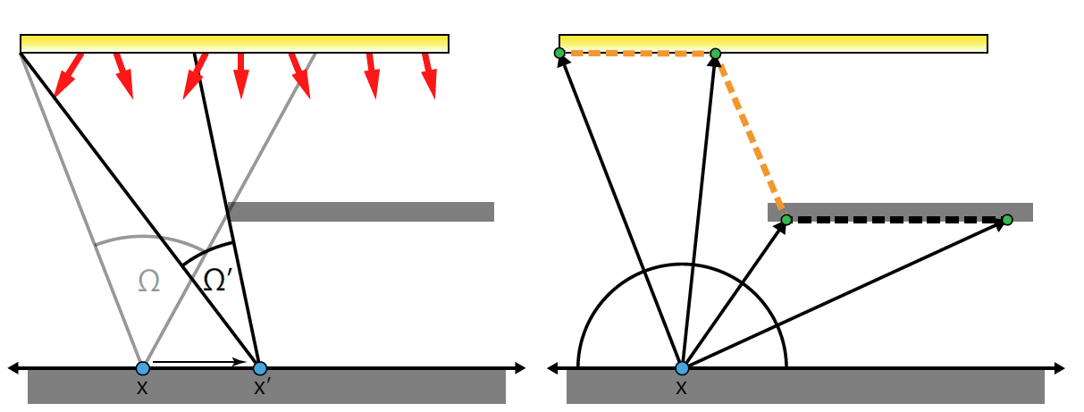
Translation Derivatives of Irradiance
Notes:
Our key insight is that it is possible to instead transform the original scene. (click)
As the figure illustrates, the solid angle subtended by the emitter is the same in both cases, and the change in solid angle, with translation of x, is also the same, even though there are no occlusions. (click)
This means that this modified scene has the same irradiance, irradiance gradient and irradiance Hessian as the original. (click)
Since we use ray tracing, we can use the information we get from sampling the hemisphere over x – the hit positions and the incoming radiance – to construct an approximation of this modified scene.
The figure shows this in 2D, where we simply connect the sample locations using segments.

Slide 55
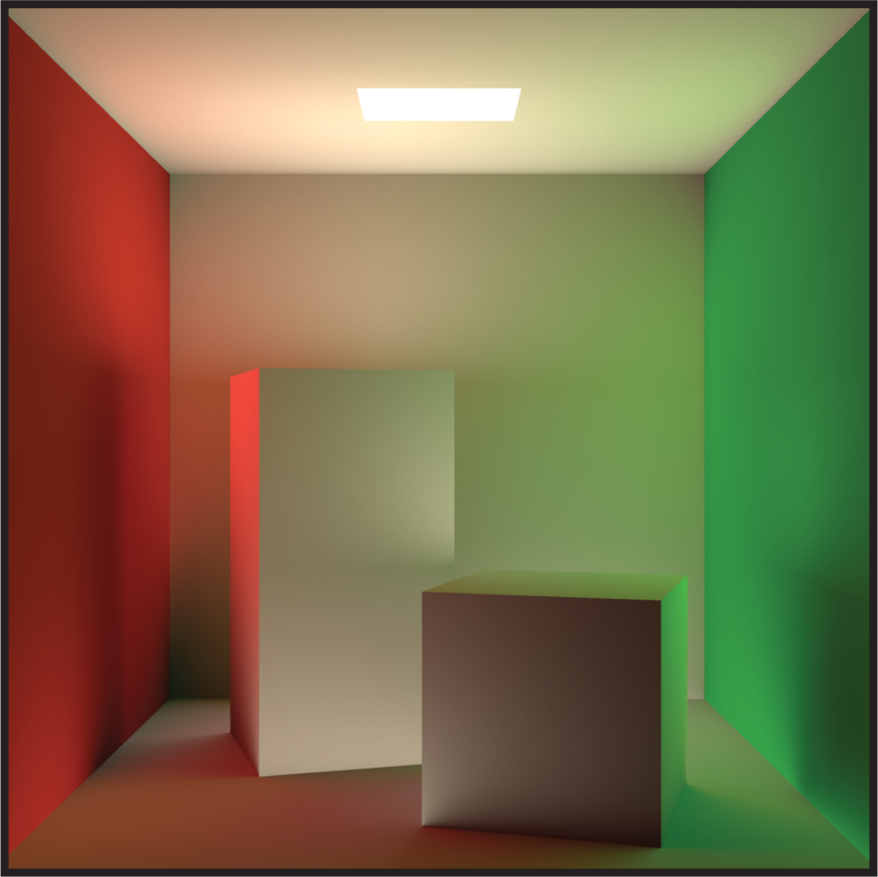
Constructing the Triangulated Environment
Notes:
In 3D, we instead need to connect neighboring samples using triangles. (click) Imagine we are sampling the hemisphere over the small dot in the figure. (click)
The right hand figure is an example of our triangulation method and the resulting mesh.
One important feature that this shows are the large triangles that connect the occluders, in this case the boxes, to the walls behind. This shows exactly how our method “encodes” the occlusion information.

Slide 56

Constructing the Triangulated Environment
Notes:
In 3D, we instead need to connect neighboring samples using triangles. (click) Imagine we are sampling the hemisphere over the small dot in the figure. (click)
The right hand figure is an example of our triangulation method and the resulting mesh.
One important feature that this shows are the large triangles that connect the occluders, in this case the boxes, to the walls behind. This shows exactly how our method “encodes” the occlusion information.

Slide 57
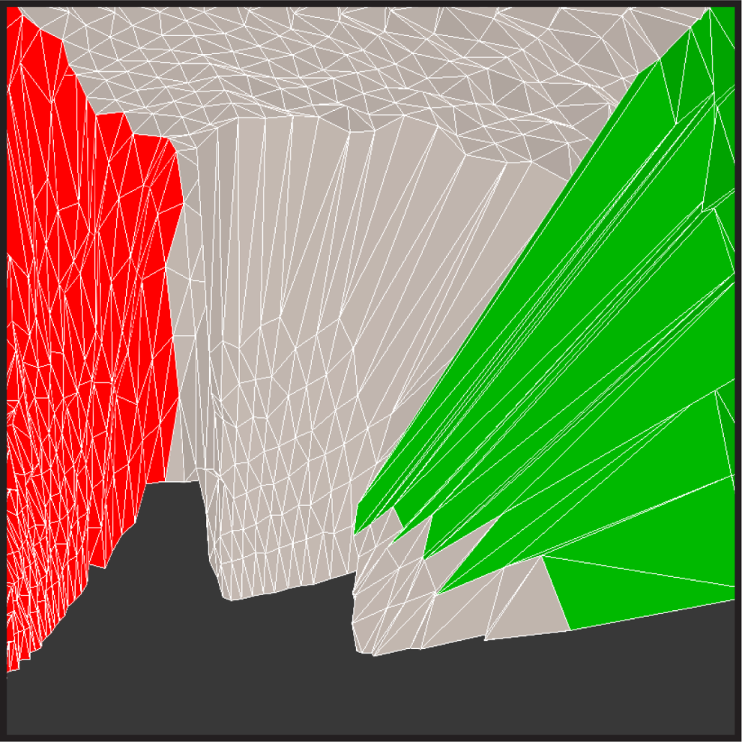
Constructing the Triangulated Environment
Notes:
In 3D, we instead need to connect neighboring samples using triangles. (click) Imagine we are sampling the hemisphere over the small dot in the figure. (click)
The right hand figure is an example of our triangulation method and the resulting mesh.
One important feature that this shows are the large triangles that connect the occluders, in this case the boxes, to the walls behind. This shows exactly how our method “encodes” the occlusion information.

Slide 58
Constructing the Triangulated Environment
Large geometric extent, but subtend small solid angle
Notes:
These triangles have a large geometric extent, but from the point of view of the sampling location, they subtend about the same solid angle as every other triangle – meaning their contribution to irradiance is not disproportionate. (click)
However, as we move the location, the solid angle these triangles subtend will change at a much higher rate, leading to a large gradient and Hessian, precisely taking the occlusions into account.

Slide 59
Constructing the Triangulated Environment
Large geometric extent, but subtend small solid angle
Change in solid angle with translation is much larger
Notes:
These triangles have a large geometric extent, but from the point of view of the sampling location, they subtend about the same solid angle as every other triangle – meaning their contribution to irradiance is not disproportionate. (click)
However, as we move the location, the solid angle these triangles subtend will change at a much higher rate, leading to a large gradient and Hessian, precisely taking the occlusions into account.

Slide 60
Occlusion-Aware Translation Hessian
New irradiance formula:
Notes:
We can now express the irradiance at x in terms of this approximate geometry.
In this case, (click) M is the number of triangles in the tessellated hemisphere, while (click) L <pause> and (click) F are the observed radiance and form-factor of each triangle. (click)
We can directly differentiate this expression to obtain new formulas for the gradient and Hessian and, since our interpretation of the samples induces no occlusion changes with translation, we can compute these form-factor derivatives independently for each triangle. Details for these formulas are included in the paper. (click)
One crucial bit of information is how do we define the radiance for each triangle.

Slide 61
Occlusion-Aware Translation Hessian
New irradiance formula:
Notes:
We can now express the irradiance at x in terms of this approximate geometry.
In this case, (click) M is the number of triangles in the tessellated hemisphere, while (click) L <pause> and (click) F are the observed radiance and form-factor of each triangle. (click)
We can directly differentiate this expression to obtain new formulas for the gradient and Hessian and, since our interpretation of the samples induces no occlusion changes with translation, we can compute these form-factor derivatives independently for each triangle. Details for these formulas are included in the paper. (click)
One crucial bit of information is how do we define the radiance for each triangle.

Slide 62
Occlusion-Aware Translation Hessian
New irradiance formula:
Notes:
We can now express the irradiance at x in terms of this approximate geometry.
In this case, (click) M is the number of triangles in the tessellated hemisphere, while (click) L <pause> and (click) F are the observed radiance and form-factor of each triangle. (click)
We can directly differentiate this expression to obtain new formulas for the gradient and Hessian and, since our interpretation of the samples induces no occlusion changes with translation, we can compute these form-factor derivatives independently for each triangle. Details for these formulas are included in the paper. (click)
One crucial bit of information is how do we define the radiance for each triangle.

Slide 63
Occlusion-Aware Translation Hessian
New irradiance formula:
Notes:
We can now express the irradiance at x in terms of this approximate geometry.
In this case, (click) M is the number of triangles in the tessellated hemisphere, while (click) L <pause> and (click) F are the observed radiance and form-factor of each triangle. (click)
We can directly differentiate this expression to obtain new formulas for the gradient and Hessian and, since our interpretation of the samples induces no occlusion changes with translation, we can compute these form-factor derivatives independently for each triangle. Details for these formulas are included in the paper. (click)
One crucial bit of information is how do we define the radiance for each triangle.

Slide 64
Occlusion-Aware Translation Hessian
New irradiance formula:
Derivatives:
Notes:
We can now express the irradiance at x in terms of this approximate geometry.
In this case, (click) M is the number of triangles in the tessellated hemisphere, while (click) L <pause> and (click) F are the observed radiance and form-factor of each triangle. (click)
We can directly differentiate this expression to obtain new formulas for the gradient and Hessian and, since our interpretation of the samples induces no occlusion changes with translation, we can compute these form-factor derivatives independently for each triangle. Details for these formulas are included in the paper. (click)
One crucial bit of information is how do we define the radiance for each triangle.

Slide 65
Occlusion-Aware Translation Hessian
New irradiance formula:
Derivatives:
Notes:
We can now express the irradiance at x in terms of this approximate geometry.
In this case, (click) M is the number of triangles in the tessellated hemisphere, while (click) L <pause> and (click) F are the observed radiance and form-factor of each triangle. (click)
We can directly differentiate this expression to obtain new formulas for the gradient and Hessian and, since our interpretation of the samples induces no occlusion changes with translation, we can compute these form-factor derivatives independently for each triangle. Details for these formulas are included in the paper. (click)
One crucial bit of information is how do we define the radiance for each triangle.

Slide 66

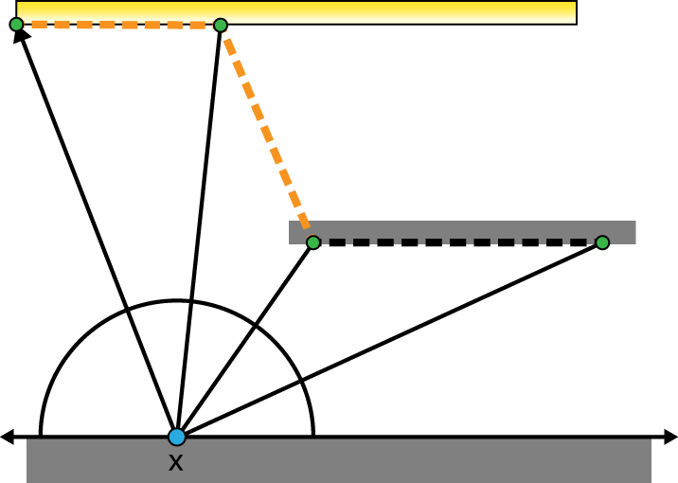
Constructing the Triangulated Environment
L = ?
Notes:
Going back to 2D, for each segment we have two choices – we can use the radiance stored at either of the vertices. As the figure shows, the only way to correctly approximate the scene is to use the radiance for the farthest one – otherwise, the second segment there would be dark, which is not what we want. In 3D, instead of segments we have triangles, and thus three possible vertex radiances. Applying the same heuristic of selecting the farthest vertex works well in practice.

Slide 67
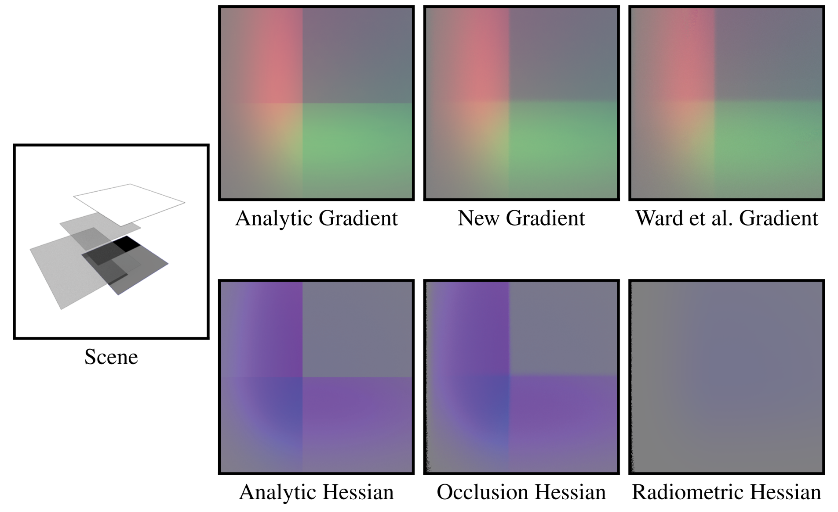
Resulting Derivative Estimates
[Jarosz et al. 2012]
Notes:
The resulting gradient and Hessian estimates are good approximations of the true derivatives for scenes with significant occlusions. (click)
In the case of the gradient, we have mapped the x, y and z coordinates to the r g b channels. Our new method has practical benefits over the standard approach, because it allows us to use arbitrary hemispherical distributions without re-derivation. For our work, we used concentric mapping because it produces more regular sampling patterns, leading to slightly better results. (click)
In the case of the Hessian, we have mapped the Hessian eigenvalues to the r g b channels. The Radiometric Hessian does not take occlusions into account, so it is not surprising that it does not match the ground truth, while our new formulation does.

Slide 68

Resulting Derivative Estimates
Notes:
The resulting gradient and Hessian estimates are good approximations of the true derivatives for scenes with significant occlusions. (click)
In the case of the gradient, we have mapped the x, y and z coordinates to the r g b channels. Our new method has practical benefits over the standard approach, because it allows us to use arbitrary hemispherical distributions without re-derivation. For our work, we used concentric mapping because it produces more regular sampling patterns, leading to slightly better results. (click)
In the case of the Hessian, we have mapped the Hessian eigenvalues to the r g b channels. The Radiometric Hessian does not take occlusions into account, so it is not surprising that it does not match the ground truth, while our new formulation does.

Slide 69
Resulting Derivative Estimates
[Jarosz et al. 2012]
Notes:
The resulting gradient and Hessian estimates are good approximations of the true derivatives for scenes with significant occlusions. (click)
In the case of the gradient, we have mapped the x, y and z coordinates to the r g b channels. Our new method has practical benefits over the standard approach, because it allows us to use arbitrary hemispherical distributions without re-derivation. For our work, we used concentric mapping because it produces more regular sampling patterns, leading to slightly better results. (click)
In the case of the Hessian, we have mapped the Hessian eigenvalues to the r g b channels. The Radiometric Hessian does not take occlusions into account, so it is not surprising that it does not match the ground truth, while our new formulation does.

Slide 70
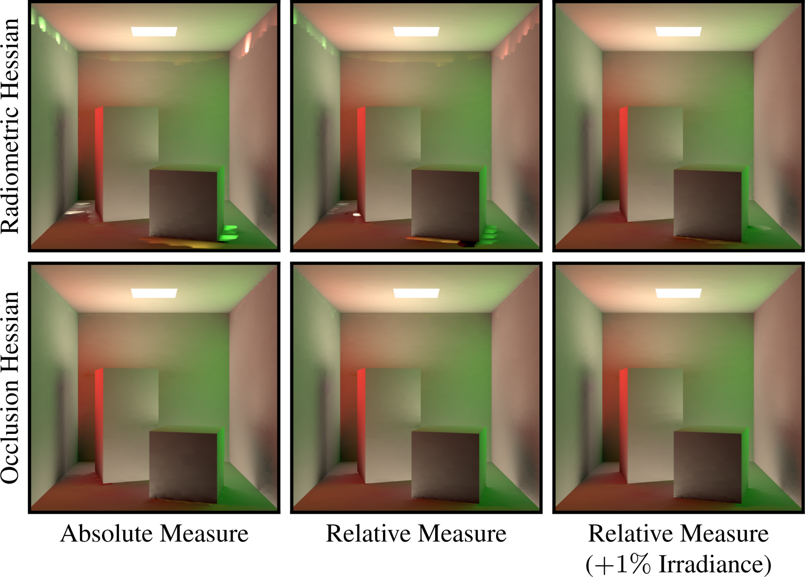
Resulting Derivative Estimates
Radiometric Hessian
[Jarosz et al 2012]
Occlusion Hessian
Notes:
Here, we compare the previous occlusion-unaware Hessian based method to our new occlusion-aware formulation in a more complex scene.
The radiometric Hessian suffers from distracting artifacts due to interpolating across very steep gradients, which happens precisely because the error measure does not take the occlusion changes into account.

Slide 71
Cache Record Valid Region
Notes:
We could now use the equation we defined earlier to compute the anisotropic validity region for the cache records.
However, this is sub-optimal because it defines the error with respect to the absolute variation in irradiance. (click)
A relative error measure is desirable for various reasons. (click) First, our visual system is much more sensitive to variations in contrast instead of absolute changes in intensity. (click)
Secondly, a relative measure is independent of the absolute scale of the scene (click) and absolute intensity of the light sources. (click)
All this makes the parameters of the algorithm more compatible across dissimilar scenes. (click)
In order to do this, we modify the error formula by dividing the Hessian by the computed irradiance – (click) leading to this modified equation, where the only difference is the appearance of the irradiance in the numerator.

Slide 72
Cache Record Valid Region
A relative error term is more desirable
Notes:
We could now use the equation we defined earlier to compute the anisotropic validity region for the cache records.
However, this is sub-optimal because it defines the error with respect to the absolute variation in irradiance. (click)
A relative error measure is desirable for various reasons. (click) First, our visual system is much more sensitive to variations in contrast instead of absolute changes in intensity. (click)
Secondly, a relative measure is independent of the absolute scale of the scene (click) and absolute intensity of the light sources. (click)
All this makes the parameters of the algorithm more compatible across dissimilar scenes. (click)
In order to do this, we modify the error formula by dividing the Hessian by the computed irradiance – (click) leading to this modified equation, where the only difference is the appearance of the irradiance in the numerator.

Slide 73
Cache Record Valid Region
A relative error term is more desirable
  Visual system responds more strongly to variations in contrast
Notes:
We could now use the equation we defined earlier to compute the anisotropic validity region for the cache records.
However, this is sub-optimal because it defines the error with respect to the absolute variation in irradiance. (click)
A relative error measure is desirable for various reasons. (click) First, our visual system is much more sensitive to variations in contrast instead of absolute changes in intensity. (click)
Secondly, a relative measure is independent of the absolute scale of the scene (click) and absolute intensity of the light sources. (click)
All this makes the parameters of the algorithm more compatible across dissimilar scenes. (click)
In order to do this, we modify the error formula by dividing the Hessian by the computed irradiance – (click) leading to this modified equation, where the only difference is the appearance of the irradiance in the numerator.

Slide 74
Cache Record Valid Region
A relative error term is more desirable
  Visual system responds more strongly to variations in contrast
  Independence from absolute scene scale
Notes:
We could now use the equation we defined earlier to compute the anisotropic validity region for the cache records.
However, this is sub-optimal because it defines the error with respect to the absolute variation in irradiance. (click)
A relative error measure is desirable for various reasons. (click) First, our visual system is much more sensitive to variations in contrast instead of absolute changes in intensity. (click)
Secondly, a relative measure is independent of the absolute scale of the scene (click) and absolute intensity of the light sources. (click)
All this makes the parameters of the algorithm more compatible across dissimilar scenes. (click)
In order to do this, we modify the error formula by dividing the Hessian by the computed irradiance – (click) leading to this modified equation, where the only difference is the appearance of the irradiance in the numerator.

Slide 75
Cache Record Valid Region
A relative error term is more desirable
  Visual system responds more strongly to variations in contrast
  Independence from absolute scene scale
  Independence from absolute light source intensity
Notes:
We could now use the equation we defined earlier to compute the anisotropic validity region for the cache records.
However, this is sub-optimal because it defines the error with respect to the absolute variation in irradiance. (click)
A relative error measure is desirable for various reasons. (click) First, our visual system is much more sensitive to variations in contrast instead of absolute changes in intensity. (click)
Secondly, a relative measure is independent of the absolute scale of the scene (click) and absolute intensity of the light sources. (click)
All this makes the parameters of the algorithm more compatible across dissimilar scenes. (click)
In order to do this, we modify the error formula by dividing the Hessian by the computed irradiance – (click) leading to this modified equation, where the only difference is the appearance of the irradiance in the numerator.

Slide 76
Cache Record Valid Region
A relative error term is more desirable
  Visual system responds more strongly to variations in contrast
  Independence from absolute scene scale
  Independence from absolute light source intensity
  Parameters are more compatible across scenes
Notes:
We could now use the equation we defined earlier to compute the anisotropic validity region for the cache records.
However, this is sub-optimal because it defines the error with respect to the absolute variation in irradiance. (click)
A relative error measure is desirable for various reasons. (click) First, our visual system is much more sensitive to variations in contrast instead of absolute changes in intensity. (click)
Secondly, a relative measure is independent of the absolute scale of the scene (click) and absolute intensity of the light sources. (click)
All this makes the parameters of the algorithm more compatible across dissimilar scenes. (click)
In order to do this, we modify the error formula by dividing the Hessian by the computed irradiance – (click) leading to this modified equation, where the only difference is the appearance of the irradiance in the numerator.

Slide 77
Cache Record Valid Region
A relative error term is more desirable
  Visual system responds more strongly to variations in contrast
  Independence from absolute scene scale
  Independence from absolute light source intensity
  Parameters are more compatible across scenes
Solution: Divide by the computed irradiance.
Notes:
We could now use the equation we defined earlier to compute the anisotropic validity region for the cache records.
However, this is sub-optimal because it defines the error with respect to the absolute variation in irradiance. (click)
A relative error measure is desirable for various reasons. (click) First, our visual system is much more sensitive to variations in contrast instead of absolute changes in intensity. (click)
Secondly, a relative measure is independent of the absolute scale of the scene (click) and absolute intensity of the light sources. (click)
All this makes the parameters of the algorithm more compatible across dissimilar scenes. (click)
In order to do this, we modify the error formula by dividing the Hessian by the computed irradiance – (click) leading to this modified equation, where the only difference is the appearance of the irradiance in the numerator.

Slide 78
Cache Record Valid Region
A relative error term is more desirable
  Visual system responds more strongly to variations in contrast
  Independence from absolute scene scale
  Independence from absolute light source intensity
  Parameters are more compatible across scenes
Solution: Divide by the computed irradiance.
Notes:
We could now use the equation we defined earlier to compute the anisotropic validity region for the cache records.
However, this is sub-optimal because it defines the error with respect to the absolute variation in irradiance. (click)
A relative error measure is desirable for various reasons. (click) First, our visual system is much more sensitive to variations in contrast instead of absolute changes in intensity. (click)
Secondly, a relative measure is independent of the absolute scale of the scene (click) and absolute intensity of the light sources. (click)
All this makes the parameters of the algorithm more compatible across dissimilar scenes. (click)
In order to do this, we modify the error formula by dividing the Hessian by the computed irradiance – (click) leading to this modified equation, where the only difference is the appearance of the irradiance in the numerator.

Slide 79
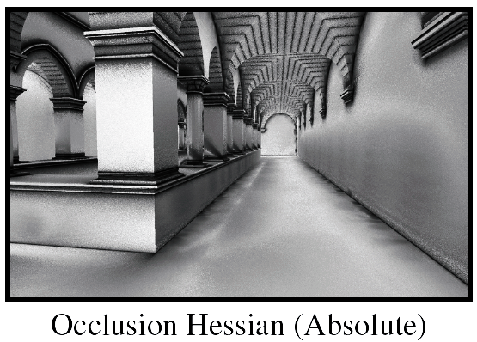
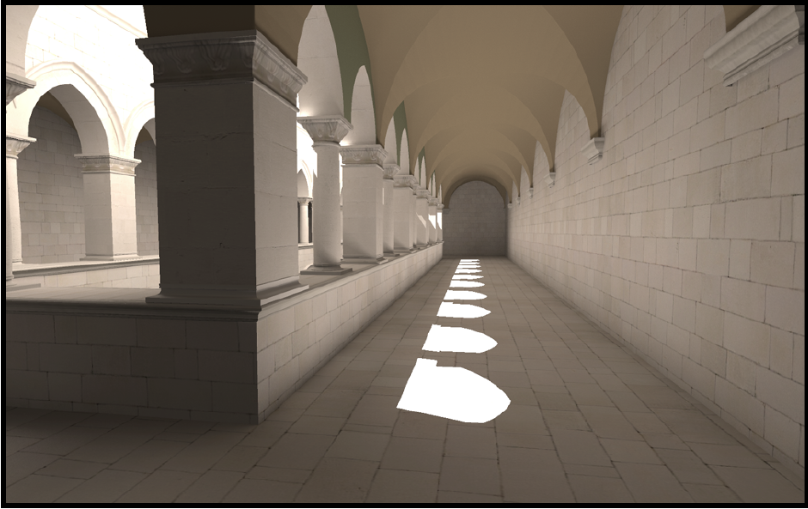
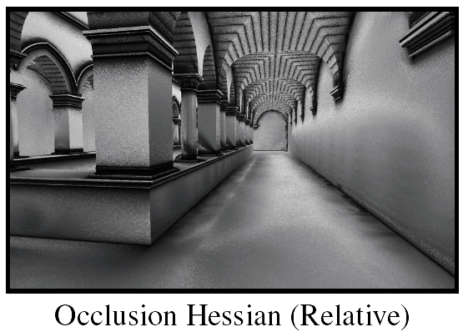
Cache Record Valid Region
Notes:
Here we compare the cache point radii produced by absolute and relative versions of our error metric in the familiar Sponza scene.
We can see that the absolute measure defines larger radii in dark areas and conversely, samples densely in bright regions.
In contrast, our relative measure places fewer samples in the bright regions, where absolute differences in irradiance induce lower perceived error.

Slide 80
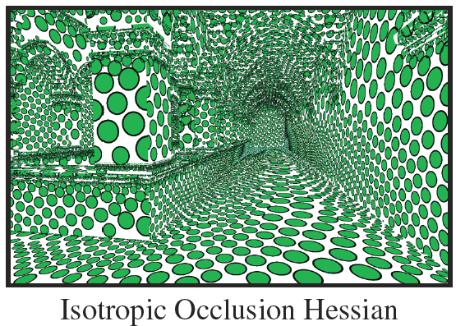
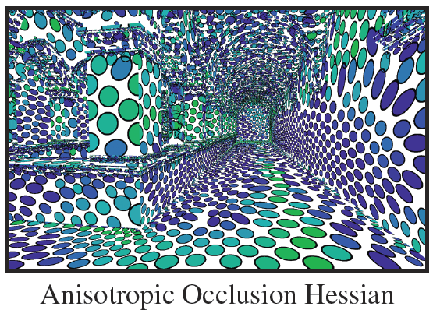
Cache Record Valid Region
Notes:
We also compare the difference between an isotropic and anisotropic version of the error measure.
Anisotropic records adapt their eccentricity to the local irradiance curvature, (click) allowing for fewer cache records for the same error threshold.

Slide 81
Cache Record Valid Region
~20,000 Records
~16,000 Records
Notes:
We also compare the difference between an isotropic and anisotropic version of the error measure.
Anisotropic records adapt their eccentricity to the local irradiance curvature, (click) allowing for fewer cache records for the same error threshold.

Slide 82
Pathological Cases
Undefined behavior is possible
Notes:
One fundamental problem of a radiometric approach is that, if all or even most of the gather rays return black, the resulting radii can be undefined or infinite. (click)
Of course, this is rarely a problem if we compute multiple bounces of indirect lighting, but its very common if we’re only computing a single bounce. (click)
Jarosz et al solved this issue by reverting to a completely geometric, though still Hessian-based, error measure, that they termed the Geometric Hessian. (click)
Instead of this “all in” approach, we add 1% of the irradiance to the radiance of all triangles in our mesh representation before computing the Hessian. (click)
Only in the special case where all rays return black, we set the radiance of all the triangles to 1.
This has the effect of reverting to a purely geometric approach only when absolutely necessary.

Slide 83
Pathological Cases
Undefined behavior is possible
  Not generally a problem if computing multiple bounces of GI
Notes:
One fundamental problem of a radiometric approach is that, if all or even most of the gather rays return black, the resulting radii can be undefined or infinite. (click)
Of course, this is rarely a problem if we compute multiple bounces of indirect lighting, but its very common if we’re only computing a single bounce. (click)
Jarosz et al solved this issue by reverting to a completely geometric, though still Hessian-based, error measure, that they termed the Geometric Hessian. (click)
Instead of this “all in” approach, we add 1% of the irradiance to the radiance of all triangles in our mesh representation before computing the Hessian. (click)
Only in the special case where all rays return black, we set the radiance of all the triangles to 1.
This has the effect of reverting to a purely geometric approach only when absolutely necessary.

Slide 84
Pathological Cases
Undefined behavior is possible
  Not generally a problem if computing multiple bounces of GI
One solution: Geometric Hessian (Jarosz et al. 2012)
  Undesirable since we want to retain advantages of radiometric approach
Notes:
One fundamental problem of a radiometric approach is that, if all or even most of the gather rays return black, the resulting radii can be undefined or infinite. (click)
Of course, this is rarely a problem if we compute multiple bounces of indirect lighting, but its very common if we’re only computing a single bounce. (click)
Jarosz et al solved this issue by reverting to a completely geometric, though still Hessian-based, error measure, that they termed the Geometric Hessian. (click)
Instead of this “all in” approach, we add 1% of the irradiance to the radiance of all triangles in our mesh representation before computing the Hessian. (click)
Only in the special case where all rays return black, we set the radiance of all the triangles to 1.
This has the effect of reverting to a purely geometric approach only when absolutely necessary.

Slide 85
Pathological Cases
Undefined behavior is possible
  Not generally a problem if computing multiple bounces of GI
One solution: Geometric Hessian (Jarosz et al. 2012)
  Undesirable since we want to retain advantages of radiometric approach
Instead: Add 1% of irradiance to every sample
  Only when computing Hessian, so we don’t distort the irradiance
Notes:
One fundamental problem of a radiometric approach is that, if all or even most of the gather rays return black, the resulting radii can be undefined or infinite. (click)
Of course, this is rarely a problem if we compute multiple bounces of indirect lighting, but its very common if we’re only computing a single bounce. (click)
Jarosz et al solved this issue by reverting to a completely geometric, though still Hessian-based, error measure, that they termed the Geometric Hessian. (click)
Instead of this “all in” approach, we add 1% of the irradiance to the radiance of all triangles in our mesh representation before computing the Hessian. (click)
Only in the special case where all rays return black, we set the radiance of all the triangles to 1.
This has the effect of reverting to a purely geometric approach only when absolutely necessary.

Slide 86
Pathological Cases
Undefined behavior is possible
  Not generally a problem if computing multiple bounces of GI
One solution: Geometric Hessian (Jarosz et al. 2012)
  Undesirable since we want to retain advantages of radiometric approach
Instead: Add 1% of irradiance to every sample
  Only when computing Hessian, so we don’t distort the irradiance
  Only if all samples are black, revert to purely geometric Hessian
Notes:
One fundamental problem of a radiometric approach is that, if all or even most of the gather rays return black, the resulting radii can be undefined or infinite. (click)
Of course, this is rarely a problem if we compute multiple bounces of indirect lighting, but its very common if we’re only computing a single bounce. (click)
Jarosz et al solved this issue by reverting to a completely geometric, though still Hessian-based, error measure, that they termed the Geometric Hessian. (click)
Instead of this “all in” approach, we add 1% of the irradiance to the radiance of all triangles in our mesh representation before computing the Hessian. (click)
Only in the special case where all rays return black, we set the radiance of all the triangles to 1.
This has the effect of reverting to a purely geometric approach only when absolutely necessary.

Slide 87
Notes:
Here, we compare the Radiometric Hessian by Jarosz et al to our new Occlusion Hessian.
While going from an absolute to a relative measure and then adding 1% of irradiance, improves both methods, the largest improvement is still achieved by going from the occlusion-less Hessian to our new occlusion-aware Hessian.

Slide 88
Rotation Error
Can we apply the same approach to rotations?
Notes:
In the case of rotations, we could in principle apply the same approach as we did for translation and derive a rotational irradiance Hessian. (click)
However, this would only attempt to estimate the change induced by rotation to the cosine foreshortening term. The common thought is that there are no changes in occlusion when we simply rotate the surface, which is not really true. In practice, the effect of geometry below the horizon becoming visible after a rotation dwarfs the effect of the change in the cosine term, and unfortunately there is no robust way to try and approximate this. (click)
In the face of these problems, we adopt the approach proposed by Tabellion and Lamorlette in 2004. We simply enforce a maximum deviation angle beyond which no interpolation is allowed.

Slide 89
Rotation Error
Can we apply the same approach to rotations?
In practice, this approach does not work well
Notes:
In the case of rotations, we could in principle apply the same approach as we did for translation and derive a rotational irradiance Hessian. (click)
However, this would only attempt to estimate the change induced by rotation to the cosine foreshortening term. The common thought is that there are no changes in occlusion when we simply rotate the surface, which is not really true. In practice, the effect of geometry below the horizon becoming visible after a rotation dwarfs the effect of the change in the cosine term, and unfortunately there is no robust way to try and approximate this. (click)
In the face of these problems, we adopt the approach proposed by Tabellion and Lamorlette in 2004. We simply enforce a maximum deviation angle beyond which no interpolation is allowed.

Slide 90
Rotation Error
Can we apply the same approach to rotations?
In practice, this approach does not work well
Practical solution – enforce a maximum deviation angle
  [Tabellion and Lamorlette 2004]
Notes:
In the case of rotations, we could in principle apply the same approach as we did for translation and derive a rotational irradiance Hessian. (click)
However, this would only attempt to estimate the change induced by rotation to the cosine foreshortening term. The common thought is that there are no changes in occlusion when we simply rotate the surface, which is not really true. In practice, the effect of geometry below the horizon becoming visible after a rotation dwarfs the effect of the change in the cosine term, and unfortunately there is no robust way to try and approximate this. (click)
In the face of these problems, we adopt the approach proposed by Tabellion and Lamorlette in 2004. We simply enforce a maximum deviation angle beyond which no interpolation is allowed.

Slide 91
Irradiance Storage and Interpolation
For each cache record, we store:
Usual suspects (position, normal, irradiance & gradients)
Notes:
With respect to storage, there are really no surprises. As for any implementation that uses gradients for interpolation, we store the sample location, the normal, the computed irradiance and the translation and rotation gradients. (click)
Since we support anisotropic radii, we also need to store both anisotropic radii, as well as the corresponding eigenvectors.

Slide 92


Irradiance Storage and Interpolation
For each cache record, we store:
Usual suspects (position, normal, irradiance & gradients)
To support anisotropic records:
  Anisotropic radii
  Corresponding eigenvectors
Notes:
With respect to storage, there are really no surprises. As for any implementation that uses gradients for interpolation, we store the sample location, the normal, the computed irradiance and the translation and rotation gradients. (click)
Since we support anisotropic radii, we also need to store both anisotropic radii, as well as the corresponding eigenvectors.

Slide 93
Results
Implemented in PBRT [Pharr and Humphreys 2010]
Notes:
Now for some results.
We implemented all methods by modifying the irradiance caching implementation included in PBRT. (click)
In the case of the split-sphere heuristic, we used the standard fixes used to control the method – adding minimum and maximum image space radii, etc. (click)
Finally, we used 4000 rays for each irradiance sample.

Slide 94
Results
Implemented in PBRT [Pharr and Humphreys 2010]
Modified the built in irradiance caching implementation
  Standard tricks to improve the Split-Sphere Heuristic
Notes:
Now for some results.
We implemented all methods by modifying the irradiance caching implementation included in PBRT. (click)
In the case of the split-sphere heuristic, we used the standard fixes used to control the method – adding minimum and maximum image space radii, etc. (click)
Finally, we used 4000 rays for each irradiance sample.

Slide 95
Results
Implemented in PBRT [Pharr and Humphreys 2010]
Modified the built in irradiance caching implementation
  Standard tricks to improve the Split-Sphere Heuristic
Used 4K gather rays per irradiance sample
Notes:
Now for some results.
We implemented all methods by modifying the irradiance caching implementation included in PBRT. (click)
In the case of the split-sphere heuristic, we used the standard fixes used to control the method – adding minimum and maximum image space radii, etc. (click)
Finally, we used 4000 rays for each irradiance sample.

Slide 96
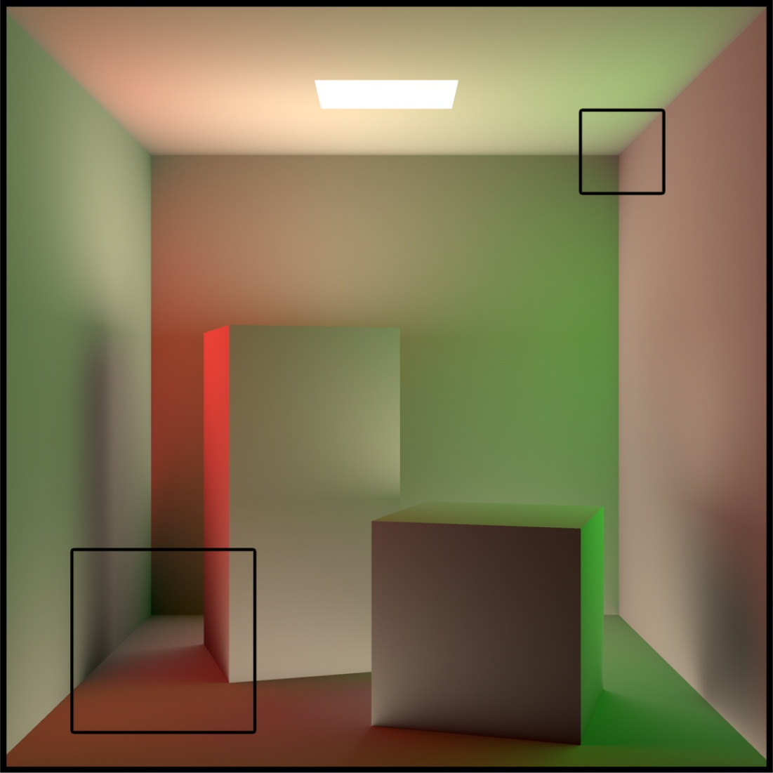
Results
Notes:
This image shows a rendering of the irradiance in the familiar Cornell Box scene. We only show the irradiance to make comparison easier, and the square outlines show the regions of the image we’ll focus on. (click)
We can see how the split-sphere heavily concentrates samples in corners and other geometric features of the scene, leading to strong artifacts, even when we clamp the maximum cache point radius. (click)
The Hessian-based methods proposed by Jarosz et al do a lot better, but the radiometric hessian still suffers from jarring artifacts, and even the geometric Hessian shows subtle artifacts in the ceiling region (click)
As you can see, our new method produces the best cache point distribution in this scene, with the least visible artifacts and lowest RMS error.

Slide 97
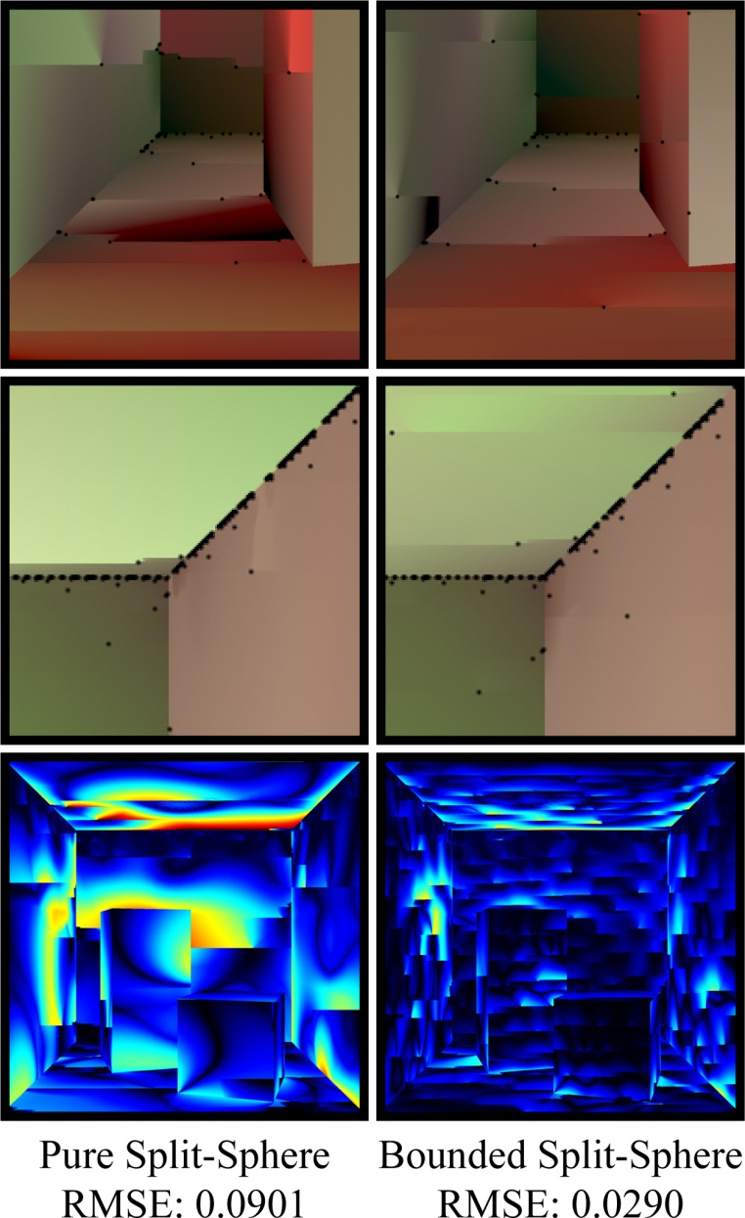

Split-Sphere
Notes:
This image shows a rendering of the irradiance in the familiar Cornell Box scene. We only show the irradiance to make comparison easier, and the square outlines show the regions of the image we’ll focus on. (click)
We can see how the split-sphere heavily concentrates samples in corners and other geometric features of the scene, leading to strong artifacts, even when we clamp the maximum cache point radius. (click)
The Hessian-based methods proposed by Jarosz et al do a lot better, but the radiometric hessian still suffers from jarring artifacts, and even the geometric Hessian shows subtle artifacts in the ceiling region (click)
As you can see, our new method produces the best cache point distribution in this scene, with the least visible artifacts and lowest RMS error.

Slide 98
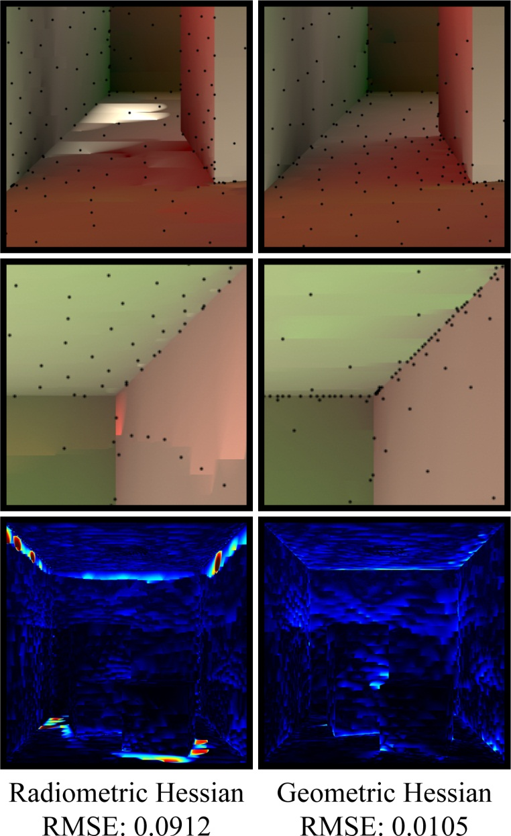
[Jarosz et al. 2012]
Notes:
This image shows a rendering of the irradiance in the familiar Cornell Box scene. We only show the irradiance to make comparison easier, and the square outlines show the regions of the image we’ll focus on. (click)
We can see how the split-sphere heavily concentrates samples in corners and other geometric features of the scene, leading to strong artifacts, even when we clamp the maximum cache point radius. (click)
The Hessian-based methods proposed by Jarosz et al do a lot better, but the radiometric hessian still suffers from jarring artifacts, and even the geometric Hessian shows subtle artifacts in the ceiling region (click)
As you can see, our new method produces the best cache point distribution in this scene, with the least visible artifacts and lowest RMS error.

Slide 99
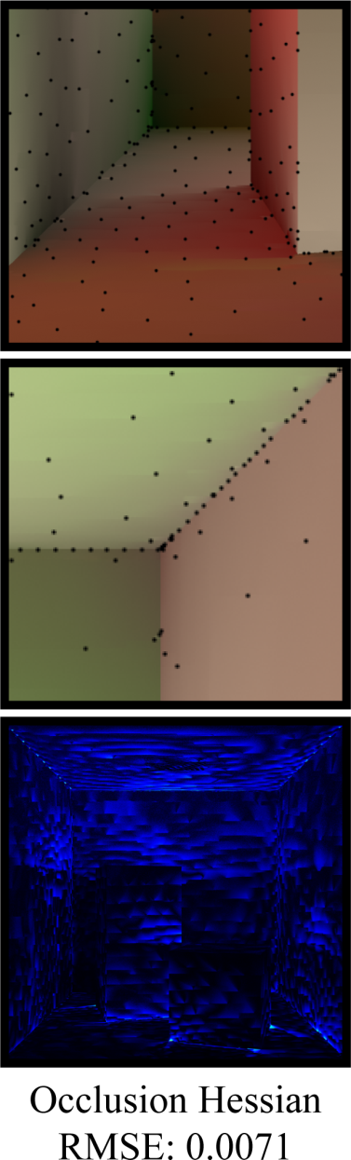
Our Method
Notes:
This image shows a rendering of the irradiance in the familiar Cornell Box scene. We only show the irradiance to make comparison easier, and the square outlines show the regions of the image we’ll focus on. (click)
We can see how the split-sphere heavily concentrates samples in corners and other geometric features of the scene, leading to strong artifacts, even when we clamp the maximum cache point radius. (click)
The Hessian-based methods proposed by Jarosz et al do a lot better, but the radiometric hessian still suffers from jarring artifacts, and even the geometric Hessian shows subtle artifacts in the ceiling region (click)
As you can see, our new method produces the best cache point distribution in this scene, with the least visible artifacts and lowest RMS error.

Slide 100
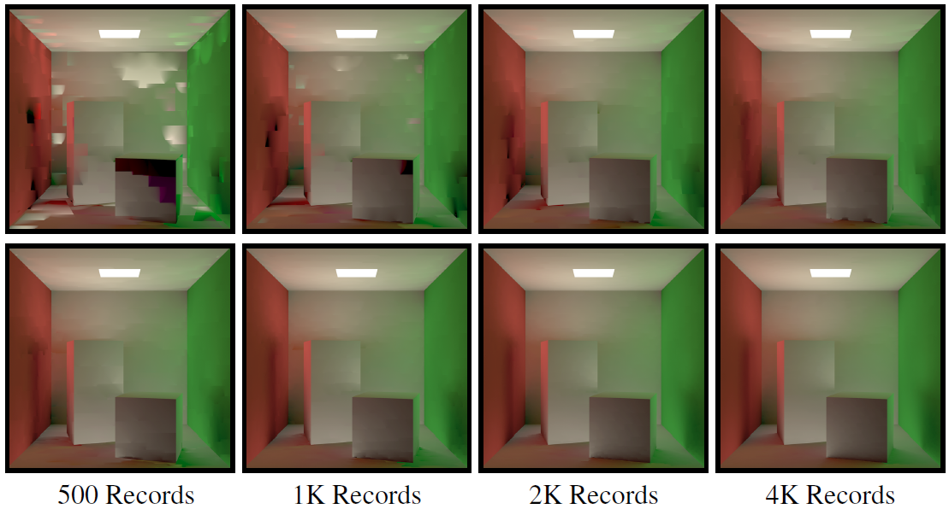
Our Method
Notes:
In this case, we analize the behavior of our new method for different total cache record counts, which we achieve by modifying the error threshold parameter.
As you can see, our method is able to produce reasonable cache point distributions, leading to a graceful decline in image quality even with a very limited number of cache records. (click)
In contrast, the split-sphere heuristic does not behave very well when we severely limit the number of cache records allowed. The very strong artifacts visible in the case of 500 or 1000 records, happen because we had to set the error threshold parameter very high in order to reach the target record count. This led to samples from the ceiling being used to interpolate irradiance on the walls, and vice versa.

Slide 101
Our Method
Split-Sphere
Notes:
In this case, we analize the behavior of our new method for different total cache record counts, which we achieve by modifying the error threshold parameter.
As you can see, our method is able to produce reasonable cache point distributions, leading to a graceful decline in image quality even with a very limited number of cache records. (click)
In contrast, the split-sphere heuristic does not behave very well when we severely limit the number of cache records allowed. The very strong artifacts visible in the case of 500 or 1000 records, happen because we had to set the error threshold parameter very high in order to reach the target record count. This led to samples from the ceiling being used to interpolate irradiance on the walls, and vice versa.

Slide 102
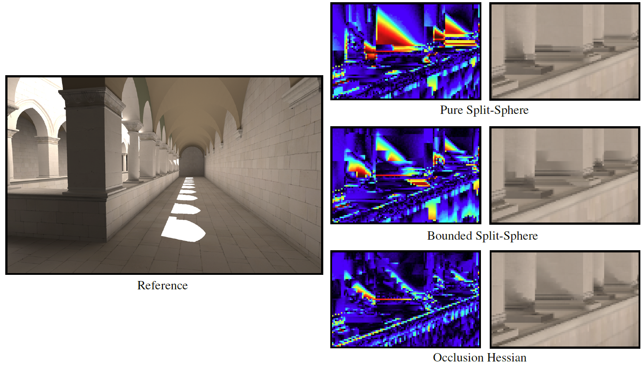
Results
Notes:
We also rendered the Sponza scene using the split-sphere, both bounded and unbounded, and our new occlusion hessian method.
We show crops from all images showing typical artifact produced by the split-sphere based methods, which are not present in the image computed using our method.
Notice how some of the shadow detail either shows heavy artifacting, or is even completely missing, for the split-sphere case.

Slide 103
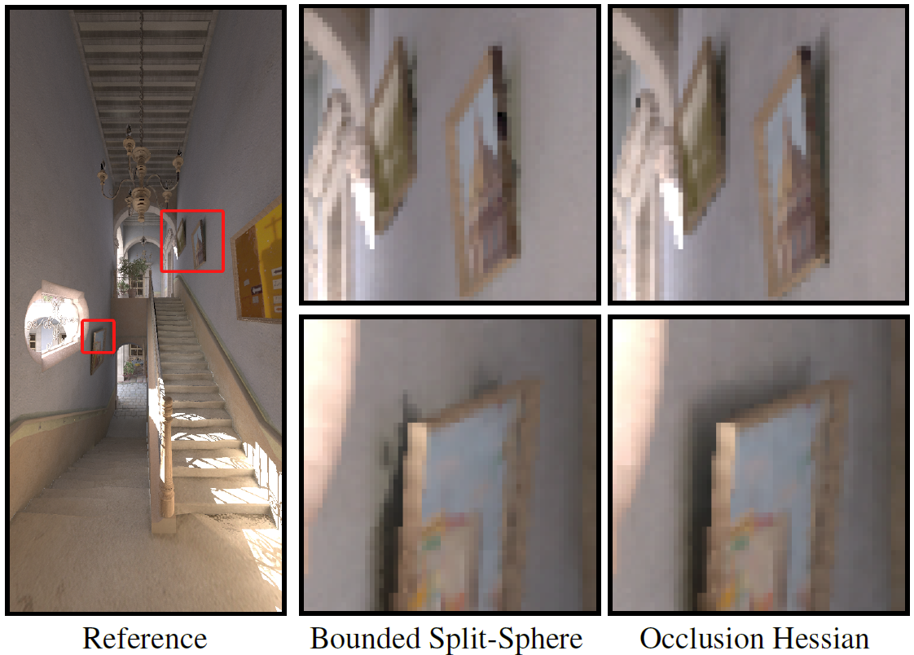
Notes:
Finally, we also rendered the San Miguel scene, which is included with the PBRT release.
Again, the split-sphere heuristic was unable to properly resolve some of the shadow details in the scene, which are properly accounted for by our new method.

Slide 104
Summary
Hessian-based approach results in better error control for Irradiance Caching
Notes:
I hope these last few examples have given you compelling reason to believe that our Hessian-based approach results in better error control for irradiance caching. (click)
Our method naturally supports anisotropic cache records, which further improve the quality of the resulting images. (click)
As a result, the record density closely follows the rate of change of illumination in the scene, leading to more a more efficient cache (click)
Also, since we don’t rely heavily on user set minimum and maximum record radii, our method is more intuitive to control. (click)
Importantly, since we completely replace the split-sphere heuristic with our new approach, any algorithms that use the split-sphere for error control can benefit from our approach – like for instance, radiance caching.

Slide 105
Summary
Hessian-based approach results in better error control for Irradiance Caching
Naturally supports anisotropic cache records
Notes:
I hope these last few examples have given you compelling reason to believe that our Hessian-based approach results in better error control for irradiance caching. (click)
Our method naturally supports anisotropic cache records, which further improve the quality of the resulting images. (click)
As a result, the record density closely follows the rate of change of illumination in the scene, leading to more a more efficient cache (click)
Also, since we don’t rely heavily on user set minimum and maximum record radii, our method is more intuitive to control. (click)
Importantly, since we completely replace the split-sphere heuristic with our new approach, any algorithms that use the split-sphere for error control can benefit from our approach – like for instance, radiance caching.

Slide 106
Summary
Hessian-based approach results in better error control for Irradiance Caching
Naturally supports anisotropic cache records
Record density follows the rate of change of irradiance
Notes:
I hope these last few examples have given you compelling reason to believe that our Hessian-based approach results in better error control for irradiance caching. (click)
Our method naturally supports anisotropic cache records, which further improve the quality of the resulting images. (click)
As a result, the record density closely follows the rate of change of illumination in the scene, leading to more a more efficient cache (click)
Also, since we don’t rely heavily on user set minimum and maximum record radii, our method is more intuitive to control. (click)
Importantly, since we completely replace the split-sphere heuristic with our new approach, any algorithms that use the split-sphere for error control can benefit from our approach – like for instance, radiance caching.

Slide 107
Summary
Hessian-based approach results in better error control for Irradiance Caching
Naturally supports anisotropic cache records
Record density follows the rate of change of irradiance
Easier to control
Notes:
I hope these last few examples have given you compelling reason to believe that our Hessian-based approach results in better error control for irradiance caching. (click)
Our method naturally supports anisotropic cache records, which further improve the quality of the resulting images. (click)
As a result, the record density closely follows the rate of change of illumination in the scene, leading to more a more efficient cache (click)
Also, since we don’t rely heavily on user set minimum and maximum record radii, our method is more intuitive to control. (click)
Importantly, since we completely replace the split-sphere heuristic with our new approach, any algorithms that use the split-sphere for error control can benefit from our approach – like for instance, radiance caching.

Slide 108
Summary
Hessian-based approach results in better error control for Irradiance Caching
Naturally supports anisotropic cache records
Record density follows the rate of change of irradiance
Easier to control
Drop-in replacement for Split-Sphere heuristic
  For example, Radiance Caching
Notes:
I hope these last few examples have given you compelling reason to believe that our Hessian-based approach results in better error control for irradiance caching. (click)
Our method naturally supports anisotropic cache records, which further improve the quality of the resulting images. (click)
As a result, the record density closely follows the rate of change of illumination in the scene, leading to more a more efficient cache (click)
Also, since we don’t rely heavily on user set minimum and maximum record radii, our method is more intuitive to control. (click)
Importantly, since we completely replace the split-sphere heuristic with our new approach, any algorithms that use the split-sphere for error control can benefit from our approach – like for instance, radiance caching.

Slide 109
Future Work
Radiance Caching
Notes:
With regards to future work, we should again mention radiance caching. Even though our new method is a drop-in replacement of the split-sphere heuristic, if we wanted to make use of our new gradient formulation and use a concentric mapped stratification, a projection of this gradient to spherical harmonics would need to be derived. (click)
We would also like to revisit the rotational component of our method. Even though our analysis shows that a rotation Hessian does not lead to an effective error metric, there might be other approaches that can produce a more principled rotational error bound. (click)
Finally, our triangulated scene representation does not only have the same irradiance, irradiance gradient and irradiance Hessian of the original – in fact, higher derivatives of irradiance also match. This presents an opportunity for even higher-order analysis and error-control.

Slide 110
Future Work
Radiance Caching
Revisit the rotation error formulation
Notes:
With regards to future work, we should again mention radiance caching. Even though our new method is a drop-in replacement of the split-sphere heuristic, if we wanted to make use of our new gradient formulation and use a concentric mapped stratification, a projection of this gradient to spherical harmonics would need to be derived. (click)
We would also like to revisit the rotational component of our method. Even though our analysis shows that a rotation Hessian does not lead to an effective error metric, there might be other approaches that can produce a more principled rotational error bound. (click)
Finally, our triangulated scene representation does not only have the same irradiance, irradiance gradient and irradiance Hessian of the original – in fact, higher derivatives of irradiance also match. This presents an opportunity for even higher-order analysis and error-control.

Slide 111
Future Work
Radiance Caching
Revisit the rotation error formulation
Higher-order derivatives
Notes:
With regards to future work, we should again mention radiance caching. Even though our new method is a drop-in replacement of the split-sphere heuristic, if we wanted to make use of our new gradient formulation and use a concentric mapped stratification, a projection of this gradient to spherical harmonics would need to be derived. (click)
We would also like to revisit the rotational component of our method. Even though our analysis shows that a rotation Hessian does not lead to an effective error metric, there might be other approaches that can produce a more principled rotational error bound. (click)
Finally, our triangulated scene representation does not only have the same irradiance, irradiance gradient and irradiance Hessian of the original – in fact, higher derivatives of irradiance also match. This presents an opportunity for even higher-order analysis and error-control.

Slide 112
Acknowledgements
UCSD Graphics Lab
Notes:
I’d like to thank the UCSD graphics lab, and also thank you for your attention.

Slide 113
Questions?
Notes:
I’d be happy to answer questions

Slide 114


Slide 115


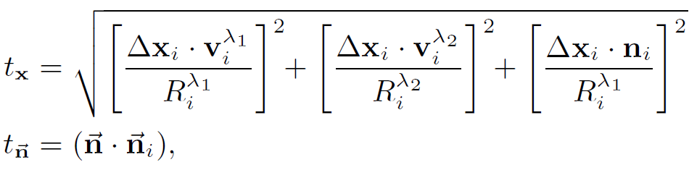
Irradiance Storage and Interpolation
New weighting function:
Notes:
To weight the contribution from each cache point, we propose a kernel weighting in both translation and orientation that falls off to zero at the boundaries (click), where k is a simple tent filter (click) and tx an tn are the translation and rotation distances.

Slide 116
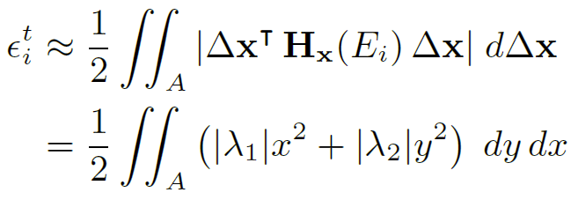
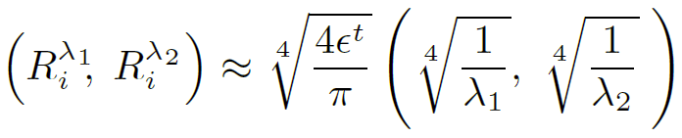
Background
Use 2nd-order Taylor expansion as oracle of irradiance:
Invert equation to obtain support area of cache record:
Notes:
If we can compute a second derivative of irradiance at the cache point, we can use a second order expansion as an oracle for the true irradiance.
The resulting expression, due to Jarosz et al, relates the total error to the Hessian of irradiance on the tangent space of the surface. (click)
If we transform the formula to polar coordinates and invert it, we have a way to derive anisotropic cache records whose expected error is below some user set threshold.
Crucially, then, we need to be able to compute (click) the second derivative of irradiance.

Slide 117
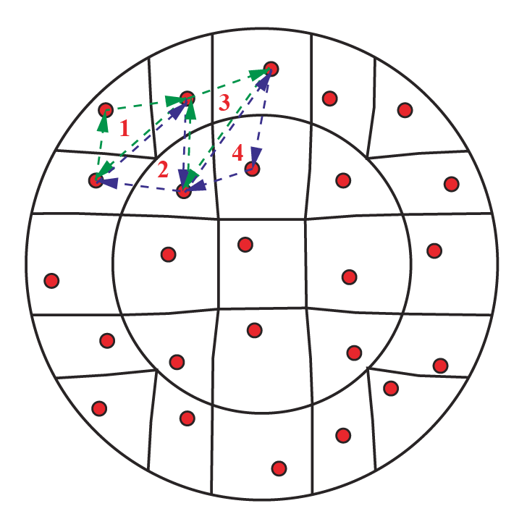
Constructing the Triangulated Environment
Notes:
To build our triangulated environment, we look at the position where each sample we trace lands.
To illustrate this, we show the hemispherical samples projected down to the surface. (click)
We then go over all the samples and connect neighbors into triangles, defining a triangular mesh. (click)
In order to make this process efficient, we use the connectivity information inherent to our stratification (in our case, a concentric mapping).

Slide 118
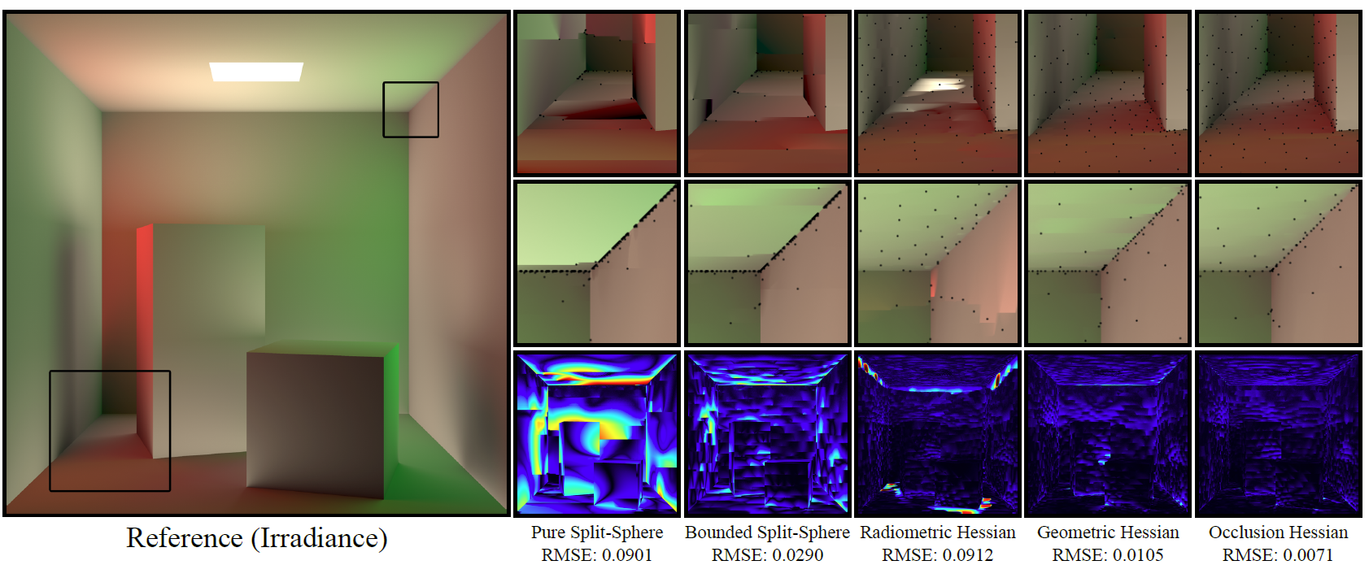
Results
Notes:
This image shows a rendering of the irradiance in the familiar Cornell Box scene. We only show the irradiance to make comparison easier.
All methods used the same number of cache records.
We can see how the split-sphere heavily concentrates samples in corners and other geometric features of the scene, leading to strong artifacts, even when we clamp the maximum cache point radius.
The Hessian-based methods proposed by Jarosz et al do a lot better, but the radiometric hessian still suffers from jarring artifacts.
Our new method produces the best cache point distribution in this scene.

