Slide 1

Analysis of Sample Correlations for Monte Carlo Rendering
SAMPLING MEASURES &
ERROR FORMULATIONS
Cengiz Öztireli
Research Scientist
Notes:
Thank you very much for the introduction.
Hi, I am Cengiz. I am excited to be able to talk about my current and future research projects that I like a lot today.
My talk will be about digital modeling of visual data for assisting creativity.
But before that, I would like very briefly talk about my background.
Changil – lightfields
Il-Kyu – facial wrinkles
Byungsoo – vectorization of images
Endri – body, cloth, dynamics capture from videos
Riccardo – texture sythesis, learning based geometry processing
Dominik & Endri – data-based pose and motion synthesis
Cengiz – data-based retouching
Derek New.– sampling for rendering
Pelin – multi-modal video understanding, video – text alignment
Marco – learning for scheduling, visual analytics
Body & face modeling from images & video
Video representations, data driven filtering
Joint geometry-video representations

Slide 2
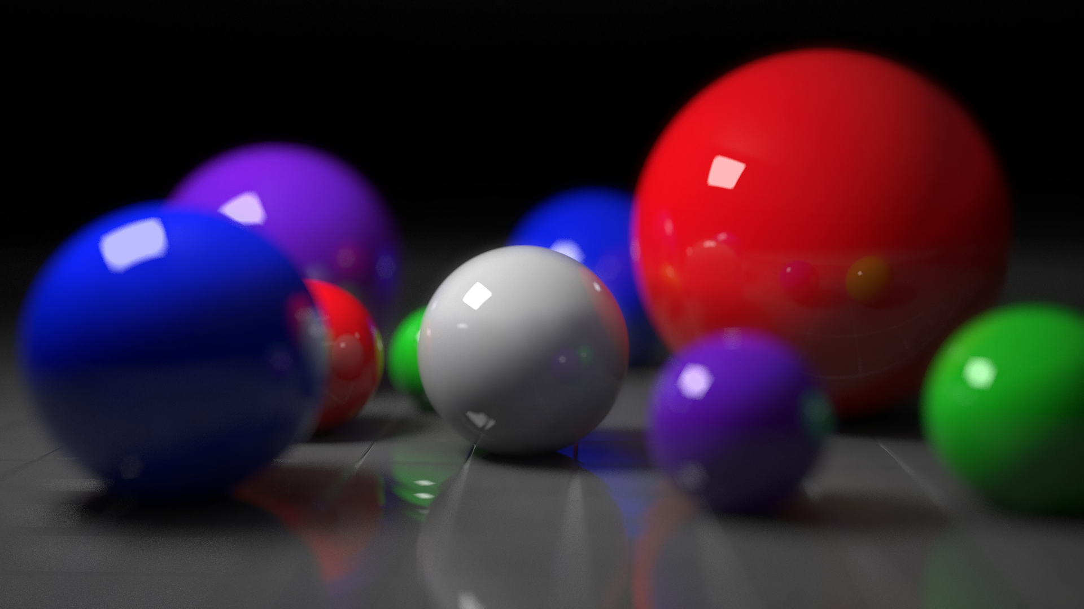
Rendering:
Computing Integrals

Slide 3
Numerical Integration
Approximate integrals with weighted sum of samples

Slide 4
Numerical Integration
Approximate integrals with weighted sum of samples
Random
Density
Arrangement
Notes:
Of course, the accuracy with which we approximate the integral depends on how we distribute the sample points. We could simply have a random set of sample points. However, typically we get much lower error by adjusting the density, for example by placing more samples where the function is one in this case, or the arrangement of points, for example by avoiding points close to each other. Rendering literature is very rich in density based sampling methods, as they are easier to analyze and understand. Some more recent works have also started to investigate the effect of arrangement of points on the error.

Slide 5
Stochastic Point Processes
Formal characterization of point patterns

Slide 6


Stochastic Point Processes
Formal characterization of point patterns
Point Process

Slide 7


Stochastic Point Processes
Examples of point processes
Natural Process
Manuel Process

Slide 8
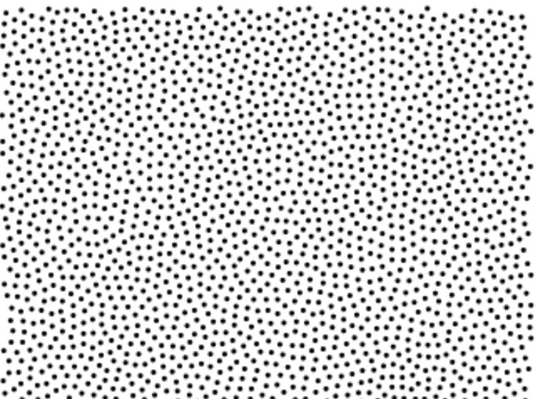
General Point Processes
Infinite point processes
Observation window

Slide 9
General Point Processes
Assign a random variable to each set

Slide 10
General Point Processes
Joint probabilities define the point process

Slide 11
Point Process Statistics
First order product density
Expected number of points around x
Measures local density

Slide 12

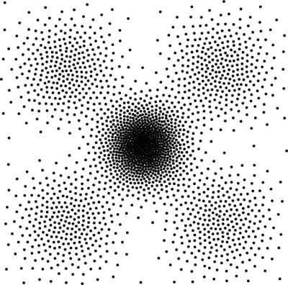
Point Process Statistics
First order product density

Slide 13
Point Process Statistics
First order product density
Constant

Slide 14
Point Process Statistics
Second order product density
Expected number of points around x & y
Measures the joint probability

Slide 15
Point Process Statistics
Higher order product density?
Expected number of points around x, y, z
Not necessary: second order dogma

Slide 16
Point Process Statistics
Summary: 1st & 2nd order correlations sufficient

Slide 17
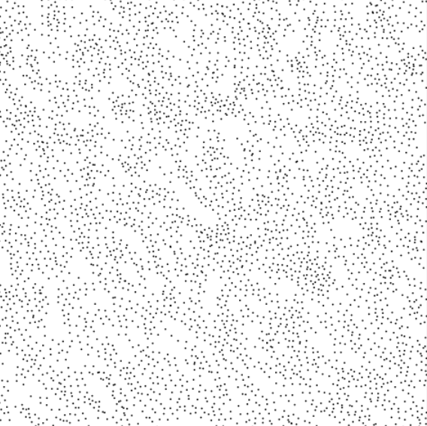

Stationary Point Processes
Stationary
(translation invariant)
Isotropic
(translation & rotation invariant)

Slide 18
Stationary Point Processes
Stationary (translation invariant)
Pair Correlation Function (PCF)
DoF reduced from 2d to d

Slide 19
Stationary Point Processes
Isotropic point process (translation & rotation invariant)
PCF

Slide 20
Estimating Correlations
Second order stationary - pair correlation function (PCF)

Slide 21
Estimating Correlations
Second order stationary - pair correlation function (PCF)

Slide 22
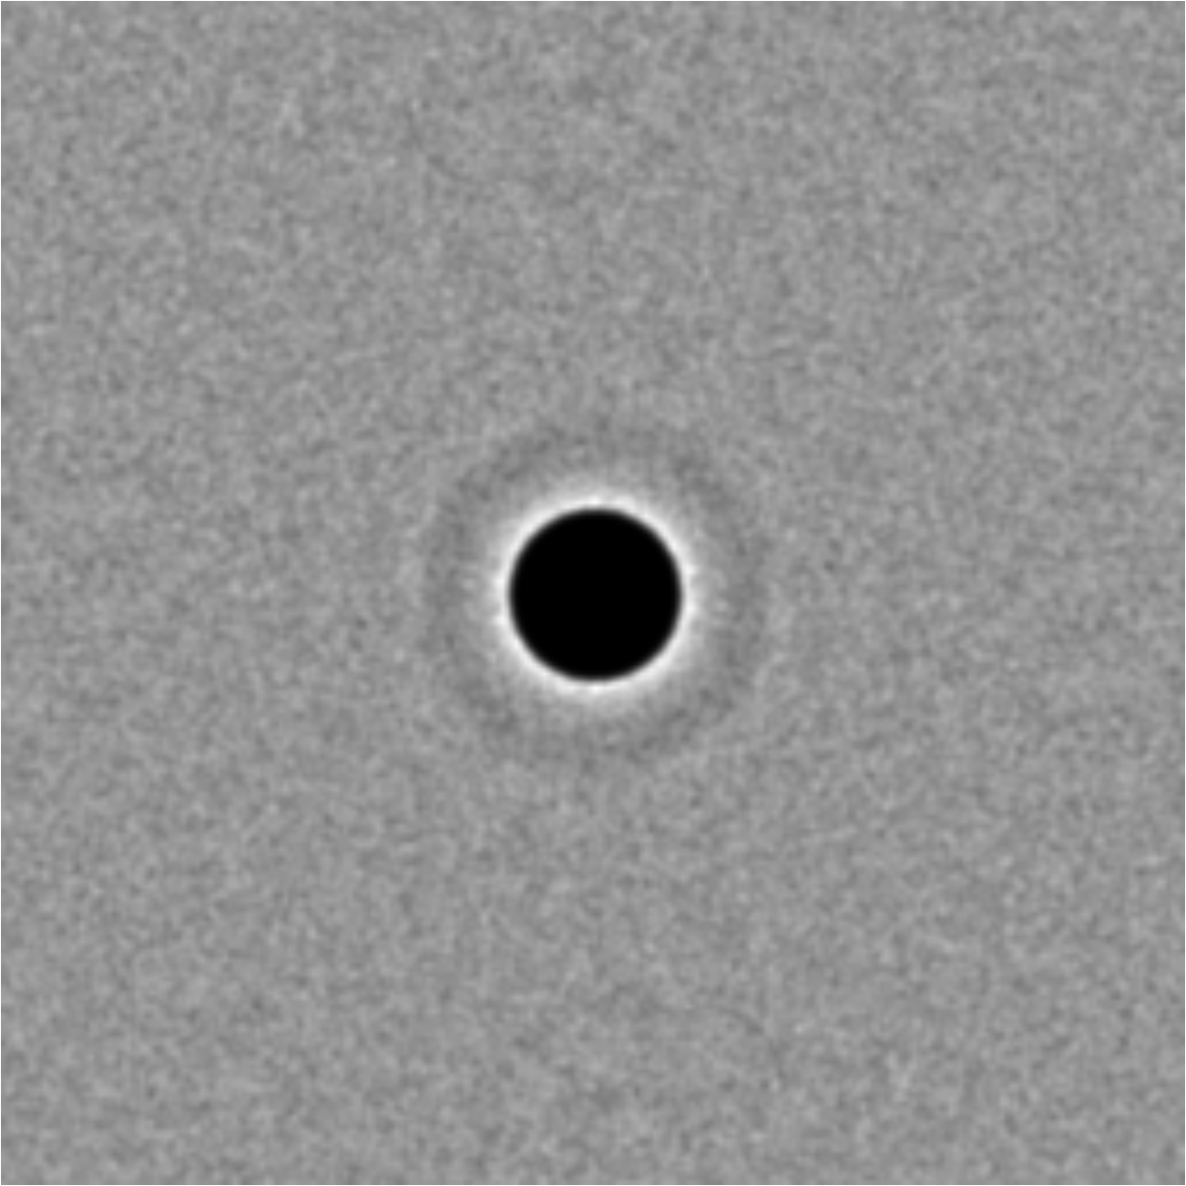
Estimating Correlations
Second order stationary - pair correlation function (PCF)
Point Distribution
Pair Correlation Function

Slide 23
Estimating Correlations
Second order isotropic - pair correlation function (PCF)
Volume of the unit
hypercube in d dimensions
Kernel
e.g. Gaussian

Slide 24
Pair Correlation Function

Slide 25
Pair Correlation Function

Slide 26
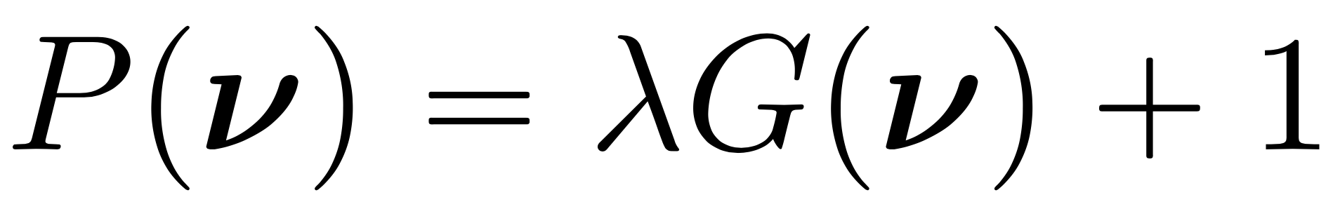
Spectral Statistics
Power spectrum
Fourier transform
of PCF

Slide 27
Spectral Statistics
Notes:
s(\mathbf{x}) = \sum w(\mathbf{x}_i) \delta (\mathbf{x} - \mathbf{x}_i)
\mathbf{s}_m = \sum w(\mathbf{x}_i) e^{-2\pi \mathbf{m}^T \mathbf{x}_i}
\mathbf{p}_m = \mathbb{E} [\mathbf{s}_m^{*} \mathbf{s}_m] = \lambda \mathbf{g}_m + 1

Slide 28
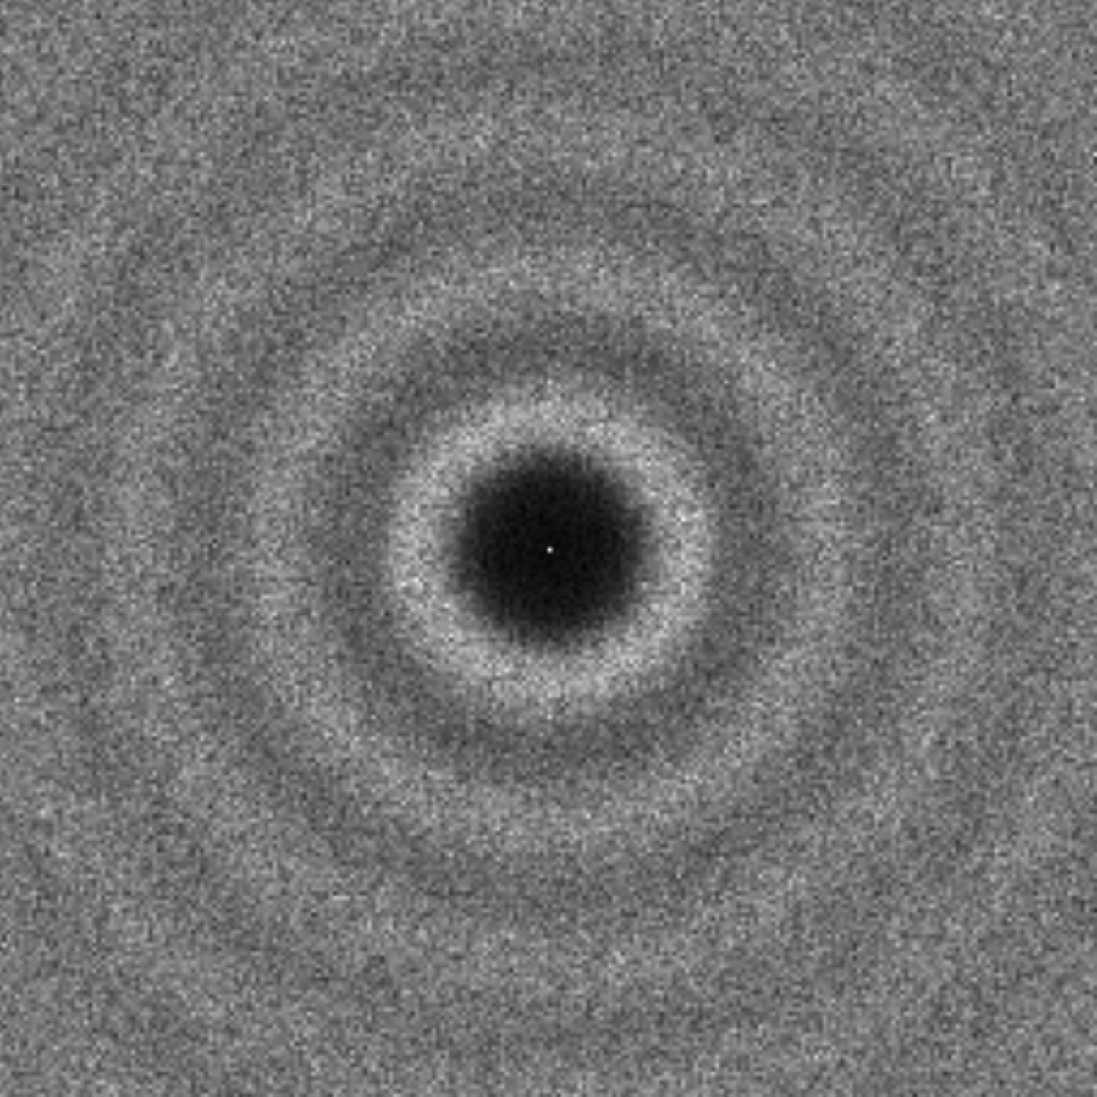
Spectral Statistics
Points
PCF
Power spectrum
Points

Slide 29
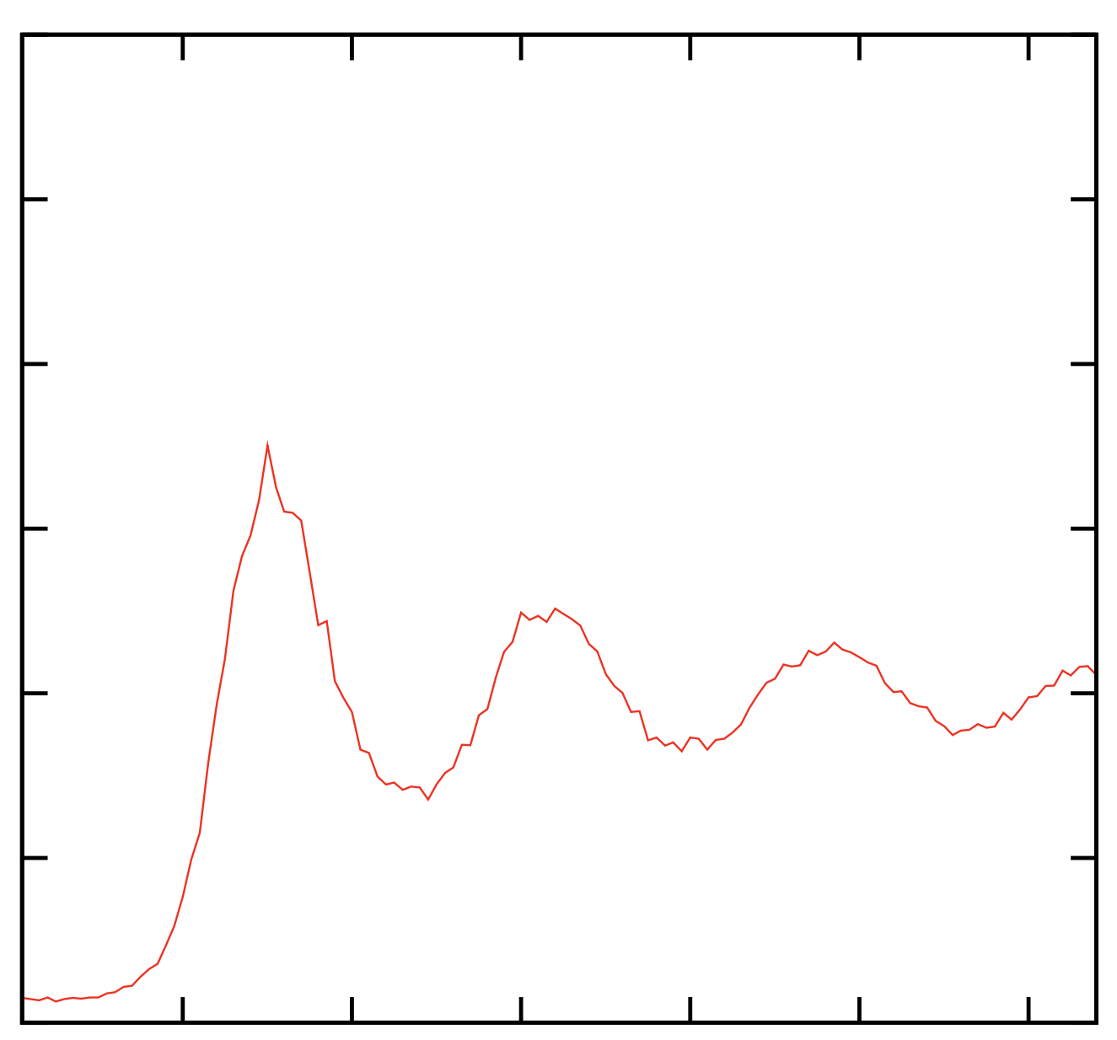
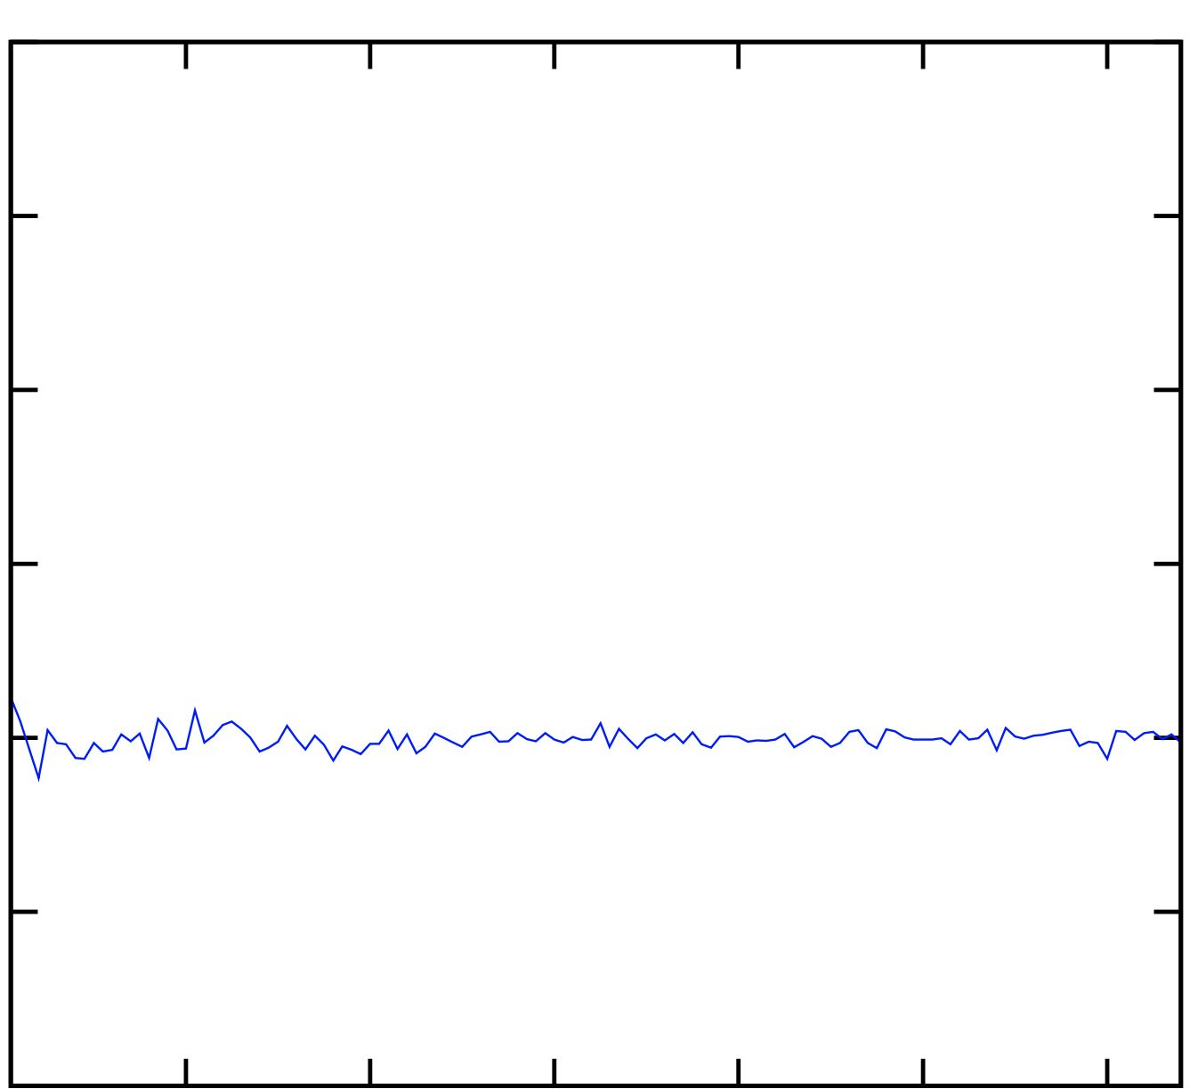
Spectral Statistics
Power spectrum
Radial average
Radial anisotropy

Slide 30
Statistics for Stationary Processes
Summary
Stationary: Spatial (PCF) & spectral (power spectrum)
Isotropic: radial averages
PCF
Power
spectrum

Slide 31
Error in Numerical Integration
Campbell’s Theorem

Slide 32
Error in Numerical Integration
Campbell’s theorem for the error of the integral estimator
Campbell’s theorem
Notes:
Given these, expressions, we can now analyze the error in numerical integration, when the sampling distributions are generated by a particular point process with these statistics. Recall that we have this estimator for the integral I. The error in this estimator is given by two terms, bias and variance. Both involve expectations.
Let’s say we would like to estimate the expected value of the estimator. We can write this as the expected value of this sum, where we assume that the weights are sampled from an underlying weight function w. Then, by Campbell’s theorem, this sum equals to the following integral.

Slide 33
Error in Numerical Integration
Campbell’s theorem for the error of the integral estimator
Notes:
We can proceed similarly to compute the expected value of the squared estimator. First, we write this as a sum of two terms, in order to utilize Campbell’s theorem. Then, each term can be written as the following integrals. Here, the first and second order correlations appear in two different terms. Hence, we can modify one or the other to reduce the variance.

Slide 34
Error in Numerical Integration
Stationary point processes
Density
Arrangement
Notes:
For stationary processes, these simplify due to the simplified statistics. In this case, we get an unbiased estimator, and the variance is given by this expression. Here, the dependence of error on density and arrangement of points given by the pair correlation function g, is even more apparent. For a Poisson process that generates random distributions, g is 1 and hence we get no reduction due to the second term. For a process that generates clustered distributions, we get g > 1, increasing the variance. For processes that generate distributions with well-spaced points, such as a blue noise distribution, we get g < 1, and hence we get reduction due to the second term.

Slide 35

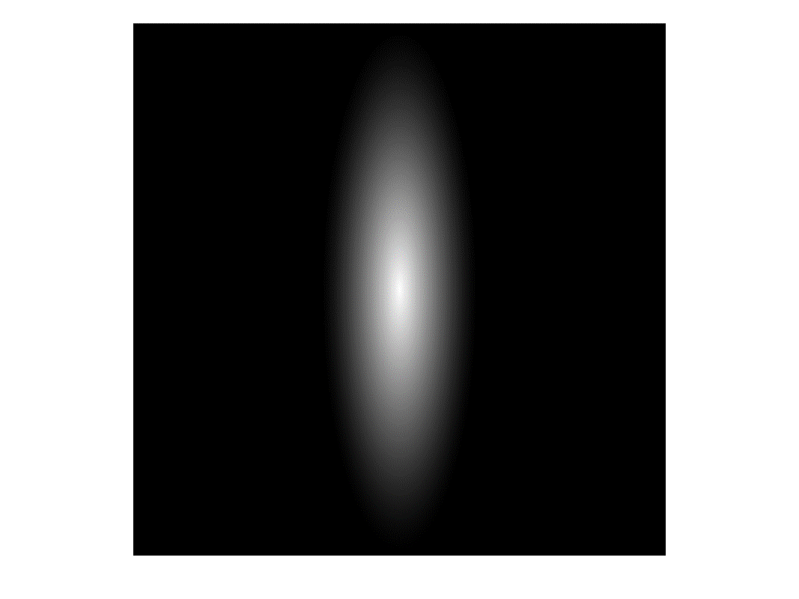
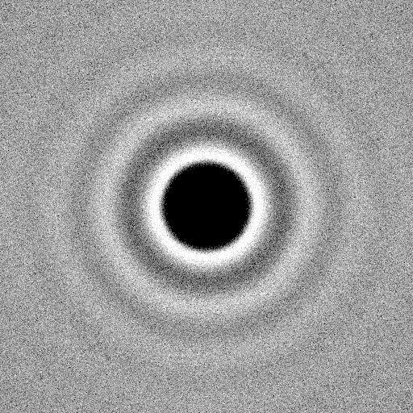
Error in Numerical Integration
Stationary point processes
Notes:
For stationary processes, these simplify due to the simplified statistics. In this case, we get an unbiased estimator, and the variance is given by this expression. Here, the dependence of error on density and arrangement of points given by the pair correlation function g, is even more apparent. For a Poisson process that generates random distributions, g is 1 and hence we get no reduction due to the second term. For a process that generates clustered distributions, we get g > 1, increasing the variance. For processes that generate distributions with well-spaced points, such as a blue noise distribution, we get g < 1, and hence we get reduction due to the second term.

Slide 36
Error in Numerical Integration
Importance Sampling – invertible warp
Notes:
\lambda(\mathbf{x}), \varrho(\mathbf{x}, \mathbf{y})

Slide 37
Error in Numerical Integration
Importance Sampling – general unbiased
Importance Sampling – random add/remove for intensity
Notes:
var(\hat{I}) = \int{\frac{f^2(\mathbf{x})}{\lambda(\mathbf{x})} d\mathbf{x}} + \int { f(\mathbf{x}) f(\mathbf{y}) \frac{\varrho( \mathbf{x}, \mathbf{y} )}{\lambda(\mathbf{x}) \lambda(\mathbf{y})} d\mathbf{x} d\mathbf{y}} - \left( \int f(\mathbf{x}) d\mathbf{x} \right)^2
var(\hat{I}) = \int{\frac{f^2(\mathbf{x})}{\lambda(\mathbf{x})} d\mathbf{x}} + \int { f(\mathbf{x}) f(\mathbf{y}) g( \mathbf{x} - \mathbf{y} ) d\mathbf{x} d\mathbf{y}} - \left( \int f(\mathbf{x}) d\mathbf{x} \right)^2

Slide 38
Error in Numerical Integration
Spectral counterparts
Power spectra
Stationary
Phase
Non-stationary
Notes:
var(\hat{I}) = I^2 var(\mathbf{s}_0) + \sum_{m \neq 0} \mathbf{f}_m^* \mathbf{f}_m \mathbb{E}[\mathbf{s}_m^* \mathbf{s}_m] + \sum_{l \neq m} \mathbf{f}_m^* \mathbf{f}_l \mathbb{E}[\mathbf{s}_m \mathbf{s}_l^*]

Slide 39
Error in Numerical Integration
Spectral counterparts – stationary point processes
Power spectra
Stationary
Notes:
var(\hat{I}) = I^2 var(\mathbf{s}_0) + \sum_{m \neq 0} \mathbf{f}_m^* \mathbf{f}_m \mathbb{E}[\mathbf{s}_m^* \mathbf{s}_m] + \sum_{l \neq m} \mathbf{f}_m^* \mathbf{f}_l \mathbb{E}[\mathbf{s}_m \mathbf{s}_l^*]

Slide 40
Error in Numerical Integration
Spectral counterparts – stationary point processes
Notes:
var(\hat{I}) = I^2 var(\mathbf{s}_0) + \sum_{m \neq 0} \mathbf{f}_m^* \mathbf{f}_m \mathbb{E}[\mathbf{s}_m^* \mathbf{s}_m] + \sum_{l \neq m} \mathbf{f}_m^* \mathbf{f}_l \mathbb{E}[\mathbf{s}_m \mathbf{s}_l^*]

Slide 41
Error in Numerical Integration
Stationary point processes – spatial vs. spectral
Notes:
\sum_{m \neq 0} (\mathbf{f}_m^* \mathbf{f}_m) (\lambda \mathbf{g}_m + 1)
\mathbf{p}_m = \mathbb{E} [\mathbf{s}_m^{*} \mathbf{s}_m] = \lambda \mathbf{g}_m + 1

Slide 42
1st order
correlations by
warp/ algorithm
2nd order
pair-wise
correlations
Study in
spatial or
spectral
Notes:
Thank you very much for the introduction.
Hi, I am Cengiz. I am excited to be able to talk about my current and future research projects that I like a lot today.
My talk will be about digital modeling of visual data for assisting creativity.
But before that, I would like very briefly talk about my background.
Changil – lightfields
Il-Kyu – facial wrinkles
Byungsoo – vectorization of images
Endri – body, cloth, dynamics capture from videos
Riccardo – texture sythesis, learning based geometry processing
Dominik & Endri – data-based pose and motion synthesis
Cengiz – data-based retouching
Derek New.– sampling for rendering
Pelin – multi-modal video understanding, video – text alignment
Marco – learning for scheduling, visual analytics
Body & face modeling from images & video
Video representations, data driven filtering
Joint geometry-video representations

Slide 43
Analysis of Sample Correlations for Monte Carlo Rendering
SAMPLING MEASURES &
ERROR FORMULATIONS
Cengiz Öztireli
Research Scientist
Notes:
Thank you very much for the introduction.
Hi, I am Cengiz. I am excited to be able to talk about my current and future research projects that I like a lot today.
My talk will be about digital modeling of visual data for assisting creativity.
But before that, I would like very briefly talk about my background.
Changil – lightfields
Il-Kyu – facial wrinkles
Byungsoo – vectorization of images
Endri – body, cloth, dynamics capture from videos
Riccardo – texture sythesis, learning based geometry processing
Dominik & Endri – data-based pose and motion synthesis
Cengiz – data-based retouching
Derek New.– sampling for rendering
Pelin – multi-modal video understanding, video – text alignment
Marco – learning for scheduling, visual analytics
Body & face modeling from images & video
Video representations, data driven filtering
Joint geometry-video representations

Slide 44
Pair Correlation Function

Slide 45
Estimating Correlations
Campbell’s Theorem

Slide 46
Estimating Correlations
First order
Point distribution
Number of point distributions

Slide 47
Estimating Correlations
Second order stationary - pair correlation function (PCF)

Slide 48
Estimating Correlations
Second order stationary - pair correlation function (PCF)
Finite domains:

Slide 49
Point Process Statistics
Correlations as probabilities
Product density
Small volumes
Points in space

Slide 50
Point Process Statistics
Higher order not necessary: second order dogma

Slide 51
Point Process Statistics
Example: homogenous Poisson point process
a.k.a. random sampling

