Slide 1
Error analysis of estimators that use combinations of stochastic sampling strategies for direct illumination
Kartic Subr, Derek Nowrouzezahrai, Wojciech Jarosz,
Jan Kautz and Kenny Mitchell
Disney Research, University of Montreal, University College London

Slide 2
direct illumination is an integral
Exitant radiance
Incident radiance

Slide 3
abstracting away the application…
0
Notes:
So, we want to compute the integral of f(x) (shown in yellow). What if f(x) was discretized and stored in an array?
http://www.sciweavers.org/free-online-latex-equation-editor

Slide 4
numerical integration implies sampling
secondary estimate using N samples
sampled integrand
0
Notes:
And the integral can easily be estimated as the average of the sampled integrand. But how good is this estimate?
http://www.sciweavers.org/free-online-latex-equation-editor

Slide 5
each pixel is a secondary estimate (path tracing)
render 1 (N spp)
render 2 (N spp)
render 1000 (N spp)
Histogram of radiance at pixel

Slide 6
why bother? I am only interested in 1 image

Slide 7
error visible across neighbouring pixels

Slide 8
histograms of 1000 N-sample estimates
deterministic
estimator
reference
stochastic
estimator 2
stochastic
estimator 1
Number of estimates
estimated value (bins)
Notes:
Given two estimators, we can now compare their respective biases and variances. But can we do such comparisons predictively?

Slide 9
error includes bias and variance
reference
bias
Number of estimates
variance
estimated value (bins)
Notes:
Given two estimators, we can now compare their respective biases and variances. But can we do such comparisons predictively?

Slide 10
error of unbiased stochastic estimator = sqrt(variance)
error of deterministic estimator = bias

Slide 11
Variance depends on samps. per estimate ‘N’
Histogram of 1000 estimates
with N =10
Histogram of 1000 estimates
with N =50
Number of estimates
Number of estimates
estimated value (bins)
estimated value (bins)
Notes:
Given two estimators, we can now compare their respective biases and variances. But can we do such comparisons predictively?

Slide 12
increasing ‘N’, error approaches bias
error
N

Slide 13
convergence rate of estimator
error
log-error
convergence rate = slope
N
log-N

Slide 14
comparing estimators
Estimator 1
log-error
Estimator 2
Estimator 3
log-N

Slide 15
the “better” estimator depends on application
Estimator 1
log-error
Estimator 2
real-time
Offline
sample budget
log-N

Slide 16
typical estimators (anti-aliasing)
log-error
random MC (-0.5)
MC with importance sampling (-0.5)
QMC (-1)
MC with jittered sampling (-1.5)
randomised QMC (-1.5)
log-N

Slide 17
What happens when strategies are combined?
Z
=
(
X
+
Y
) / 2
combined
estimate
single estimate
using estimator 1
single estimate
using estimator 2
?
& what about convergence?

Slide 18
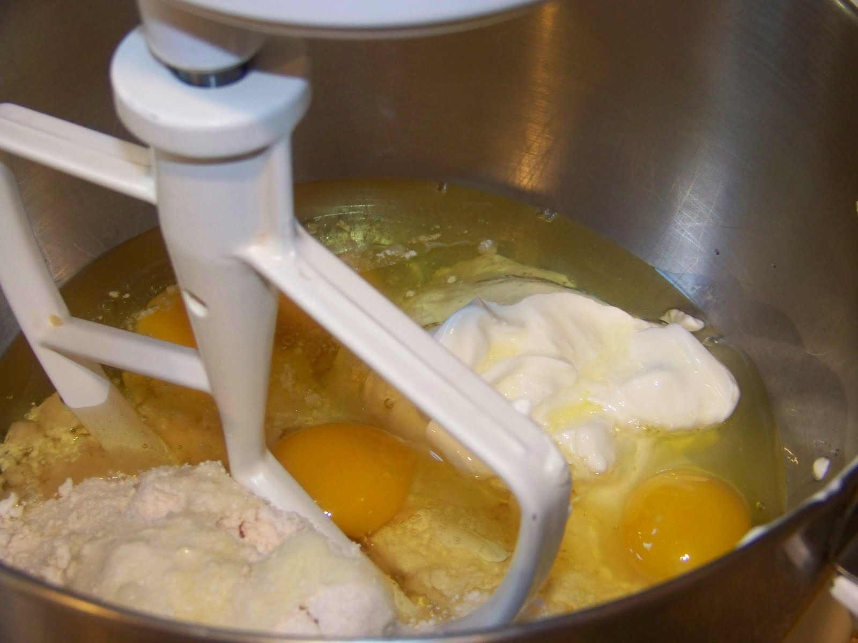
What happens when strategies are combined?
Non-trivial, not intuitive
needs formal analysis
can combination improve convergence or only constant?

Slide 19
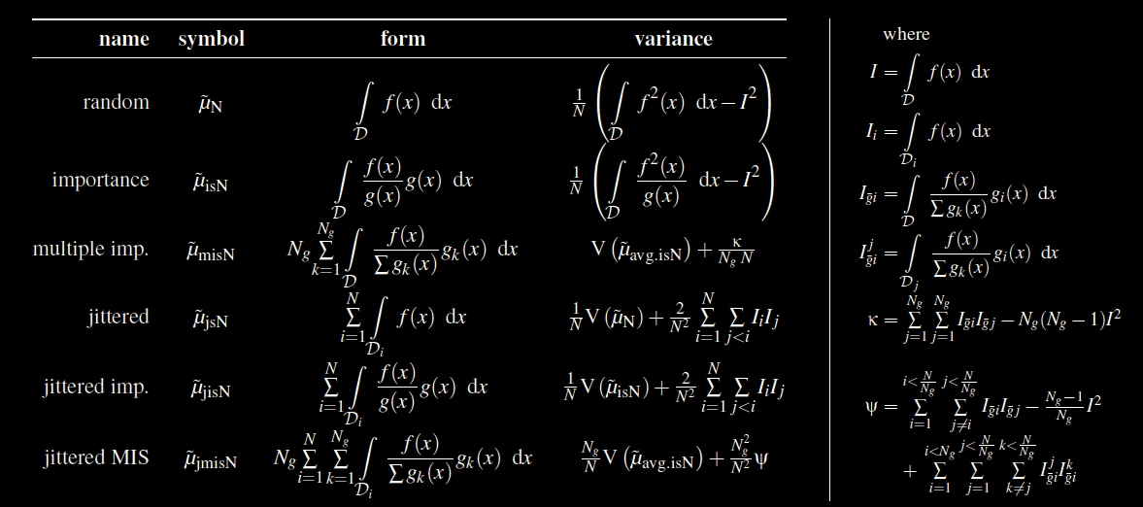
we derived errors in closed form…

Slide 20
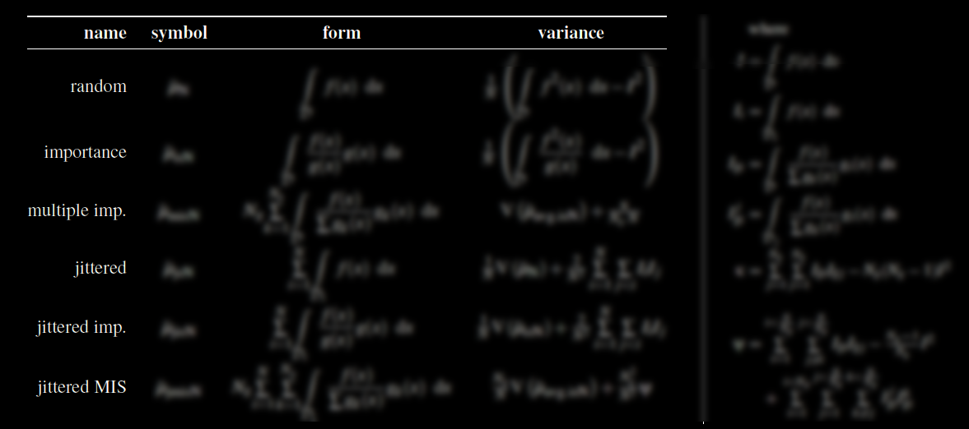
combinations of popular strategies

Slide 21
Improved convergence by combining …
Strategy A
Strategy B
Strategy C
New strategy D
Observed
convergence of D
is better than
that of A, B or C

Slide 22
exciting result!
jittered
antithetic
importance
Strategy A
Strategy B
Strategy C
New strategy D
Observed
convergence of D
is better than
that of A, B or C

Slide 23
related work
Variance reduction
Monte Carlo
sampling
Combining variance reduction schemes
Quasi-MC methods
Correlated and
antithetic sampling
Notes:
There are several classes of work that are relevant. For this talk, I will briefly describe three of them.

Slide 24
goals
Assess combinations of strategies
Notes:
. What distinguishes our work from theirs is that we derive explicit equations for the bias and variance of integrators and that we do not completely ignore phase.

Slide 25
Intuition
(now)
Formalism
(suppl. mat)
Notes:
Let us look at the intuition behind our Fourier-domain analysis of integrators that use stochastic sampling.

Slide 26
recall combined estimator
Z
=
(
X
+
Y
) / 2
combined
estimate
single estimate
using estimator 1
single estimate
using estimator 2

Slide 27
applying variance operator
V ( )
(
) / 4
Z
V ( )
X
V ( )
=
+
Y
combined
estimate
single estimate
using estimator 1
single estimate
using estimator 2
+ 2 cov ( , ) /4
X
Y

Slide 28
variance reduction via negative correlation
V ( )
(
) / 4
Z
V ( )
X
V ( )
=
+
Y
combined
estimate
single estimate
using estimator 1
single estimate
using estimator 2
+ 2 cov ( , ) /4
X
Y
best case is when X and Y have a correlation of -1

Slide 29
“antithetic” estimates yield zero variance!
V ( )
(
) / 4
Z
V ( )
X
V ( )
=
+
Y
combined
estimate
single estimate
using estimator 1
single estimate
using estimator 2
+ 2 cov ( , ) /4
X
Y

Slide 30
antithetic estimates vs antithetic samples?
X = f(s)
Y = f(t)
X
Y
f(x)
Y
X
s
t
x

Slide 31
antithetic estimates vs antithetic samples?
if t=1-s, corr(s,t)=-1
(s,t) are antithetic samples
(X,Y) are not antithetic estimates unless f(x) is linear!
worse, cov(X,Y) could be positive and increase overall variance
f(x)
Y
X
s
t
x

Slide 32
antithetic sampling within strata
f(x)
?
s
t
x

Slide 33
integrand not linear within many strata
But where linear, variance is close to zero
As number of strata is increased, more benefit
i.e. if jittered, benefit increases with ‘N’
thus affects convergence
Possibility of increased variance in many strata
Improve by also using importance sampling?
Notes:
In summary, we have seen that the phase of the sampling spectrum encodes vital information. Yet, we cannot expect to know the phase of the integrand.

Slide 34
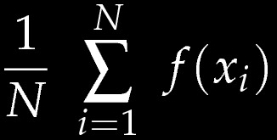
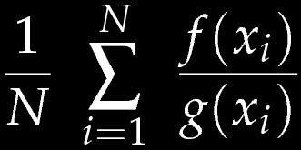
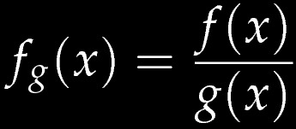
review: importance sampling as warp
g(x)
f(x)
uniform
x
Ideal case: warped integrand is a constant
Notes:
\frac{1}{N} \,\,\sum\limits_{i=1}^N \,\, \frac {f(x_i)} {g(x_i)}
www.sciweavers.org/free-online-latex-equation-editor

Slide 35
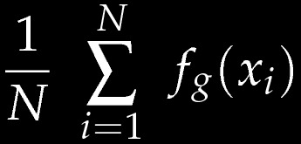
with antithetic: linear function sufficient
with
with
with
x
Notes:
\frac{1}{N} \,\,\sum\limits_{i=1}^N \,\, \frac {f(x_i)} {g(x_i)}
www.sciweavers.org/free-online-latex-equation-editor

Slide 36
with stratification + antithetic: piece-wise linear is sufficient
Warped integrand
x

Slide 37
summary of strategies
antithetic sampling
zero variance for linear integrands (unlikely case)
stratification (jittered sampling)
splits function into approximately piece-wise linear
importance function
zero variance if proportional to integrand (academic case)
Notes:
In summary, we have seen that the phase of the sampling spectrum encodes vital information. Yet, we cannot expect to know the phase of the integrand.

Slide 38
summary of combination
Stratify
Find importance function that warps into linear func.
Use antithetic samples
Resulting estimator: Jittered Antithetic Importance sampling (JAIS)
Notes:
In summary, we have seen that the phase of the sampling spectrum encodes vital information. Yet, we cannot expect to know the phase of the integrand.

Slide 39
details (in paper)
Generating correlated samples in higher dimensions
Testing if correlation is positive (when variance increases)

Slide 40
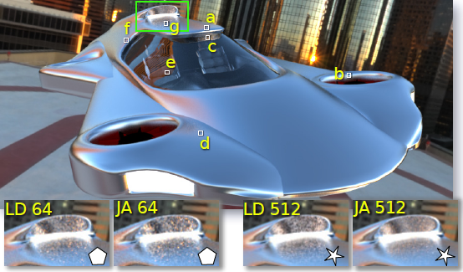
results
Low discrepancy
Jittered antithetic MIS

Slide 41
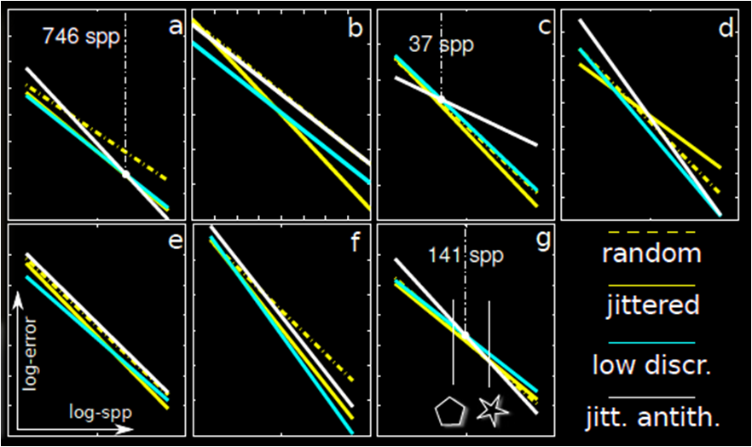
results

Slide 42
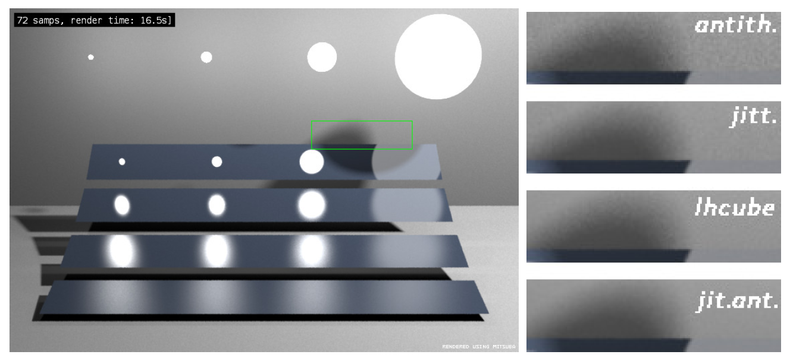
comparisons using Veach’s scene
antithetic
jittered
LH cube
JA+MIS

Slide 43
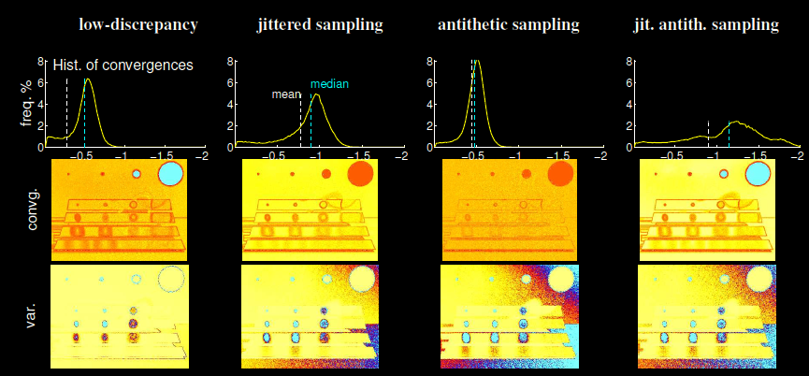
comparison with MIS

Slide 44
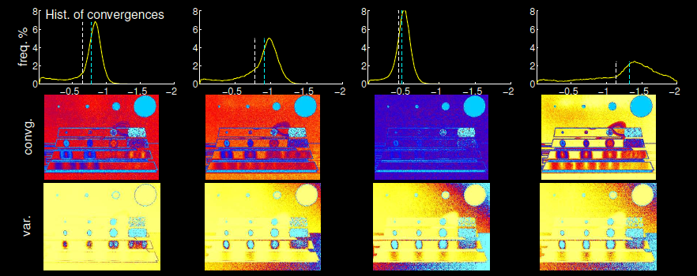
comparison with solid angle IS

Slide 45
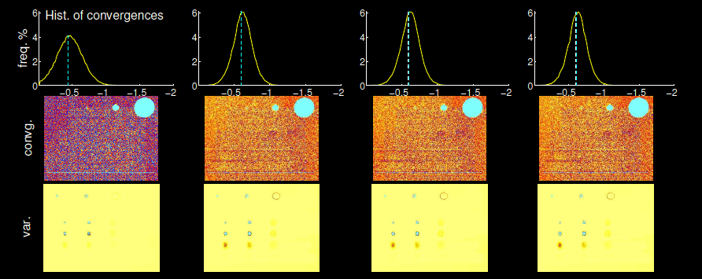
comparison without IS

Slide 46
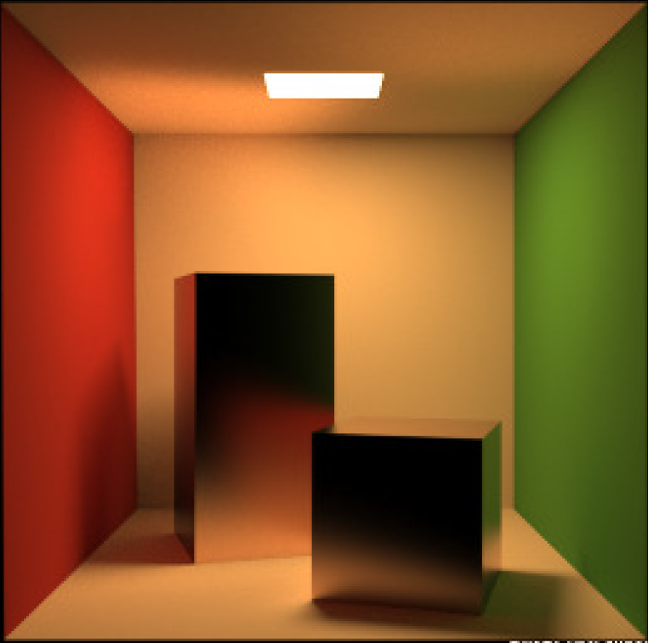
limitation
GI implies high dimensional domain
Glossy objects create non-linearities

Slide 47
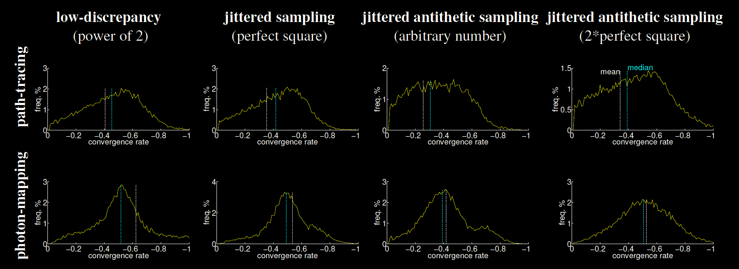
limitation: high-dimensional domains

Slide 48
conclusion
Which sampling strategy is best?
Integrand?
Number of secondary samples?
Bias vs variance?
Convergence of combined strategy
could be better than any of the components’ convergences
Jittered Antithetic Importance sampling
Shows potential in early experiments

Slide 49
future work
Explore correlations in high dimensional integrals
Analyse combinations with QMC sampling
Re-asses notion of importance, for antithetic importance sampling

Slide 50
acknowledgements
I was funded through FI-Content, a European (EU-FI PPP) project.
Herminio Nieves - HN48 Flying Car model. http://oigaitnas.deviantart.com
Blochi - Helipad Golden Hour environment map. http://www.hdrlabs.com/sibl/archive.html

Slide 51
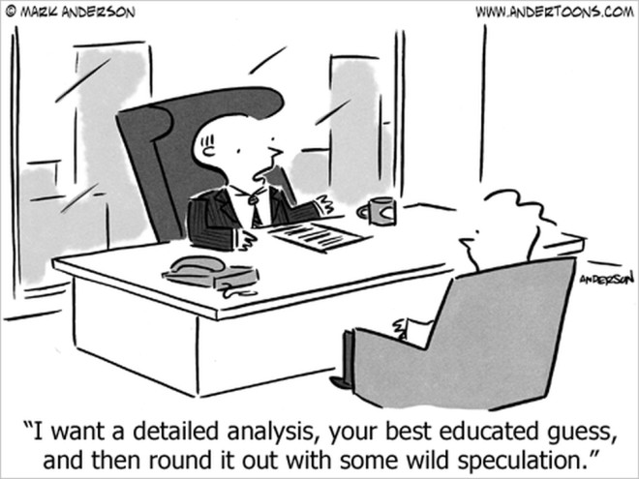
thank you

Slide 52
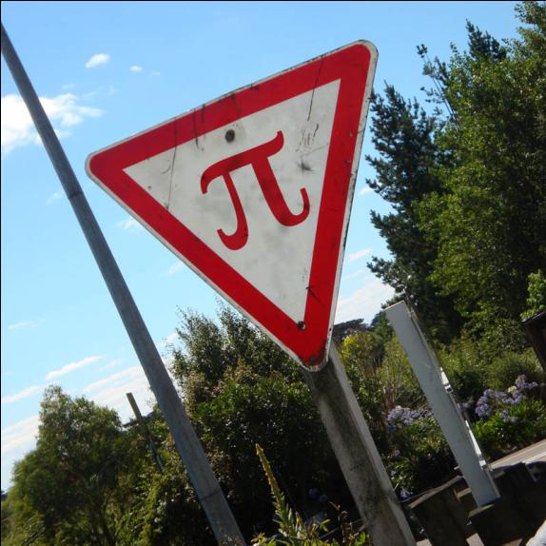
Theoretical results
Notes:
I shall now present the results of our analysis, and refer you to the paper for their derivations.

