Slide 1
Scalable Virtual Ray Lights Rendering for Participating Media
Nicolas Vibert Adrien Gruson Heine Stokholm Troels Mortensen
Wojciech Jarosz Toshiya Hachisuka Derek Nowrouzezahrai
McGill University Luxion VIA University College Dartmouth College The University of Tokyo
Notes:
Thanks for the introduction. This is a presentation about rendering participating media using scalable virtual ray lights.

Slide 2
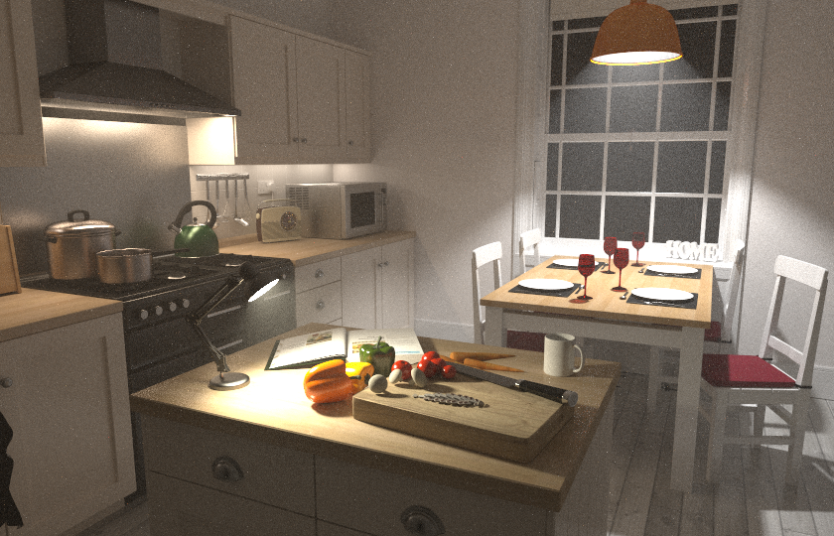
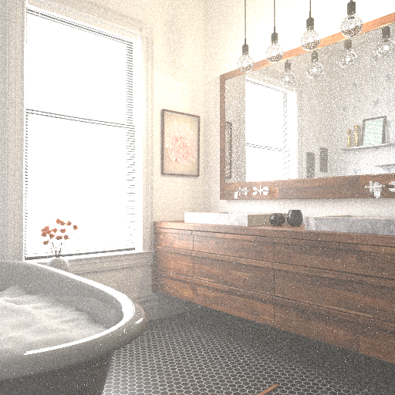
MOTIVATION: Surface and Volume interaction
Notes:
One challenge is computer graphics is the rendering of photorealistic images.
To achieve these physically plausible results, we need to simulate light transport in the scene, more explicitly how light travel from emitters, interact through space and reach the sensor.

Slide 3
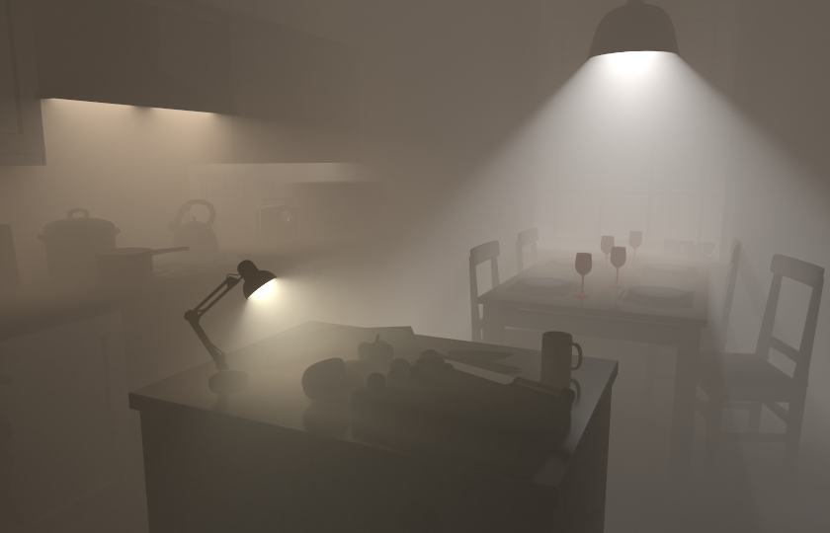
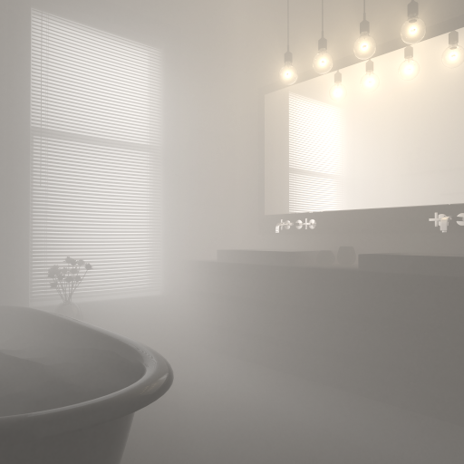
MOTIVATION: Volume interaction only
Notes:
Participating media is one of those light interaction that participate in the visual perception of photorealism.
In particular, in this work we are interested only in the rendering of the participating media part.
More specifically, in improving its computational cost using VRL with scalable methods.

Slide 4
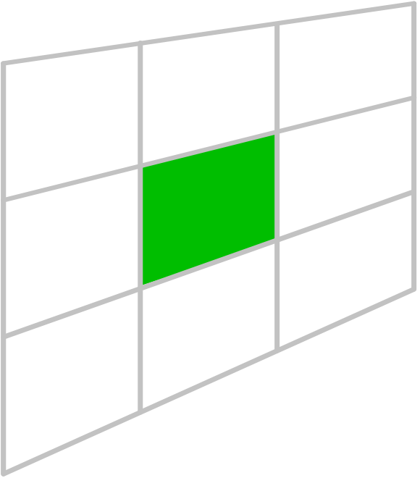
VOLUMETRIC RENDERING
s
Sensor
Image Plane
$$x_{u}$$
$$\vec{ω}$$
$$L_{m}(x,\vec{ω})=\int_{0}^{s}{T_{r}(u)L_{i}(x_{u,}\vec{ω})du}$$
Notes:
So Let’s consider the following scene where we have a sensor, and a participating medium.
For a given pixel, we are interested to compute the amount of light that scatter from the participating media toward the direction OMEGA.
More formally. We can formulate this problem as an integration problem where Li is the total incoming light at the point X U that scatter into the direction OMEGA. The other term T_R(u) express the attenuation due to the media absorption. Those quantities must integrated along the ray segment that cross the participating media.
This additional integration along the ray is computationally intensive and we want to improve this part in our work.

Slide 5
VOLUMETRIC RENDERING: Rendering techniques
Path tracing / Bidirectional path tracing
Notes:
To estimate this integral it already exists many specialized techniques.
We can regroup them roughly into 3 class of methods.
The first group is about path-based techniques where each path are constructed incrementally and independently for each pixel.

Slide 6
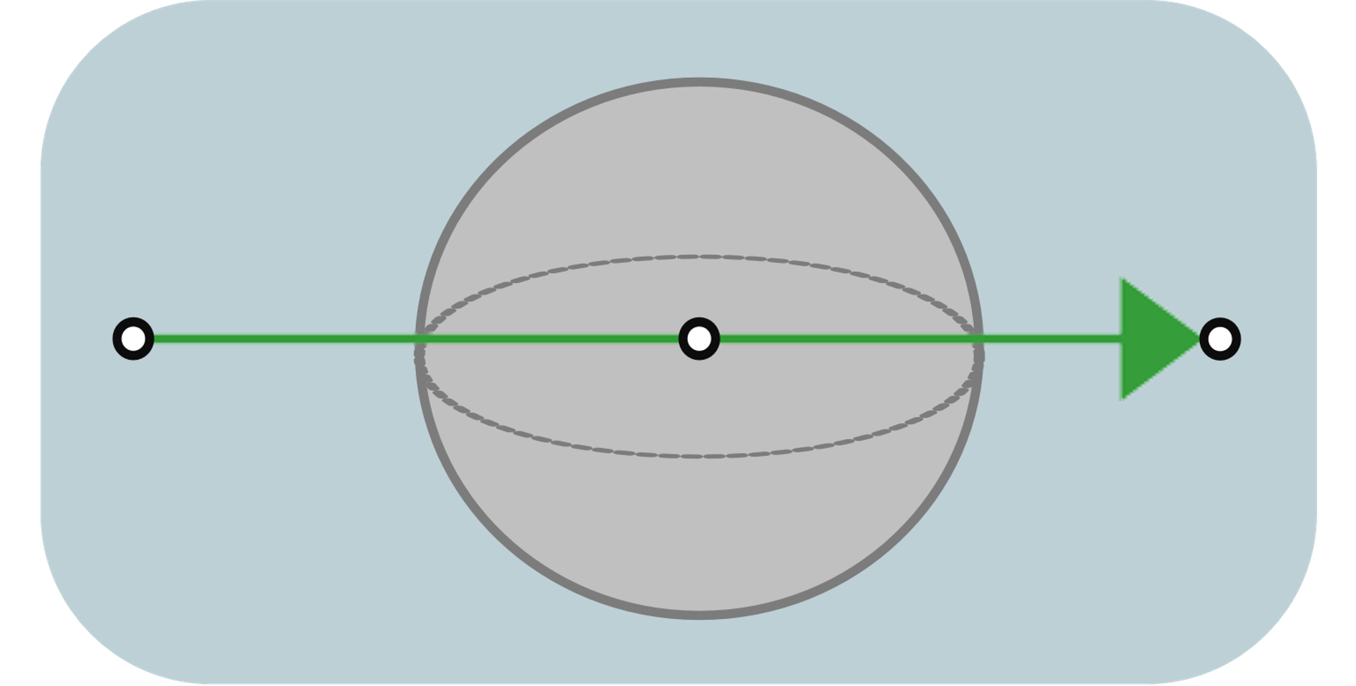
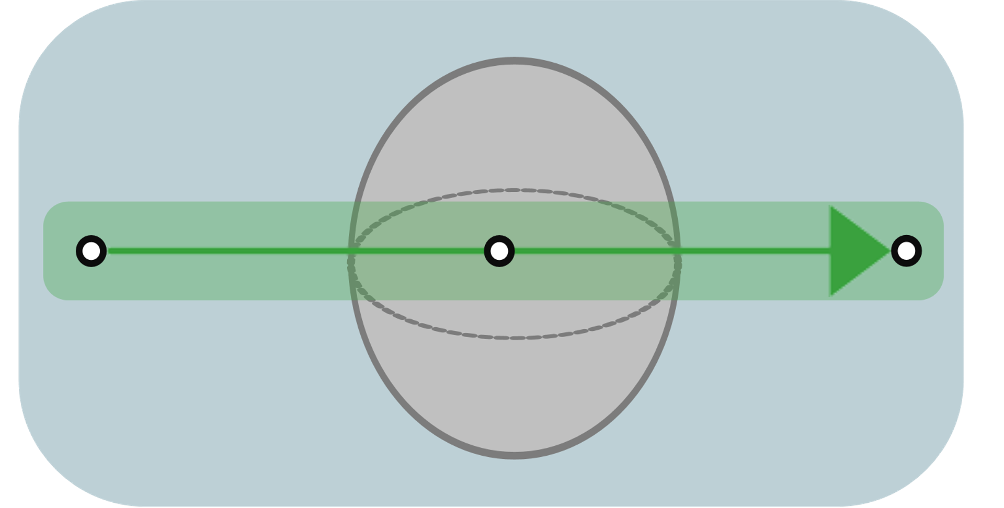
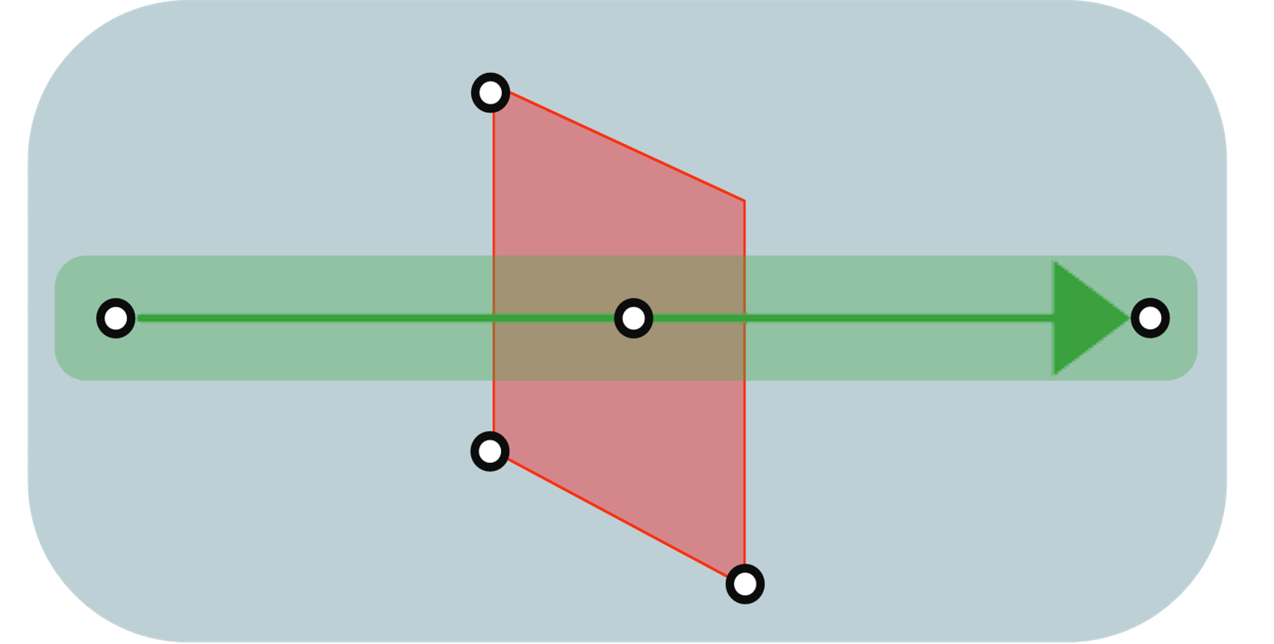
VOLUMETRIC RENDERING: Many techniques
Path tracing / Bidirectional path tracing
Density estimation:
Volumetric Photon Mapping
Photon Beam
Photon Planes
“Higher-order geometric primitives”
Notes:
The second group is using density estimation which represents light particles as point, beam or higher primitive like planes.

Slide 7
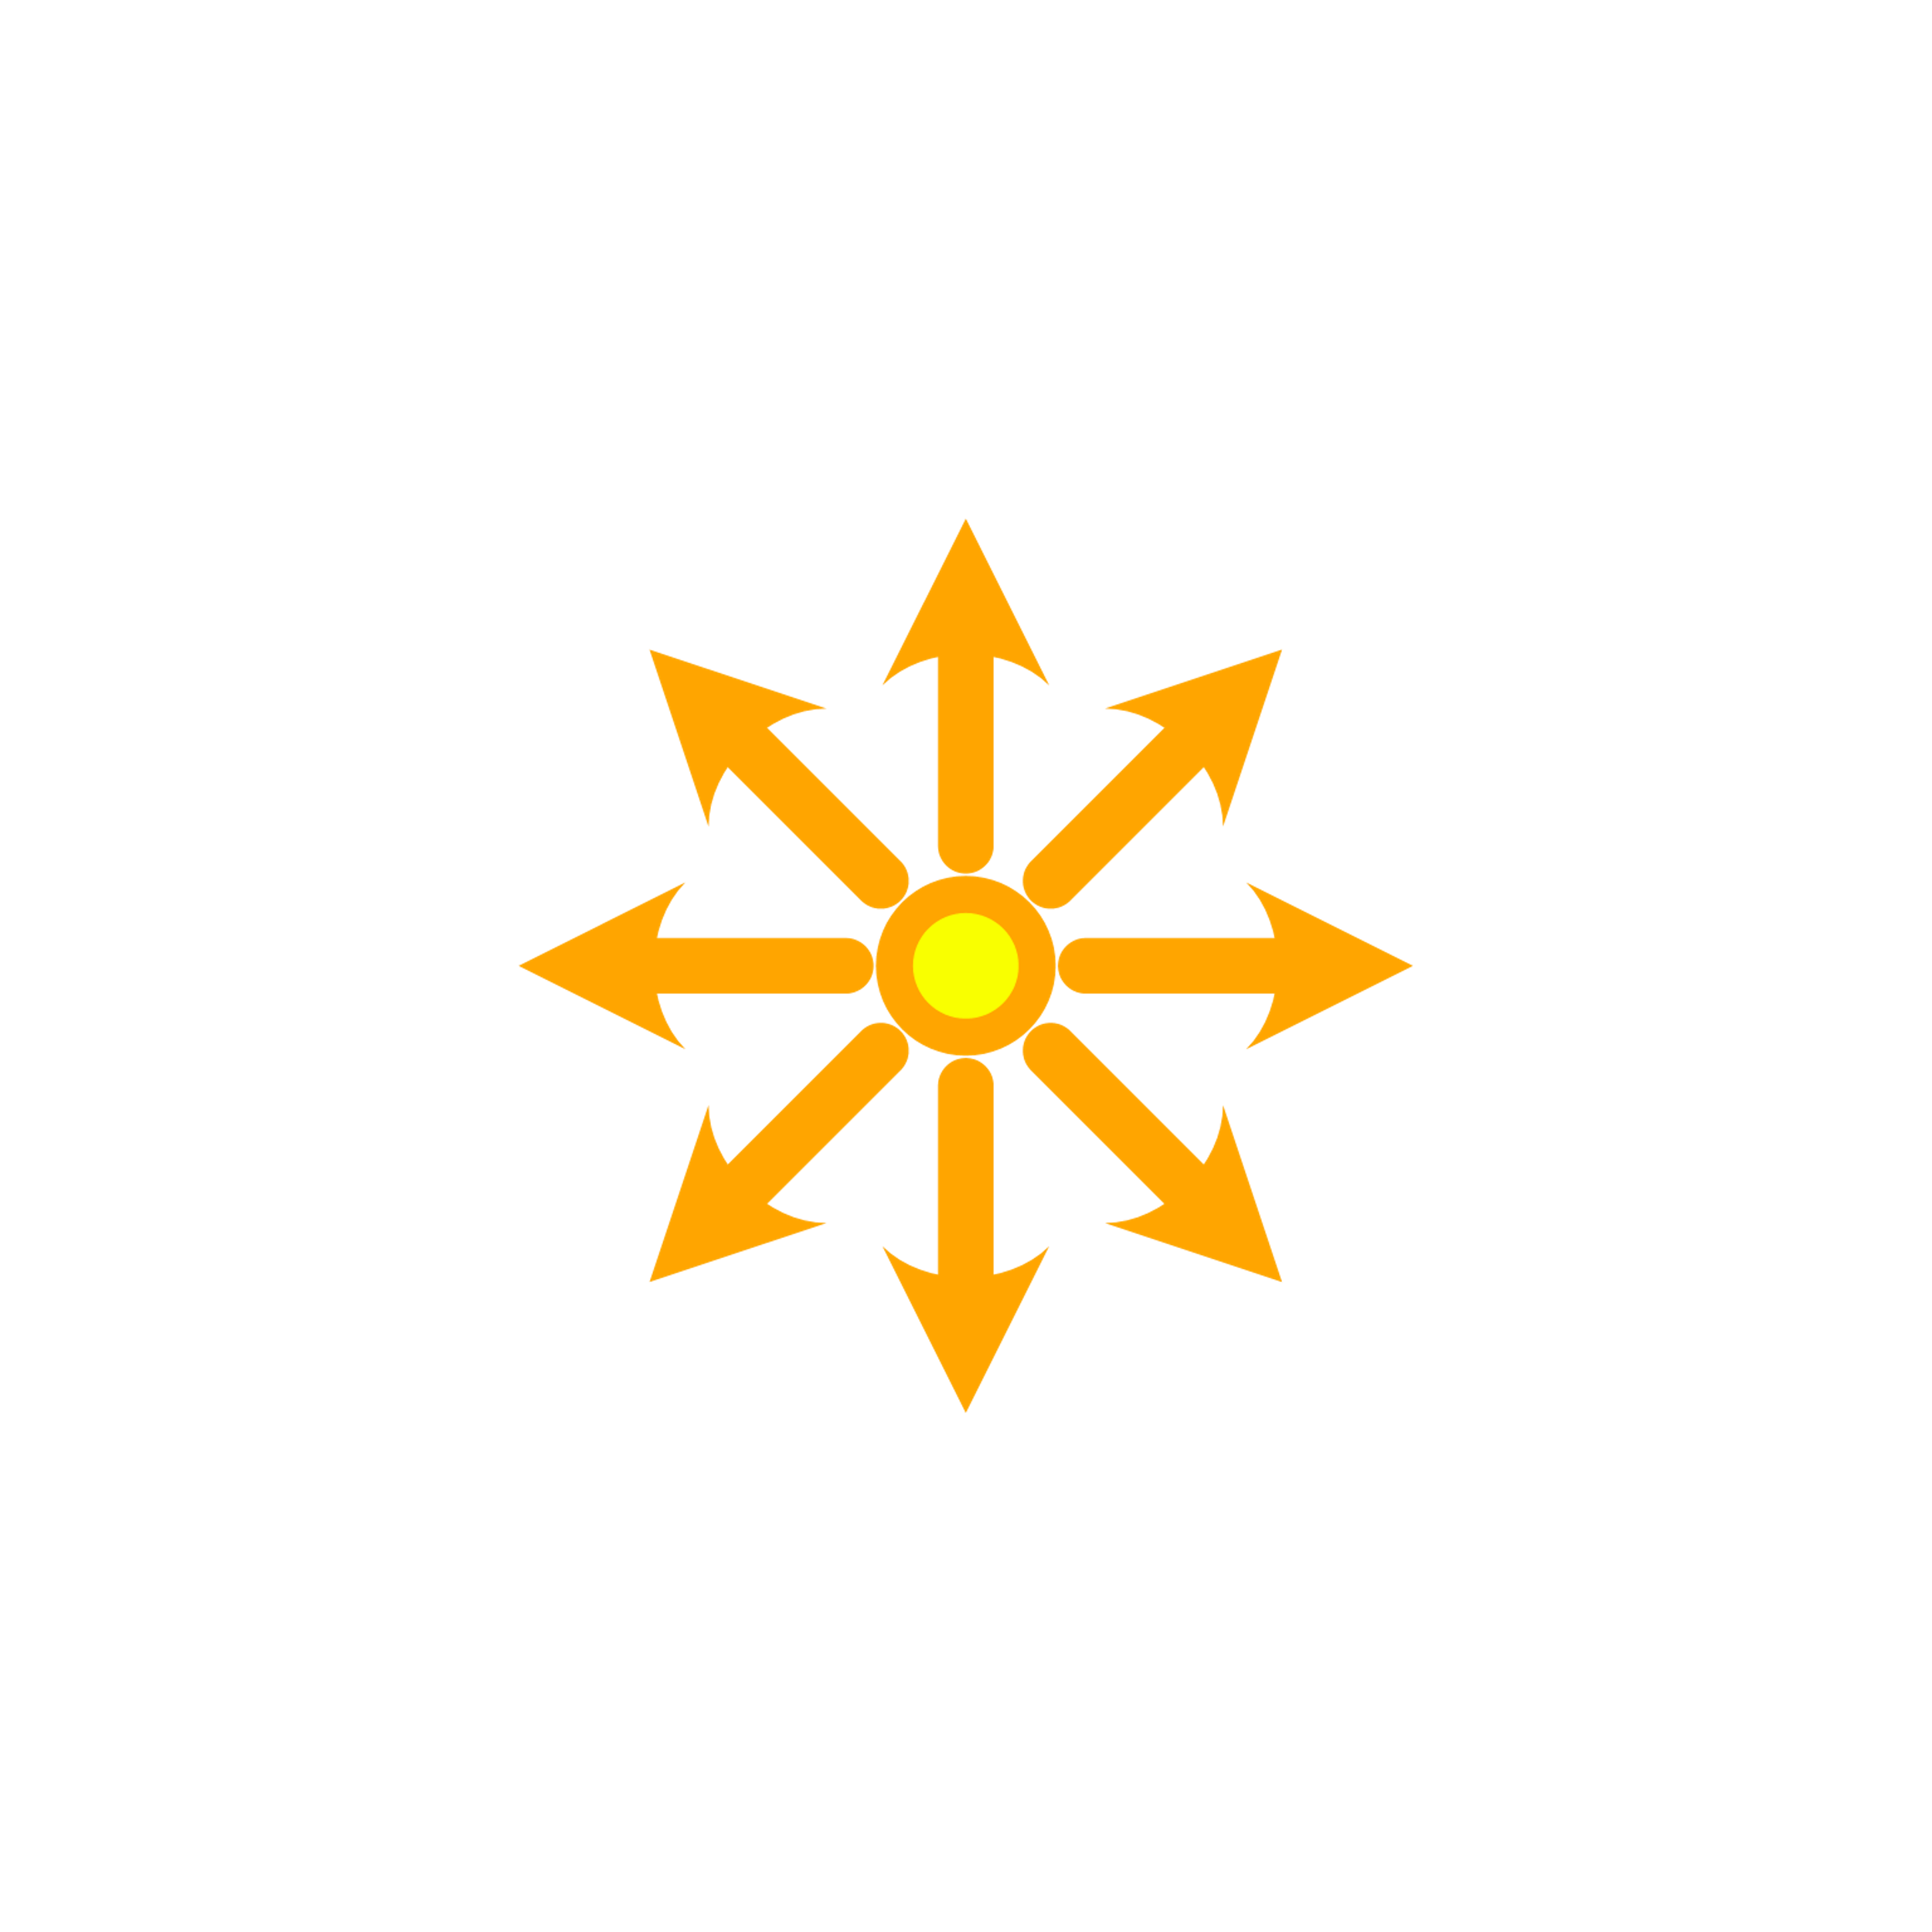
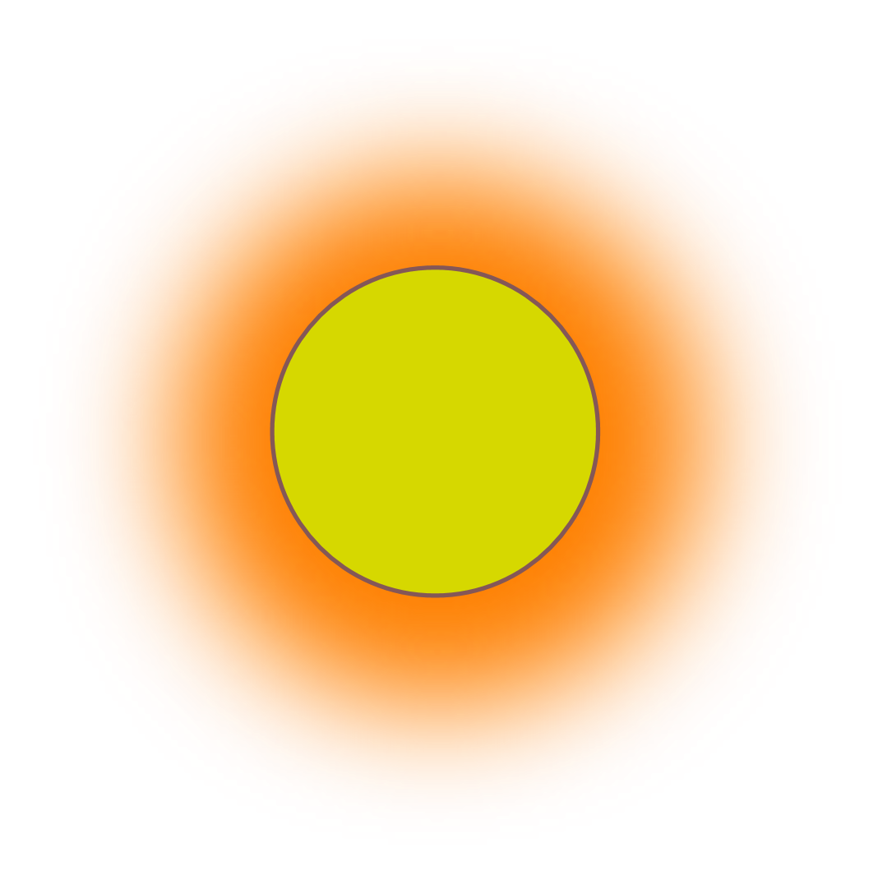
VOLUMETRIC RENDERING: Many techniques
Path tracing / Bidirectional path tracing
Density estimation:
Volumetric Photon Mapping
Photon Beam
Photon Planes
“Higher-order geometric primitives”
Many lights:
Virtual point lights
Virtual spherical lights
Virtual ray lights
“Higher-order geometric primitives”
Notes:
Finally, the last category is the many light methods which compute the indirect lighting by using many indirect virtual light sources. Similarly to density estimation techniques it exists different shape for the virtual light source like: point, blurred point, line and again higher-order geometric primitives. In this work, we focus to use the virtual ray light as it is an efficient technique to render participating media.

Slide 8
MANY LIGHTS
Many-light techniques have been introduced in “instant radiosity” [Keller et al. 1997]
Indirect illumination as a sum of direct illumination of virtual lights
$$\vec{ω}$$
Notes:
Many-light techniques have been originally introduced in “instant radiosity” by Keller and colleague in 1997 (nineteen ninety seven).
The core idea is to simplify the complex light transport problem as a sum of direct illumination coming from many virtual lights.
This rendering technique is a bidirectional algorithm that runs in two stages.
The first stage is a light tracing pass that generate light sub-path starting from emitter, then it deposit so-called Virtual Lights at scattered interactions.
The second stage computes the total incoming radiance for each pixel by simply accumulating the direct illumination contribution from each virtual lights.
Let see what is the contribution of this particular VL.

Slide 9
MANY LIGHTS
Virtual point light contribution
$$y$$
$$L_{m}^{VPL}=\frac{\left.VPL(y,x_{u}\right)}{\left.{|y−x_{u}|}^{2}p(x_{u}\right)}$$
$$x_{u}$$
Notes:
If the virtual light is a point, the technique is usually called virtual point light. Here, we have a virtual point light y and we gather its contribution at the gather location x u. We will not explain fully all the term to compute this contribution. You just need to be aware that it exists:
A Term P(x u) which represent the probability of sampling position x u along view direction
And another term that is the squared distance between y and x u which is for the geometry term.

Slide 10
MANY LIGHTS
Virtual point light contribution
$$y$$
$$L_{m}^{VPL}=\frac{\left.VPL(y,x_{u}\right)}{\left.{|y−x_{u}|}^{2}p(x_{u}\right)}$$
\
$$∝\frac{1}{{\left|y−x_{u}\right|}^{2}}$$
$$x_{u}$$
Notes:
It is important to notice that this distance can be arbitrary small which generates high contribution when gathering the VPL. These high values usually translate as fireflies inside the image. Note that it exists some techniques to alleviate this issue by clamping the VPL contribution and compensate the energy loss. This is not the focus of our presentation.

Slide 11
MANY LIGHTS
VPL vs. short VRL
Notes:
Instead, we want to use higher primitive order to reduce the noise inside the rendering image. This motivate us to use VRL instead of VPL.
VRL is a continuous generalization of the concept of VPL.
Instead of depositing virtual point at scattered interactions along light path, VRL simply use all light path edges.
This increase light sample density significantly which produce better results. Note that VRL can be interpreted as an infinite collection of correlated VPL.

Slide 12
MANY LIGHTS: VRL
Virtual ray lights contribution
$$VRL$$
$$v$$
$$L_{m }^{\text{VRL}}=\int_{0}^{s}{ }\int_{0}^{t}{\frac{\left.VRL(u,v\right)}{w{\left(u,v\right)}^{2}}\text{d}v\text{d}u}$$
$$u$$
Notes:
The total contribution of a particular VRL over a sensor ray is represented by the double integral on the right side.
For readability we factor all the term used to compute the VRL contribution except the geometry factor that is equal to the inverse squared distance uv.

Slide 13
MANY LIGHTS: VRL
Virtual ray lights contribution
$$VRL$$
$$v$$
$$L_{m}^{VRL}=\frac{\left.VRL(u,v\right)}{\left.w{\left(u,v\right)}^{2}p(u,v\right)}$$
$$p\left(u,v\right)∝w{\left(u,v\right)}^{−2}$$
$$u$$
Notes:
To evaluate these double integral a Monte Carlo estimator is used where u and v are sampled according to the pdf p(u,v).
In case of isotropic participating media, this pdf is proportional to the inverse of the geometry factor and cancel-out.
This simplification eliminate a major source of variance in the integrand.

Slide 14
MANY LIGHTS: VRL vs. VPL
VRL
VPL
Equal rendering time
Notes:
This slide show a side by side comparison of VPL and VRL for equal rendering time.
VPL on the right side show many visible artifact due to the geometric term that lead to high variance in the integral.
On the other side VRL is more smoother thanks to their special sampling scheme.
As now we have seen the advantage of VRL against VPL, we can now talk about the rendering cost.

Slide 15
MANY LIGHTS
Realistic rendering :
Unmanageable amount of virtual lights
Cost linear with lights
Notes:
The quest for ultra realistic rendering brings us to very complex lighting effects and in the context of many light an unmanageable amount of virtual lights can be produce.
However, as the cost is linear with the number of lights, the rendering time also increase linearly.
This led to inefficient rendering methods.

Slide 16
MANY LIGHTS
Realistic rendering:
Unmanageable amount of virtual lights
Cost linear with lights
Aim:
Sub-linear cost
Scalable methods [Walter et al. 2005][Walter et al. 2006][Walter et al. 2012] [Hasan et al. 2007][Ou et al. 2011][Bus et al. 2015]
Notes:
Our aim is to achieve sub linear cost with scalable algorithm.
By having a sublinear cost, we can afford a large number of lights which will help to maintaining perceptual fidelity of the rendered image.
Many scalable technique already exist and depending of the scalable algorithm that you use, you will have some differences likes constructing another tree on the sensor path and so on.
In our approach, we used the technique proposed by walter and collegue also named Lightcuts.
Let see how it work
I will present a high level overview of the technique, for an in depth explanation I invite you to read the Scalable Realistic Rendering with Many-Light Methods

Slide 17
SCALABILITY
Notes:
Imaging that we have 5 different VRLs. Each of them will contribute differently to the final image.
The key idea behind Lightcuts is to avoid to compute contribution of similar VRL by constructing a hierarchy.

Slide 18
SCALABILITY
INDIVIDUAL
LIGHTS
Notes:
The leaves of this hierarchy on the right will represent an individual VRL and its bounding volume.

Slide 19
SCALABILITY
CLUSTERS
INDIVIDUAL
LIGHTS
Notes:
Then, the hierarchy is build by clustering similar lights.

Slide 20
SCALABILITY
CLUSTERS
INDIVIDUAL
LIGHTS
Notes:
For example, this orange node will represent the set of VRL inside the displayed dashed box.
To compute the contribution of this cluster of VRL, only a subset of VRL is used as representatives.
If this group is well approximated, we will only use this subset of VRL and skip the rest of the computation.

Slide 21
RELATED WORKS
Previous works have already explored a combination of VRLs with scalable techniques:
Adaptive light-slice for virtual ray light [Frederickx al. 2015]
Adaptive matrix column sampling and completion for rendering participating media [Huo et al. 2016]
Notes:
Note that the combination of VRL and scalable technique have been already explored before by two previous work. The first work was by Frederickx and collegue and uses lightslice as scalable technique.
Lightslice uses variance estimators and heuristic to found the set of representative VRL.
Despite the authors effort to reduce the number of user parameter, these technique are sensitive to the noise inside the variance estimates which can results to suboptimal clusters. The second work by Huo and collegue used a graph cut approach and complicated sampling and completion matrix algorithm. Note that, these authors motivate the choice of avoiding Lightcuts-based approach due to the difficulty of deriving sufficiently tight bounds on the VRL contributions.
We derive such a bound for a cluster of VRLs that is efficient to evaluate, allowing us to refine shading estimates automatically.
Our approach does not rely on hand-tuned user parameters nor heuristics, and so is simple to implement atop existing VRL renderers.

Slide 22
Our solution: Upper bound
$\frac{\left.VRL(u,v\right)}{\left.w{\left(u,v\right)}^{2}p(u,v\right)}$ < B
B=?
Notes:
To forge such an upper bound B we need to maximize this previously seen equation.
We will revue each term one by one and see how we bound them to define the unknown upper bound B.

Slide 23
Our solution: Upper bound
$Φf(u,v)$: Constant within the VRL cluster
$\frac{Φf(u,v)T_{r}(u)T_{r}(w\left(u,v\right))}{\left.w{\left(u,v\right)}^{2}p(u,v\right)}$ < B
Notes:
This term is the flux and the phase function. It is a constant in the case of isotropic phase function.

Slide 24
Our solution: Upper bound
$Φf(u,v)$: Constant within the VRL cluster
$T_{r}(u)$: Impossible to control, assuming worst case => 1
$\frac{Φf(u,v)T_{r}(u)T_{r}(w\left(u,v\right))}{\left.w{\left(u,v\right)}^{2}p(u,v\right)}$ < B
Notes:
This term is the transmittance along query ray. There no way to control it, we bound it to 1.

Slide 25
Our solution: Upper bound
$Φf(u,v)$: Constant within the VRL cluster
$T_{r}(u)$: Impossible to control, assuming worst case => 1
$T_{r}(w\left(u,v\right))$: Based on the min distance
=> $h_{min}≤w_{k}(u,v)$
=>$T_{r}(w (u,v)$) < $T_{r}(h_{min}$)
$\frac{Φf(u,v)T_{r}(u)T_{r}(w\left(u,v\right))}{\left.w{\left(u,v\right)}^{2}p(u,v\right)}$ < B
$$v$$
AABB
$$w (u,v)$$
$$h_{min}$$
$$u$$
Notes:
The term in green is the transmittance for the distance $w$ between the point u on the ray and the sampled point v on the VRL.
We minimize this distance using the h_min distance.
This distance is the shortest between the node AABB and query ray.
Consequently the maximum value for this term is simply the transmittance of this minimum distance.

Slide 26
Our solution: Upper bound
$Φf(u,v)$: Constant within the VRL cluster
$T_{r}(u)$: Impossible to control, assuming worst case => 1
$T_{r}(w\left(u,v\right))$: Based on the min distance
=> $h_{min}≤w_{k}(u,v)$
=>$T_{r}(w (u,v)$) < $T_{r}(h_{min}$)
$\frac{Φf(u,v)T_{r}(u)T_{r}(w\left(u,v\right))}{\left.w{\left(u,v\right)}^{2}p(u,v\right)}$ < B
$$v$$
AABB
$$w (u,v)$$
$$h_{min}$$
$$u$$
Notes:
The last term to bound is the denominator.
This is how we procced.

Slide 27
Our solution: Upper bound
$${ w}_{k}{\left(u,v\right)}^{2}p\left(u,v\right)$$
=$w_{k}{\left(u,v\right)}^{2}p(u|v)p(v)$
Notes:
We rewrite the join probability as a product.

Slide 28
Our solution: Upper bound
$${ w}_{k}{\left(u,v\right)}^{2}p\left(u,v\right)$$
=$w_{k}{\left(u,v\right)}^{2}p(u|v)p(v)$
Worst case when VRL and sensor ray are parallel.
$\left.p(v\right)<\frac{1}{L_{max}}, with L_{max}$ the maximum length inside the cluster.
Notes:
P(v) is the marginalized pdf of sampling a particular position on the VRL.
To bound this term we consider the worst case scenario when VRL and sensor ray are parallel and coplanar
Therefore it degenerate to uniform sampling over the maximum length inside the cluster $L_{max}$.

Slide 29
Our solution: Upper bound
$${ w}_{k}{\left(u,v\right)}^{2}p\left(u,v\right)$$
=$w_{k}{\left(u,v\right)}^{2}p(u|v)p(v)$
Worst case when VRL and sensor ray are parallel.
$\left.p(v\right)<\frac{1}{L_{max}}, with L_{max}$ the maximum length inside the cluster.
Notes:
Now we need to maximize left term in red.
This term is the squared distance between point u,v multiplied by the conditional pdf of sampling a point on the sensor ray given that we first sampled v.
To bound this term we use the Kulla parameterization.

Slide 30
Our solution: Upper bound
$$v$$
AABB
$$Θ$$
$$\overline{h}$$
$$w (u,v)$$
$$u$$
$$\overline{u}$$
$$s$$
Notes:
He we have a geometric view of Kulla parameterization.
With a VRL and its bounding box that is parallel to query ray and samples point u,v respectively on ray query and VRL.

Slide 31
Our solution: Upper bound
$w{\left(u,v\right)}^{2}p\left(u | v\right)$ = $\frac{\overline{h}({\overline{h}}^{2}+{\overline{u}}^{2})}{Θ({\overline{h}}^{2}+{\overline{u}}^{2})}$
$$v$$
AABB
$$Θ$$
$$\overline{h}$$
$$w (u,v)$$
$$u$$
$$\overline{u}$$
$$s$$
Notes:
We can now simply rewrite our previous product into this ratio.

Slide 32
Our solution: Upper bound
$w{\left(u,v\right)}^{2}p\left(u | v\right)$ = $\frac{\overline{h}({\overline{h}}^{2}+{\overline{u}}^{2})}{Θ({\overline{h}}^{2}+{\overline{u}}^{2})}$
= $\frac{\overline{h}}{Θ}$
$$v$$
AABB
$$Θ$$
$$\overline{h}$$
$$w (u,v)$$
$$u$$
$$\overline{u}$$
$$s$$
Notes:
Terms cancel-out.
We need to maximize the remaining ratio.
First we will minimize the numerator $\overline{h}$ that is equal to the shortest distance of sample v on VRL to query ray.
This minimum distance is equal to the minimum distance between the AABB and query ray.
This lead to the following configuration.

Slide 33
Our solution: Upper bound
$w{\left(u,v\right)}^{2}p\left(u | v\right)$ = $\frac{\overline{h}({\overline{h}}^{2}+{\overline{u}}^{2})}{Θ({\overline{h}}^{2}+{\overline{u}}^{2})}$
= $\frac{\overline{h}}{Θ}$
$\overline{h}$ > $h_{min}$
AABB
$$Θ$$
$$h_{min}$$
$$s$$
Notes:
Where translate the VRL sample point to AABB corner for being at the shortest distance.

Slide 34
Our solution: Upper bound
$w{\left(u,v\right)}^{2}p\left(u | v\right)$ = $\frac{\overline{h}({\overline{h}}^{2}+{\overline{u}}^{2})}{Θ({\overline{h}}^{2}+{\overline{u}}^{2})}$
= $\frac{\overline{h}}{Θ}$
$\overline{h}$ > $h_{min}$
AABB
$$Θ$$
$$h_{min}$$
$$s$$
Notes:
Now we need to maximize Theta.

Slide 35
Our solution: Upper bound
$w{\left(u,v\right)}^{2}p\left(u | v\right)$ = $\frac{\overline{h}({\overline{h}}^{2}+{\overline{u}}^{2})}{Θ({\overline{h}}^{2}+{\overline{u}}^{2})}$
= $\frac{\overline{h}}{Θ}$
$\overline{h}$ > $h_{min}$
AABB
$$Θ_{max}$$
$$h_{min}$$
$$s$$
Notes:
Theta is maximum when projected vrl sample is at the middle of query ray.
Using this geometric configuration we can retrieve Theta_max.

Slide 36
Our solution: Upper bound
$w{\left(u,v\right)}^{2}p\left(u | v\right)$ = $\frac{\overline{h}({\overline{h}}^{2}+{\overline{u}}^{2})}{Θ({\overline{h}}^{2}+{\overline{u}}^{2})}$
= $\frac{\overline{h}}{Θ}$
$\overline{h}$ > $h_{min}$
$$Θ<Θ_{max}$$
AABB
$$Θ_{max}$$
$$h_{min}$$
$$s$$
Notes:
We have finally our complete bound B

Slide 37
Our solution: Upper bound
B = $\frac{Φf\left(u,v\right)T_{r}\left(h_{min}\right)Θ_{max}L_{max}}{h_{min}}$
Notes:
This is the final bound, You can observe that this bound is quite simple and cheap to evaluate as we need to only compute h_min (the most costly part)
Now the missing part is building an efficient ligh tree for VRL.

Slide 38
Our solution: Light tree
Agglomerative approach [Walter et al. 2008]:
- Not multithreaded
- Does not scale with high node overlapping $O(N^{2})$
What we need:
Fast/Parallelizable
Agglomerative principal
Notes:
Building a good the light tree Is not trivial, it is even more true with VRL.
In comparison with VPL, VRL has 2 extra dimensions, direction and extend.
There are two major approaches for building light trees, agglomerative (bottom-up clustering) and divisive (top-down).
We also use the agglomerative approach but we found it difficult to parallelize and did not scale well with high node overlapping due to geometric extend of VRL.
This motivated use to design an hybrid agglomerative algorithm that is fast and works well with VRL.

Slide 39
Our solution: Light tree
Notes:
We can imagine a 2D scene with VRL list.
Each VRL has it is own AABB

Slide 40
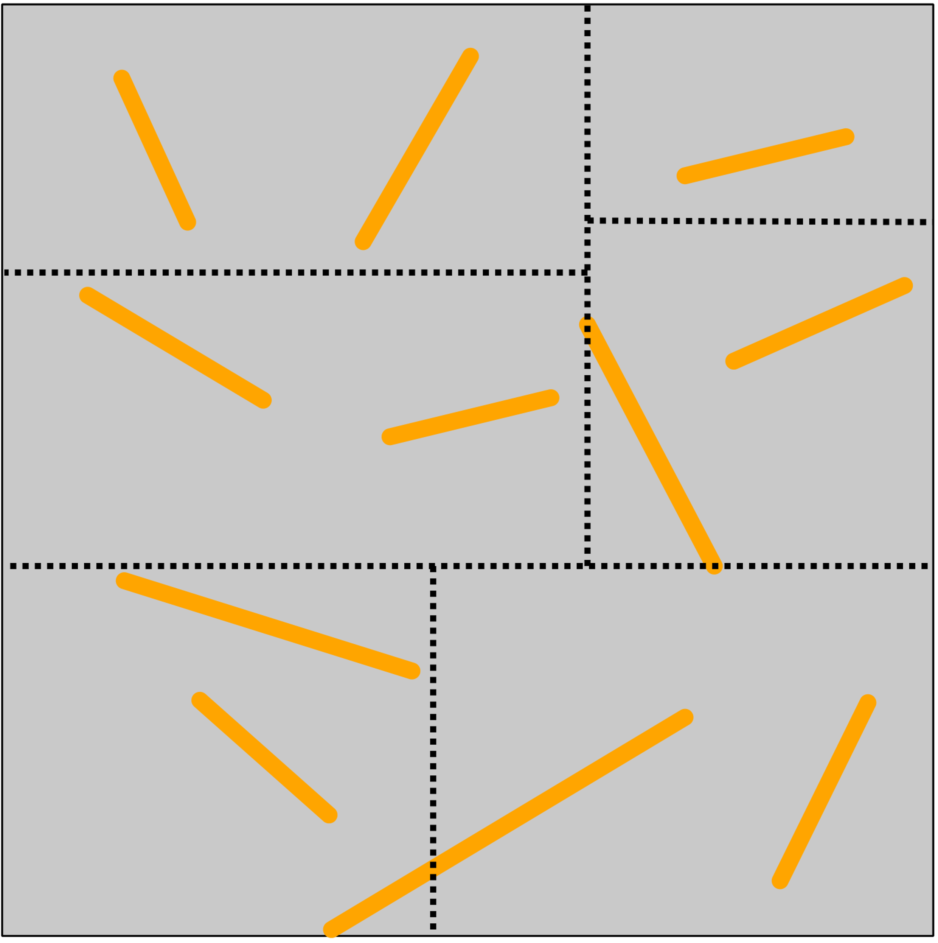
Our solution: Light tree
Step 1: Partition the space with sorting
Notes:
We first partitions the space by sorting VRLs along all principal directions before selecting according to a median split.
We chose the split that minimize bounding box overlap in the resulting children nodes.
We do this recursive subdivision scheme until we reach a target number of VRL.

Slide 41
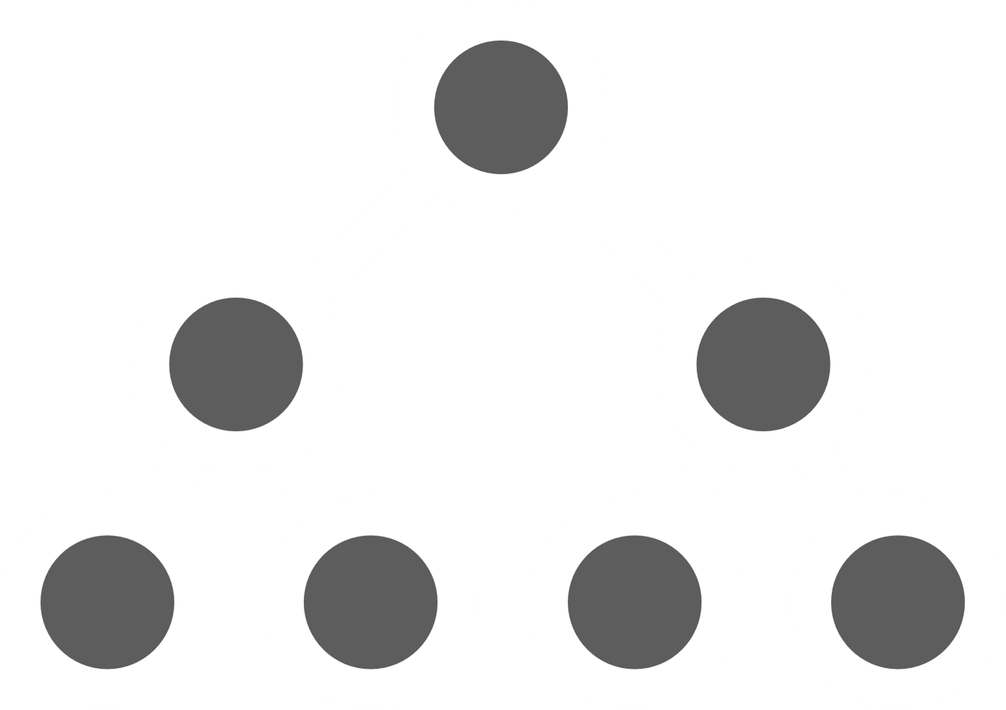
Our solution: Light tree
Step 2: Build local light tree that minimize the metric
Notes:
Then we build a light trees for each sub list using Walter agglomerative algorithm.
At this point we have a list of local mini trees.

Slide 42
Our solution: Light tree
Step 3: Build final tree with agglomerative process
Notes:
To build the final tree we use again the same agglomerative process with all local light tree as input node.
This generate a more spatially coherent light tree.

Slide 43
Results
Equal time comparison
VPL with LC
VRL
Two metrics
RMSE: sensitive to fireflies
SMAPE: robust to fireflies
Isotropic medium, only medium-medium interactions
Notes:
We will now see some results.
Those results are equal time comparison, with VRL, VPL LC.
We show two errors metrics. RMSE that sensitive to fireflies and SMAPE that is robust to fireflies.
And we only consider isotropic medium to medium interaction.

Slide 44
Results
Reference | VPL LC (1M) 344 secs RMSE: 9.01 SMAPE: 3.25 | VRL LC (100k) 370 secs RMSE: 2.70 SMAPE: 4.31 | VRL (10k) 323 secs RMSE: 5.46 SMAPE: 9.93
Notes:
Here we have the staircase scene with equal time comparison.
There is one light at the top and a dense medium that produce a relatively smooth lighting.
A reference result is on the left and a VRL without LC on the right.
In the middle we have VPL and VRL both with LC.
RMSE is high for VPL LC compare to our method, this is due to the geometric term we have seen previously.
We do not clamp VPL contribution.
SMAPE is higher for VRL LC, this is mainly due to the smooth lighting in the scene.
Also Notice that our technique produce a 10 time “speed up” for VRL, from 10k to one thousand VRL.
//Symmetric mean absolute percentage error

Slide 45
Results
VPL LC (1M) - 147 secs RMSE: 0.33 SMAPE: 2.44 |  | VRL LC (100k) - 121 secs RMSE: 0.01 SMAPE 1.88 |  | VRL (10k) - 147 secs RMSE: 0.05 SMAPE 9.11
> $0.05$
SMAPE
0.0
Notes:
Now we have the Veach lamp scene with equal rendering time.
There is two lights that produce a sharper lighting than in previous result.
VRL without LC on the right.
On the left we have VPL and VRL both with LC.
We can see that both RMSE and SMAPE are lower with out technique.
This is due to the sharp lighting effect that are difficult to capture by VPL because the sampling on the sensor ray are independent of the light distribution.
Our scalable technique is able to sample higher density that lead to less variance.
Notice we also have a 10x speedup for VRL.

Slide 46
Results
Relative speed-up | STARCAISE VEACH-LAMP | VEACH-LAMP |  | BATHROOM
 | VRL count |  | VPL count
Notes:
This graphic shows the relative speedup between the scalable technique VRL and VPL.
On the left we can see that our technique speedup increases when more VRLs are contained in the light tree but cannot achieve the same sublinear scaling as VPL.
This is mainly due to the AABB overlapping with VRL.

Slide 47
Summary
Contributions:
New bound for VRL cluster
Efficient tree construction
X10 Speedup
Notes:
To summarize our contribution,
We have a new lightcuts technique for medium and VRL
An efficient light tree building
A 10x time speedup compared to classic VRL

Slide 48
Questions ?

