Slide 1
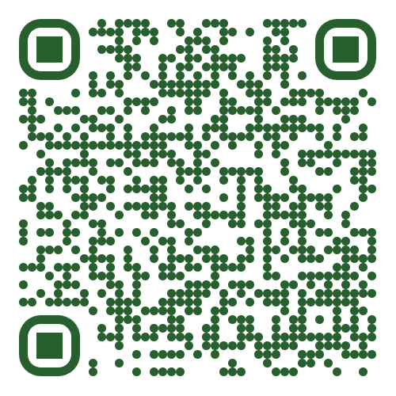




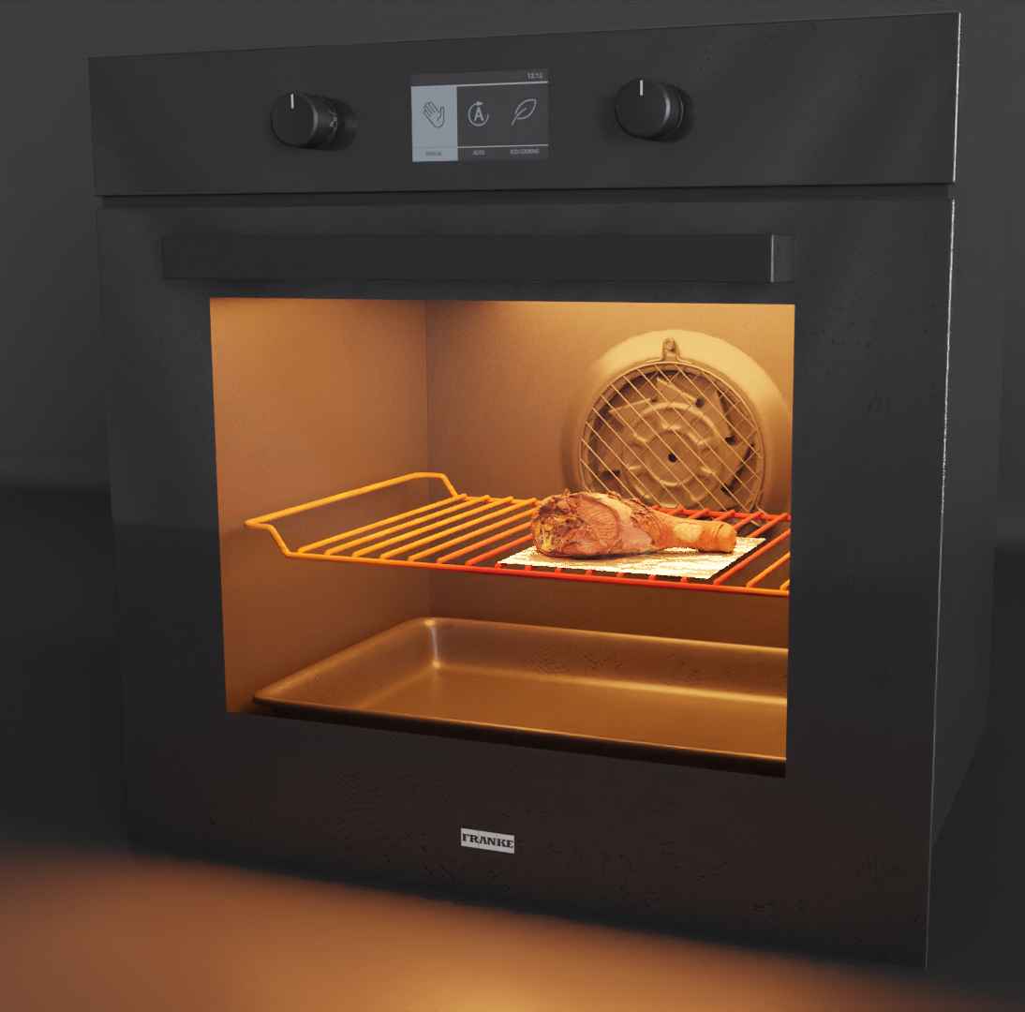
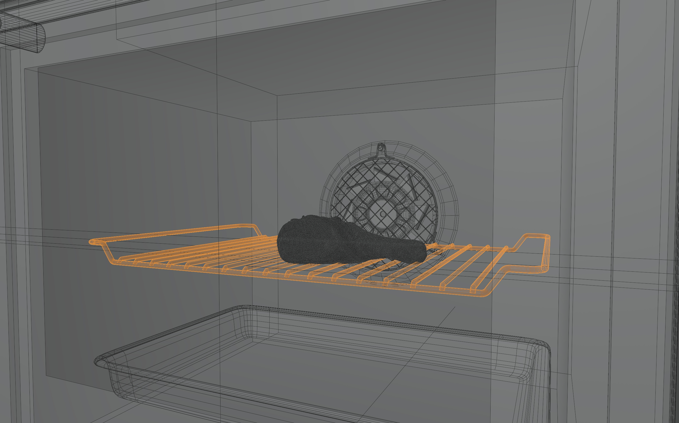
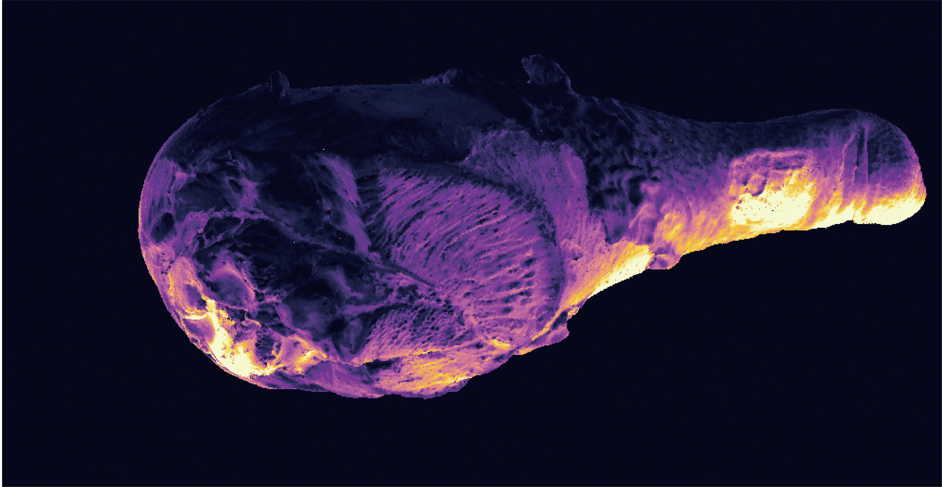
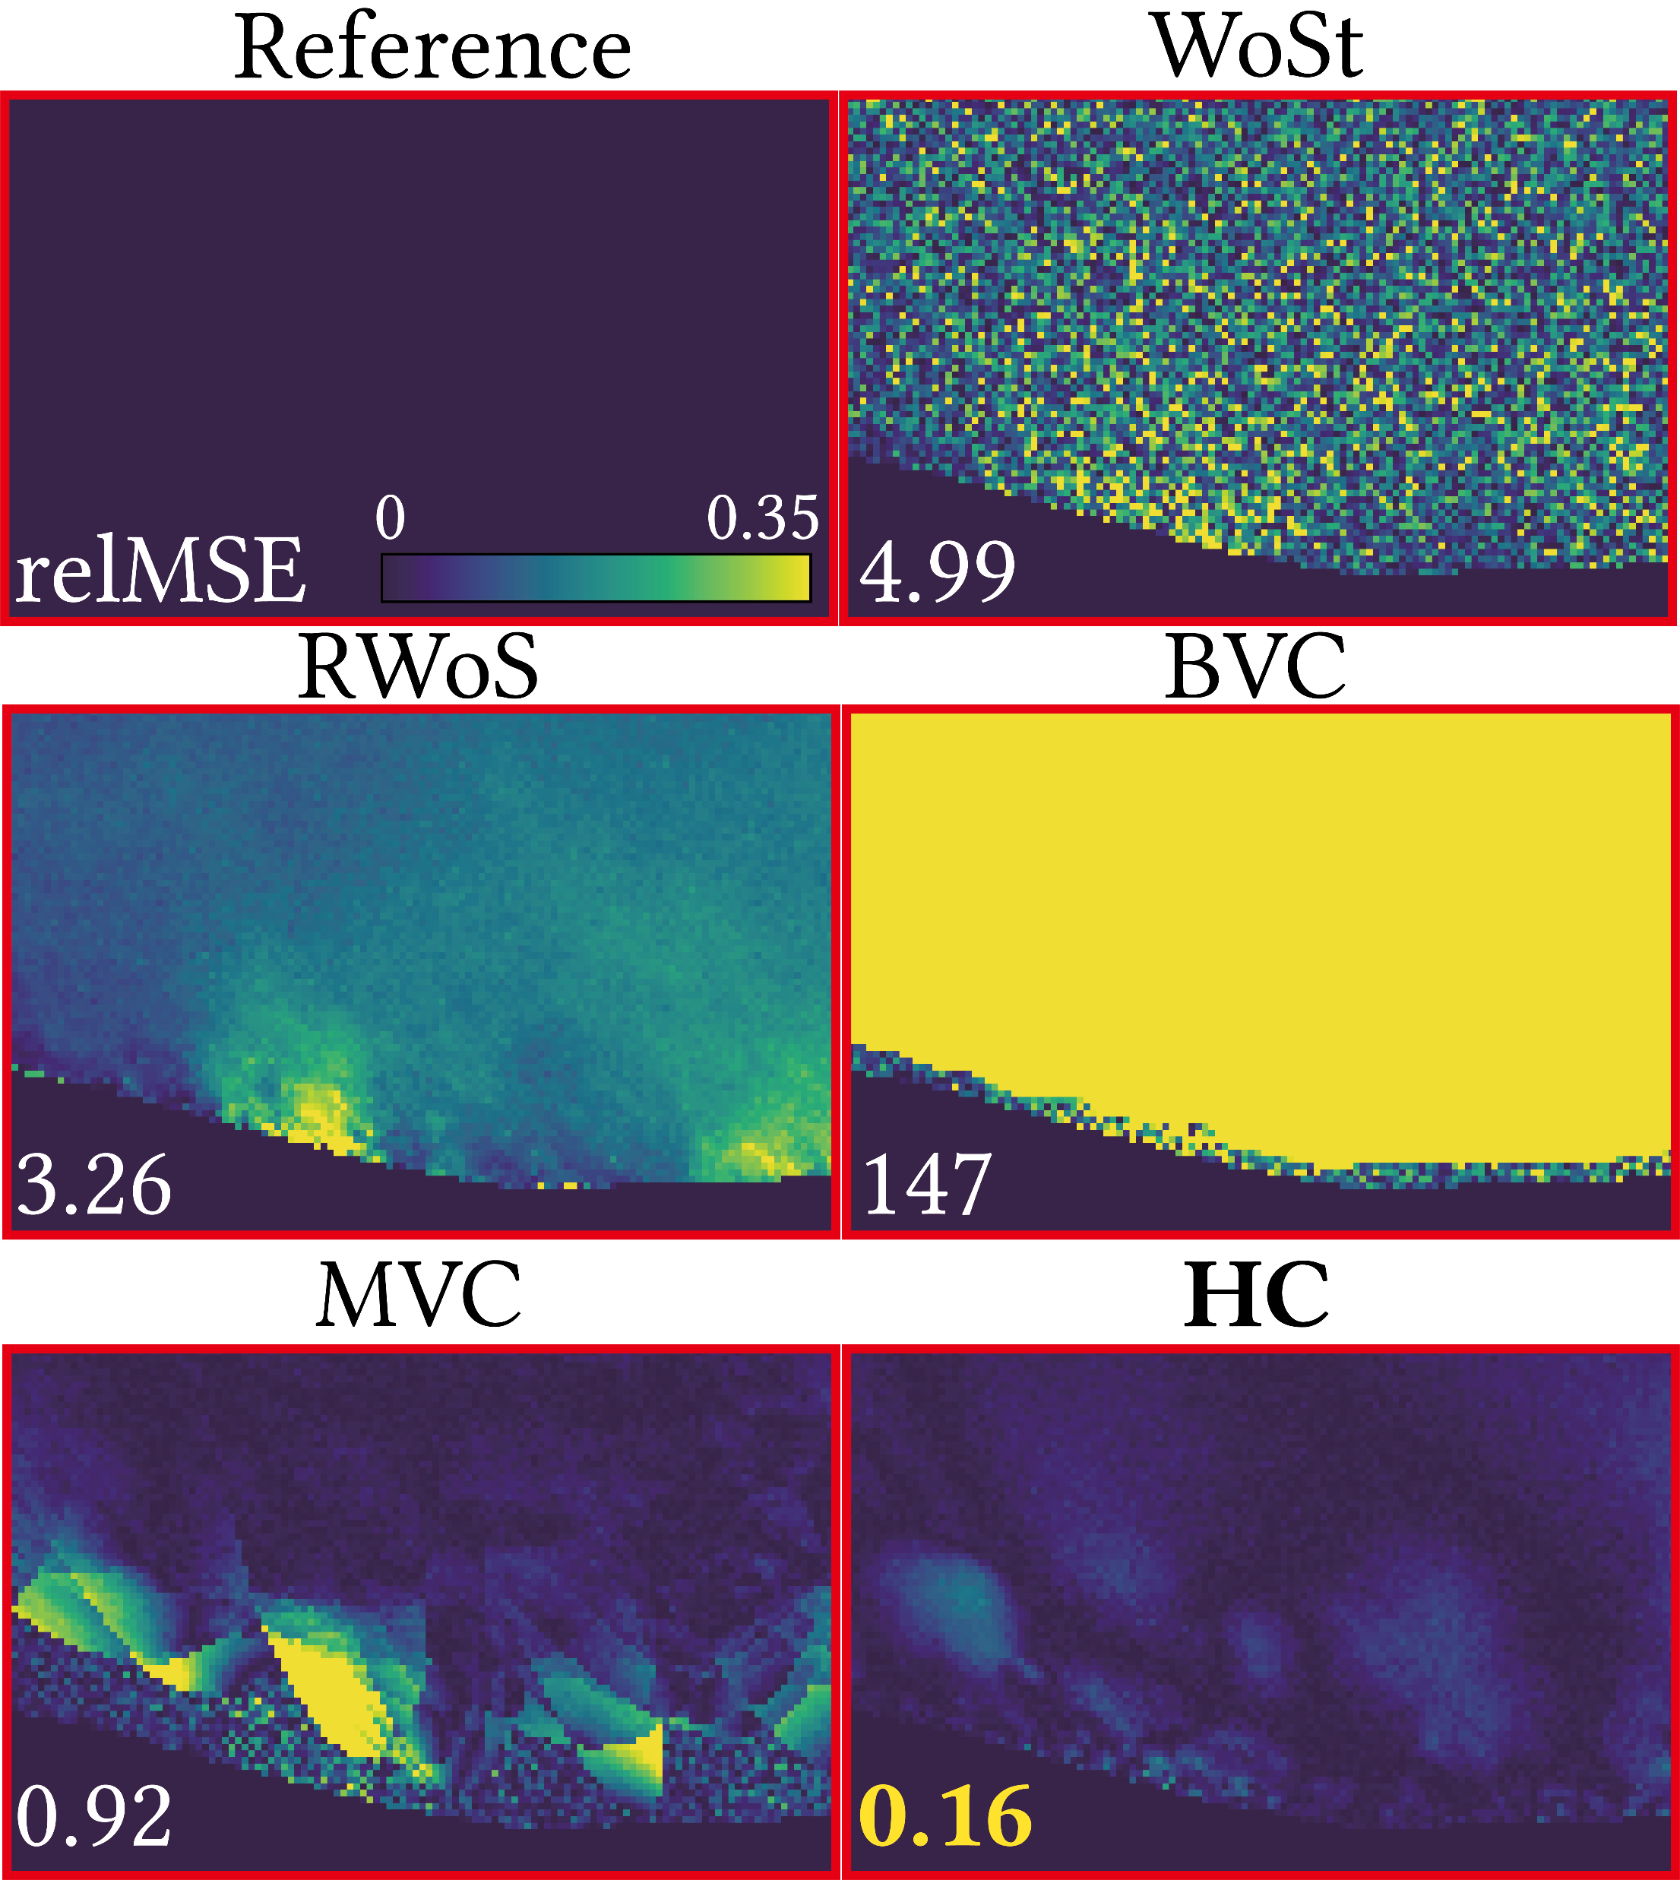
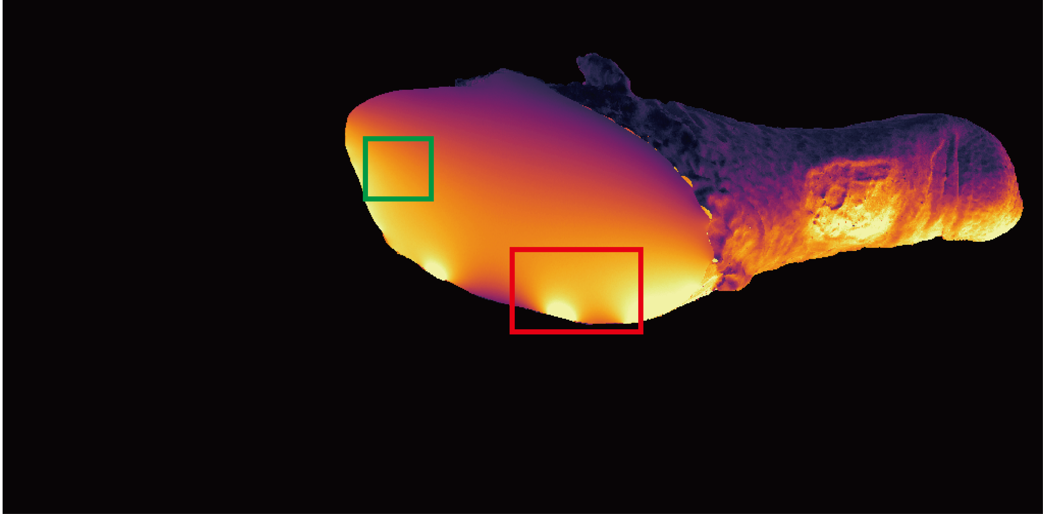

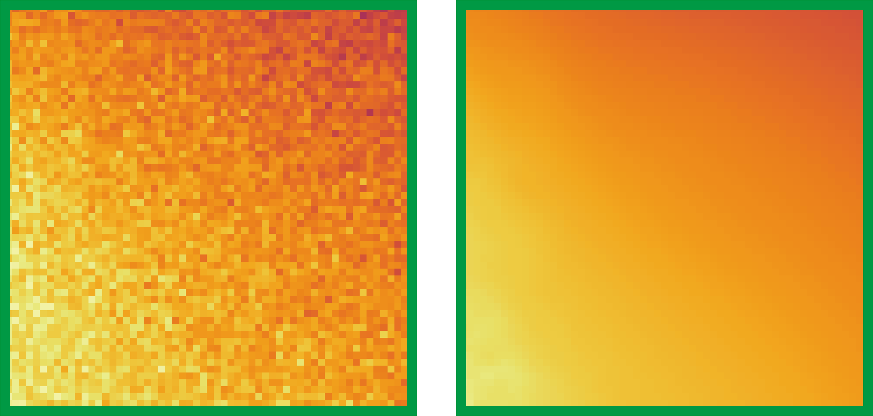

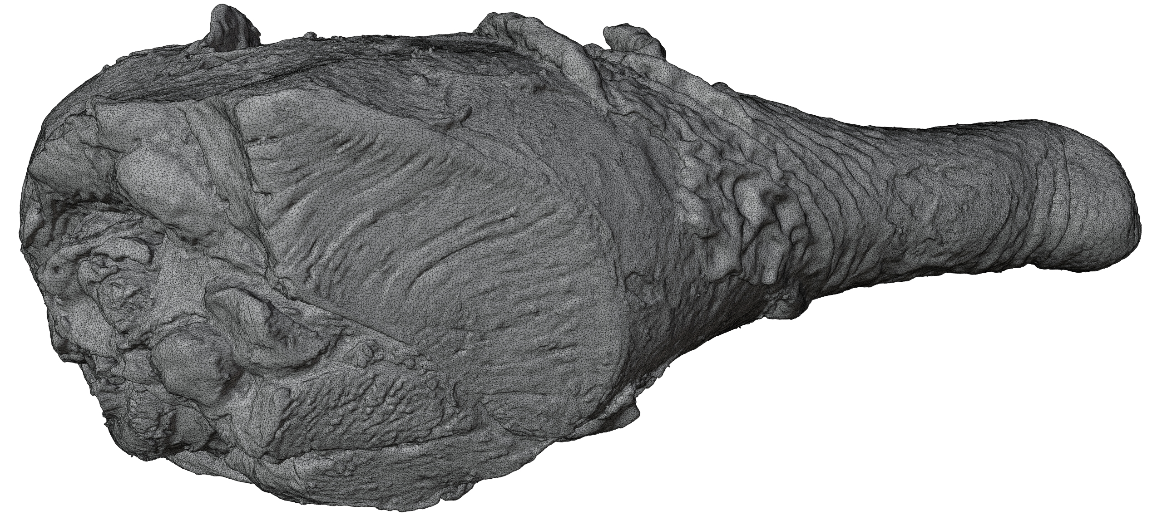
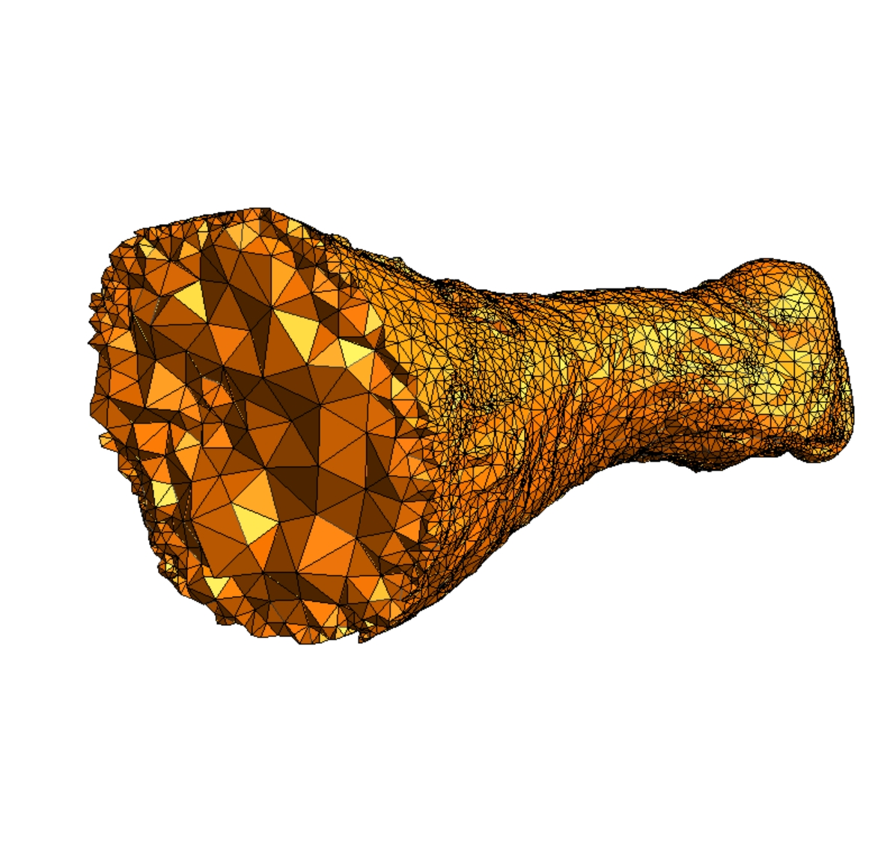
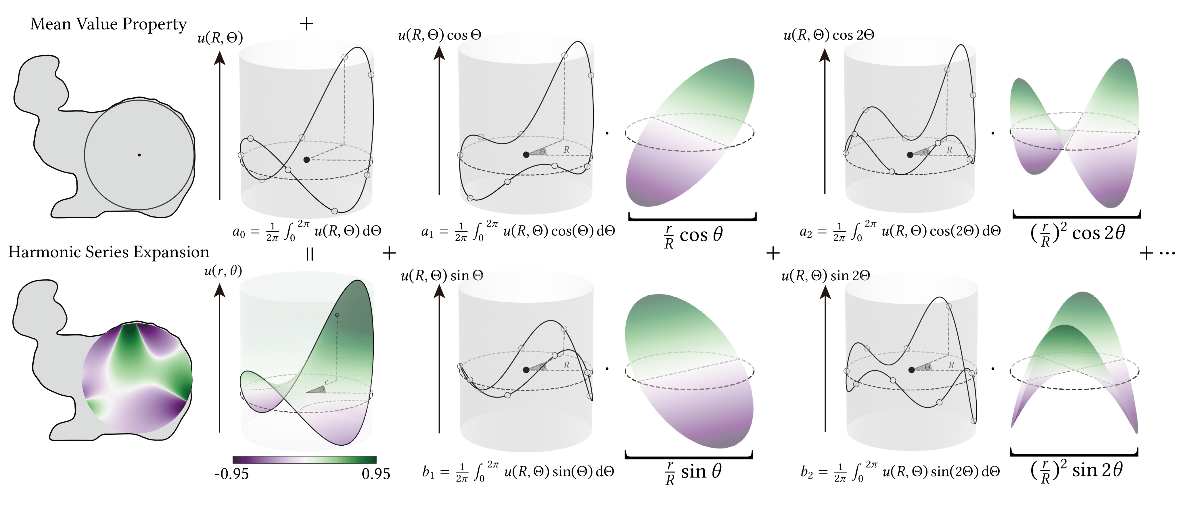
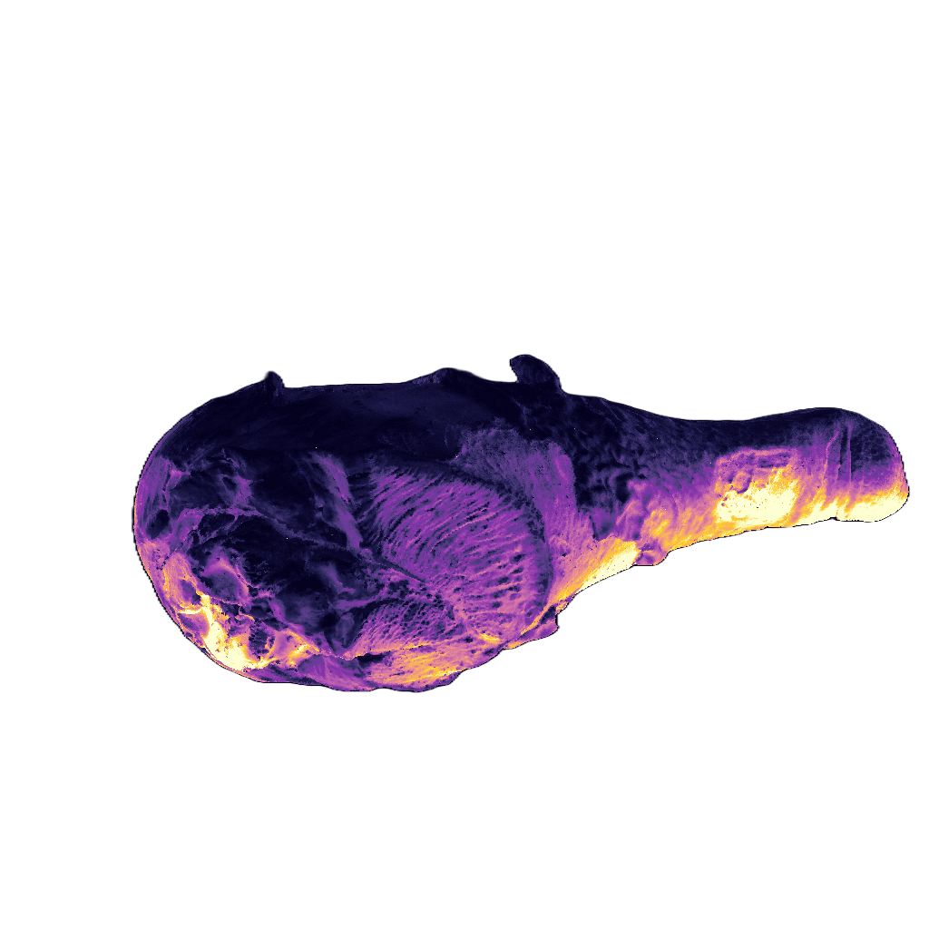
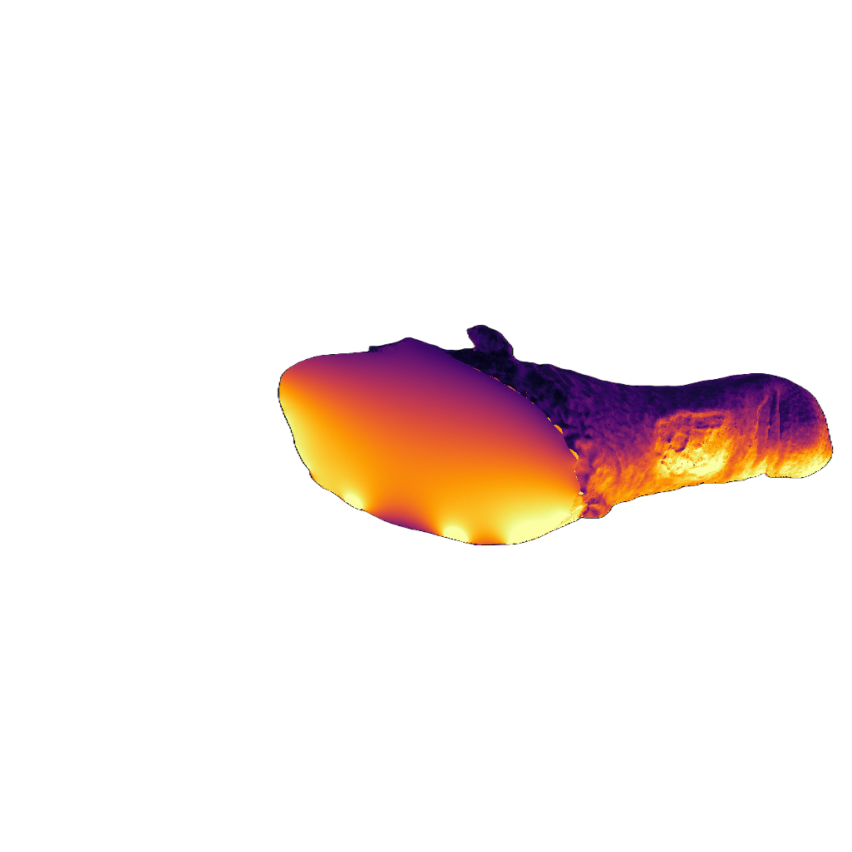
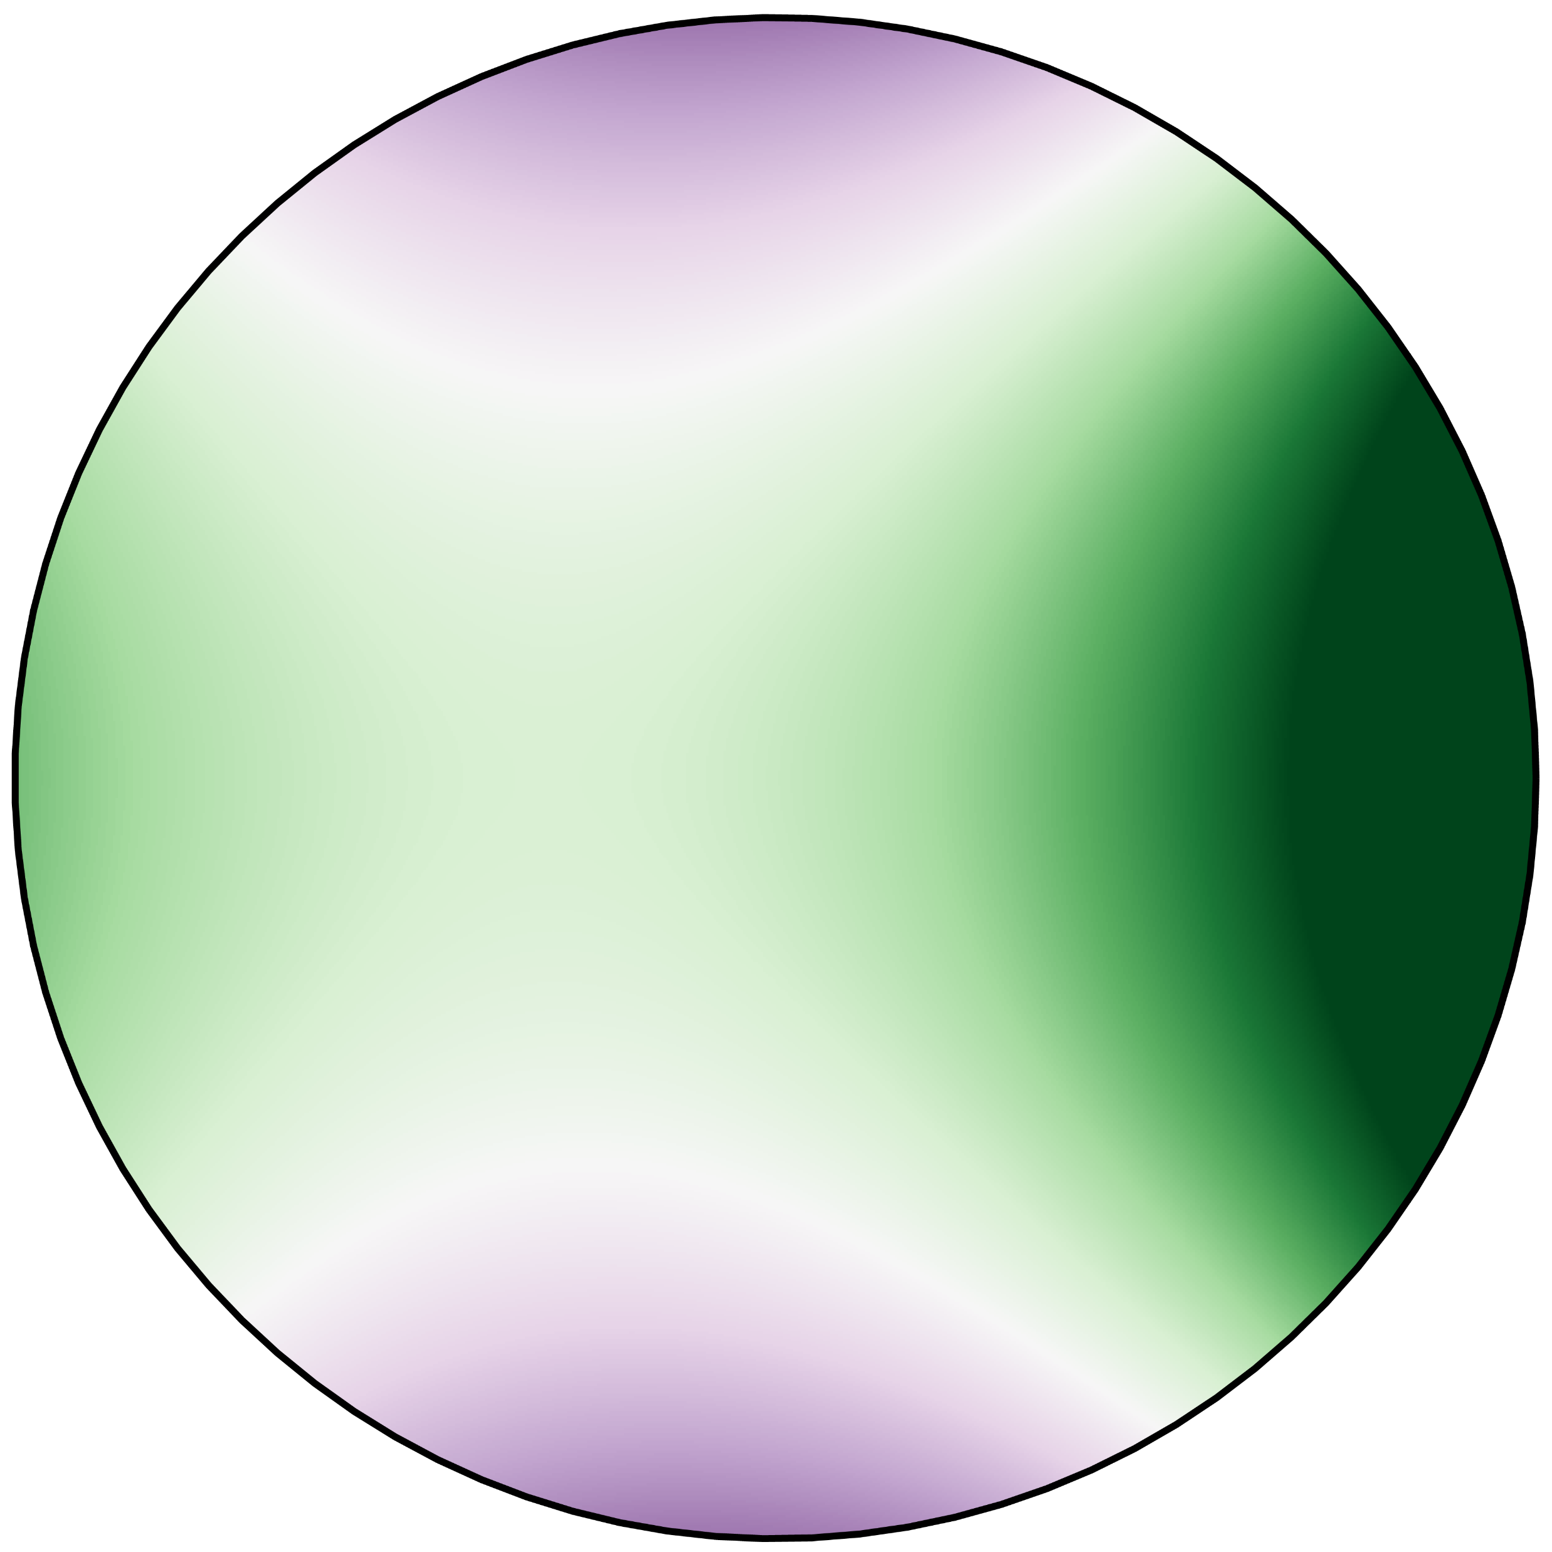
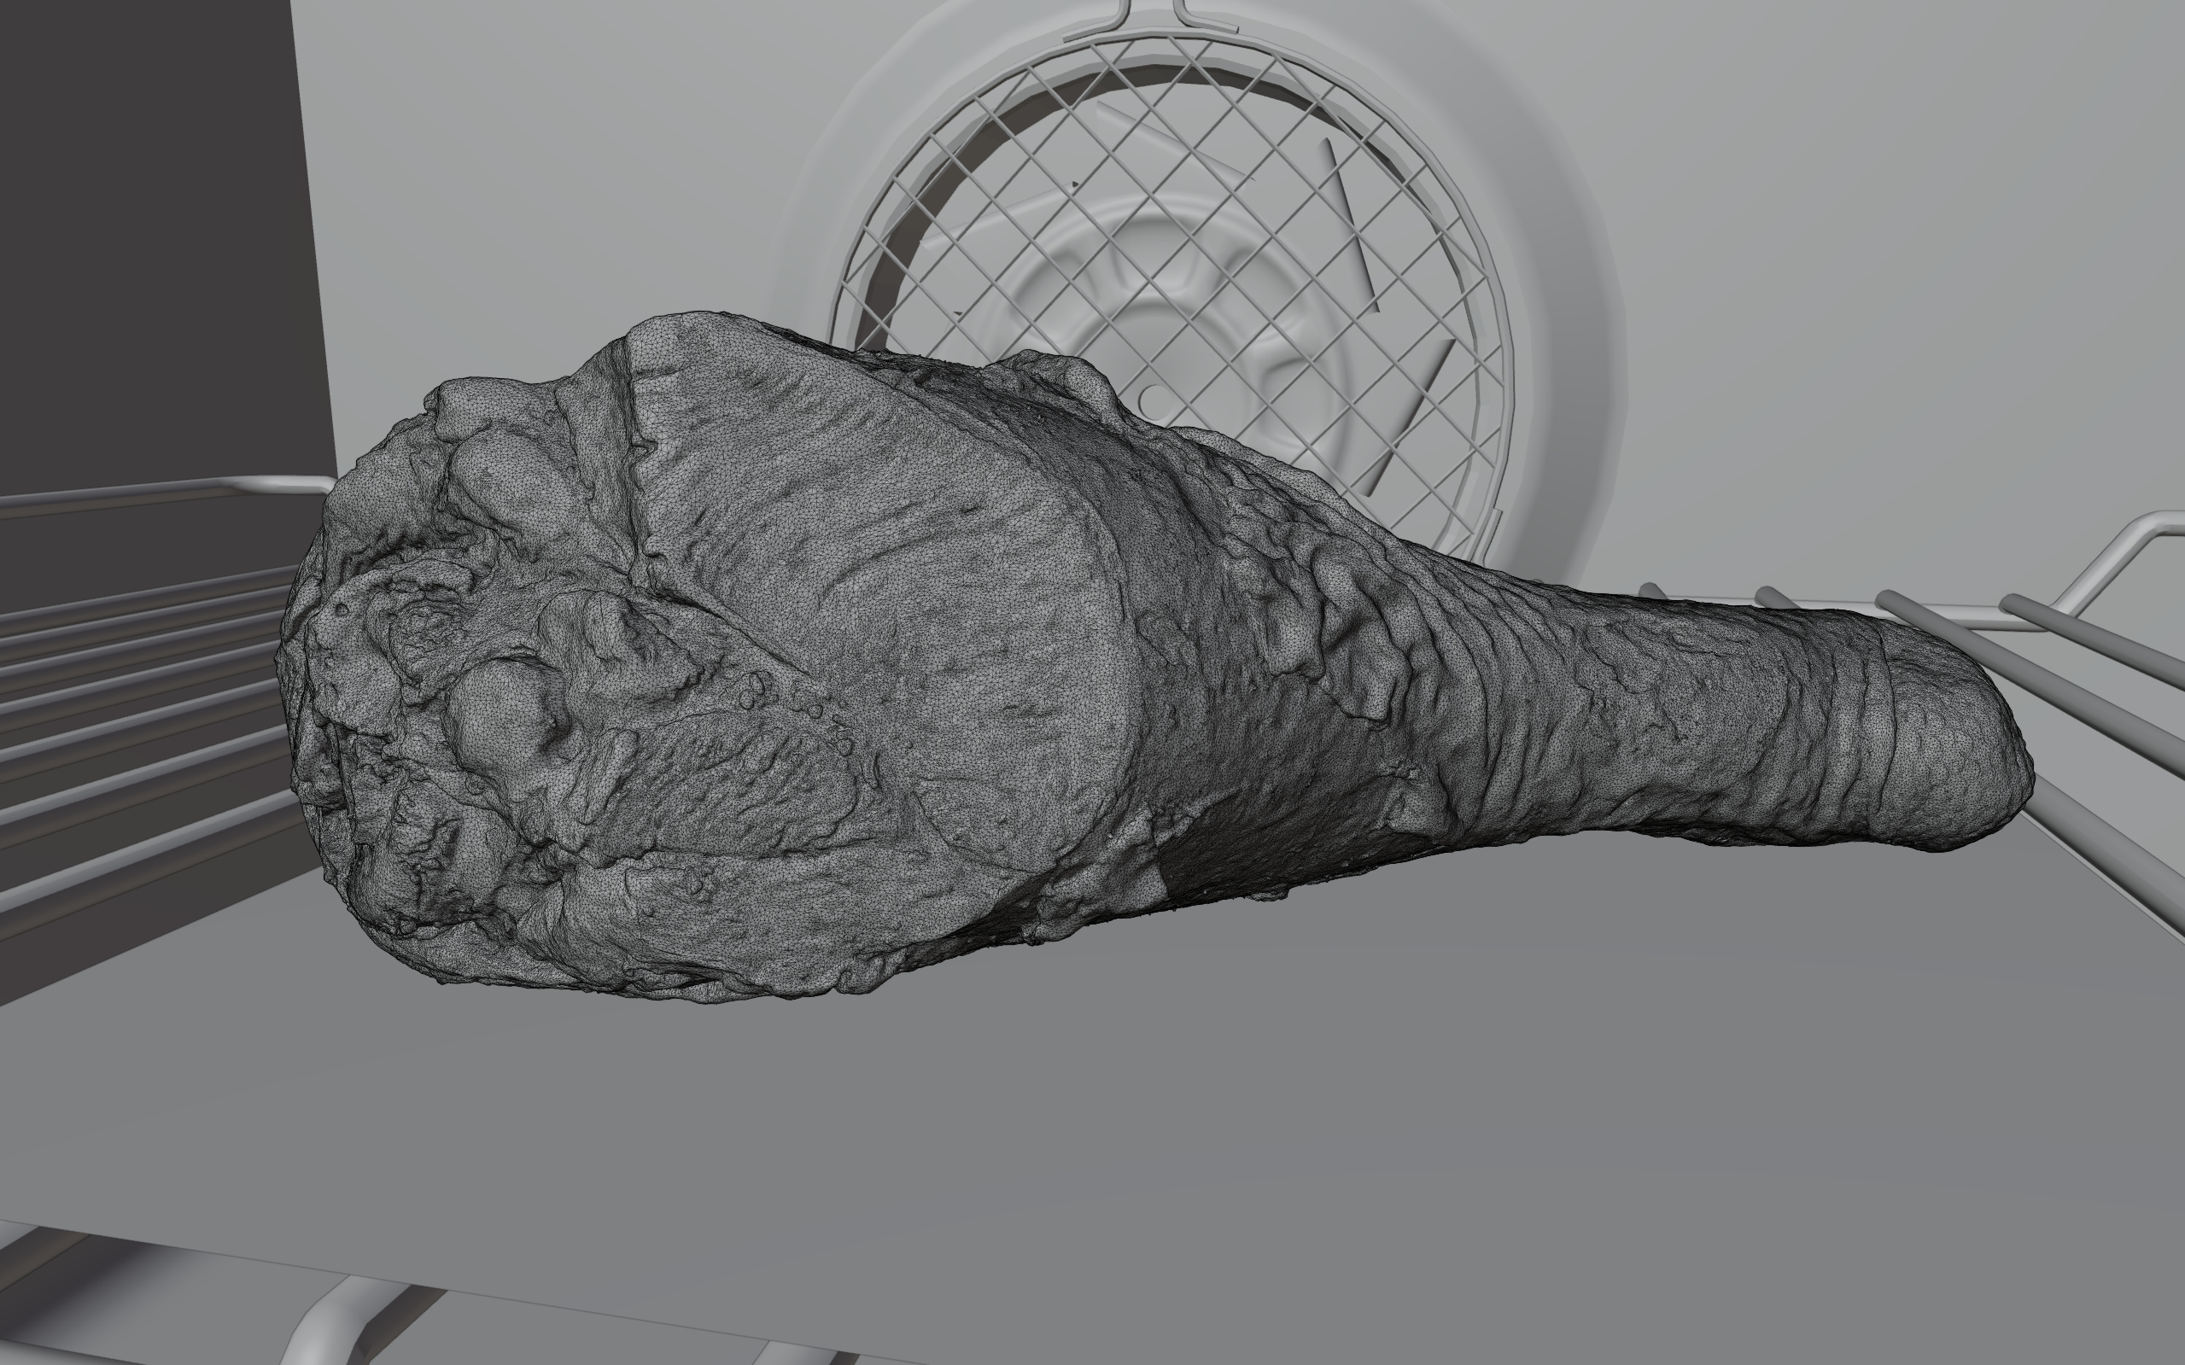
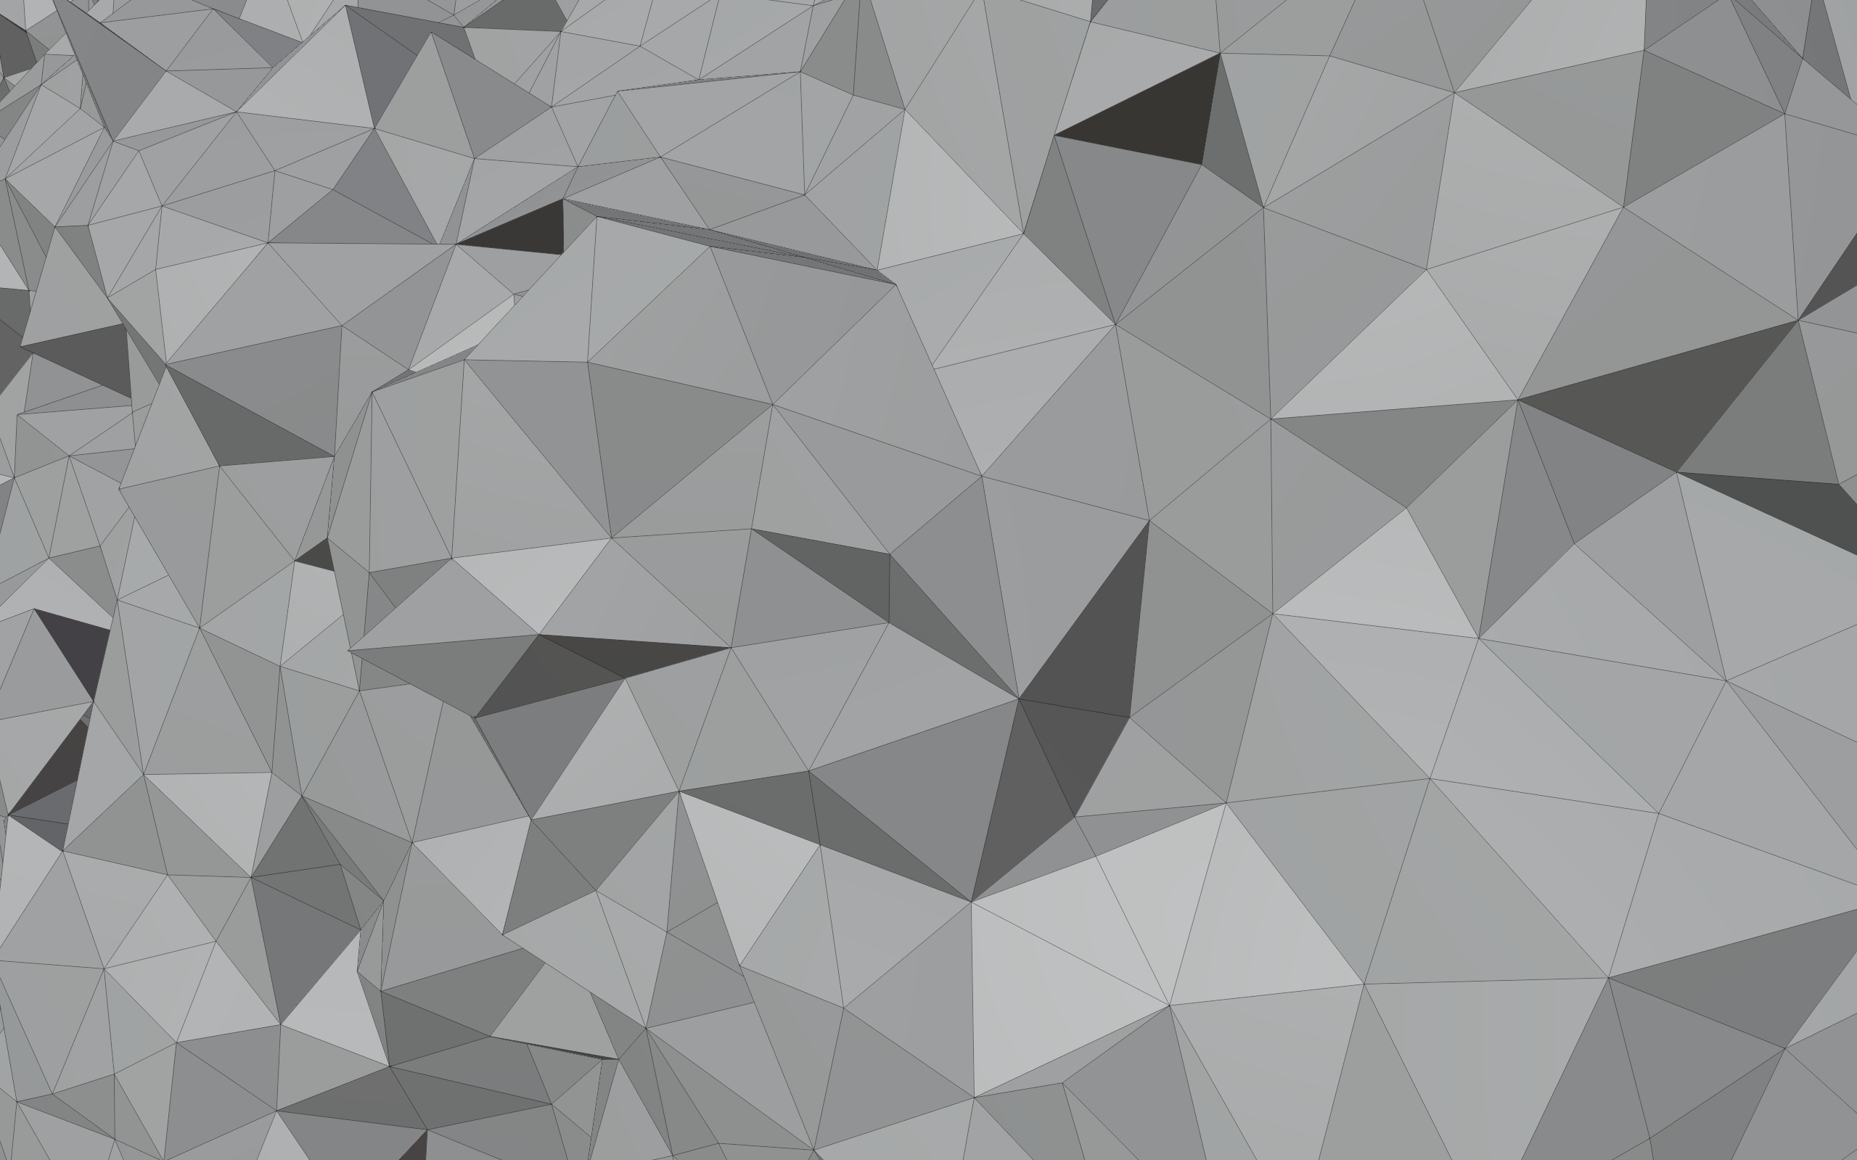

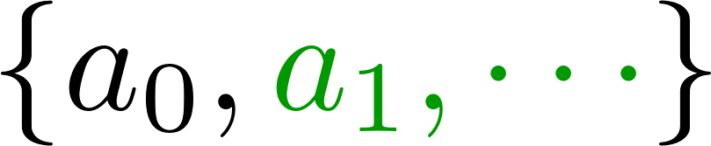
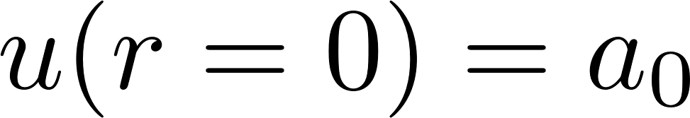
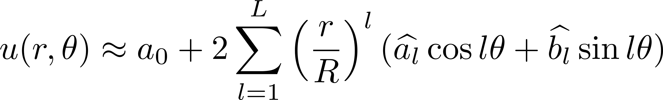
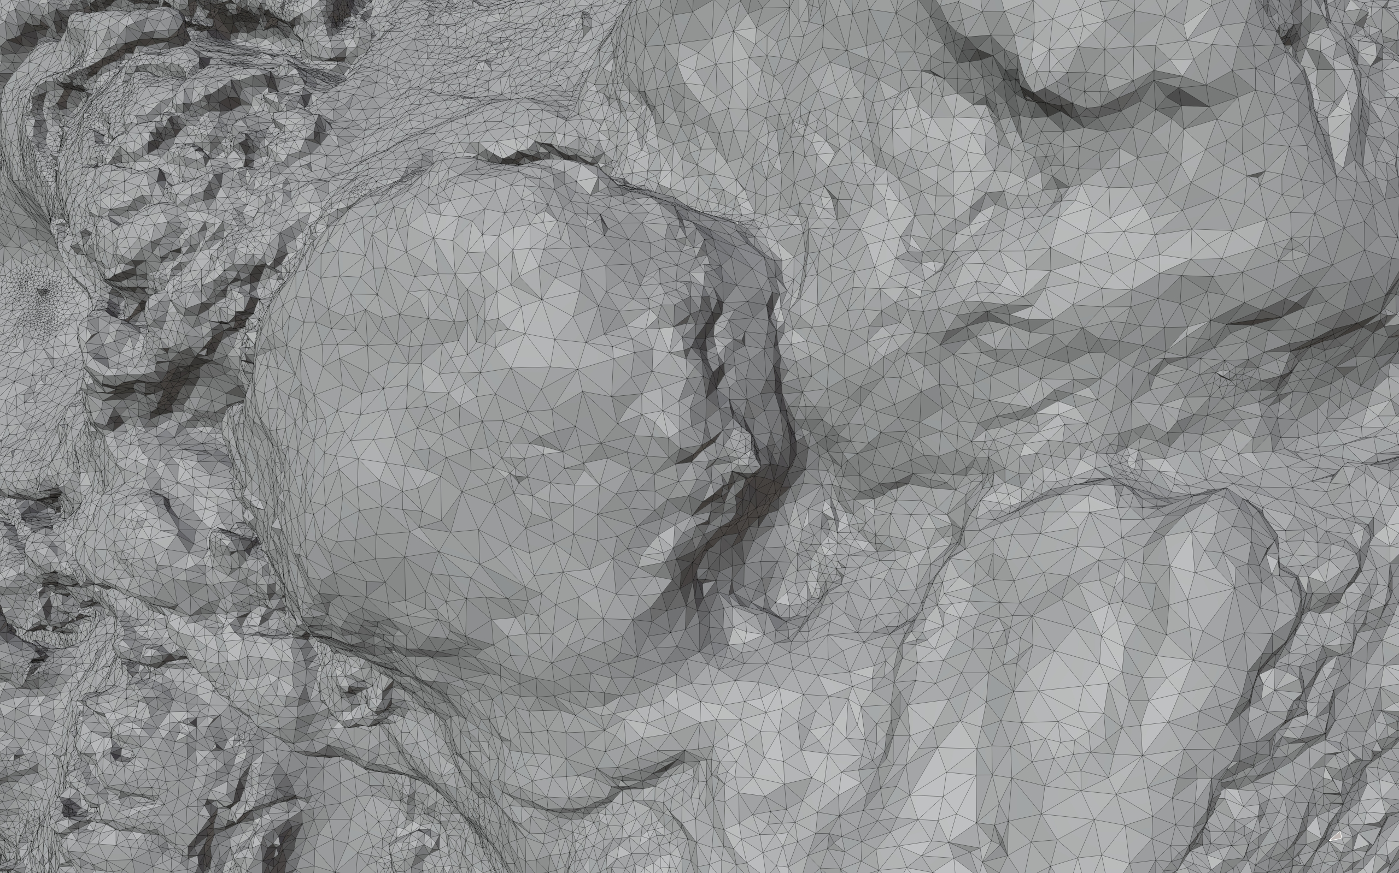

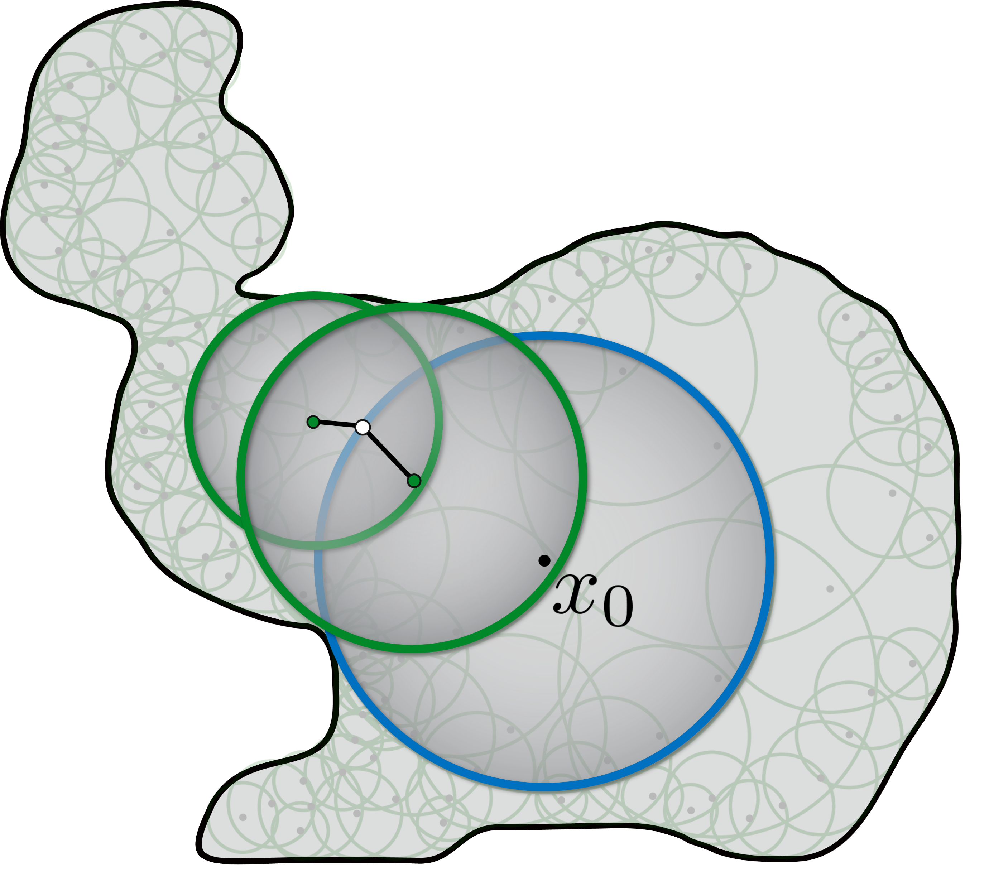
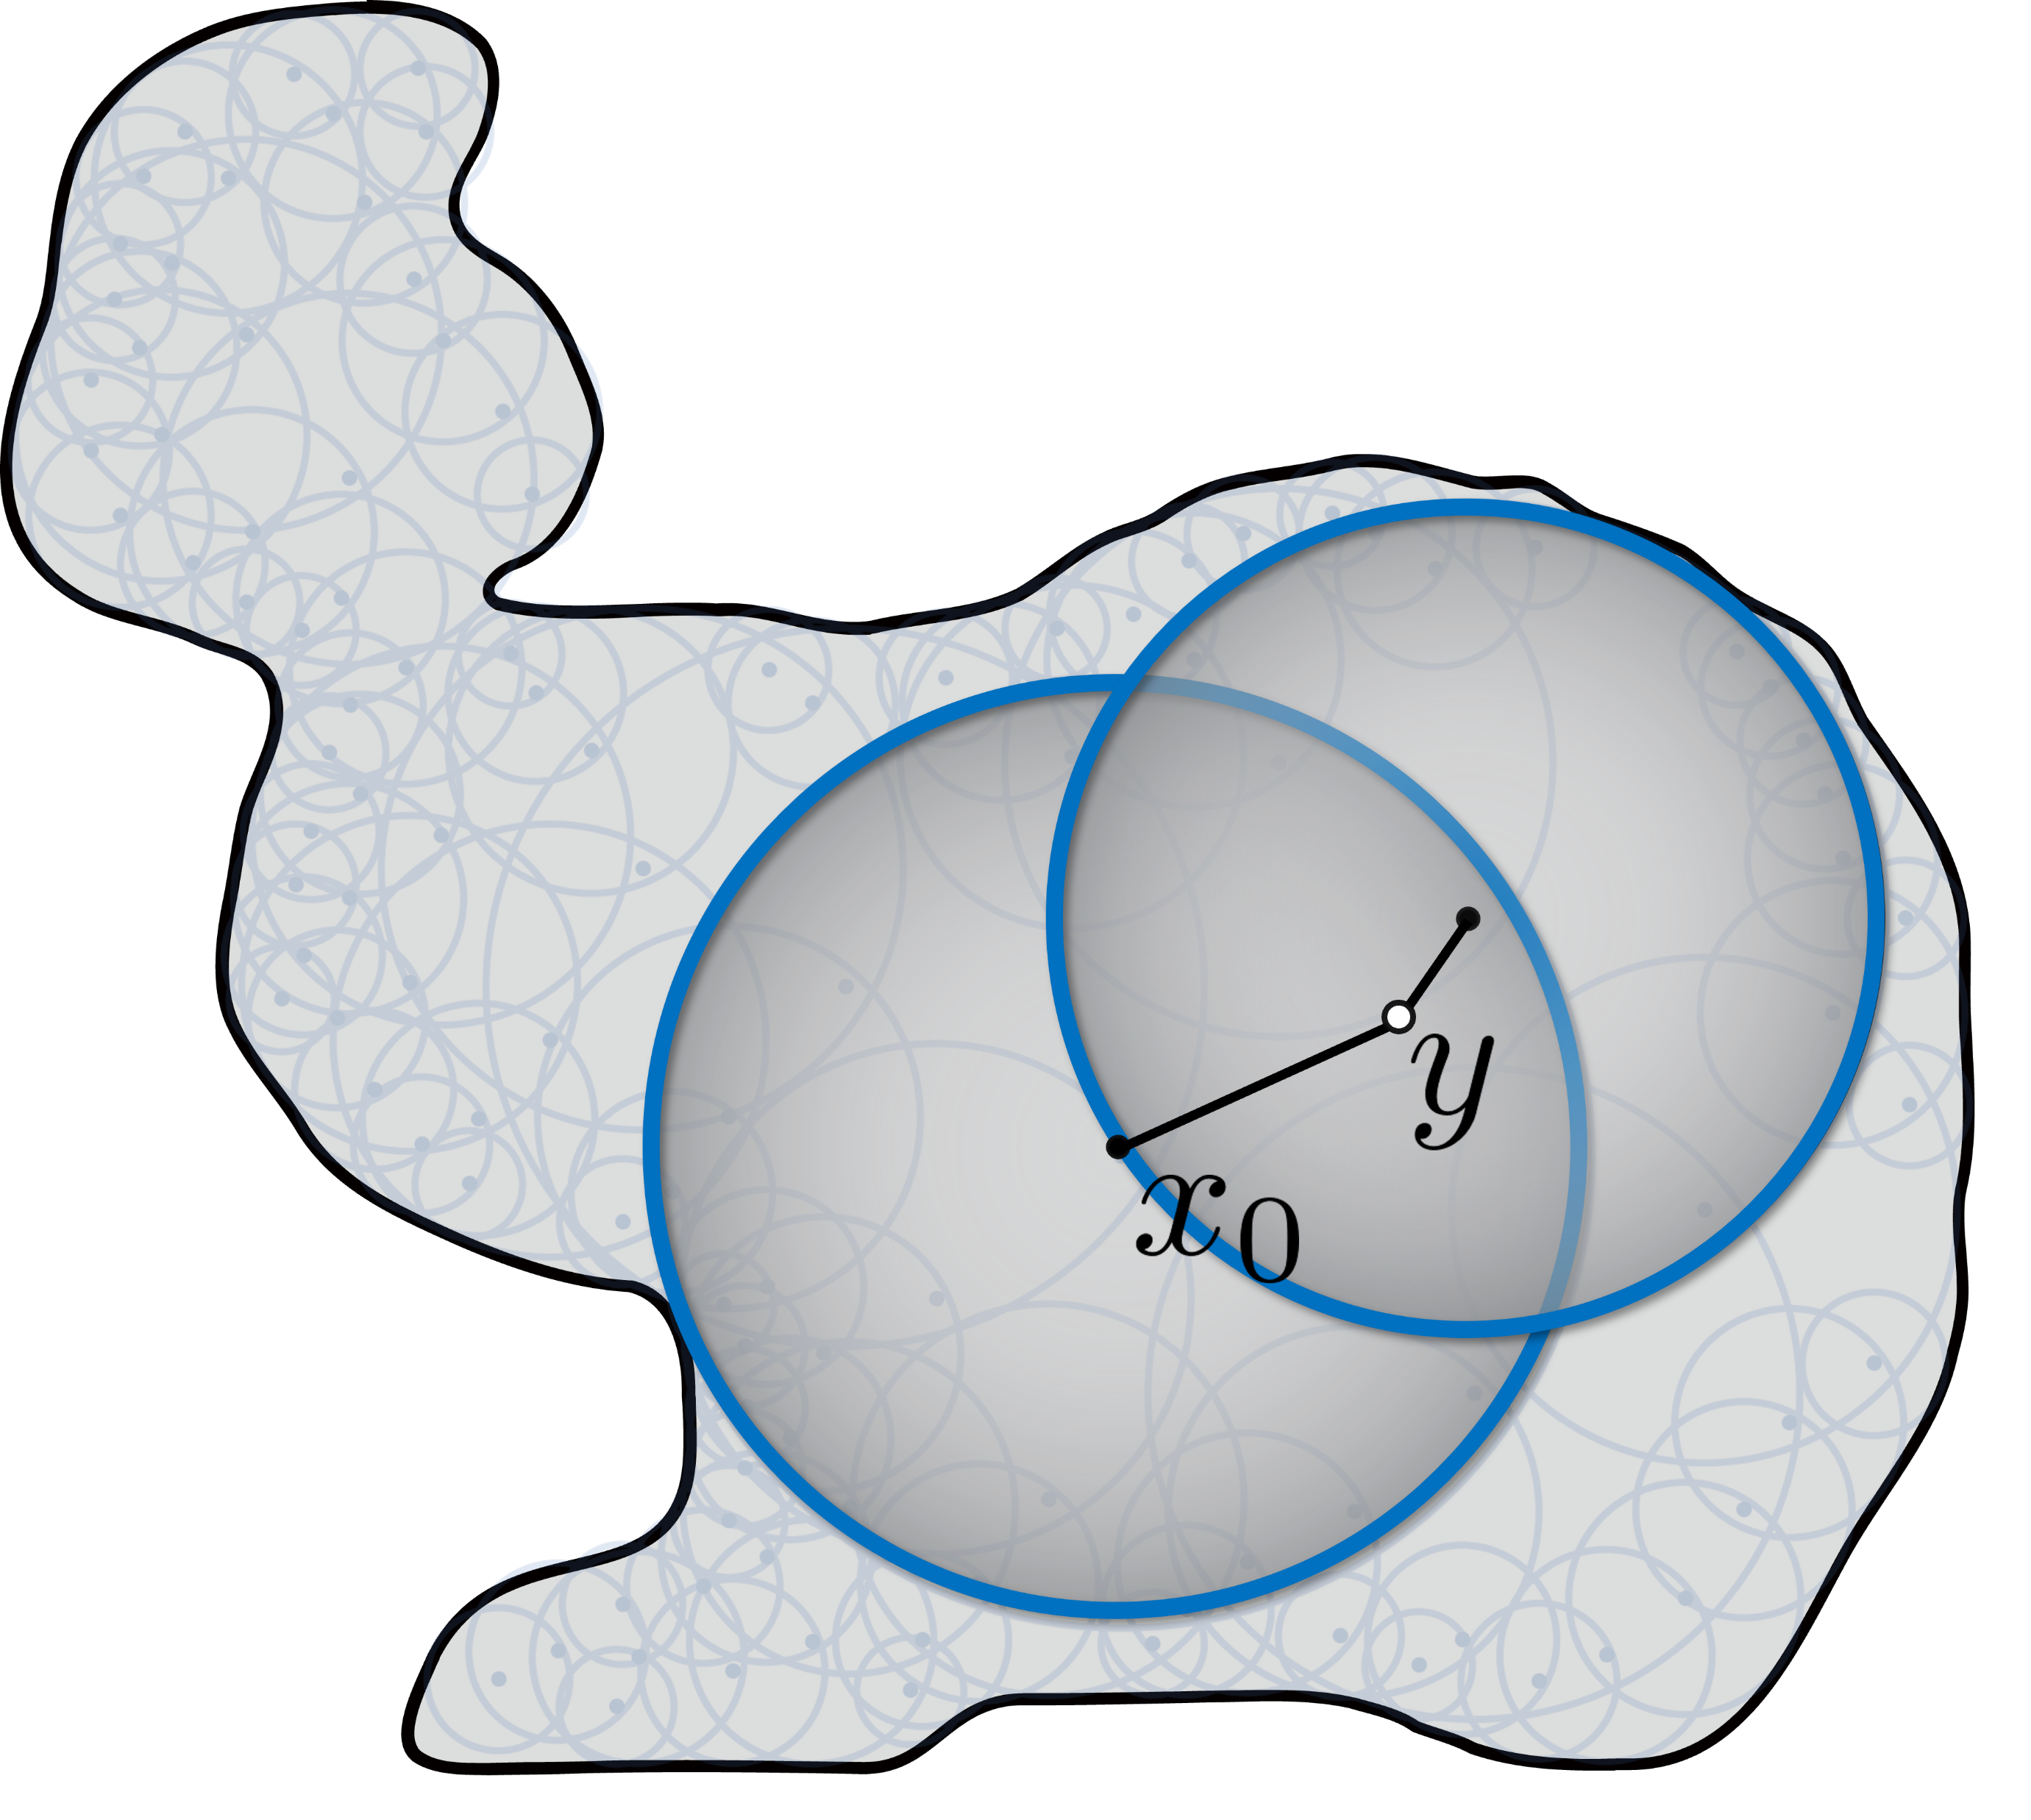
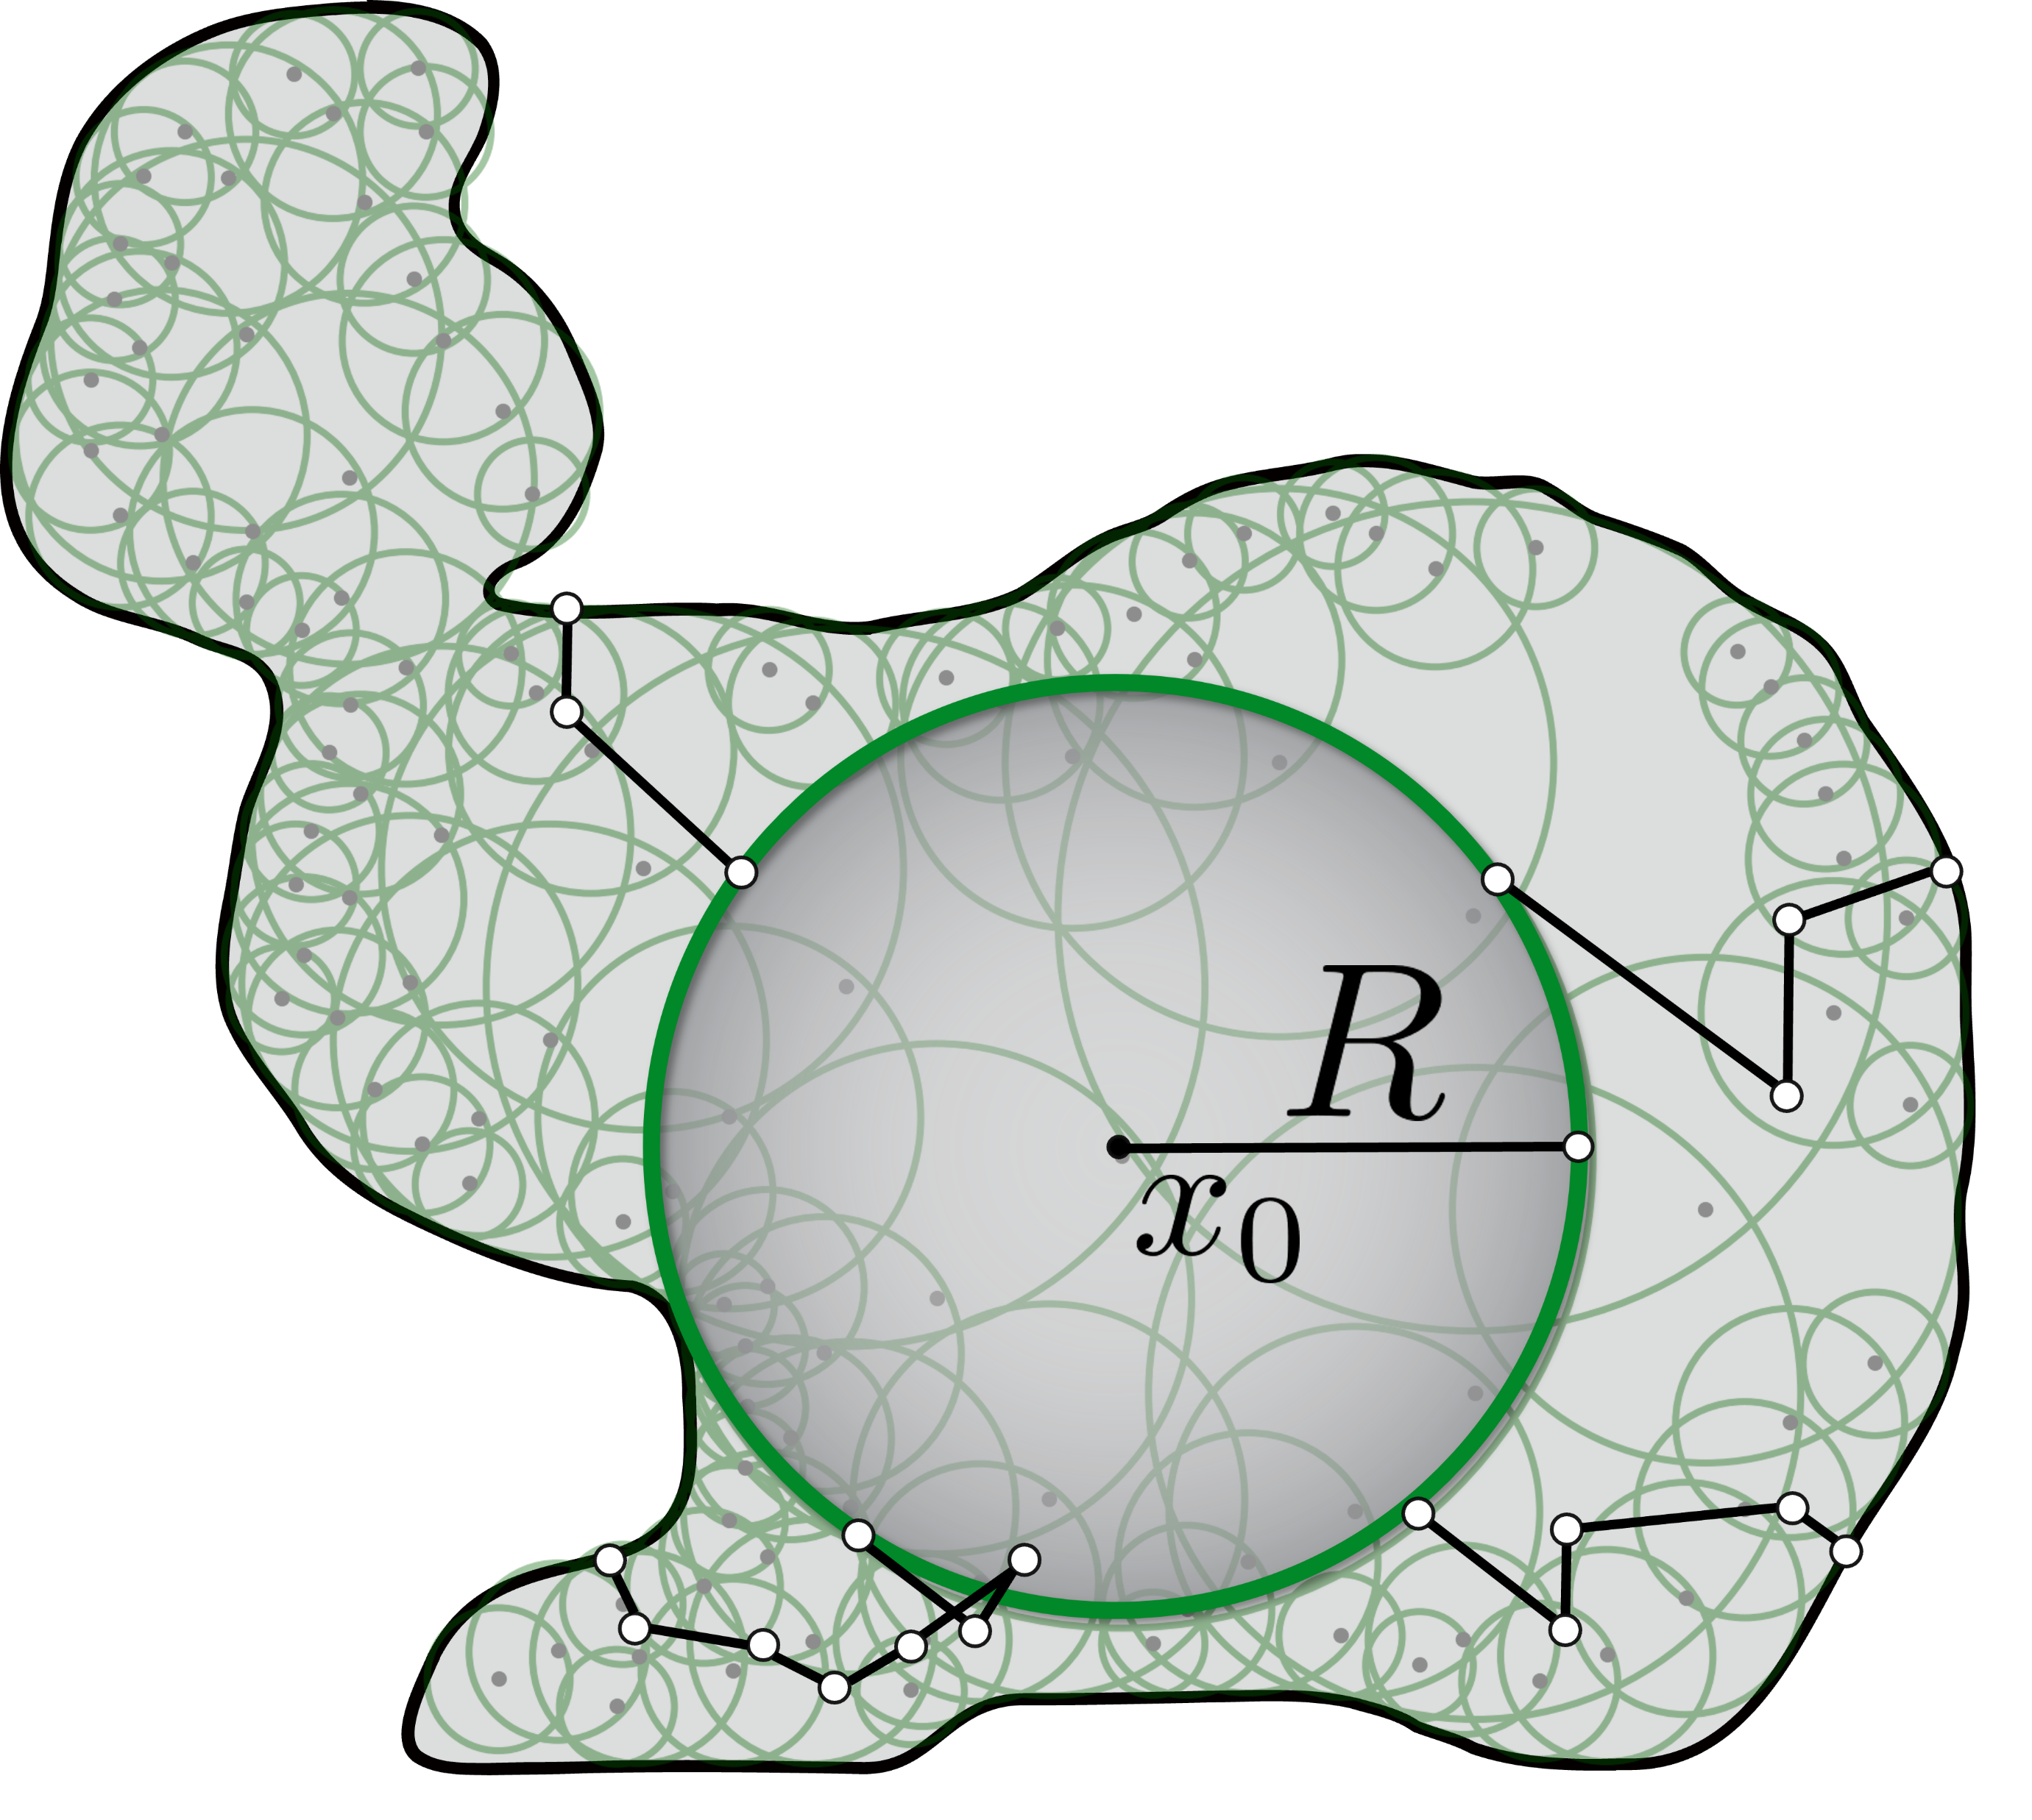


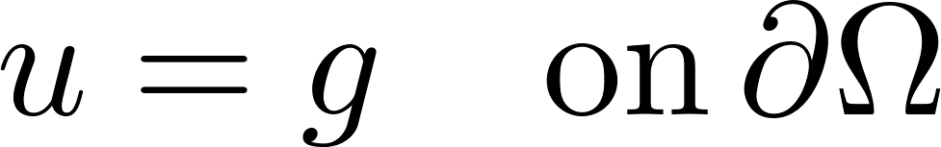
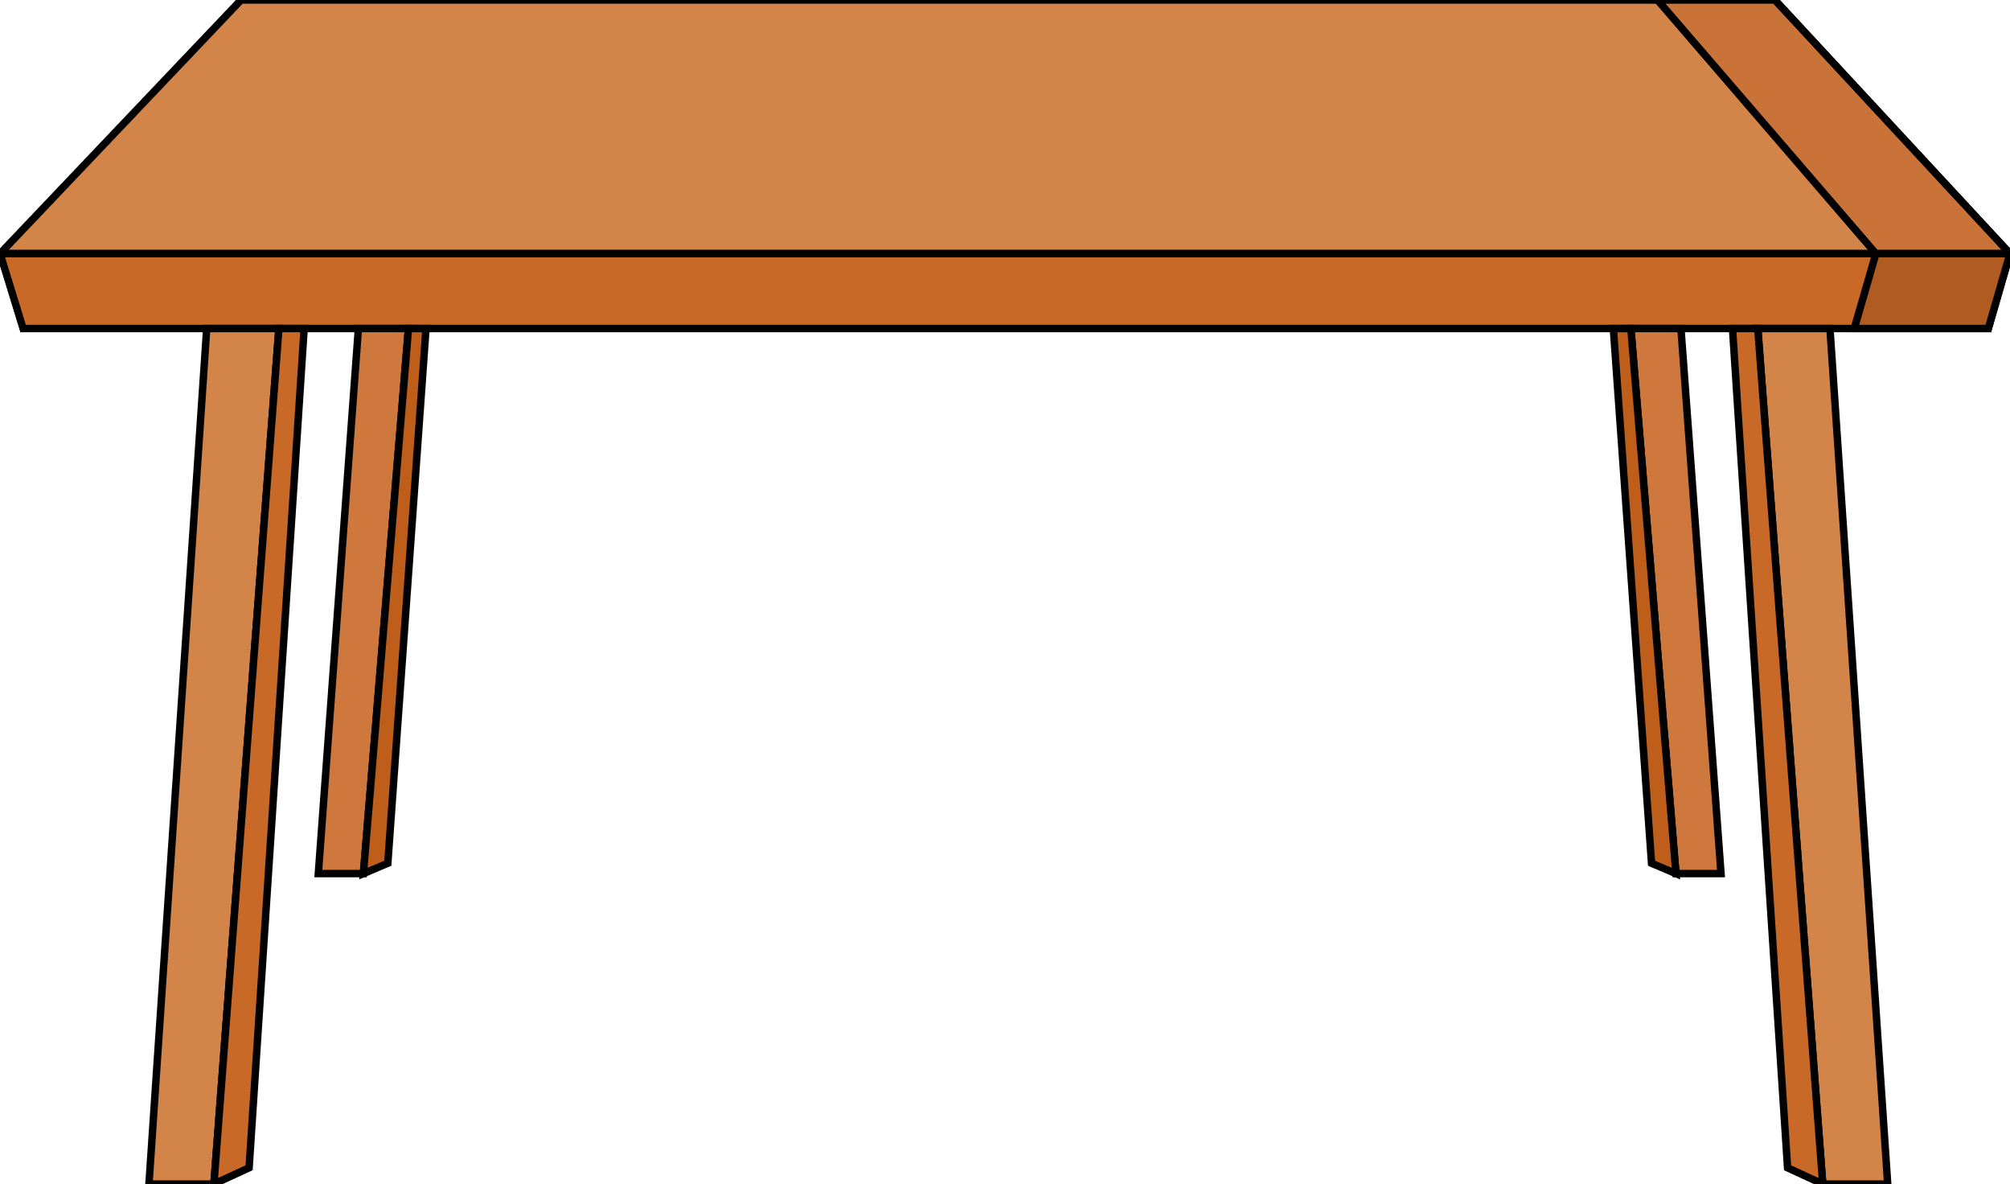
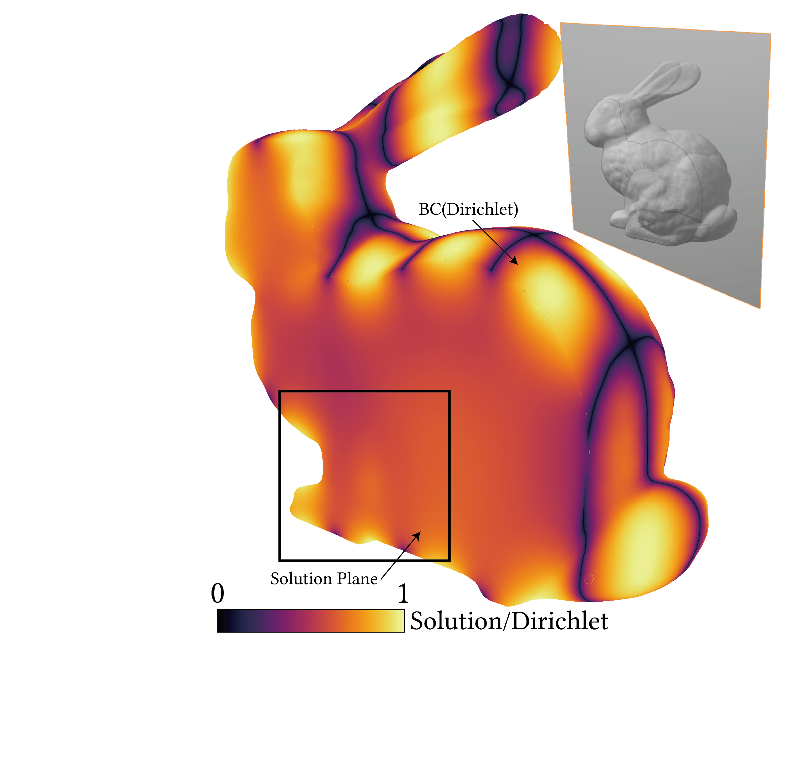
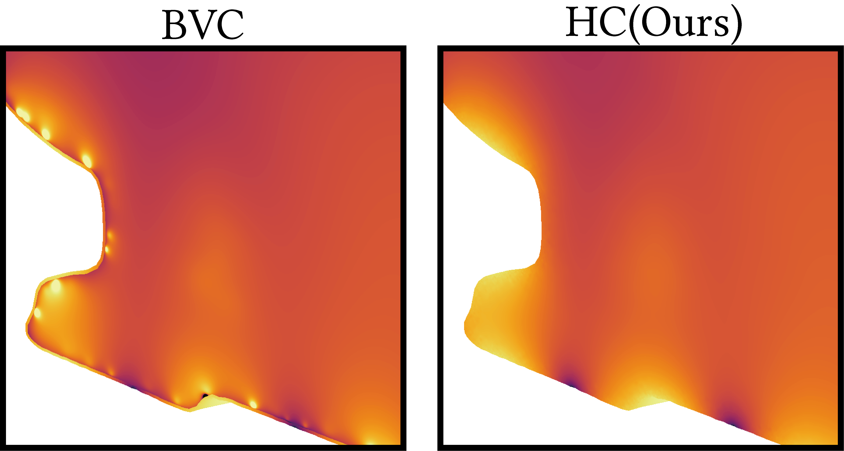
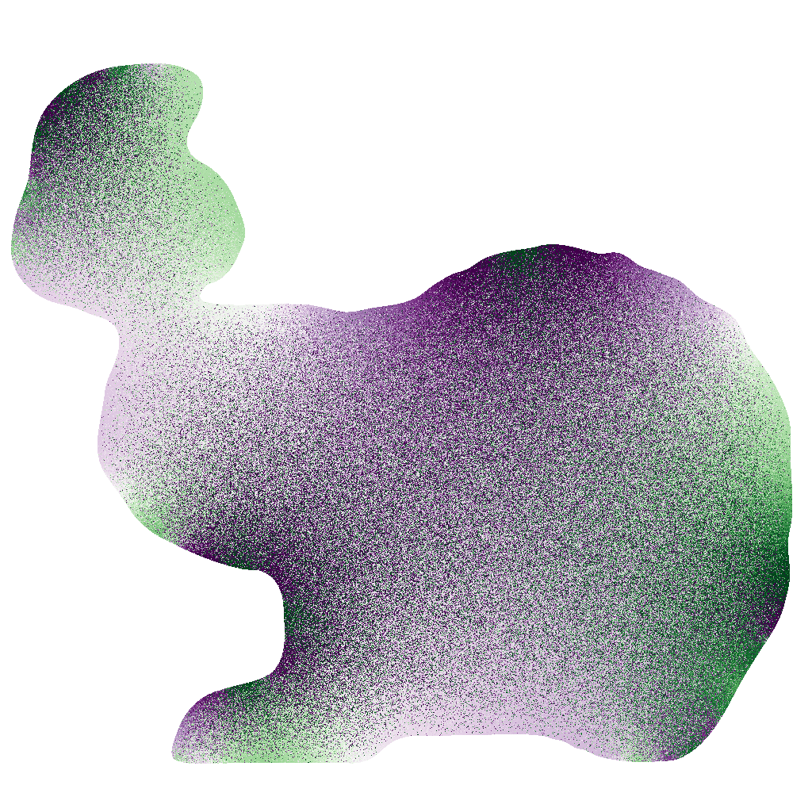
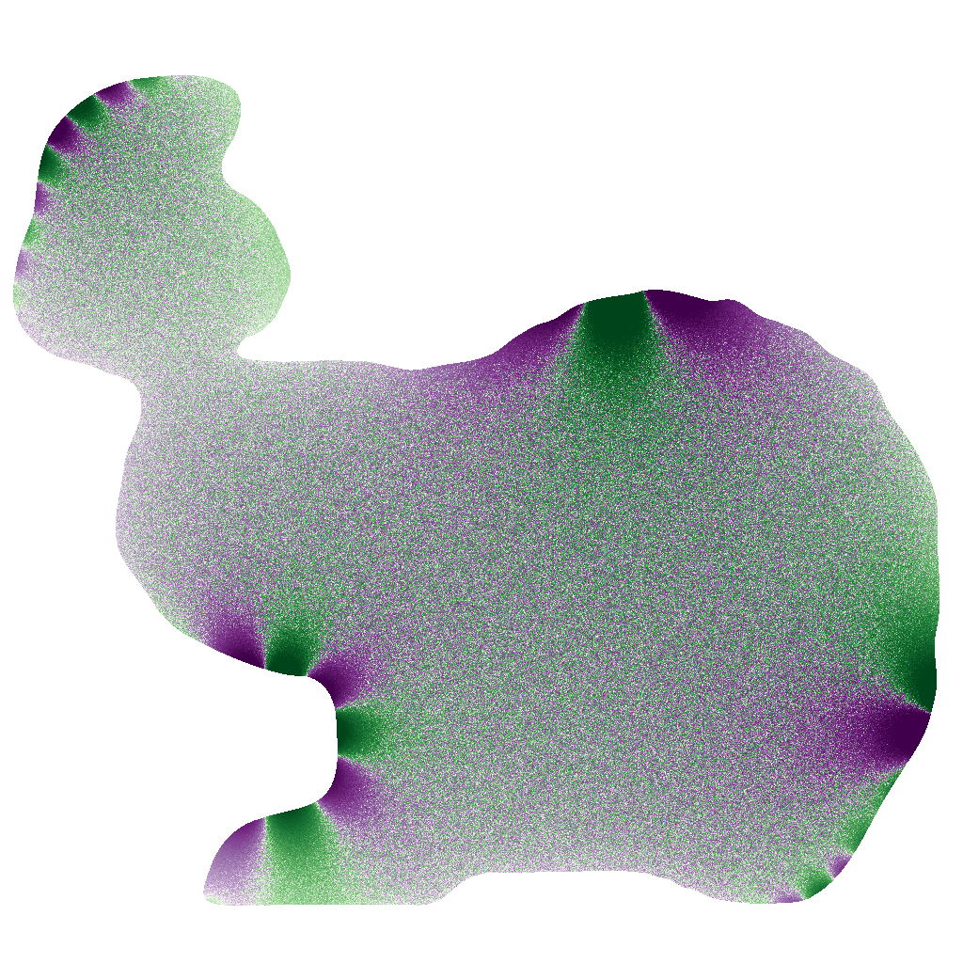
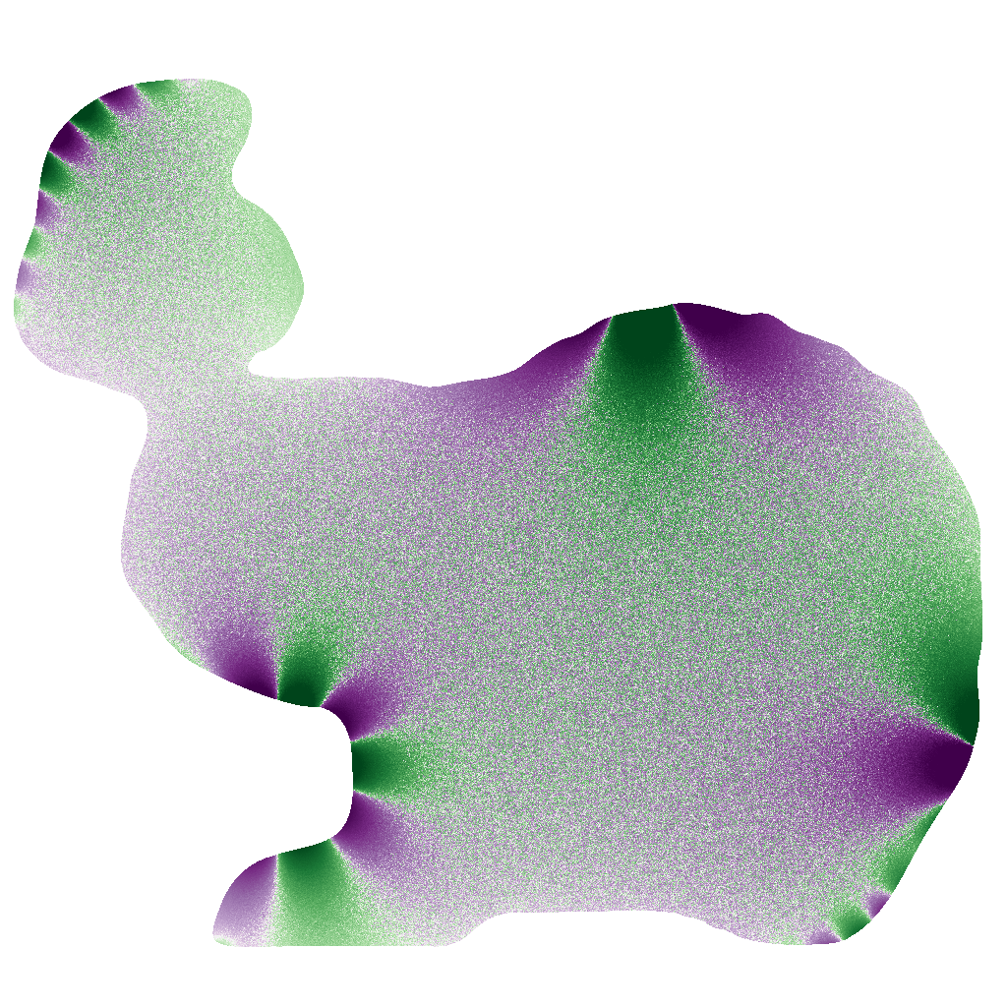
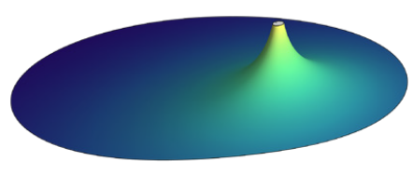
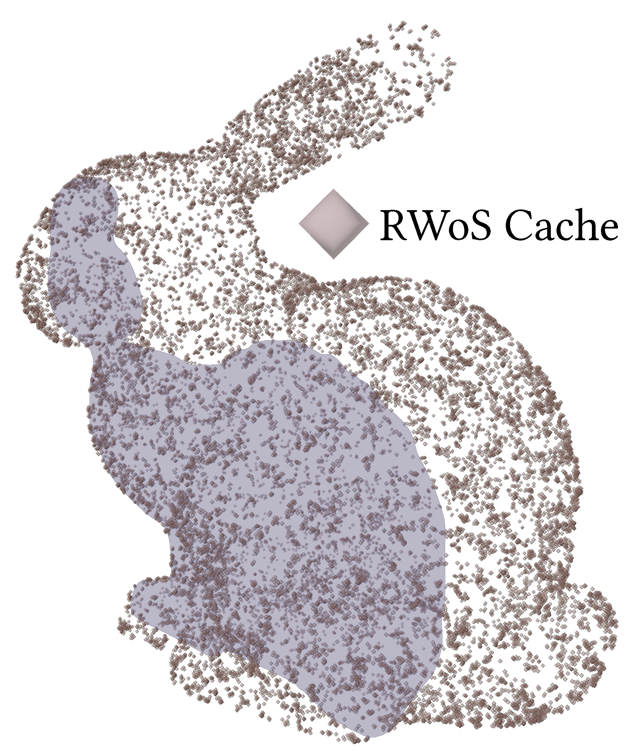
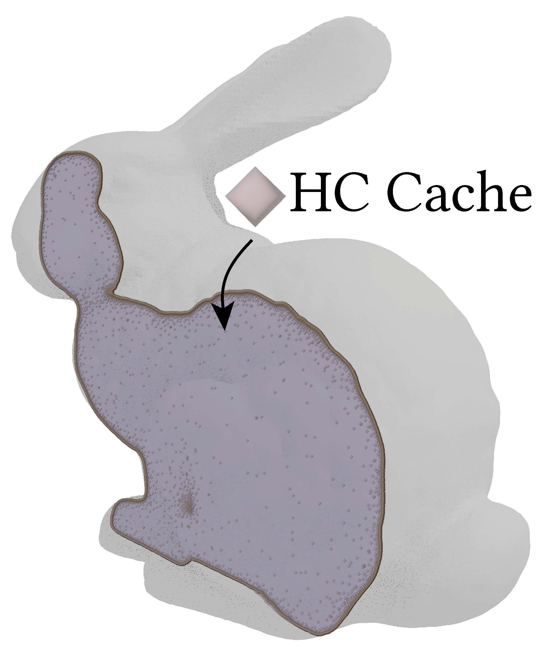
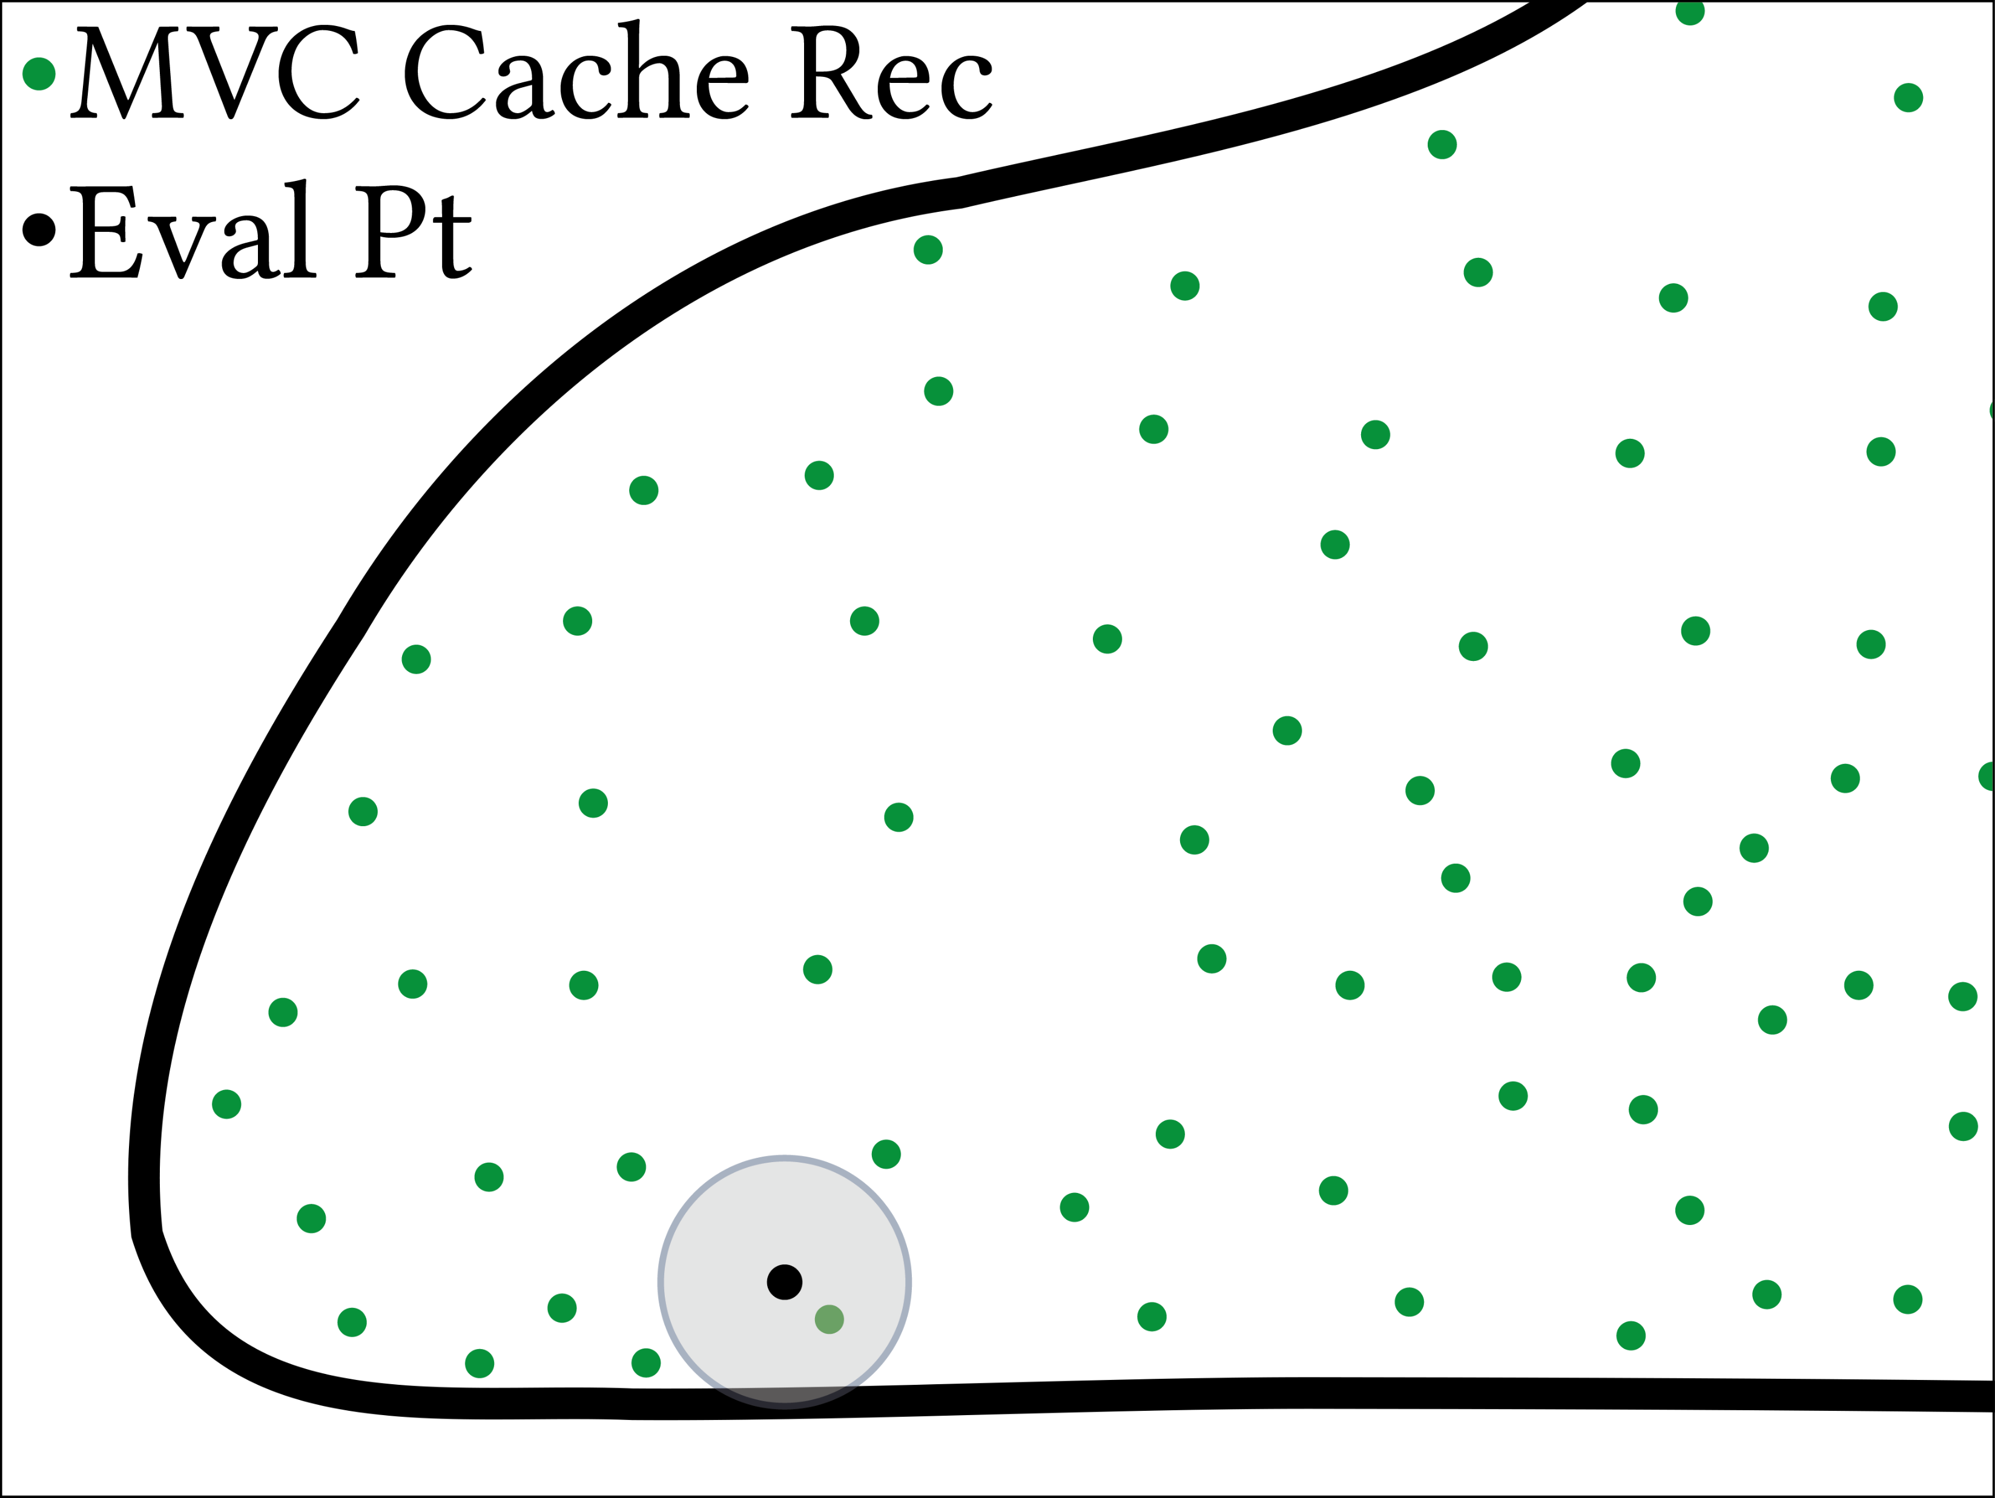
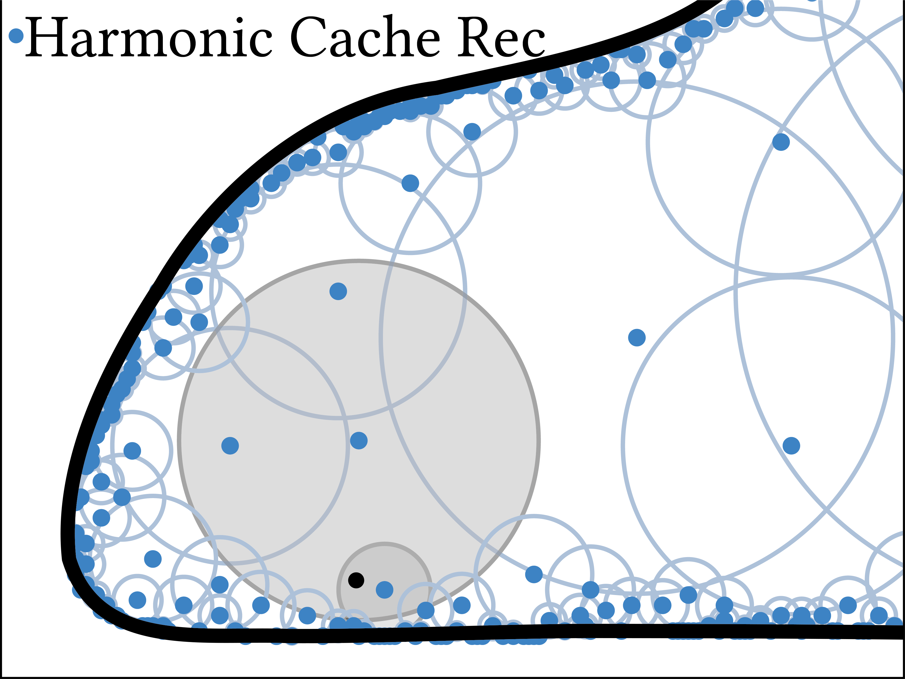

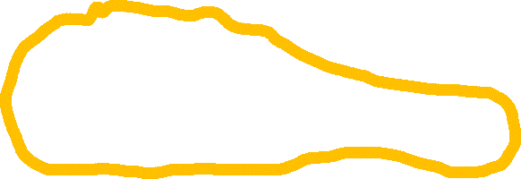
Harmonic Caching for Walk on Spheres
Zihong Zhou¹, Eugene d’Eon², Rohan Sawhney², Wojciech Jarosz¹
¹DARTMOUTH COLLEGE, ²NVIDIA
We present a variance reduction technique for Walk on Spheres (WoS) that solves
PDEs by combining overlapping harmonic expansions of the solution.
Robin BC
Heat Source
Radiation (Ray tracing)
Conduction (Walk on Stars)
Solution
Rendering
Simulation Setup
WoSt
Ours
FEM pipeline
Our key insights💡: Harmonic Series Expansion (HSE)
1. Input Boundary Meshing
2. Tetrahedralizing
3. Assemble Matrix & BC
4. Solve Linear System
Meshing can be challenging
Mean Value Property
Harmonic Series Expansion
Input boundary mesh
Tetrahedral mesh boundary
Run N walks using WoS
Average N walk estimation to get
zeroth order coefficients:
Reconstruct a (single) solution at the center:
Run N walks using WoS
(Weighted) Average N walk estimation to get zeroth and high order coefficients:
Reconstruct the solution anywhere inside the largest ball:
0.5h 1.3GB Memory
[Fast Tetrahedral Meshing in the Wild]
5.5h 46GB Memory
Harmonic Caching: form & combine overlapping expansions
Run WoS to estimate coefficients
per cache record.
Look up the cache from 1st pass &
Apply HSE to denoise
and update coefficients
Look up the refined cache &
Apply HSE to reconstruct
solution at evaluation pt
✔ Center
✔ Radius
✔ Coeffs
✔ Center
✔ Radius
✔ Coeffs
Cache
Grid-Free PDE solver avoids meshing
Cache
Record
Refined
Record
Refined
Record
Walk
Cache
Lookup
Cache
Lookup
1. Cache Population Pass
2. Refinement Pass
3. Reconstruction Pass
Path tracing
Walk on Spheres
Comparison with state-of-the-art caching algorithms
Problem: WoS produces noisy estimations
 | Output Sensitivity | Singularity Free | Progressive Evaluation
WoS | ✔ | ✔ | ✔
BVC¹ | ✔ | ✘ | ✔
RWoS² | ✘ | ✔ | ✔
MVC³ | ✔ | ✔ | ✔
Ours | ✔ | ✔ | ✔
Singularity
✔ Singularity Free
1 Walk/Eval Pt
2s
512 Walk/Eval Pt
180s
1024 Walk/Eval Pt
360s
RWoS Cache Record
HC Cache Record
References
[1] Bailey Miller, Rohan Sawhney, Keenan Crane, and Ioannis Gkioulekas. 2023. Boundary Value Caching for Walk on Spheres.
[2] Qi, Y., Seyb, D., Bitterli, B. and Jarosz, W. 2022. A bidirectional formulation for Walk on Spheres.
[3] Bakbouk, Ghada, and Pieter Peers. 2023. Mean Value Caching for Walk on Spheres.
✘Output Sensitive
✔Output Sensitive
MVC expands the largest ball around the evaluation point: fewer records available.
HC gathers records from overlapping balls: more are available even near the boundary!

