Slide 1
Harmonic Caching for
Walk on Spheres
Zihong Zhou
Dartmouth College
Eugene d’Eon
NVIDIA
Rohan Sawhney
NVIDIA
Wojciech Jarosz
Dartmouth College
Notes:
Thanks for the introduction—let’s dive in.

Slide 2
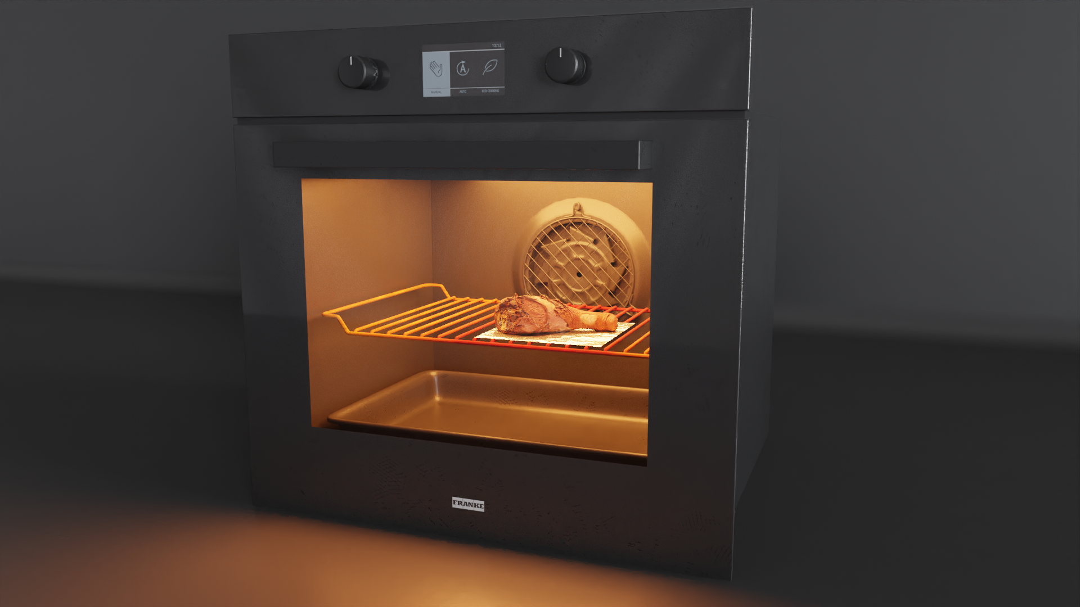
Rendering
Notes:
Here is a nice rendering of a turkey leg placed in an oven, with a warm lighting.
This light transport simulation gives us a realistic sense of its appearance. But we might also wonder,[c] what if we actually

Slide 3
Rendering
Notes:
Try to turn on the oven and grill the food?

Slide 4
Heat Simulation?
Notes:
Can we run a heat simulation and understand how heat distributes throughout our food at steady state?

Slide 5
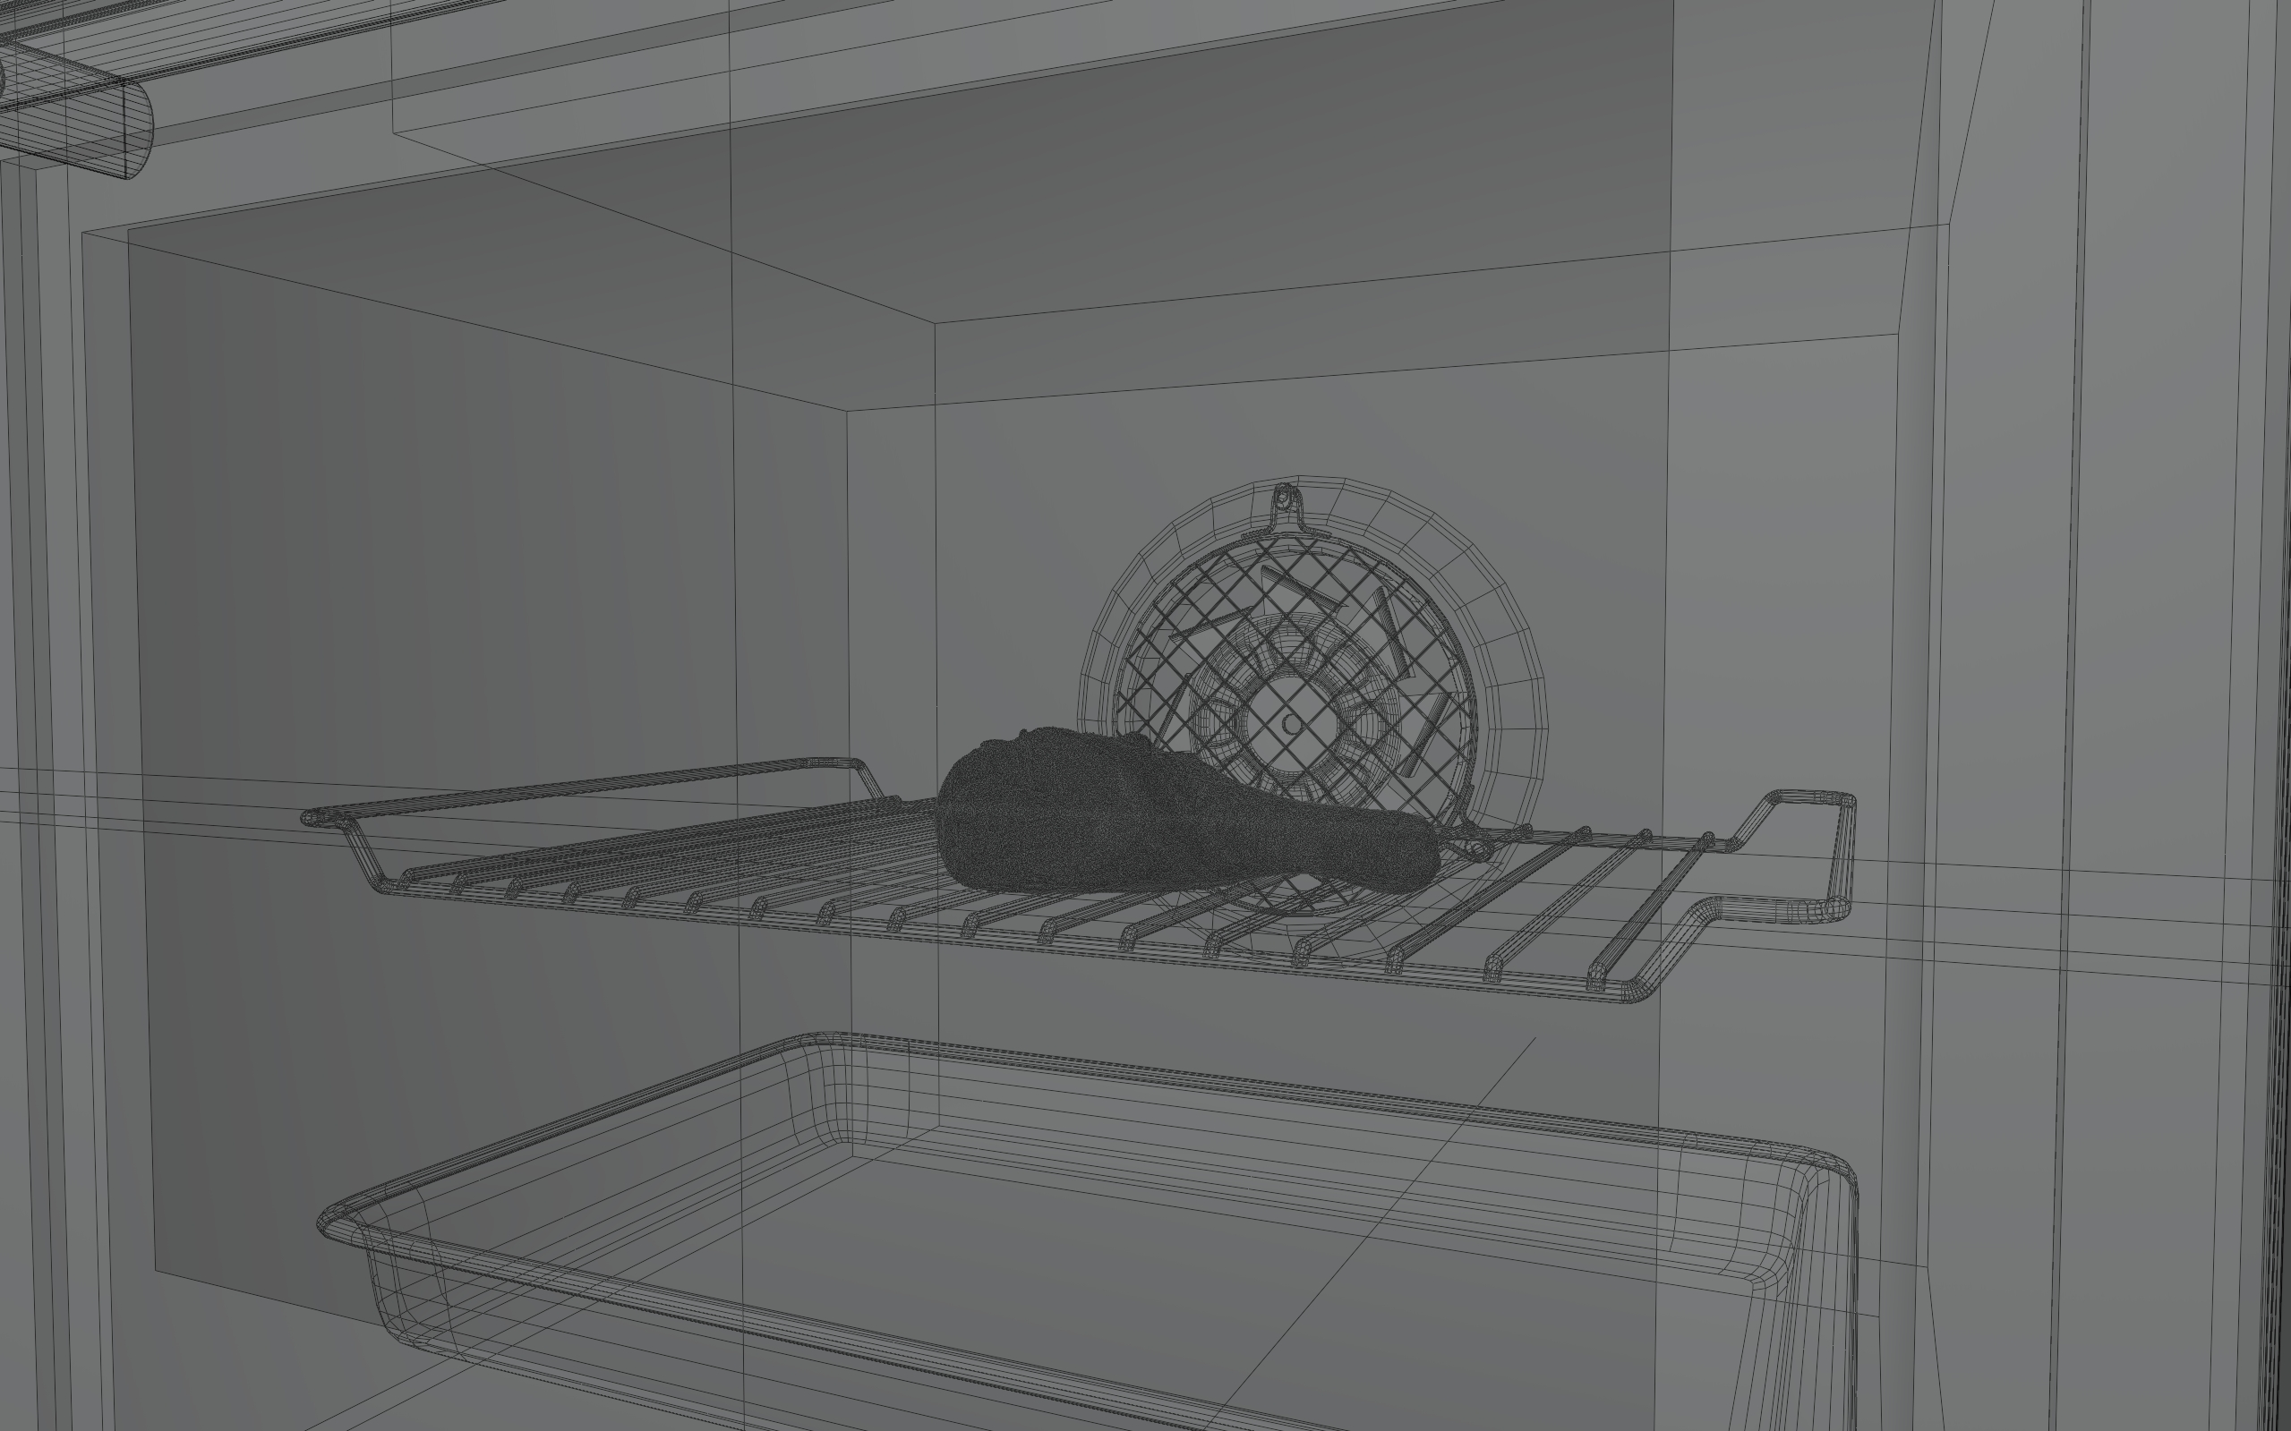

Setup
Notes:
This is our scene setup for running the thermal analysis.
Our heat source [c] comes from the grilling rack and the top area light.

Slide 6
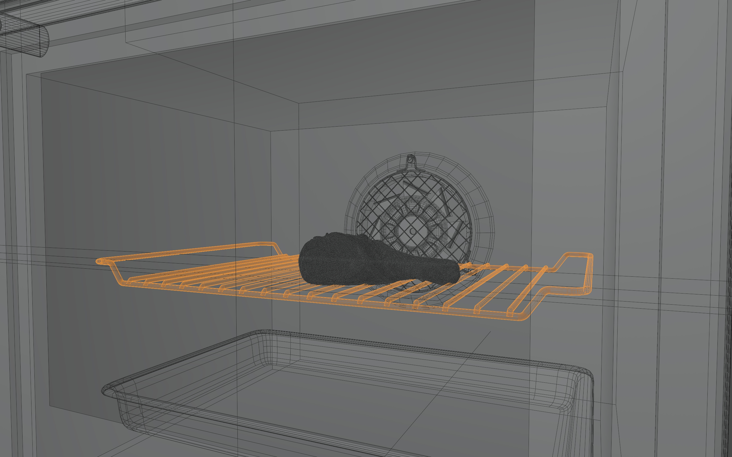
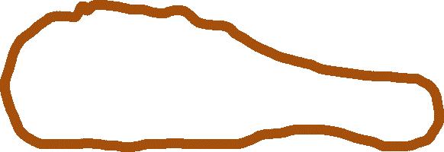
Radiation (Ray tracing)
Heat Source
Setup
Notes:
We can use ray tracing [c] to compute the radiative heat flux arriving at the leg surface as a boundary condition.

Slide 7


Radiation (Ray tracing)
Heat Source
Conduction
Conduction (Solver Needed)
Setup
Notes:
The heat then flows through the leg by conduction, [c] which is described by the Laplace equation and motivates us to find a solver.

Slide 8
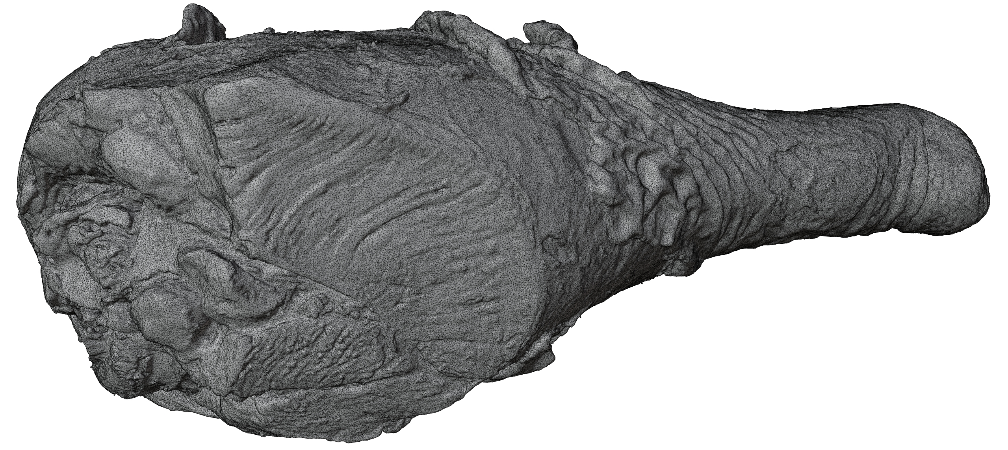
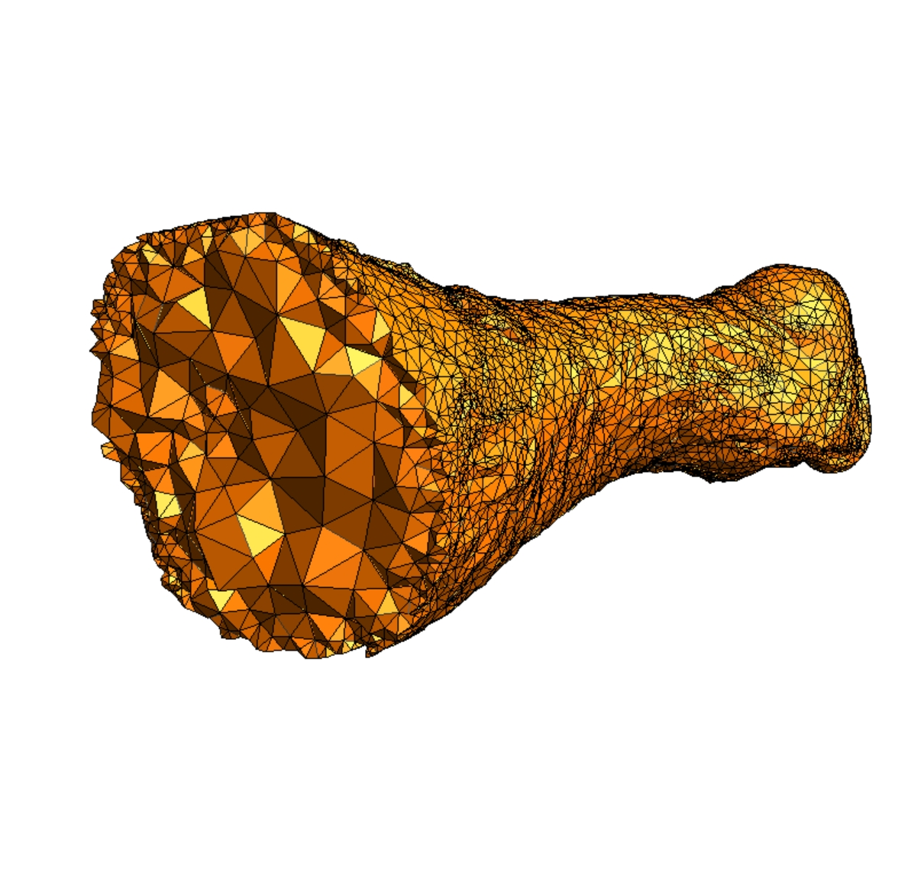
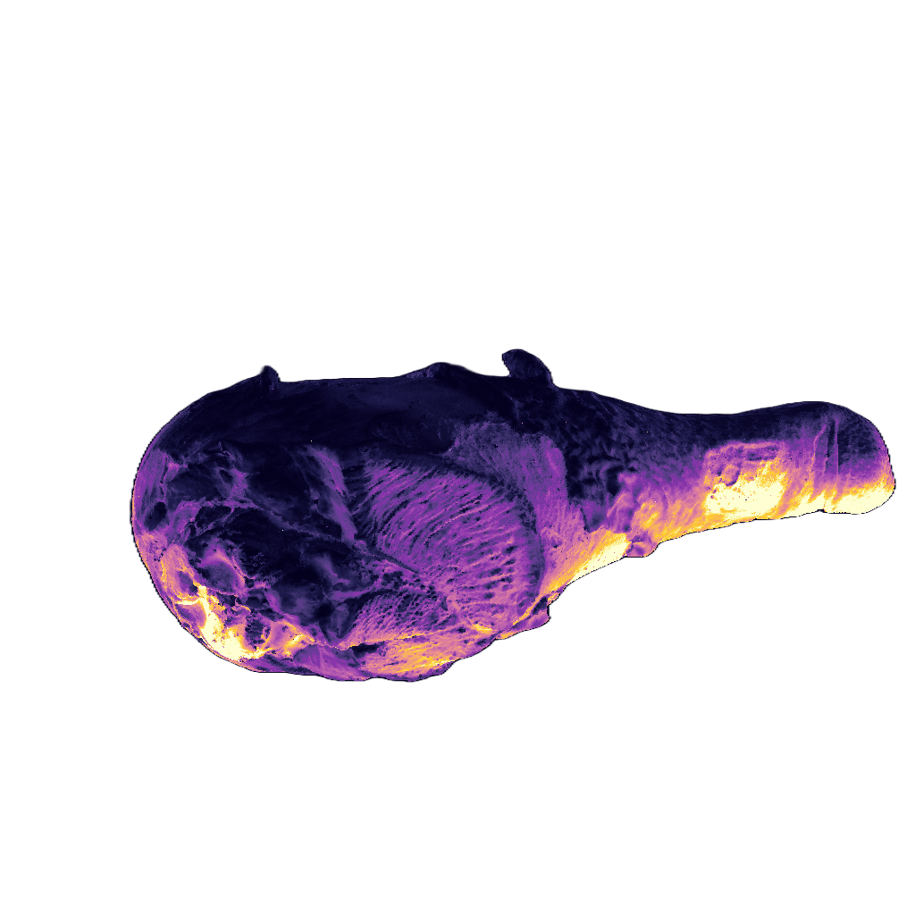
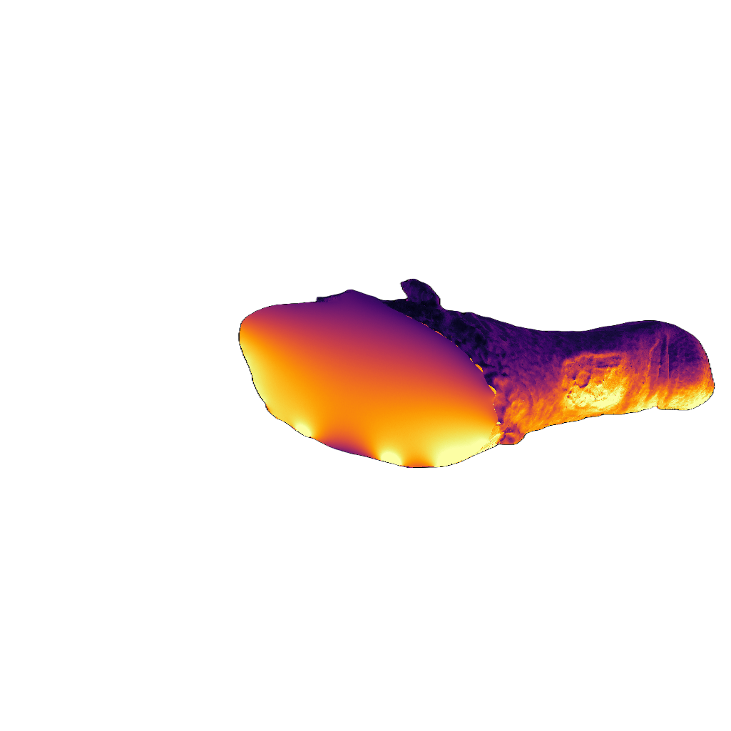
Grid-based solvers require meshing
1. Modeling boundary mesh
2. Meshing volumetric domain
3. Assembling boundary conditions
4. FEM solving
FEM Pipeline
Notes:
Traditional grid-based solvers, such as the Finite Element Method, are widely used. However, beyond [c] defining the domain boundaries and applying boundary conditions, these methods require [c] generating a volumetric mesh before solving the equation.

Slide 9
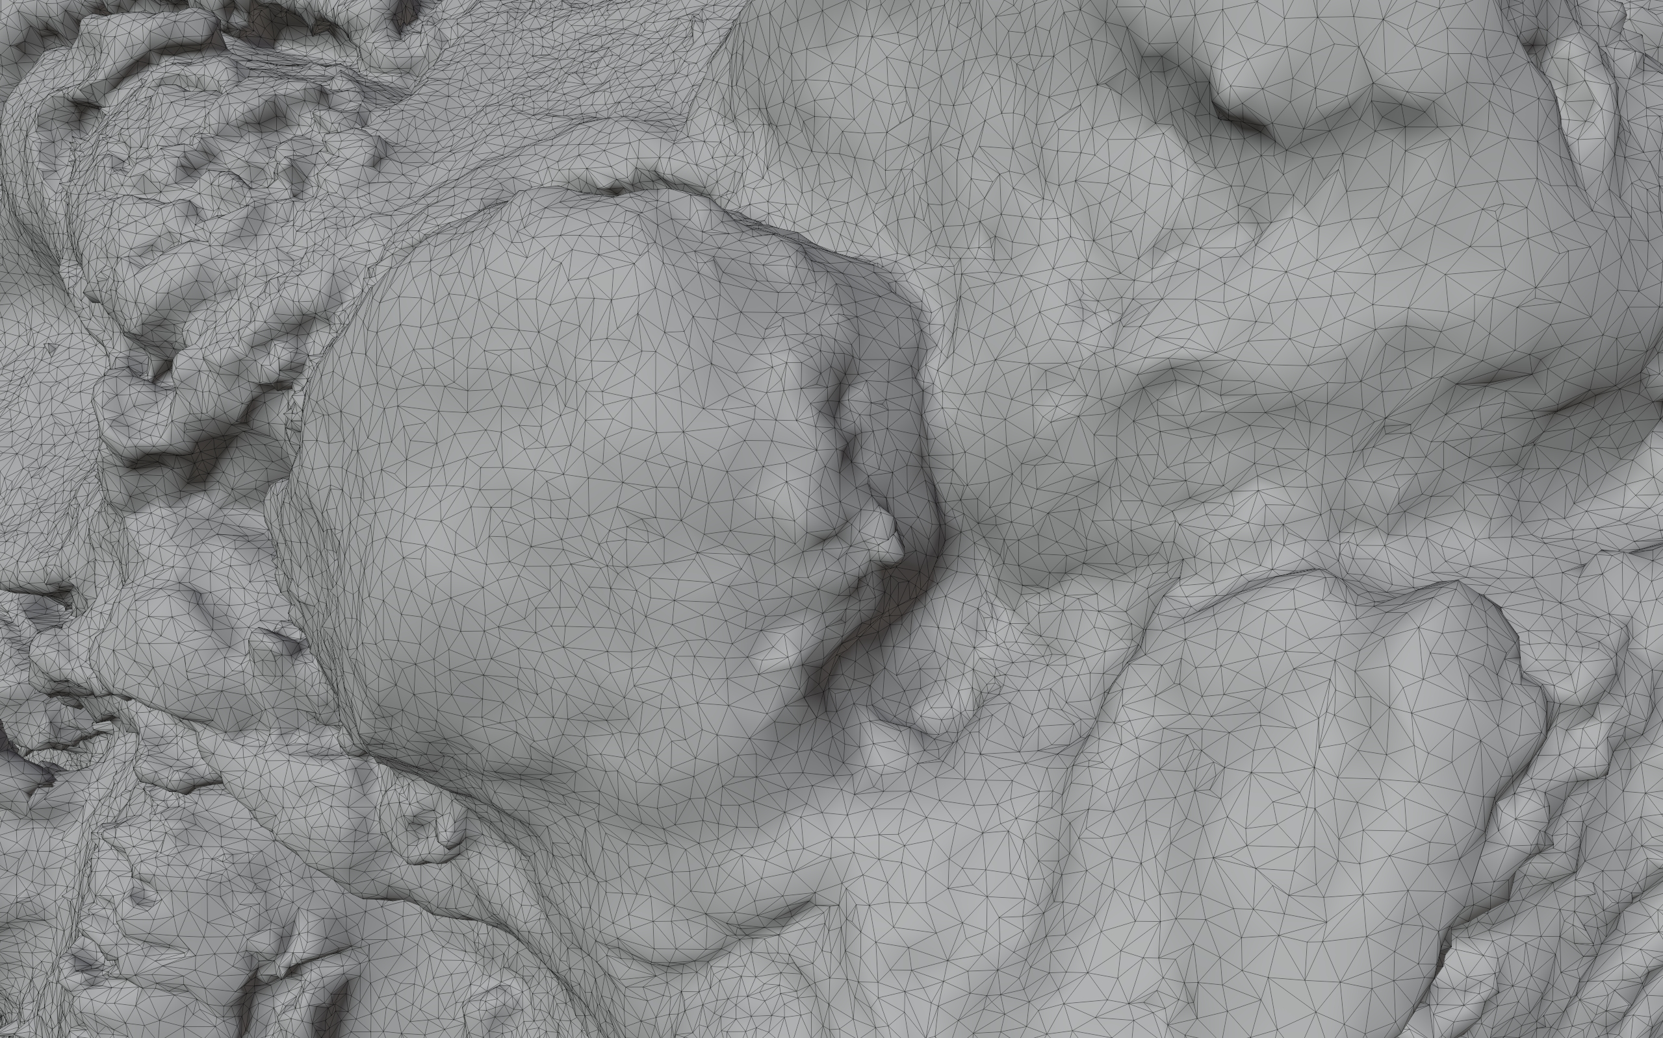
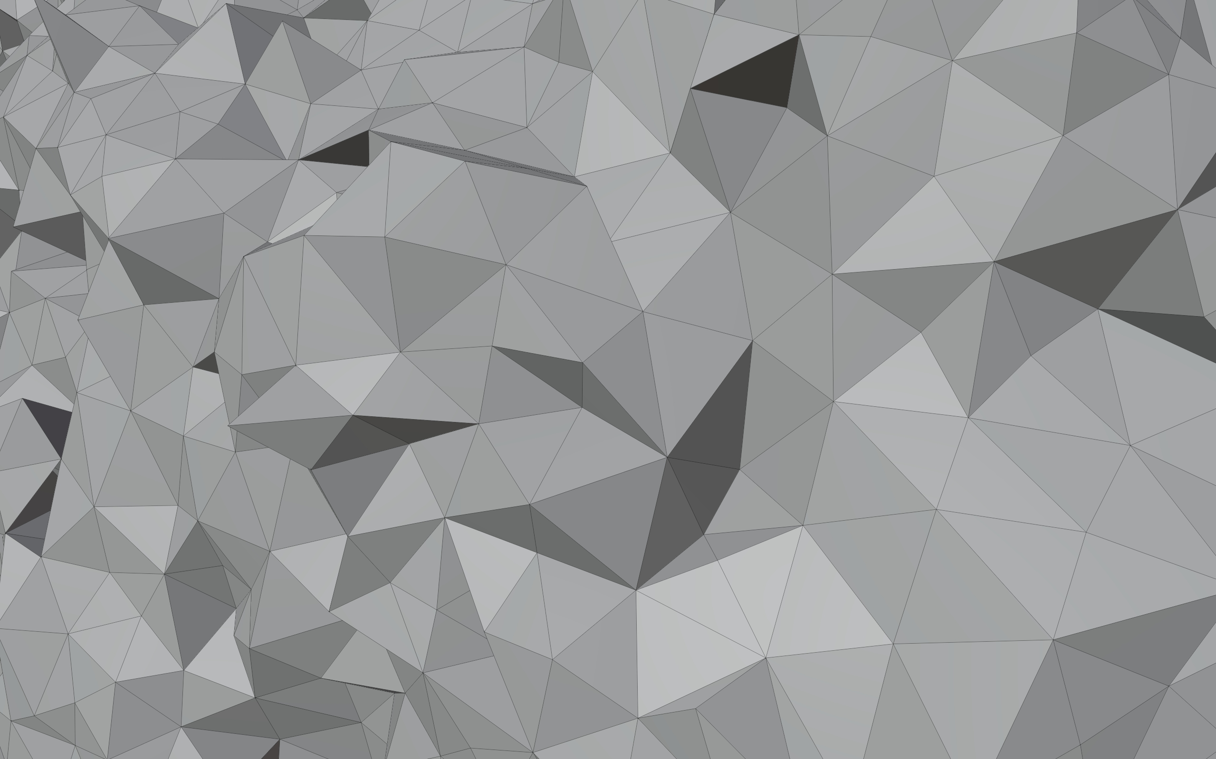
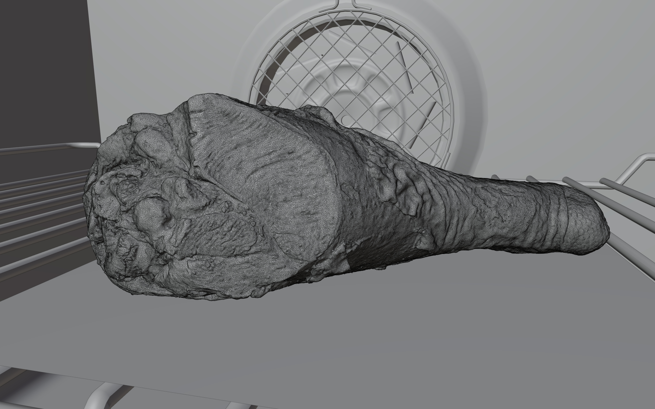
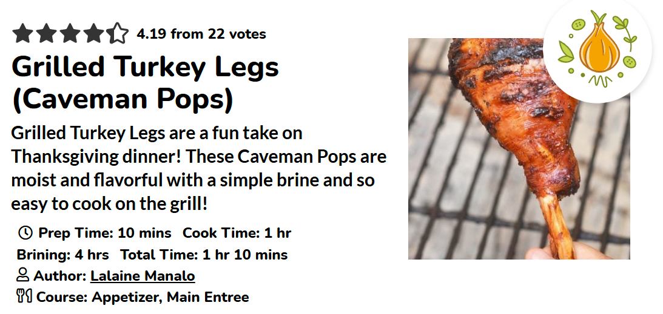
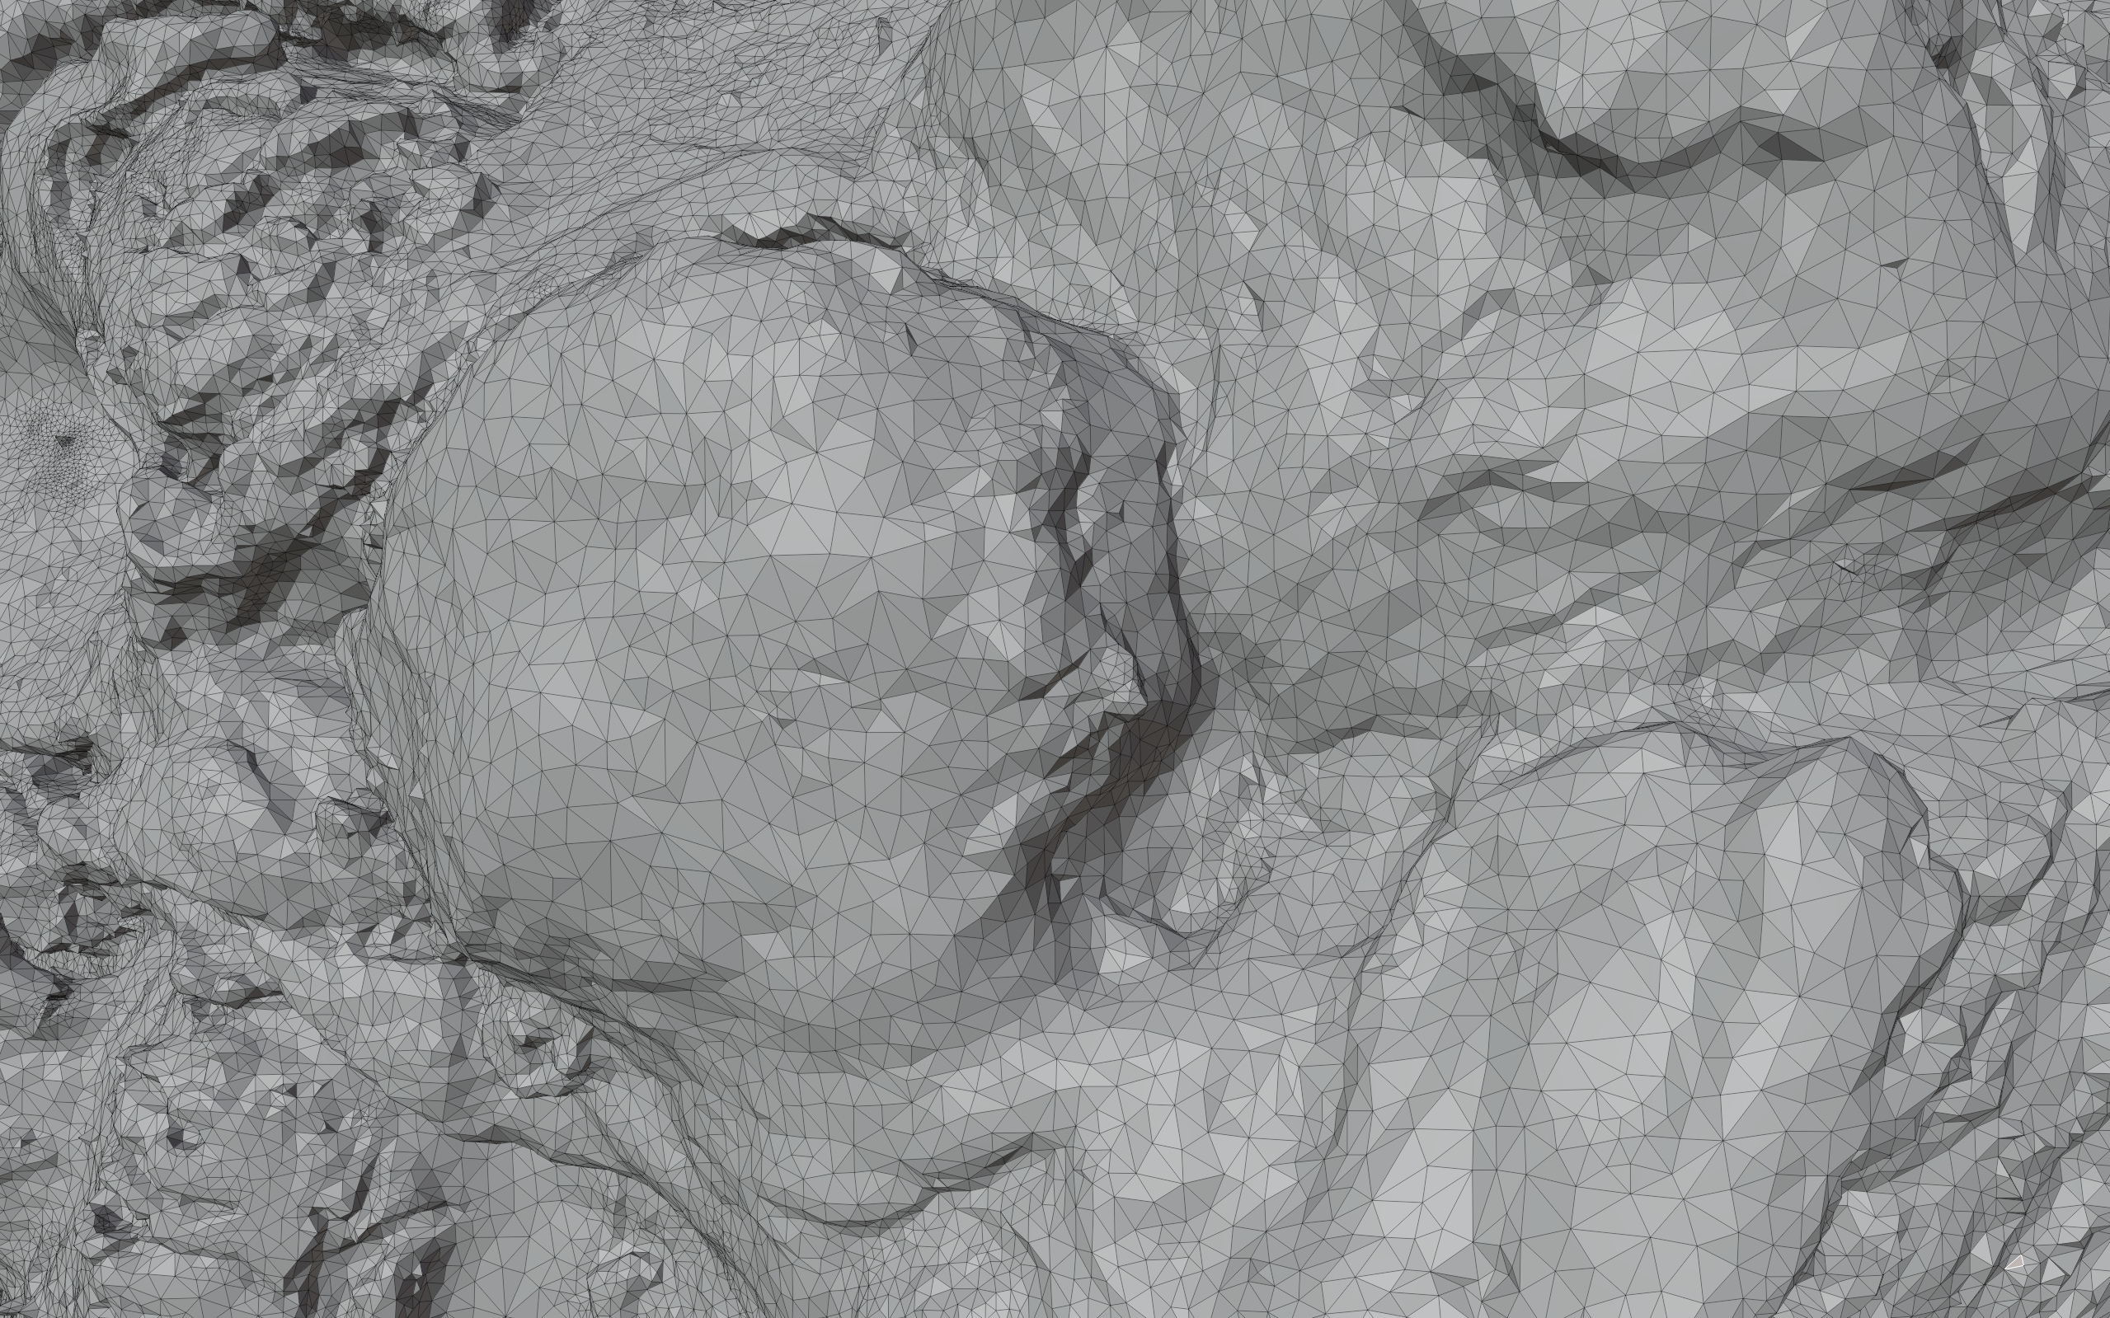
Meshing can be challenging
Input boundary mesh
Tetrahedral mesh boundary
0.5h 1.3GB Memory
[Fast Tetrahedral Meshing in the Wild]
5.5h 46GB Memory
https://www.onionringsandthings.com/grilled-turkey-legs/
Notes:
However, meshing itself [c][c] is a challenging task. And it can take [c] a long time to faithfully reconstruct the input boundary.
And 5.5 hours of meshing [c] is actually longer [c][c] than grilling one yourself in real life!

Slide 10
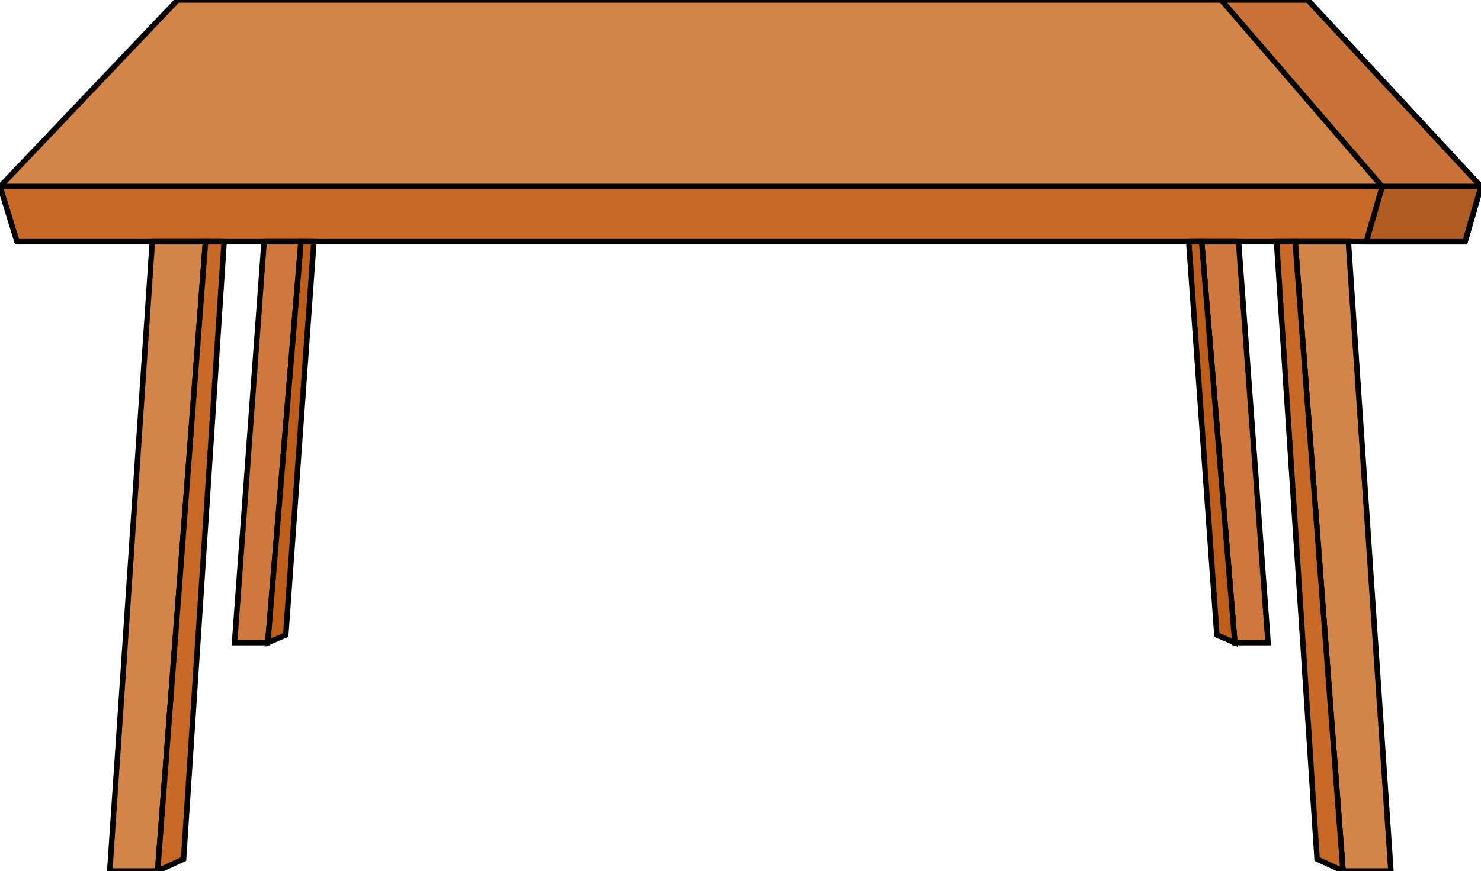
Path tracing and grid free PDE solvers
Path tracing
Walk on Spheres
Notes:
We instead turning to walk on spheres [c], a grid-free [c][c] Monte Carlo approach similar to ray tracing, which does not require volumetric meshing.
[1min25s~]

Slide 11
Background
Notes:
To review this algorithm,

Slide 12
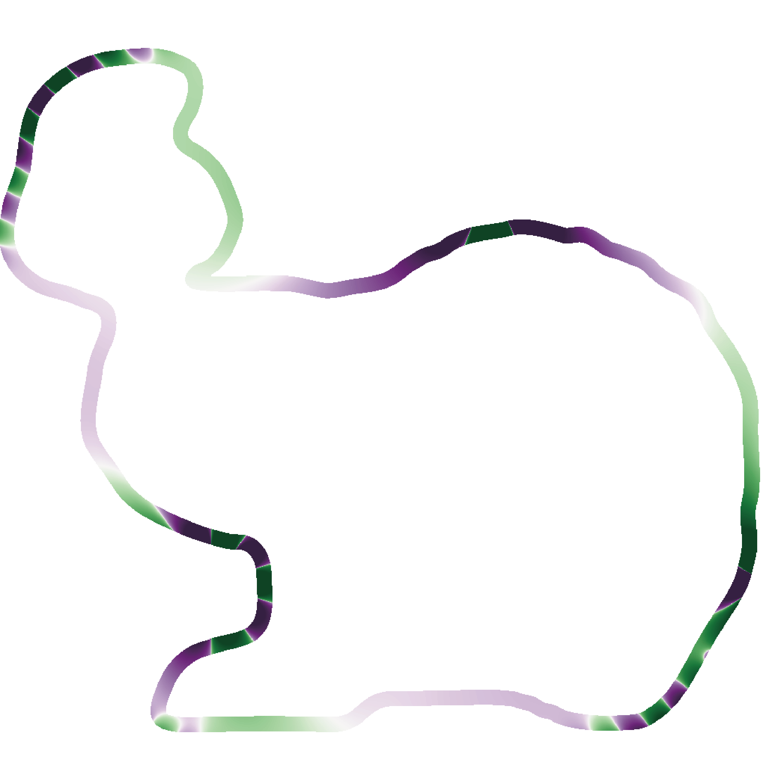
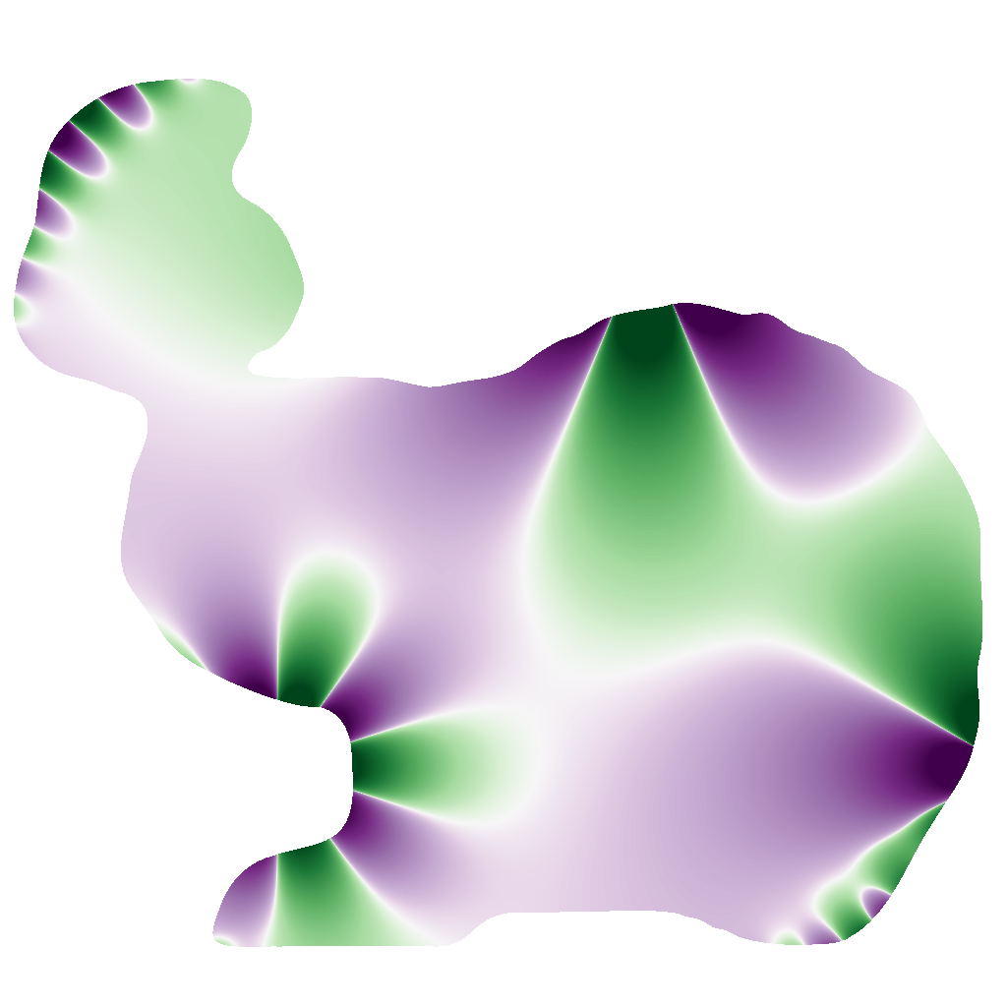
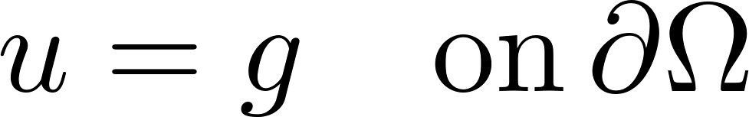


Dirichlet problem
Notes:
Let’s look at 2D Dirichlet problem.
A Dirichlet BC prescribes [c] some known values on the boundary.
And inside the domain, we want to find a [c] harmonic function satisfying the [c] Laplace equation.

Slide 13
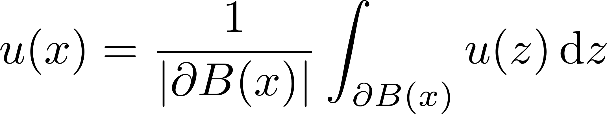
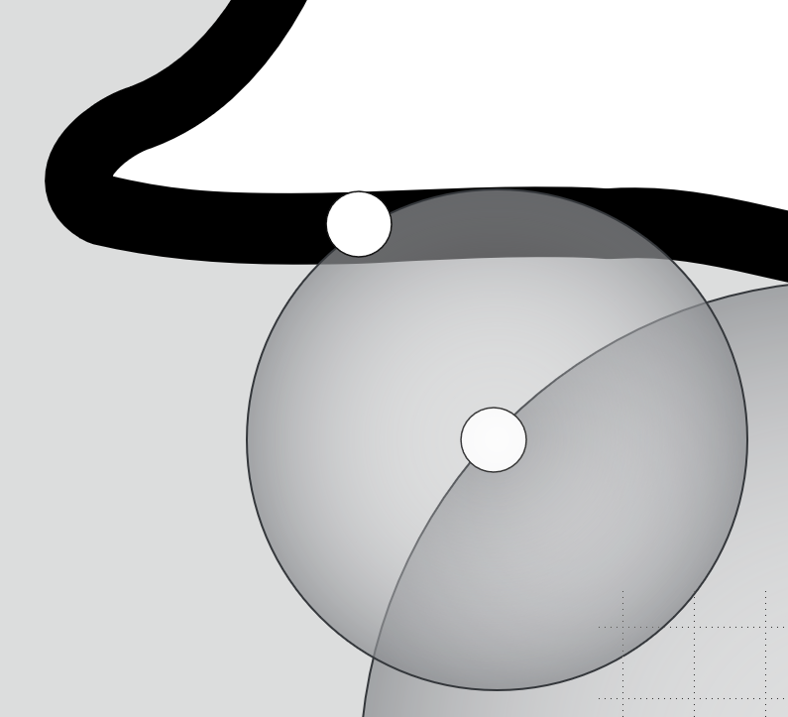
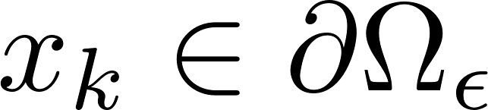
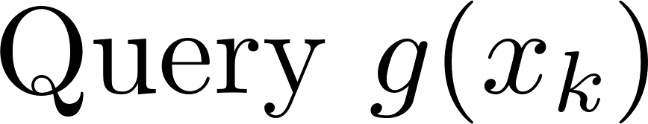

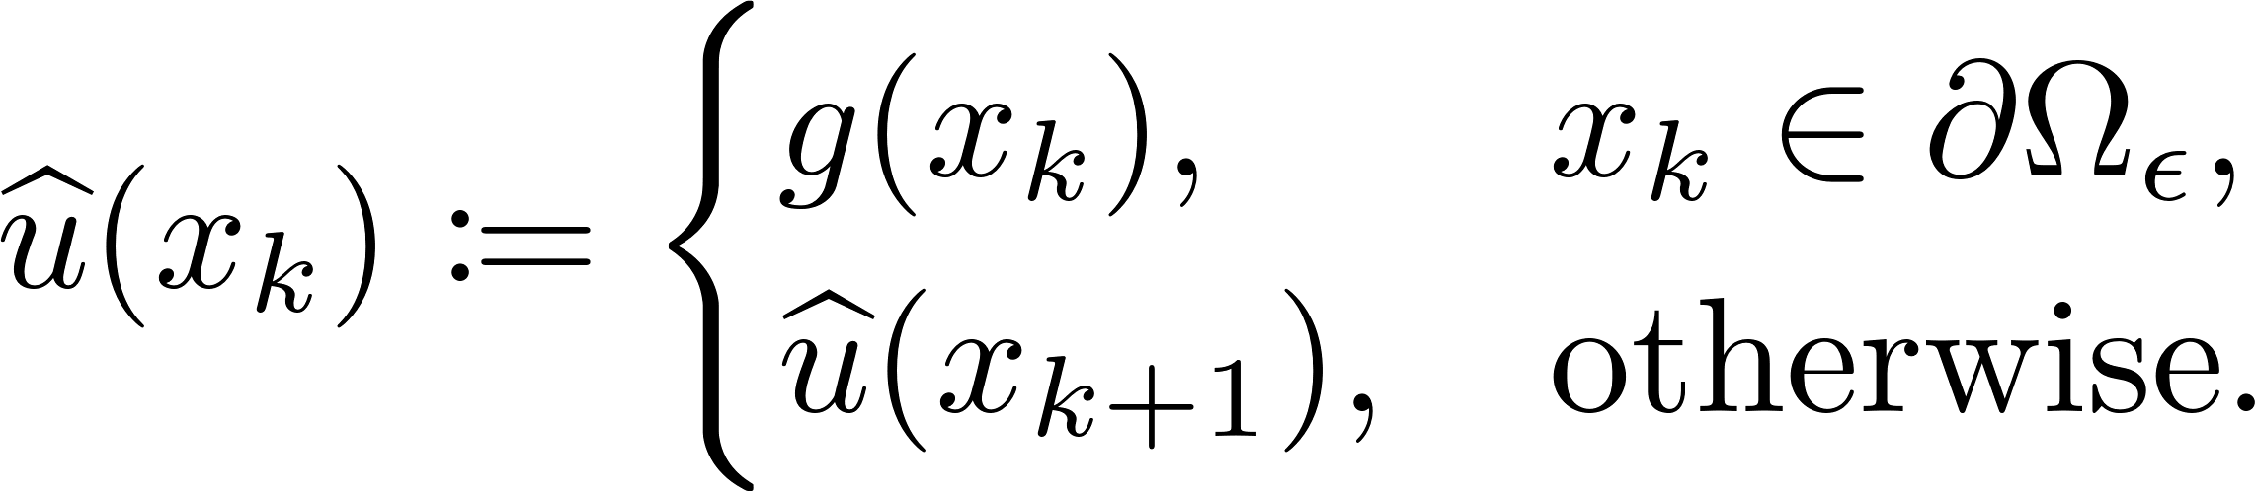
Dirichlet problem
Mean Value Property
Walk on Spheres [Muller 1956]
Notes:
Leveraging the mean value property [c], a Monte Carlo estimator [c] can be developed to obtain solutions at any point [c] by Walk on Spheres.
For any evaluation point [c], we expand the largest sphere [c] contained in the domain and randomly sample [c] one point on the sphere.
We then repeat this process [c][c][c][c] until it’s within an epsilon shell of the boundary.
And [c] we query the boundary value there [c], this is [c] our one-sample estimator for the equation.

Slide 14
Dirichlet problem
Mean Value Property
Walk on Spheres [Muller 1956]
Notes:
[c]

Slide 15
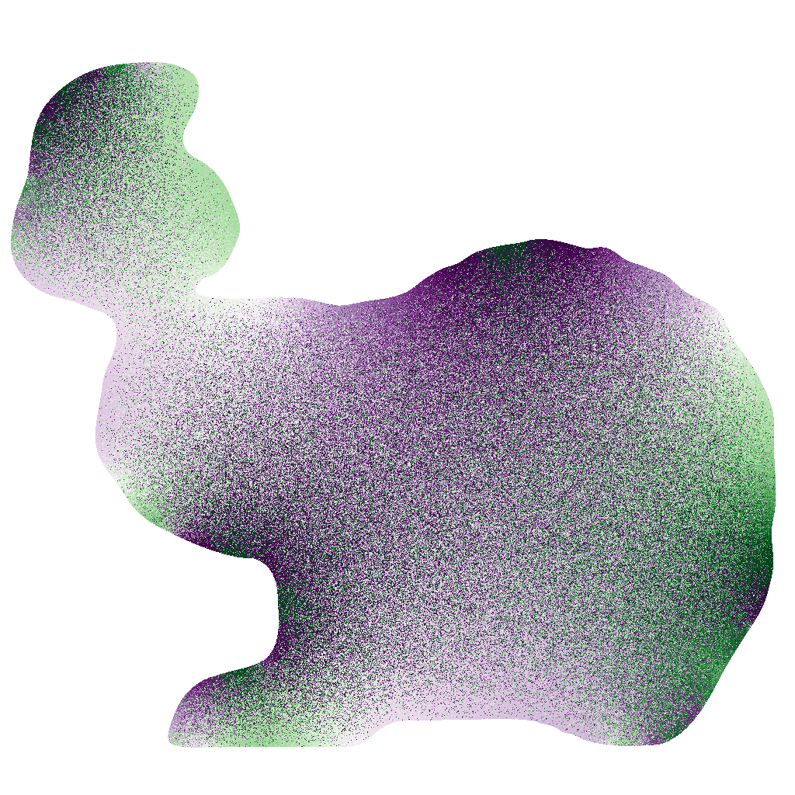
Dirichlet problem
1 Walk/Eval Pt
Mean Value Property
Walk on Spheres [Muller 1956]
Notes:
But this can be noisy.

Slide 16

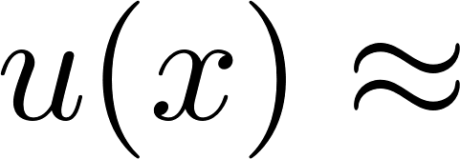

Run more walks to reduce variance
Maybe do more walks?
5 Walk/Eval Pt
Notes:
We can run more walks and average to reduce the variance.

Slide 17
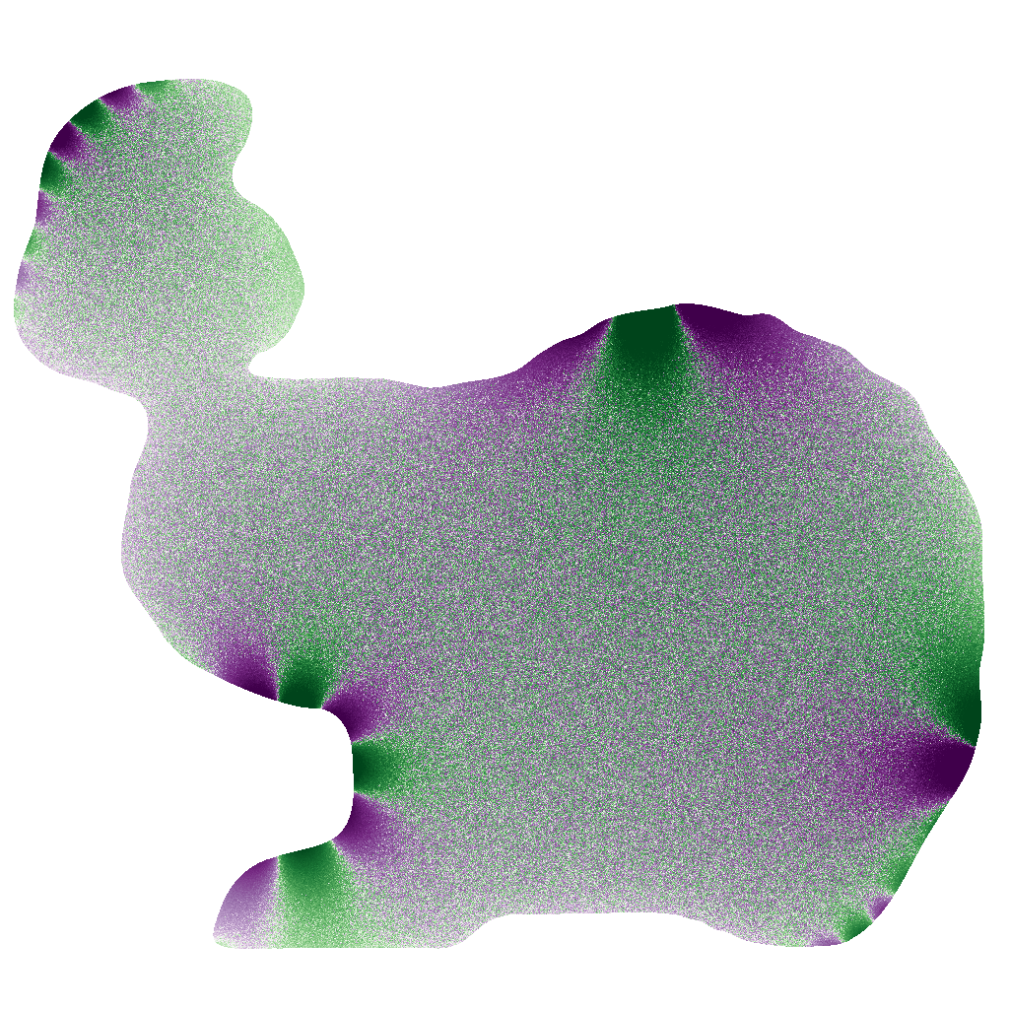
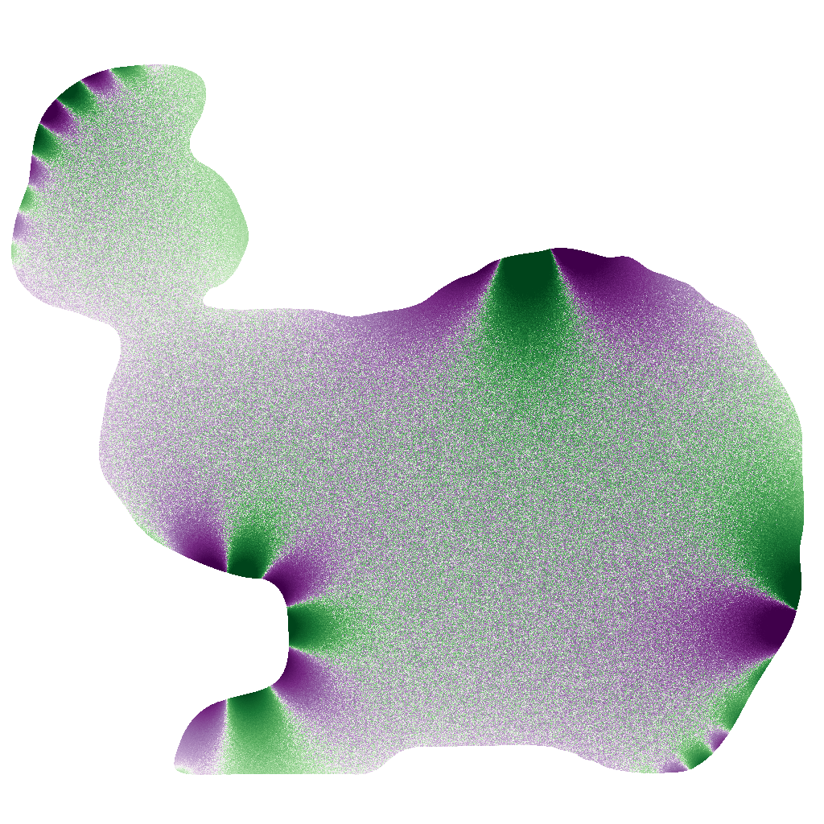
WoS produces noisy estimations
1 Walk/Eval Pt
2s
512 Walk/Eval Pt
180s
1024 Walk/Eval Pt
360s
Notes:
But this is time consuming.
===
[2min18s]

Slide 18
Method
Notes:
Here comes our approach;

Slide 19
Harmonic series expansion [Booth 1981, 1982]
Notes:
Our building block is the harmonic series expansion.
Which shows that the solution [c] within the ball in the domain can be reconstructed [c] by a weighted sum

Slide 20
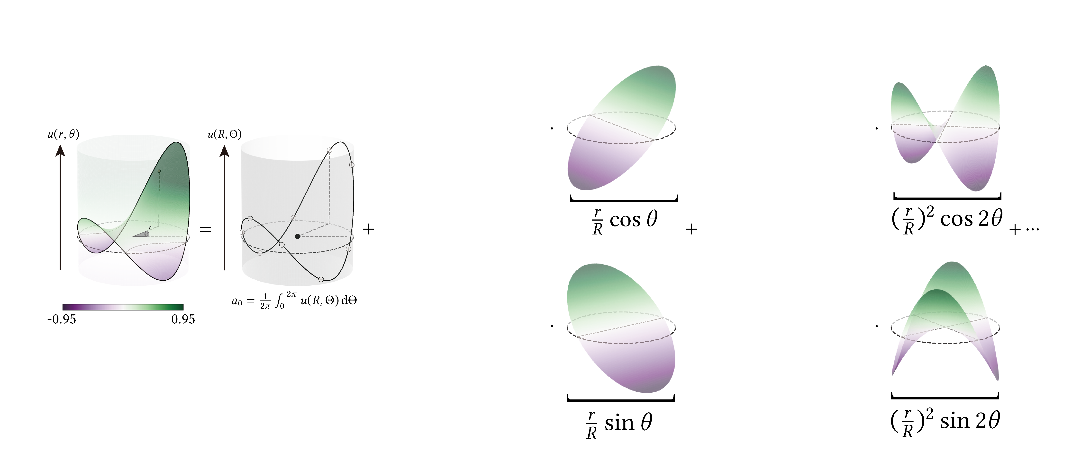
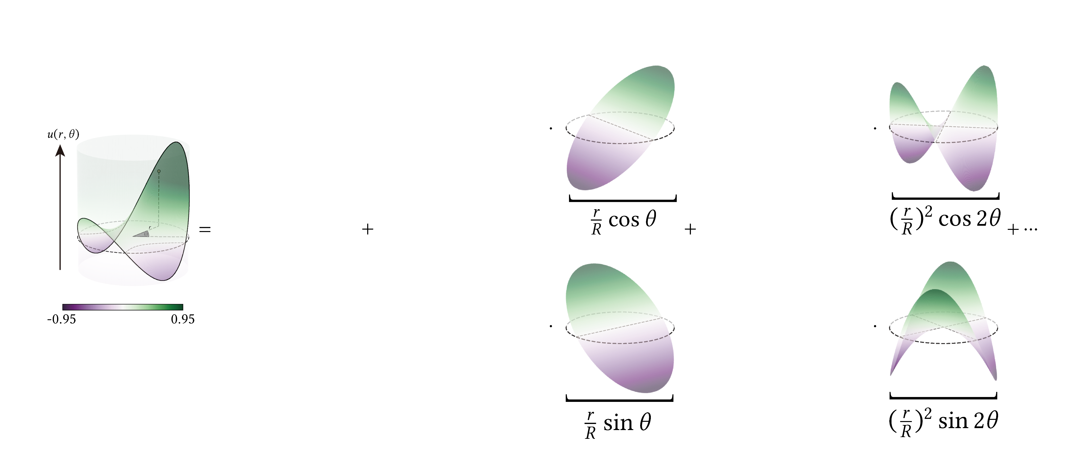



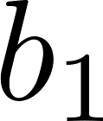
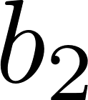
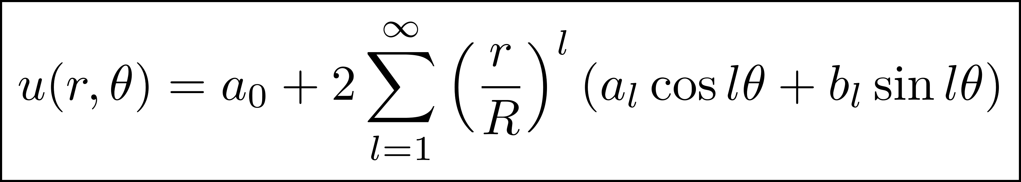
Harmonic series expansion [Booth 1981, 1982]
Notes:
of [c] separable basis functions. And coefficients [c] are easy to compute.
[c]The zeroth order coefficient [c][c] recalls the mean value property [c]

Slide 21
Harmonic series expansion [Booth 1981, 1982]
Mean Value Property
Notes:
And it says: averaging solutions [c] on the sphere gives out the SINGLE solution [c] at the center!
But we want the full solution within the ball, that’s why
We need more terms.

Slide 22
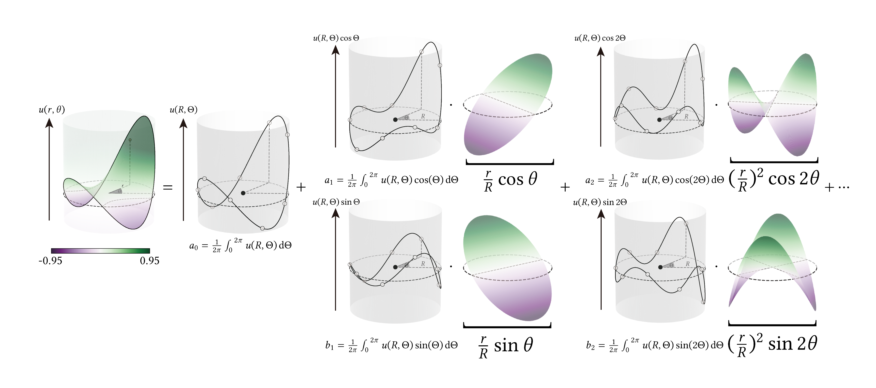
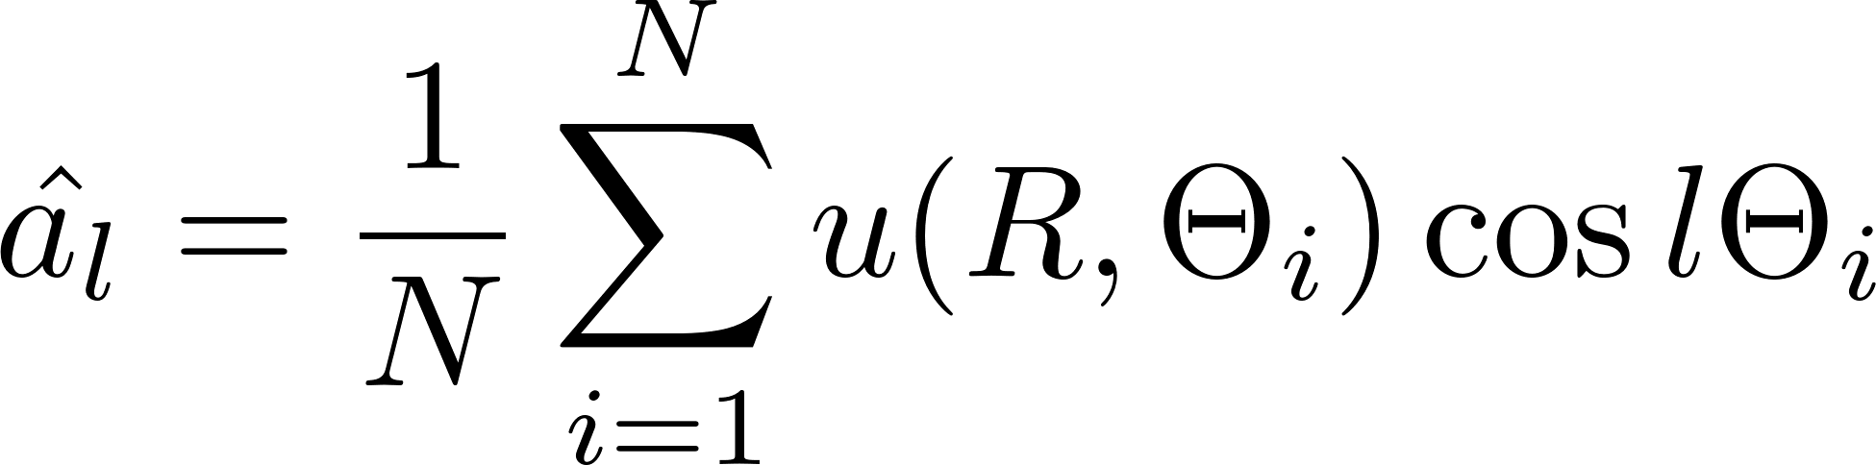
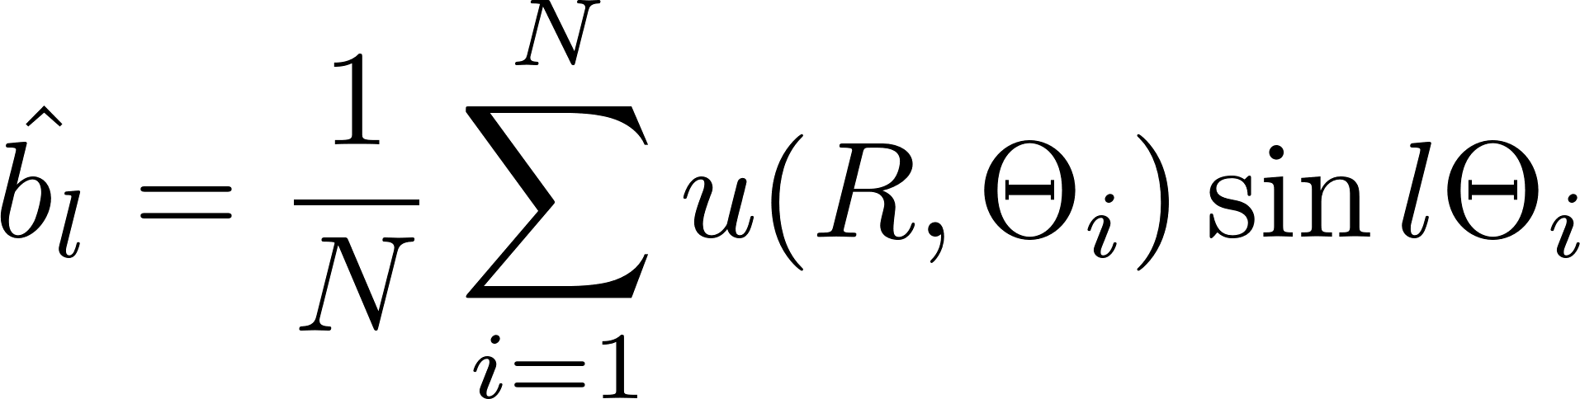
Harmonic series expansion [Booth 1981, 1982]
Notes:
And those higher order coefficients can be estimated [c] in a similar way [c] by averaging the solution weighted by different sinusoids.

Slide 23

Noise free reconstruction after WoS
WoS returns single estimation:
Notes:
Back to our WoS algorithm:
Beyond simply averaging [c] these expensive N walks to [c] get a single solution at the center,

Slide 24
Noise free reconstruction after WoS
WoS returns single estimation:
Notes:
[c]

Slide 25
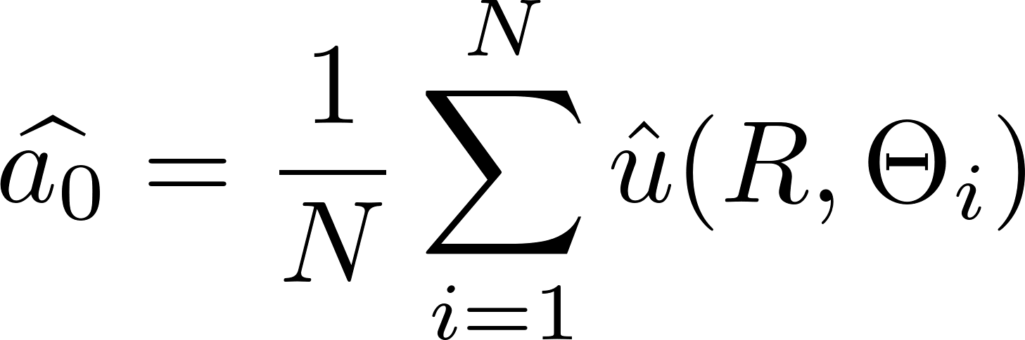
Noise free reconstruction after WoS
0th order coefficient from
N walks:
Notes:
Which produces the zeroth order coefficient.

Slide 26
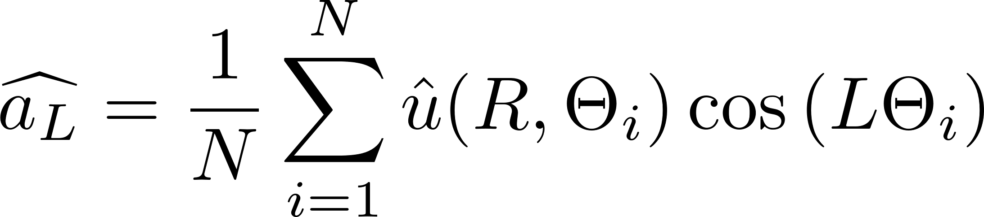
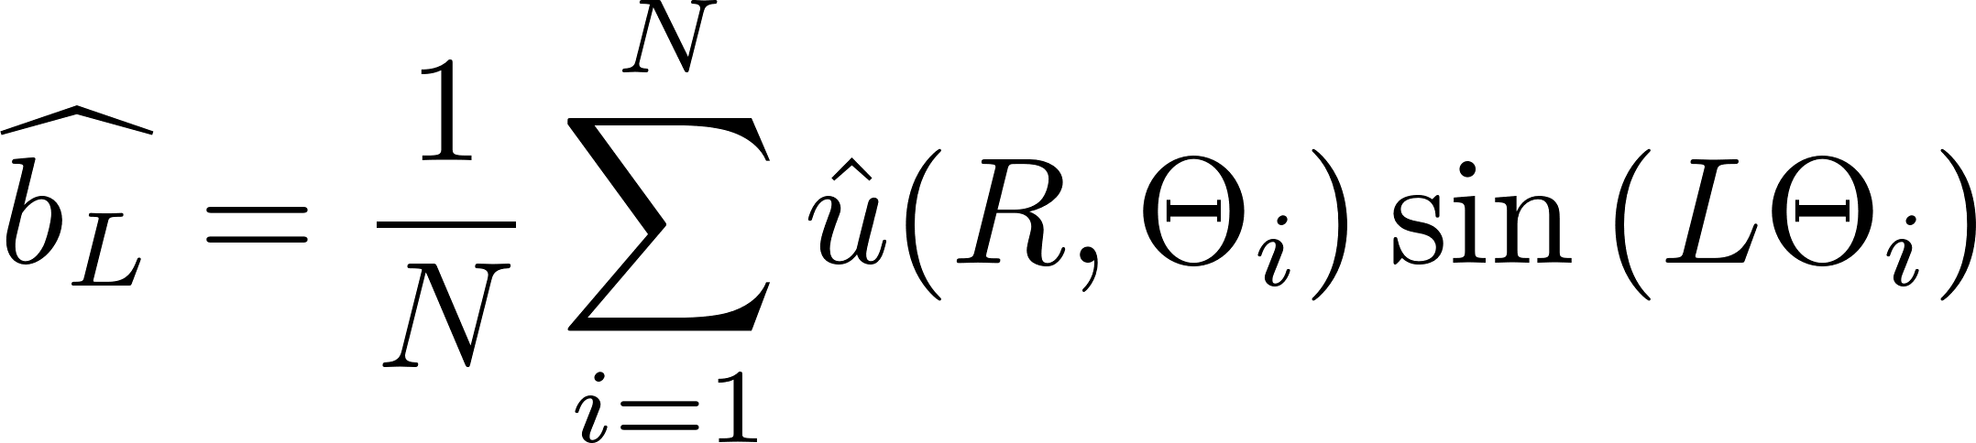
Noise free reconstruction after WoS
0th, 1st, 2nd,… order coefficients
from the same N walks:
Notes:
We can do a few more weighted averages to obtain additional higher-order coefficients, up to some order L.

Slide 27
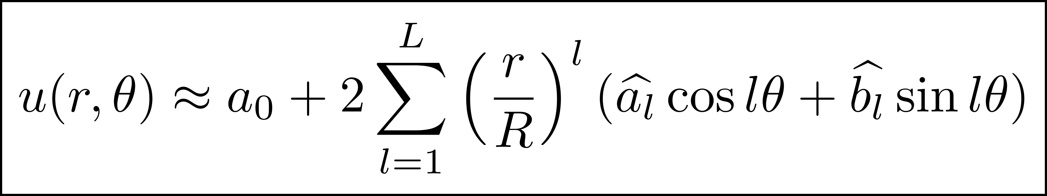




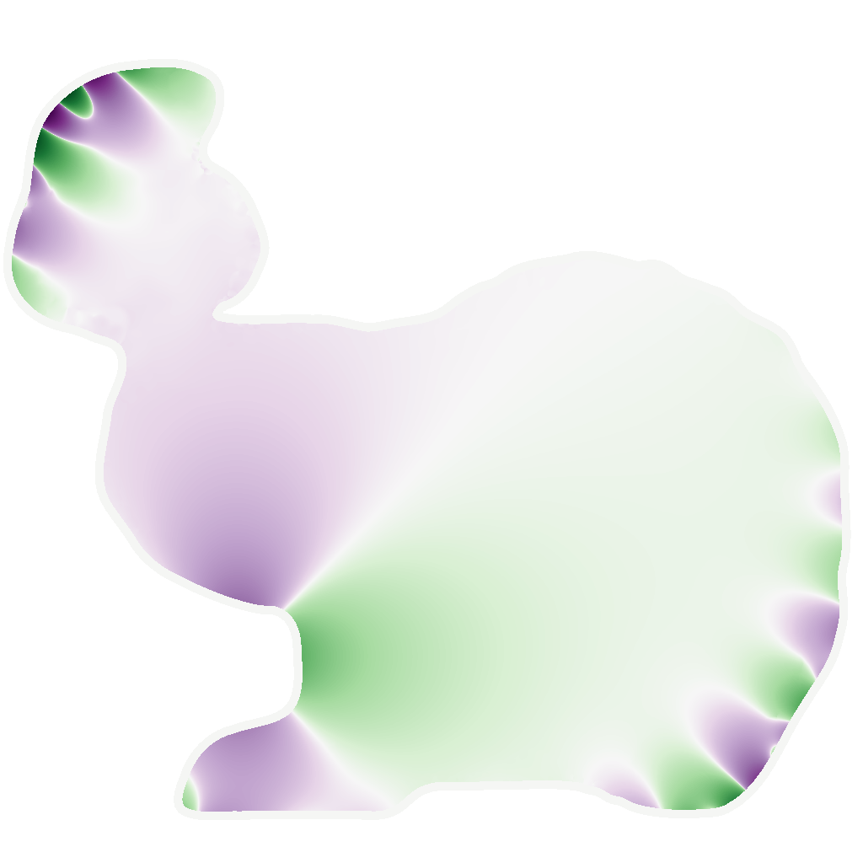
Noise free reconstruction after WoS
Reconstruct solutions within
the entire disk by:
In theory, we need infinite number of terms…
In practice, is enough even in the worst scenario.
Notes:
And now With the same number of walks we can reconstruct the solution everywhere inside the disk [c] expanded from the center using the series expansion.
[c]But you may wonder, how many number of terms we need for the series.
In theory [c], this is infinite, but I will show that [c] we only need 10 more higher order terms.

Slide 28

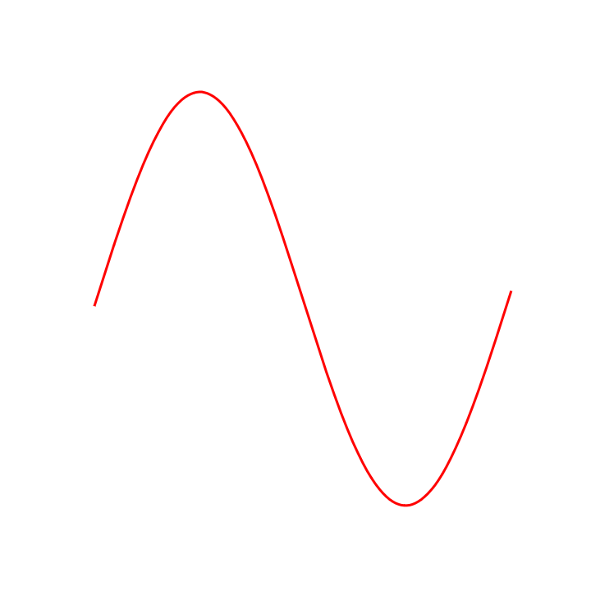
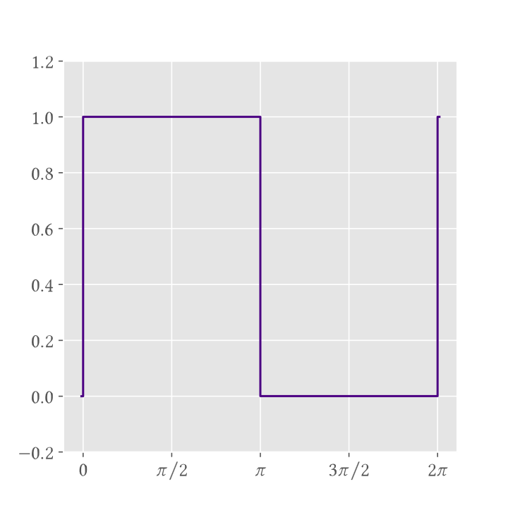
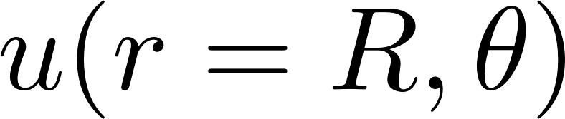
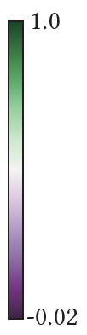



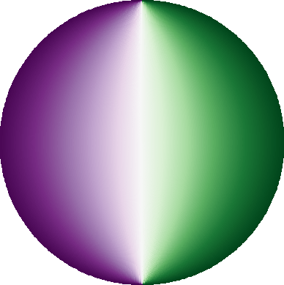

How to choose ?
Ground Truth in the Disk
Notes:
Let’s consider the worst-case scenario in which the domain [c] is exactly a disk, and the boundary condition is [c] a step function, which has infinite frequencies.
The reference solution inside the disk is shown on the left [c].
And we show the first order reconstruction [c] on the boundary in the right.
When L=1, it reconstructs a sinusoid on the boundary, which is clearly a poor approximation.
We can increase L to ten [c], a hundred [c], or even a hundred thousand for a lower error… but this quickly becomes computationally expensive.

Slide 29
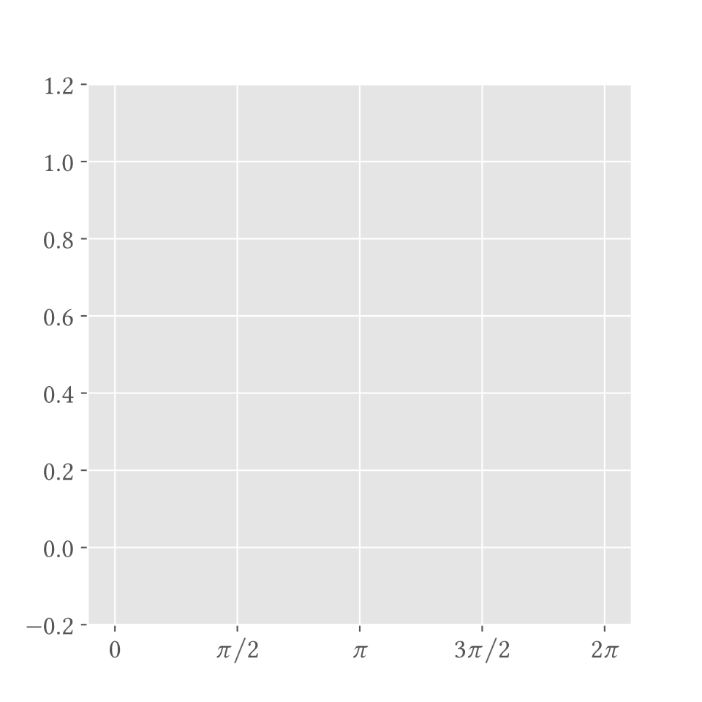
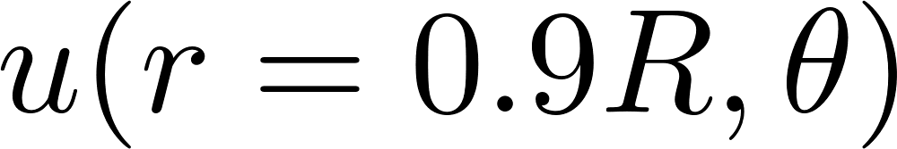
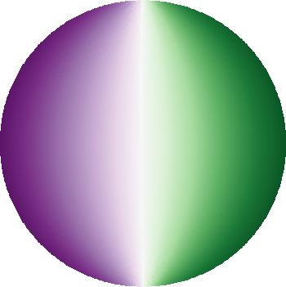
How to choose ?
Ground Truth in the Disk
Notes:
Now let’s take a look at a smaller [c] circle inside the disk,
We notice that the ground truth solution [c] on this 90% of the maximum circle will be much smoother. Now [c] with truncating at order 10th, our reconstruction can already provide a good approximation.

Slide 30
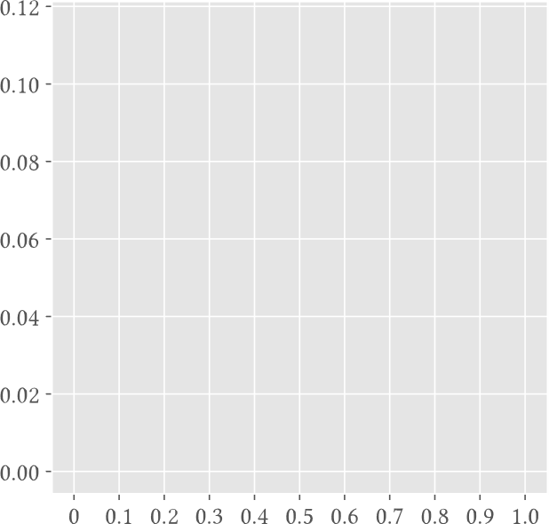
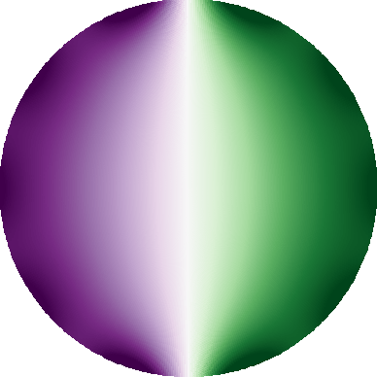
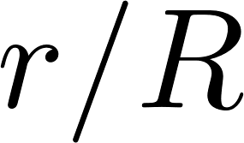
Let’s choose even in the worst scenario
Reconstruction in the Disk
Notes:
Now we show our series reconstruction in the disk [c] using only 10 higher order terms.
If we [c] plot out the accumulated error as we expand away from the center,
we observe that the error remains low when the reconstruction is stopped at 90% of the disk.
===[5min]

Slide 31



Noise free reconstruction after WoS
Reconstruct solutions within
the 90% of the maximum disk:
How about non-spherical regions of interest?
Cover by more disks!
Reconstruct solutions within
the entire disk:
Notes:
As a summary, we choose L=10 [c] in general and limit [c] reconstruction radius to 90%.
But how about [c] non spherical regions? Our key idea is to use more [c] disks to cover them.
====
[5min]

Slide 32
Harmonic Caching
Notes:
And this motivates our harmonic caching algorithm.
====
[5min]

Slide 33




Cache records population
Lazy evaluation style population [Ward et al. 1988]
Cache
Record
Cache Population Pass
Walk
[Practical Global Illumination with Irradiance Caching]
Reconstruction Pass
Irradiance Caching
Cache Records Visualization
Notes:
In the first pass [c], we take inspiration from [c] irradiance caching algorithm and populate [c][c] a set of cache balls by lazy evaluation.
===

Slide 34

Cache records population
Lazy evaluation style population [Ward 2008]
Cache
Record
Cache Population Pass
Walk
Reconstruction Pass
✔ Center
✔ Radius
✔ Coeffs
Cache (by Octree)
Notes:
For each cached ball [c], we record its center [c], the maximum radius [c], and harmonic coefficients [c], which can be computed using walk on spheres.

Slide 35

Reconstruction by series expansion
(Weighted) sum of series expansions from cache balls
Cache
Record
Cache Population Pass
Cache
Lookup
Reconstruction Pass
✔ Center
✔ Radius
✔ Coeffs
Cache (by Octree)
Notes:
In the reconstruction pass, to get the solution at a point y[c], we query all cache balls [c] overlapping this point [c], and apply series expansion to reconstruct a noise free solution.

Slide 36

Reconstruction by series expansion
(Weighted) sum of series expansions from cache balls
Cache
Record
Cache Population Pass
Cache
Lookup
Walk
Reconstruction Pass
✔ Center
✔ Radius
✔ Coeffs
Cache (by Octree)
Notes:
This would work, but it [c] suffers from artifacts.

Slide 37


Coefficients estimation can be noisy
Cache
Record
Cache Population Pass
Walk
Reconstruction Pass
✔ Center
✔ Radius
✔ Coeffs
Noisy!
Noisy!
Cache (by Octree)
Notes:
One reason is that when we use independent WoS [c] to estimate the solution on the largest sphere at a cache record, they are noisy [c] and in turn [c], lead to noisy [c] coefficients!

Slide 38
Additional refinement pass
Reconstruct by series expansion!
Cache Population Pass
Cache
Record
Cache Population Pass
Refinement Pass
Cache
Lookup
Walk
Refinement Pass
Reconstruction Pass
✔ Center
✔ Radius
✔ Coeffs
Noise free!
Noisy!
Reconstruction Pass
Noise free!
Noisy!
Cache (by Octree)
Notes:
We propose an additional refinement pass after cache population to recompute coefficients at the same location [c].
But now instead of doing [c] these random walks which are noisy, we query the cache [c][c] and perform series expansion [c] to reconstruct solution at these locations[c] and we can get a smooth estimation of coefficients as well!

Slide 39
Intermediate pass to refine coefficients
Apply series expansion!
✔ Center
✔ Radius
✔ Coeffs
Cache Population Pass
Cache from the 1st pass
Refinement Pass
✔ Center
✔ Radius
✔ Coeffs
Cache from the intermediate pass
Reconstruction Pass
Notes:
and recompute coefficients [c] by looking up the old cache [c] and applying series expansion [c][c][c] to the boundary samples on the sphere.
To get coefficients, we have lots walks on the boundary, each of the walks; instead of taking 1 walk, fading using more walks. SHOW WE HAVE MORE WALKS.

Slide 40

Without refinement
With refinement
(+10% More time)
Notes:
With refinement[c], this help minimize the correlation artifacts without incurring high cost.

Slide 41
Without refinement
With refinement
(+10% More time)
Notes:
With refinement[c], this help minimize the correlation artifacts without incurring high cost.

Slide 42

Generalizations
✔ 2D, 3D
✔ Source term (Poisson equation)
✔ Screening term (screened Poisson eq)
✔ Reflecting and mixed BCs by WoSt [Miller et al. 2024]
Notes:
Our algorithm can be generalized to 3D [c] and handling [c] source and screening terms.
Using walk on stars algorithm to [c] estimate solutions allows our algorithm handles reflecting boundary conditions, and we refer to the paper for more details.
==
[Don’t use HC, use harmonic series expansion]
===
[7min]

Slide 43
Evaluation

Slide 44


2D comparisons: WoS/Ours (Equal Time)
WoS Error 118443
Ours Error 0.86318
Notes:
Our caching algorithm can reduce the error by [c] orders of magnitude compared to the pointwise WoS algorithm at equal time.
===

Slide 45


3D comparisons to related work
Reference
Setup
Dirichlet BC
Evaluation plane/
Region of Interest
(ROI)
Notes:
Here we setup a 3D Dirichlet problem [c][c] to compare with various caching algorithms [c] for estimating solutions in the slice plane of the bunny.

Slide 46

Reverse WoS [Qi et al. 2022]
[Qi et al. 2022]
Notes:
The reverse WoS algorithm from our group shares similarities to bidirectional path tracing, and starts the walk from source and boundaries.

Slide 47



Reverse WoS vs Ours
RWoS
Ours
HC Cache Record
✘Output sensitive
✔ Output sensitive
Notes:
But it’s not output sensitive, which means we are wasting lots of efforts caching outside our region of interest.
Our harmonic caching [c] method preserves output sensitivity and only generates cache records in regions of interest.

Slide 48

Notes:
As a comparison, we will have [c] fewer correlation artifacts

Slide 49
Boundary Value Caching [Miller et al. 2022]
Reference
Notes:
The boundary value caching [c] Generates samples

Slide 50
Boundary Value Caching [Miller et al. 2022]
Reference
Notes:
on boundary and estimate normal derivative by walk on stars

Slide 51
Boundary Value Caching [Miller et al. 2022]
Reference
Notes:
And splats the solution to the region of interest.

Slide 52


Boundary Value Caching [Miller et al. 2022]
BVC
[Miller et al. 2022]
Singularity!
Notes:
But it’s prone to singularities [c] due to Green’s function.

Slide 53

Harmonic Caching (Ours)
Ours
We use smooth basis functions:
✔ Singularity free
Notes:
Our series expansion leverages smooth [c] basis functions, and has no singularities [c]

Slide 54

Notes:
[c][wait for 2s]

Slide 55



Mean Value Caching [Bakbouk et al. 2023]
MVC expands the largest ball around the evaluation point: fewer records available.
Ours gathers records from overlapping balls: more are available even near the boundary!
Notes:
The mean value caching expands [c] the largest ball and average all walk on sphere estimations in the first pass for a single evaluation point. But it would have few records available if it’s the boundary.
Our approach [c] can instead gather [c] more records from overlapping balls far away from the evaluation point.

Slide 56

Notes:
As a comparison [c], our result has fewer correlation artifacts.

Slide 57
Radiation (Ray tracing)
Heat Source
Conduction
Conduction (Solver Needed)
Setup
Notes:
Back to our thermal analysis experiment, which solves a Laplace equation on Robin boundary condition.

Slide 58

Noise free!
Notes:
And The walk on stars estimator [c] suffers from high frequency noise as we slice through the domain and run the solver, while our algorithm [c] provides a noise free and smooth [CLICK TRIANGLE ON VIDEO TO RESUME] reconstruction at equal time.
===
[REUSE SPACE BETTER. ZOOM VIDEO IN AS WE CHANGE]

Slide 59





Robin BC
Solution
WoSt
Ours
Notes:
Compared to other caching algorithms, our method achieves robust estimation with lower error and fewer correlation artifacts.
Please refer to our paper for more comparisons.

Slide 60

Notes:
Compared to other caching algorithms, our method achieves robust temperature estimation with lower error and fewer correlation artifacts.
===
[Too many comparisons, no time to read Maybe show 1 example. We compare lots of theme in the paper, the ighlvel message is that we could beat them in high level] [Please check out the paper for more details]

Slide 61
Conclusion
Notes:
[9.5min]

Slide 62
Conclusion
  A novel caching algorithm for WoS:
    Leverages harmonic structures in PDE solutions
    Reduces variance by orders of magnitude
    Easy to implement
    Supports various boundary conditions, sources and screening terms
Notes:
To summarize our contribution, we have presented a novel caching algorithm for WoS [C] leveraging the harmonic structures in PDE solutions by harmonic series expansion [c].
It can effectively reduce variance by orders of magnitude while [c] being easy to implement.
And it supports various BCs, source and screening terms.

Slide 63


Future work
Other estimators for coefficients estimation?
Still more work to do for reducing artifacts!
[Huang et al. 2025]
Notes:
As for future work [c], we want to explore other estimators such as the guiding based importance sampling for WoSt [c] to estimate harmonic coefficients.
This may open new opportunities to reduce artifacts under challenging boundary conditions.

Slide 64




Acknowledgements
Harmonic Caching for Walk on Spheres
Eugene d’Eon
NVIDIA
Rohan Sawhney
NVIDIA
Wojciech Jarosz
Dartmouth College
Notes:
This concludes my talk, and I would like to thank all my collaborators, advisors and everyone here for your attention.

Slide 65

Limitations/future work
Improve performance on high frequency Neumann BCs.
[Sawhney et al. 2023]
Notes:
As a future work, we would like to improve our performance on high frequency Neumann BCs, which typically results in long walks for WoSt estimators.

Slide 66
Limitations/future work
Improve performance on high frequency Neumann BCs.
Notes:
Even though we could still provide significant speed up to WoSt estimator,

Slide 67
Limitations/future work
Improve performance on high frequency Neumann BCs.
Notes:
The boundary value caching could provide a better reconstruction in this scenario.
This concludes my talk, thank you for your attention.
[Need to close things add a summary.]

Slide 68

Notes:
===
Need NSF funding show up.

Slide 69
Future work
Body Level One
  Body Level Two
    Body Level Three
      Body Level Four
        Body Level Five

Slide 70

Notes:
Compared to MVC, we have fewer correlation artifacts under equal time.
====
[9.5min]

Slide 71




Dirichlet problem
Mean Value Property
Notes:
to a sphere. Precisely, the solution at the center of the sphere,

