Slide 1
Recent Advances in Adaptive Sampling and Reconstruction for Monte Carlo Rendering
M. Zwicker Univ. of Bern | W. Jarosz Disney Research | J. Lehtinen Aalto Univ. | B. Moon KAIST | R. Ramamoorthi UC San Diego
F. Rousselle Disney Research | P. Sen UC Santa Barbara | C. Soler INRIA | S.-E. Yoon KAIST

Slide 2
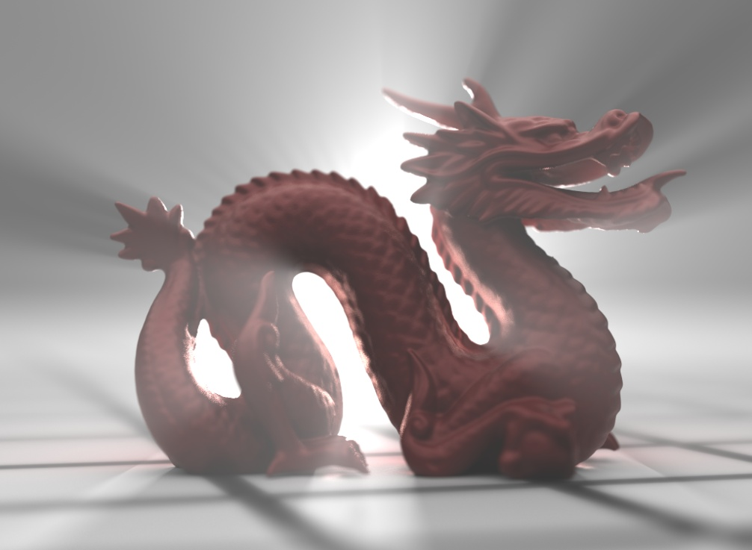
Introduction
32000 samples per pixel, 12h
Monte Carlo path tracing
Physically based
Very general
Guaranteed convergence (except pathological cases)
Disadvantages
Noise, slow convergence

Slide 3
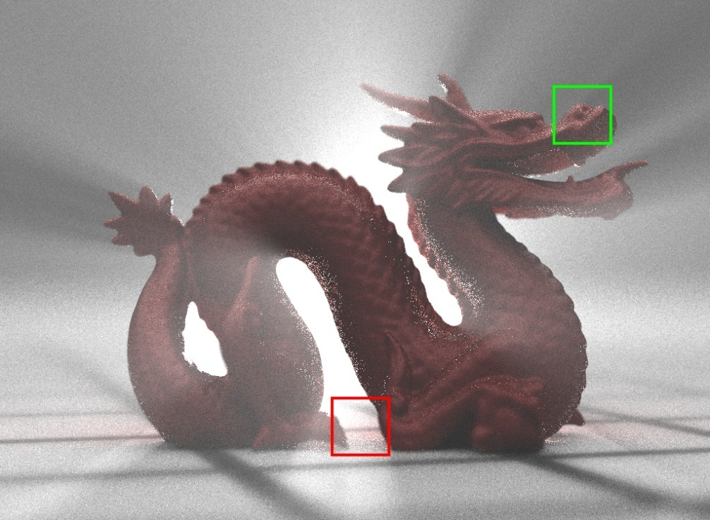
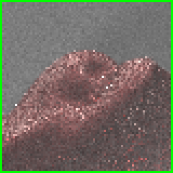
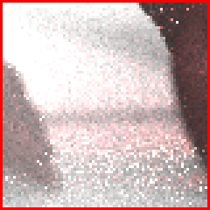
Introduction
32 samples per pixel, 42s
Monte Carlo path tracing
Physically based
Very general
Guaranteed convergence (except pathological cases)
Disadvantages
Noise, slow convergence

Slide 4
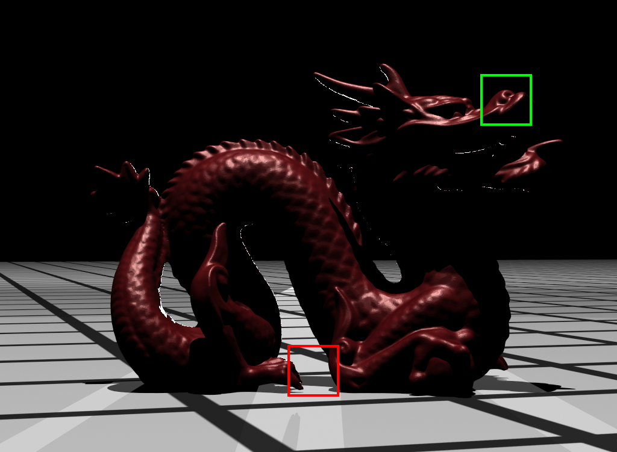
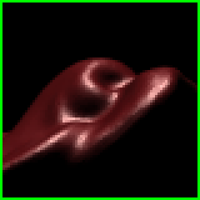
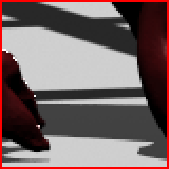
Introduction – curse of dimensionality
→ Anti-aliasing – 2D

Slide 5
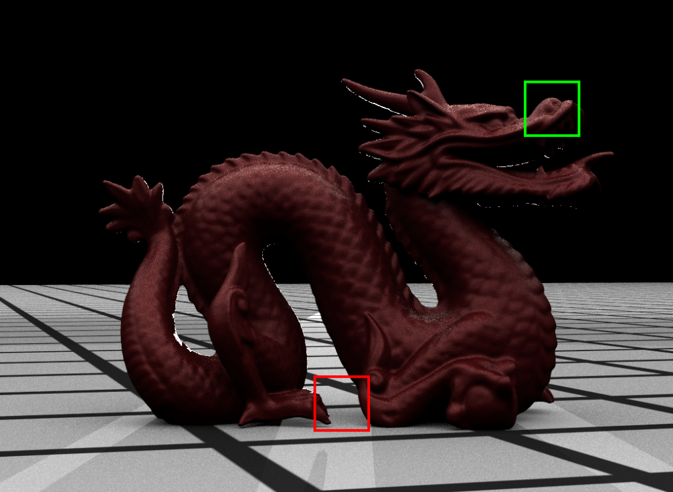
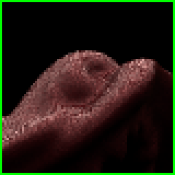
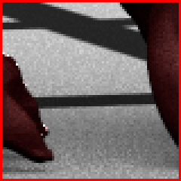
Introduction – curse of dimensionality
→ Anti-aliasing – 2D
→ Area-lighting – 2D

Slide 6
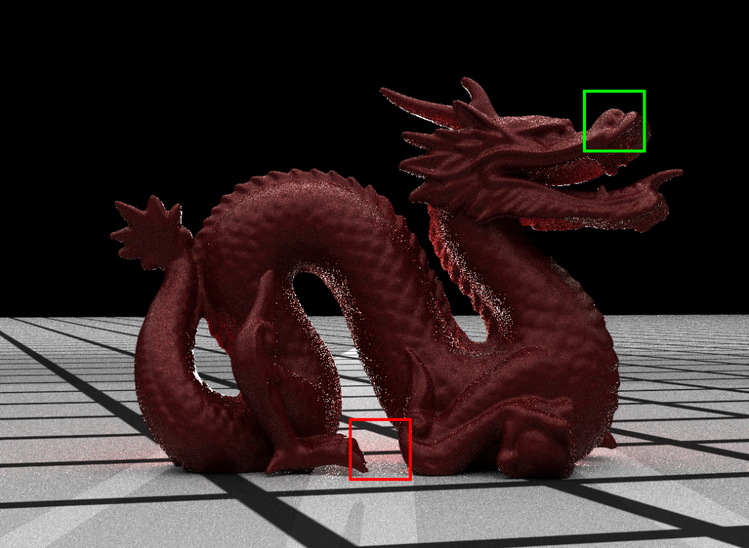
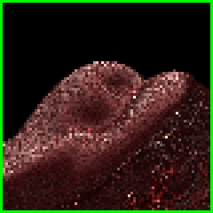
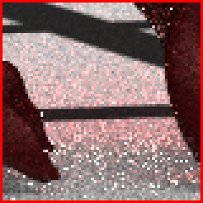
Introduction – curse of dimensionality
→ Anti-aliasing – 2D
→ Area-lighting – 2D
→ Single-bounce indirect illumination – 2D

Slide 7
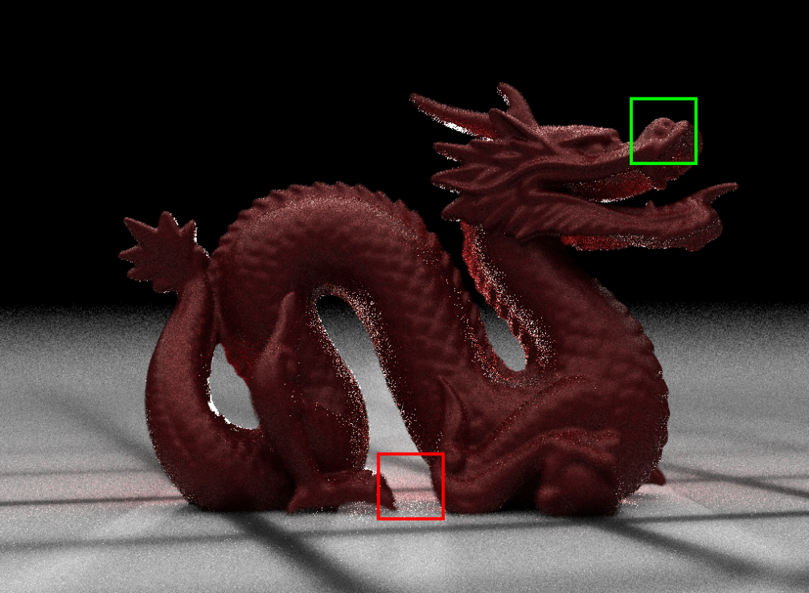
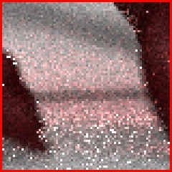
Introduction – curse of dimensionality
→ Anti-aliasing – 2D
→ Area-lighting – 2D
→ Single-bounce indirect illumination – 2D
→ Depth-of-field – 2D

Slide 8
Introduction – curse of dimensionality
→ Anti-aliasing – 2D
→ Area-lighting – 2D
→ Single-bounce indirect illumination – 2D
→ Depth-of-field – 2D
→ Single-scattering participating media – 1D
Total: 9D

Slide 9
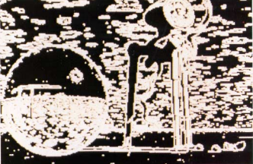
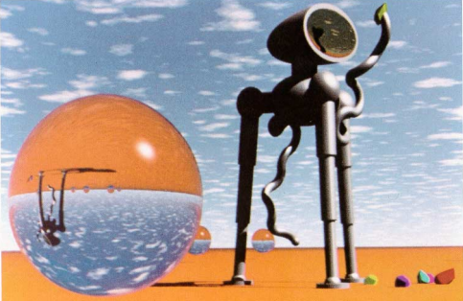
Early approaches
Sample map
Output image
[Mitchell 1987]

Slide 10
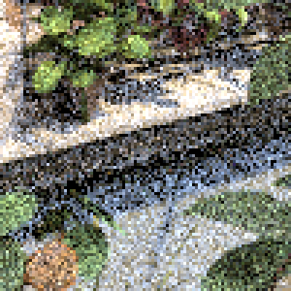
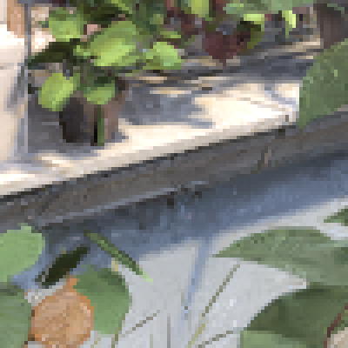
Recent advances
Path tracing, 55s
Rousselle et al. 2013, 57s
Notes:
Here is an equal-time comparison with a standard raytracer using low-discrepancy sampling. As we can see, our method significantly reduces the amount of noise while preserving the details of the scene.

Slide 11
Adaptive sampling and reconstruction
Locally analyze error (variance)
Adapt sampling density to error
Reconstruct image by aggregating data over several pixels

Slide 12
Outline
A priori
A posteriori
Analyze light transport equations around individual samples
Estimate sampling rates, reconstruction filters based on analysis
Ignorant of light transport effects
Estimate sampling rates, reconstruction based on empirical statistics from sets of acquired samples

Slide 13
Outline
A priori
A posteriori
Frequency analysis (Cyril)
Light field structure (Matthias)
Derivatives (Wojciech)
Fabrice

