Slide 1
Light Field Structure Analysis
With material courtesy of Jaakko Lehtinen

Slide 2
Key observation
Light rays are highly coherent
Rays originating from same surface point vary smoothly over angle
Represent light rays in light field parameterization
Rays correspond to points in a 4D position-direction space
Exploit coherent, anisotropic structure of light fields

Slide 3
Motion blur and depth of field
Requires lots of samples
5D integration: 2D pixels, 2D aperture, 1D time

Slide 4
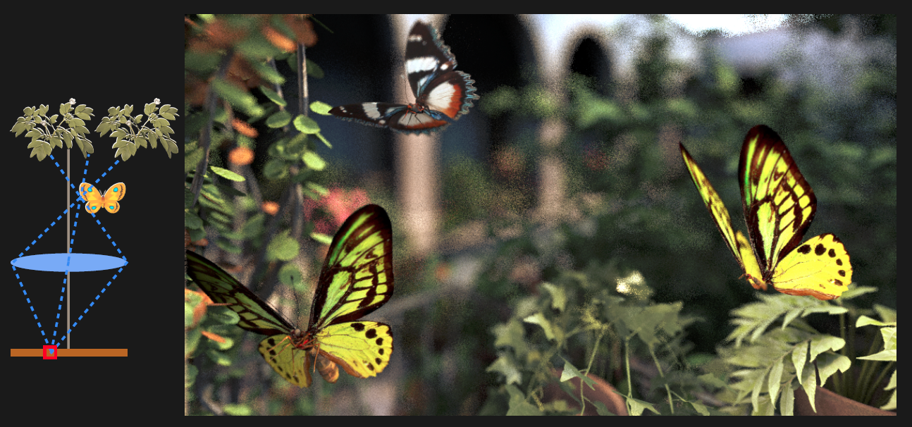
Depth of field (defocus blur)

Slide 5
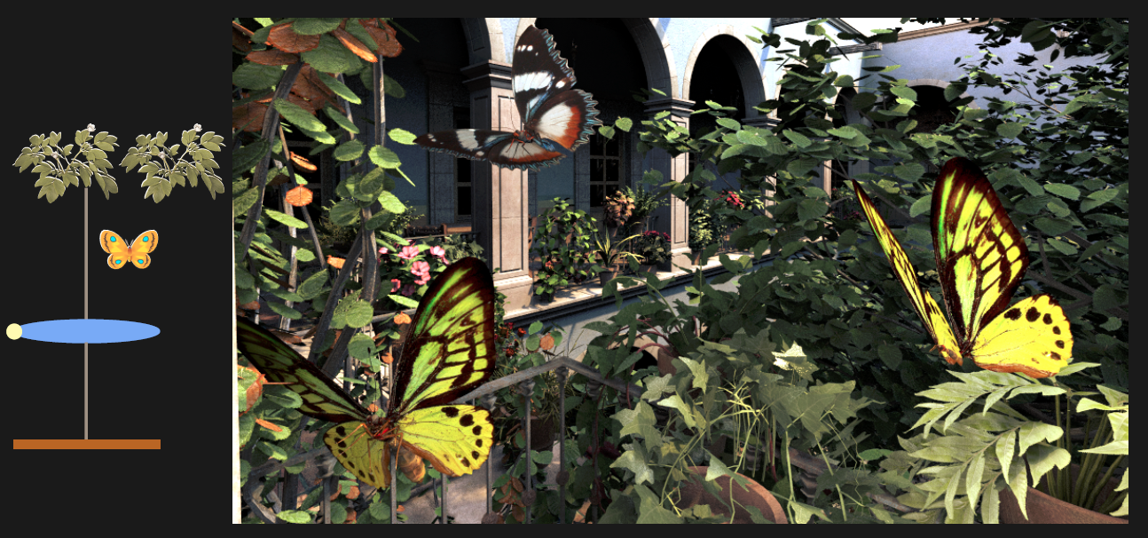
Depth of field (defocus blur)

Slide 6
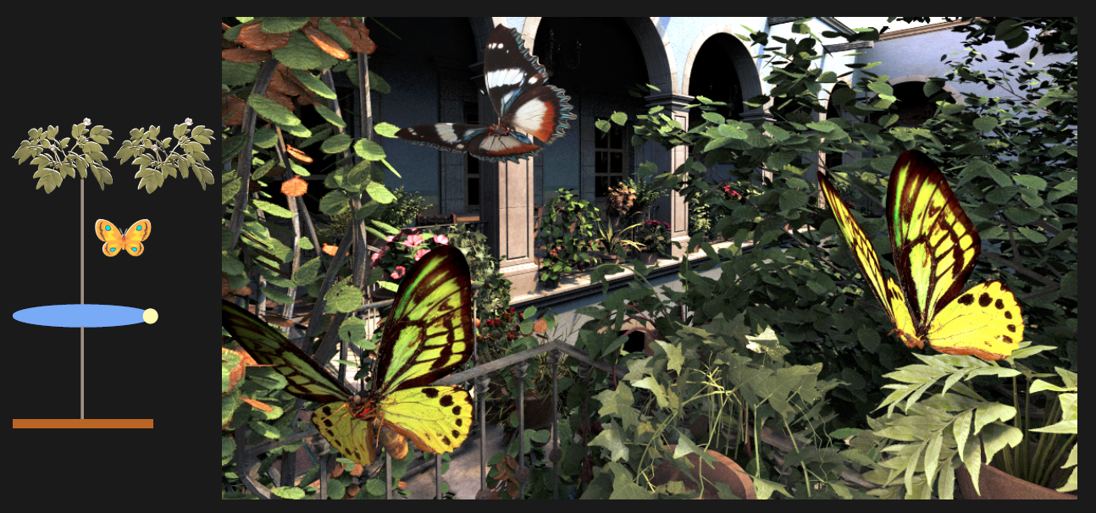
Depth of field (defocus blur)

Slide 7
Light field parameterization
u
x

Slide 8
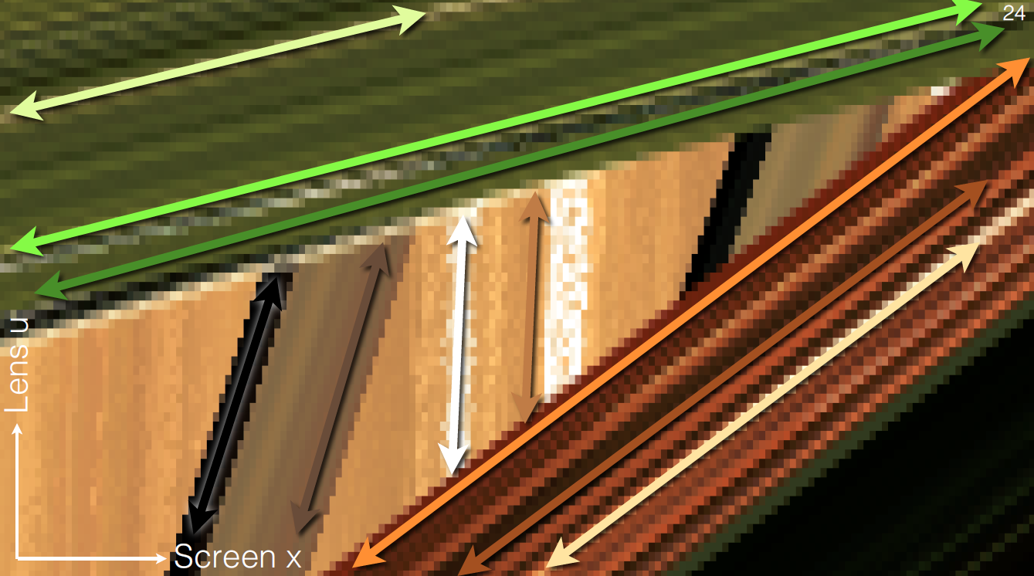
Anisotropy
Slopes depend on depth!

Slide 9
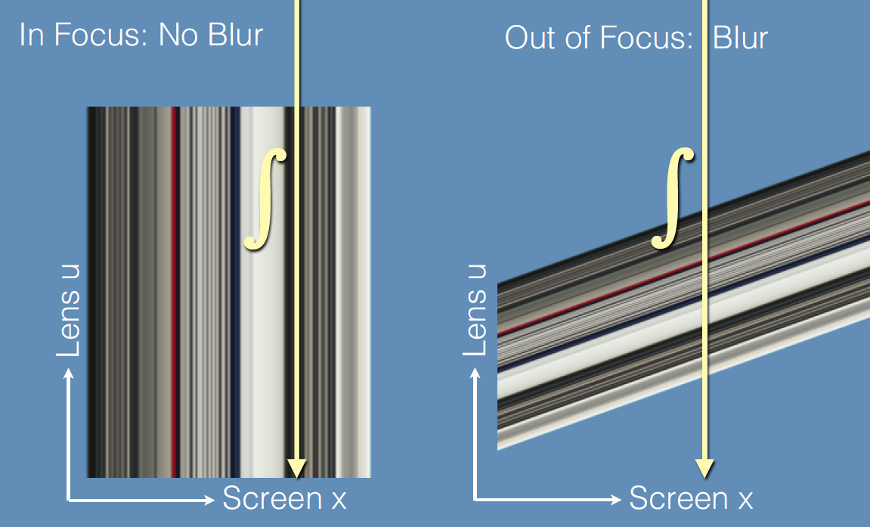
Defocus blur: integration over lens

Slide 10
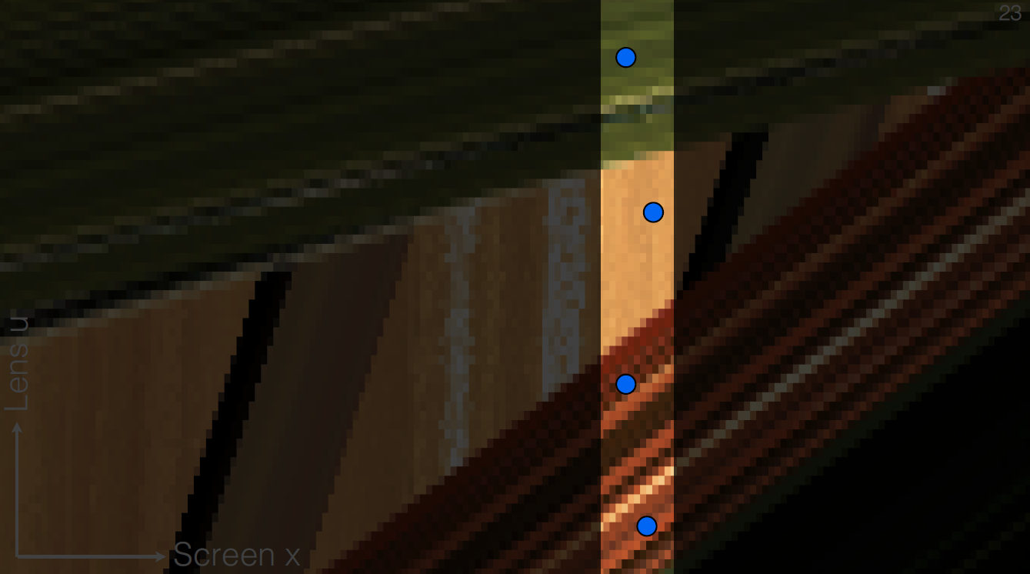
Naive approach
One pixel

Slide 11
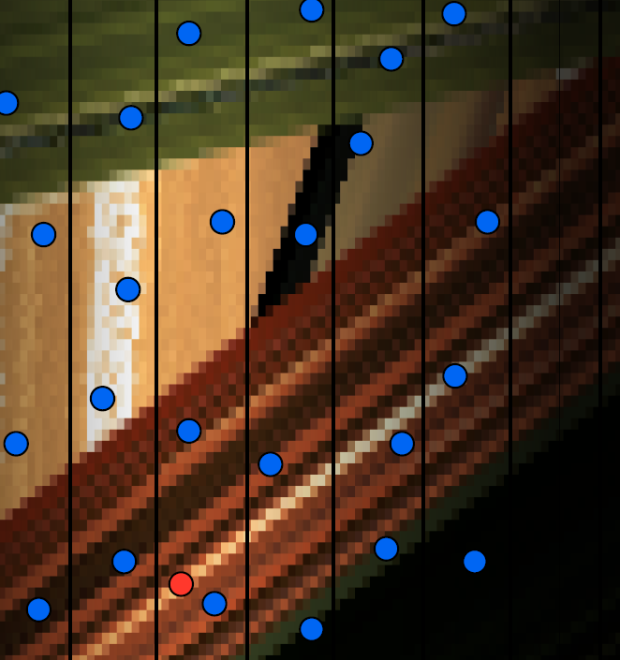
Exploiting anisotropy
Input: sparse sampling

Slide 12
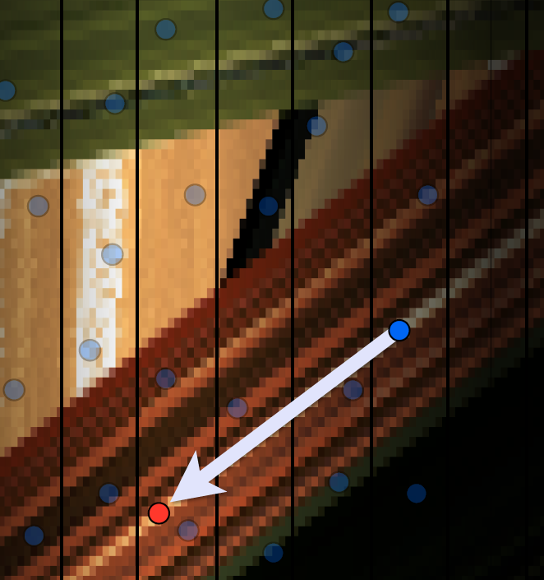
Exploiting anisotropy
Input: sparse sampling
Upsampling
Extrapolation along known slopes

Slide 13
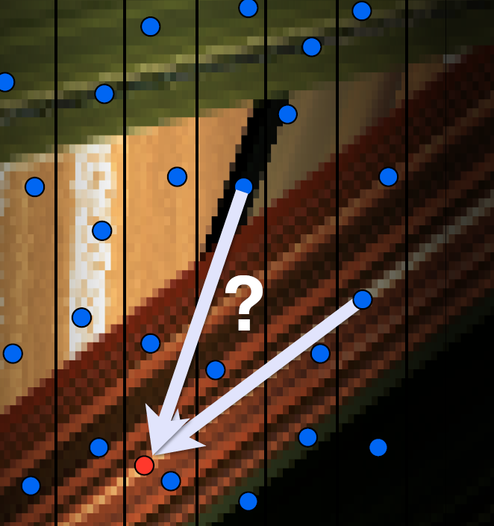
Exploiting anisotropy
Input: sparse sampling
Upsampling
Extrapolation along known slopes
Core challenge: visibility

Slide 14
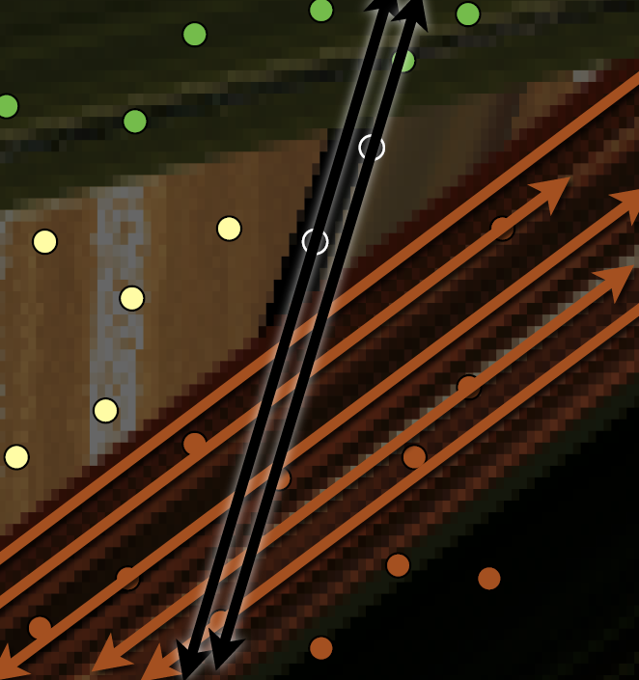
Exploiting anisotropy
Input: sparse sampling
Upsampling
Extrapolation along known slopes
Core challenge: visibility
Visibility events produce intersections
Detect by locally triangulating foreground samples

Slide 15
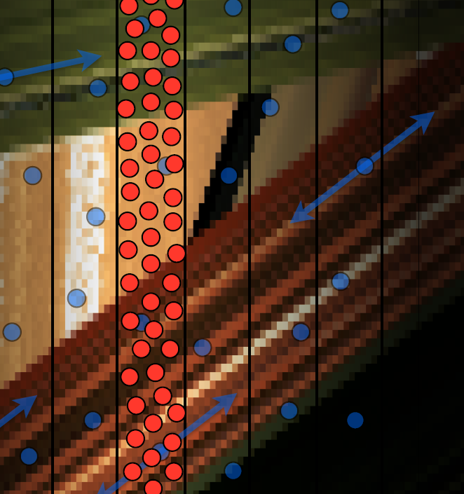
Summary
Input: sparse sampling
Upsampling
Extrapolation along known slopes
Resolve visibility
For each pixel, usual Monte Carlo integration of upsampled data

Slide 16
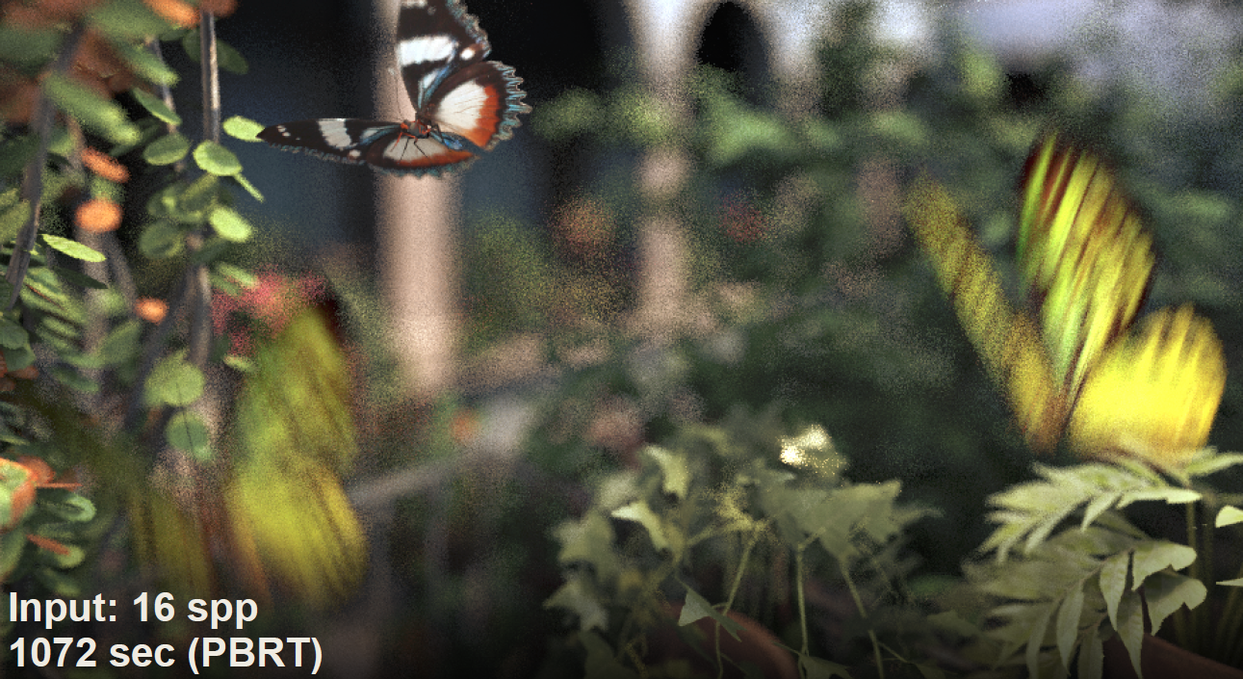
Results (depth of field, motion blur)

Slide 17
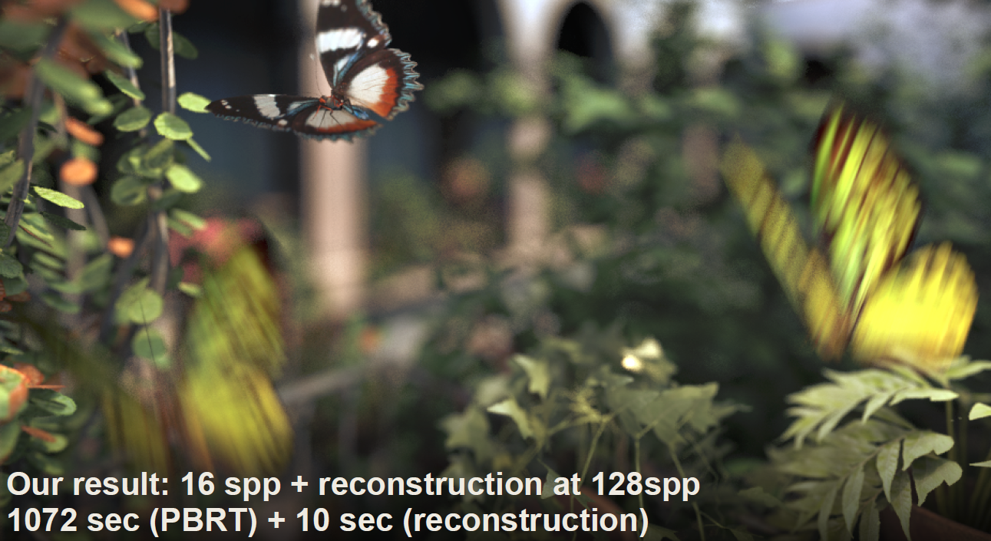
Results (depth of field, motion blur)

Slide 18
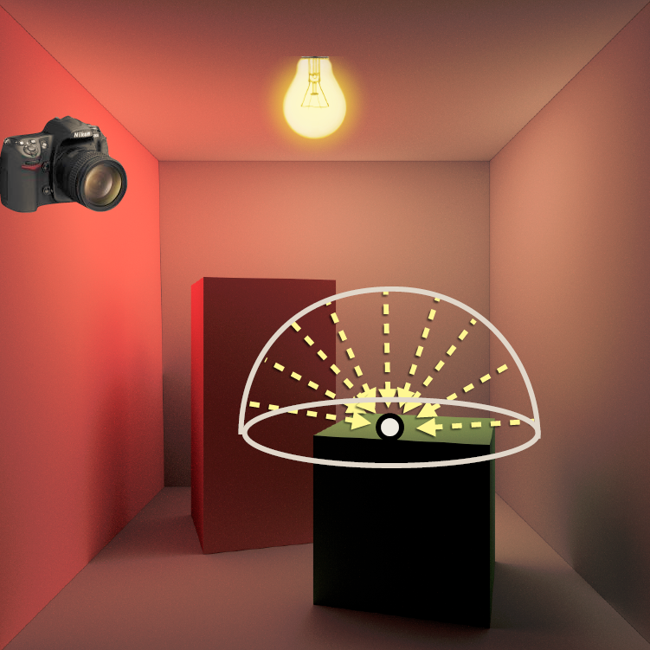
Extension to indirect illumination
Challenge: at each pixel, compute incident indirect illumination over hemisphere

Slide 19
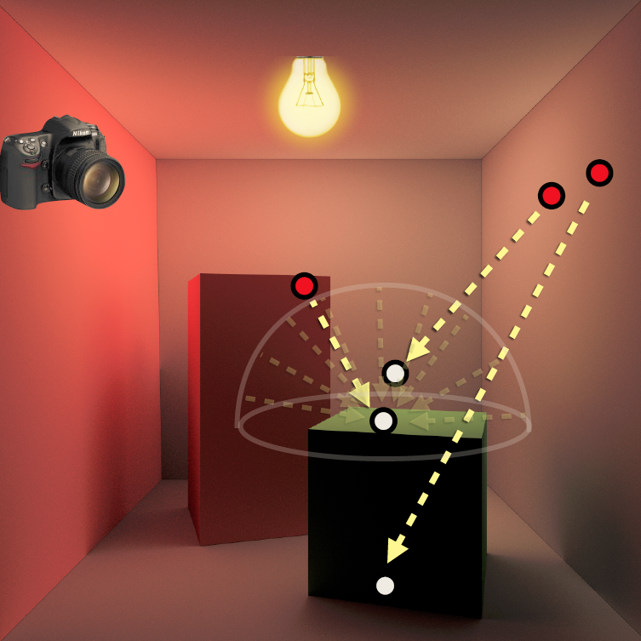
Extension to indirect illumination
Challenge: at each pixel, compute incident indirect illumination over hemisphere
Key idea: interpolate incident rays from sparsely sampled, scattered ray segments

Slide 20
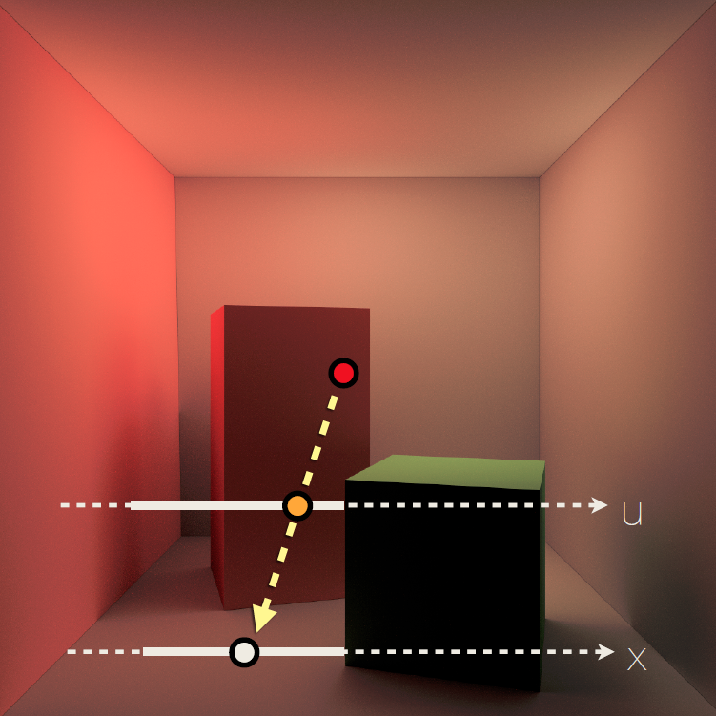
Light field parameterization
Represent incident rays using light field parameterization

Slide 21
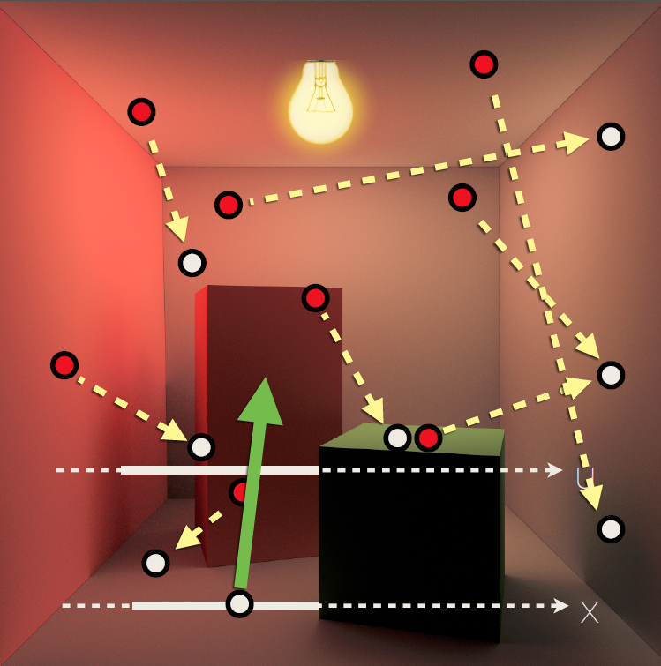
Approach
Input: path tracing with sparse samples
Store path segments for indirect illumination
Query incident ray by interpolating in light-field parameterization

Slide 22
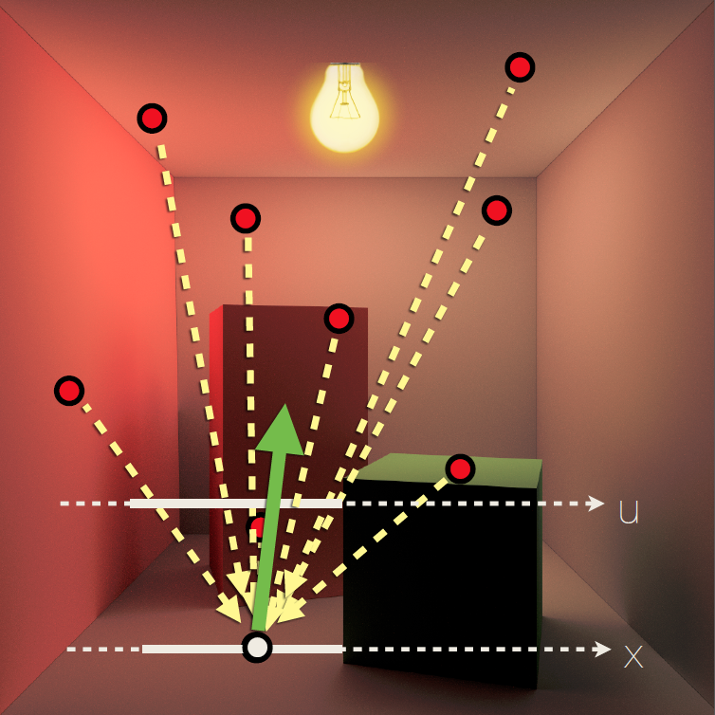
Interpolation
Reproject input sample rays into light field parameterization at query location
Interpolate at query ray
Challenges
Visibility
Non-diffuse surfaces

Slide 23
Visibility
Detect occlusions using a coarse point-based scene representation

Slide 24
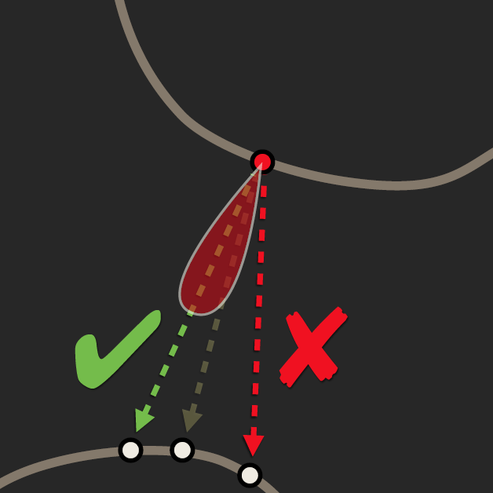
Glossy surfaces
Store glossy BRDF lobe
Use as weight when extrapolating sample

Slide 25
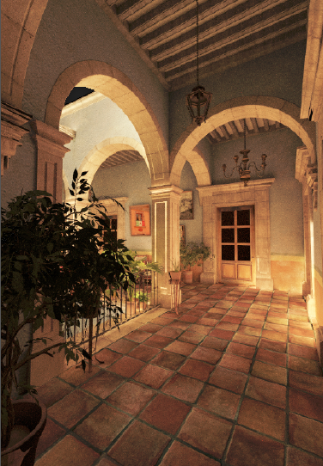
Results: diffuse indirect illumination
Input 8spp
Reconstruction
PBRT 512spp

Slide 26
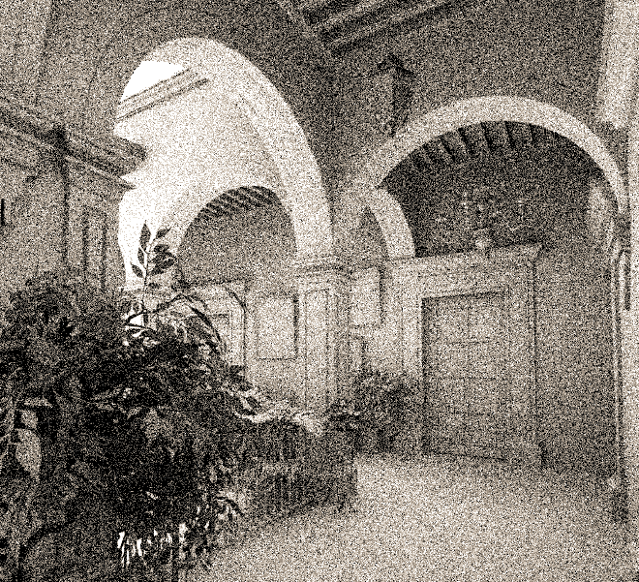
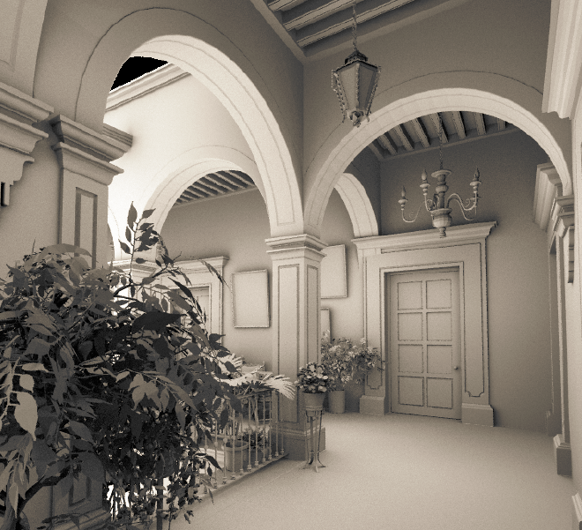
Results: ambient occlusion
Input 4spp
Reconstruction

Slide 27
Conclusions
Light field parameterization reveals anisotropic structure of incident light
Convenient representation for upsampling and interpolation
Easy to preserve light field structure
Good results from very sparse input
Challenges
Visibility
Glossy surfaces
Memory requirements

