Slide 1
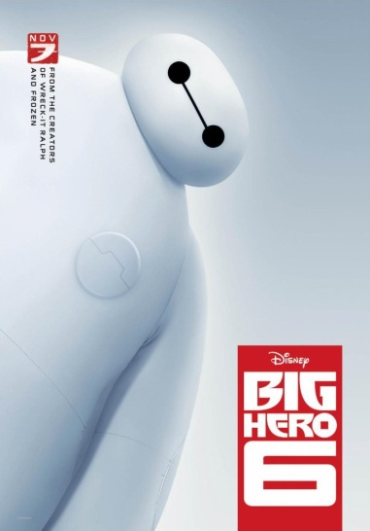
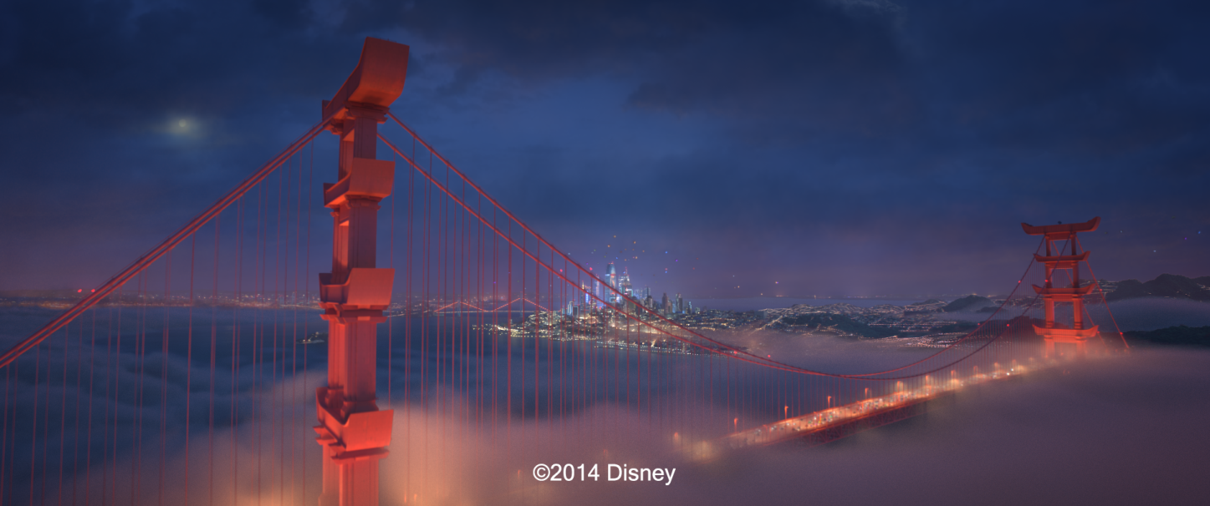
Conclusions
STAR documents great progress over last 5-7 years
Active area, more than 20 ACM TOG papers since 2010
Recent practical applications

Slide 2
Source code
Please see STAR for full list

Slide 3
Open challenges
Real-time applications
Animation sequences
Integration of a priori and a posterior techniques
Leverage theoretical foundations
Learning-based techniques
Sparse methods
Theoretical analysis, proof of lower bounds on sampling density

Slide 4
Thank you!
Funding agencies and partners
NSF, Intel, Nvidia, SNSF, NRF
Co-authors
M. Zwicker Univ. of Bern | W. Jarosz Disney Research | J. Lehtinen Aalto Univ. | B. Moon KAIST | R. Ramamoorthi UC San Diego
F. Rousselle Disney Research | P. Sen UC Santa Barbara | C. Soler INRIA | S.-E. Yoon KAIST

