Slide 1

Combining volumetric estimators
Jaroslav Křivánek
Charles University – Render Legion | Chaos Group
Notes:
In the previous parts of the course, we’ve seen a number of different estimators used in volumetric light transport: bidirectional path tracing, volumetric photon mapping, the beam radiance estimate, photon beams etc.
In this part of the course, we ask ourselves whether and how to combine them into a robust volumetric light transport algorithms.

Slide 2



Unifying points, beams, and paths in Volumetric light transport simulation
Jaroslav
Křivánek
Charles University
in Prague
Iliyan
Georgiev
Light Transportation Ltd.
Toshiya Hachisuka
Aarhus University
Petr
Vévoda
Charles University
in Prague
Martin
Šik
Charles University
in Prague
Derek Nowrouzezahrai
Univesity of Montreal
Wojciech
Jarosz
Disney Research Zurich
Notes:
The material is based on our SIGGRAPH paper from 2014

Slide 3
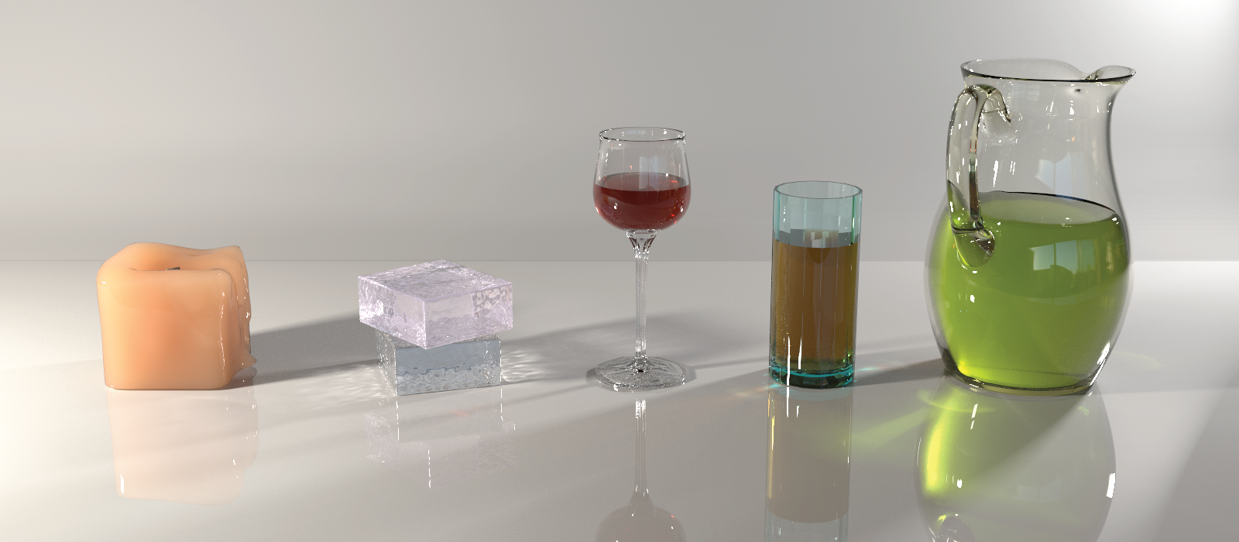
Goal: Robust rendering of media
Robust to: media properties, lighting
high scattering
low scattering
dense
rare
diffuse
lighting
focused
lighting
Notes:
Let us start by motivating the work.
Our aim to render participating media in a manner that is robust to media properties and to lighting.
We want to handle optically dense or rare media with high or low scattering albedo.
We want to handle diffusive multiple scattering (as in subsurface scattering) or highly focused lighting (as in volumetric caustics).
The algorithm we’ve developed has all these features and it was actually used to render the image shown here.

Slide 4
Existing volumetric rendering algorithms
MC path integration
  Path tracing [Kajiya ‘86, Rushmeier and Torrance ‘88]
  Bidirectional path tracing [Lafortune and Willems ‘96]
Photon density estimation
  Volumetric photon mapping [Jensen and Christensen ‘98]
  Beam radiance estimate [Jarosz et al. ‘08]
  Photon beams [Jarosz et al. ‘11]
No existing algorithm can handle all cases
Notes:
Existing approaches for volumetric light transport can be divided into two categories.
First, we have Monte Carlo path integration, such as bidirectional path tracing.
And second, we have techniques derived from photon density estimation, such as volumetric photon mapping, the beam radiance estimate, or photon beams.
While each of these techniques is great in certain types of media, it may fail for other types.
Our aim is to address this problem.

Slide 5
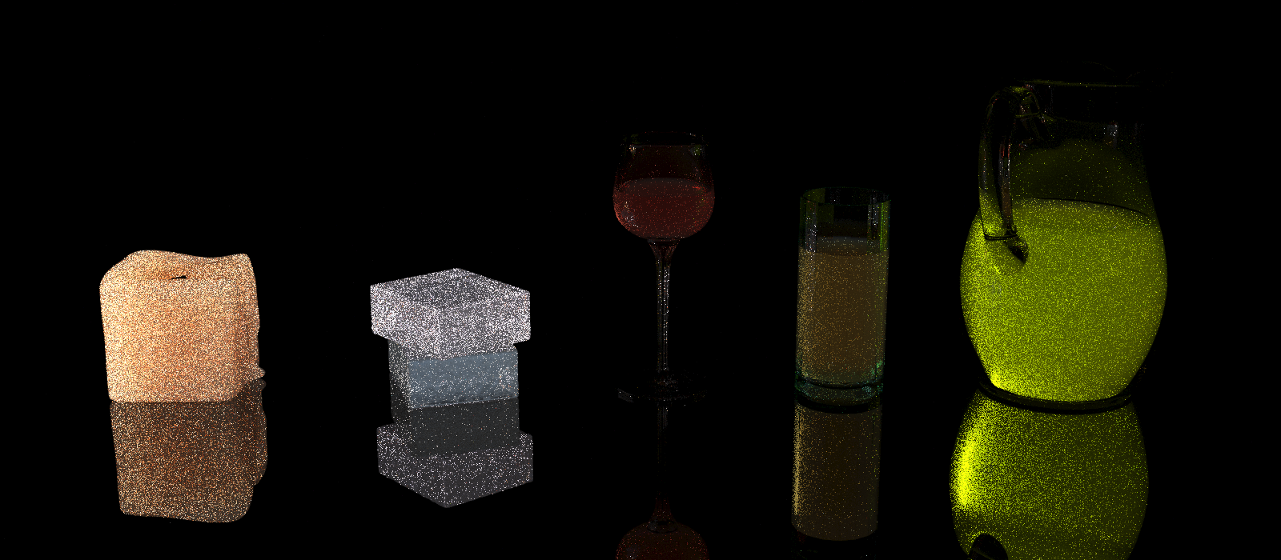
Bidirectional path tracing
1 hour
Notes:
To further motivate our work, let’s look at the volumetric light transport in the previously shown scene as rendered by some of the existing algorithms.
This is bidirectional path tracing, and we can see that the image is pretty noisy even after an hour.

Slide 6
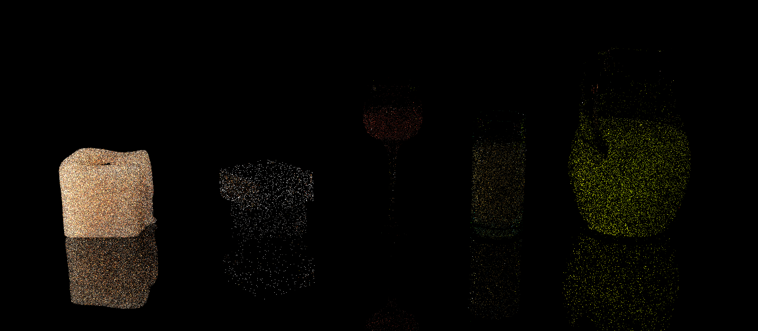
Volumetric photon mapping
1 hour
Notes:
Volumetric photon mapping

Slide 7
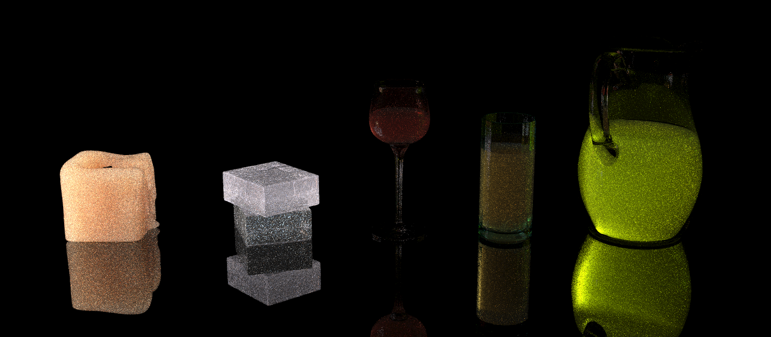
Beam radiance estimate
1 hour
Notes:
Beam radiance estimate, much better but still not great.

Slide 8
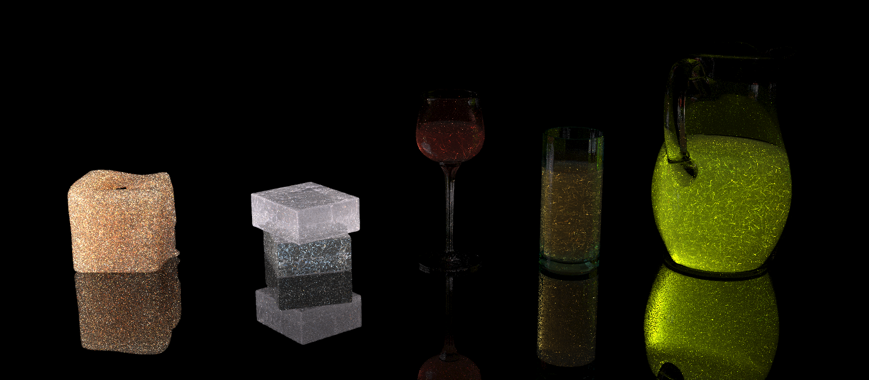
Photon beams
1 hour
Notes:
Photon beams.

Slide 9
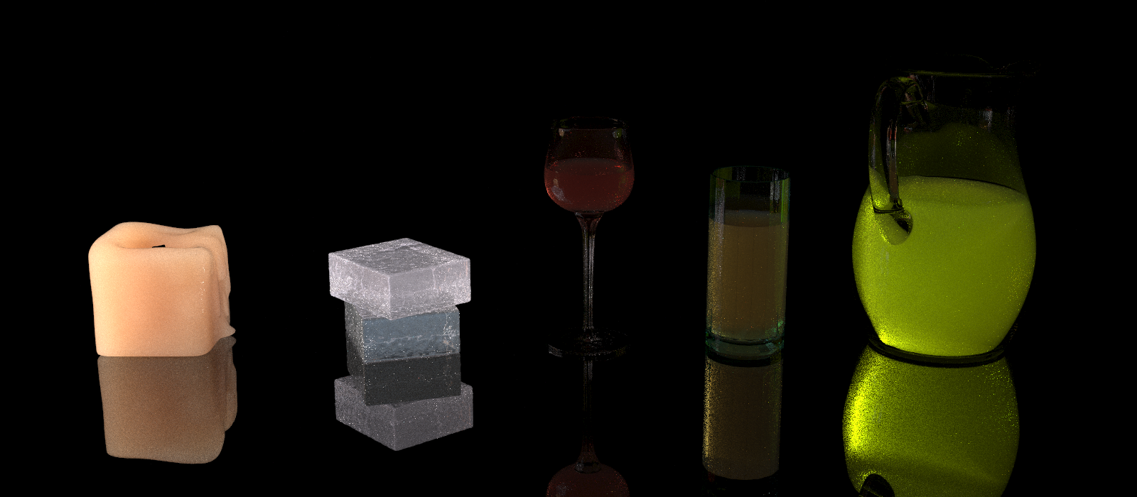
UPBP algorithm
1 hour
Notes:
And finally, the combined UPBP algorithm is able to produce a much cleaner image in the same amount of time.

Slide 10
Approach: Combine estimators
  Multiple Importance Sampling [Veach and Guibas ‘95]
Previous work
  Bidirectional path tracing (BPT) [Veach and Guibas ‘95]
  Vertex connection and merging (VCM) [Georgiev et al. ‘12]
  Unified path sampling (UPS) [Hachisuka et al. ‘12]
Our algorithm
  “Unified points beams and paths” (UPBP)
Notes:
To achieve these results, we follow previous work that has shown that combining different estimators using Multiple Importance Sampling is a good way to achieve robustness.
Notably, the Vertex Connection and Merging and Unified Path Sampling frameworks have recently combined MC path integration with photon density estimation.
We apply the idea of combining estimators to volumetric light transport.
We call the resulting algorithm “unified points, beams and paths” (UPBP) to reflect the multitude of different estimators in the mixture.

Slide 11
Contributions
“Does it make sense to combine the estimators?”
  Variance analysis of estimators
“How can we combine the estimators?”
  Extended multiple importance sampling
“How do we make the method practical?”
  A combined volume rendering algorithm
Notes:
We have addressed some interesting open questions related to combining estimators in volumetric light transport.
First, there are more estimators in volumes than on surfaces.
Do they have some complementary advantages to justify their combination?
To answer this question, we derived their variance and found out that the variance behavior is indeed complementary, so the combination makes sense.
And as a bonus, we’ve shown that there is a very tight connection between what we in graphics call the photon points and beams and the so-called collision and track-length estimators used in neutron transport.
This is probably the most significant contribution of the UPBP paper.
The second question is how exactly to combine the estimators.
To do this, we’ve developed a new generalization of Multiple Importance Sampling.
Third, we developed a practical combined rendering algorithm robust to different media properties.
Before giving details on these points....

Slide 12
Volumetric Photon Density estimators
Notes:
… let me briefly review the different volumetric photon density estimators.

Slide 13


RADIANCE
REP.:
photon points
photon beams
QUERY
point
Point - Point
Beam - Point
beam
Point - Beam
Beam - Point
[Jarosz et al. ’11a]
Notes:
Photon density estimation works in two passes.
In the first pass, we trace paths from light sources and store a representation of equilibrium radiance.
In media, we can represent the radiance either by particles or photon points, or by particle tracks, or photon beams.
In the second pass, we query this representation to render an image.
Here, we can use a radiance estimate at a certain query point, or along an entire ray, or query beam.
This gives us four basic types of estimators: Point-point, Beam-point, Point-Beam, Beam-Beam.

Slide 14
“Long” vs. “short” beams
[Jarosz et al. ’11b]
Photon beams
Query beams
  The same story
surface
“Short” beams
“Long” beams
Notes:
In addition, the photon beams may either be limited to the actual trajectory of the path that generated them, which we call “short” beams.
Or they may extend all the way to the next surface (or to infinity, if the medium is not bounded), which we call “long” beams.
This difference has a significant impact on the estimator variance.
We can apply the exact same thing also to the query beams, so we can have short and long query beams.

Slide 15

Bottom line: Many estimators
Points
Points
×
“Short” Beams
“Short” Beams
“Long” Beams
“Long” Beams
Notes:
The bottom line is, there are many volumetric estimators.
Does it make sense to combine them?

Slide 16
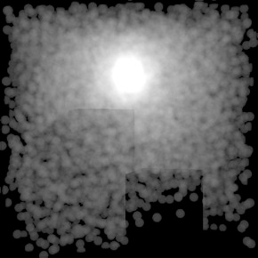
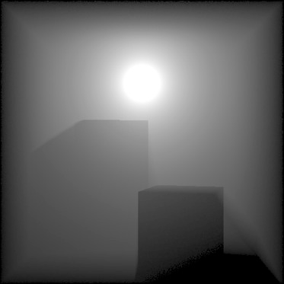
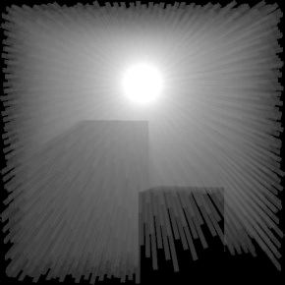
Why combine points and beams?
Won’t photon beams always outperform photon points?
100k photon points
reference
5k photon beams
from [Jarosz et al. ’11a]
Notes:
For example, intuitively, one could expect that because the beams fill up the space so much faster, they might be always better than points.
But our analysis shows that while photon beams are great in some media, they may be outperformed by points in other media.

Slide 17
Variance analysis
Notes:
To asses the performance of the different estimators, we derived their variance in a canonical configuration.

Slide 18
Variance analysis – Canonical setup
Notes:
The configuration that we consider consists of two fixed perpendicular rays in a homogeneous medium.
The green one is at the end of a light sub-path and the red one at the end of an eye sub-path.
We choose a constant cube kernel and assume that both rays pass through the kernel.
In rendering, this configuration is sampled randomly which incurs some extra variance.
But this variance is the same for all the estimators so we won’t need to worry about it here because our goal is to compare the variance of the different estimators.

Slide 19
Variance analysis – Expected value
transmittance
transmittance
Notes:
To simplify the diagram, I’ll draw it in flatland.
In this setup, the expected value of the estimators is the integral of transmittance over the kernel along the light ray …
… times the same thing for the eye ray.
And each of the estimators estimates this value in a different way with different variance for which we have derived analytical expressions.
And this variance depends in an interesting way on the size of the kernel compared to the mean free path of the medium.

Slide 20
Variance analysis – Estimators
“Long” beam
“Short” beam
Point
transmittance
Notes:
Let’s have a closer look at how the integral is estimated by the three estimator types along one of the two rays.
The long beam estimator shoots an infinite ray and simply always return the right answer calculated analytically, which is a zero-variance estimators of the integral.
The short beam estimator samples a finite ray with length proportional to transmittance and returns the length of the portion of the ray that lies inside the kernel. This could be zero if the ray does not reach the kernel. The variance in this case is non-zero and stems from two factors: whether or not the kernel is reached at all, and if it is, what portion of the ray actually lies inside the kernel.
The point estimator samples a finite ray as before, but it returns a constant number if the end point fall within the kernel and zero otherwise. So the variance is only due to the chance of ‘hitting’ the kernel.
Let’s now explain the variance behavior of the short beam and point estimators on an intuitive level:
If the kernel is really large, the point estimator will have low variance because it often hits the kernel and there is not other source of variance. The short beam, on the other hand, will show high variance because of the varying length of the ray segment that overlaps the kernel.
If, on the other hand, the kernel is small, the point estimator will have a high variance because it will have hard times sampling a position in the kernel. The short beam variance will be low because the variability of the ray segment over the kernel will be small (simply because the kernel itself is small).

Slide 21
Variance analysis results
rare
media
dense
media
normalized
std. dev. (NSD)
Short beam – B_{l}
Point – B_{l}
0
1
4
kernel width [mean free path]
Notes:
Let’s now plot the normalized standard deviation (NSD), which is a measure of relative variance, against the kernel width (expressed in the units of the mean free path length of the medium).
Equivalently, if we fix the kernel size, the horizontal axis tells us how dense or rare the medium is.
On the left there are rare media or small kernels, on the right, there are dense media or large kernels.
We plot the NSD for two selected estimators, short-beam – long-beam and point – long-beam.
The long beam contributes zero variance, so we’re really comparing short beams to points.
And we see that while the NSD happens to be constant for the short beams, it has an interesting behavior for the points.
As the kernel gets smaller, or equivalently, the medium gets thinner, the NSD of the point estimator diverges.
On the other hand, for large kernels or dense media, the NSD of points approaches zero.
There’s a cross point between the short beams and points at the kernel width of 1 mean free path.
This behavior exactly corresponds to the intuition given on the previous slide.

Slide 22
Variance analysis results
rare media
dense media


beams:


points:
Notes:
The take-home message from this analysis is: beams are better in rare media, where the mean free path is much longer than the kernel size.
On the other hand, in dense media, when the mfp is shorter than the kernel size, points perform better.
We believe this is a really interesting results, and we consider the variance analysis one of the major contributions of the paper, because so far, the relative performance of point- and beam-based estimators has been unknown.

Slide 23
“How to combine?”
Extended MIS
Notes:
The next question is, how to combine the estimators.
To do this, we’ve developed a new generalization, or extension of Multiple Importance Sampling.

Slide 24
Our MIS extension
Extended MIS – accommodate all the different estimators
Compatible with RR interpretation of density estimation kernels (like VCM [Georgiev et al. ‘12])
Alternative view: extended path space [Hachisuka et al. ’12, Hachisuka et al. ’17]
Notes:
Why can’t we use the MIS as is?
The problem is that blurring by the density estimation kernel corresponds to extra integral dimensions over the usual path integral.
So we are actually combining estimators of integrals over spaces of different dimension and the original MIS just isn’t designed to do this.
We extend the MIS to directly recognize that some of the estimators in the mixture may have some extra dimensions.
We’ve also developed the corresponding balance heuristic that allows us to calculate the combination weights.
The result is compatible with the VCM and UPS frameworks but our formulation is more general and possibly applicable beyond the problem of combining volumetric estimators.

Slide 25
“How to implement IT?”
The Combined algorithm
Notes:
Now we have a lot of theory and we want to use it to implement a practical combined algorithm. And that’s a matter of engineering design.

Slide 26
Estimator choice
Point-Point
Beam-Point
Point-Beam
Beam-Beam
Notes:
First, we need to choose the estimators to combine.
We use the point-point, point-beam, beam-beam estimators.
We do not use Beam-Point estimator because it has similar properties to the Point-Beam but its implementation is much less efficient.

Slide 27
“Long” vs. “short” beams
“Short” photon beams
“Long” query beams
Notes:
Second, it makes little sense to combine long and short beam version of the same estimator so we need to choose one.
In our test, the best performance was obtained with short photon beams but we use long query beams.

Slide 28
Family of estimators
+ Bidirectional path tracing
Notes:
And we add the sampling techniques from bidirectional path tracing.

Slide 29
UPBP – Algorithm overview
Light tracing
surface
Notes:
Here’s how the algorithm works.
In each iteration we start by tracing a number of paths from the light sources.
We connect their vertices to the eye, which corresponds to light tracing.
We store the vertices as photon points, and the path segments as photon beams.
And we do this for multiple paths from the lights.

Slide 30
UPBP – Algorithm overview
Beam-Beam
Point-Beam
surface
Notes:
In the second phase of the iteration, we trace eye paths through each pixel.
For each segment of the path, we look up the photons and evaluate to the point-beam estimator.
We then look up the beams, which is the beam-beam estimator.

Slide 31
UPBP – Algorithm overview
BPT
surface
Notes:
After that, we sample the scattering distance along the eye ray and connect to the light path vertices. This corresponds to bidirectional path tracing.

Slide 32
UPBP – Algorithm overview
Point-Point
surface
Notes:
Then we query the photons around the scattering location and evaluate the point-point estimator.

Slide 33
UPBP – Algorithm overview
surface
Notes:
And then we extend the eye path and repeat.

Slide 34
RESULTS
Notes:
Let’s see what the algorithm does.

Slide 35
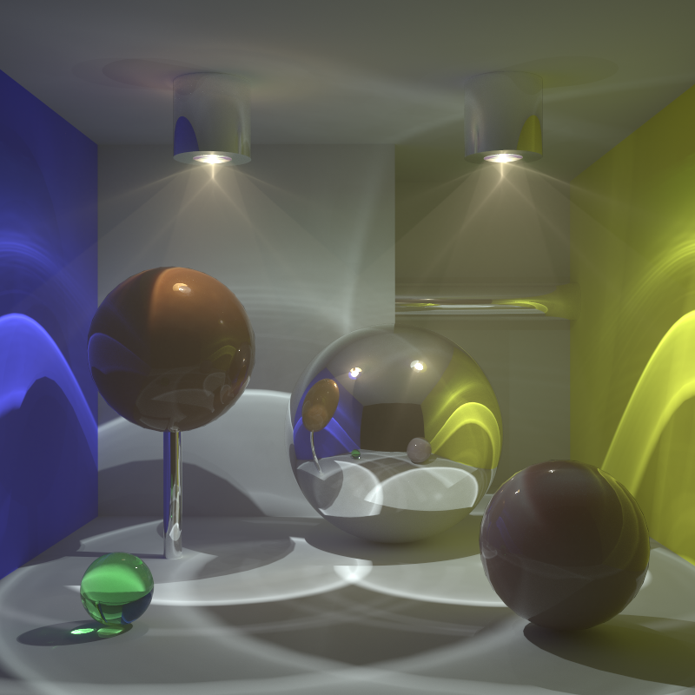
Full transport
rare, fwd-scattering fog
back-scattering
high albedo
back-scattering
Notes:
We have set up this test scene which is filled with rare, forward scattering fog.
There are two spheres filled with a dense back-scattering medium.
And the scene is illuminated almost entirely by caustic lighting.

Slide 36
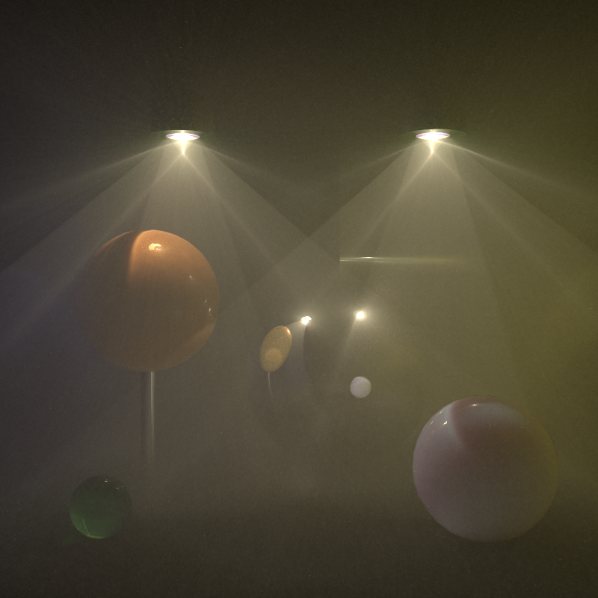
Medium transport only
Notes:
For the algorithm comparison, we again consider only transport in media.

Slide 37
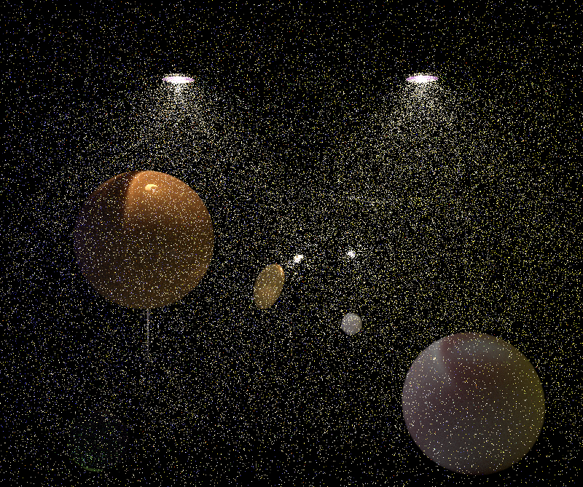

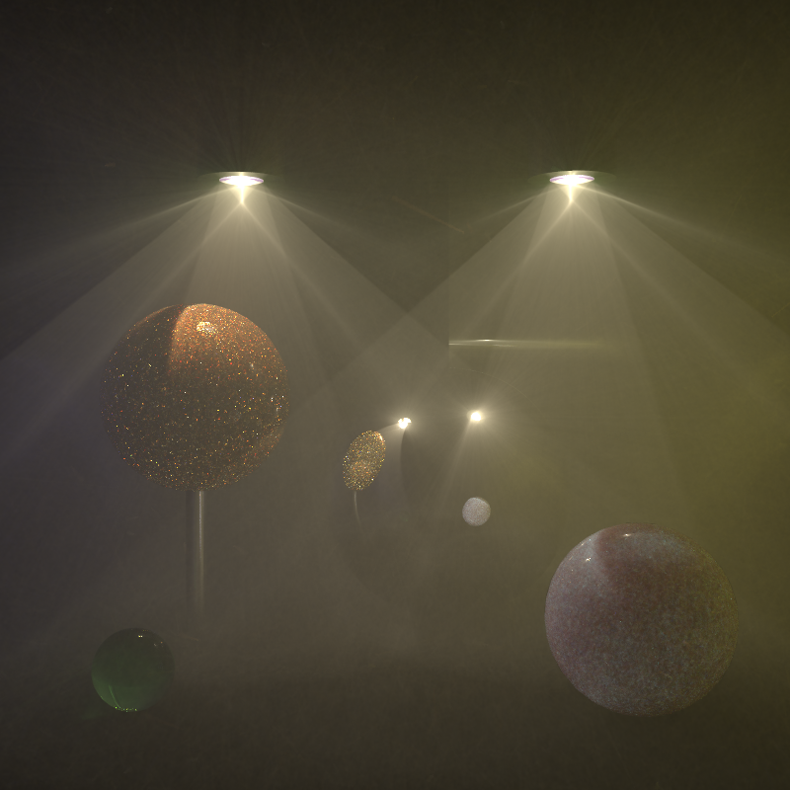
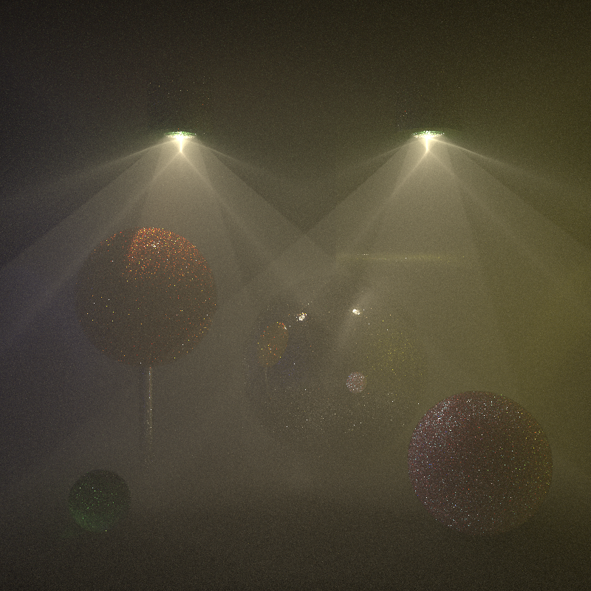
Previous work comparison, 1 hr
Point-Point 3D (≈vol. ph. map.)
Point-Beam 2D (=BRE)
Beam-Beam 1D (=photon beams)
Bidirectional PT
Notes:
And here’s how the previous work does.
The point-point estimator, which is equivalent to volumetric photon mapping without ray marching, does a pretty good job at rendering the dense spheres but cannot handle the sparser fog.
The point-beam estimator, or the beam radiance estimate, does a much better job at rendering the fog, though it still fairly noisy as you can see in the inset.
The beam-beam estimator, or photon beams, provides excellent results for the fog, bug the spheres suffer from some nasty noisy artifacts.
Bidir handles the fog quite well, though not as well as the photon beams. It produces bad artifacts in the dense spheres because much of the illumination there is essentially a reflected caustic.

Slide 38
Previous work comparison, 1 hr
Point-Point 3D
Point-Beam 2D
Beam-Beam 1D
Bidirectional PT

Slide 39
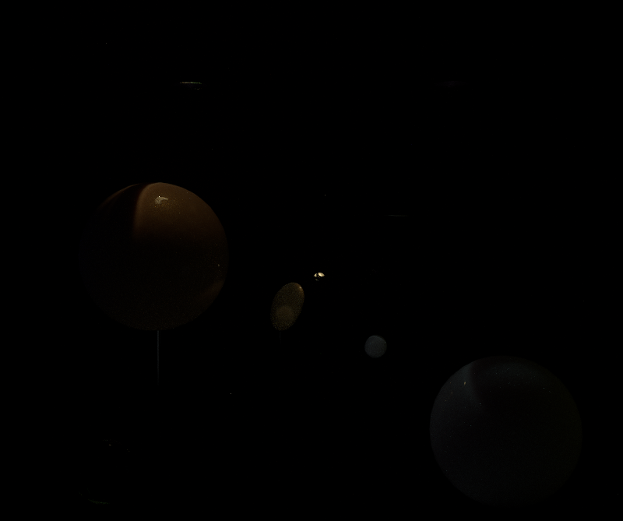
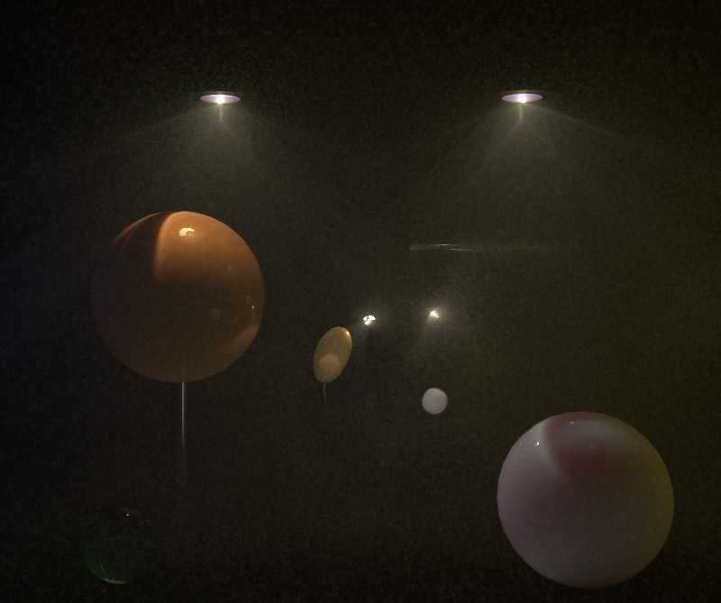
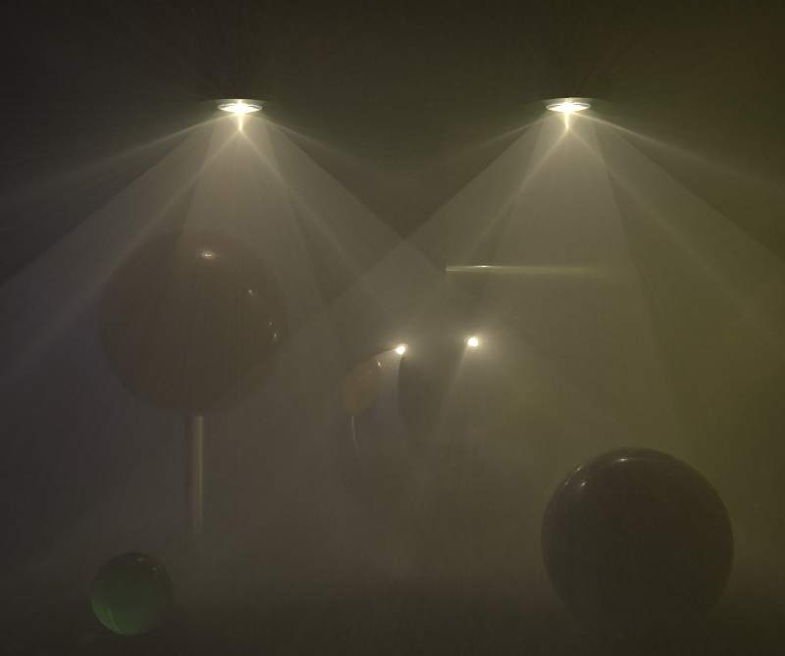
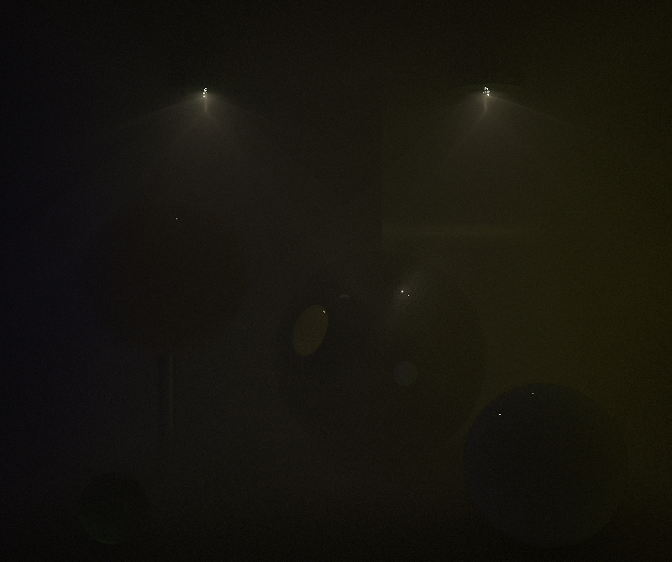
Point-Point 3D
Point-Beam 2D
Weighted contributions
Beam-Beam 1D
Bidirectional PT
Notes:
Let us now inspect the MIS-weighted contribution of the individual estimators to our combined result.
PP, PB, BB, BPT.
We see that most of the image is made up from the contributions of the point-beam and beam-beam estimators, where the point-beam takes care of rendering the dense, back-scattering spheres, and the beam-beam estimator renders the rarer fog.
Bidirectional path tracing contributes mostly the surface-to-medium transport, which is visible as the blue tint of the right sphere.

Slide 40
UPBP, 1 hr
Notes:
Our algorithm is able to take the best from the individual techniques to produce a much cleaner image.

Slide 41

Notes:
I’ve already shown the results for this scene…

Slide 42
UPBP
Beam-Point 2D (BRE)
Beam-Beam 1D (photon beams)
Notes:
… but I want to use it to point out that in this case, even though none of the previous algorithm handles this scene well, the combination is almost clear.
This provides some evidence that our MIS-based combination is more robust than a heuristic combination that would be based on selecting a particular estimator for each medium.

Slide 43
Limitations & future work
Efficiency-based combination
Overhead
  Number of samples from different estimators
Notes:
Of course our work does not come without its limitations.
First, tThe estimator combination relies only on the variance considerations, but taking bias and efficiency into account could significantly improve the results.
Having a solid theory that would tell us how many samples to take from each estimator would be extremely useful, especially in the cases where some estimators could be completely disabled.

Slide 44
Take-home message
rare media
dense media


beams:


points:
Notes:
The take-home message from this talk could be: Beams are not always better than points.
Beams are great for rare media.
But dense media are better handled by points.
We have provided evidence for this through our theoretical variance analysis and the rendered images.

Slide 45
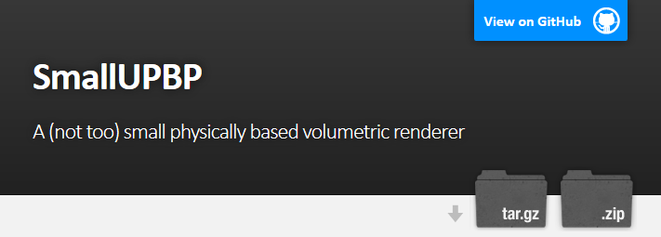
Source code
http://www.smallupbp.com/
Notes:
The source code that was used to generate all our results is available, including scripts to reproduce all the results.
It’s called SmallUPBP for historical reasons – it’s built on SmallVCM, but it’s not really that small anymore.

Slide 46
Acknowledgment
Funding: Czech Science Foundation (16-18964S)

