Slide 1
CS 10:
Problem solving via Object Oriented Programming
Animated Images

Slide 2
Agenda
Multiple blobs: lists
Images
Animated images
Notes:
Today we will look at handling multiple objects and store them in a list. We’ll then use the list to store images and animate them.

Slide 3
Java provides an ArrayList that can hold a collection of objects
ArrayList
Stores list of objects in order
Variable length – don’t specify size; can grow (unlike C array, but like Python List)
Random access – get item by index (starting at 0)
Must be imported from java.util (IntelliJ can help!)
Provides methods to add or remove elements
Specify what type of object it holds in angle brackets <> (e.g., ArrayList<Blob> or ArrayList<String>)
ArrayList called a generic container because it can hold any type of object
All objects must be of same type (unlike Python)

Slide 4
ArrayList methods provide a consistent means of interaction
ArrayList methods
add (E elmt) – appends element elmt to end of list
add (int index, E elmt) – inserts element elmt at position index
get (int index) – returns the element at position index
remove (int index) – removes (and returns) the element at position index
set(int index, E elmt) – sets item at position index to elmt
size() – returns the number of elements in the ArrayList
Others on Oracle website
Notes:
You’ll see this type of interaction again and again in this course – example of polymorphism
E means object type

Slide 5
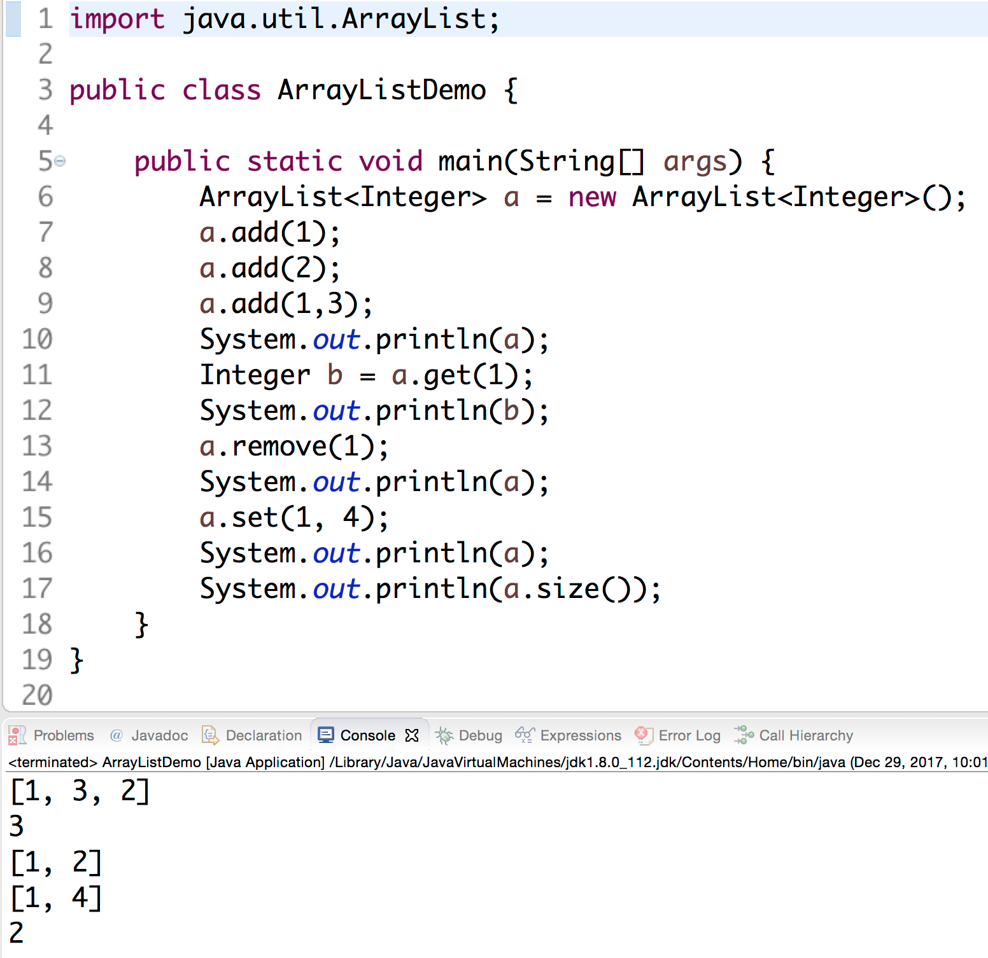
ArrayListDemo.java: ArrayLists can hold multiple objects; provide useful methods
Provide type of objects ArrayList will hold in <> brackets (can’t be primitive)
Integer is the object version of int
ArrayLists can hold only one type of object (unlike Python)
ArrayLists called generic containers because can hold any type of object (Integers, Doubles, Strings, Blobs)
Don’t need to specify length of ArrayList, it can grow (unlike C array)
Must import Arraylist
IntelliJ Settings/Preferences
Select Editor->General->Auto Import
Check the "Add unambiguous imports on the fly"

Slide 6
ArrayListDemo.java: ArrayLists can hold multiple objects, provide useful methods
add(E elmt) appends item to end of ArrayList
  E = type (Integer here)
  elmt = object (element) to add to ArrayList

Slide 7
ArrayListDemo.java: ArrayLists can hold multiple objects, provide useful methods
add(E elmt) appends item to end of ArrayList
  E = type (Integer here)
  elmt = object (element) to add to ArrayList
ArrayList a
1

Slide 8
ArrayListDemo.java: ArrayLists can hold multiple objects, provide useful methods
add(E elmt) appends item to end of ArrayList
  E = type (Integer here)
  elmt = object (element) to add to ArrayList
ArrayList a
1
2

Slide 9
ArrayListDemo.java: ArrayLists can hold multiple objects, provide useful methods
add(int i, E elmt) adds item at index i
ArrayLists are zero indexed (start at index 0, unlike Matlab)
Items slide right to make room
ArrayList a
1
2

Slide 10
ArrayListDemo.java: ArrayLists can hold multiple objects, provide useful methods
add(int i, E elmt) adds item at index i
ArrayLists are zero indexed (start at index 0, unlike Matlab)
Items slide right to make room
ArrayList a
1
3
2

Slide 11
ArrayListDemo.java: ArrayLists can hold multiple objects, provide useful methods
add(int i, E elmt) adds item at index i
ArrayLists are zero indexed (start at index 0, unlike Matlab)
Items slide right to make room
ArrayList a
1
3
2

Slide 12
ArrayListDemo.java: ArrayLists can hold multiple objects, provide useful methods
ArrayLists provide random access (can get item from anywhere)
get(int i) returns item at index i
Remember zero-based indexing!
ArrayList a
1
3
2

Slide 13
ArrayListDemo.java: ArrayLists can hold multiple objects, provide useful methods
ArrayLists provide random access (can get item from anywhere)
get(int i) returns item at index i
Remember zero-based indexing!
ArrayList a
1
3
2

Slide 14
ArrayListDemo.java: ArrayLists can hold multiple objects, provide useful methods
Can remove item from anywhere in ArrayList
remove(int i) removes item at index i and “pushes” remaining items left
ArrayList a
1
3
2

Slide 15
ArrayListDemo.java: ArrayLists can hold multiple objects, provide useful methods
Can remove item from anywhere in ArrayList
remove(int i) removes item at index i and “pushes” remaining items left
ArrayList a
1
3
2

Slide 16
ArrayListDemo.java: ArrayLists can hold multiple objects, provide useful methods
set(int i, E elmt) sets the item at index i to elmt
ArrayList a
1
2

Slide 17
ArrayListDemo.java: ArrayLists can hold multiple objects, provide useful methods
set(int i, E elmt) sets the item at index i to elmt
ArrayList a
1
4

Slide 18
ArrayListDemo.java: ArrayLists can hold multiple objects, provide useful methods
size() returns the number of items stored in the ArrayList
ArrayList a
1
4

Slide 19
ArrayListDemo.java: ArrayLists can hold multiple objects, provide useful methods
size() returns the number of items stored in the ArrayList
ArrayList a
1
4

Slide 20
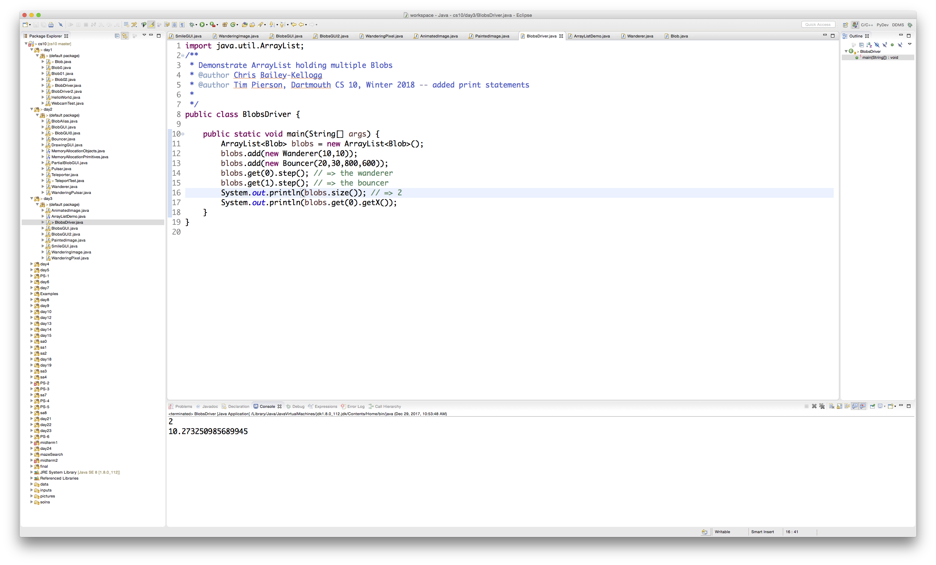
BlobsDriver.java: ArrayList holds multiple Blobs, each of different subclass
ArrayList to hold multiple Blob objects

Slide 21
BlobsDriver.java: ArrayList holds multiple Blobs, each of different subclass
ArrayList to hold multiple Blob objects
Because each subclass (e.g., Wanderer, Bouncer) “is a” Blob, Java allows adding objects that are subclasses from Blob base class

Slide 22
BlobsDriver.java: ArrayList holds multiple Blobs, each of different subclass
ArrayList to hold multiple Blob objects
Because each subclass (e.g., Wanderer, Bouncer) “is a” Blob, Java allows adding objects that are subclasses from Blob base class
Use get(i) to access Blobs stored in ArrayList at index i

Slide 23
BlobsDriver.java: ArrayList holds multiple Blobs, each of different subclass
ArrayList to hold multiple Blob objects
Because each subclass (e.g., Wanderer, Bouncer) “is a” Blob, Java allows adding objects that are subclasses from Blob base class
Use get(i) to access Blobs stored in ArrayList at index i
Can call object methods after getting (e.g., call getX() after getting Blob at index 0)

Slide 24
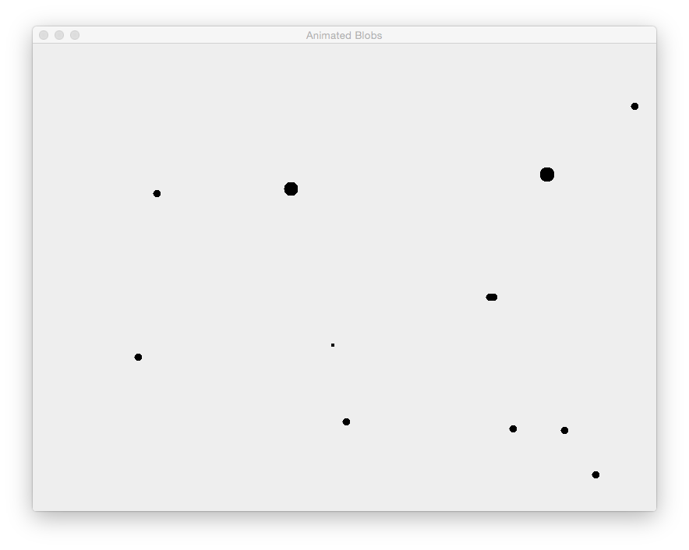
BlobsGUI.java uses an ArrayList to store multiple Blobs
Pulsars
Wanderers
Bouncers

Slide 25
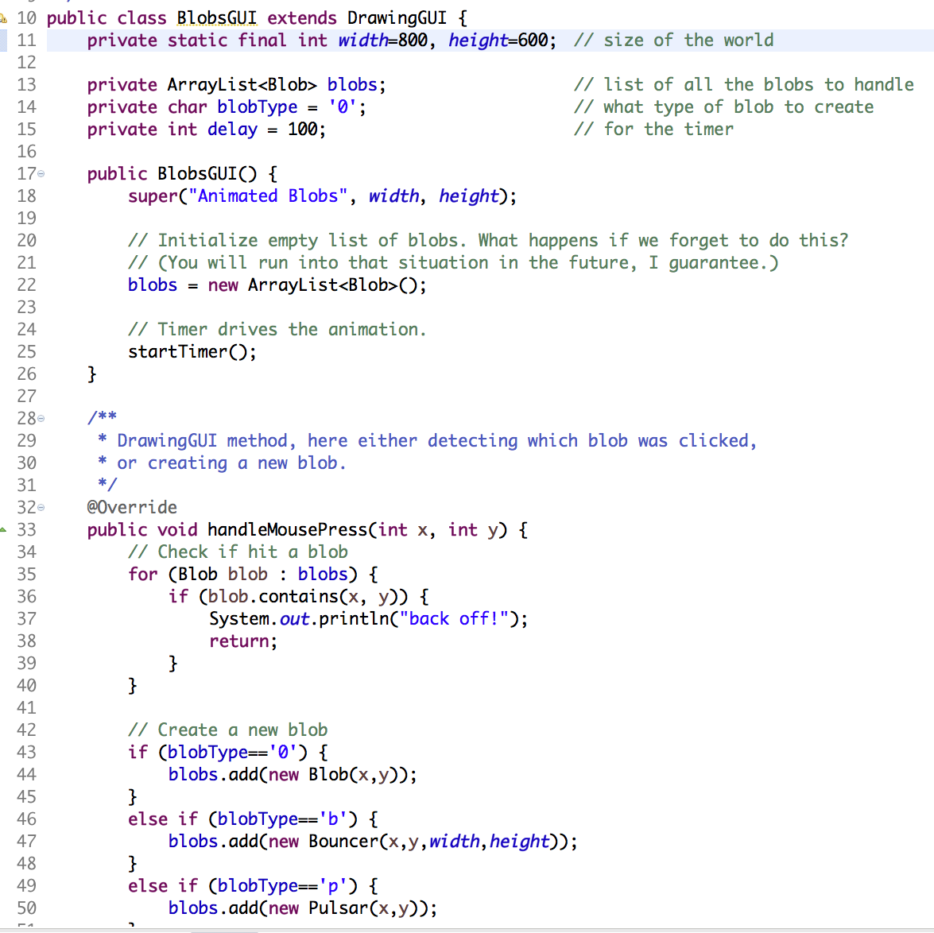
BlobsGUI.java uses an ArrayList to store multiple Blobs
ArrayList to hold multiple Blob objects (previously only one Blob)
blobType keeps track of what kind of blob to add next (changed on keypress)

Slide 26
BlobsGUI.java uses an ArrayList to store multiple Blobs
On mouse press, check to see if mouse is inside any Blob (return if true)
This is a for-each loop
Read as “for each blob in blobs”
Loops through each blob object in ArrayList blobs, one at a time
Same as Python (strange for C folks)

Slide 27
BlobsGUI.java uses an ArrayList to store multiple Blobs
On mouse press, check to see if mouse is inside any Blob (return if true)
This is a for-each loop
Read as “for each blob in blobs”
Loops through each blob object in ArrayList blobs, one at a time
Same as Python (strange for C folks)
Add new blob to ArrayList each time mouse clicked if mouse not inside any Blob

Slide 28
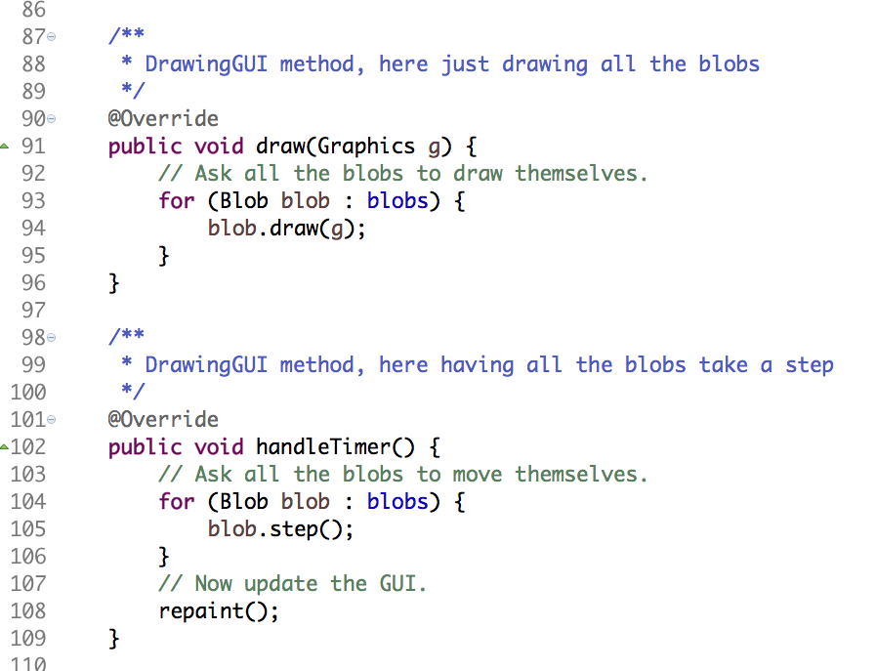
BlobsGUI.java uses an ArrayList to store multiple Blobs
draw() and handleTimer() each use the for-each loop to draw and step each of the Blobs in the ArrayList

Slide 29
Agenda
Multiple blobs: lists
Images
Animated images

Slide 30
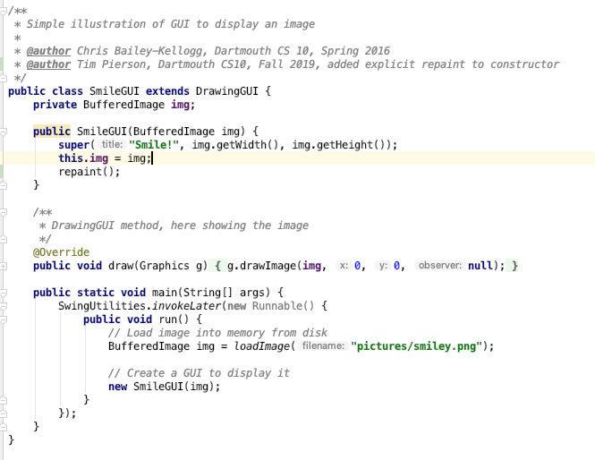
SmileGUI.java: DrawingGUI has method to load and store images in a BufferedImage
BufferedImage instance variable to hold image that will be loaded from disk
BufferedImage has helpful getWidth() and getHeight() methods
Store image in instance variable
Trigger draw() method
Override draw() to show image instead of asking each Blob to draw itself
Remember draw() is called by repaint()
Load image from disk with loadImage() method
Call constructor, passing newly loaded image

Slide 31

SmileGUI.java: DrawingGUI has method to load and store images in a BufferedImage
Result

Slide 32
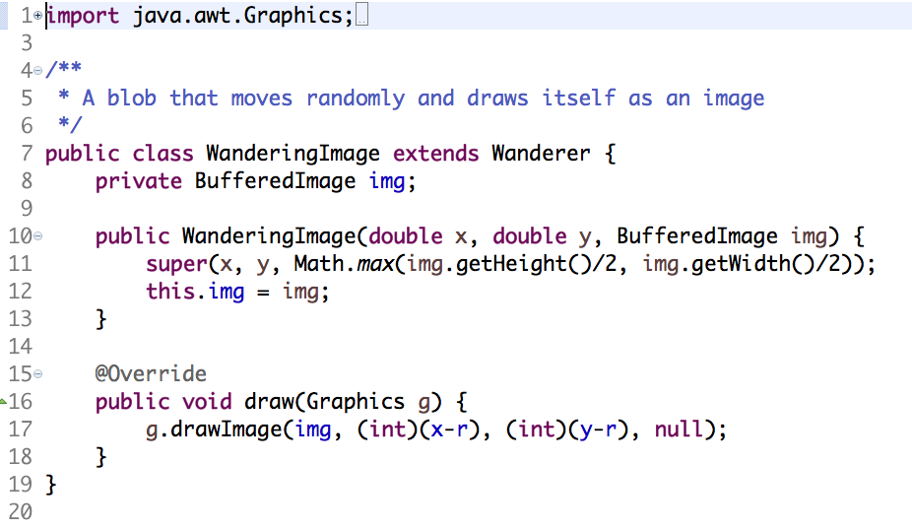
WanderingImage.java: Creates a new Blob subclass that shows image instead of oval
Inherit from Wanderer, no need to duplicate code
Store image in BufferedImage instance variable
Call Wander constructor
Set r based on max of height or width
Save image in constructor
Override Wanderer’s draw() function to show image instead of calling fillOval()
Note how little code has to change for the Blob to do something completely different (this is all the code for the WanderingImage class)
BlobGUI2.java makes minor tweak to add ability to use WanderingImage Blobs on graphics

Slide 33
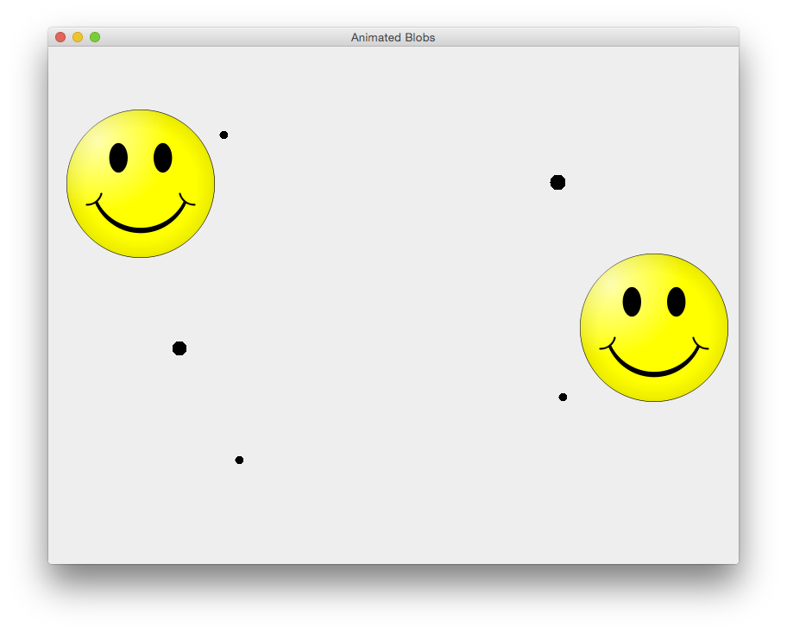
BlobGUI2: Can now add WanderingImage Blobs
Bouncer
Pulsar
WanderingImages
Pulsar
Bouncer

Slide 34
Agenda
Multiple blobs: lists
Images
Animated images

Slide 35
Java can represent colors as a 24-bit integer
Bit
23 16 15 8 7 0
Red
Green
Blue
24 bits
Java can use 24-bit integer to represent red, green, and blue color component intensity
Each color component has 8 bits, so intensity range for each component is 0-255:
  0 = no color
  255 = max color
Java provides a convenient Color class to store color values
Notes:
We will look at colors in more detail in the next class

Slide 36
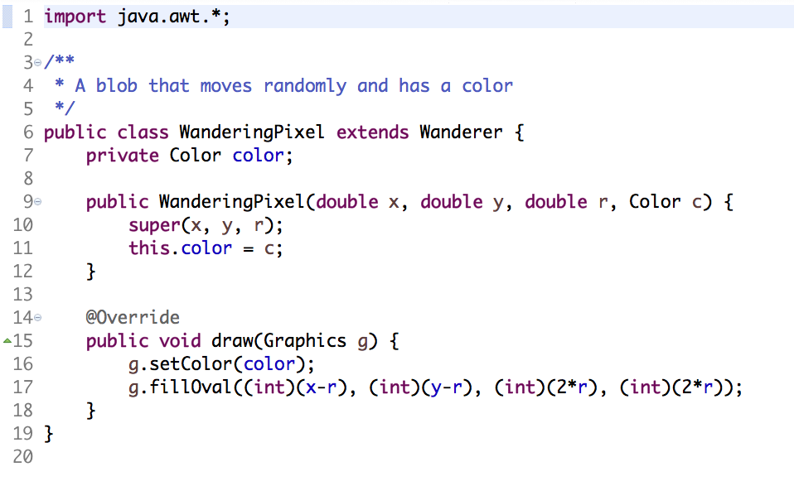
WanderingPixel.java: Makes colorful Blobs using Java’s Color class
Inherit from Wanderer, no need to duplicate code
Store Blob color in instance variable
Set color in draw()

Slide 37

Images are made up of pixels, each with a (x,y) location and a color
NOTE Y axis counts downward!
800 x 600 image
 | 0 | 1 | 2 | … |  |  |  |  | 799
0
1
2
…
599
We can get and set image pixel colors (img is BufferedImage)
img.getRGB(x,y) – returns Color of pixel at x,y
img.setRGB(x,y,color) – sets Color of pixel at x,y
Notes:
We will look at colors in more detail in the next class

Slide 38

AnimatedImage.java: Now we can have some fun with images
Pseudo code
Load image
Create 20,000 WanderingPixels (colorful blobs)
  Randomly pick x,y location
  Use getRGB(x,y) to pick up image color at x,y
  Set blob to that color
At each timer tick, randomly choose 1,000 blob to step()
Image jitters
AnimatedImage.java has actual code

Slide 39
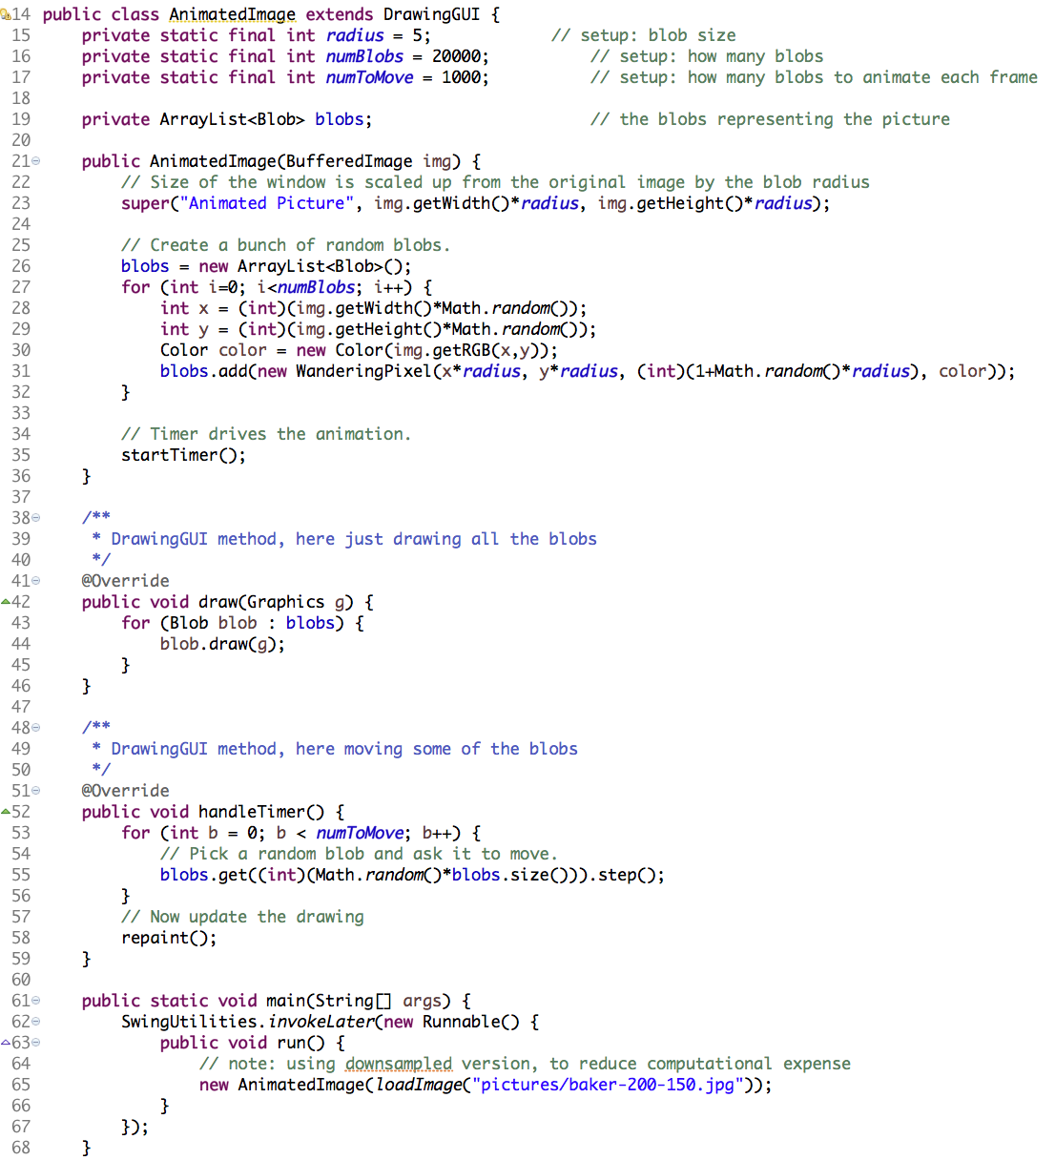
AnimatedImage.java: Now we can have some fun with images
Extend DrawingGUI to get functionality
ArrayList called blobs will hold 20,000 Blobs
Set up graphics window
Create 20,000 Wandering Pixels (colored Blobs)
Get blob color from random x,y location on image
Add new Wandering Pixel to blobs ArrayList
Start timer ticking
On each timer tick, randomly select 1,000 Wandering Pixels, then have those step()
repaint() screen when done
Load background image
Pass image to constructor

Slide 40
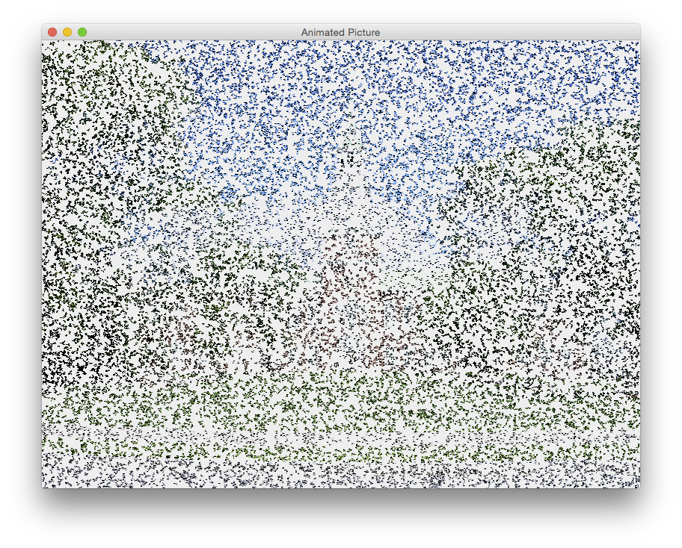

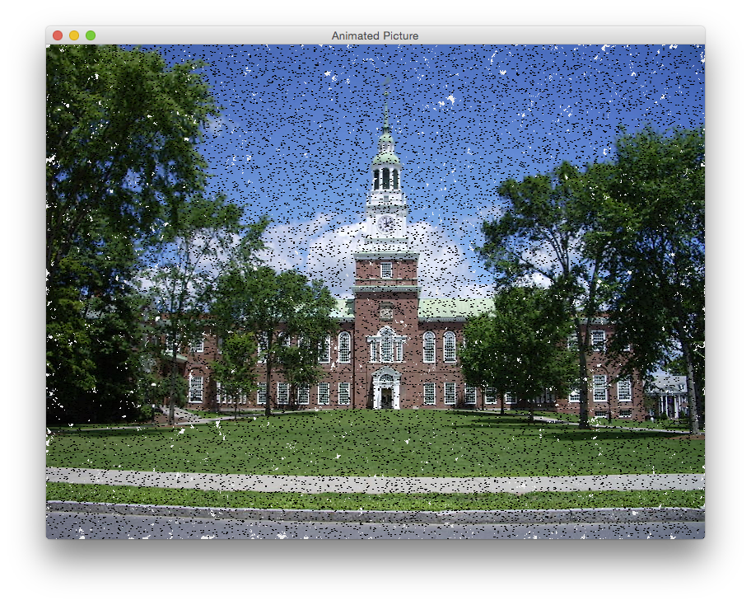
PaintedImage.java: Fade in image using two BufferedImages
Pseudo code
Load image into BufferedImage called original
Create blank BufferedImage called result and display result on screen
Create 20,000 Wanders at random x,y locations
At each timer tick, randomly choose 5,000 Wanders
  Pick up color from original image at Wander’s x,y location with getRBG(x,y)
  Copy color to result image with setRGB(x,y,color)
  Step Wander to move to nearby x,y location
Repaint result image
PaintedImage.java has actual code

Slide 41
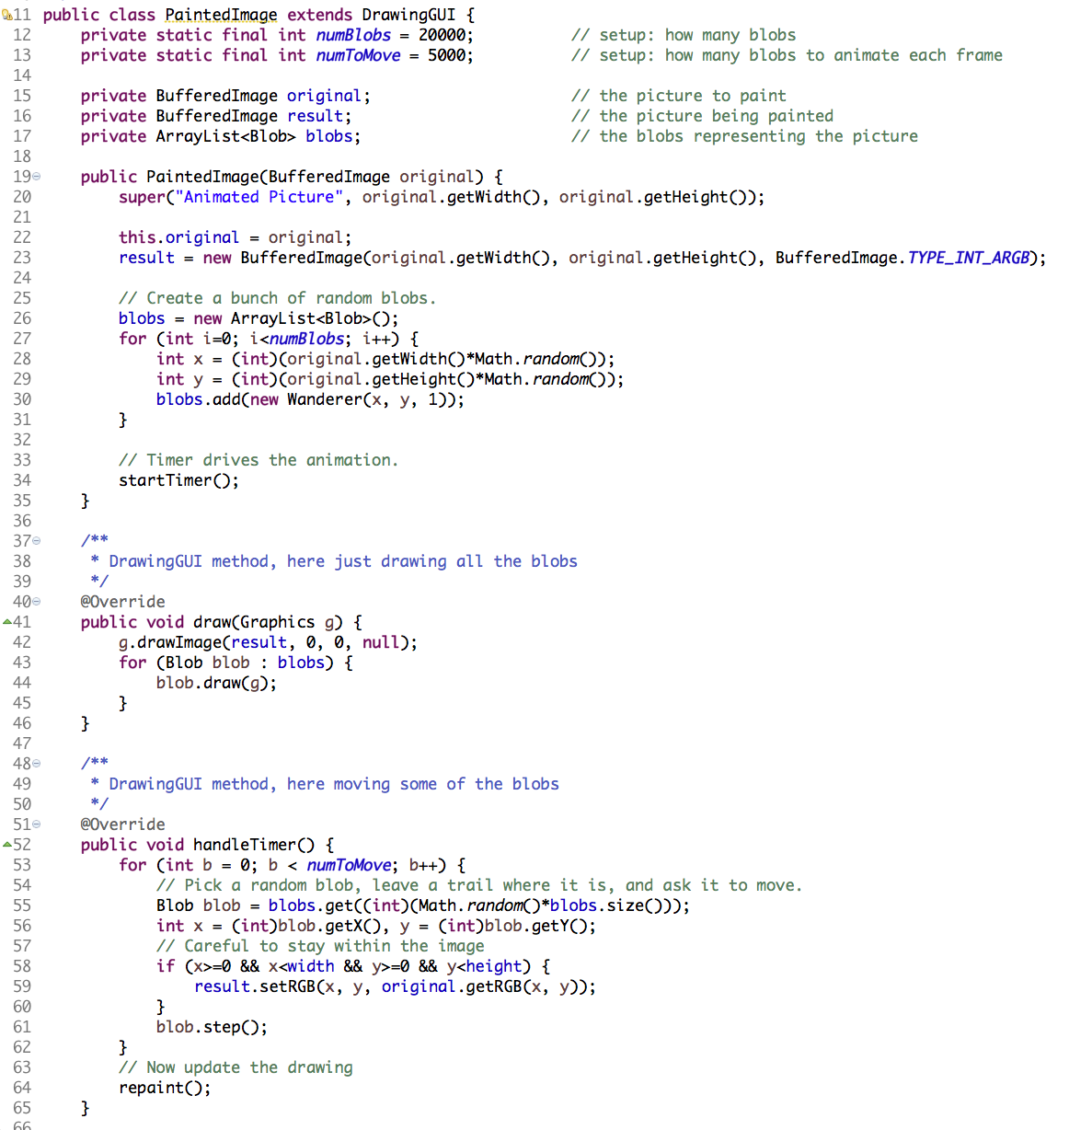
PaintedImage.java: Fade in image using two BufferedImages
Extend DrawingGUI to get functionality
Set up GUI
Save original image
Create new image called result (initially blank)
result will image will fade in original image
Create 20,000 Wander Blobs at random x,y locations with r=1
Start timer ticking
Show result image (was initially blank, but 5,000 pixels colored in every timer tick)
blobs show up as black dots
On timer tick choose 5,000 random Blobs
Get color from original image at Blob’s x,y location
Copy color to result image at x,y location
step() blobs, then repaint() when done (calls draw())
result image gets colored in over time
main() loads image (code not shown on this slide), passes to constructor

