Slide 1



Doppler Time-of-Flight Rendering
Juhyeon Kim¹, Wojciech Jarosz¹, Ioannis Gkioulekas², Adithya Pediredla¹
¹Dartmouth College, ²Carnegie Mellon University
Notes:
Hi, I am Juhyeon Kim. Today, I will present our paper titled “Doppler Time-of-Flight Rendering“, an efficient simulation algorithm for emerging imaging technology, called Doppler Time-of-Flight camera.

Slide 2
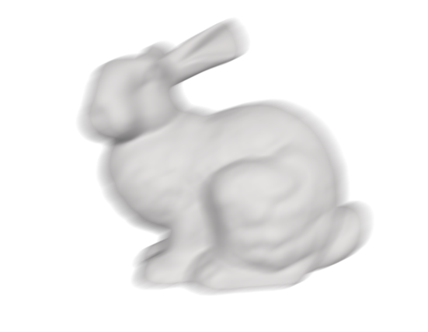
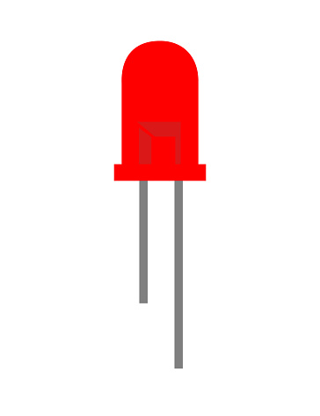
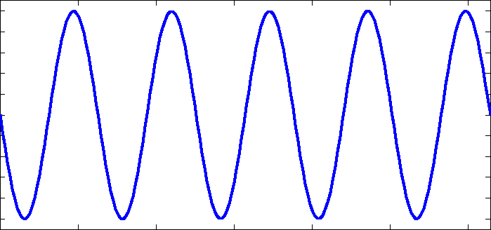

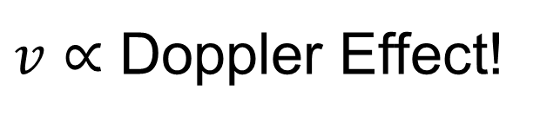
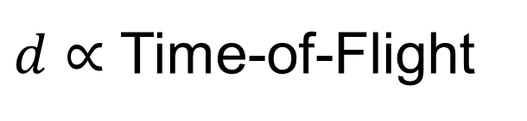


Doppler Time-of-Flight (D-ToF) Imaging [Heide 2015]
$$d$$
$$v$$
$d∝$ Time-of-Flight
$v∝$ Doppler Effect!
Notes:
So, what is Doppler camera?
Doppler Time-of-Flight camera, or just D-ToF camera is a variation of traditional ToF cameras that aim to measure radial velocity of moving objects using high-frequency modulation signals.
This camera can not only estimate the distance by time-of-flight, but also object velocity by Doppler effect.

Slide 3

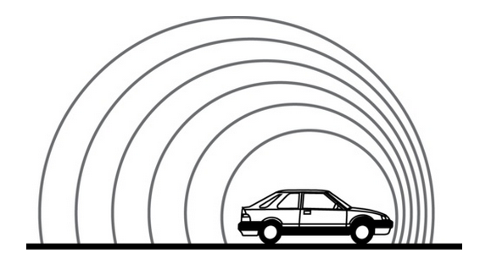
What is Doppler Effect?
Notes:
Doppler effect is a phenomenon that the frequency of wave is changed by relative speed between source and observer.
A common example of Doppler effect is the change of pitch heard from approaching sound source, like vehicle.

Slide 4
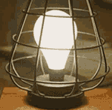
Doppler Effect on Amplitude Modulation
Notes:
Replacing the sound source with a temporally flickering, or in other words, amplitude modulated light source, we can observe a similar Doppler effect.
Doppler ToF camera utilizes such Doppler effect on amplitude modulation frequency.

Slide 5
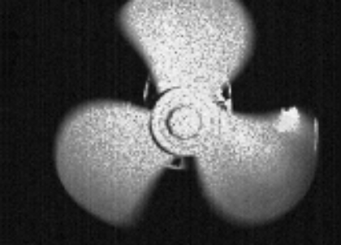
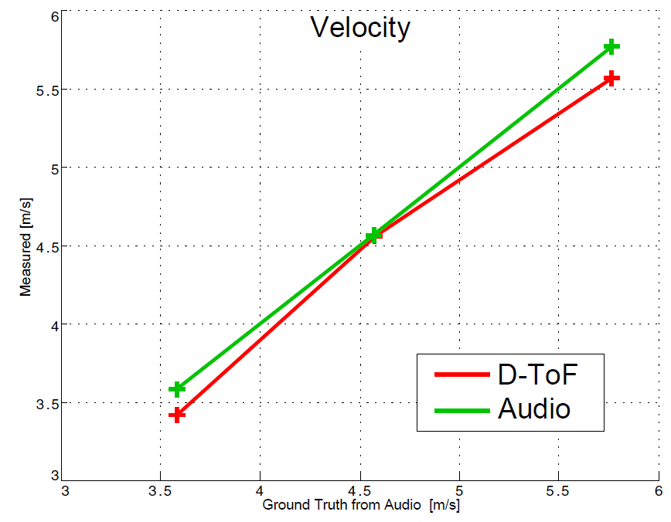
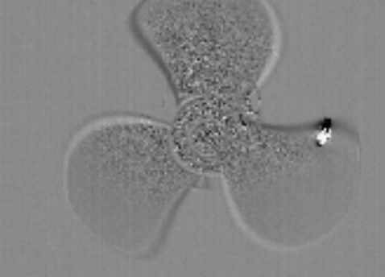
Doppler Time-of-Flight Imaging [Heide 2015]
Amplitude Modulated!
Light Source
Camera
Imaging system setup for D-ToF camera
D-ToF measurements
Radial Velocity
Estimation
All images are from [Heide 2015]
Notes:
This is the example D-ToF imaging system setup from Heide’s seminal paper.
By measuring the deviation due to the Doppler effect, one can estimate the radial velocity of moving objects.

Slide 6
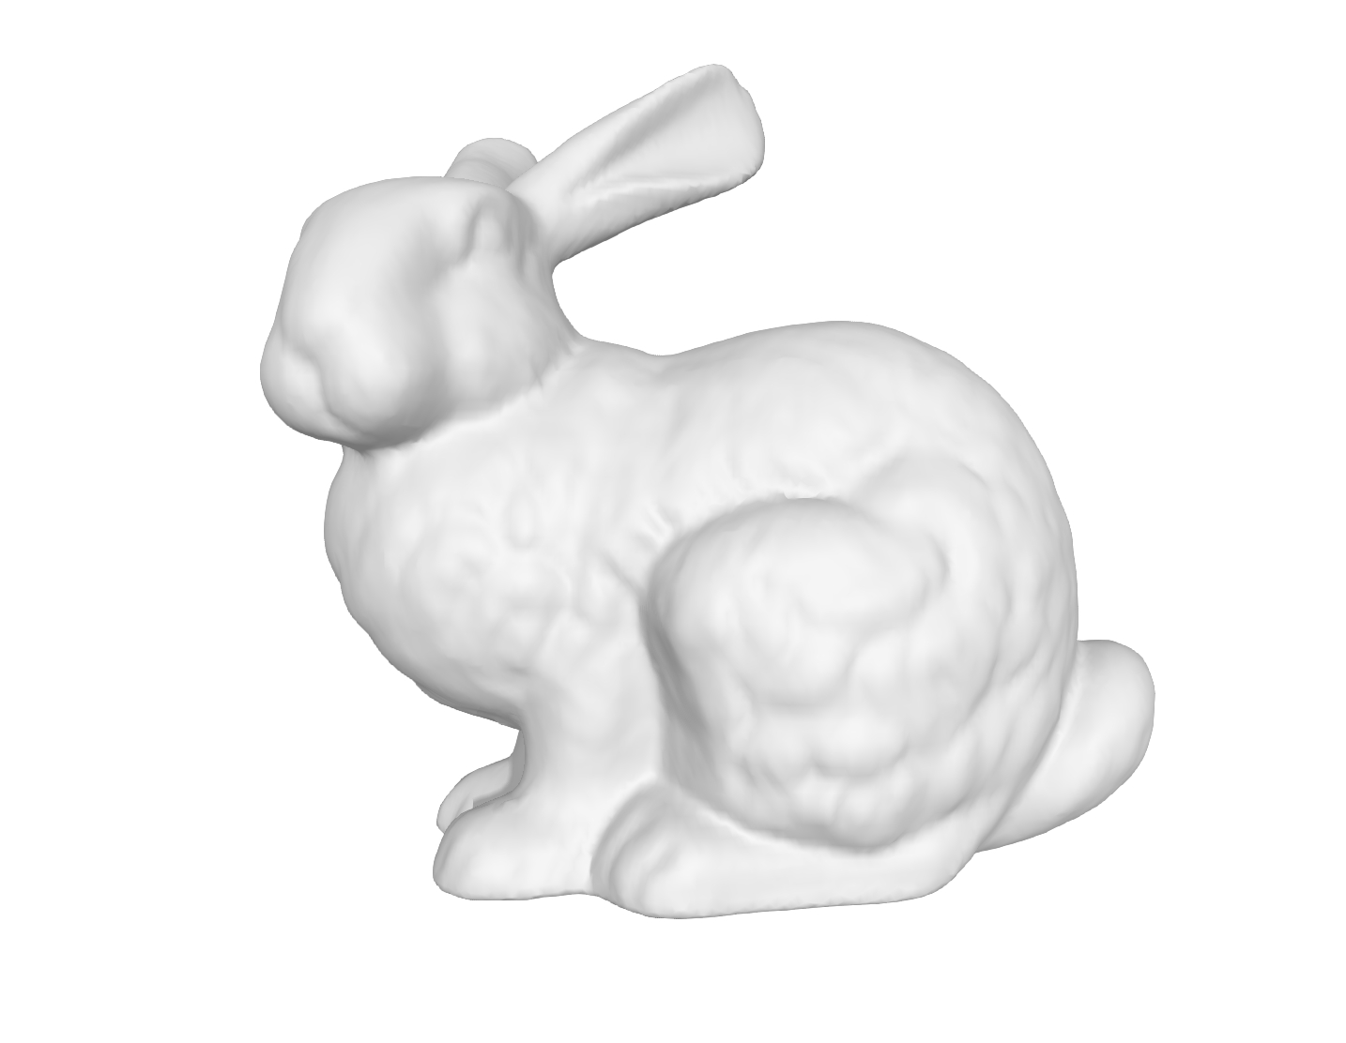
Doppler Time-of-Flight Imaging : Advantage
Inter-frame method
D-ToF camera
Multi-frame sensing
Long time interval
Instant sensing
Good for high-speed applications
Notes:
Compared to inter-frame method that evaluates velocity by multi-frame depth measurements, D-ToF camera enables instant velocity estimation which is desirable for high-speed applications such as automobiles or robotics.

Slide 7
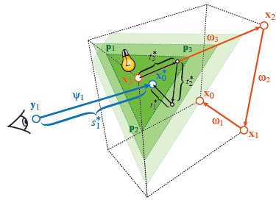
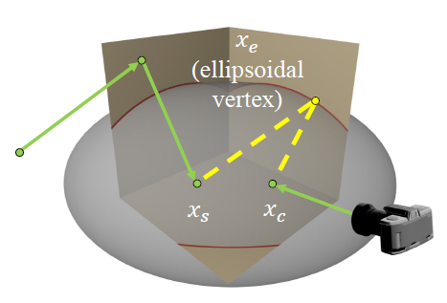
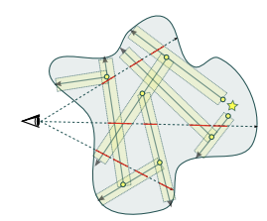
Digital Twin for D-ToF Imaging System
Digital Twin
Imaging / Hardware
Rendering / Software
ToF
[Pediredla 2019]
[Marco 2017, 2019]
[Liu 2022]
?
D-ToF
Notes:
Despite the Doppler camera is a promising emerging technology, it has been hardly studied how to simulate this cameras.
Considering that ToF rendering has stimulated researches on ToF cameras by working as a digital twin, we could expect that D-ToF rendering will also boost researches on D-ToF cameras.

Slide 8
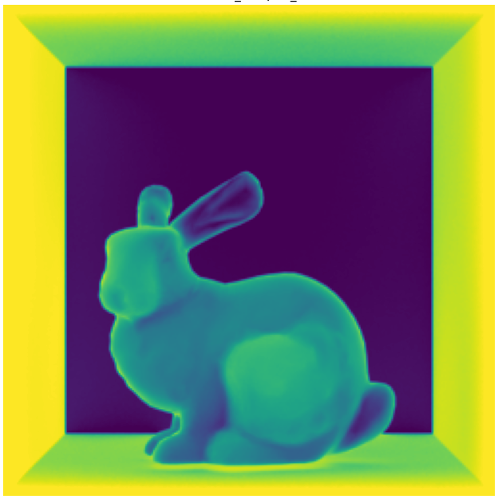
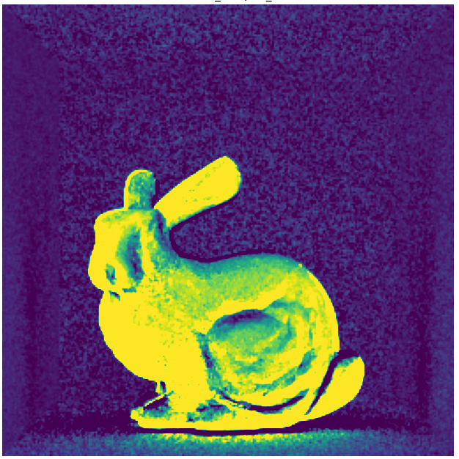
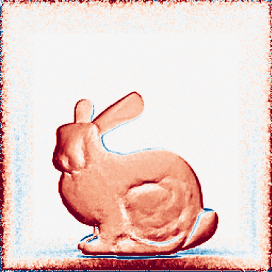
Doppler Time-of-Flight Rendering
Simulated D-ToF measurements
Per-pixel radial velocity
✓ Physically Accurate
Red/Blue : radial velocity
Notes:
In this work, we introduce Doppler time-of-flight rendering, an extension of time-of-flight rendering for dynamic scenes, with applications in simulating Doppler cameras in a physically accurate manner.
This greenish image will appear a lot in the rest of the slides and note that they all refer to D-ToF measurements.

Slide 9
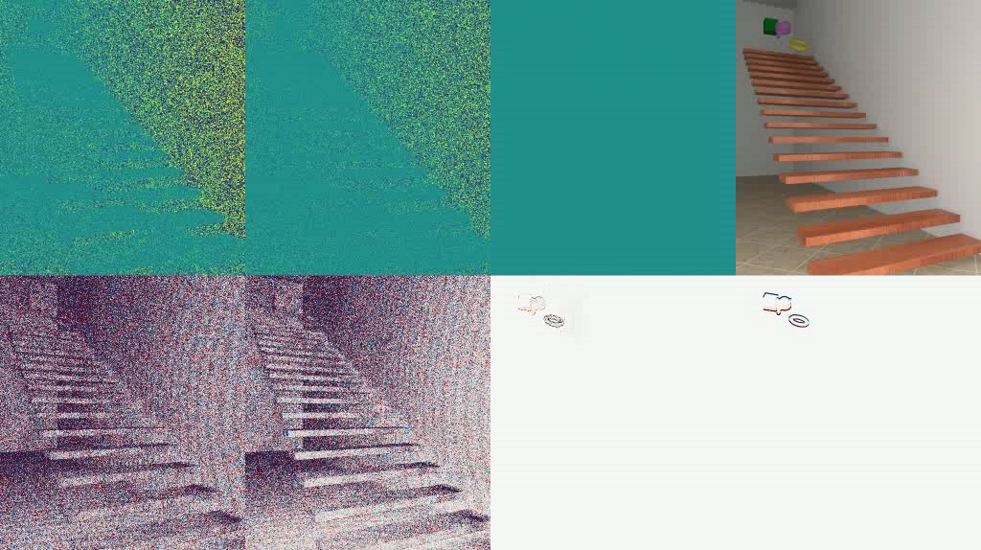
Uniform
Stratified
Ours
Standard Rendering
D-ToF Measurements
GT Radial Velocity
Reconstructed Radial Velocity
Notes:
Using our simulator, one could faithfully reproduce the physically-accurate D-ToF simulation with orders of magnitude faster than naïve methods.

Slide 10
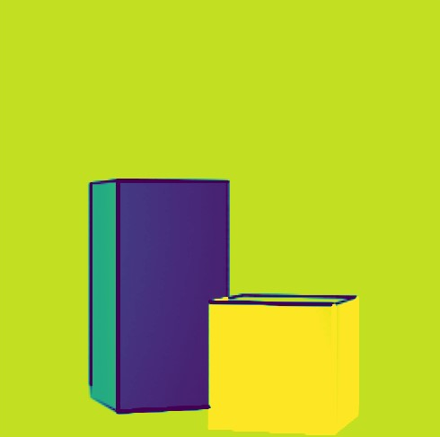
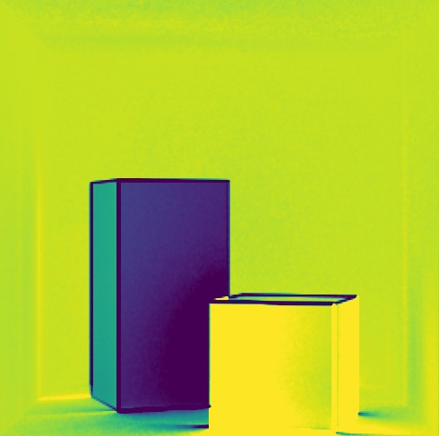
Why Physically-based Rendering Required?
[Heide, 2015]
Physically Not Accurate
Single-bounce
Physically Accurate
Multi-bounce
Notes:
Guessing many of you here are imaging researchers, you may wonder why don’t we just use the simple single-bounce model for simulation.
This approximately works well for many cases but is not perfectly accurate method.
In real world, we need to consider multi-bounced paths which cause inter-reflection effects.

Slide 11
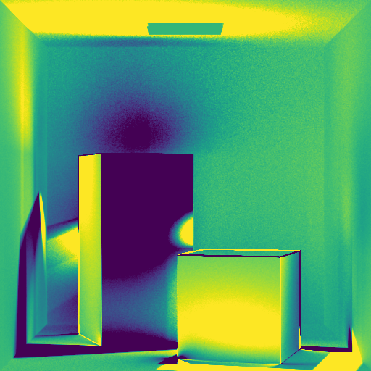
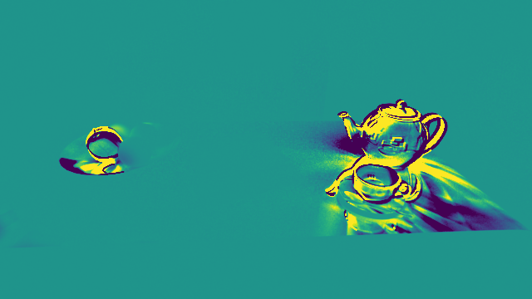
Why Physically-based Rendering Required?
Extreme Multi-bounce Cases
Notes:
Such effect could be considerably large under certain scene configurations and the single-bounced model cannot reproduce such complex interplay of diverse light paths.

Slide 12
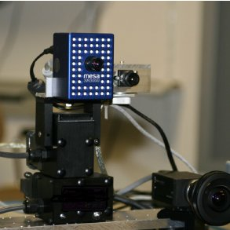
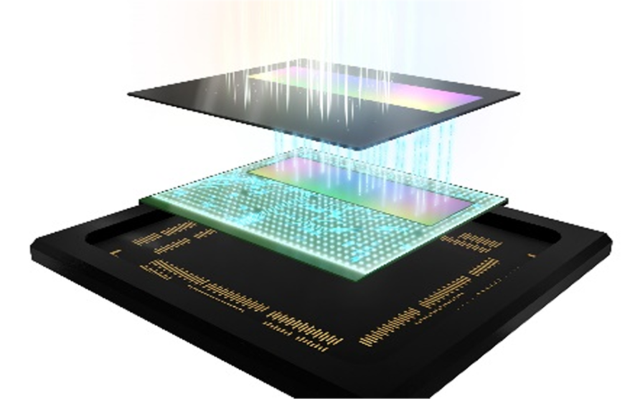
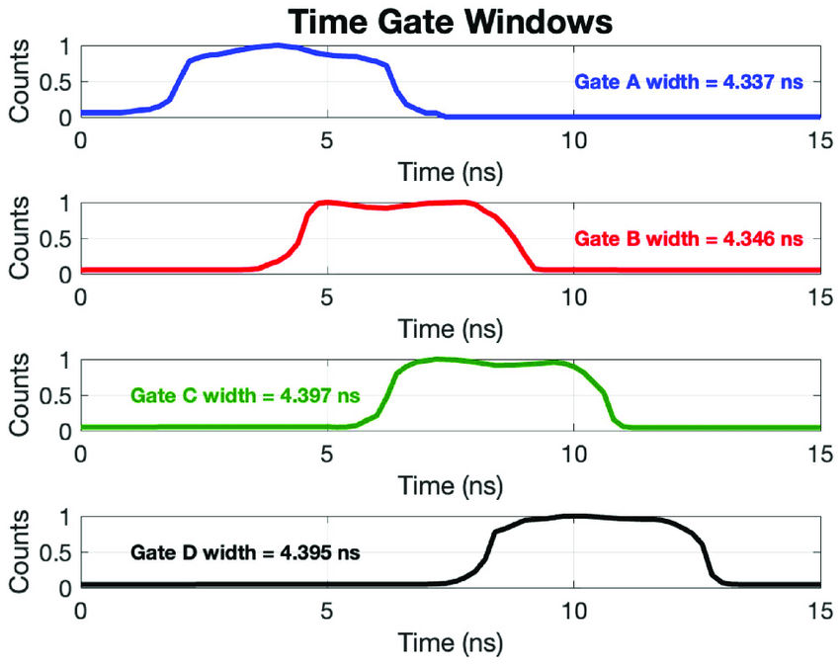
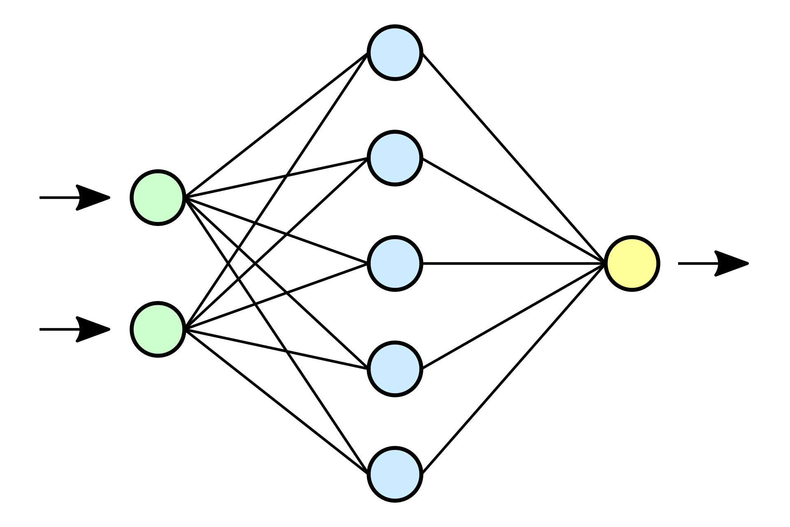
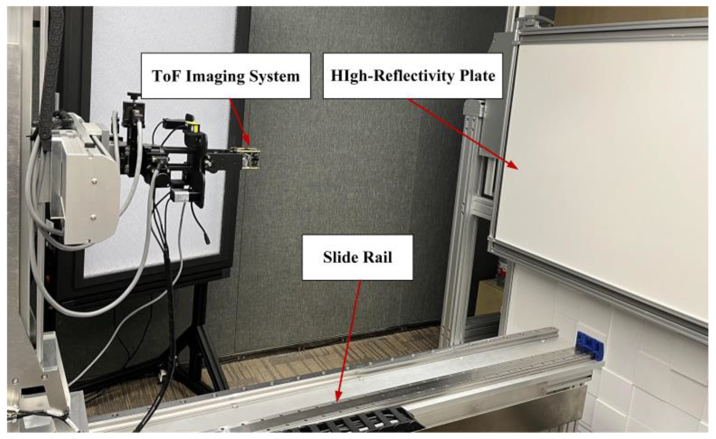
Why Physically-based Rendering Required?
Imaging System Design & Simulation
Large Dataset Generation for Machine Learning
Sensor Design
Notes:
Using our physically accurate renderer, one can faithfully model and simulate imaging system under various configurations, which would be also useful for sensor design.
Or, you can use our renderer for large dataset generation for machine learning, like neural network for removing the multi-bounce effect.

Slide 13
Two Challenges of Doppler Time-of-Flight Rendering
ToF (Transient / Time Gated) Rendering
Doppler ToF Rendering
[Jarabo 2012, 2014; Marco 2017, 2019; Pediredla 2019; Liu 2022]
Static Scene
Dynamic Scene
Path Correlation
High-frequency
Modulation
(10-1000 MHz)
Delta-Modulation
Antithetic Sampling
Notes:
There have been several ToF rendering works, but they are not adequate for Doppler time-of-flight rendering because of two reasons.
First, Doppler time-of-flight rendering deals with dynamic scenes which has not been considered in existing works.
Second, Doppler time-of-flight rendering utilizes high-frequency modulation functions while other works have focused on transient or time-gated rendering which deals with near delta modulation.
To handle each problem, we propose antithetic time sampling with path correlation which will be elaborated in following sections.

Slide 14
Simulation of D-ToF Camera
Notes:
Before diving into the D-ToF rendering, let’s first look at basics of D-ToF imaging system.

Slide 15



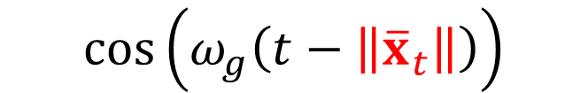

Backgrounds: D-ToF Camera
$$\cos{(ω_{g}t)}$$
$${\overline{x}}_{t}$$
Transmitted
$$\left\|{\overline{x}}_{t}\right\|$$
$${\overline{x}}_{t}$$
Received
$$\cos\left(ω_{g}\left(t−\left\|{\overline{x}}_{t}\right\|\right)\right)$$
Time-of-Flight
Notes:
Assume there is an illumination with modulation of frequency \omega_g.
Then for the received signal at time t for certain path x_t, is retarded cosine function with the amount of time-of-flight.

Slide 16
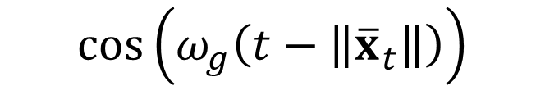
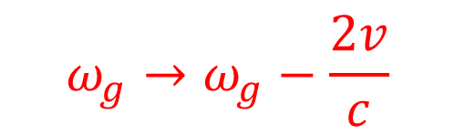
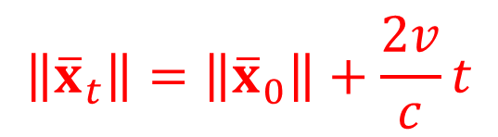

Backgrounds: D-ToF Camera
$$\cos{(ω_{g}t)}$$
$${\overline{x}}_{t}$$
Transmitted
$${\overline{x}}_{t}$$
Doppler-Frequency Shift
Received
$$v$$
$$\left\|{\overline{x}}_{t}\right\|=\left\|{\overline{x}}_{0}\right\|+\frac{2v}{c}t$$
$$\cos\left(ω_{g}\left(t−\left\|{\overline{x}}_{t}\right\|\right)\right)$$
$$ω_{g}→ω_{g}−\frac{2v}{c}$$
Notes:
If the object is moving with constant speed v, time-of-flight becomes a linearly increasing function regarding time.
This makes observed frequency not only retarded, but also exhibits frequency shift which is called Doppler-frequency shift.

Slide 17



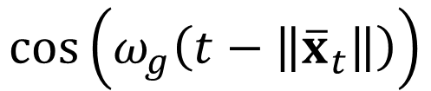

Backgrounds: D-ToF Camera
$$\cos{(ω_{g}t)}$$
$${\overline{x}}_{t}$$
Transmitted
$${\overline{x}}_{t}$$
Received
$$\cos\left(ω_{g}\left(t−\left\|{\overline{x}}_{t}\right\|\right)\right)$$
$$\int_{0}^{T}{ }$$
$$\cos{(ω_{s}t+ψ)}$$
$$m\left(T\right)$$
Camera Modulation
$T$: exposure time
Notes:
The observed signal is then multiplied with camera modulation which is also sinusoidal function with frequency of \omega_s .
The final measurement m(T) is the integration of this signal over exposure time.

Slide 18





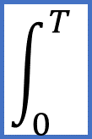
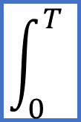
Backgrounds: D-ToF Measurement
$$\cos\left(A+B\right)$$
$$A=ω_{s}t+ψ$$
$$B=ω_{g}\left(t−\left\|{\overline{x}}_{t}\right\|\right)$$
$$\int_{0}^{T}{ }$$
Vanish
=
+
$$\cos{A}\cos{B}$$
$$\int_{0}^{T}{ }$$
?
$$\cos\left(A−B\right)$$
Notes:
The multiplied signal could be decomposed into two parts, high-frequency term and low-frequency term
Because high-frequency term vanishes by integration over time, we are only interested in the low-frequency term.

Slide 19



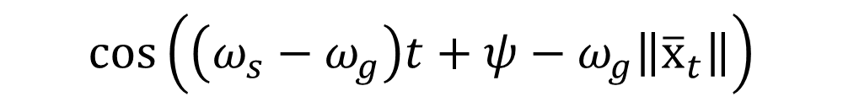

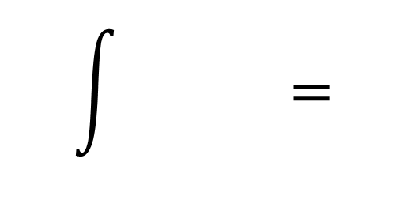

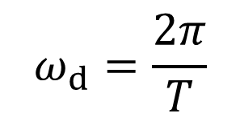

Backgrounds: D-ToF Measurement
$$A=ω_{s}t+ψ$$
$$B=ω_{g}\left(t−\left\|{\overline{x}}_{t}\right\|\right)$$
$$\cos\left(A−B\right)$$
$$\cos\left(\left(ω_{s}−ω_{g}\right)t+ψ−ω_{g}\left\|{\overline{x}}_{t}\right\|\right)$$
Heterodyne frequency
$$0$$
$$ω_{d}=ω_{s}−ω_{g}$$
$$T$$
One-period sinusoidal [Heide 2015]
$$\int{ }=$$
?
$$ω_{d}=\frac{2π}{T}$$
Notes:
So how does the low frequency term look like over time? By substituting A and B in previous slide, we get a cosine function with frequency of \omega_s minus \omega_g.
This beat frequency is known as heterodyne frequency \omega_d.
Various heterodyne frequencies are possible, but let’s consider one-period case as Heide’s setting for now.
So, how can we evaluate this integration?

Slide 20

D-ToF Measurement – Static Object
Static Object
$$0$$
$$T$$
$$\int{ }=$$
$$0$$
Notes:
For static object, the signal is exactly one-period sinusoidal function, and the integration is zero.

Slide 21


D-ToF Measurement – Dynamic Object
Moving Object
$$0$$
$$T$$
Doppler shift!
$$\int{ }=$$
$$v$$
$$ε∝v$$
small value
Notes:
For dynamic object, due to Doppler frequency shift, the signal is slightly deviated from one-period sinusoidal function.
Therefore, the integration is some small value which is proportional to object velocity.

Slide 22
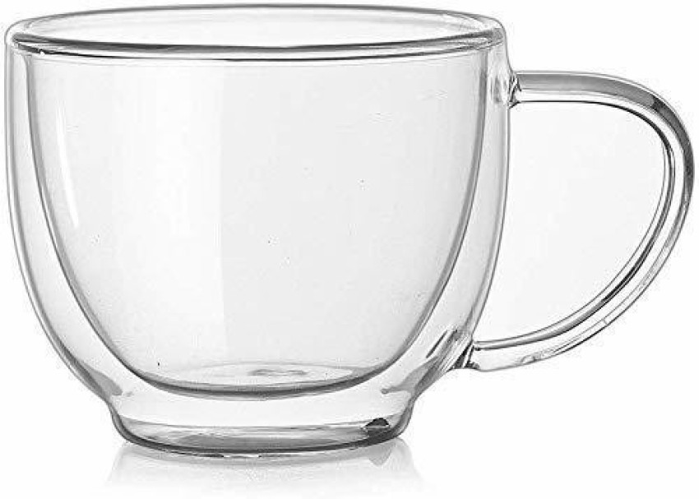

D-ToF Measurement – General Cases
✗ Analytic→ Biased!
✓ Monte Carlo→ Unbiased!
Deviation is not analytically interpretable
$$0$$
$$T$$
$$\int{ }=$$
$$ε$$
small value
Notes:
In general multi-bounced cases, the signal remains slightly deviated so that the integration gives a small value, but such deviation is no longer analytically interpretable.
Therefore, we should rely on Monte Carlo method to get unbiased simulation.

Slide 23









Monte Carlo Evaluation for D-ToF Measurement
Naïve Sampling
$$+1$$
$$+1$$
-0.65
-0.82
$$0$$
$$0$$
$$T$$
$$T$$
0.49
0.72
$$−1$$
$$−1$$
x90
GT of $m(T)$ : 0.001
$\left\langle m(T)\right\rangle$: (0.49+0.72-0.65-0.82) / 4 = -0.09
Extremely Low SNR
Notes:
All of the cases, we need to integrate sinusoidal function which has positive and negative lobe that subtract each other a lot.
And, as you can expect, subtracting two large values to get a small value is vulnerable to extreme noise when we use MC method.
For example, if we evaluate the integral using four samples, our estimation is -0.09 which is 90 times larger than the ground truth value.

Slide 24
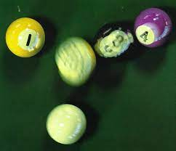
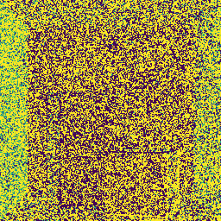
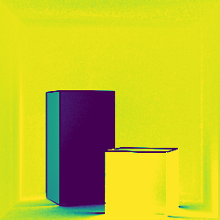
Evaluation of the Integrand using Monte Carlo Method
D-ToF Rendering
Motion Blur with Uniform Time Sampling
Ground Truth
Typical Motion Blur Scene
Notes:
This is the reason why indiscriminate naïve sampling based on motion blur technique makes the image really noisy.

Slide 25





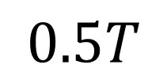
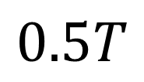






Proposed Method : Antithetic Time Sampling
Naïve Sampling
Antithetic Sampling
$$0.5T$$
$$+1$$
$$+1$$
Antithetic
$$t_{a}=t+0.5T$$
$$0$$
$$0$$
$$T$$
$$t$$
$$T$$
Primal
$$−1$$
$$−1$$
$$0.5T$$
$$\cos{x}+\cos\left(x+π\right)=0$$
Notes:
To resolve this problem, instead of naïve sampling, we propose to use antithetic sampling technique.
Given a primal sample at t, we sample from shifted position with 0.5T, which is called antithetic sample.
Such primal and antithetic sample pair enables efficient subtraction which makes the final estimation sufficiently small.

Slide 26
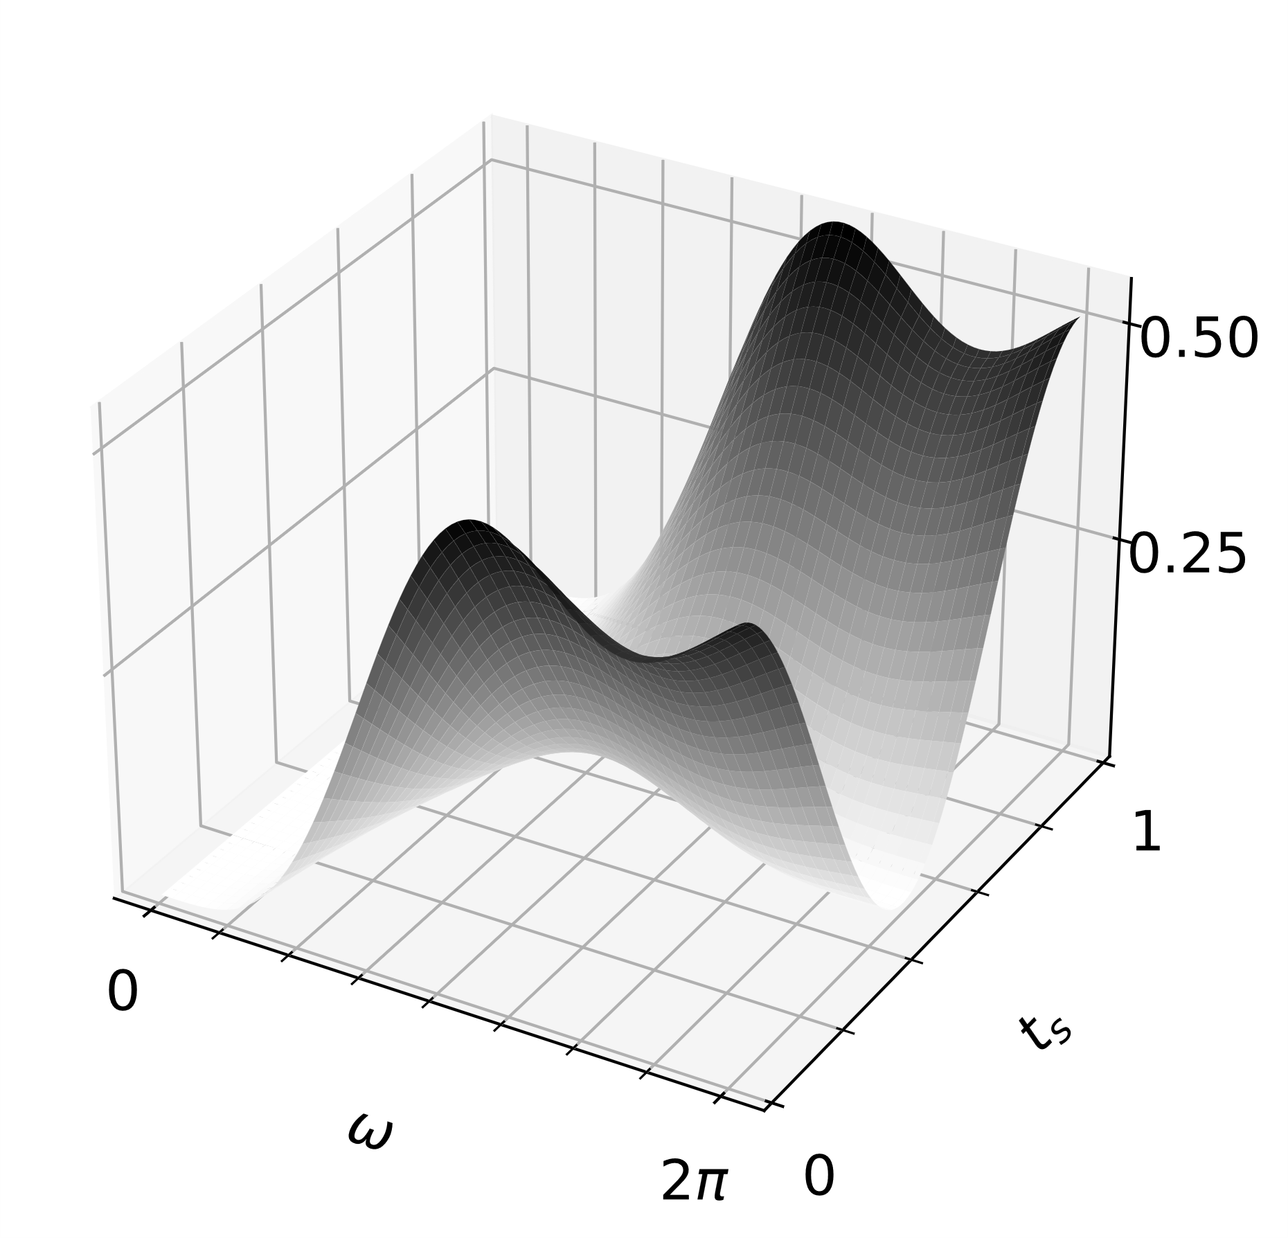
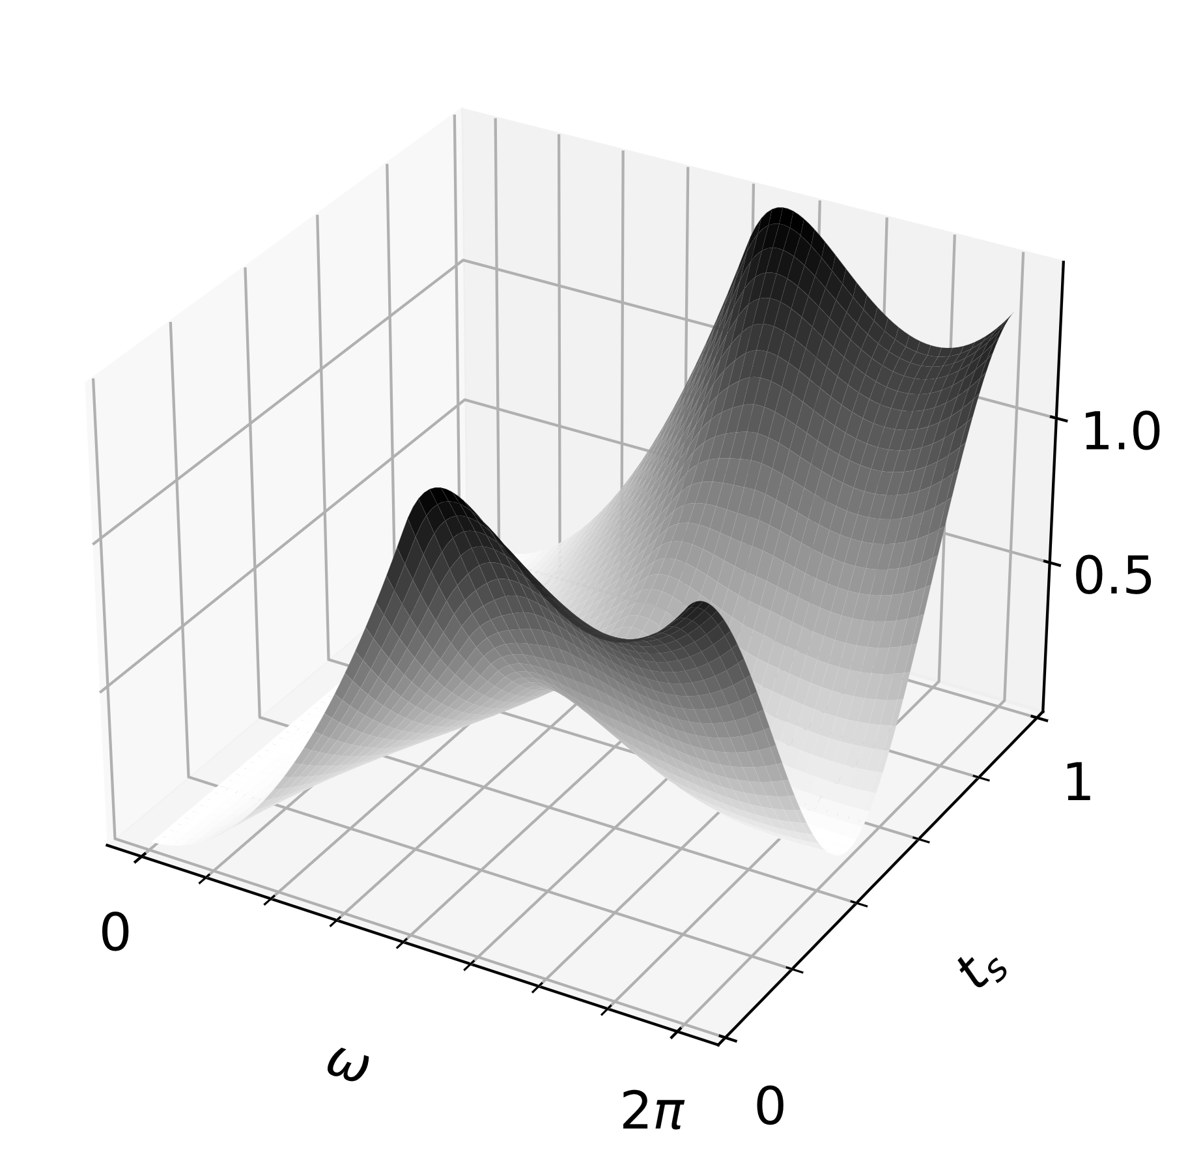
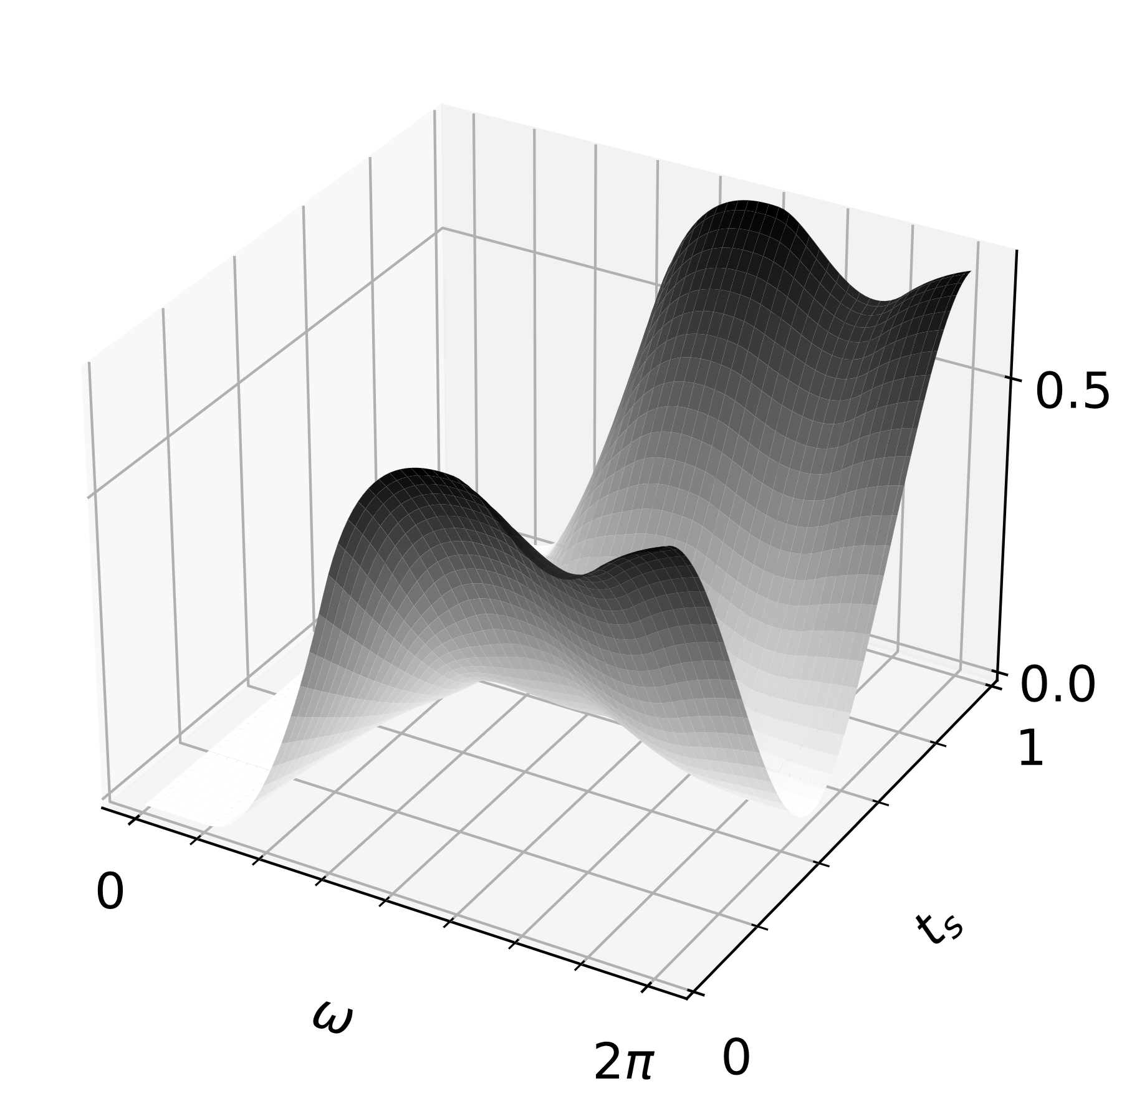
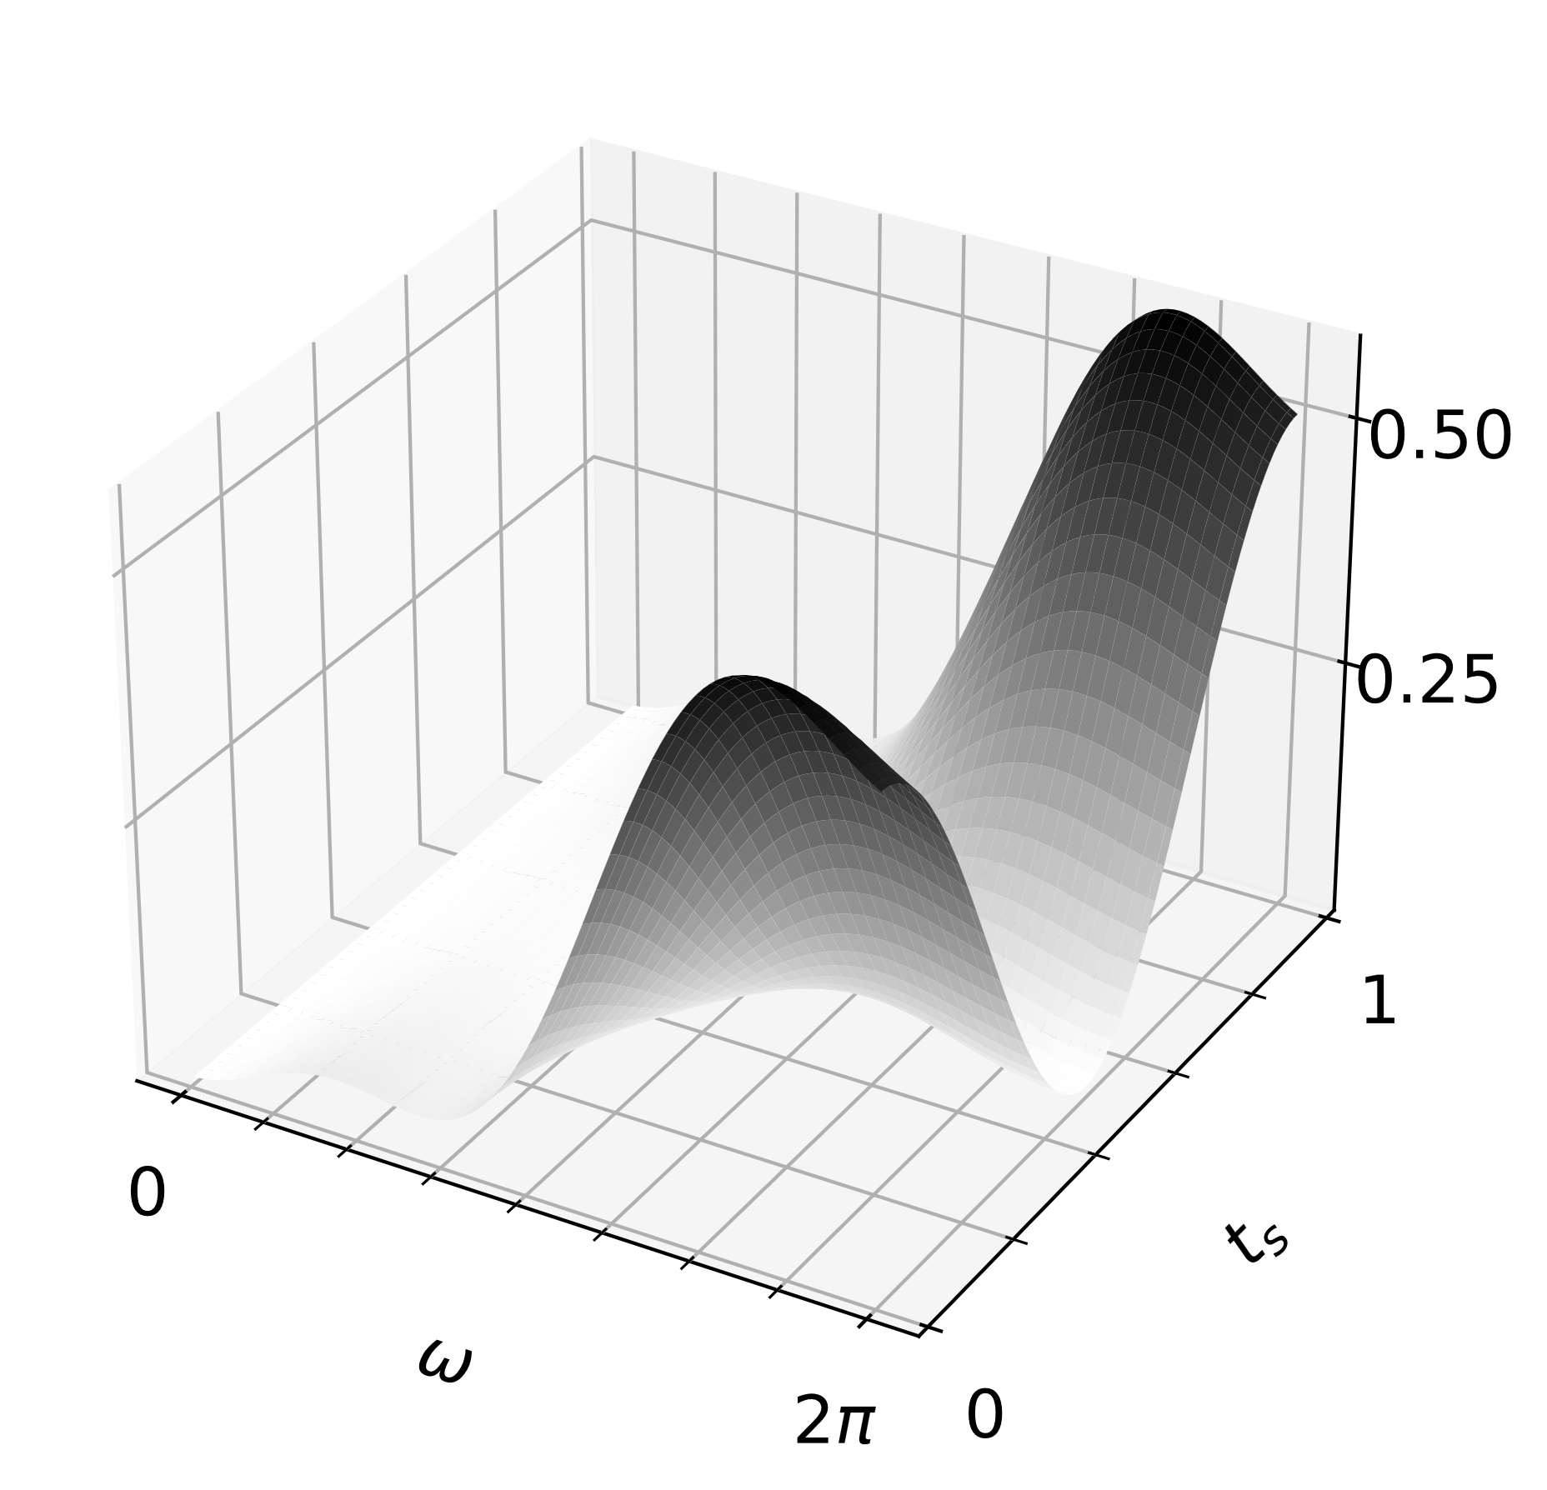
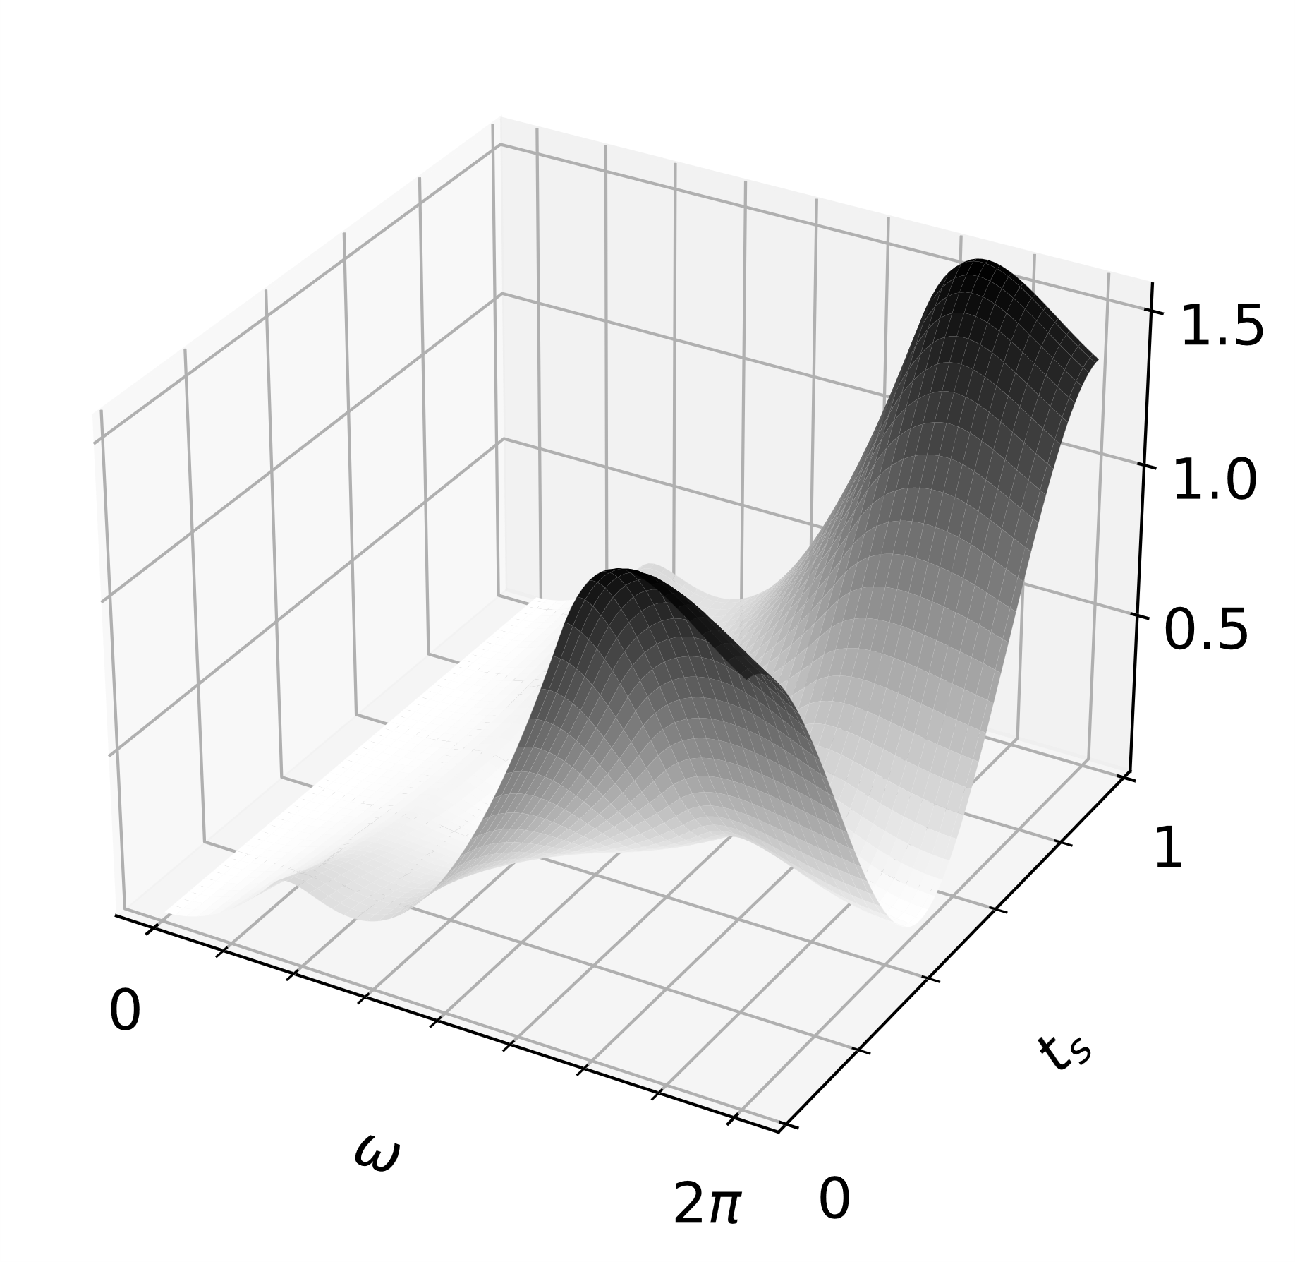
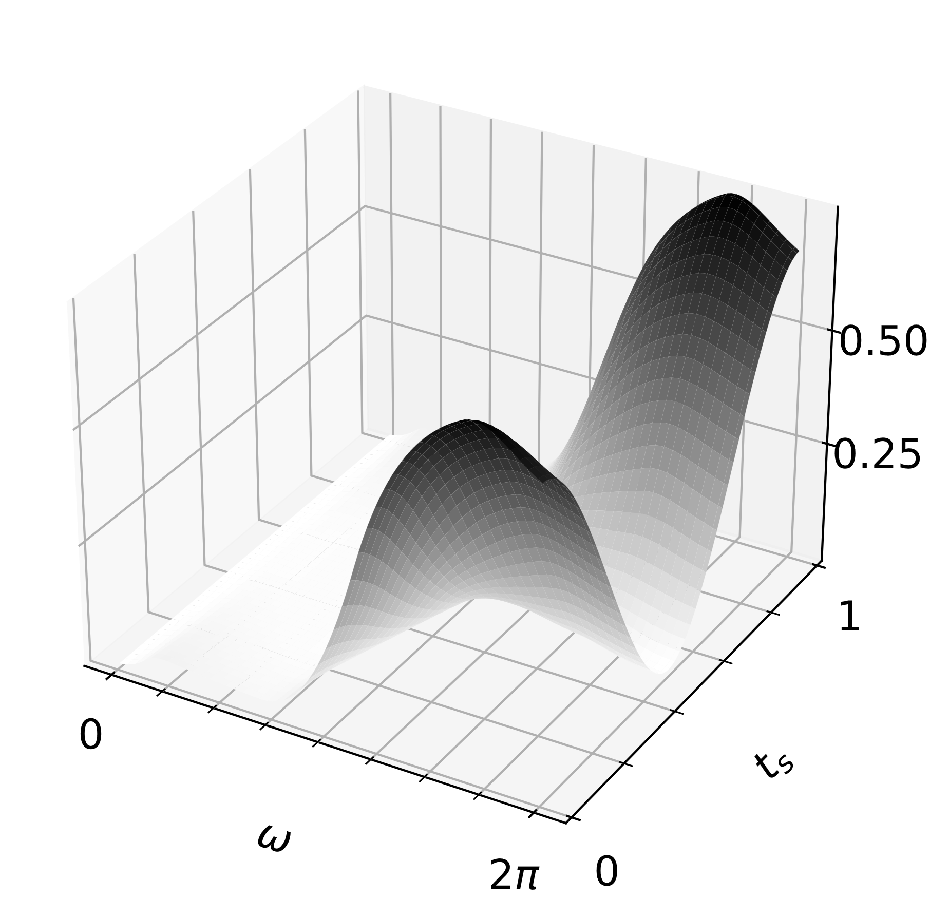







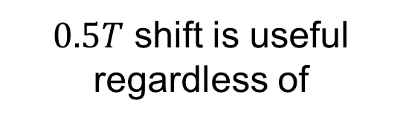







Proposed Method : Antithetic Time Sampling
Sinusoidal
Triangular
Trapezoidal
$0.5T$ shift is useful regardless of
$$Var(ω_{d},θ=0, t_{s})$$
$$t_{s}$$
$$t_{s}$$
$$t_{s}$$
Frequency
$$ω_{d}$$
$$ω_{d}$$
$$ω_{d}$$
Phase Offset
Waveform
(only some)
$$Var(ω_{d},θ=0.6π, t_{s})$$
$$t_{s}$$
$$t_{s}$$
$$t_{s}$$
Mathematically provable!
$$ω_{d}$$
$$ω_{d}$$
$$ω_{d}$$
Notes:
One interesting thing is that such antithetic sampling with 0.5T shifting is not only useful for exact 1-period sinusoidal function, but also for arbitrary frequencies, arbitrary phase offsets and some well-known waveforms.
Optimality of such antithetic estimator could be mathematically proven. Please check the paper for the details.

Slide 27









Arbitrary frequency $0<ω_{d}<\frac{2π}{T}$
Arbitrary phase offset $0<θ<2π$
[Heide 2015]
$$ω_{d}=\frac{2π}{T}$$
$$θ=0.94π$$
$$T$$
[Hu 2022]
$$ω_{d}=k\frac{2π}{T}$$
$$θ=1.71π$$
$$T$$
✓ Applicable to arbitrary modes!
✓ Useful for multi-bounce simulation
Notes:
The fact that proposed antithetic sampling is optimal regardless of frequencies makes our simulator applicable to not only original Heide’s method, but also Hu’s method that has exploited arbitrary heterodyne mode.
Also since it is optimal regardless of phase offset, it could be useful for multi-bounce simulation that all the subpath has different path length.

Slide 28












Aligning Path over Time
Modulation
Path throughput
$$\int_{0}^{T}{ }$$
$$\int_{𝒫(t)}{ }$$
$$\cos\left(ω_{d}t+ψ−ω_{g}\left\|{\overline{x}}_{t}\right\|\right)$$
$$f({\overline{x}}_{t})$$
$$0.5T$$
Antithetic
$$t_{a}=t+0.5T$$
$$0$$
$$0$$
$$t$$
$$T$$
$$T$$
Primal
$f({\overline{x}}_{t})$ constant
over time
Notes:
Until now, we only considered the modulation term, but actual integrand is also multiplied with path throughput term f.
Our antithetic sampling becomes useless if path throughput term does not remain constant over time.
Therefore, we want to make this path throughput as constant as possible over time.

Slide 29



Aligning Path over Time
Time : $t$
Primal Path
Time : $t_{a}=t+0.5T$
Which path?
$$f({\overline{x}}_{t})$$
Antithetic Path
Notes:
Considering primal path at time t, we know that antithetic path should be sampled at the shifted timestamp. But which antithetic path should we sample at that time?
Should we sample this red path? Or should we sample this orange path? Which path is more similar to the sampled primal path so that path throughput remains constant?

Slide 30



Aligning Path over Time using Shift Mapping
Shift Mapping
[Kettunen 2015]
Gradient Domain Rendering
$$i+1$$
$$i$$
Base Path
Offset Path
Notes:
To handle this problem, we adopt the shift mapping, which was firstly introduced in gradient domain rendering.
It was used to evaluate the image gradient by subtracting a closely correlated paths over adjacent pixels, namely base path and offset path.

Slide 31









Aligning Path over Time using Shift Mapping
Temporal Shift Mapping
[Manzi 2016]
$$t_{a}$$
$$t+1$$
$$t$$
$$t+1$$
$$t$$
$$t_{a}$$
$$t$$
$$t+1$$
$$t_{a}$$
Base Path
Primal Path
Offset Path
Antithetic Path
Notes:
Similarly, we can define temporal shift mapping between adjacent frames to evaluate temporal gradient.
We can exploit this temporal shift mapping to impose correlation between primal and antithetic time samples.

Slide 32









Aligning Path over Time using Shift Mapping
Random Replay
[Hua 2019, Manzi 2016]
Path Reconnection
[Kettunen 2015]
$$t_{a}$$
$$t_{a}$$
$$t$$
$$t$$
$$t$$
$$t$$
$$t_{a}$$
$$t_{a}$$
Generally good for specular
Generally good for diffuse
Mixed strategy based on surface material!
Notes:
Many shift mapping strategies have been proposed.
One is repeating the random sequence which is known as random replay and this method is generally good for specular material.
Another well-known method is path reconnection that reconnects vertex whose local position is preserved over time. This method is generally good for rough surfaces.
To this end, we exploit a hybrid strategy based on surface material.

Slide 33







Proposed Sampling Strategy Overview
Goal : Integrate
Constant!
Efficient time sampling for
$$\cos\left(ω_{d}t+θ\right)f\left({\overline{x}}_{t}\right)$$
$$\cos\left(ω_{d}t+θ\right)f\left({\overline{x}}_{t}\right)$$
$$\cos\left(ω_{d}t+θ\right)$$
$$θ=ψ−ω_{g}\left\|{\overline{x}}_{t}\right\|$$
Integrand
Time Space
$$[0,T]$$
Time Space
Time Space
Path Space
$$𝒫\left(t\right)$$
Path Space
Path Correlation
Antithetic Sampling
Unbiased Monte Carlo Estimate
Notes:
To sum up, we define correlated paths who have similar property over time, so that throughput term remains constant over time.
Then, only considering the modulation term, we proposed to use an antithetic sampling that significantly reduces variance.
Our proposed method provides efficient unbiased MC estimate for D-ToF cameras.

Slide 34
Experiments & Result
Notes:
Now, we will show some results.

Slide 35

Standard Rendering
Notes:
First, we show qualitative result for SOCCER BALL scene at full heterodyne mode.
This is standard rendering.

Slide 36

Per-Pixel Radial Velocity
Notes:
This is per-pixel radial velocity

Slide 37



Reference D-ToF Image at
$$ω_{r}=1.0$$
Equal to $ω_{d}=\frac{2π}{T}$
Equal sample per pixel was used for every result! (roughly equal time)
Notes:
This is reference D-ToF image at perfect heterodyne mode. Instead of heterodyne frequency \omega_d, we use relative version \omega_r for simpler notation. For following comparisons, we used equal spp which is also roughly equal time.-

Slide 38



Uniform
$$0$$
$$T$$
spp=1024
Notes:
First, this is result of uniform sampling, which is extremely noisy.

Slide 39

Stratified
$$0$$
$$T$$
spp=1024
Notes:
Adding stratification improves the result, but it is still not satisfactory.

Slide 40



Antithetic (Proposed)
$$0.5T$$
$$0$$
$$T$$
$$0.5T$$
spp=1024
Notes:
While, the proposed antithetic sampling gives the best result compared to the reference image.

Slide 41
Reference
spp=1024

Slide 42





Antithetic
Without Shift Mapping
$$\cos\left(ω_{d}t+θ\right)$$
$$0.5T$$
$$0$$
$$T$$
$$0.5T$$
$$f({\overline{x}}_{t})$$
Not constant!!
$$0$$
$$T$$
spp=1024
Notes:
If we do not use shift mapping, the path throughput term does not remain constant, so the advantage of antithetic sampling degrades.

Slide 43
Antithetic
With Shift Mapping
$$\cos\left(ω_{d}t+θ\right)$$
$$0.5T$$
$$0$$
$$T$$
$$0.5T$$
$$f({\overline{x}}_{t})$$
$$0$$
$$T$$
spp=1024

Slide 44

Standard Rendering
Uniform
Stratified
Antithetic (Ours)
G.T.
Radial Velocity
spp = 1024
Notes:
We show more result for other scenes. Compared to naïve sampling method, our proposed antithetic sampling gives much lower error.

Slide 45












Result 1: Comparison on Various Heterodyne Frequencies
[Heide 2015]
[Hu 2022]
Perfect Heterodyne
Arbitrary Heterodyne
$$ω_{r}=1$$
$${0<ω}_{r}<1$$
$$0.5T$$
$$0.5T$$
Antithetic
Antithetic
$$t_{a}=t+0.5T$$
$$t_{a}=t+0.5T$$
$$0$$
$$0$$
$$t$$
$$T$$
$$t$$
$$T$$
Primal
Primal
Does our method work well for other heterodyne frequencies?
Notes:
To show that our method works robustly for arbitrary heterodyne frequencies, we tested with different heterodyne frequency between 0 to 1.

Slide 46









spp = 1024
Homodyne
Heterodyne
$$0.0$$
$$0.1$$
$$0.2$$
$$ω_{r}$$
$$0.8$$
$$0.9$$
$$1.0$$
RMSE
Uniform
$$⋯$$
Stratified
x 8~30 lower
Antithetic (Ours)
46
Notes:
We could find for near perfect-heterodyne regions, that our proposed method clearly outperform other methods.
However, we could not find clear advantage of proposed method for near homodyne frequencies that \omega_r is near 0.
But this is not that significant as real bottleneck for D-ToF simulation is near-heterodyne region, where proposed method gives 8 to 30 times performance improvement.

Slide 47








spp = 1024
Homodyne
Heterodyne
$$0.0$$
$$0.1$$
$$0.2$$
$$ω_{r}$$
$$0.8$$
$$0.9$$
$$1.0$$
RMSE
Uniform
$$⋯$$
Stratified
x 4~7 lower
Antithetic (Ours)
Notes:
We could find the similar improvement for other scene with 4-7 times lower variance.

Slide 48







Result 2 : Comparison of Number of Time-Samples
$$N_{t}=2$$
$$N_{t}=4$$
$$0.25T$$
$$0.5T$$
Path space
Path space
$$T$$
$$T$$
Time space
Time space
Why only 2 time-samples? Can’t we use more for better estimate for
$$\int{\cos\left(ω_{d}t+ψ−ω_{g}\left\|{\overline{x}}_{t}\right\|\right)}$$
Notes:
Until now, we only considered single antithetic time-samples, but one may wonder why don’t we use more time samples N_t for better estimates for the inner time integral. For example, why don’t we use three antithetic samples with 0.25 shift?

Slide 49







spp = 1024
$$ω_{r}=0.8$$
$$ω_{r}=0.9$$
$$ω_{r}=1.0$$
stratified
antithetic
(shifted)
RMSE
Cornell-Box
RMSE
Living-Room
spp = 1024
RMSE
Bedroom
$$N_{t}$$
$$N_{t}$$
$$N_{t}$$
Antithetic sampling with only one sample ($N_{t}=2$) works best in most of the cases
Notes:
To demonstrate that N_t=2 is enough, we plot error versus N_t.
Empirically, we could find that just using one antithetic sample, or N_t equals two, shows the best performance throughout the various configurations.
Actually there were few exceptions like cornell-box with \omega_r=0.8.

Slide 50



Result 2 : Comparison of Number of Time-Samples
Simple scene
Complex scene
Integrand
Integrand
Time Space
Time Space
Path Space
Path Space
Can use more time samples
Need to consider path space!
Notes:
This happens because scene is relatively simple for cornell-box case, so we can dedicate more time samples to evaluate the inner time integral more accurately.
On the other hand, for complex scene, we also need to consider diversity of sampled path.

Slide 51
Result 2 : Comparison of Path Correlation Strength
Path space
Path space
Path space
Path space
Time space
Time space
Time space
Time space
Variance in time space decreases ✓
Less correlation
More correlation
Variance in path space increases ✗
More result & discussion in main paper
Notes:
Number of time-samples could be generalized to path correlation strength which has clear trade-off on time and path space variance. For details, please refer to the main paper.
But again, just using single antithetic sample with full-depth shift mapping worked well for most of the configurations.

Slide 52







Result 3 : Comparison of Shift Mapping Methods
spp = 8192
Path Reconnection
Adaptive
Reference
Mirror-like
Random Replay
Adaptive (analytic)
Adaptive (analytic by [Heide 2015])
Diffuse
Considering Path Evolution
(1st Taylor Approximation)
Not Considering Path Evolution
(0th Taylor Approximation)
Path evolution : non-constant $f({\overline{x}}_{t})$
Notes:
Finally, We compare several shift-mapping strategies.
As expected, path reconnection fails at mirror-like material while random replay fails at diffuse material. Adaptive method successfully reproduces noiseless image.
We also included result for analytic methods, which is fast, but biased.
We have not explained the details, but what we want to say is that considering path evolution over time is important for more physically-accurate simulation.

Slide 53
Applications of D-ToF Simulator
Notes:
So, now that we have a well-validated Doppler simulations, let's look at what we can do with it.

Slide 54














Reproducing D-ToF Paper Results (Simulation)
[Hu 2022] setup
[Heide 2015] setup
$$−0.5$$
$$0.5$$
Large
difference
10 Hz
Small
difference
5 Hz
0 Hz
-5 Hz
-10 Hz
Ratio ($r_{2}$)
Ratio ($r_{OF}$)
✓ Robust to Poisson noise
✗ Vulnerable to Poisson noise
$$−1.5$$
$$−0.5$$
$$0$$
Phase offset $ψ$
$$π$$
$$0$$
Phase offset $ψ$
$$π$$
Notes:
We firstly reproduce experimental result of Hu’s paper that their proposed optimal heterodyne frequency gives larger difference compared to the Heide’s setup, so that become more robust to Poisson noise.

Slide 55

Reproducing D-ToF Paper Results (from [Hu 2022])
[Hu 2022] setup
[Heide 2015] setup
Large
difference
Small
difference
✓ Robust to Poisson noise
✗ Vulnerable to Poisson noise
[Hu 2022], Fig 8.
Notes:
This is the original result which is consistent with our simulation result.

Slide 56

More Results: Siggraph Domino (spp=4096)
Standard Rendering
Uniform
Stratified
Proposed
GT Radial Velocity
Reconstructed Radial Velocity
Notes:
We finally show animated D-ToF simulation and velocity reconstruction results.
Compared to naïve sampling methods, our method shows clear advantage.

Slide 57

More Results: Falling-Box (spp=4096)
Standard Rendering
Uniform
Stratified
Proposed
GT Radial Velocity
Reconstructed Radial Velocity

Slide 58

More Results: MerryGoRound (spp=16384)
Standard Rendering
Uniform
Stratified
Proposed
GT Radial Velocity
Reconstructed Radial Velocity

Slide 59


Conclusion
Dynamic
Path Correlation
Static
Amplitude Modulation
Antithetic Time Sampling
Notes:
In conclusion, we propose a novel ToF rendering algorithm that can handle dynamic scene with amplitude modulation. We exploit path correlation and antithetic sampling to handle each property. We expect that our work could be used as a digital twin for imaging researchers.

Slide 60



Thank you
Project Page : https://juhyeonkim95.github.io/project-pages/dopplertof/
Code for both
Mitsuba0.6 (CPU)
Mitsuba3 (CUDA)
Acknowledgments: This project was supported by NSF award 1844538, 1730147, 1900849, Sloan Research Fellowship and Burke research initiation award.
are available!
Notes:
We thank our sponsors for their support.
For more details, please visit our project page.
You could find the Mitsuba implementation in both CPU and CUDA version with some tutorials.
Thank you for listening.

Slide 63
Strength of Path Correlation
Primal Path
Antithetic Path (Shift-mapped)
Path space
Full Correlation
(Correlation Depth Full)
Time space
Notes:
In main paper, we did more discussion on strength of path correlation by not only increasing number of correlated paths,

Slide 64
Strength of Path Correlation
Primal Path
Antithetic Path (Shift-mapped)
Antithetic Path (Uncorrelated)
Path space
No Correlation
(Correlation Depth 0)
Time space
Not Correlated!
Notes:
but also correlation depth

Slide 65
Strength of Path Correlation
Primal Path
Antithetic Path (Shift-mapped)
Antithetic Path (Uncorrelated)
Path space
Pixel Correlation
(Correlation Depth 1)
Time space
Loosely Correlated!

Slide 66
Strength of Path Correlation
Primal Path
Antithetic Path (Shift-mapped)
Antithetic Path (Uncorrelated)
Path space
Partial Correlation
(Correlation Depth 2)
Time space
Partially Correlated!

Slide 67
Strength of Path Correlation
Primal Path
Antithetic Path (Shift-mapped)
Antithetic Path (Uncorrelated)
Path space
Full Correlation
(Correlation Depth Full)
Time space
Perfectly Correlated!

Slide 68












Simplification using Pathlength Importance
Static Scene
Dynamic Scene
$$m\left(T\right)=\int_{0}^{T}{s\left(t\right)\int_{𝒫}{f\left(\overline{x}\right)g\left(t−\left\|\overline{x}\right\|\right)dμ\left(\overline{x}\right)}dt}$$
$$m\left(T\right)=\int_{0}^{T}{s\left(t\right)\int_{𝒫(t)}{f\left({\overline{x}}_{t}\right)g\left(t−\left\|{\overline{x}}_{t}\right\|\right)dμ\left({\overline{x}}_{t}\right)}dt}$$
Switch intregral order
$$=\int_{𝒫}{f\left(\overline{x}\right)}\int_{0}^{T}{s\left(t\right)g\left(t−\left\|\overline{x}\right\|\right)dt}dμ\left(\overline{x}\right)$$
$$=\int_{𝒫}{f\left({\overline{x}}_{t}\right)}\int_{0}^{T}{s\left(t\right)g\left(t−\left\|{\overline{x}}_{t}\right\|\right)dt}dμ\left({\overline{x}}_{t}\right)$$
Analytic integration
$$=\int_{𝒫}{f\left(\overline{x}\right)}W_{T}\left(\left\|\overline{x}\right\|\right)dμ\left(\overline{x}\right)$$
$$=\int_{𝒫}{f\left({\overline{x}}_{t}\right)}W_{T}\left(\left\|{\overline{x}}_{t}\right\|\right)dμ\left({\overline{x}}_{t}\right)$$
Pathlength Importance
[Pediredla 2019], [Liu 2022]
Not Valid!
$$𝒫(t_{3})$$
$$𝒫(t_{3})$$
Time
$$𝒫(t_{2})$$
Time
$$𝒫(t_{2})$$
$$𝒫(t_{1})$$
$$𝒫(t_{1})$$
Notes:
For static scenes, because the path domain remains the same over the exposure time, we can switch the order of double integral and analytically integrate the inner term which is known as the pathlength importance. On the other hand, for dynamic scenes, since the path domain evolves over time, such integral order inversion is not valid.

Slide 69

Analytic
Biased!
spp=1024
Notes:
We also show analytic method which is fast, but biased.

Slide 70
Further Stratification in Time Domain
Without Further Stratification
With Further Stratification
Path space
Path space
Time space
Time space
Notes:
Finally, we exploit additional stratification in the time domain to spread samples over the whole time-space.

Slide 71















Result 01: Comparison of Sampling Methods
[Heide 2015]
[Hu 2022]
Homodyne
Heterodyne
Arbitrary Heterodyne
$$ω_{r}=1$$
$${0<ω}_{r}<1$$
$$ω_{r}=0$$
$$μ$$
$$t_{a}=t+0.5T$$
$$t_{a}=t+0.5T$$
$$μ$$
$$t$$
$$t$$
$$T$$
$$t$$
$$t_{a}$$
$$=T−t$$
$$T$$
$$T$$
$$μ$$
Primal
Primal
Antithetic
Antithetic
Mirrored Antithetic
Shifted Antithetic
Shifted Antithetic
(or Mirrored Antithetic)
Notes:
To show that our method works robustly for arbitrary heterodyne frequencies, we plot the error versus heterodyne frequencies under various sampling configuration.
Here, We plot the error of under different heterodyne frequencies.

Slide 72






Result 01: Comparison of Sampling Methods
uniform
Cornell-box
stratified
shifted antithetic
Color
mirrored
antithetic
$$𝔼_{θ}[RMSE(ω_{d}, θ)]$$
with shift mapping
Shape
spp = 1024
without shift mapping
$$0.0$$
$$0.5$$
$$1.0$$
$$ω_{r}$$
Perfect Homodyne
Perfect Heterodyne
Notes:
Here, Y axis is RMSE while X axis is heterodyne frequency.
We could find for near-heterodyne regions that \omega_r in [0.5, 1], that our proposed method with antithetic sampling with path correlation clearly outperform other methods.

Slide 73
Result 01: Comparison of Sampling Methods
uniform
Bedroom
stratified
shifted antithetic
Color
mirrored
antithetic
$$𝔼_{θ}[RMSE(ω_{d}, θ)]$$
with shift mapping
Shape
spp = 1024
without shift mapping
$$0.0$$
$$0.5$$
$$1.0$$
$$ω_{r}$$
Perfect Homodyne
Perfect Heterodyne
Notes:
Such tendency holds for other scenes.

Slide 74
Result 01: Comparison of Sampling Methods
Kitchen
uniform
stratified
shifted antithetic
Color
mirrored
antithetic
$$𝔼_{θ}[RMSE(ω_{d}, θ)]$$
with shift mapping
Shape
spp = 1024
without shift mapping
$$0.0$$
$$0.5$$
$$1.0$$
$$ω_{r}$$
Perfect Homodyne
Perfect Heterodyne

Slide 75

Comparison of Sampling Methods (1-D Case)
uniform
stratified
shifted antithetic
Color
mirrored
antithetic
$$𝔼_{θ}[RMSE(ω_{d}, θ)]$$
$$0.0$$
$$0.5$$
$$1.0$$
$$ω_{r}$$
Perfect Homodyne
Perfect Heterodyne
Notes:
Considering 1-D case, this is consistent with out expectation.

Slide 76
Comparison of Sampling Methods (1-D Case)
uniform
stratified
shifted antithetic
Color
mirrored
antithetic
$$𝔼_{θ}[RMSE(ω_{d}, θ)]$$
$$0.0$$
$$0.5$$
$$1.0$$
$$ω_{r}$$
Perfect Homodyne
Perfect Heterodyne
Notes:
But what about \omega_r in [0.0, 0.5]?
According to 1-D case, we expect that mirrored antithetic sampling with path correlation gives the best result.

Slide 77
Result 01: Comparison of Sampling Methods
uniform
Cornell-box
stratified
shifted antithetic
Color
mirrored
antithetic
$$𝔼_{θ}[RMSE(ω_{d}, θ)]$$
with shift mapping
Shape
spp = 1024
without shift mapping
$$0.0$$
$$0.5$$
$$1.0$$
$$ω_{r}$$
Perfect Homodyne
Perfect Heterodyne
Notes:
However, we could not find clear advantage of proposed method for near homodyne mode.

Slide 78
Result 01: Comparison of Sampling Methods
uniform
Bedroom
stratified
shifted antithetic
Color
mirrored
antithetic
$$𝔼_{θ}[RMSE(ω_{d}, θ)]$$
with shift mapping
Shape
spp = 1024
without shift mapping
$$0.0$$
$$0.5$$
$$1.0$$
$$ω_{r}$$
Perfect Homodyne
Perfect Heterodyne

Slide 79
Result 01: Comparison of Sampling Methods
Kitchen
uniform
stratified
shifted antithetic
Color
mirrored
antithetic
$$𝔼_{θ}[RMSE(ω_{d}, θ)]$$
with shift mapping
Shape
spp = 1024
without shift mapping
$$0.0$$
$$0.5$$
$$1.0$$
$$ω_{r}$$
Perfect Homodyne
Perfect Heterodyne

Slide 80
Doppler Time-of-Flight Rendering
Juhyeon Kim¹, Wojciech Jarosz¹, Ioannis Gkioulekas², Adithya Pediredla¹
¹Dartmouth College, ²Carnegie Mellon University

